Slide 1
Data-Driven Chaos Indicators for Beam Dynamics
Robert Rainer
NSLS-II, BNL
Nov. 1-4, 2022
3rd ICFA Beam Dynamics Mini-Workshop on Machine Learning Applications for Particle Accelerators

Slide 2
Contributors
Yongjun Li – Brookhaven National Lab, Upton, NY
Jinyu Wan – Inst. High Energy Physics, Beijing
Allen Liu – Purdue University, W Lafayette, IN
Yi Jiao – Uni. Chinese Academy of Sciences, Beijing
Rob Rainer – Brookhaven National Lab, Upton, NY

Slide 3
Outline
Predictability vs. chaos
Proof-of-principle with Hénon map
Application on accelerator design
Summary
*Brief* Q & A

Slide 4
Chaos vs. Predictability
More chaotic
Prediction is inaccurate
Less chaotic, prediction is accurate (interpolate/extrapolate)
Prediction performance appears to be directly related to level of chaos
Is it possible to use the predictability as a chaos indicator?
Less chaotic
Prediction is accurate

Slide 5
Proof-of-Principle with Hénon Map
$$μ=2πν, ν=\frac{1}{3},\frac{1}{4},\frac{1}{5},⋯$$
At resonances, motion is chaotic and even unstable
Blackbox
Hénon map
X_{in}
X_{out}

Slide 6
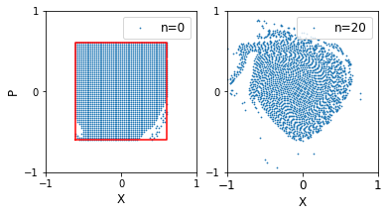
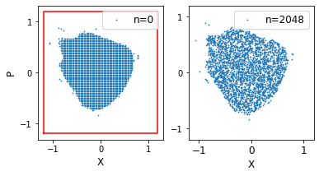
Cheap vs. Expensive Computations
Cheap: fewer initial conditions, short time
Expensive: more initial conditions, long time
-0.6 < X,P < 0.6, 20 iterations
-1.2 < X,P < 1.2, 2048 iterations
X_{in}
X_{out}
Red box is area of interest
Blue points are stable, survived

Slide 7
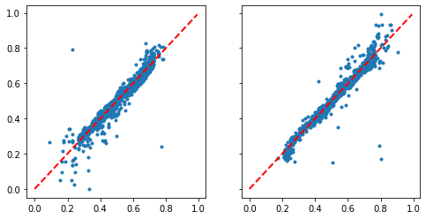
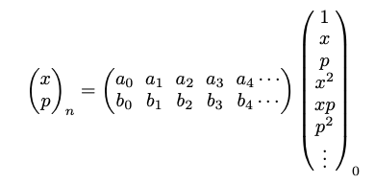
Surrogate Model’s Performance
Training data constructs surrogate model: polynomial, NN, SVM, etc.
Testing data checks the prediction performance
X
P
Model prediction
Original test data

Slide 8
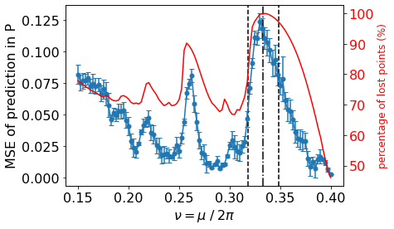
Tune Scan for Hénon Map
We see:
Nonlinear resonances
Stopband widths
Consistent with (expensive) tracking
Blue line: data-driven chaos indicator
Red line: long-term tracking
Black dashed lines: stopband width

Slide 9
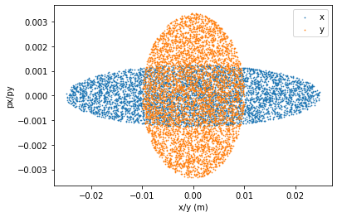
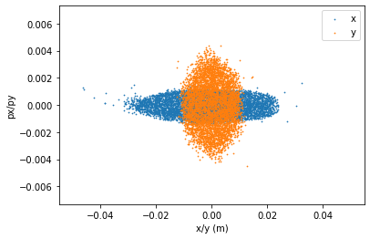
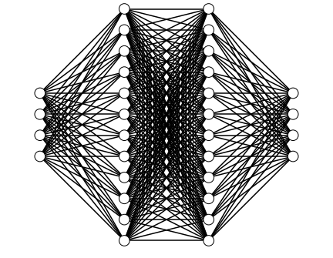
Applied to Particle Accelerator Design
NSLS-II ring lattice

Slide 10
ANN for Surrogate Model
4-Later Artificial Neural Network
I/O: 4-D phase space coordinates
SCIKIT-LEARN & KERAS Packages
6 “Families” of Harmonic Sextupoles
Symplectic Particle Tracking: ELEGANT
4 X 12 X 12 X 4
Tuning “Knobs”

Slide 11
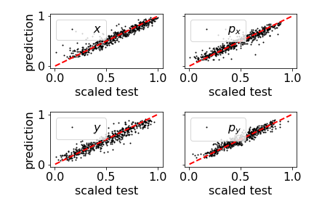
DDCI for the NSLS-II Accelerator
Not well-optimized nonlinear lattice
Well-optimized nonlinear lattice

Slide 12
DDCI as Optimization Objective
Tuning nonlinear magnets in an accelerator
Compute DDCI for each configuration
Using multi-objective genetic algorithm to minimize DDCI

Slide 13
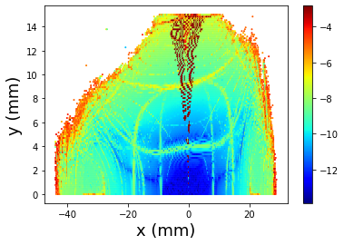
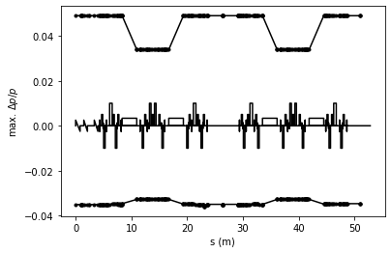
Testing with Real Beam at NSLS-II
Dynamic aperture
Momentum acceptance

Slide 14
Summary
DDCI is independent of model type (polynomial, NN, SVR, etc.)
Computation cost of DDCI is low
Used as the objective of population-based optimization
A new perspective of nonlinear dynamics is provided
Publication: https://doi.org/10.1016/j.nima.2021.166060

Slide 15
Acknowledgements
Funded by DoE under Contract No. DE-SC0012704
NSLS-II colleagues and external collaborators
ML workshop Committee
Questions and comments are welcome

