Slide 1
Neutrino Research at BNL
Steve Kettell, EDG Group Leader
7/7/2022

Slide 2
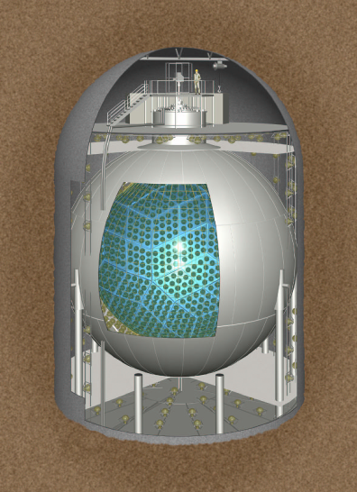
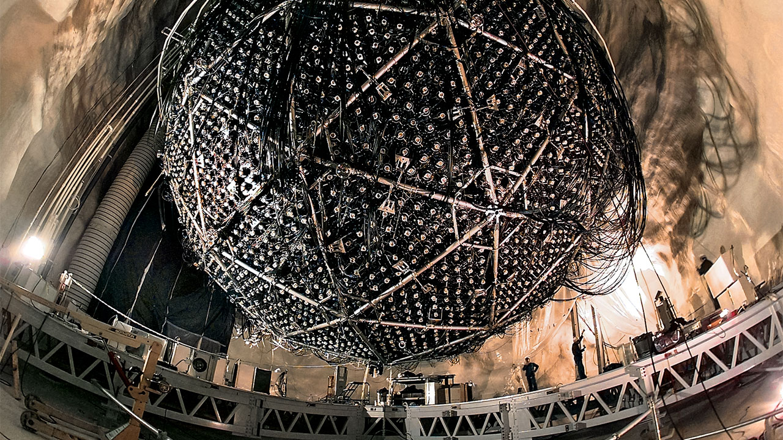
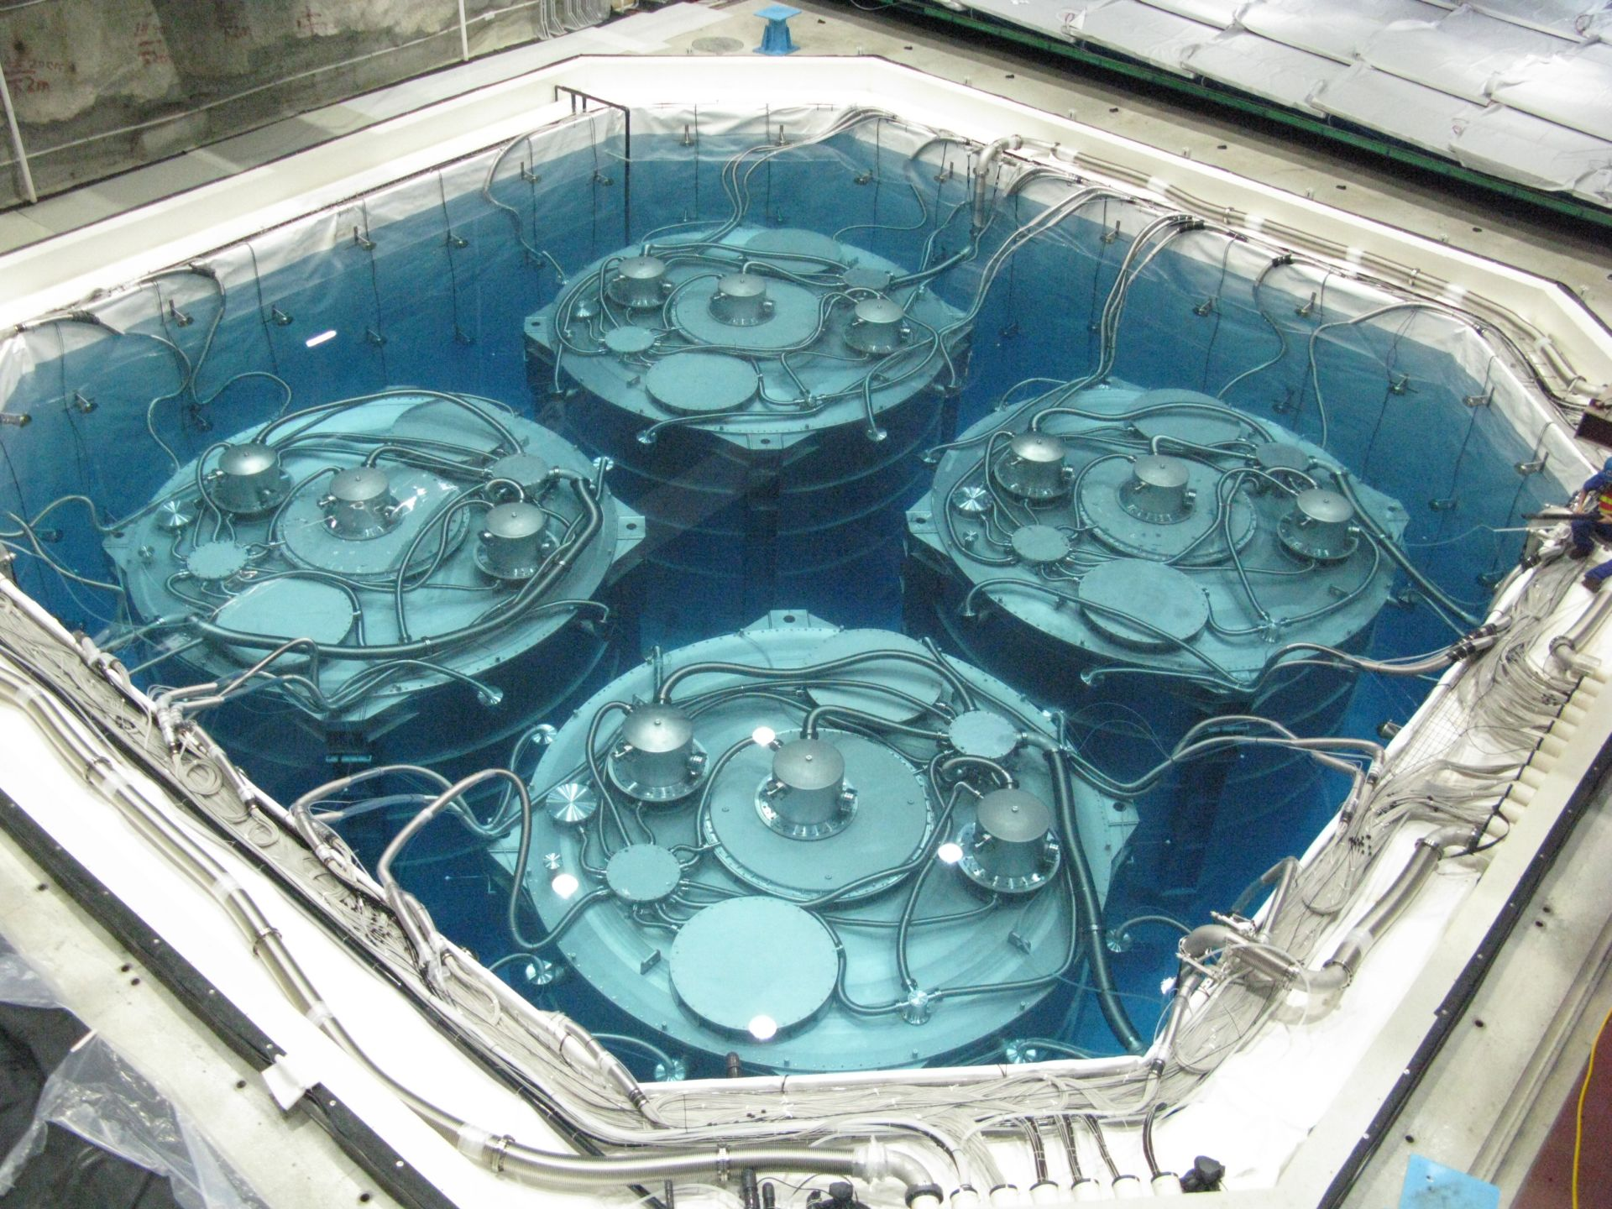

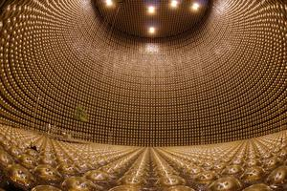
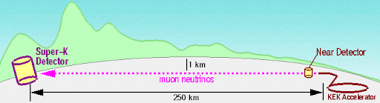
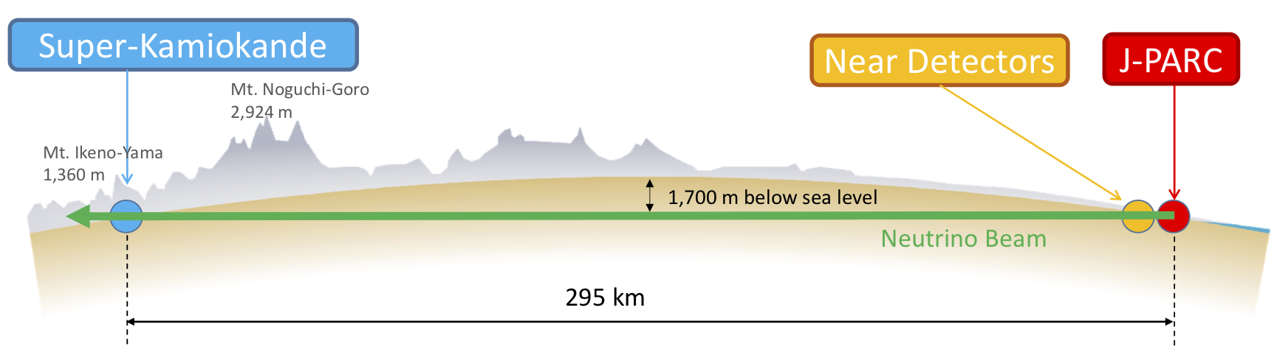
2016 Breakthrough Prize
KamLAND
Daya Bay
SNO
K2K
Super-K
2015 Nobel Prize
Takaaki Kajita & Art McDonald
T2K

Slide 3
History of Neutrinos at BNL
Goldhaber Helicity Experiment 1957: Brookhaven Lab’s Maurice Goldhaber performed an experiment that revealed neutrinos to be "left-handed."
Discovery of the Muon Neutrino 1962:, a new type of neutrino, the muon neutrino, was discovered at the Alternating Gradient Synchrotron at Brookhaven. Leon Lederman, Mel Schwartz, and Jack Steinberger received the 1988 Nobel Prize for this work, which established that there was more than one flavor of neutrino.
The Solar Neutrino Problem (Homestake Mine in South Dakota 1962-1980s): Ray Davis was the first to directly detect electron neutrinos produced by the sun. But he only observed about one-third of the expected amount. Ray Davis shared the Nobel Prize in 2002
The Irvine-Michigan-Brookhaven (IMB) detector Brookhaven’s Maurice Goldhaber was also a founding member of a pioneering experiment in the Morton salt mine in Ohio in the early 1980s that became famous for observing neutrinos from Supernova 1987A (along with the Kamioka detector in Japan).
GALLEX and SNO: From the 1990s through the mid-2000s, Brookhaven's neutrino group played important roles in the GALLEX (Gallium Experiment) and SNO (Sudbury Neutrino Observatory) experiments in Italy and Canada, respectively. In 2015, Arthur B. McDonald of Canada’s Queen's University and SNOLAB, shared the Nobel Prize in Physics with Takaaki Kajita, leader of the Super-Kamiokande experiment in Japan, for their work demonstrating that neutrinos change identities, or oscillate.
Super-Kamiokande: Brookhaven was represented by physicist and former Lab Director Maurice Goldhaber, confirmed that neutrinos do indeed oscillate and have mass.
MINOS 1990’s-2015: Brookhaven then became involved in the ongoing MINOS (Main Injector Neutrino Oscillation Search) experiment based at Fermilab, which began taking data in 2005 and has since provided measurements of mixing angles and oscillation frequency that describe how muon and tau neutrino types oscillate between one form and another.
T2K: Physicists in Brookhaven’s Superconducting Magnet Division used direct wind machines to make superconducting corrector magnets for the JParc beamline that takes protons to the target for making neutrinos for T2K. The correctors were completed in 2008.
Daya Bay: BNL had a lead role in the Daya Bay Neutrino Project, which took data from 2011-2021.
MicroBooNE Cryogenic Neutrino Detector: Brookhaven scientists and engineers played leading roles in design, construction and analysis of MicroBooNE at Fermilab.
The Precision Reactor Oscillation and Spectrum Experiment (PROSPECT): The study of antineutrinos with PROSPECT allows scientists to search for a previously unobserved particle, the so-called sterile neutrino, while probing the nuclear processes inside a reactor. BNL engineers, physicits and chemists involved in many aspects of PROSPECT
LBNE: BNL conceived an intense wide-band neutrino beam to travel 800 hundred miles through the Earth to a far detector .This program evolved into the Long-Baseline Neutrino Facility (LBNF) and Deep Underground Neutrino Experiment (DUNE).
The Deep Underground Neutrino Experiment (DUNE) More than 1100 collaborators. A huge liquid argon Time-Projection-Chambers detector in the Sanford Underground Research Facility (SURF) in Lead, SD. Fermilab’s Main Injector Ring will produce an intense collimated beam of neutrinos that will travel 800 miles through the Earth before striking its target at SURF (Homestake Mine in which Ray Davis did his experiment). Brookhaven Lab is one of the principal collaborators in the planning, design, and operation of this experiment. From fundamental neutrino science to beam and detector design, prototyping and construction, Brookhaven Lab has had a foundational role in DUNE.

Slide 4
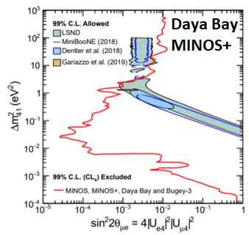
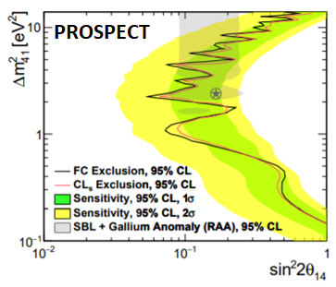
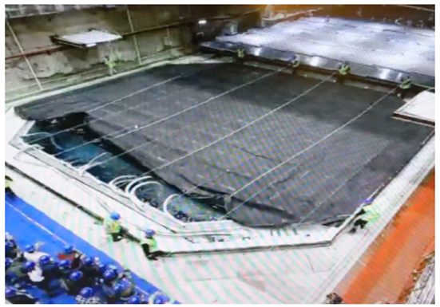
Latest Results from BNL
Observed ν_{e} candidate rates are statistically consistent with predicted background rates in the LEE region
Daya Bay
Successful end of operation after 9 years, 2011/12/24 – 2020/12/12 (3275 days)
Improved constraints on sterile neutrino mixing in combination with MINOS+ and Bugey-3.
PRL 125:071801 (2020)
PROSPECT​
Improved sterile neutrino oscillation search and reactor neutrino spectrum results with the full data set.
PRD103:032001 (2021)

Slide 5
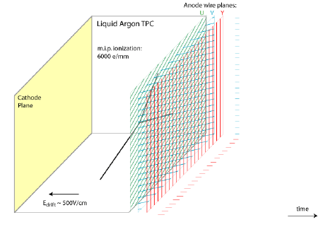
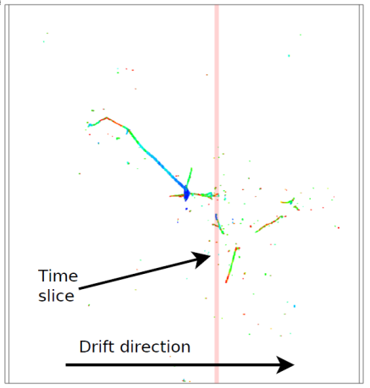

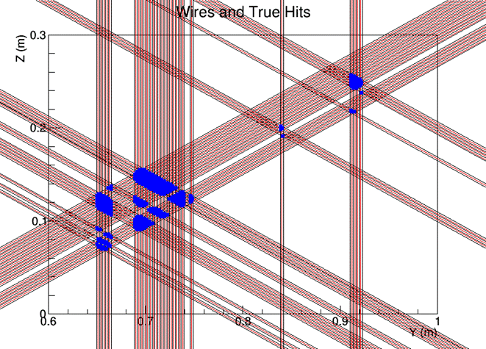
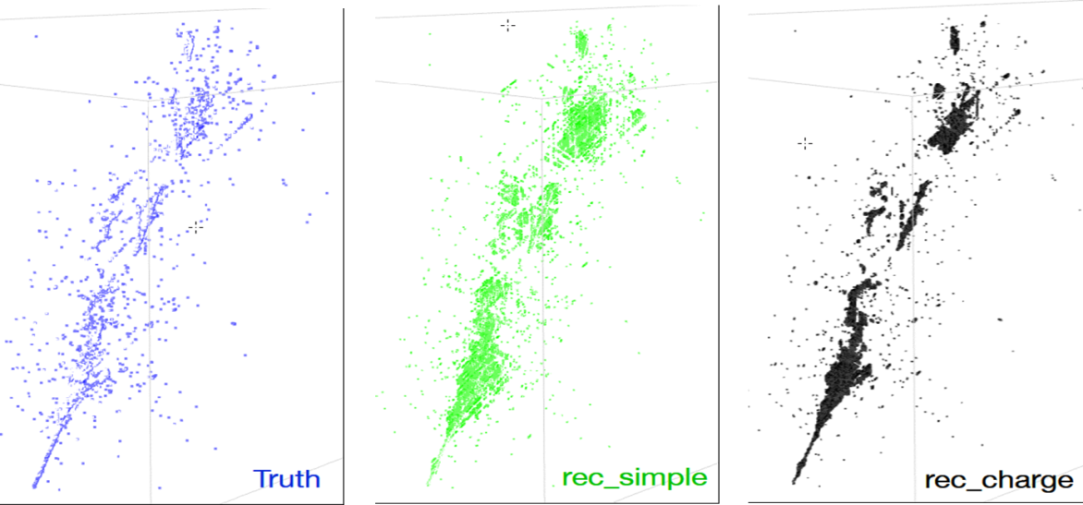
Wire-Cell 3-D Imaging and Reconstruction (Xin Qian, Chao Zhang, Hanyu Wei, Brett Viren)
LArTPC Signal Formation
slicing
tiling
merging
solving

Slide 6
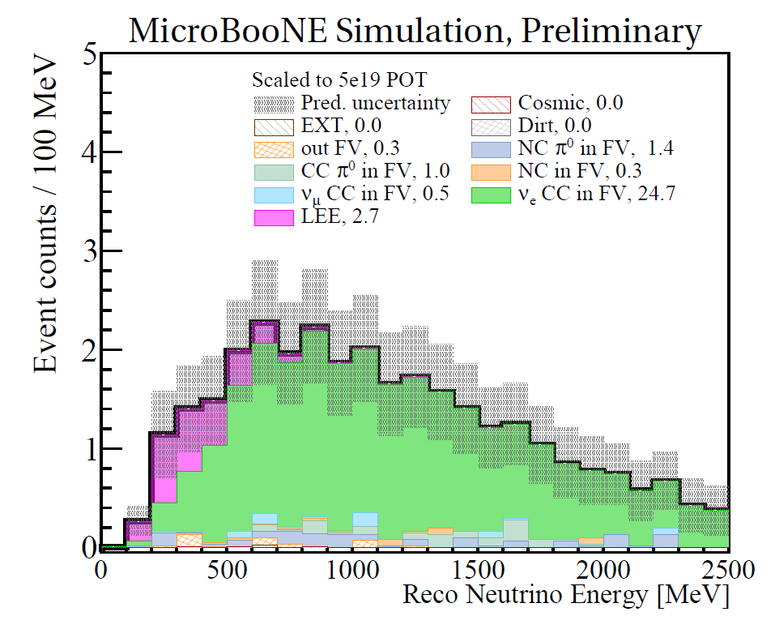
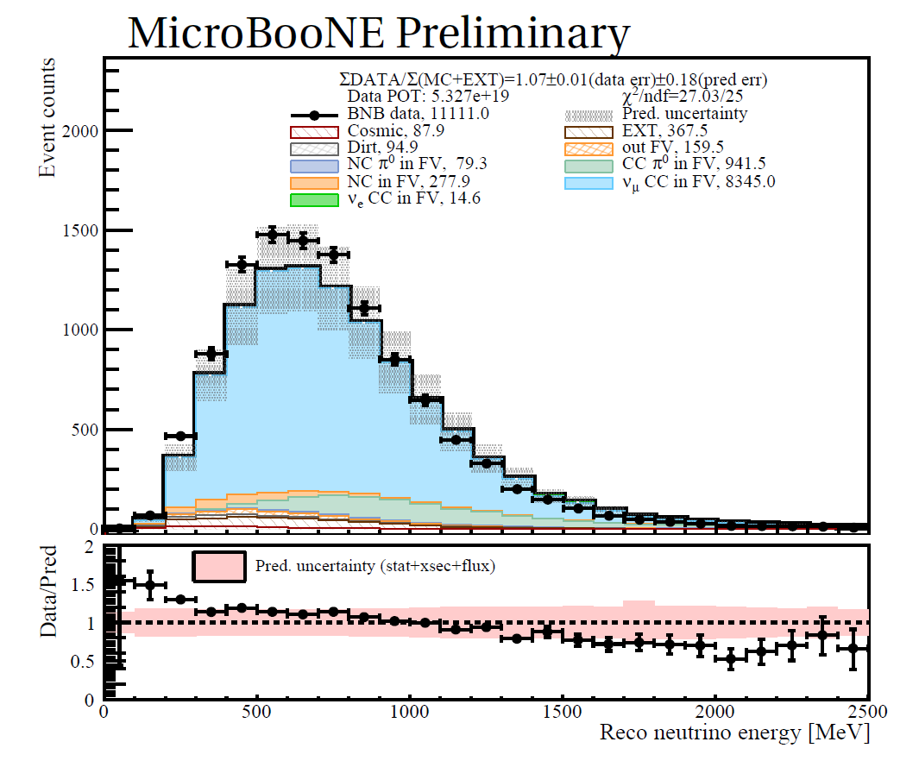
Low-Energy Excess Analysis in MicroBooNE
MicroBooNE-PUB 1095
Wire-Cell in MicroBooNE
High-performance inclusive charged-current ν_{µ} and ν_{e} event selection is achieved for the first time in a LArTPC
  Generic neutrino selection (arXiv:2012.07928, arXiv:2101.05076, submitted to PRL/PR Applied)
  Wire-Cell 3D imaging, clustering, and charge-light matching (arXiv:2011.01375, accepted by JINST)
  Wire-Cell 3D pattern recognition (under preparation)
Improved inclusive ν_{µ}CC interaction total and differential cross sections focusing on the neutrino energy reconstruction (results in collaboration review)
Search for electron low-energy excess with 6.37e+20 POT (data unblinding is in progress, currently far side band opened)
ν_{e}CC
42% efficiency
83% purity
ν_{µ}CC
65% efficiency
93% purity

Slide 7
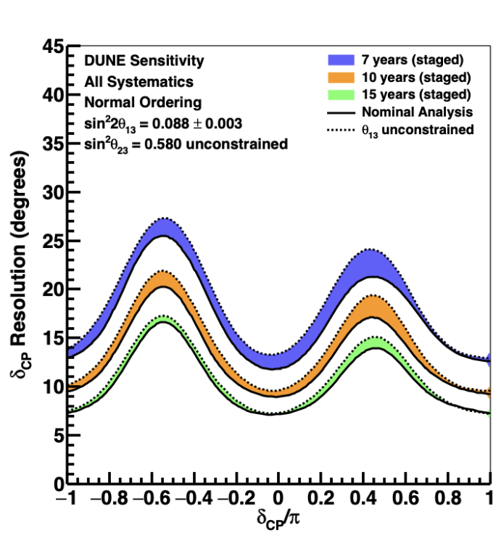
DUNE Physics Leadership
DUNE papers/documents w/ EDG contributions:
  “Long-baseline neutrino oscillation physics potential of the DUNE experiment,” Eur.Phys.J.C 80 (2020) 10, 978.
  “Neutrino interaction classification with a convolutional neural network in the DUNE far detector,” Phys.Rev.D 102 (2020) 9, 092003.
  “Prospects for beyond the Standard Model physics searches at the Deep Underground Neutrino Experiment,” Eur.Phys.J.C 81 (2021) 4, 322.
  “Experiment Simulation Configurations Approximating DUNE TDR,” arXiv:2103.04797.
  “Deep Underground Neutrino Experiment (DUNE) Near Detector Conceptual Design Report,” arXiv:2103.13910.
DUNE scientific leadership:
  Worcester: past physics Coordinator
  Carneiro: Interactions/SM Physics Working Group Convener
  Qian, Worcester: Vertical Drift Physics Task Force

Slide 8
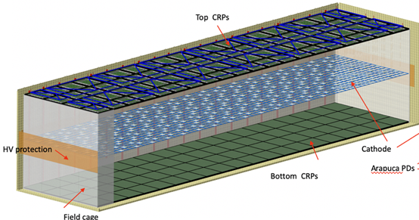
DUNE Project
FD2 (Vertical Drift)
  Leading overall international Vertical Drift project
    Technical Design Report
    Completed Preliminary technical design
  Leading US Vertical Drift project
    CD-1rr: July 2022
    CD-2/3: March 2023
    Operations: 2028
  Leading development of anode readout (CRP), HV, cold electronics
    Exciting new technology for liquid argon time projection chamber (LArTPC)
    Optimizing perforated pcb-anode technology
  Leading US contributions to HV, CRP and installation; major contributions to cold electronics
FD1 (Horizontal Drift, including joint FD1-FD2 activity)
  Major effort in cold electronics (key technology for both FD1 and FD2)
  Lead HV
  Leading Installation planning
LBNF/DUNE Project Leadership Roles
  Steve Kettell (FD2 Technical Coordinator, Mary Bishai (Review Office Chair), Jim Stewart (FD Installation Manager)

Slide 9
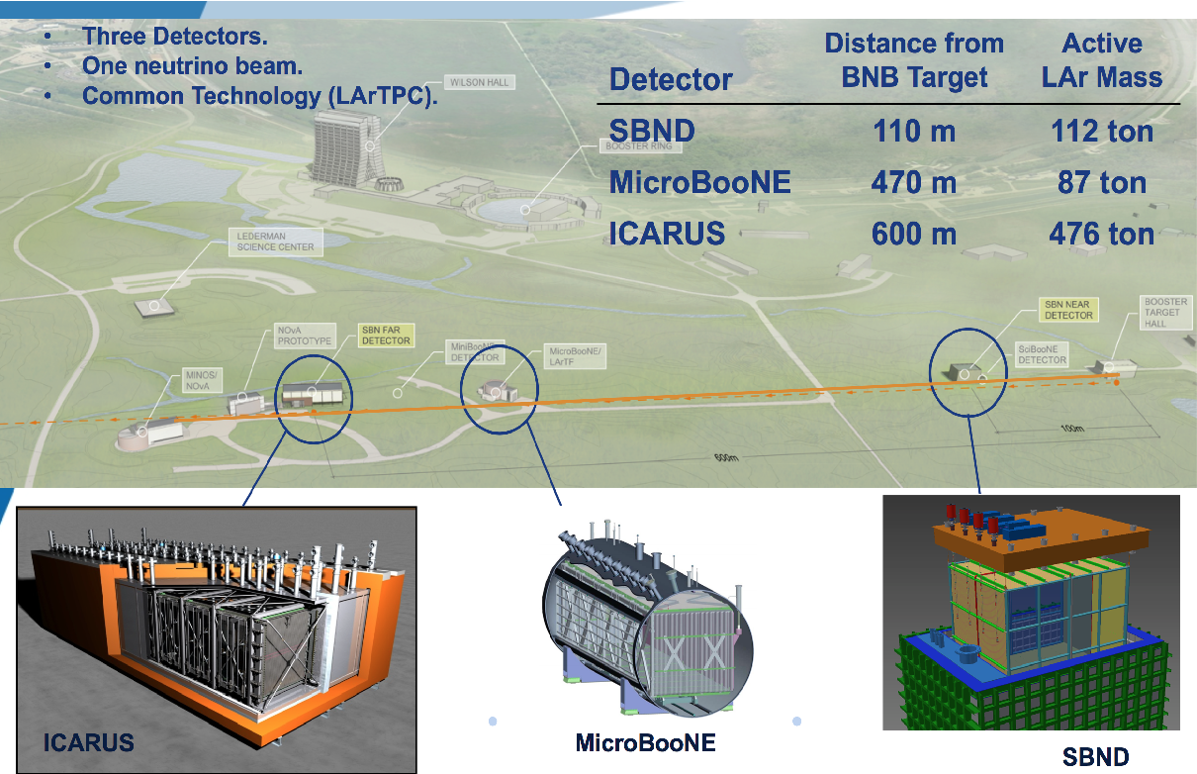
The Short Baseline Neutrino Program (SBN)

Slide 10
BNL involvement in SBN
SBN: Common analysis framework development (Diana Mendez-Mendez, Mateus Carniero)
SBND: TPC Design, Cold Electronics PI: Elizabeth Worcester. Diana Mendez-Mendez (tour)
ICARUS: Signal processing, Simulation, PMT system commissioning, trigger PIs: Chao Zhang, Milind Diwan, Elizabeth Worcester. Andrea Scarpelli (past run coordinator)

Slide 11
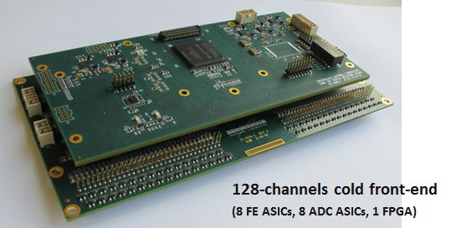
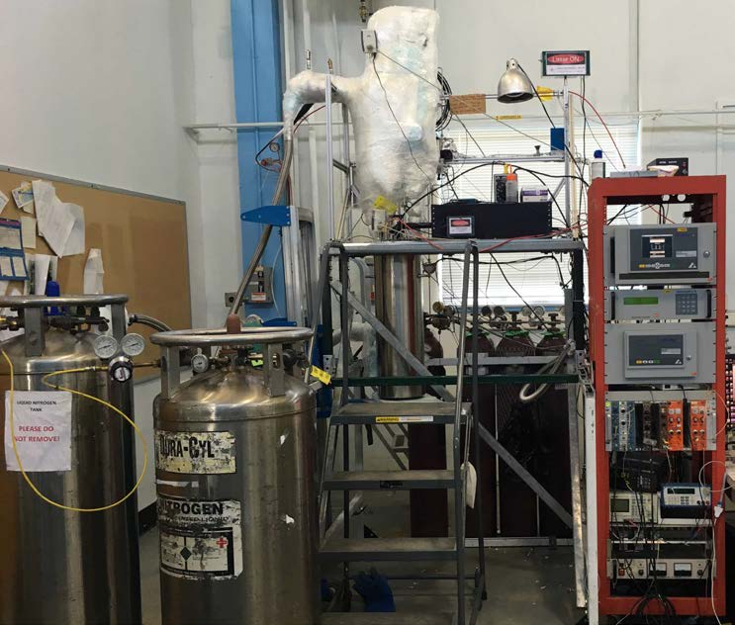
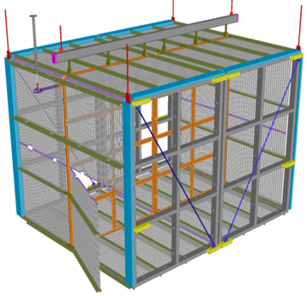
LArTPC R&D at BNL
(tour by Yichen Li)
Cryogenic electronics design and R&D
(tour by Shanshan Gao)
LArTPC novel designs
Liquid Argon properties teststand
https://lar.bnl.gov/

Slide 12
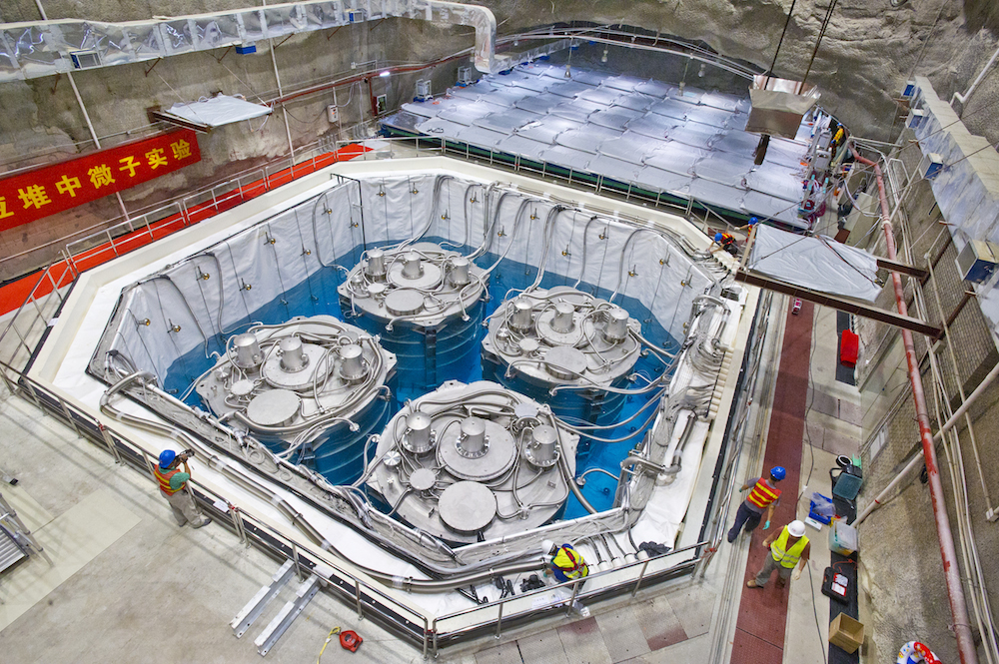
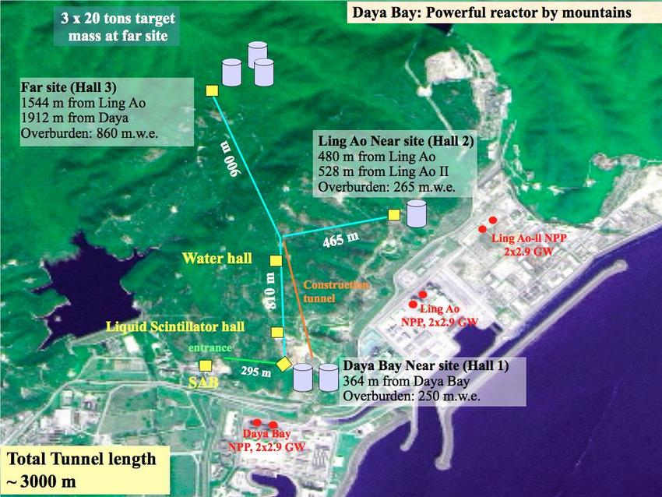
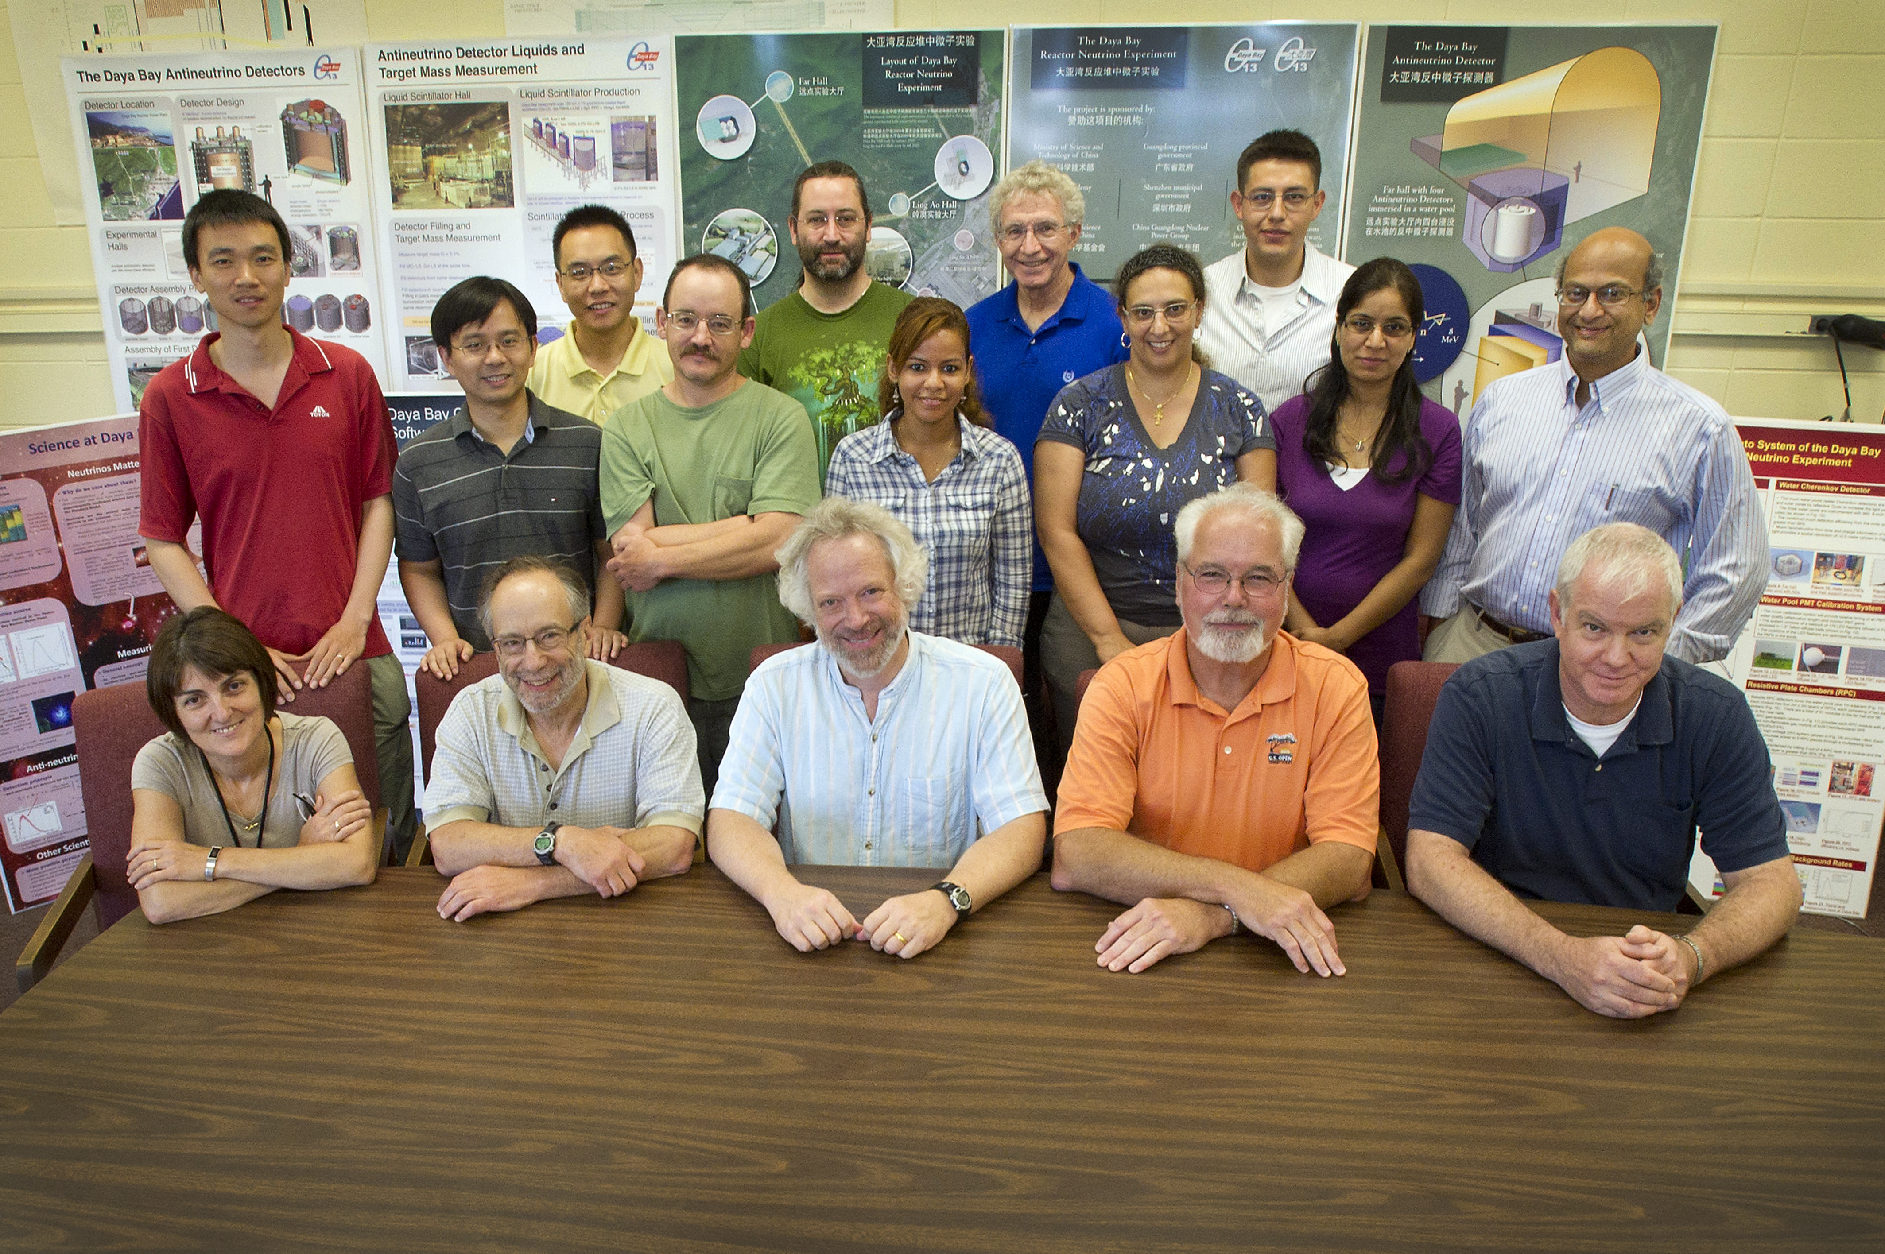
Daya Bay Reactor Neutrino Experiment
https://www.bnl.gov/science/dayabay.php

Slide 13
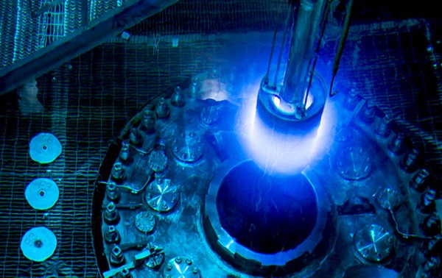
PROSPECT Reactor Neutrino Experiment
Th
The High Flux Isotope Reactor (HIFR), Oakridge National Lab

Slide 14
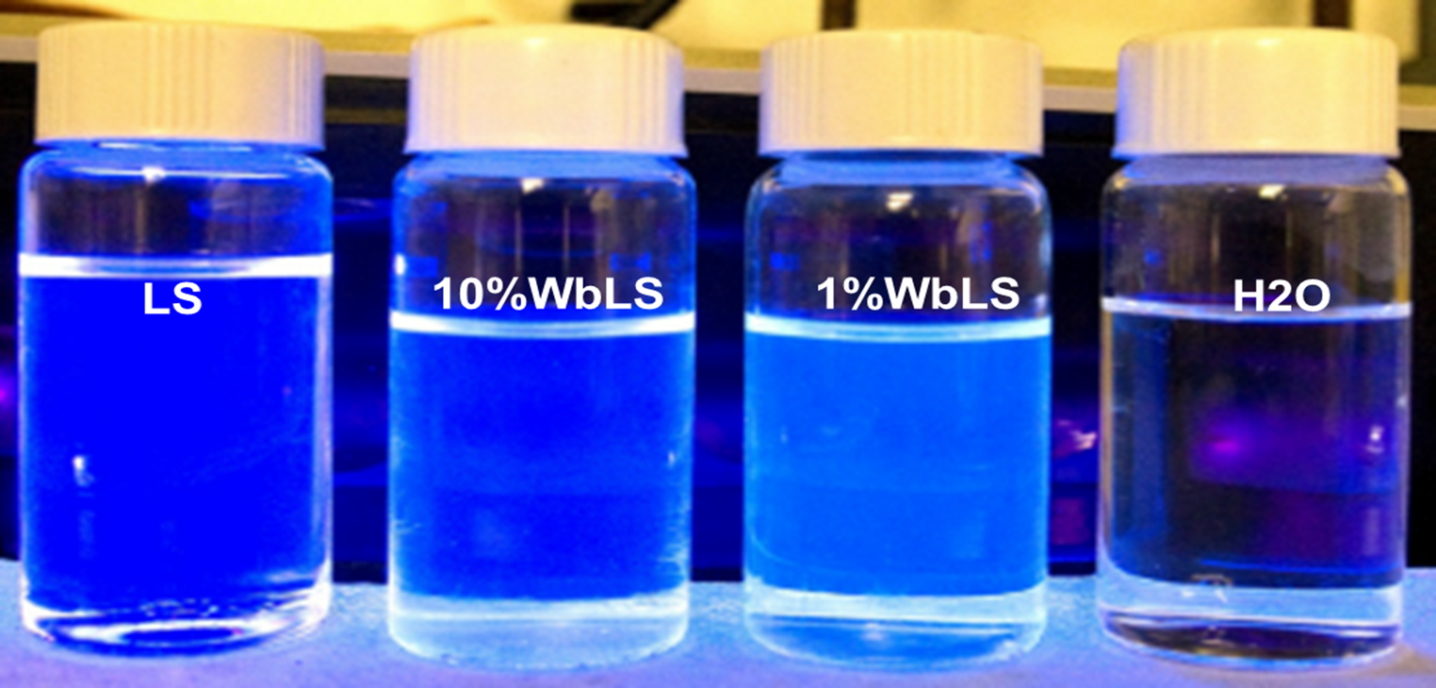
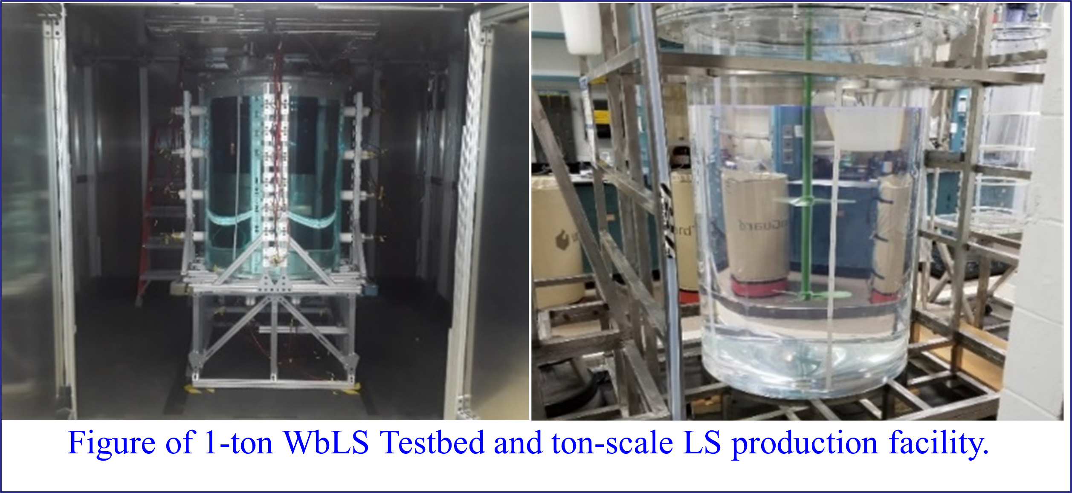
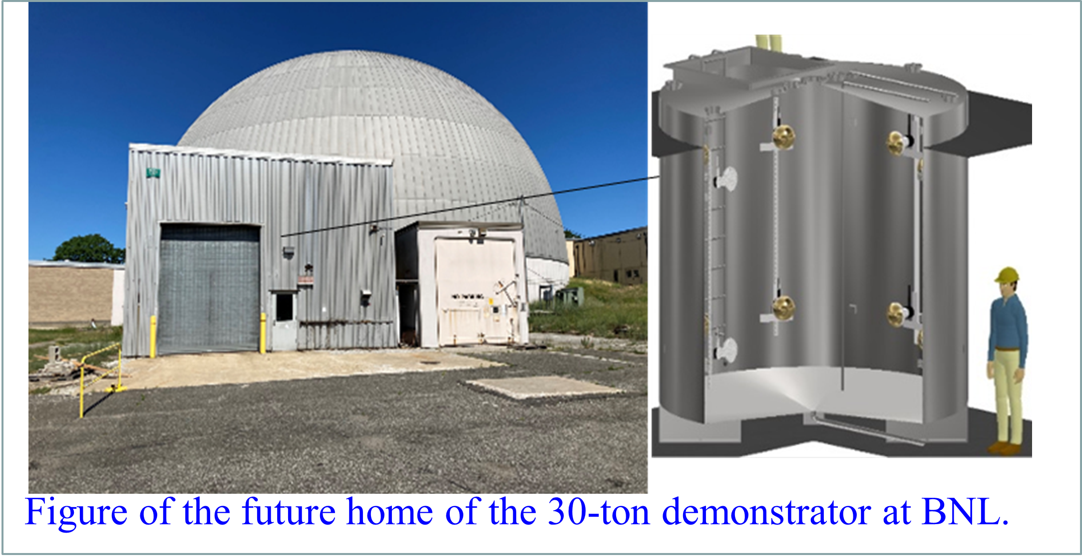
BNL LS Development
(tours by Richard Rosero and Xin Xing)
Advanced development of novel liquid scintillator-based detector for neutrinos and other rare-event physics
  Developer and production lead of Gd-doped LS for DayaBay experiment and LZ dark matter search
  Initiator of Water-based Liquid Scintillator (WbLS): high energy Cherenkov & low-energy scintillation; A rich physics program spanning topics in nuclear, high-energy, and astrophysics, and across a dynamic range from hundreds of keV to many GeV.
  Leverage existing expertise and facilities in photon detection and scintillator detector research with unique scientific leads across CO/IO/PO
    LS Research Center includes in-house ton-scale LS production facility and multiple instrumentation labs
    1T-BNL Testbed: highly instrumented; capable of testing different liquid matrix; commissioned in 2022
    30T-BNL demonstrator; scale-up subsystems: WbLS circulation, Gd-plant, organic-nanofiltration, water-purification for WbLS kton-deployment; ~ready in 2023
  Ideal research platform for student researches (host ~3 per year)
M. Yeh for WbLS Team

Slide 15
QUESTIONS? DISCUSSION

