Slide 1
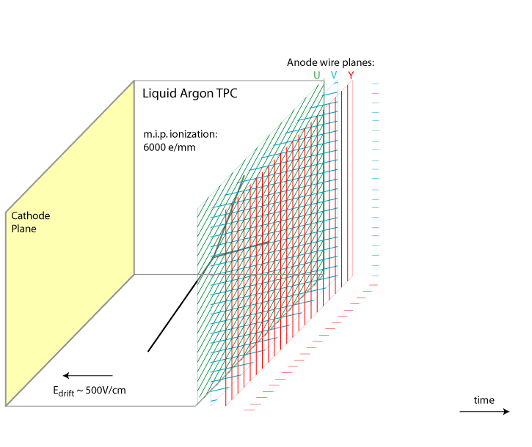
Liquid Argon TPC
Charged particles passing through detector ionize the argon atoms, and the ionization electrons drift in the electric field to the anode wall on a timescale of milliseconds. The anode consists of layers of active wires forming a grid.
time
3 Wire Plane readout with Excellent Space and Energy resolution
3D-imaging: full event topology reconstruction
Higher sensitivity to neutrino physics and for some of the proton decay channels (e.g. p → K𝛎)
Notes:
Let’s look the principle of liquid argon TPC.
liquid argon TPC is very sensitive which can meet the requirement of studying neutrino physics and for some of the proton decay channels.
As you can see in this animation,
Charged particles passing through detector ionize the argon atoms,
and the ionization electrons drift in the electric field to the anode wall on a timescale of milliseconds.
The anode consists of layers of active wires forming a grid.
With 3 wire plane readout, time, geometry and charge information are collected with excellent resolution.

Slide 2
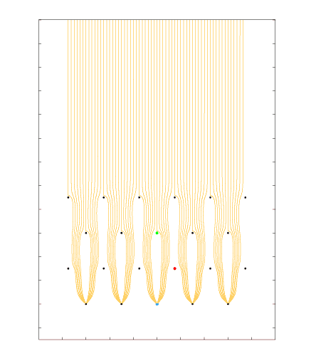
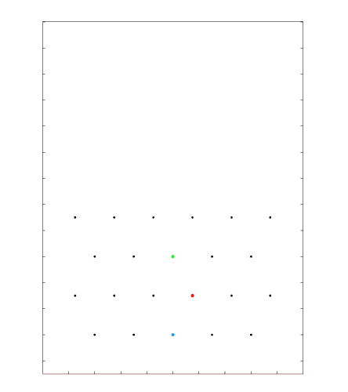
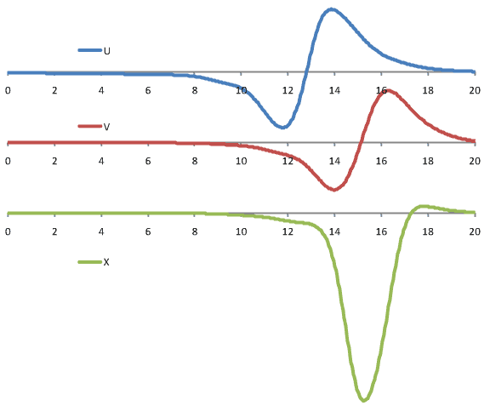
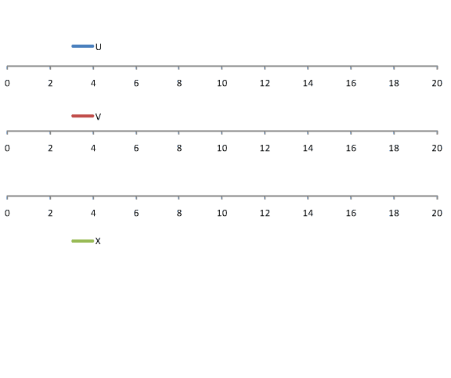
Signal Formation: Induced Signals from a Track Segment
Grid
U
V
[µs]
X
Charge signal is very small due to there is no electron amplification inside Lar.
DUNE style wire arrangement: 3 instrumented wire planes + 1 grid plane
Raw current waveforms convolved with a 0.5µs gaussian to mimic diffusion
Notes:
Let’s look signal formation of 4-layer anode plane array.
Grid plane is ESD protection to the inner layers, which is transparent to the drifting electrons.
U and V layer, as known as induction layer, produce bipolar induction signals as the electrons pass through them.
X layer, as known as collection layer, collects the drifting electrons, resulting in a monopolar signal.

