Slide 1
NEURAL_NETWORKS
By: Jose Modesto Alanis III

Slide 2
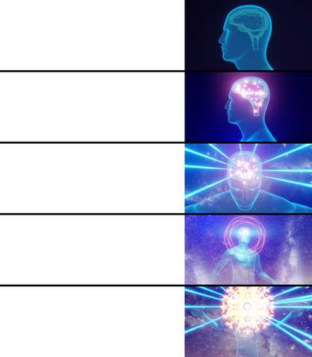
General_Outline
What is a Neural Network?
How does it help us?
(NNS) & Physics
Data processing
(NNS) & image recognition
Biomimicry
References
Me not knowing what Neural Networks are?
My brain while looking at, Jose’s, presentation.
Learning about Neural Networks and using them to my advantage.
Creating my own Neural Network to enhance my capabilities.
Working at BNL while using a Neural Network to classify Neutrino flavors.

Slide 3
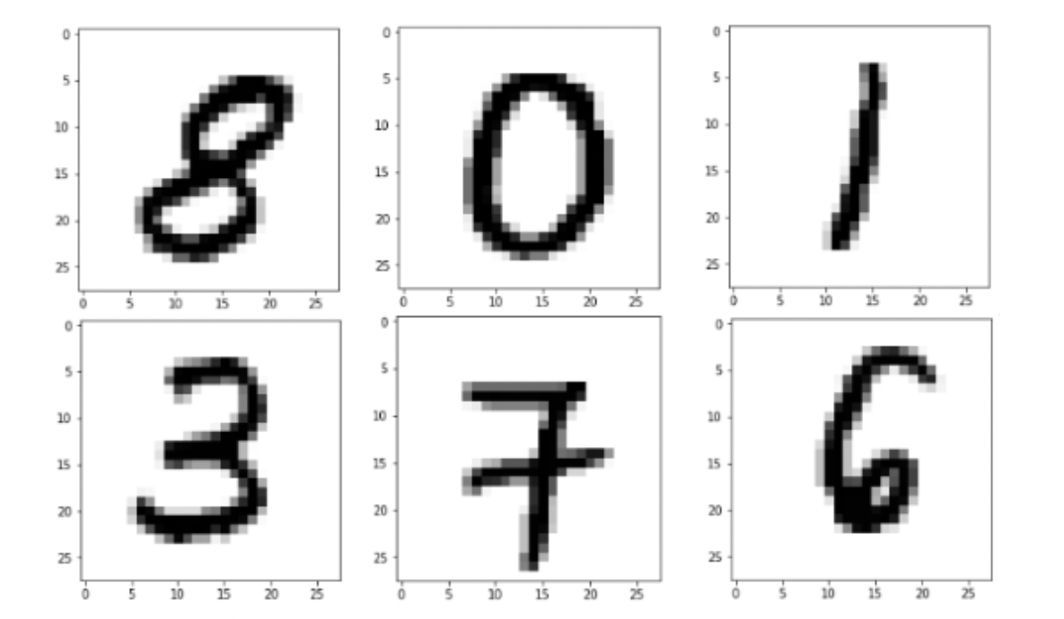
ACTIVATING_MY_NEURONS
What do you all see in these images?

Slide 4
ACTIVATING_MY_NEURONS
What do you all see in these images?
That is right, the low rendered images are portraying numbers, eight, zero, one, three, seven, and six.
Your eyes alone did not recognize the numbers, something within your brain helped you classify each individual image. Your neurons themselves had to activate and look in to passed experiences in order to obtain a recognition of the numbers.

Slide 5
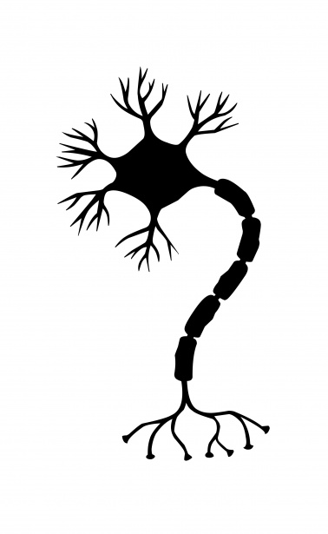
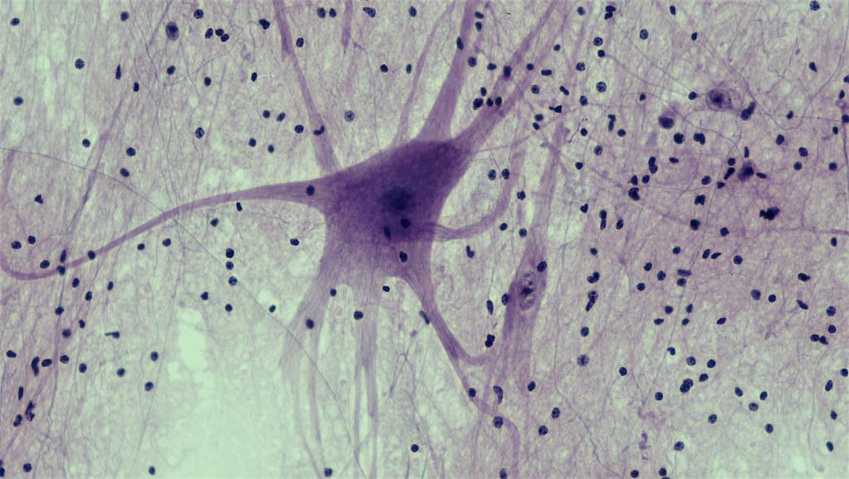
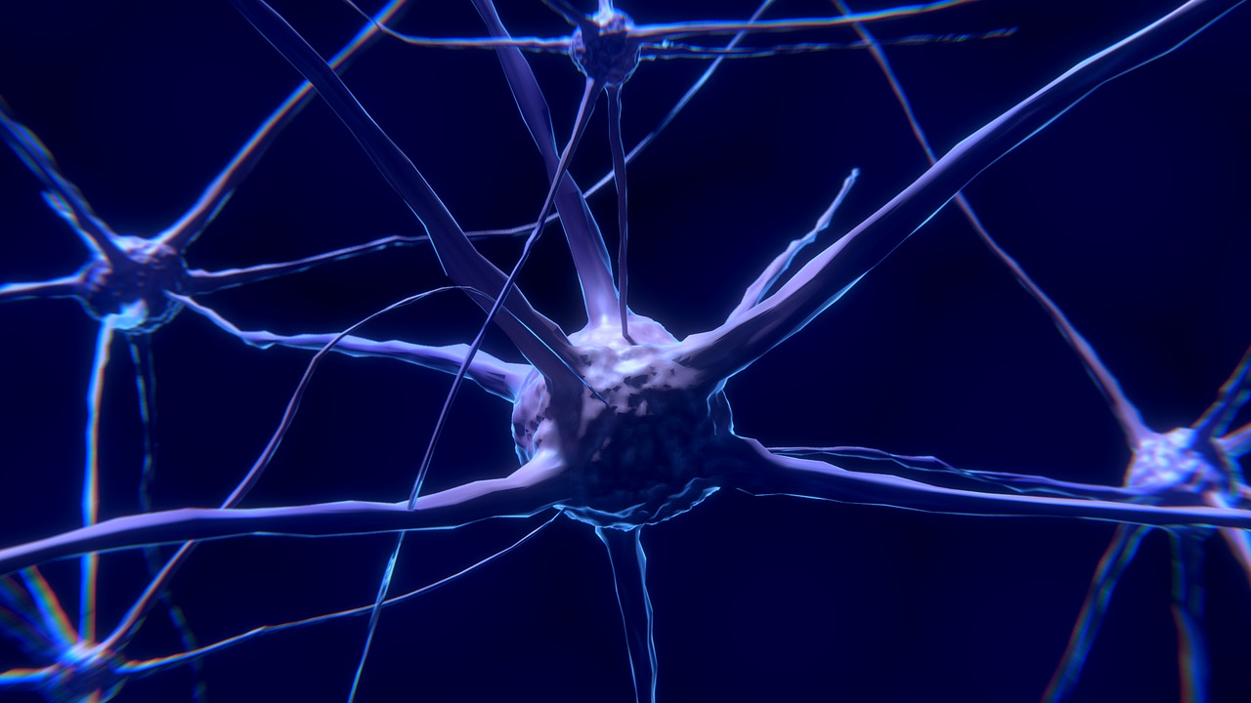
NEURAL _NETWORKS (NNS)
First and foremost, what is a neuron?
A neuron or nerve cell is an electrically excitable cell that communicates with other cells via specialized connections called synapses.

Slide 6
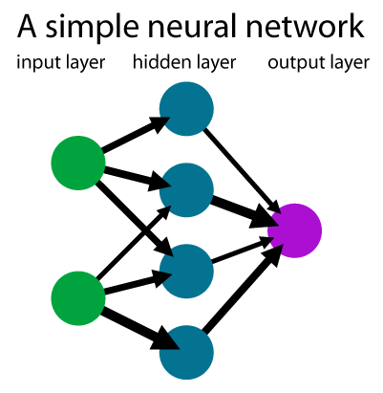
NEURAL _NETWORKS (NNS)
What is a (NNS)?
A neural network is a network or circuit of biological neurons, or, in a modern sense, an artificial neural network, composed of artificial neurons or nodes. Thus, a neural network is either a biological neural network, made up of biological neurons, or an artificial neural network, used for solving artificial intelligence (AI) problems.

Slide 7
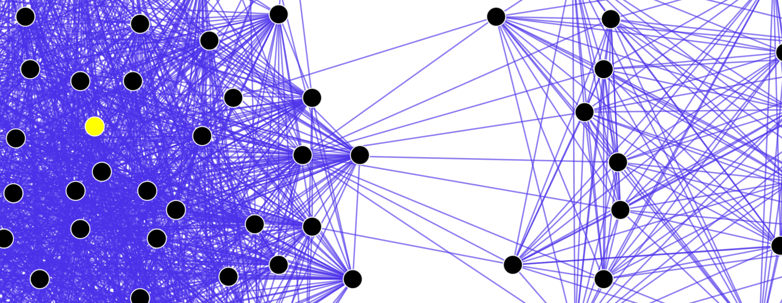
HOW_CAN_IT_HELP_US
Ever heard of, Alexa, Cortana, Siri, or Google assistant. All of these involve some form of speech pattern recognition.
Have you tried searching for similar image/items on a database. Or similar song. Who do you think is doing the searching?

Slide 8
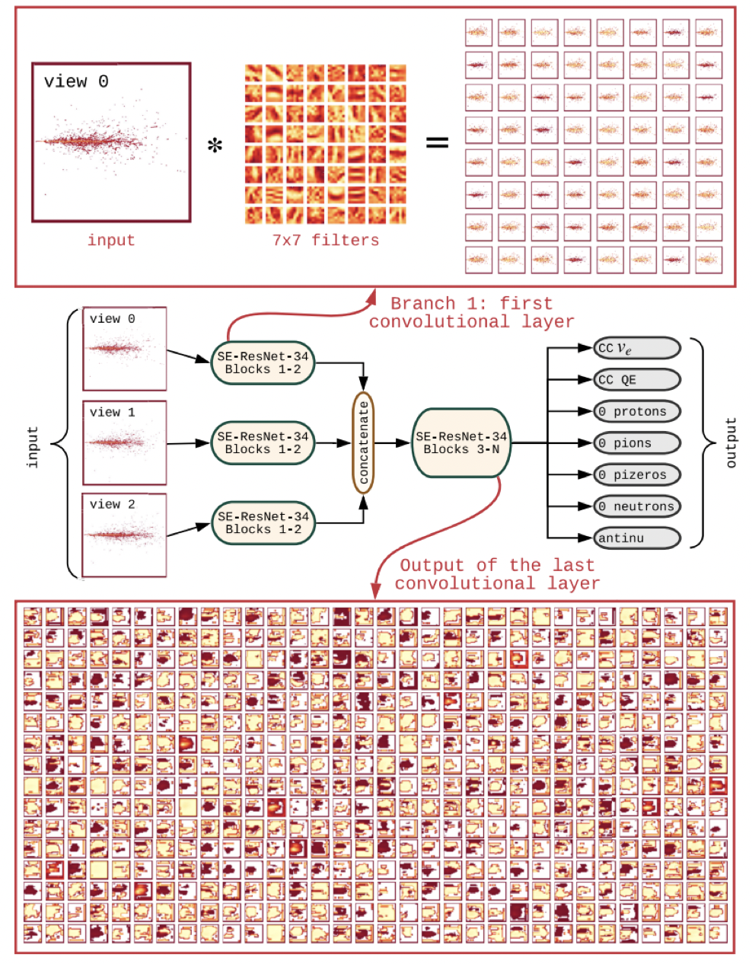
(NNS)_&_PHYSICS
How are Neural Networks used at Brookheaven National Laboratory?
BNL is starting to implement “Deep Neural Networks” particularly a brand called convolutional neural networks in order to classify Neutrino Flavors.

Slide 9
Image_Regocnition
Something that, Mr. Nitish Nayak, showed me was a Neural Network that works to recreate a typed phrase or word.
https://huggingface.co/spaces/dalle-mini/dalle-mini
Following the link will show us a brief example.

Slide 10
Data processing
Kouzou Sakai for Quanta Magazine

Slide 11
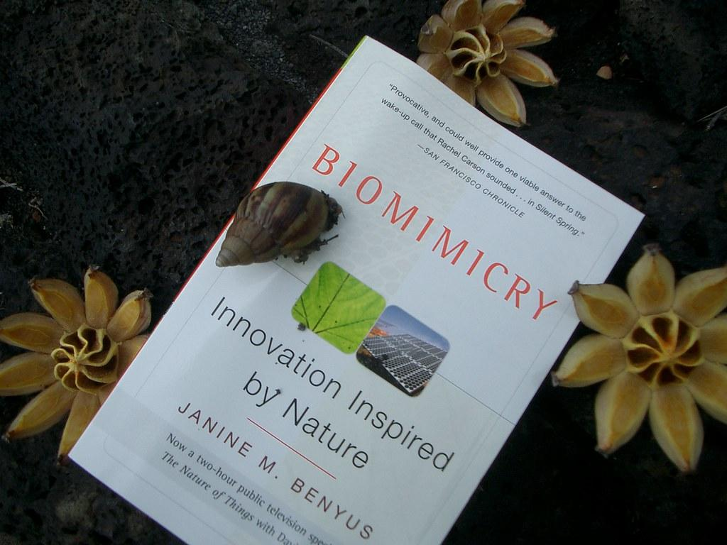
BIOMIMICRY
The concept of Neural Networking is a perfect example of BIOMIMICRY.
In essence we are trying to make computers mimic our human biology something that was naturally evolved by nature.https://www.youtube.com/watch?v=iMtXqTmfta0
The world is poorly designed. But copying nature helps.

Slide 12
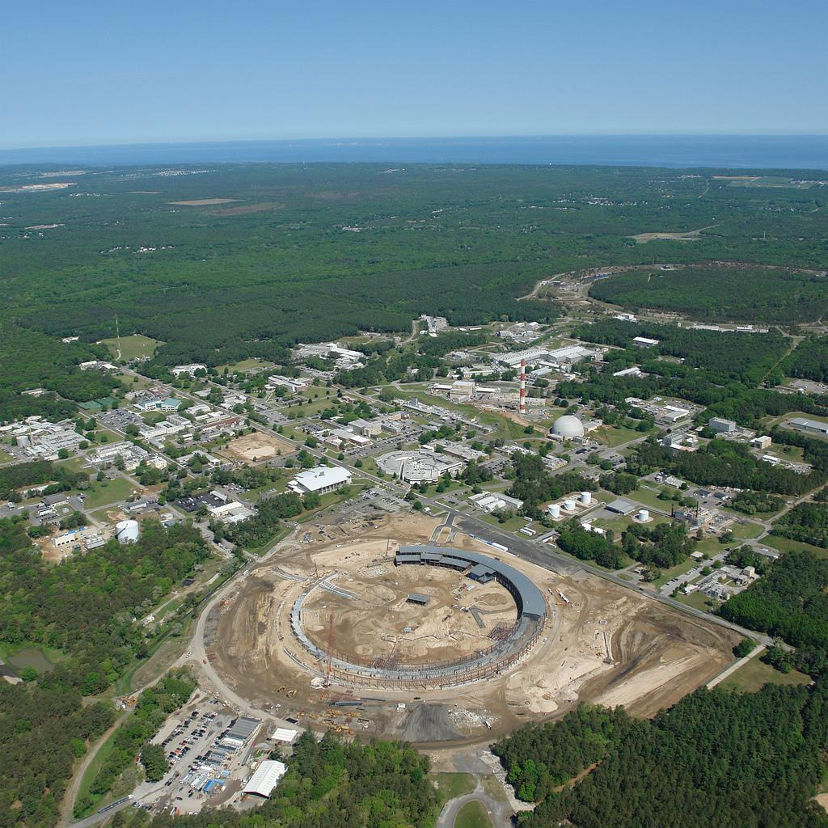
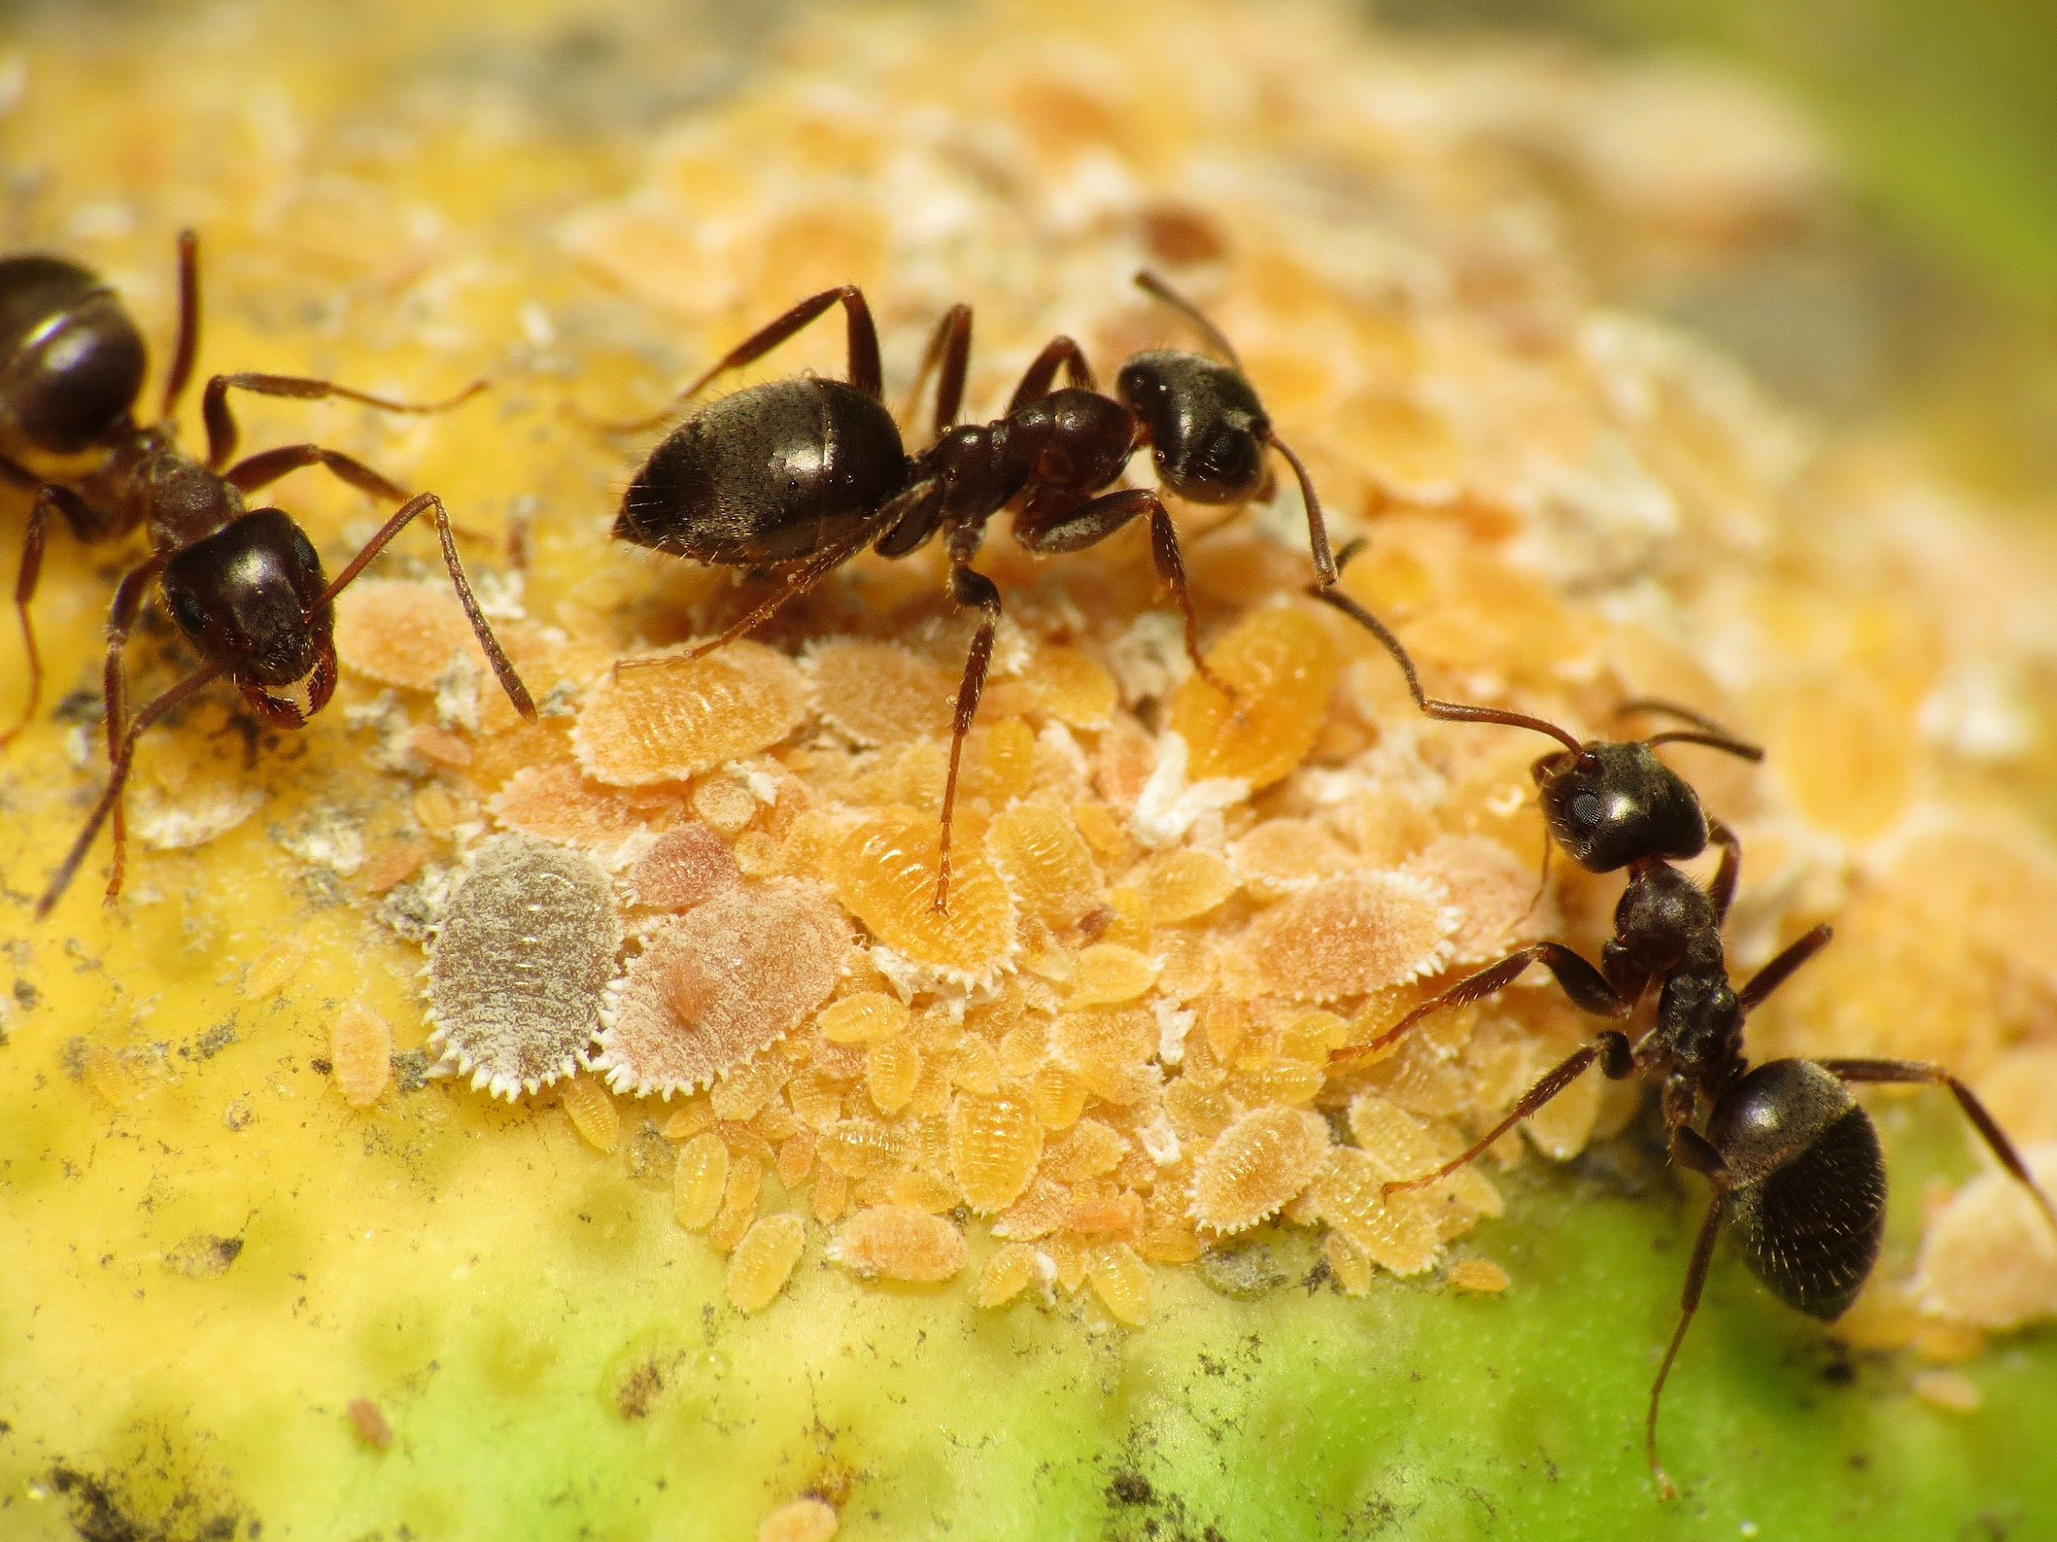

Slide 13
REFERENCES
Borrowed from, Nitish Nayak’s (BNL), “Machine Learning for Neutrino Identification”.
Vijayan, J. (2017, August 25). Classifying devanagari vowels with TFLearn. Jayanand Vijayan. Retrieved July 15, 2022, from https://jayanand90.github.io/Classifying-Devanagari-vowels-with-TFLearn/
3Blue1Brown. (2017, October 5). But what is a neural network? | Chapter 1, Deep Learning. YouTube. Retrieved July 15, 2022, from https://www.youtube.com/watch?v=aircAruvnKk
Wikimedia Foundation. (2022, July 11). Neuron. Wikipedia. Retrieved July 15, 2022, from https://en.wikipedia.org/wiki/Neuron
Wikimedia Foundation. (2022, June 27). Neural network. Wikipedia. Retrieved July 15, 2022, from https://en.wikipedia.org/wiki/Neural_network

Slide 14
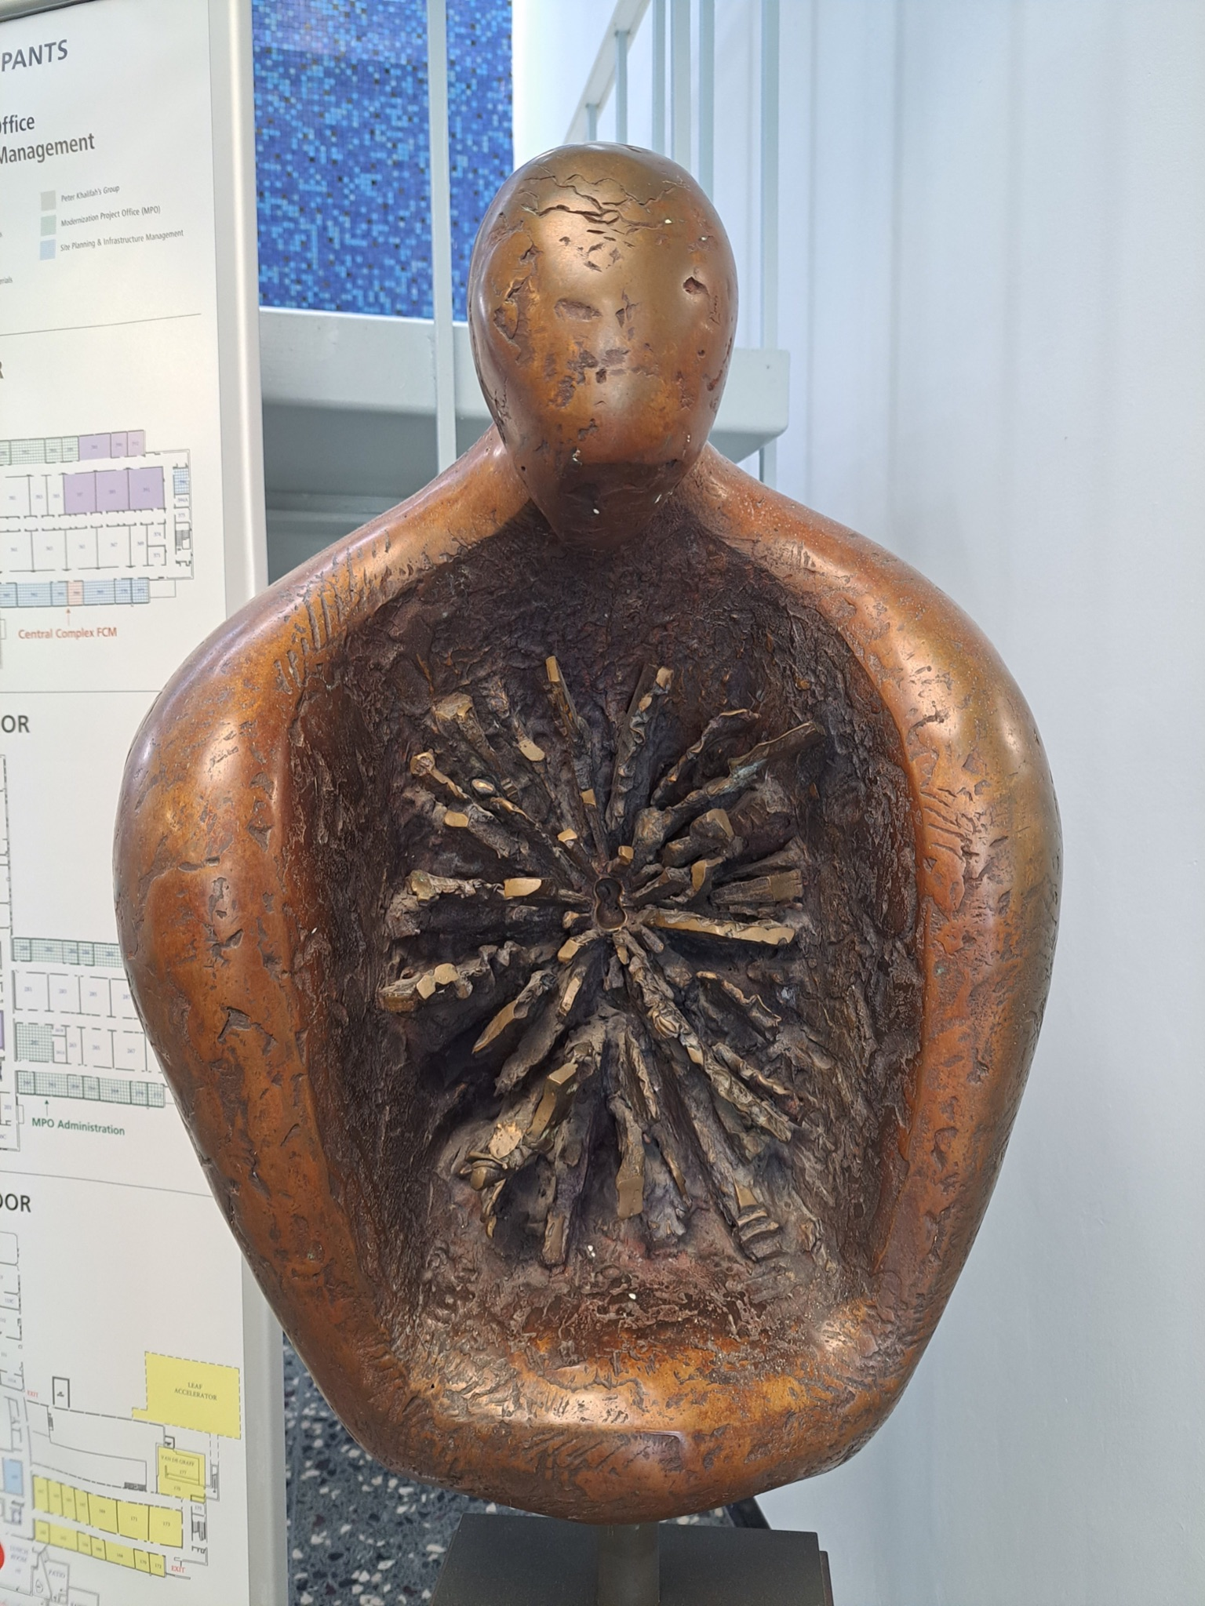
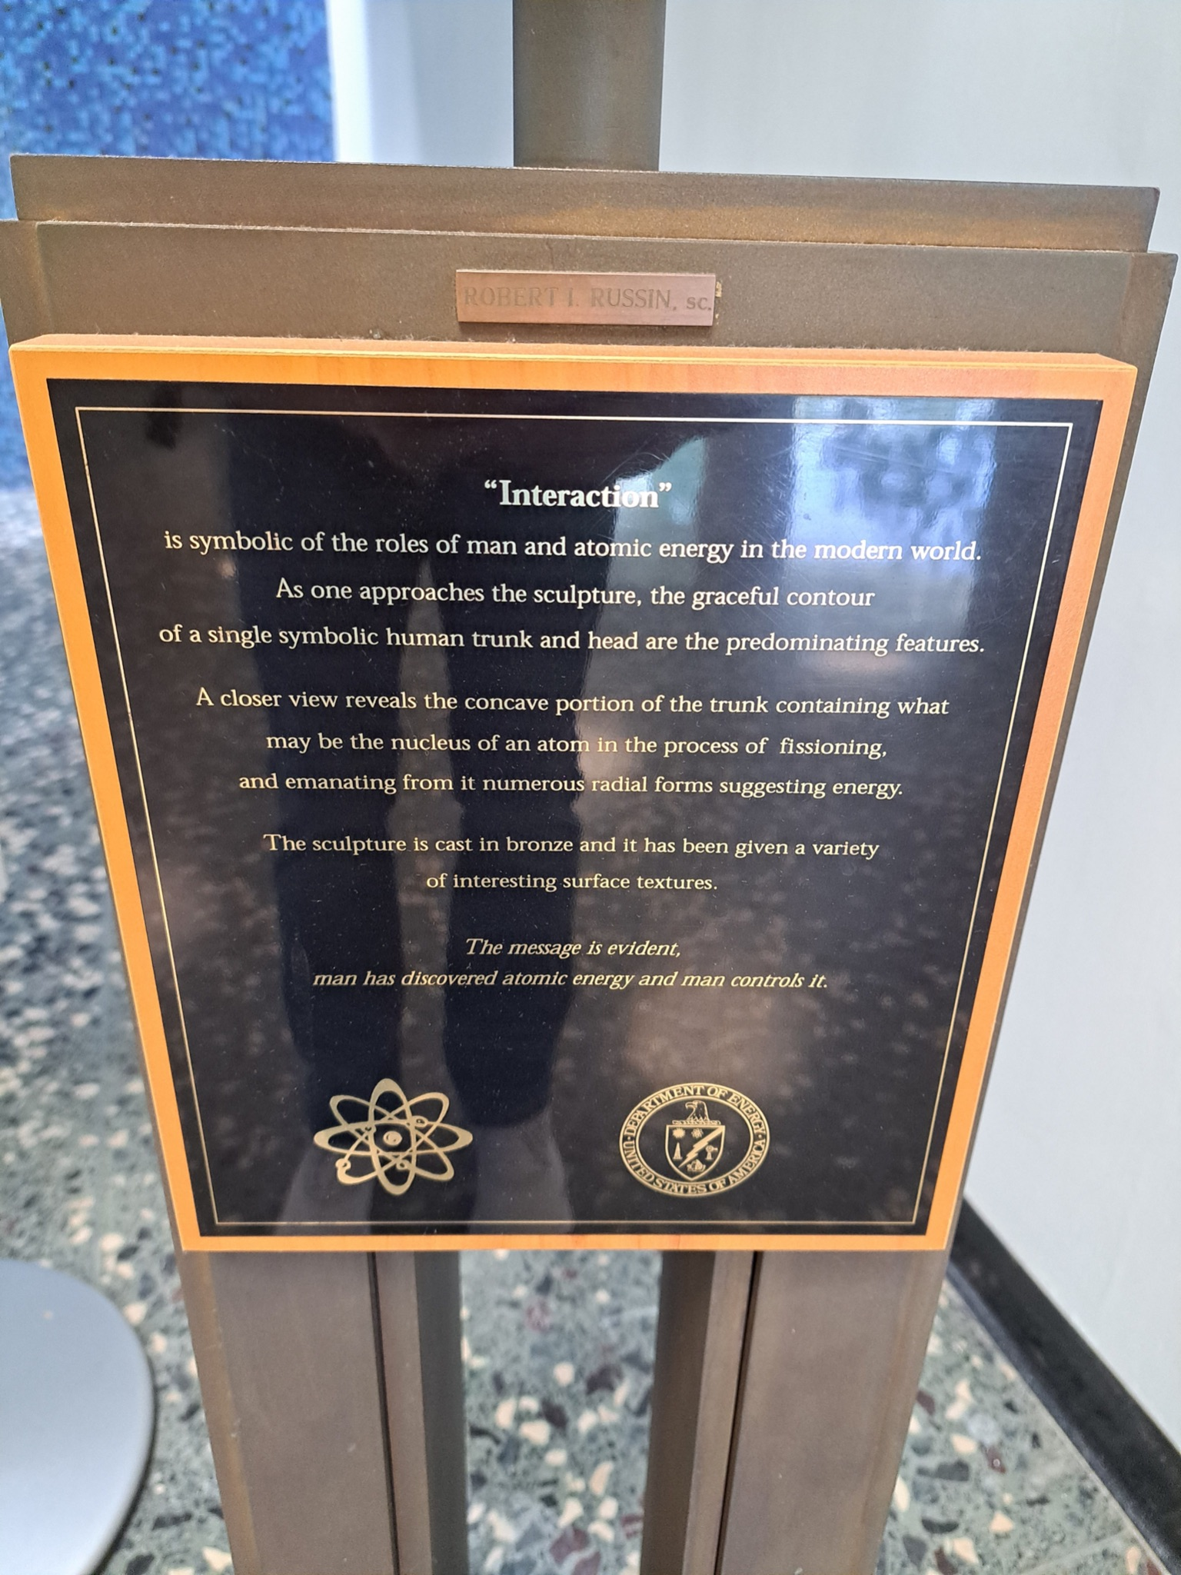

Slide 15
“The mystery of life isn't a problem to solve, but a reality to experience.”
“A process cannot be understood by stopping it. Understanding must move with the flow of the process, must join it and flow with it.”
Frank Herbert, Dune
Thank you, Brookhaven National Laboratory, and NuSTEAM, it was a pleasure to meet everyone.

Slide 16
General_Outline
What is a Neural Network?
How will it help us?
(NNS) Data processing
(NNS) & Philosophy
(NNS) & Physics
(NNS) & Art
AI
Biomimicry
References
Me not knowing what Neural Networks are?
My brain while looking at, Jose’s, presentation.

Slide 17
END REMAR

