Slide 1
DUNE CE ASIC R&D & QA
Carl Bromberg, Kendall Mahn, Dean Shooltz
Michigan State University

Slide 2
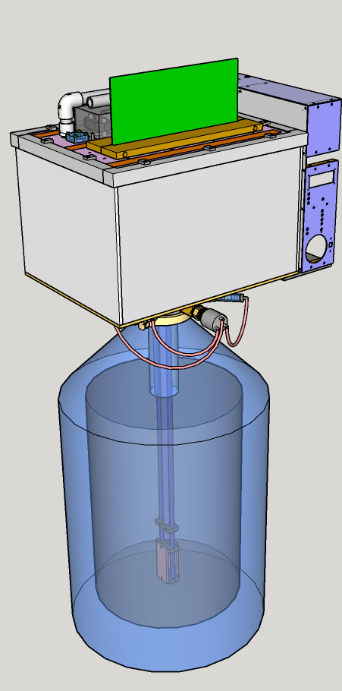
“Foam insulated kitchen sink”
...quote from FNAL safety review
Cryo Testing Station
– Cycle time is roughly one hour (plus electronics testing time)
– Fans and heaters are located inside test chamber
– Slight pressure in Dewar used to raise LN2 into test chamber
– Relieve pressure and LN drains back into Dewar
– CTS cycle keeps DUT dry throughout the cycle
4 ASICs or 1 FEMB
Load/Unload
Lid removed
Fan off
Heat off
no LN2
Warmup
Fan on
Heat on
no LN2
Supply N2 gas
Purge and Dry
Fan on
Heat on
no LN2
Supply N2 gas
CTS
Cycle
Immerse
Fan off
Heat off
10 cm LN2
Cooldown
Fan on
Heat off
1 cm LN2
Heater
LN2 Dewar

Slide 3
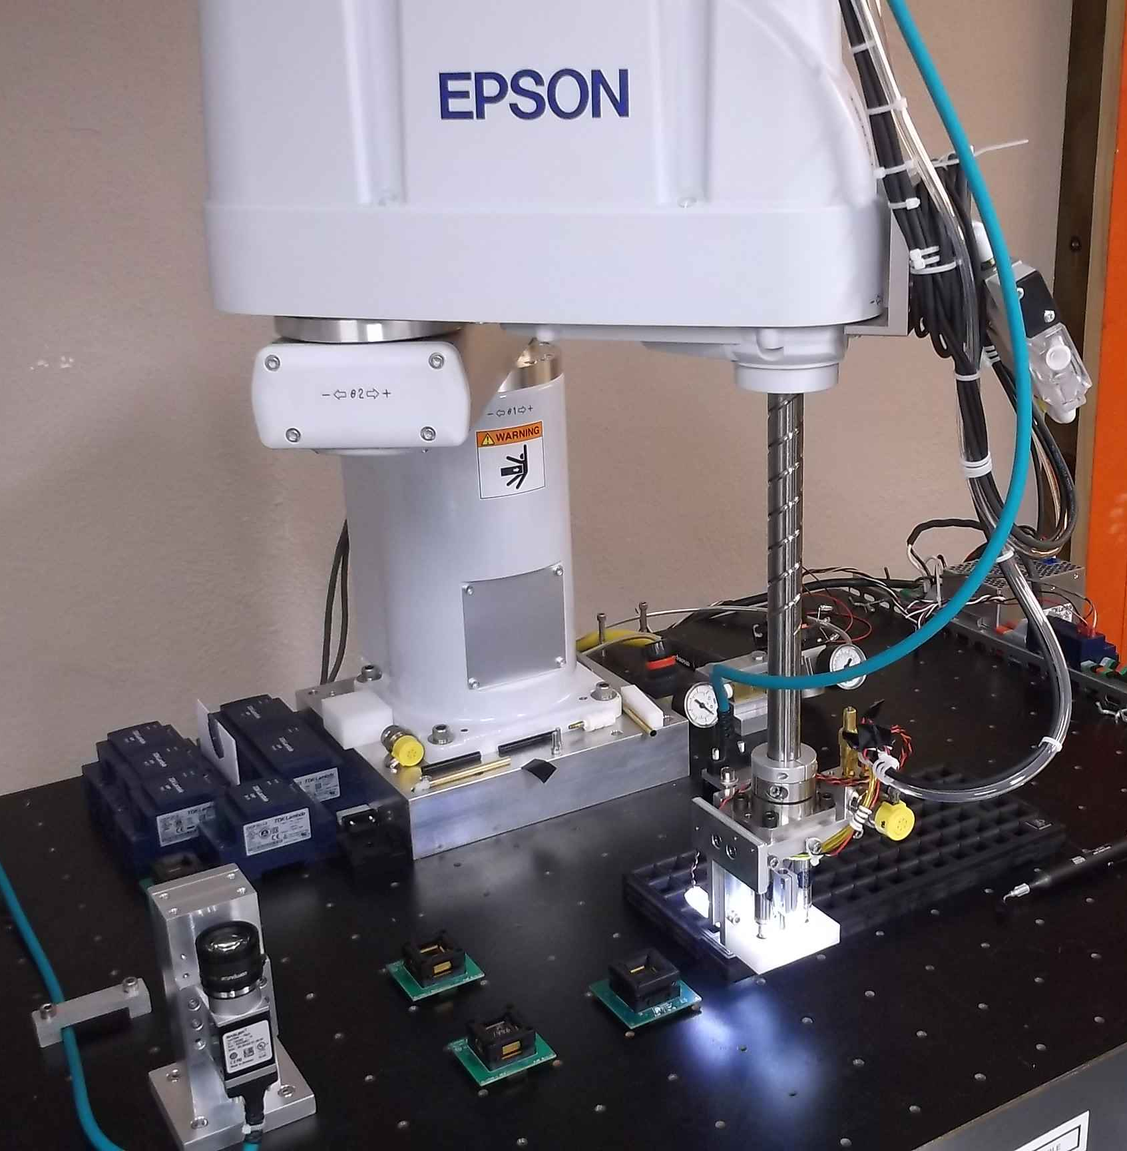
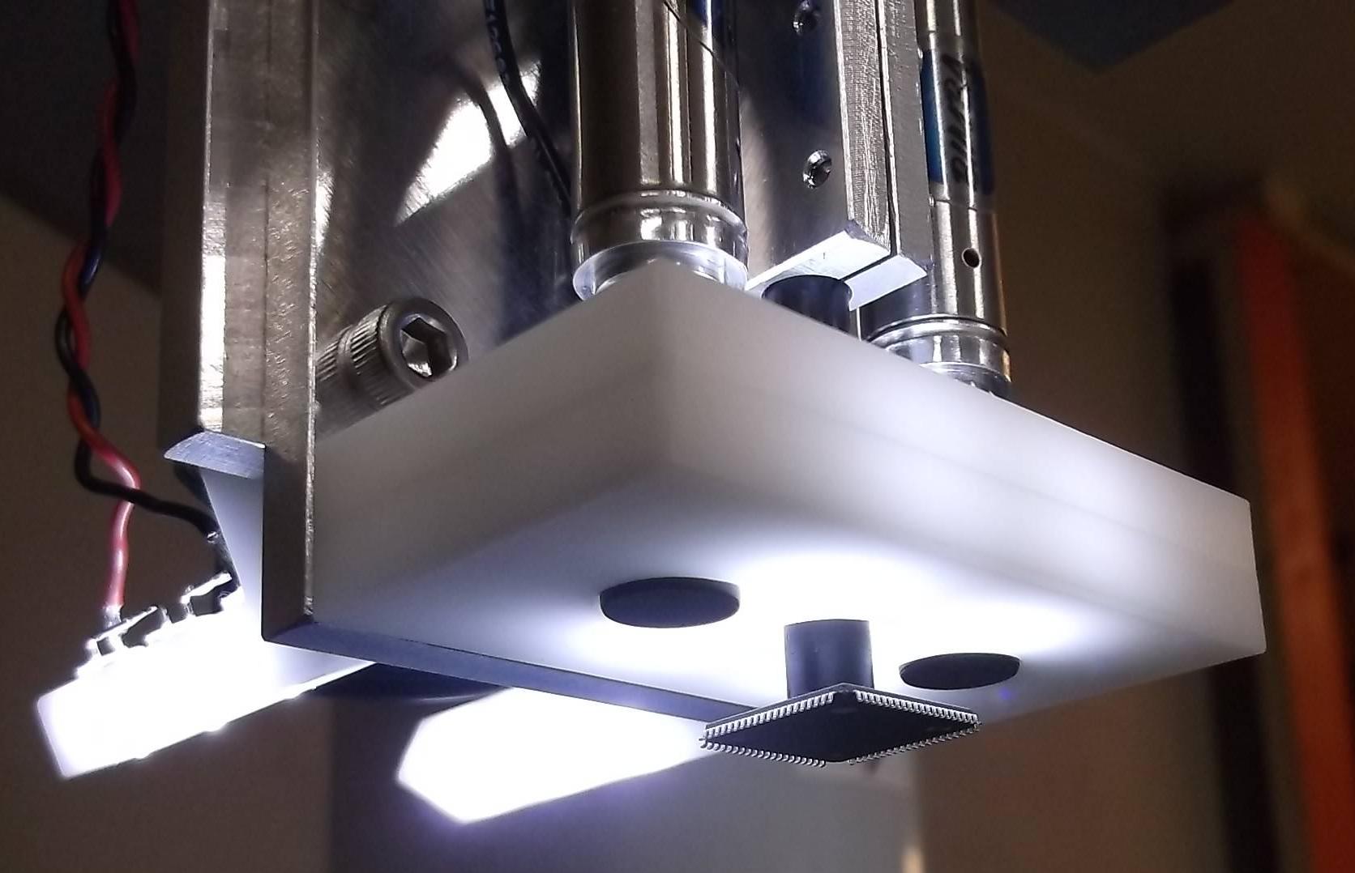
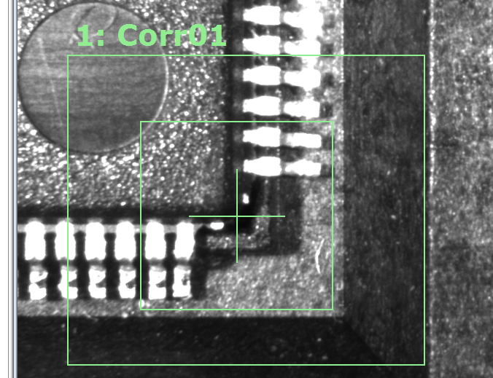
Robotic ASIC Handling
– SCARA 4-axis robot
– End-Of-Arm-Tooling designed to load/unload LQFP-128 and LQFP-208 ASIC test sockets
Includes a camera system
– Positioning refinement
– ASIC optical inspection
– Bent pin detection

Slide 4
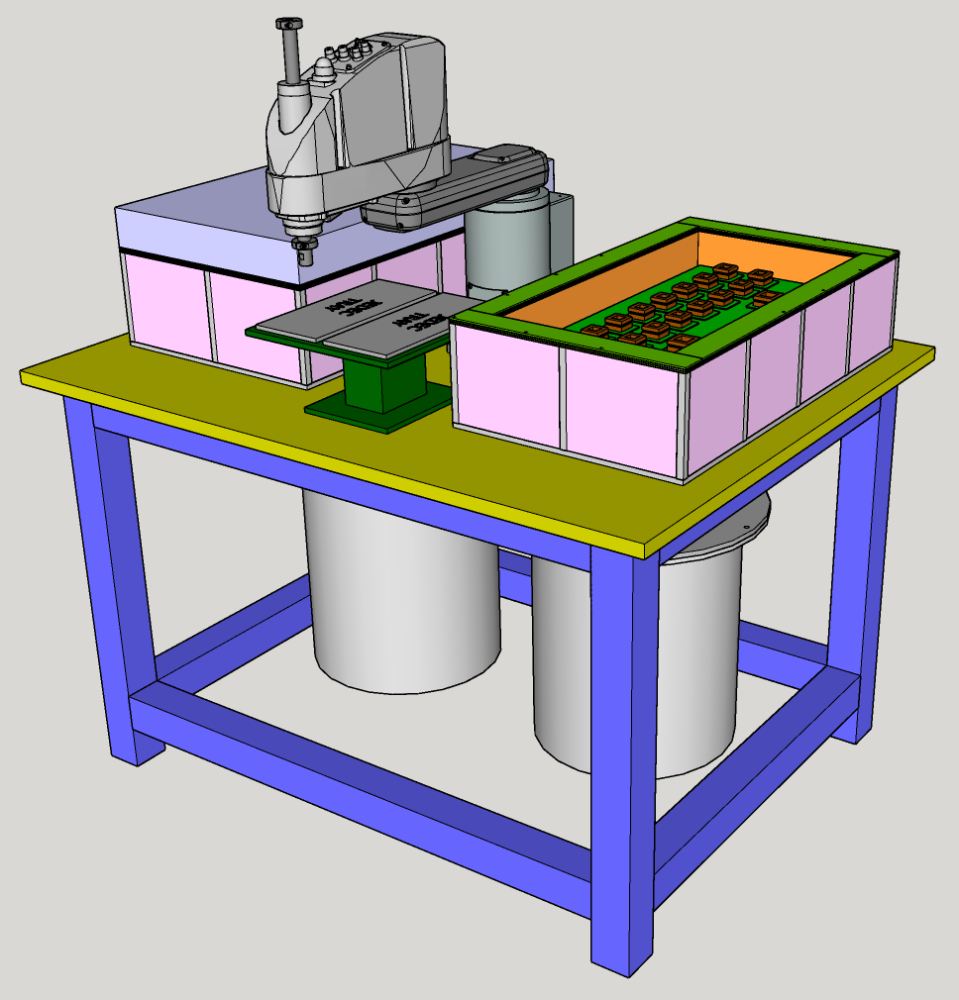
Scaling up to a full-size dual-chamber RTS
The membrane-style test chamber
is easy to scale up to fit the 26”
by 13” BNL DAT board.
Two chambers just fit within the
operating envelope of a SCARA
robot with 550 mm reach.
The system needs to be mounted
to a stiff working table.
Current table design is welded from
3” square steel box beams with a
steel top plate. This follows common
designs found in industry.
The table is designed to be movable
with a standard pallet jack.
We will also explore options based on
aluminum strut systems (“80/20” or
Similar).

Slide 5
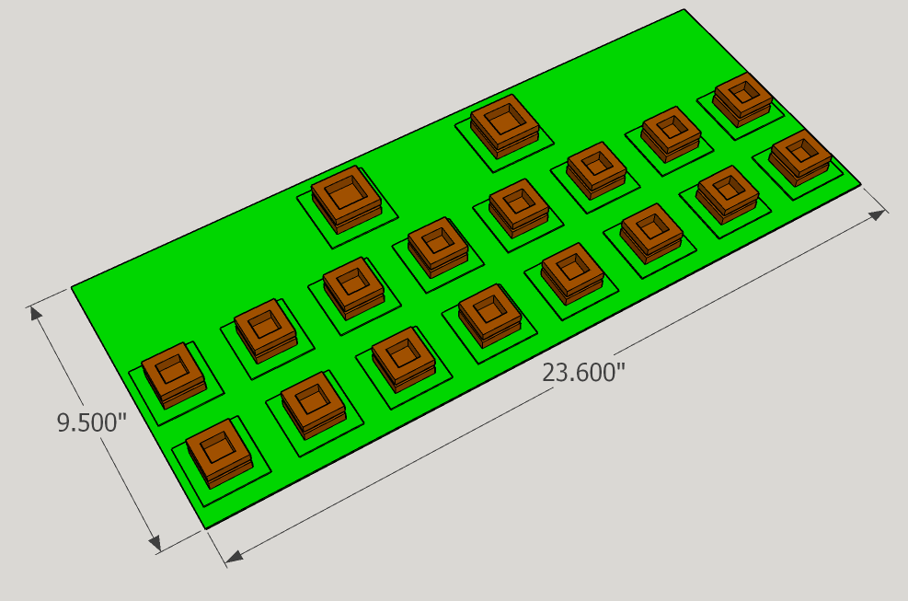
Straw-Man design for DUNE CE testing boards
– Topology follows FEMB design (18 ASICs)
– All 18 ASICs (8 LArASIC, 8 ColdADC, 2 ColdData) are located on one side of the PCB
– PCB is spread out enough to allow ASIC mezzanines (soldered or socketed) at each position
– Spacing derived from previous BNL testing hardware (quad-socket LArASIC tester)
– BNL (Shanshan) seems to think that this is a reasonable starting point for designing new CTS
The “DAT”

Slide 6
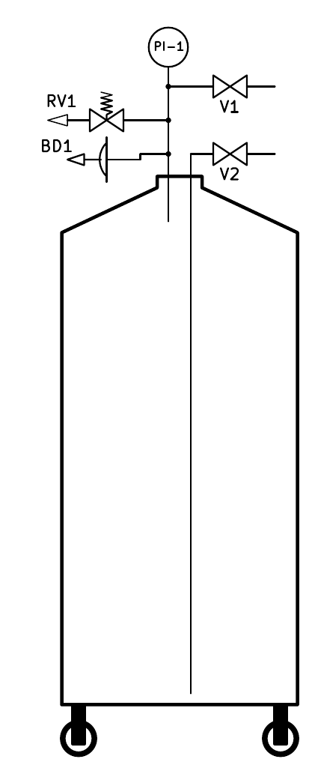
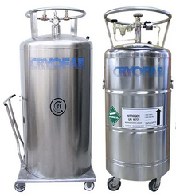
Modular Design for RTS cryo system
A standard LN2 Dewar has become an integral part of the RTS cryogenic design.
– Common in many Physics labs
– Can be filled locally from on-site supply
– Also available from commercial vendors (delivered full)
– At MSU we can get 250 liters delivered for $100, with no rental fee
(which is half the price of using our own on-site LN2 supply)
– These Dewars are self-pressurizing, simplifying RTS (-vs- CTS)
– Eliminates need for placing heaters in the Storage Dewar
– Use this “Vendor Dewar” (VD) to:
(1) Refill SD before each RTS cycle (auto-refill while we change ASICs)
(2) Supply N2 gas under pressure to operate the CTS cycle
– Swap to a full “Vendor Dewar” as necessary (once per week?)
VD = Vendor Dewar
LN2 Dewar 160-250 liters

Slide 7
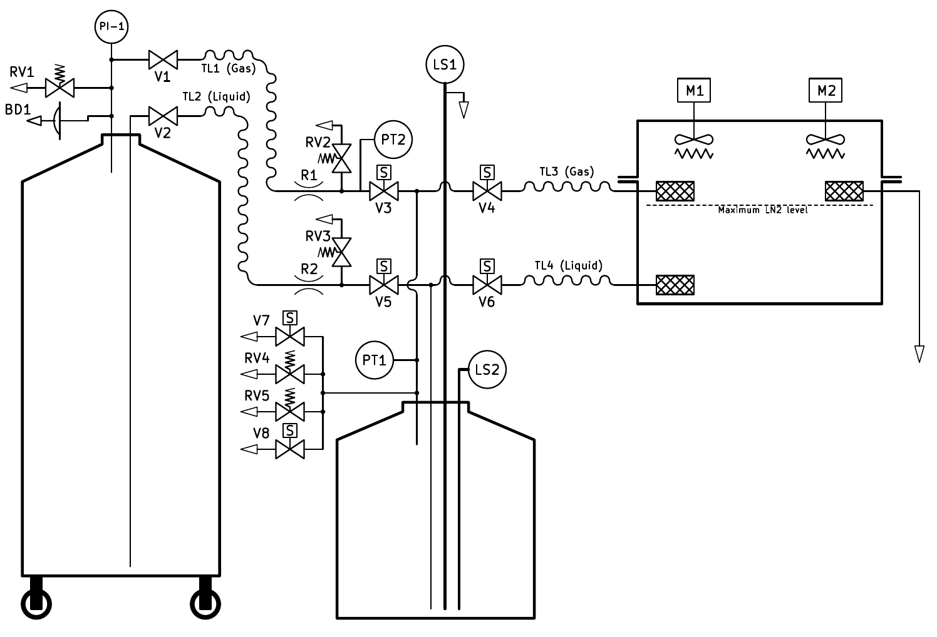
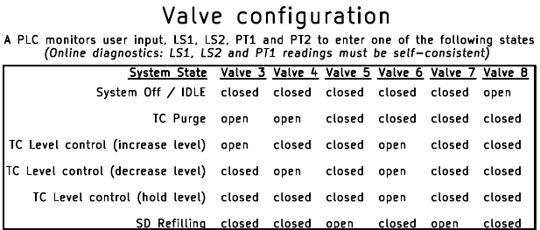
Modular Design for RTS cryo system
Control system is simply a state machine with 6 states
Inputs
LS1, LS2, PT1, PT2, User
Logic (PLC)
State Machine
Outputs
Valves V3, V4, V5, V6, V7

Slide 8
DUNE CE Robotic Testing Station (RTS) Status
– Robotics in hand and ASIC loading tested
– Preliminary review at FNAL of Cryogenic system design saw no show-stoppers
– Cryogenic valving & piping components in hand and being assembled
– Pan and supports for DAT board have been prototyped and LN2 tested
– DAT board layout at BNL being reviewed to be followed by fabrication
Socket test is the current focus at MSU
– Mockup board with multiple sockets prepared
– Loaded with 16 dummy chips (128 pins) with internal pair-connection – then daisy-chained
– Run robotic load/unload with full cryogenic cycle to determine socket mean-time to failure.
– Sockets on DAT board are replaceable (socketed) – but with robotic handling this may be rare

