Slide 1

60% Design/Engineering for EIC Detector Solenoid Magnet
Renuka Rajput-Ghoshal (JLab)
On Behalf of EIC Detector Magnet team
Solenoid Design Project Overview
Mid-Project Review
2022-06-27

Slide 2
Outline
Detector-1
Magnet Specification
Magnet-Area of Interest
Magnet Procurement Options
Solenoid- Long Lead Procurement
Design of 1.5 T magnet
  Design milestones (60% design)
  Design milestones (90% design)
Team Members
Work with CEA and Task list for 60% design
Current Status
What Next
Summary

Slide 3
The ECCE Magnet- Detector 1 Magnet
The BaBar superconducting solenoid will be repurposed for the ECCE detector.
  The BaBar magnet is already at BNL for use by the sPHENIX experiment (see photo).
ECCE also plans to reuse the surrounding combined hadronic calorimeter and flux containment system for this magnet
This provides the 1.4 T field that suffices to do the EIC science with an AI optimized detector
The warm bore diameter of 2.84m and coil length of 3.512 m corresponds to a 39 deg angle, this covers the required region covered by the barrel detectors in the YR (~40 deg angle).
Reuse of a magnet can induce risk, so we plan to mitigate this risk.

Slide 4
Need for a Replacement Magnet

Slide 5
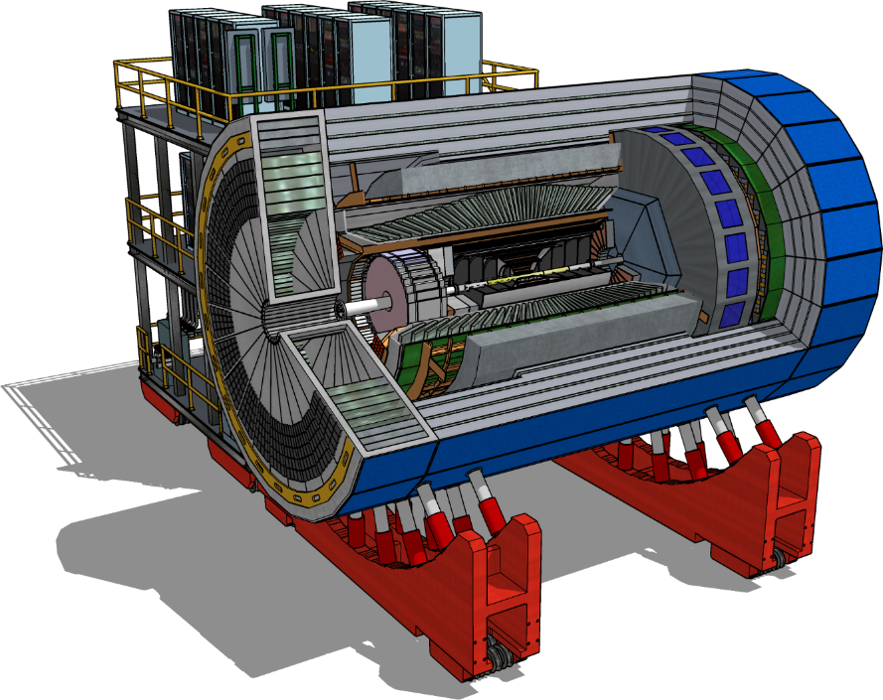
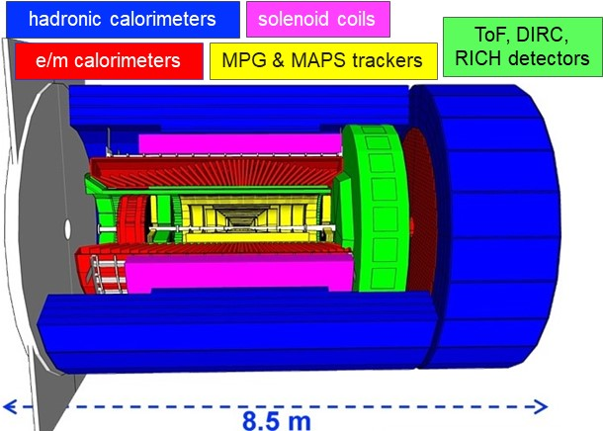
Detector-1

Slide 6
Detector Solenoid Magnet Specifications
Parameter | Detector 1-Solenoid
Central Field (T) | 1.5
Coil length (mm) | 3512
Warm bore diameter (m) | 2.84
Polarity | Bipolar
Lowest operating field (T) | 0.5
Flat Field area | ± 100 cm around center 80 cm radius
Field uniformity in Flat field Area (%) | 8.5
RICH area | From z=+180 cm to 280 cm
Projectivity in RICH Area (mrad@30GeV/c) Projectivity in RICH Area (A/Tmm²) | 0.1** 10
Stray field requirement | <0.5 mT @ z=-5.3 m, @z=+7.4 m, and @R=3.4 m
Cryostat length (m) | <3.85
Cryostat outer diamter (m) | <3.54
Charging voltage (V) | 10
Fast discharge voltage maximum (V) | 500
Quench hot spot temperature (K) | <150
Temperature margin (K) | >1.5
Current margin (%) | >30
Charging time (hr) | 2-3
Cooldown time (weeks) | 3-4
Cooling scheme | Thermosiphon
Conductor | Al Stabilized NbTi Rutherford Cable
Operating Temperature | 4.5
}
Topic of further study
Accelerator fringe field requirements, under further study. These may imply local shielding around IR magnets.
Topic of further study

Slide 7
Magnet- Area of interest
The solenoid Field specification document is finalized . There are three areas of importance from the magnetic field point of view, these are:
Flat Field Area
RICH detector Area
Stray field limitation at IR magnets and RCS
Flat Field Area: This are is 200 cm long and 80 cm in radius around the IP, the field uniformity required in this area is 8.5%
Stray Field:
The detector solenoid has neighboring IR magnets, in order to reduce the effect of solenoid magnet on IR magnets, there is a requirement of stray field less than 5G at B0ApF and Q1ApR magnets, these magnets extends from z= 7.4 m to 8 m and z=-5.3 m to -7.1 m respectively.
The RCS is radially 335.2 cm from the magnet central axis and stray field requirement there is <0.007 Tm
RICH detector Area: To maximize the RICH performance based on the gas radiator it is critical to minimize the bending of the tracks in the volume of the gas radiator.
For this one needs to shape the field that it is parallel to the different scattering angles of particles covered by the RICH. The RICH area extends from z=+180 cm to +280 cm.

Slide 8
Magnet Procurement Options
There are typically four procurement approaches. Only two of these options (1 and 2) will be considered here for the detector solenoid:
Build-to-Print – Jlab-CEA produces a 90% design, a full set of manufacturing drawings and a Statement of Work (SOW). The vendor uses these drawings to build the magnet.
Vendor Design-Build – Jlab-CEA provides a 'Performance Specification', preliminary design and a Statement of Work (SOW) to the vendor who then completes the design, produces their own manufacturing drawings and builds the magnet.
Design and Build at JLab – Jlab-CEA produces the complete 90% design of the magnet, all the manufacturing drawings and builds the magnet.
    This option is presently not considered to be realistic for the EIC project due to the lack of appropriate manufacturing facilities and manufacturing resources at JLab
JLab 60% design + Vendor Design-Build – Jlab-CEA produces a design to the 60% completion point, the vendor completes this design, produces manufacturing drawings and then builds the magnet.
    This option is not presently being considered based on previous experience, not very successful implementations of this approach. When used in the recent past (2013 – 2017), vendors adopted one of two approaches when presented with a 60% design. They either;
      Completed the design, apparently without due consideration for the manufacturability of the system, which then led to significant rework which in turn increased cost and extended schedules, or
      Spent time reworking the design to ensure manufacturability, which also led to increased cost and extended schedules.
    The fact that the vendors were working to a fixed-price contract meant that they were reluctant to increase their costs and this unfortunately led to reduced quality of components and build.
Option 2: It is like a 60% design, but giving the vendor an option to validate and modify the design!

Slide 9
Solenoid- Long Lead procurement
The Detector solenoid is foreseen as a long-lead procurement item.
  The detector solenoid is required to install all the detectors. The estimated installation time is 17 months.
  The average time to procure a superconducting magnet from a vendor is approximately 5 years. This is based on experience with JLab-12GeV upgrade SC magnet procurement.
  There are not many vendor for making this large size magnet nationally or internationally.
  The conductor required for this magnet is also a long lead item. The conductor will be Al-cladded Rutherford cable and the Rutherford cable will be made with small SC strands.
  The estimated time for Rutherford cable delivery is about 2 years, this is based on discussions with one vendor.
The selected procurement strategy for the magnet is “Vendor Design-Build”, we will provide a 'Performance Specification’, reference design and a Statement of Work (SOW) to the vendor who then completes the design, produces their own manufacturing drawings and builds the magnet). In this option vendor has an option to validate and modify the design!
In order to be ready for a long-lead procurement for the magnet at CD-2/3A, we need to complete the reference design, reference drawings and a SOW for the vendor by CD-2/3A.

Slide 10
Design of 1.5T Magnet
The design will be divided in 60% and 90% design phase.
Conductor R&D
In parallel:
    Continue monitoring sPHENIX magnet run
    Update risk analysis based on the sPHENIX run.
    Update the Risk analysis document
    Review the results
    Make a decision about the magnet choice (existing vs replacement new)
  Prepare document for RFQ

Slide 11
Design of 1.5 T Magnet (60% milestones)
Complete 60% design including the following:
  Complete conductor stability calculation (100%)
  Finalize the conductor R&D plan (100%)
  Start preparing conductor samples (after finalizing the vendor) (100%) ,
  Preliminary quench calculation on the selected conductor (100%) ,
  Finalize the conductor (100%)
  Finalize power supply, current leads and quench protection scheme (100%)
  Request for Information (RFI) to magnet and power supply vendors (100%)
  Detailed electromagnetic Design (60%)
  Detailed mechanical (60%)
  Thermal Analysis (60%)
  Quench Analysis (60%)
  Cryogenic Design (30%)
  I&C (10%)
  System and sub-system drawings (60%)
  Vendor search for conductor, magnet, power supply, current leads and other subsystems (60%)

Slide 12
Design of 1.5 T Magnet (90% milestones)
Complete 90% design including the following:
  Complete electromagnetic Design (90%)
  Complete mechanical (90%)
  Thermal Analysis (90%)
  Quench Analysis (90%)
  Cryogenic Design (90%)
    Cryoflex line design (100%)
    Cryocan design (100%)
  I&C (90%)
  System and sub-system drawings (90%)
  Vendor search for conductor, magnet, power supply, current leads and other subsystems (100%)
  Procurement reviews for all sub-systems
  Complete RFQ documents

Slide 13




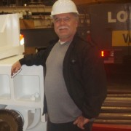

JLab- Technical Team Members
RENUKA RAJPUT-GHOSHAL
L3 CAM, JLab Project Lead, Conductor R&D, Electromagnetic design, Conductor Stability, Quench, interface between JLab and CEA, Saclay
PROBIR K. GHOSHAL Risk Analysis, FMEA, Quench, Power Supply, C&I
ERIC SUN Mechanical and Thermal Analysis
SANDESH GOPINATH, Thermal Analysis and , interface between CEA, Saclay Engineers and JLab Designers
DAN YOUNG
Designer
Catherine Hall
Designer

Slide 14
CEA- Technical Team Members

Slide 15
Other Team Members
JLab
  Rolf Ent- Co-Associate Director for the Experimental Program, Detector Management
  Mitch Laney, Procurement
  Giuseppina (Jessie) Tenbusch, Procurement
  Walter Wittmer, Project office
CEA, Saclay
  Lionel Quettier- Resource manager and Expert Engineer
BNL
  Elke Aschenauer- Co-Associate Director for the Experimental Program, Detector Management
  Roberto Than- Cryogenic interface
  Alexander Kiselev- HCal integration and material
  Rahul Sharma-Infrastructure interface
  Roland Wimmer- System Integration

Slide 16
Work with CEA and Task List
CEA, Saclay is our collaborator for the design phase.
The existing contract is for 60% design work,
This work will be a collaborating work between JLab and CEA, Saclay.
The following tasks will be complete and delivered at the end of 60% design
Conductor stability calculations and conductor selection
  This task will result in finalizing the conductor.
Preliminary quench analysis
  This task will result in a preliminary quench report. This will also help in finalizing the power supply including the current leads.
Electromagnetic design (60%)
  In this subcontract the following tasks will be completed for the electromagnetic design:
    Magnet design fulfills all the physics requirements including the stray field requirement (if stray field requirement is not fulfilled, an agreement has to be reached with the accelerator group for the acceptable limits of the stray field)
    The turns and layers layout are complete based on conductor dimensions
    Magnet operating parameters finalized
    Conductor length and possible piece size finalized
    Winding technique discussed and if possible finalized
    Magnetic forces calculated and given as input for the mechanical analysis

Slide 17
Work with CEA and task list-contd.
Mechanical design (60%)
  In this subcontract 3-d analysis will be done using ANSYS software, showing that the main mechanical parts and stress level in all the parts are within the design limit and system is in safe operational limits. In this subcontract the following tasks will be completed for the mechanical design:
    Standard 3-d mechanical analysis using ANSYS
    Stress analysis using the gravitational load, winding, electromagnetic and thermal loads
    Make sure all the stresses are with-in the safe design and operating limits
    Material selection for all the supports and vessels
    Considered all thermal contractions and drawing adjusted to that
    Winding tension to be used on the conductor
Thermal Design (60%)
  In this subcontract 3-d analysis will be done using ANSYS software, showing the temperature distribution in the cold mass and stress while cool down the system to liquid Helium temperature. In this contract following tasks will be completed for the thermal design:
    Standard 3-d thermal analysis using ANSYS
    Thermal distribution for the mechanical analysis
    Thermal distribution for current and temperature margin
    Thermal distribution across the whole cold mass
    Decide about the rate of cooldown and warm up the cold mass
    Stress during cooldown and warm up, any limit to set on these in the controls

Slide 18
Work with CEA and task list-contd.
Quench Analysis (60%)
  The final quench analysis will be done using the standard multi-physics equations and OPERA 3-d quench modeling. The quench analysis will take input from thermal analysis, electromagnetic design. In this subcontract the following tasks will be completed for the quench analysis:
    Standard 3-d quench analysis in OPERA
    Quench validation using standard multi-physics equations
    Make sure all the temperatures in the event of quench are within the safe limits
    Make sure that the magnet stored energy is dissipated in the safe manner in the event of quench
Cryogenic design (30%)
  In this subcontract preliminary 3-d analysis will be done using ANSYS software, this will include the 4-K circuit design, thermal shield design, vacuum vessel design. This will also include cryo-flex and cryocan design. In this subcontract, the following tasks will be completed for the cryogenic design:
    Finalize the cooling scheme and cooling layout
    Calculated all the heat loads
    Input for thermal and mechanical design
    Input for quench analysis
Instrumentation and controls design (10%)
  This will take input from all the above sub-system designs and make a list of all the instruments to be used in the system and how to control all of these. The following tasks will be done:
    Prepare a list of all the instrumentation and control
    Preliminary electrical drawing
    Discussion with the project control person to plan the control strategy
Components, sub-systems and system drawing (60%)

Slide 19
Current Status
We have started looking at the existing magnet in details. A CAD-model is created using existing drawings.
JLab and CEA teams are working together for new magnet design and collaboration is going well.
The interaction with the BNL team is working well..
Project mid-review tomorrow, we are on track to achieve 60% design by September end.
Discussions with the vendors for conductor is going on, changing Al-stabilizer to Cu- stabilizer has helped project significantly.
Working on conductor selection process.
Working on EM, Mechanical, Thermal, and quench analysis.
Cryogenic design and instrumentation and controls design will start soon.
Magnet and infrastructure discussions just started.

Slide 20
What Next
Finalize the magnet specification (including stray field limit on other magnets).
Update BaBAR magnet risk assessment.
Complete 60% design including the following:
  Complete conductor stability calculation, finalize the conductor R&D plan, start preparing conductor samples (after finalizing the vendor), preliminary quench calculation on the selected conductor, finalize the conductor.
  Finalize power supply, current leads and quench protection scheme.
  Complete the detailed electromagnetic, mechanical, thermal and cryogenic analysis of the magnet
  Start working on I&C
  Start working on the system and sub-system drawings
Vendor search for conductor, magnet, power supply, current leads and other subsystems

Slide 21
Summary
The design team is in place at JLab and CEA, Saclay
The design work is progressing well.
Mid-project review tomorrow,
Work is on track for the 60% design completion by end of September.

Slide 22
Back up Slides

