Slide 1
CRYOGENICS SYSTEM
ROBERTO THAN

Slide 2
IR04
56MHZ
STORAGE CAVITY
4.5K

Slide 3
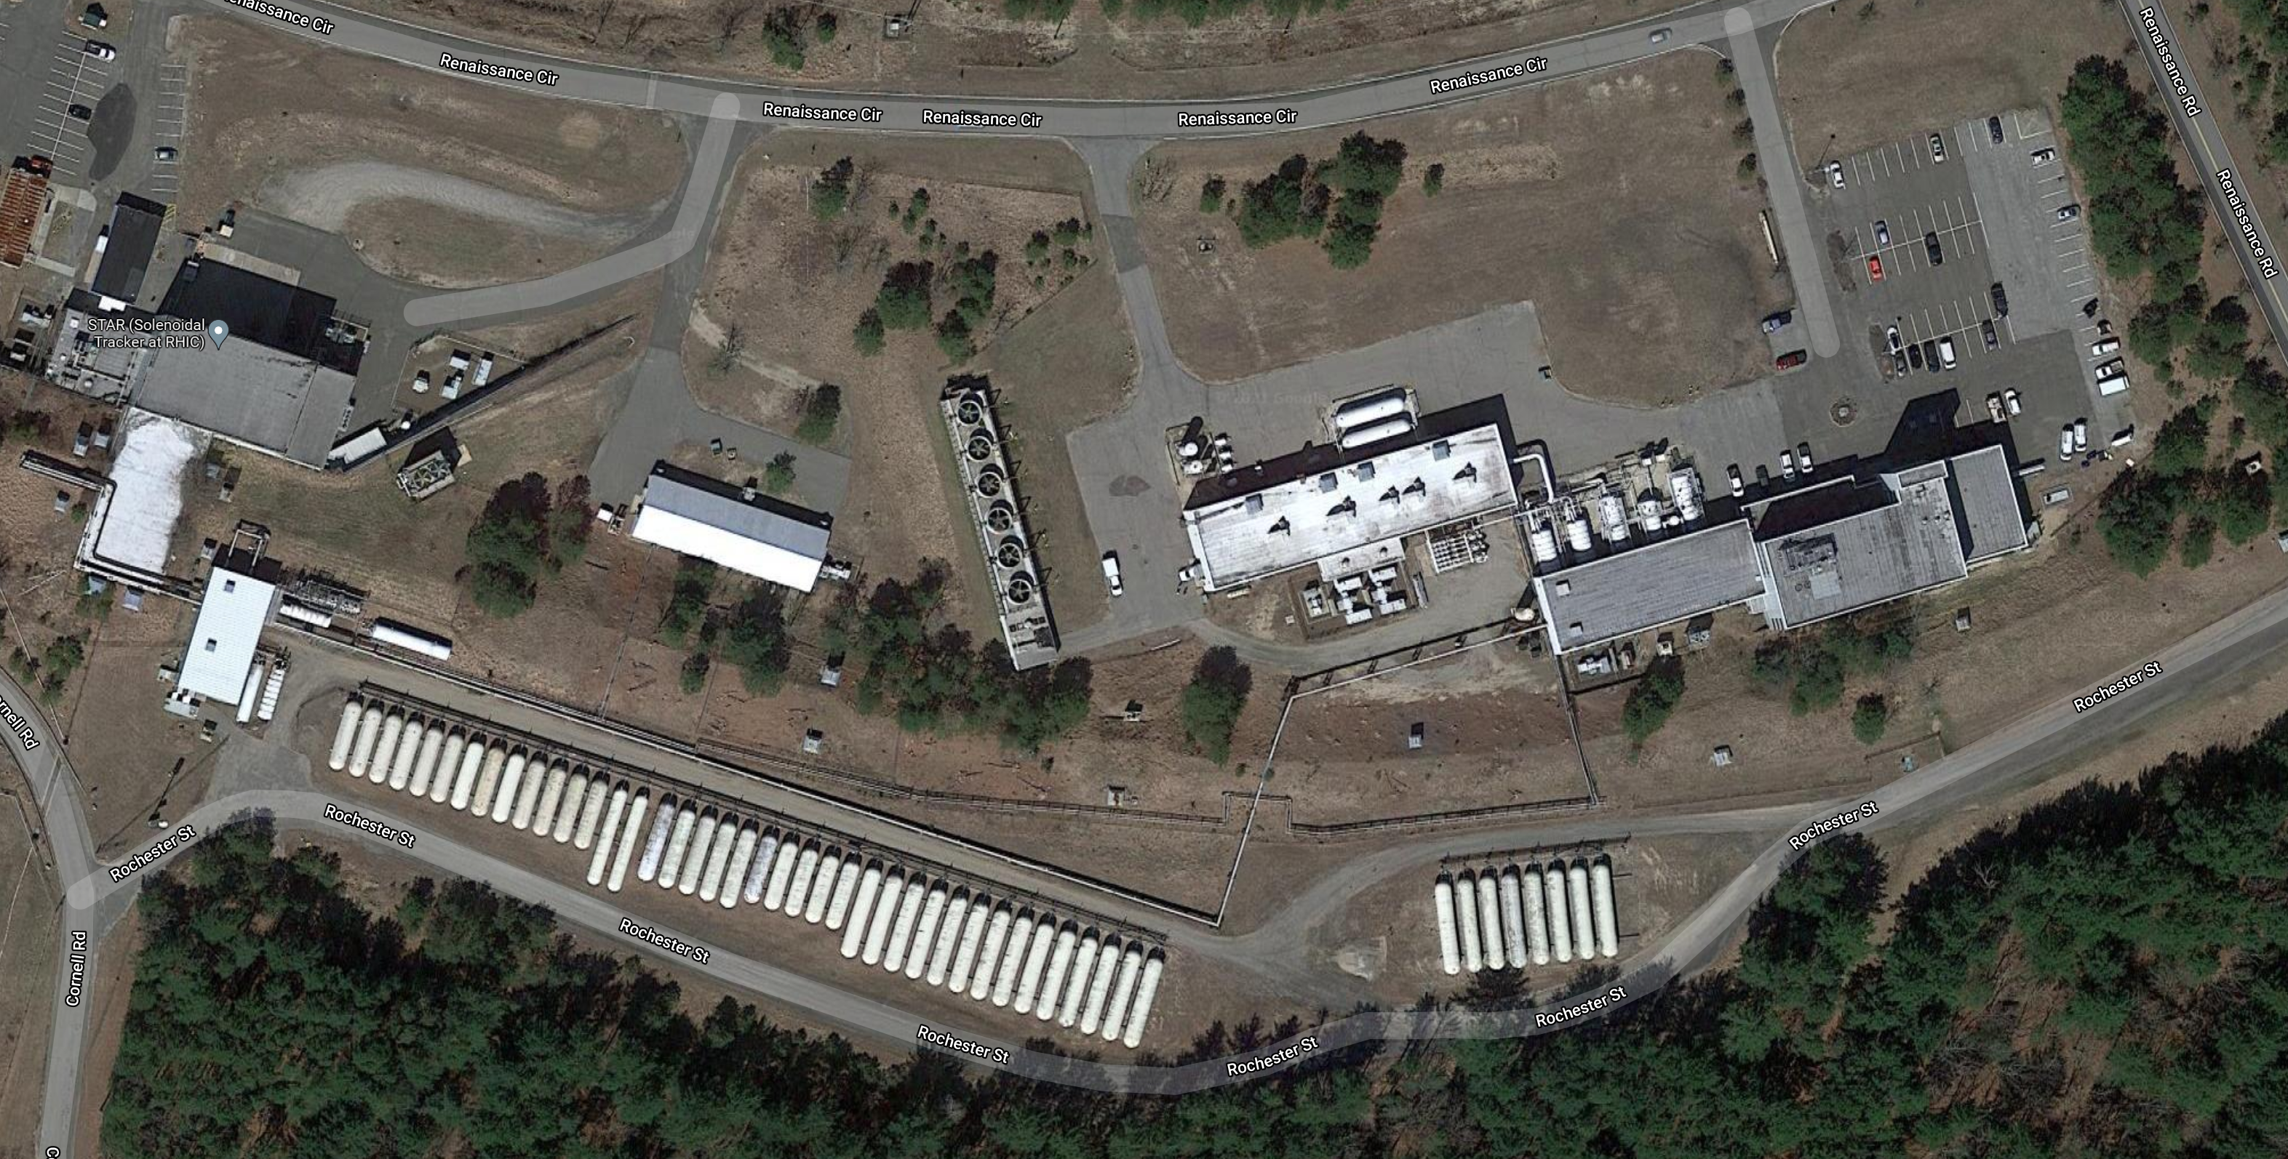
COMPRESSOR BLDG
COOLING TOWER
REFRIGERATION BLDG
1006B
LIQUID HELIUM STORAGE
TANK FARM
TANK FARM

Slide 4
SYSTEMS
RHIC STORAGE RINGS 4.5K: FORCED FLOW
IR10: ELECTRON LENSES: 4.5K: BATH
IR02: CEC: SRF CAVITIES: 2K BATH: SUB-ASTMOSPHERIC ➔ HELIUM VACUUM PUMPS
IR02: LEREC: SRF CAVITY: 2K BATH: SUB-ASTMOSPHERIC ➔ HELIUM VACUUM PUMPS
IR04: 56MHZ: 4.5K ➔RE-INSTALL POST RUN22 RUN 24
SPHENIX SOLENOID: 4.5K ➔FINAL INSTALL POST RUN22 RUN 23 -25
AGS COLDSNAKE in AGS Ring

Slide 5
CRYOGENIC DISTRIBUTION
6 Blue & 6 Yellow Valveboxes
located in service buildings
Cryogenic valves & Recooler,
SC busses current leads interface {“Leadpot”}
Service Bld
1012
ValveBox
ValveBox
IR12
M : Magnet, 4.5K Loop
1006
ValveBox
C
e
n
t
r
a
l
P
l
a
n
t
Sector 11
Sector 12
Service Bld
1002
U : Utility, 9.6K Gas Return
Service Bld
1010
S : Supply, 4.5K Liquid
Sector 10
Sector 1
ValveBox
R : Return, 4.5K vapor Return
ValveBox
ValveBox
ValveBox
H : Heatshield Collider loop
IR10
IR2
M : Magnet, 4.5K Loop
U : Utility, 9.6K Gas Return
CR
S : Supply, 4.5K Liquid
HS
Sector 8
Sector 2
R : Return, 4.5K vapor Return
S
H : Heatshield Collider loop
Sector 9
Sector 3
WR: Warm Return loop
R
WR: Warm Return loop
HR
M : Magnet, 4.5K Loop
1006
ValveBox
WR
U : Utility, 9.6K Gas Return
WS
IR8
IR4
S : Supply, 4.5K Liquid
ValveBox
R : Return, 4.5K vapor Return
Service Bld
1004
Service Bld
1008
ValveBox
ValveBox
ValveBox
H : Heatshield Collider loop
Sector 6
Sector 4
M : Magnet, 4.5K Loop
Sector 7
IR6
Sector 5
U : Utility, 9.6K Gas Return
S : Supply, 4.5K Liquid
Service blds
1005H,1005R
R : Return, 4.5K vapor Return
CENTRAL PLANT
H : Heatshield Collider loop
Service Bld
1006
ValveBox
ValveBox

Slide 6
CENTRAL PLANT
Wcompressor=5.5MW
13 MW COMPRESSOR MOTOR POWER
Maximum 4500 g/s Compressor flow; Original Design Carnot Work: 3.2MW
≈Equivalent 45kW@4.5K
1 ➔ 4 bar ➔ 16 bar
RHIC: 1800 -2200 g/s
Redundant set of Oil bearing expanders
2x 6 Expander
1 x Gas Bearing expander Expander 7
1885 g/s;15bar
45 g/s
54 kW
300K
HX-1
HX-2
HX-3.2
HX-3.1
45K
HX-4
HX-5
HX-6
HX-7.2
HX-7.1
HX-8.1
9K
HX-8.2
HX-9
HX-20
RHIC 2006 Upgrade
125 g/s
HX-21
4.5K
85K 9.8bar
45K 14.8bar
HX-22
25kW
HX-23
BLUE RING SHIELD
HX-24
4.65K;1.26bar
RHIC Project
4.45K;1.25bar
Current Leads 44 g/s
473g/s; 4.55K;4.15bar
4.45K;1.25bar
8.2kW
4/5
2/3
12/1
10/11
8/9
6/7
4/5
2/3
12/1
10/11
8/9
6/7
YELLOW RING SHIELD

Slide 7
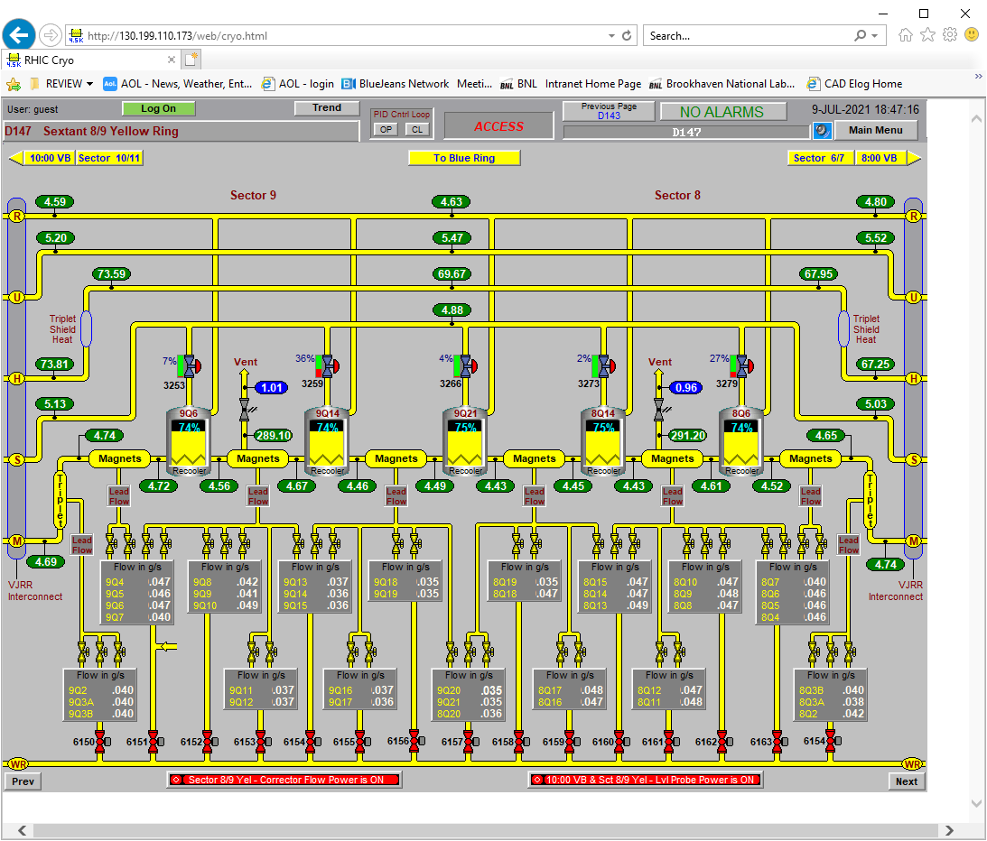
EACH MAGNET RING
30 Sextant Recoolers
6 Valvebox Recoolers
TOTAL: 72 Recoolers
472 CORRECTOR MAGNETS LEAD COOLING

Slide 8
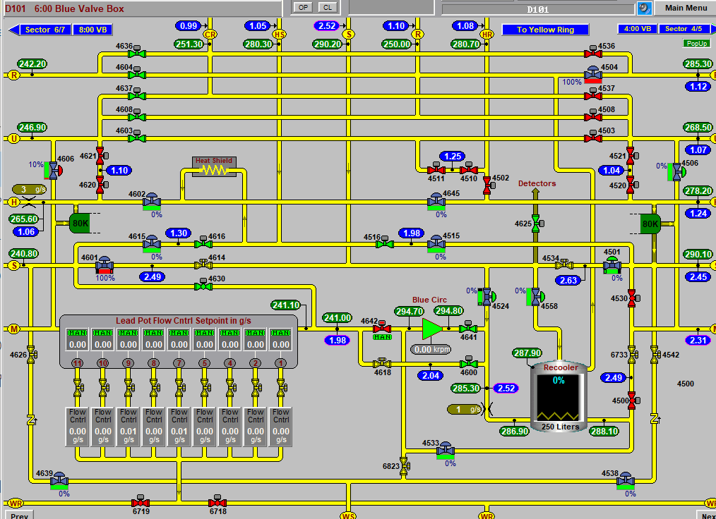
Service building Valveboxes with Leadpot: Magnet Current Leads

Slide 9
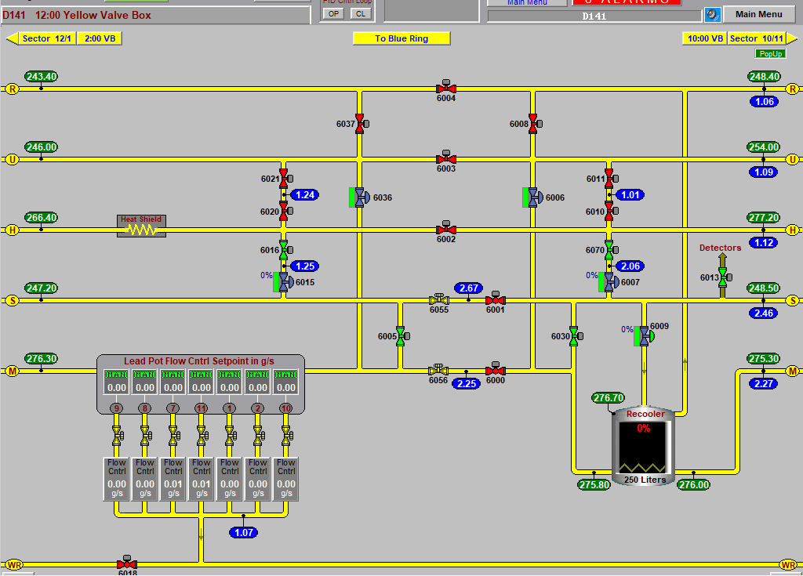

Slide 10
Compressor System 1005H
20 x First Stage Compressors: Howden 321/1.65. 600 HP motor. 235 g/s. + Oil cooler HX
5 x Second Stage Compressors: Howden 321/1.65, 2200 HP. 940 g/s. + Oil cooler HX
Central Intercooler/After cooler Heat exchangers after each compression stage
Oil Coalescers (20 vessels)
Oil vapor removal Charcoal Beds (3 vessel)
Utility Compressor: Howden 255/1.65, 600 HP, 80 g/s
250 g/s Purifier Coldbox system
Oil processing skid
Instrument Air compressor
Maintenance
Compressor Bearings
Motor/Compressor Alignments
Oil Filter cleaning
Water filter cleaning
MCC cleaning
Valves & actuators
Instrumentation
Oil change and processing
Relief devices inspection/recertification
Charcoal replacement

Slide 11
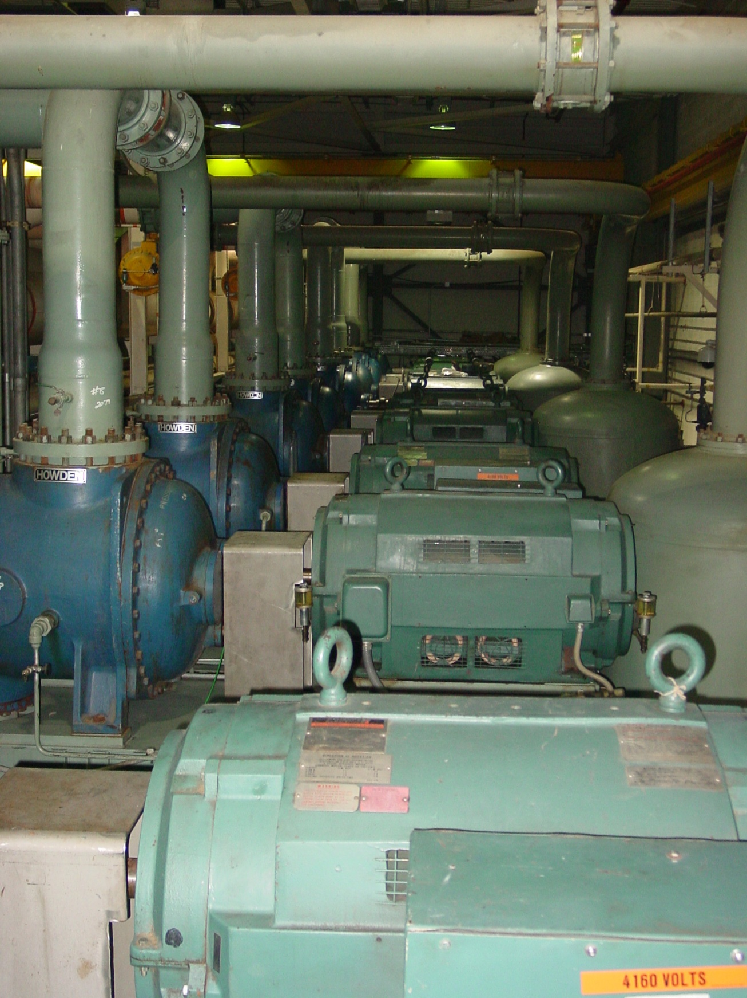
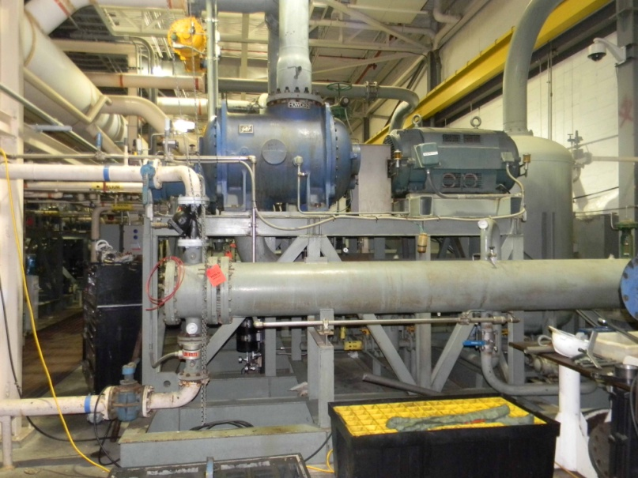
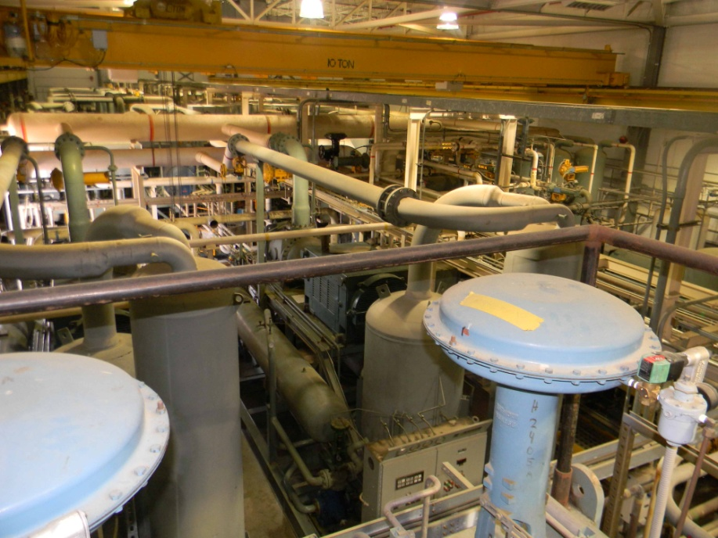
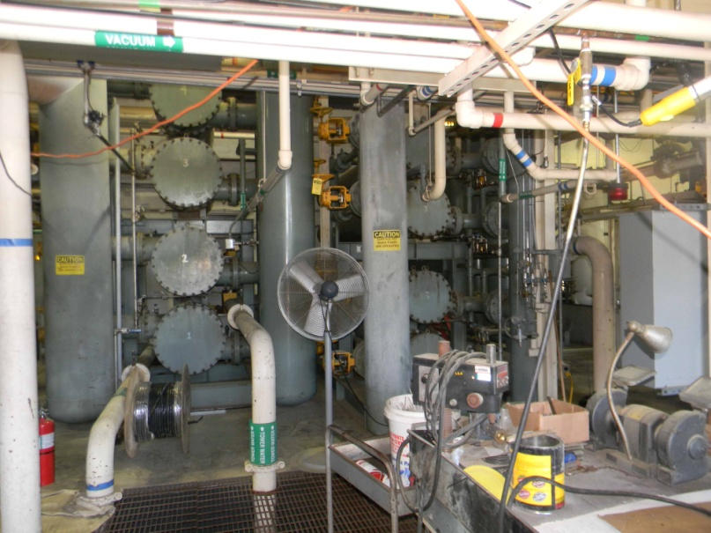
Compressor System 1005H
First Stage Compressor skid
First Stage Compressor Row
Intercoolers/ Aftercoolers
2nd Stage
Compressor skid

Slide 12
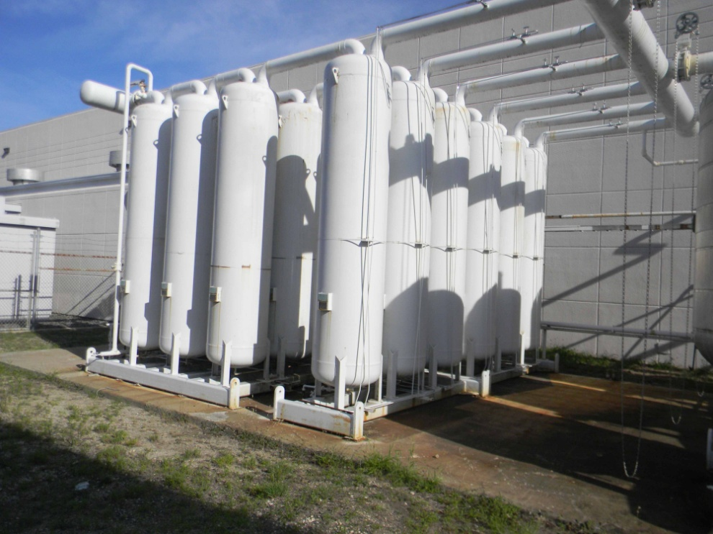
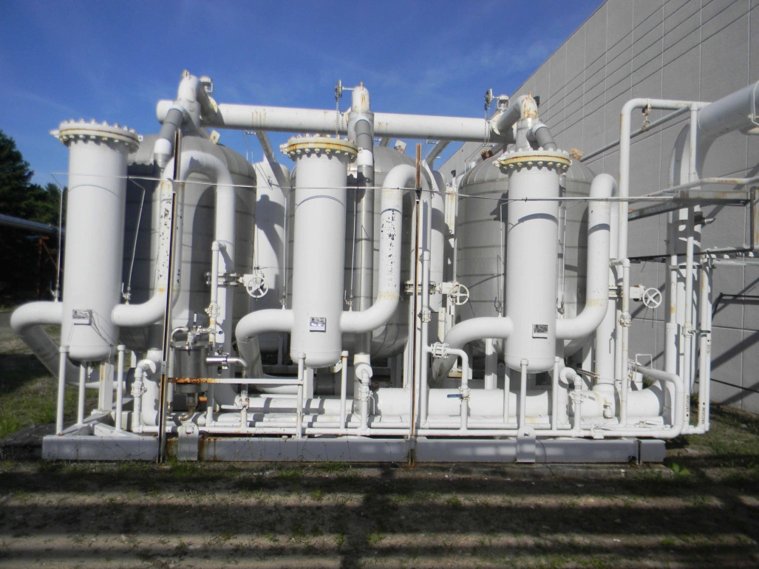
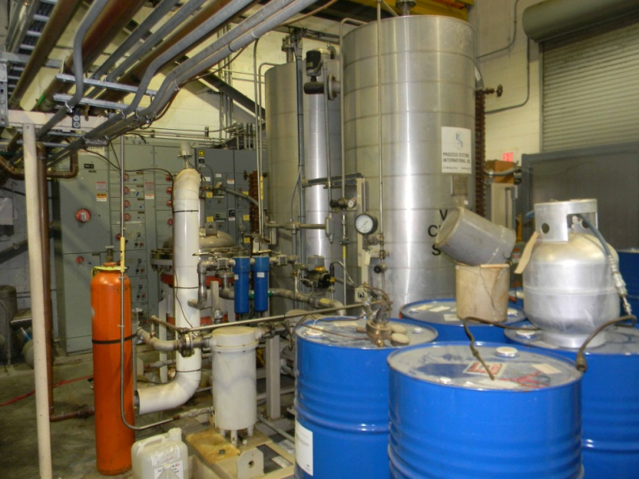
Compressor System 1005H: Oil removal
Oil Mist Removal
4 Stages Coalescers
5 parallel banks
Vapor removal
3 parallel charcoal beds
6 ft diameter
Oil Vapor Removal
3 parallel charcoal beds
6 ft diameter parallel banks
Coalescers
Charcoal Beds
Oil Processing System

Slide 13
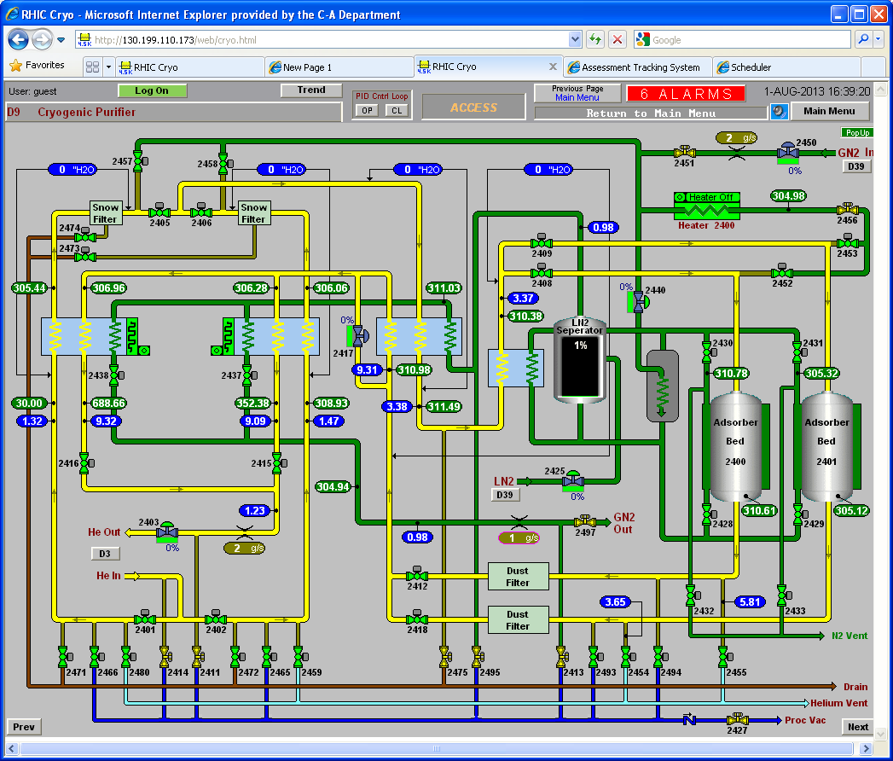
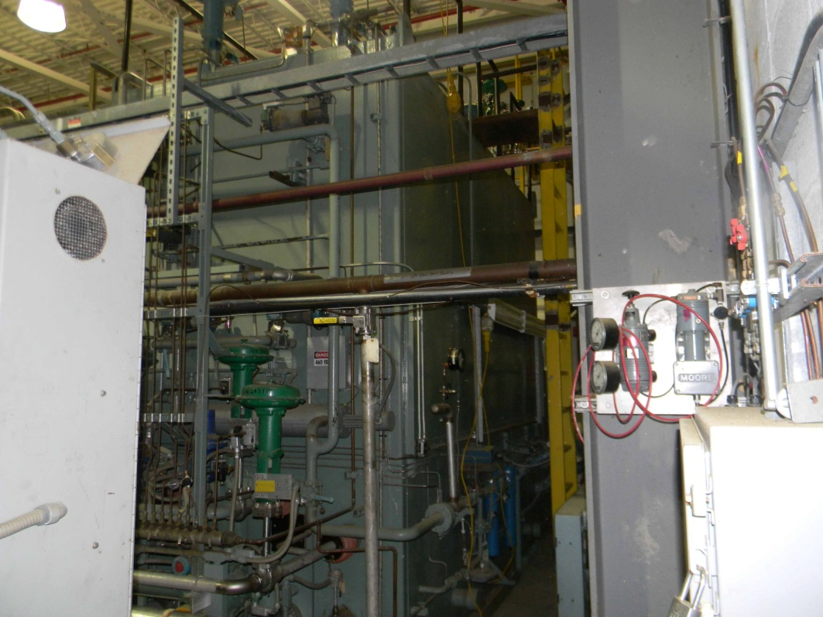
Compressor System: Purifier
250 g/s
Dual freeze out heat-exchanger
Dual charcoal bed
Regen gas heater
LN2 cooled
Maintenance
Regeneration
Valves
Instruments
Relief Devices

Slide 14
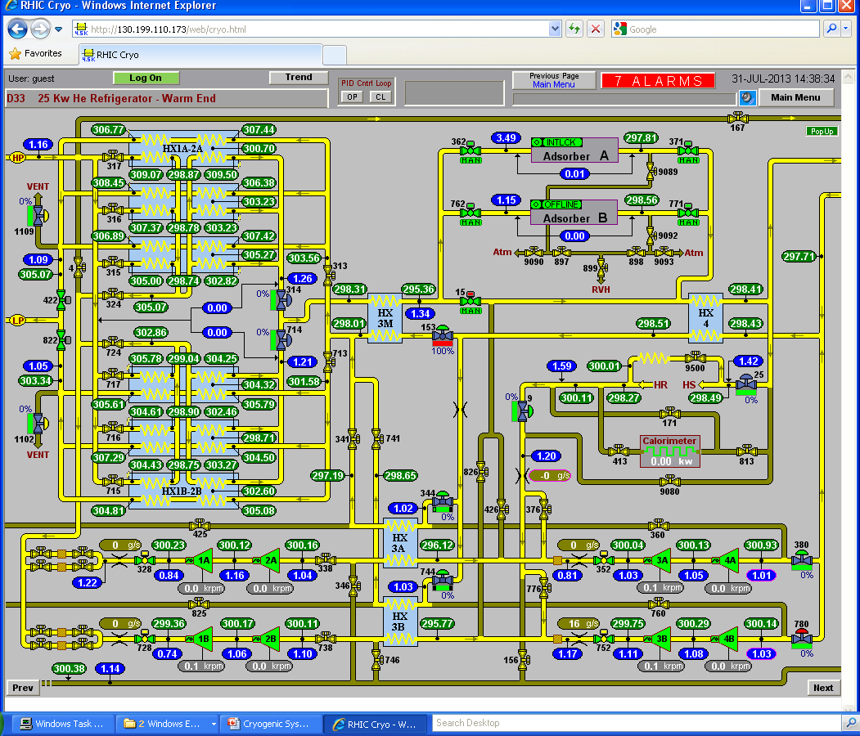
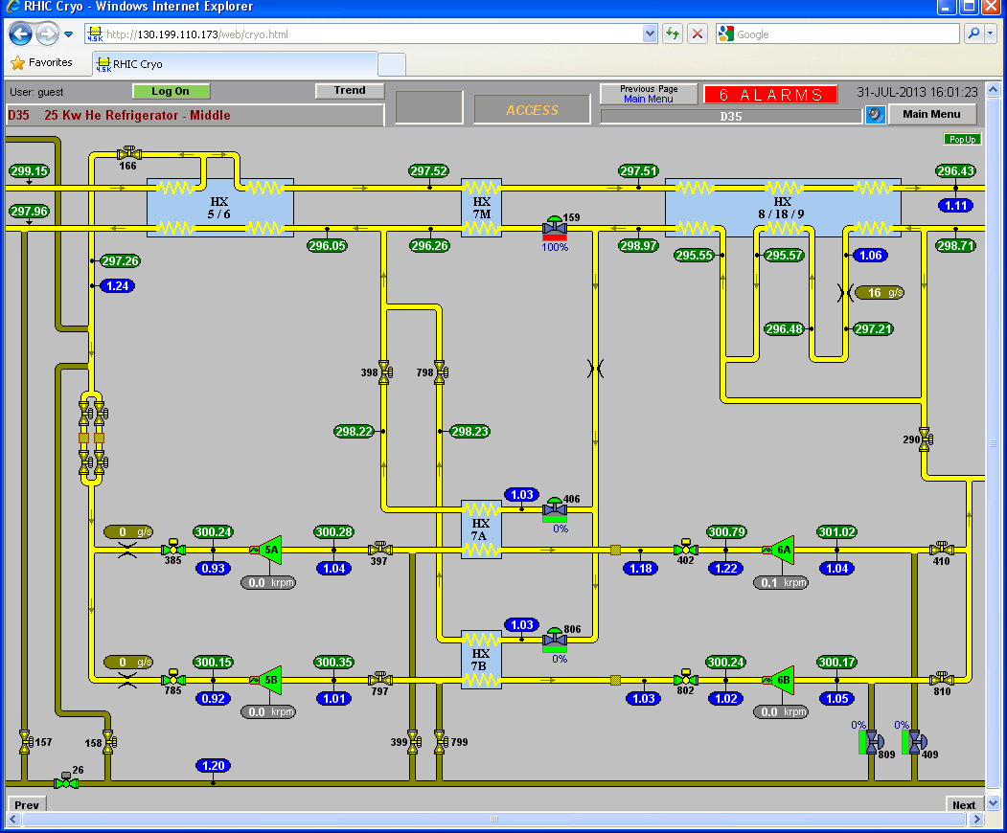
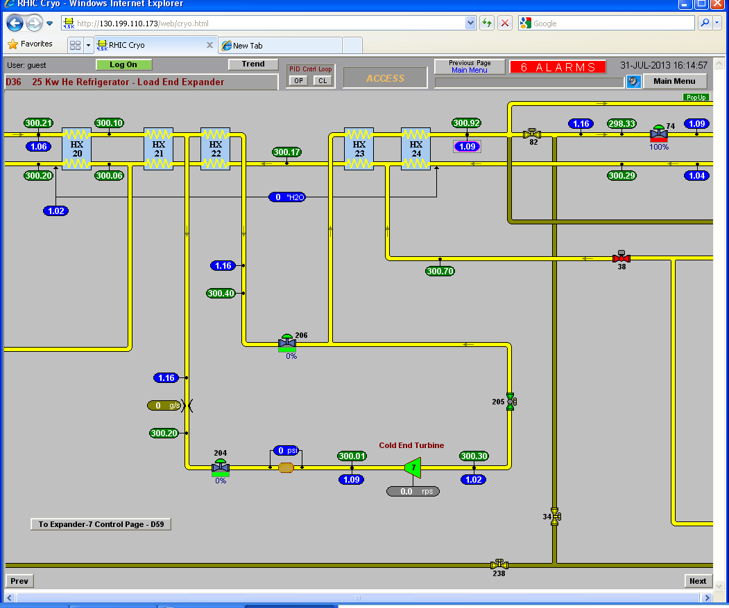
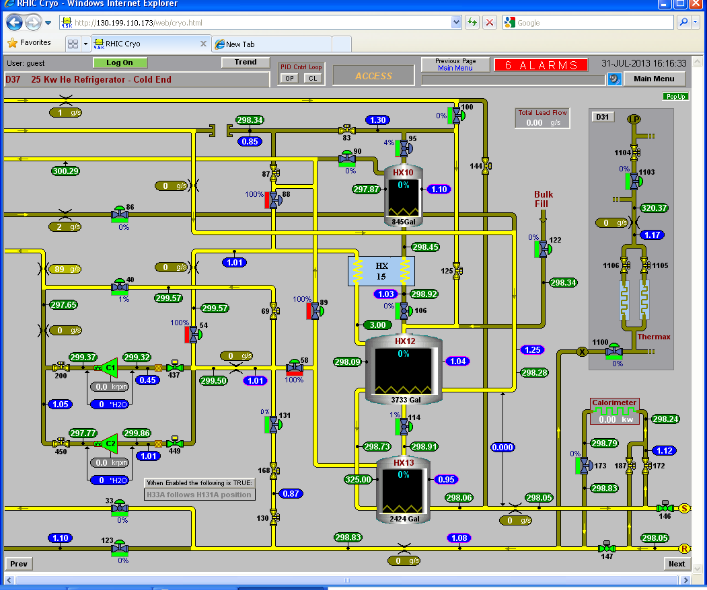
4.5K COLDBOX(ES)

Slide 15
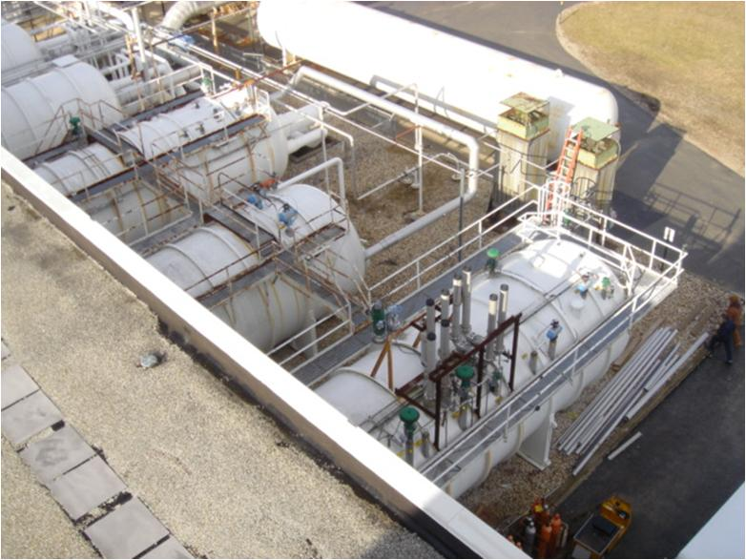
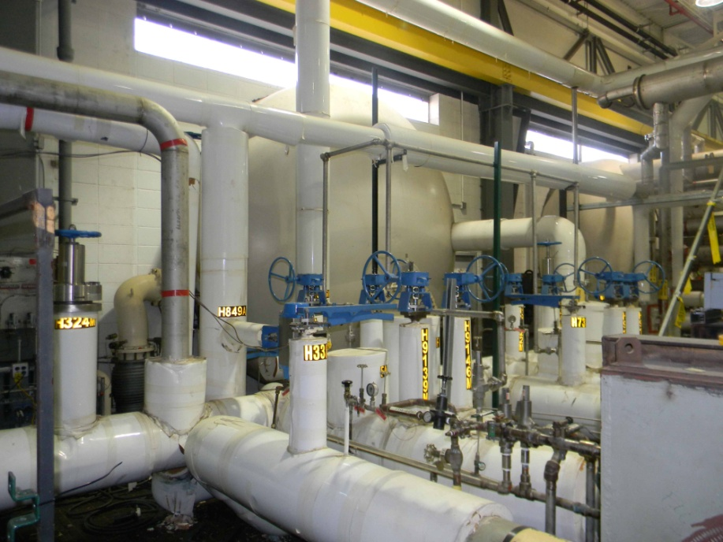
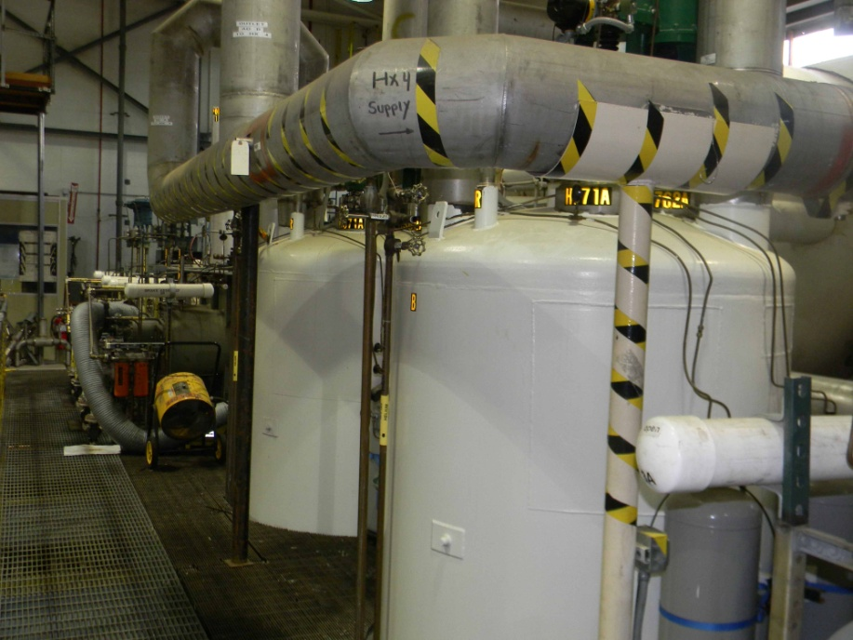
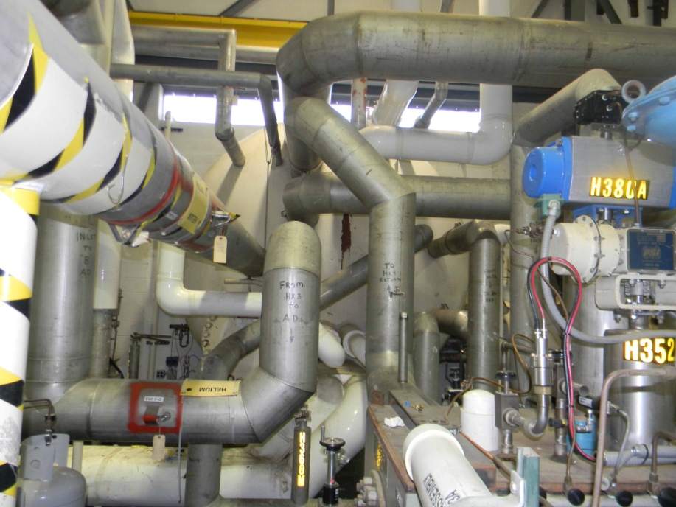
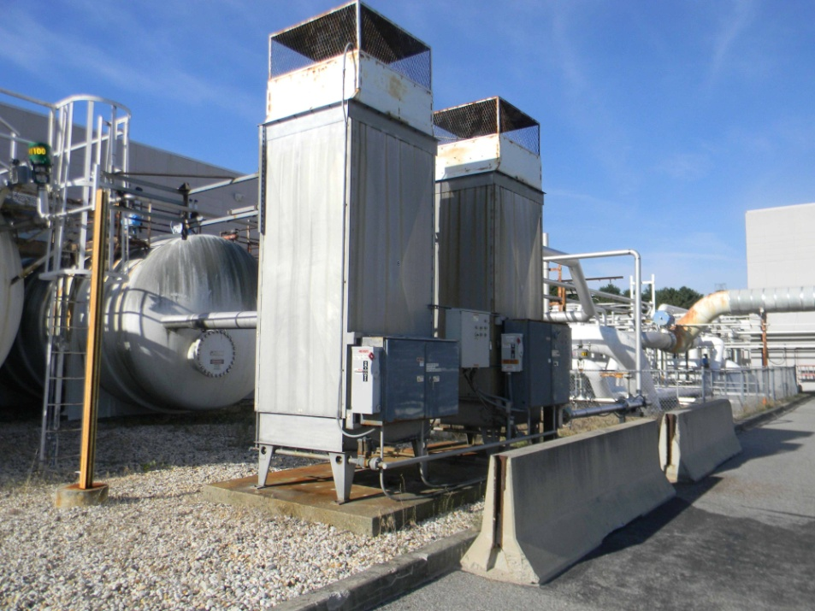
Cold 3 120K-65K
4.5K Coldbox System
ColdBoxes, last Coldbox 5
Forced Convection
Ambient vaporizers
65K Charcoal
Adsorption Beds
Cold Box 4 65-5K

Slide 16
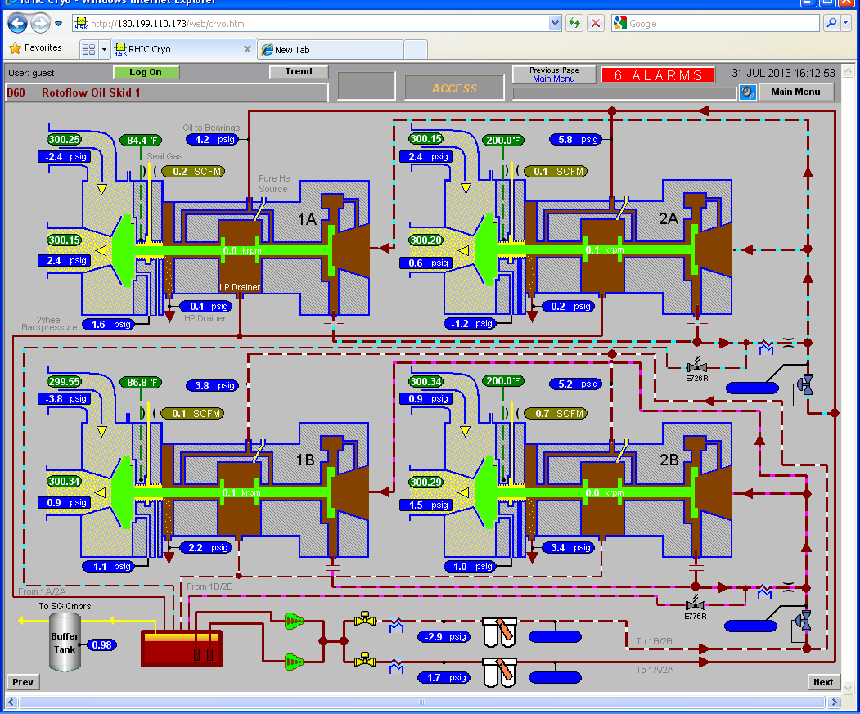
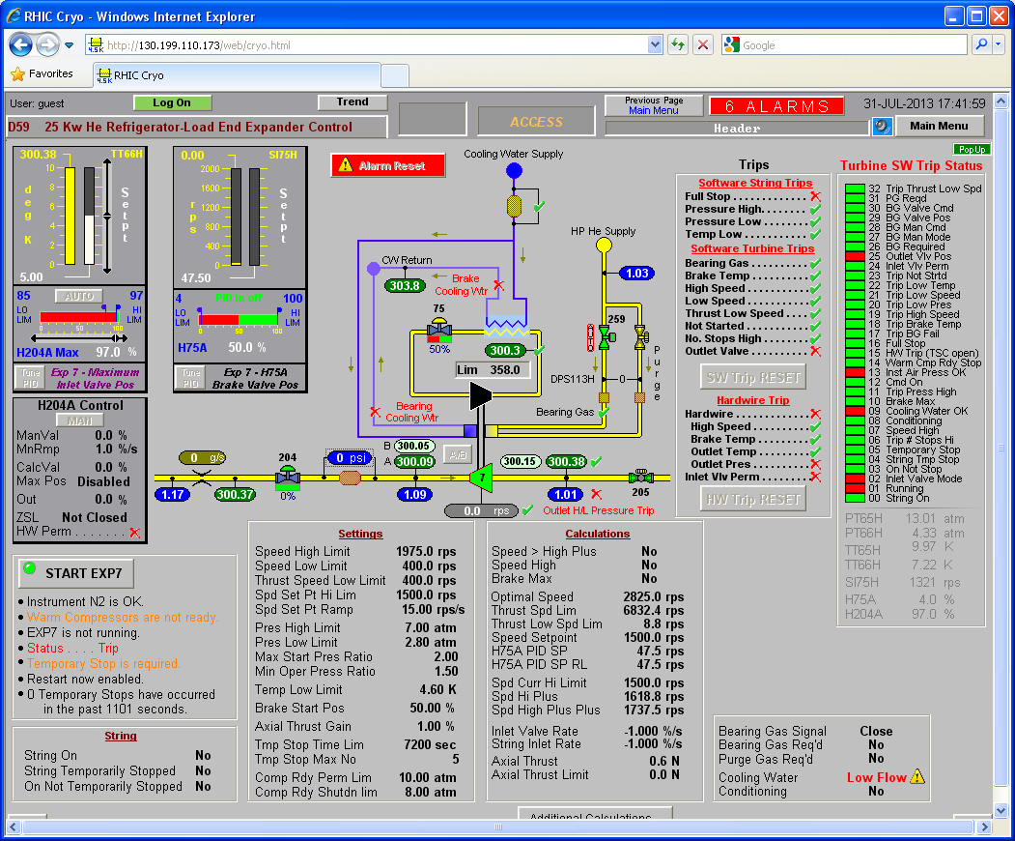
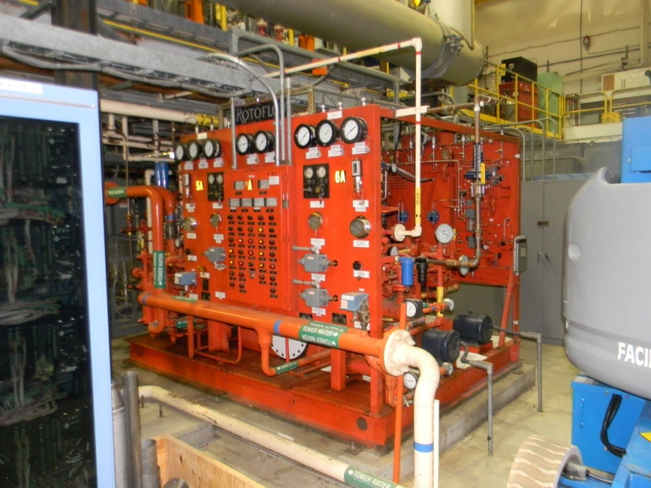
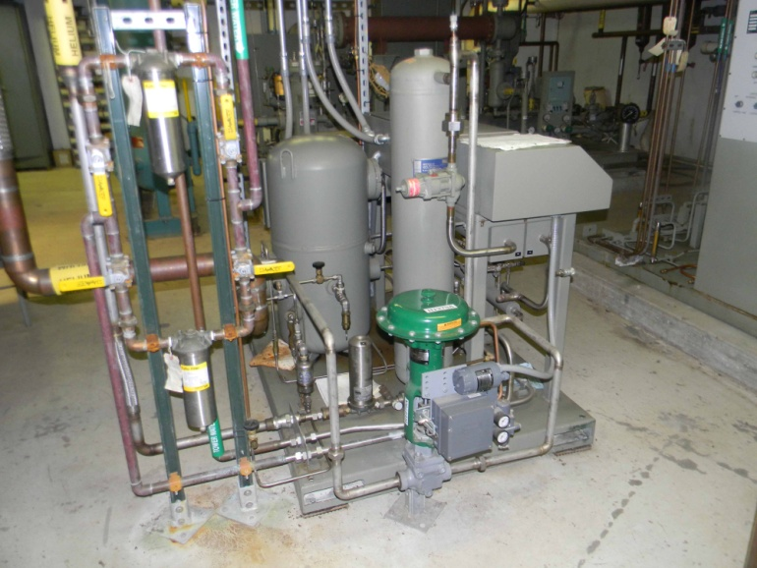
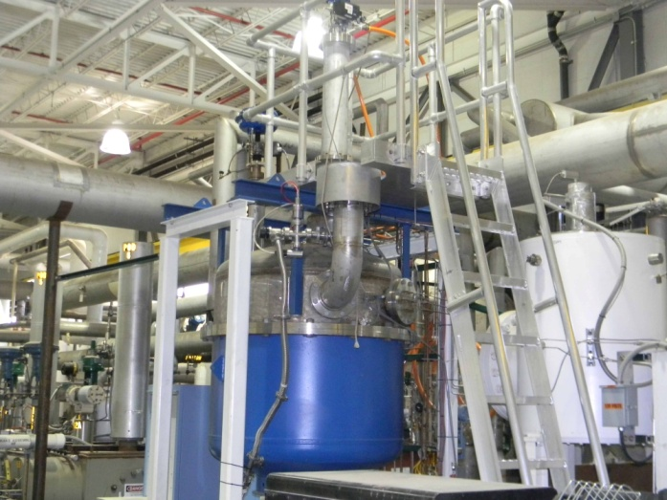
T1 thru T6 Oil bearing expander + T7 Gas Bearing
Rotoflow expander
Oil skid
Seal Gas Compresssor
Gas Bearing Expander

Slide 17
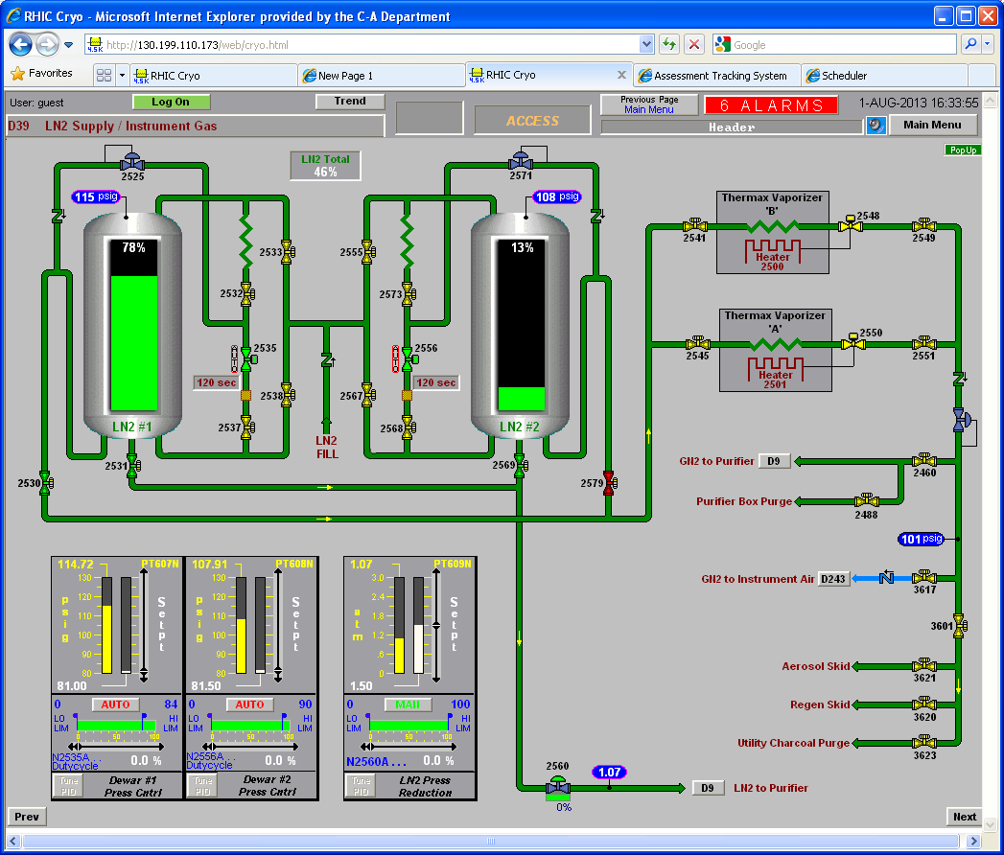
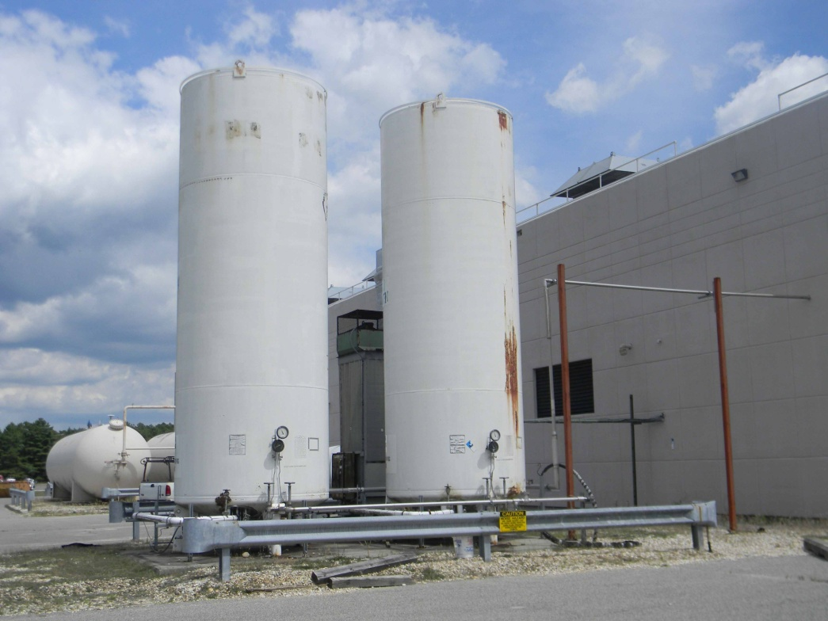
LN2 Supply @ 1005H
Twin 6000 Gallons LN2 towers
Gas generation for regeneration
Liquid delivery to Purifier
Maintenance
Valves
Relief Devices
Insulating vacuum
Defrosting of coils
Liquid N2 Dewars

Slide 18
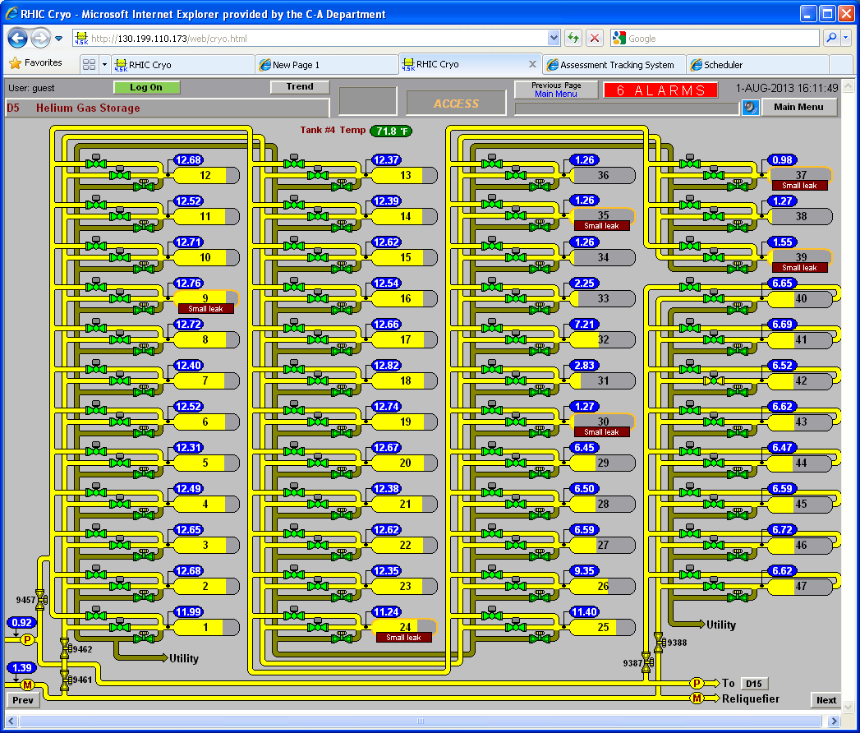
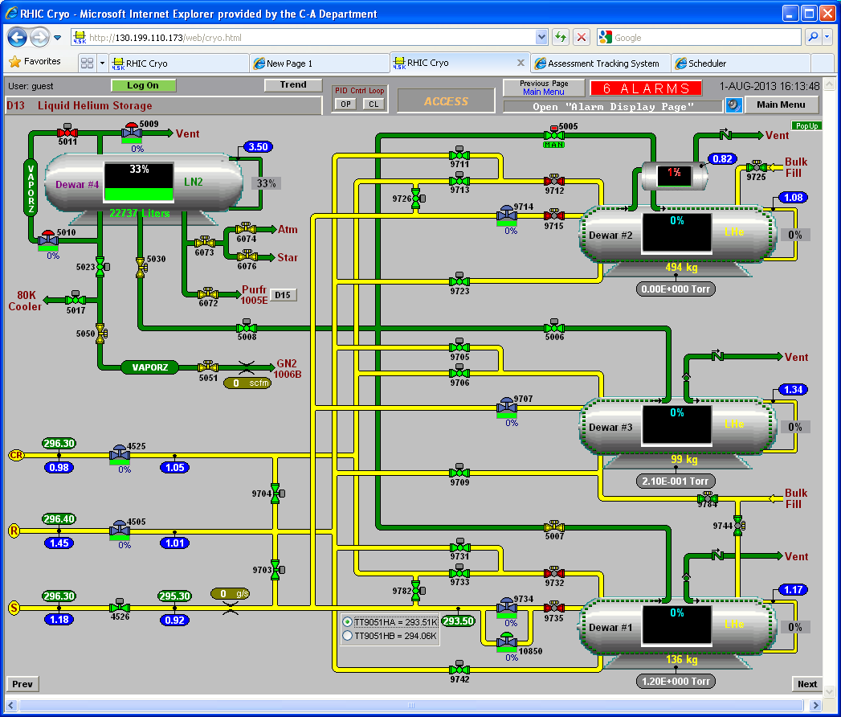
Helium Inventory: Gas & Liquid Storage
Maintenance
Valves
Relief Devices
Insulating vacuum
47 Gas Tanks [5,700,000 L]
~ 28,000 Liquid Gallons equivalent
3 x 10,000 Gallons [38,000 L] Liquid Helium Dewar
20,000 Gallons [750,000 L] LN2 dewar
Maintenance
Valves
Relief Devices
Insulating vacuum
Operational Requirement: 48,000 Gallons Liquid helium

Slide 19
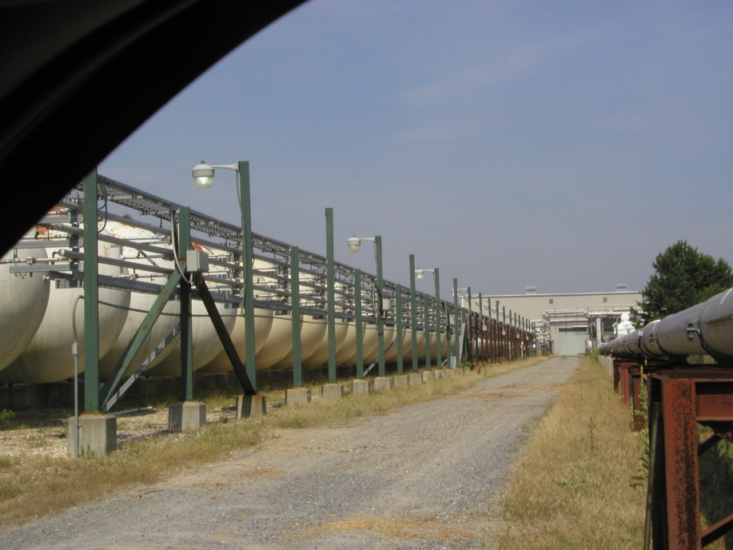
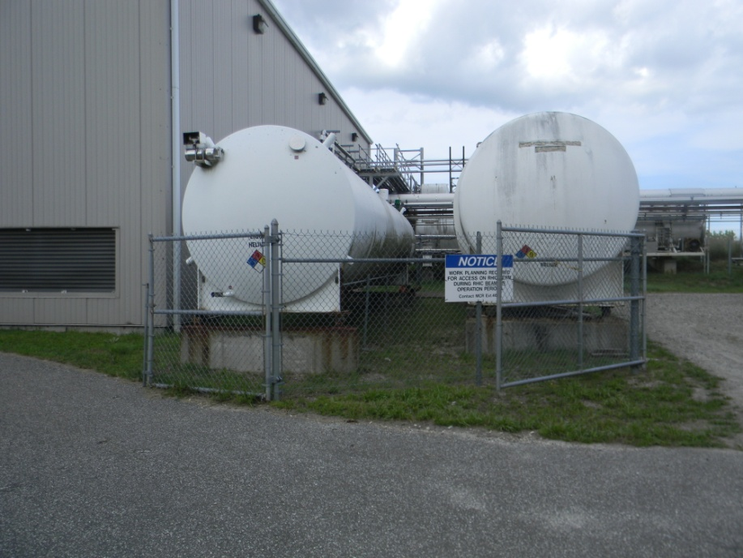
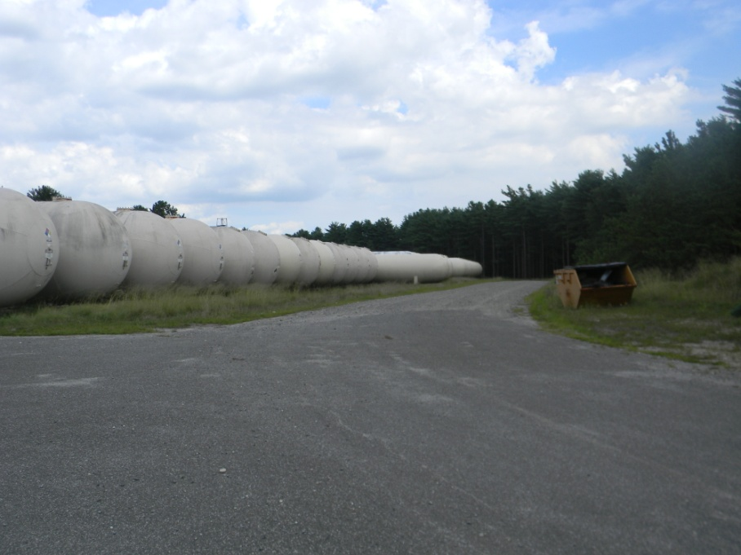
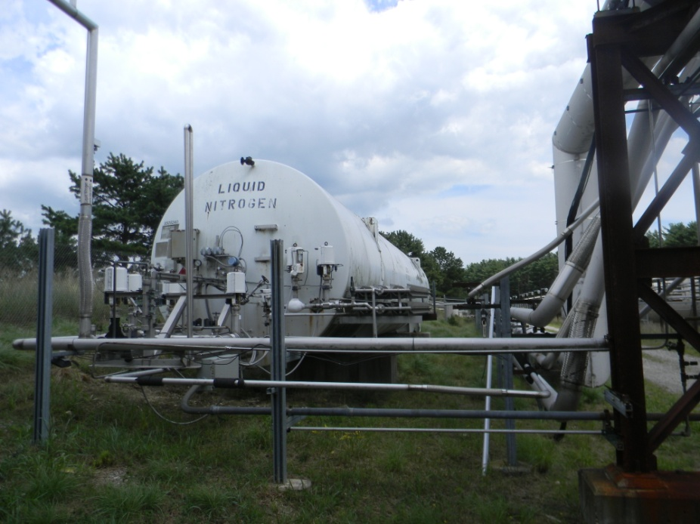
Helium Inventory: Gas & Liquid Storage
Tank Farm
Liquid Helium Dewars
Tank Farm
Liquid N2 Dewar

Slide 20
CRYO CONTROLS
INDEPENDENT CONTROLS FROM MCR
HMI/SCADA: (INDUSOFT) AVEVA EDGE
INTERFACE TO MCS/POWER SUPPLY
Current leads helium cooling ramps with Magnets current ramping
Temperature permissive for magnet ramping
Interlocks for corrector magnets lead cooling
Interlocks directly to SRF Cavities: 56MHz, CEC, LEREC
Data cryo to MCR for display

Slide 21
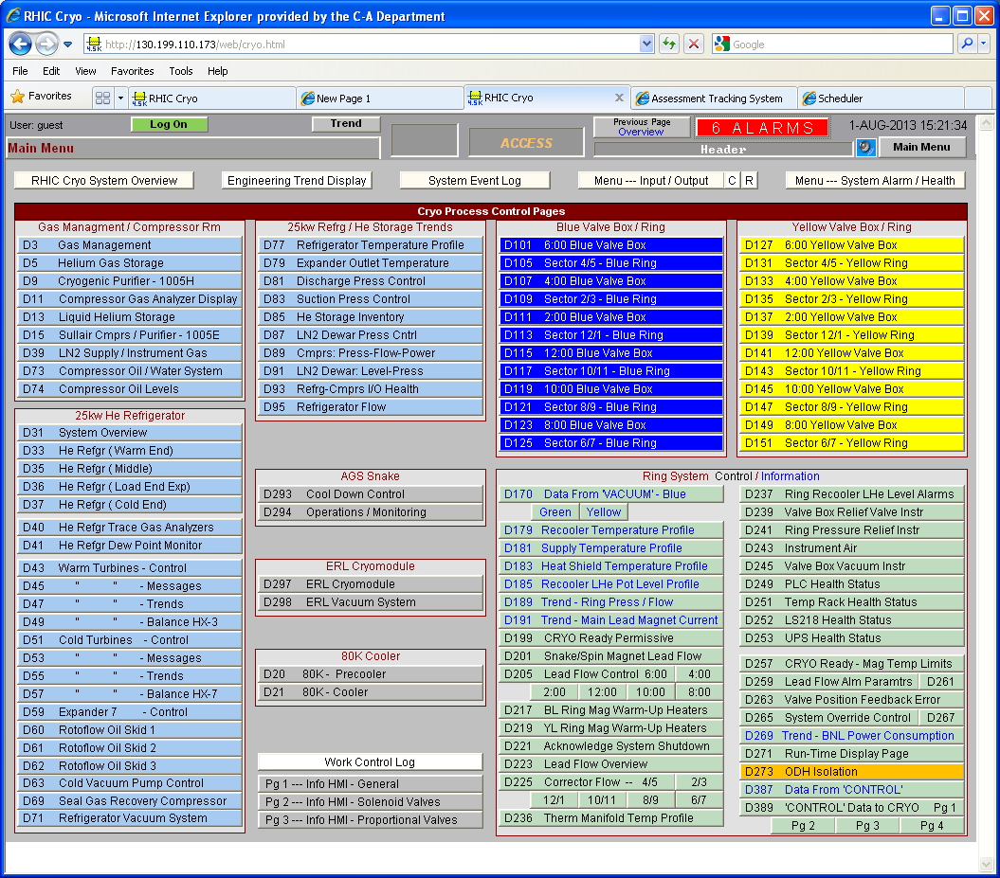
CRYO CONTROLS
6 SERVICE BUILDINGS:
CRYOCONTROLS PLC RACKS
1005S
MAIN SUPERVISORY SCADA
COMPRESSOR BLDG 1005H
PLC RACKS
REFRIGERATOR BLDG 1005R
PLC RACK

Slide 22
INTERLOCKS / BEAMPERMIT
Correctors Current leads: NO voltage taps ➔ No quench protection➔ Loss of lead flow ➔ Powers down magnet ➔ BEAM PERMIT
56 MHZ SRF CAVITY @ IP4: Interlock
MAGNET QUENCH ➔ POWER SUPPLY GROUP ➔ QUENCH PROTECTION ➔ BEAM PERMIT
MAGNET POWERING PERMISSIVE
MAGNET TEMPERATURES PERMISSIVE
Oxygen Deficiency Hazard
VODH: VACUUM ODH
Vacuum switches in the magnet cryostats; Triggers ODH alarms
Triggers the cryogenic system sextant valves to close isolating helium inventory
Automatic only active during “ACCESS” MODE

Slide 23
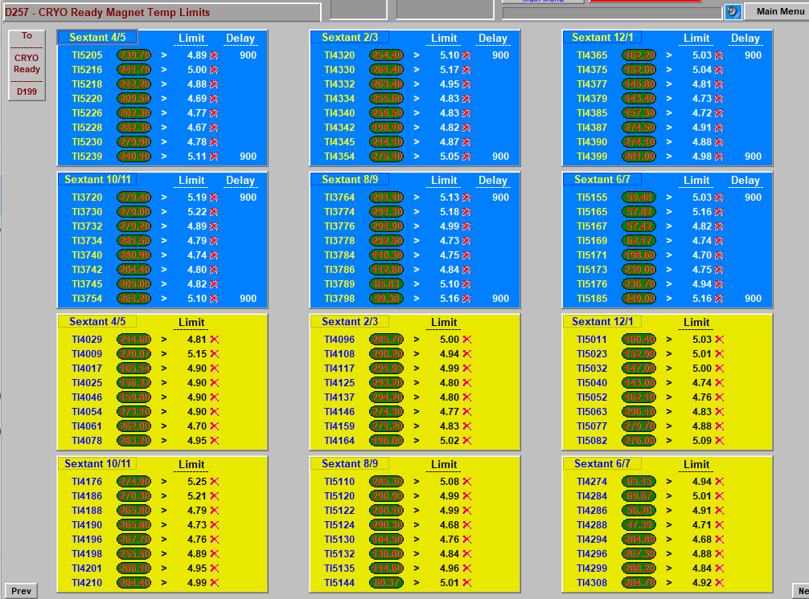

Slide 24
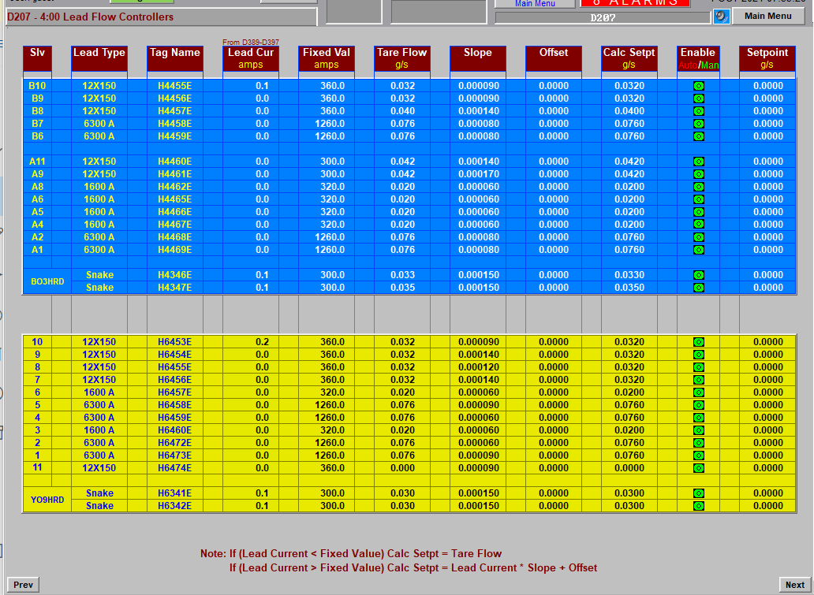

Slide 25
RHIC EXPERIMENTS WITH CRYOGENICS
COHERENT ELECTRON COOLING
112MHZ SRF GUN CAVITY @ 4.5K
704MHZ 5-CELL LINAC@ 2K
Low Energy Rhic Electron Cooling
704MHZ ½ CELL CAVITY@ 2K
56MHz Storage Cavities
ELECTRON LENSES: 5 T solenoids@ 4.5K
sPHENIX SOLENOID, 1.5 T @4.5K

Slide 26
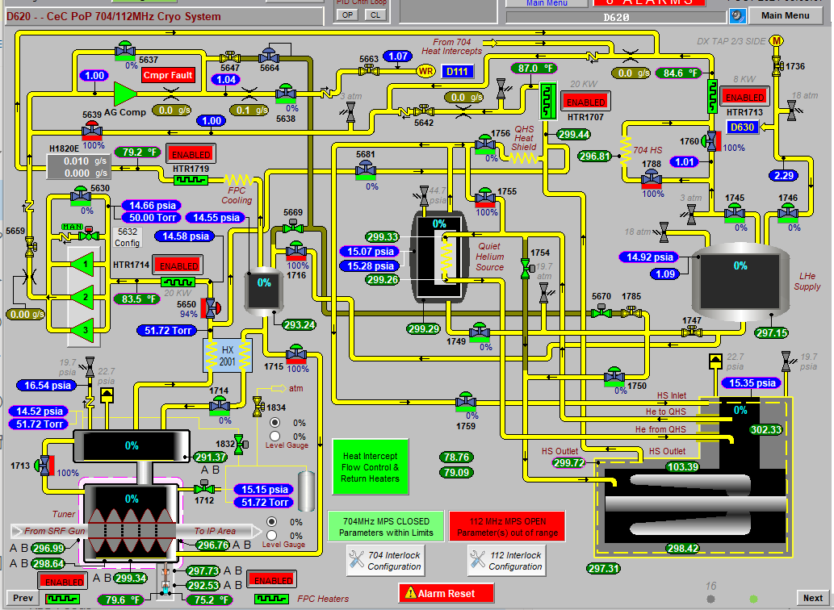
COHERENT ELECTRON COOLING

Slide 27
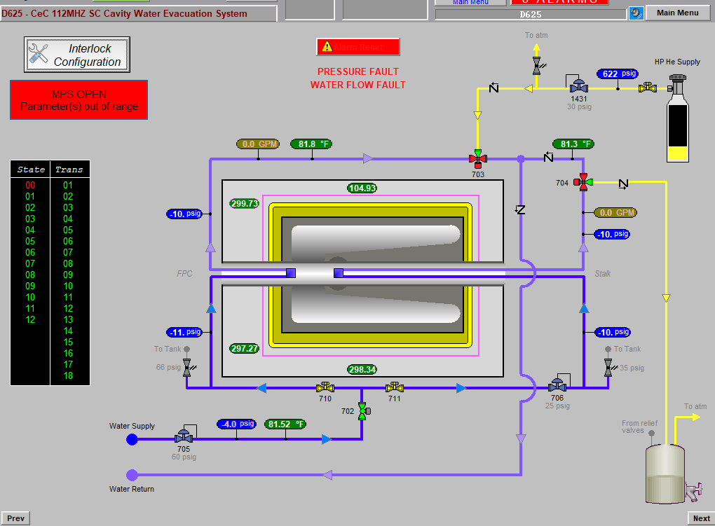
COHERENT ELECTRON COOLING

Slide 28
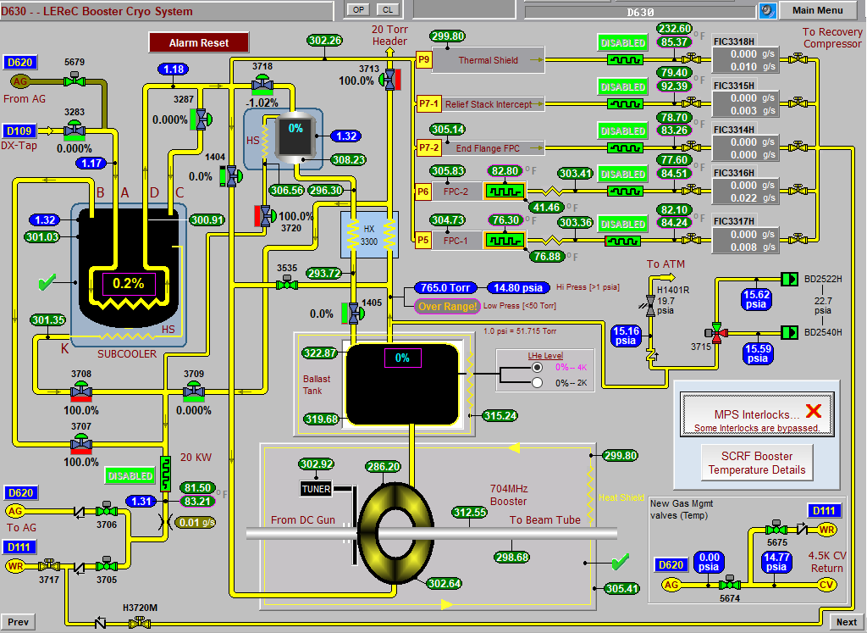
LOW Energy RHIC Electron COOLING

Slide 29
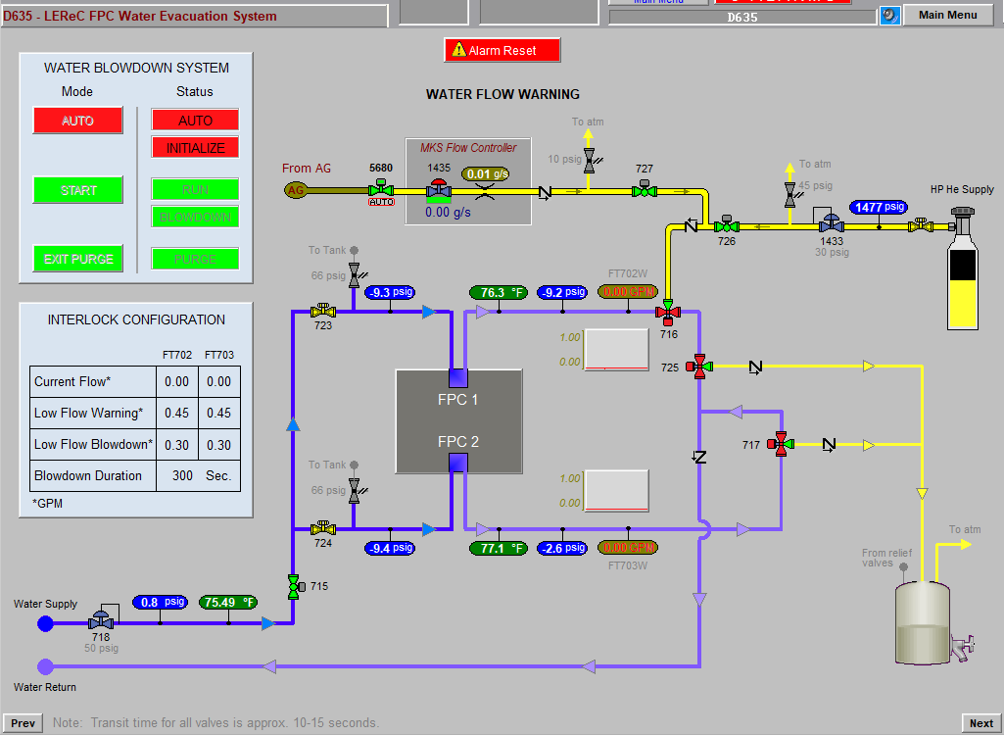
LOW Energy RHIC Electron COOLING

Slide 30
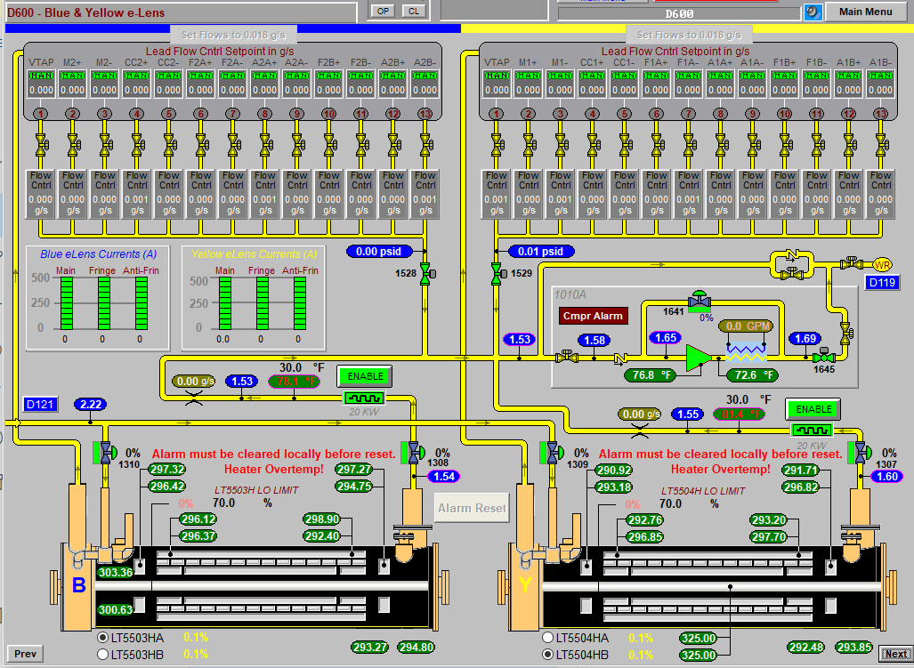
ELECTRON LENSES

Slide 31
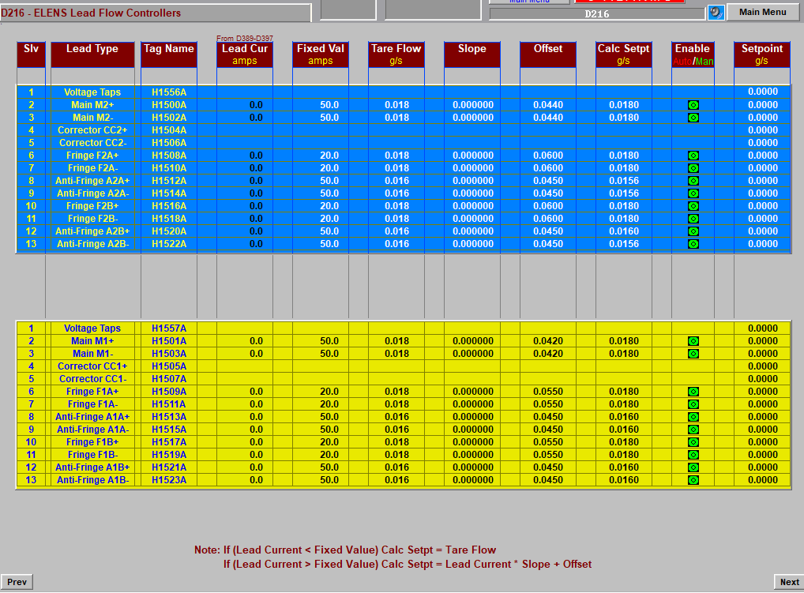
ELECTRON LENSES

Slide 32
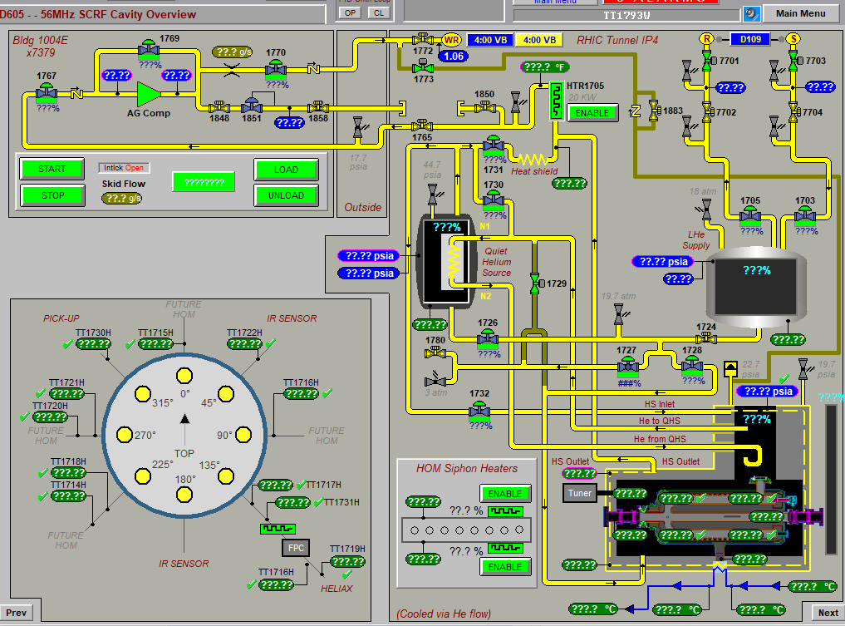
56MHz SRF Cavity

Slide 33
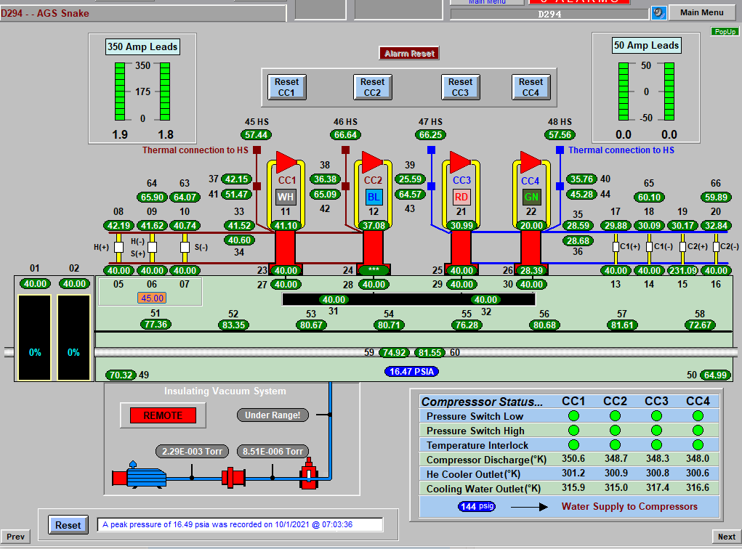
AGS COLD SNAKE

Slide 34
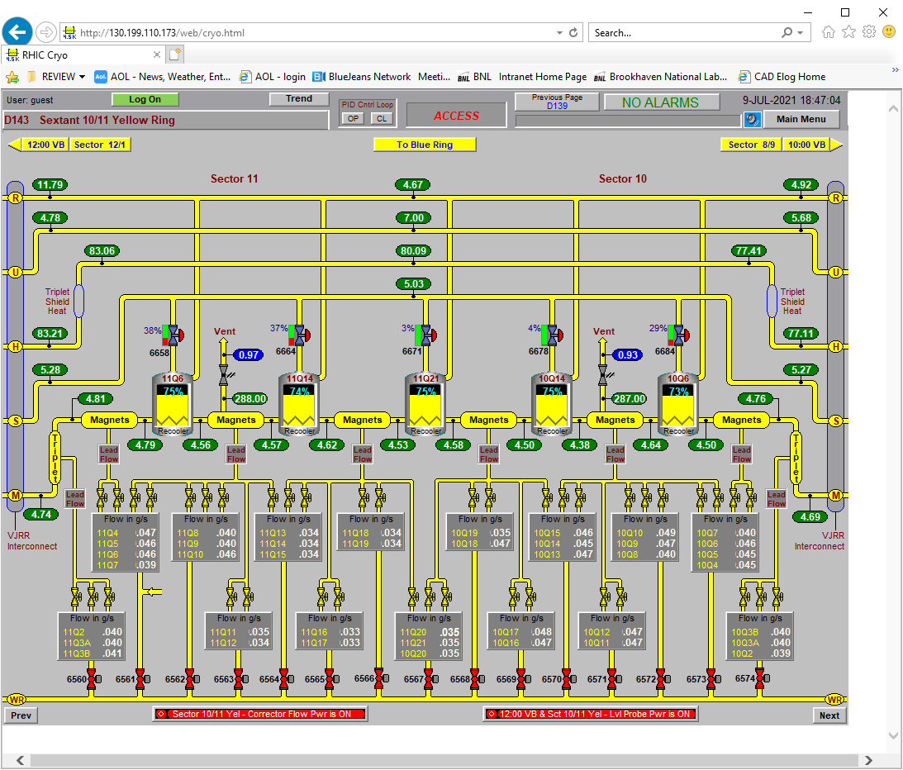

Slide 38
