Slide 1
SPHENIX CRYOGENICS 6.27.2022
Roberto Than
Collider Accelerator Department
Brookhaven National Laboratory

Slide 2
History
BABAR Cryogenics
Testing in building 912 with piston expander helium plant
Low power test
High power test with extension modification of the interconnect from solenoid to valvebox
SPHENIX CRYOGENICS

Slide 4
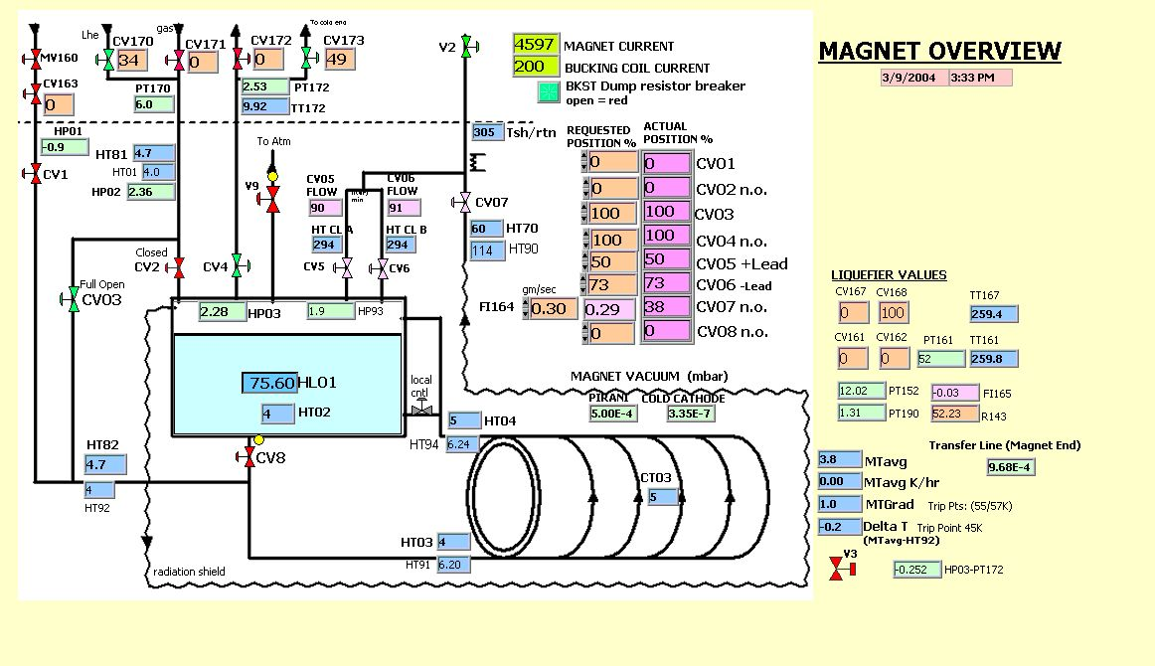

Slide 5
SLAC: BABAR Operations
Plant produces liquid in storage dewar
Storage dewar operated at 12 psig
Storage dewar used as buffer in the event of plant trip
Feed is co-axial (60 m) Liquid/ Vapor
THERMO-SIPHON
Not stable
PHASE SEPARTOR too small
Operated without siphon.

Slide 6
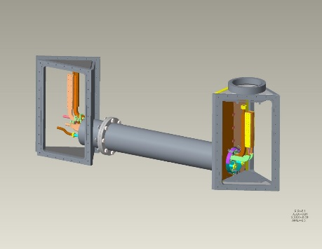
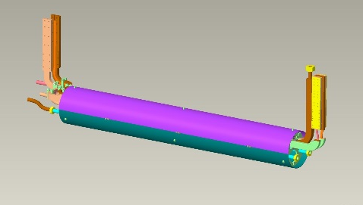
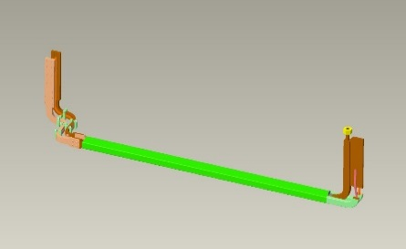
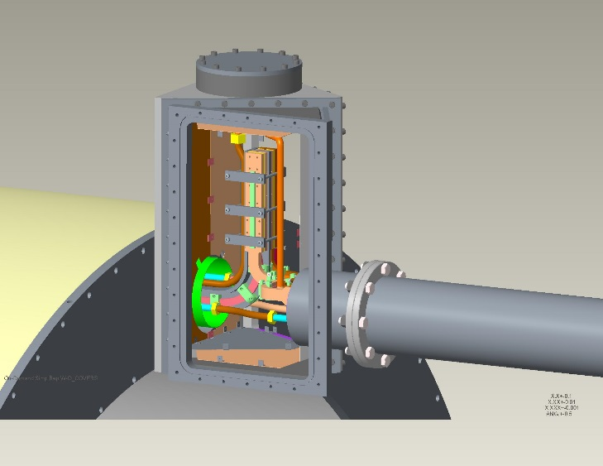
SC Splice joint vertical
Helium Vertical loop up/down

Slide 7
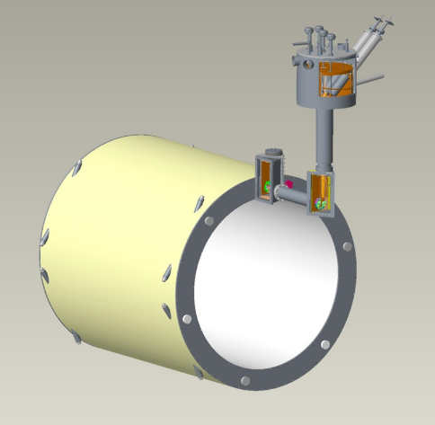
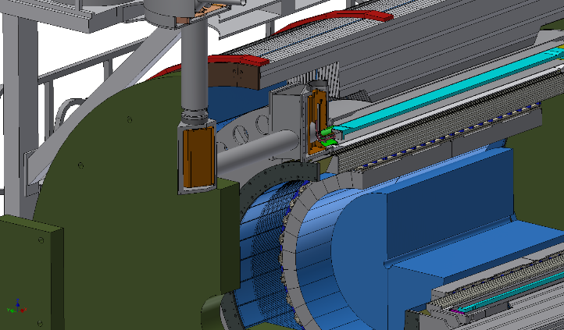
Solenoid Valve box &
5 kA Current leads
SC Bus/Cryolines extension

Slide 8
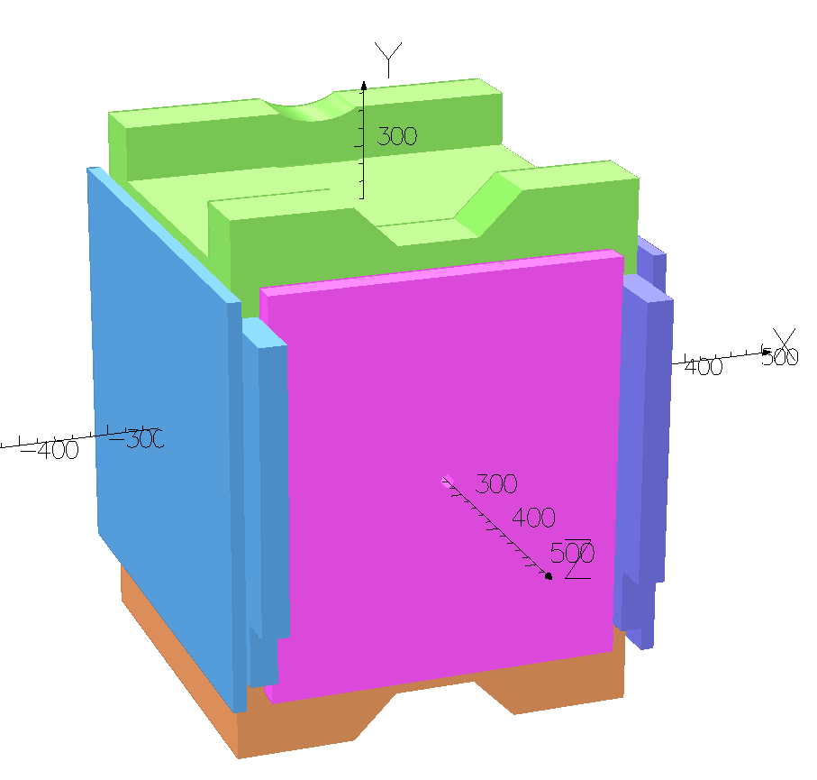
HIGH POWER TEST in Bldg 912
Extension tested in high power test in bldg. 912 using 4 cylinder piston expander plant
Duration was short, few hours at full current

Slide 9
SPHENIX REQUIREMENTS
Keep the existing solenoid valve/leadpot cryostat
Keep solenoid cold during summer shutdown below 100K
LN2 supply and exchanger
Controlled cooldown with maximum 40K gradient
No warm gas source at IR08
local heater

Slide 10
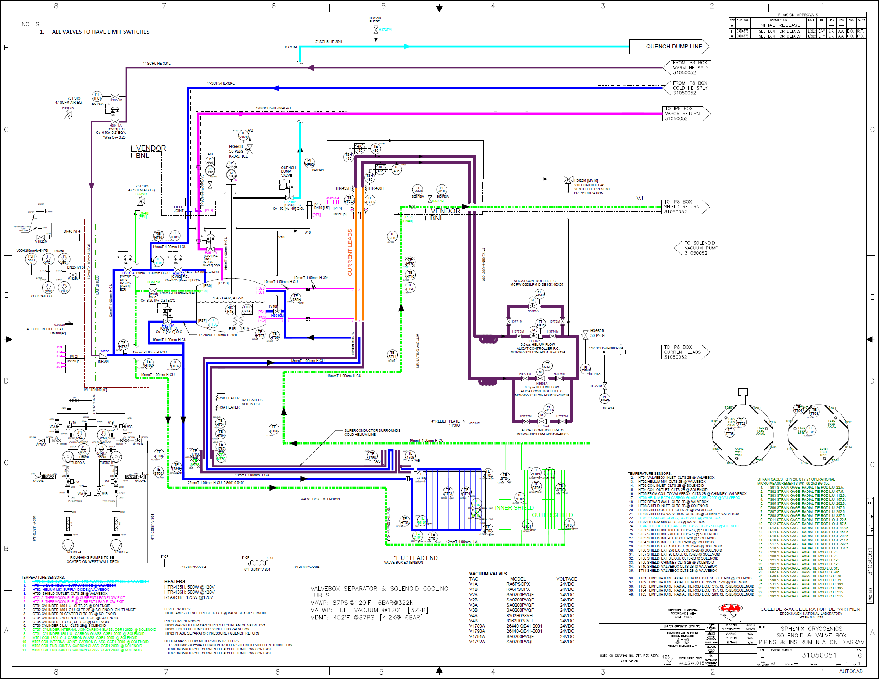
SPHENIX CRYOGENICS
SHIELD SUPPLIED WITH 4.5K VAPOR

Slide 11
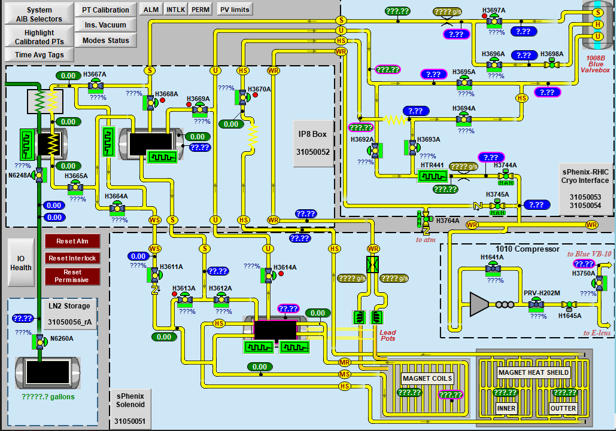
sPHENIX CRYO CONTROLS SYSTEM SCREEN

Slide 12
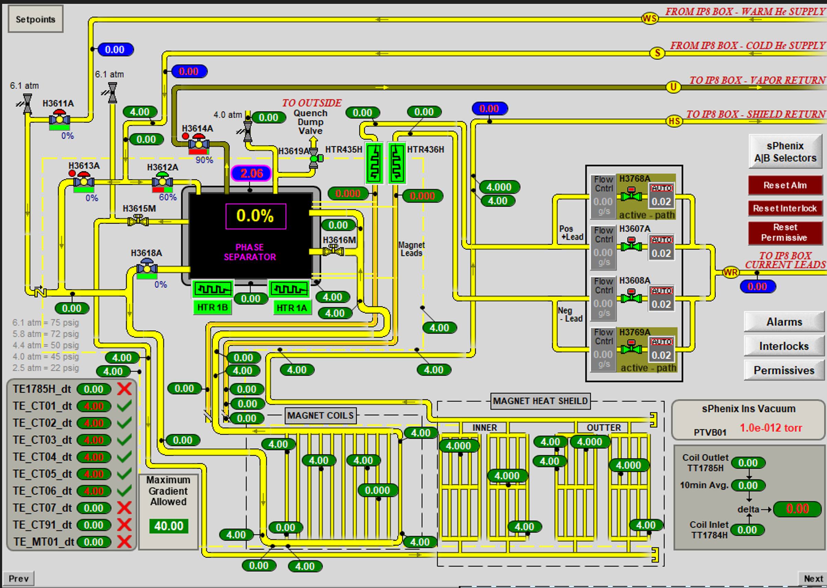

Slide 13
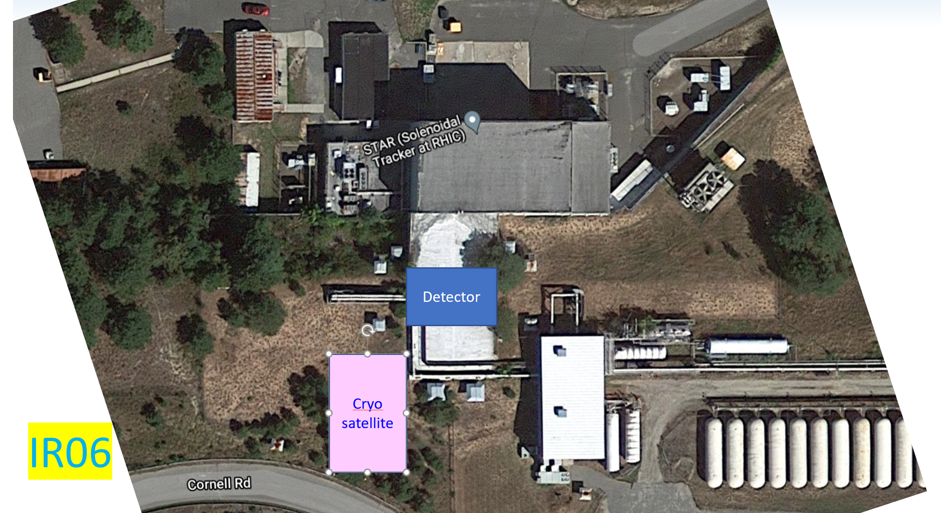

Slide 14
EIC DETECOR CRYOGENICS

Slide 15
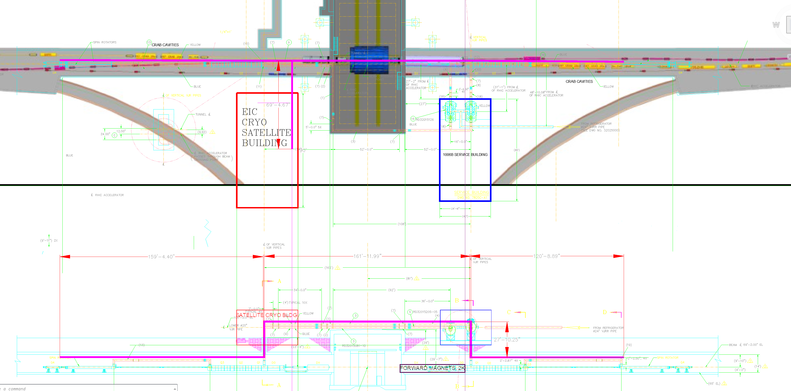

Slide 16
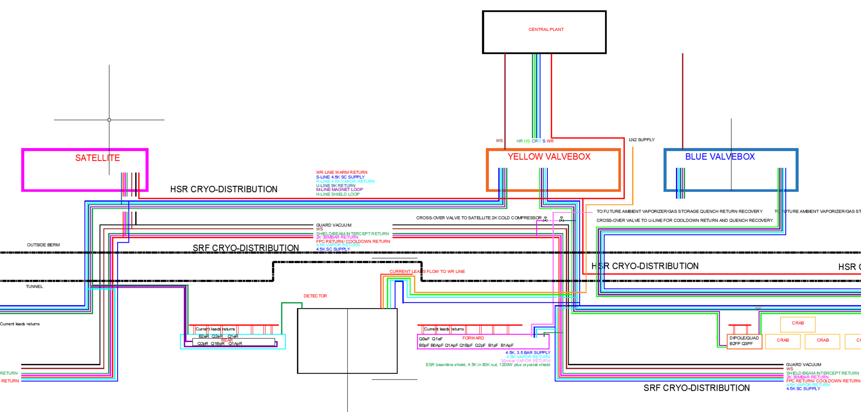

Slide 17
CRYOGENIC DISTRIBUTION
6 Blue & 6 Yellow Valveboxes
located in service buildings
Cryogenic valves & Recooler,
SC busses current leads interface {“Leadpot”}
Service Bld
1012
ValveBox
ValveBox
IR12
M : Magnet, 4.5K Loop
1006
ValveBox
C
e
n
t
r
a
l
P
l
a
n
t
Sector 11
Sector 12
Service Bld
1002
U : Utility, 9.6K Gas Return
Service Bld
1010
S : Supply, 4.5K Liquid
Sector 10
Sector 1
ValveBox
R : Return, 4.5K vapor Return
ValveBox
ValveBox
ValveBox
H : Heatshield Collider loop
IR10
IR2
M : Magnet, 4.5K Loop
U : Utility, 9.6K Gas Return
CR
S : Supply, 4.5K Liquid
HS
Sector 8
Sector 2
R : Return, 4.5K vapor Return
S
H : Heatshield Collider loop
Sector 9
Sector 3
WR: Warm Return loop
R
WR: Warm Return loop
HR
M : Magnet, 4.5K Loop
1006
ValveBox
WR
U : Utility, 9.6K Gas Return
WS
IR8
IR4
S : Supply, 4.5K Liquid
ValveBox
R : Return, 4.5K vapor Return
Service Bld
1004
Service Bld
1008
ValveBox
ValveBox
ValveBox
H : Heatshield Collider loop
Sector 6
Sector 4
M : Magnet, 4.5K Loop
Sector 7
IR6
Sector 5
U : Utility, 9.6K Gas Return
S : Supply, 4.5K Liquid
Service blds
1005H,1005R
R : Return, 4.5K vapor Return
CENTRAL PLANT
H : Heatshield Collider loop
Service Bld
1006
ValveBox
ValveBox

