Slide 1
60% Design/Engineering for EIC Detector Solenoid Magnet Sandesh Gopinath(JLAB) On Behalf of EIC Detector Magnet team
EIC Detector Solenoid Support Structure
Mid-Project Review
2022-06-28

Slide 2
Outline
BaBar Solenoid Structural Overview
Tie Rods
sPHENIX vs EIC :
Coil & yoke Design
Axial EM Force
Coil & Yoke offset
sPHENIX Detector Structure
Force Limiting Components
What's Next
Summary

Slide 3
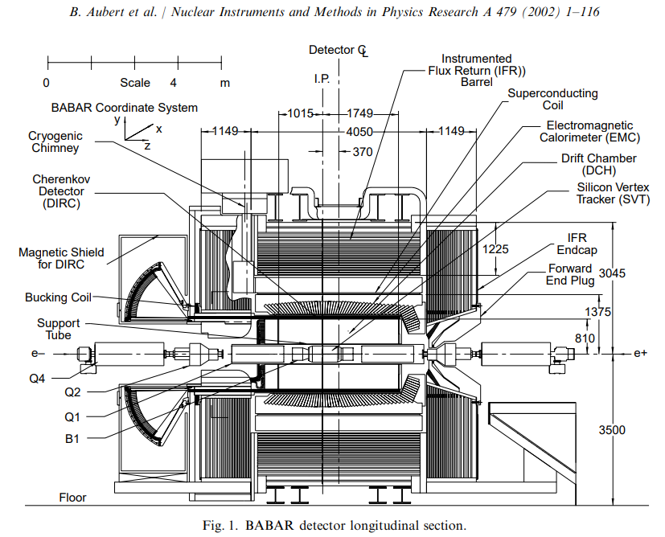
BaBar Solenoid Structural Overview
BaBar Cryostat
2 layer solenoid internally wound on an aluminum support mandrel
Cold mass connected to cryostat using axial and radial tie rods attached to the support mandrel
Coil placed in an non-symmetric flux return yoke as part of two detectors
BaBar
sPHENIX
Presently reviewing a similar possibility for EIC of placing the coil in a new configuration of flux return.
BaBar Detector Cross-section

Slide 4
BaBar Solenoid Structural Overview
Cryostat
Tie Rod
Winding Support cylinder
Winding
BaBar Cryostat Cross-section

Slide 5
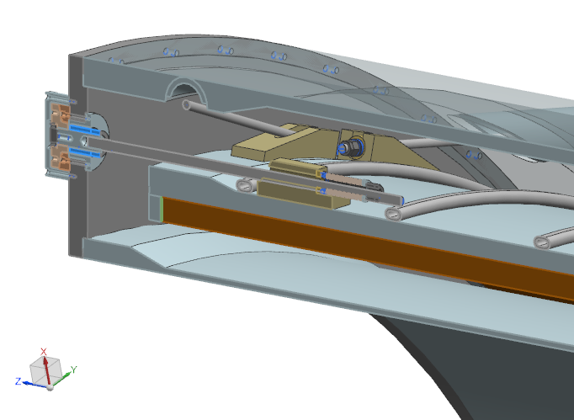
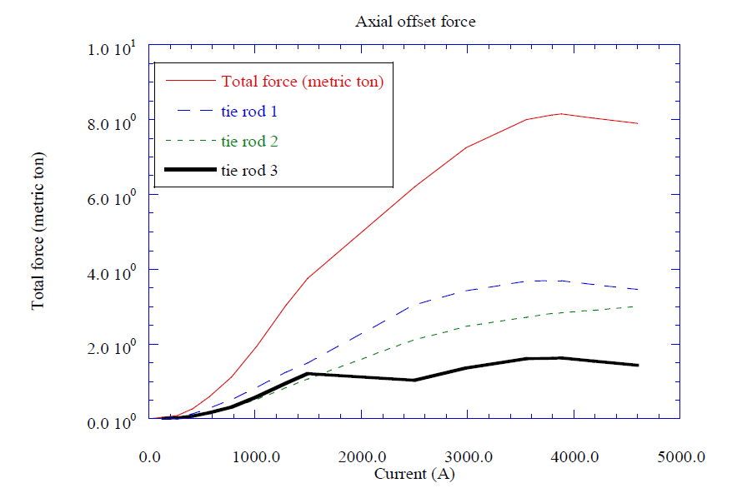
Tie Rods
8 tangential and 6 axial tie rods present made from 718 Inconel ¾” dia rods
Only the 8 tangential rods are only loaded due to gravity during assembly
All 6 axial tie rods loaded during cooldown of which only 3 loaded during operation
Axial electromagnetic force applied on cold mass due to the non-symmetric flux return causing unequal loading of 3 axial tie rods in tension
BaBar detector axial EM load 8 tonnes
Axial
Tangential
Tie Road Axial Offset Force -‘Design Study For The BABAR Superconducting Solenoid – May 1995

Slide 6
Tie Rods
Tangential Tie Rods

Slide 7
Tie Rods
Axial Tie Rods

Slide 8
sPHENIX vs EIC: Coil & Yoke Design
sPHENIX
EIC
TBD
Extra iron to reduce fringe field
Endcap thickness modification to reduce imbalance axial force
HCal Barrel modification to reduce fringe field
Any modification to Hcal –endcap & Barrel – for accommodating detectors
Additional support structure and ferrous material in the vicinity

Slide 9
sPHENIX vs EIC: Axial EM forces
sPHENIX
 | Fx [kN] | Fy [kN] | Fz [kN] | Tx [kN-cm] | Ty [kN-cm] | Tz [kN-cm]
No misalignment | -1 | -14.1 | 15.6 | 335 | 160.1 | 0
Coil shift, dx= 2 mm | 9.4 | -14.1 | 15.6 | 335.3 | 157.1 | -2.8
Coil shift, dz= 2 mm | -1 | -13.9 | 21.2 | 354.5 | 159.3 | 0
sPHENIX Technical Design Report 1, Updates to PD-2/3 Release, October 15, 2019
EIC
Values subject to change depending on possible changes mentioned in previous slide

Slide 10
Coil & Yoke offset
Coil and barrel axial offset slightly varies depending on the source
28.5 mm BNL TOSCA model
30 mm Technical papers^{[1]}
27.5 mm JLAB interpretation of ‘as manufactured drawings’
Axial EM load sensitive to axial position of winding relative to steel flux return
JLAB drawing with winding to cryostat offset
[1] T. G. O'Connor et al., "Design and testing of the 1.5 T superconducting solenoid for the BaBar detector at PEP-II in SLAC," in IEEE Transactions on Applied Superconductivity, vol. 9, no. 2, pp. 847-851, June 1999, doi: 10.1109/77.783429.

Slide 11
sPHENIX Detector Structure

Slide 12
sPHENIX Detector Structure
Currently being assembled
Depending on final EIC Flux return size there is possibility of using existing column support structure and Cold Carriage.
https://www.bnl.gov/newsroom/news.php?a=219443

Slide 13
Force Limiting Mechanical components
Axial EM load
Axial Tie rod
Support cylinder
Cryostat
Outer Hcal steel
Cradle Carriage
Floor
Approx. total axial load capacity of tie rods is 31 tonnes with a safety factor of 3
Support seems to be designed to withstand a max axial load of 38 tonnes for SLAC(Design Study For The BABAR Superconducting Solenoid – May 1995)
1.2g sideways and 2g vertical
20 tonnes force due to Alignment error
Current sPHENIX structure to with stand at least 21 tonnes of EM forces

Slide 14
What Next
Finalize winding to cryostat offset
Define worst case EM loads for coil offset and misalignments
Cryostat load bearing calculations for EIC
sPHENIX structure strength calculations for EIC

Slide 15
Summary
JLAB reverse engineered a detailed 3D CAD of the winding support mandrel, cryostat, tie rods & heat shields from manufacturing drawings
Our Italian is improving
EM loads compared in different flux return configuration
Deduced from ‘Design Study For The BABAR Superconducting Solenoid – May 1995’ & ‘sPHENIX Technical Design Report 1, Updates to PD-2/3 Release, October 15, 2019’
Working towards analyzing support structure for BaBar solenoid with EIC flux return configuration

Slide 16
Back up Slides

Slide 17
BaBar Coil info

Slide 20
BaBar TOSCA

