Slide 1
60% Design/Engineering for EIC Detector Solenoid Magnet
Valerio CALVELLI (CEA/IRFU)
On Behalf of EIC Detector Magnet team
2D / 3D MARCO Preliminary Magnetic Design
Mid-Project Review
2022-06-28

Slide 2
Outline
MARCO Design Strategy
Upper limits on the Interaction Length
MARCO Dimensions
MARCO Magnetic Design

Slide 3
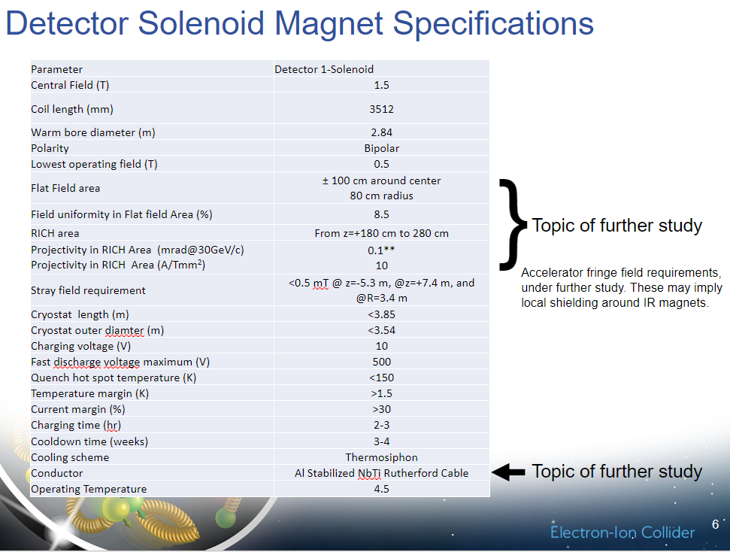
MARCO Specifications
Specifications related to the magnetic design
Discussed in R. Rajput-Ghoshal talk

Slide 4
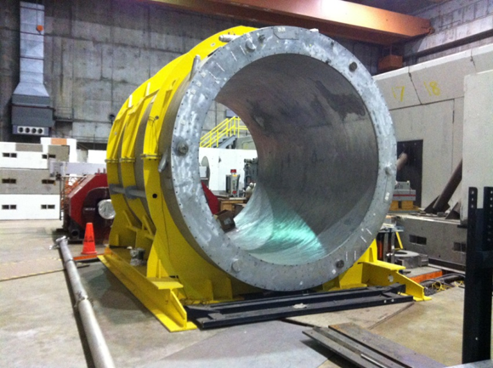
Strategy followed to achieve the specifications
Strategy
Fix the overall dimensions as BaBar's ones
Fix the coils axial length / inner radius as BaBar
Respect the same interaction length
Conductor with Al stabilizer is not an option today due to the lack of manufacturers.
Choose to design a conductor with Cu stabilizer
Reduce the overall coil + mechanical structure thickness to respect 3
Increase the current density
Propose a simplified design (cost effective) and check if it satisfies the requirements
BaBar Solenoid

Slide 5
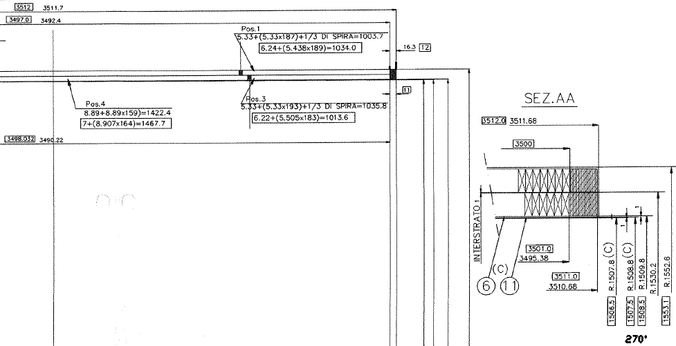
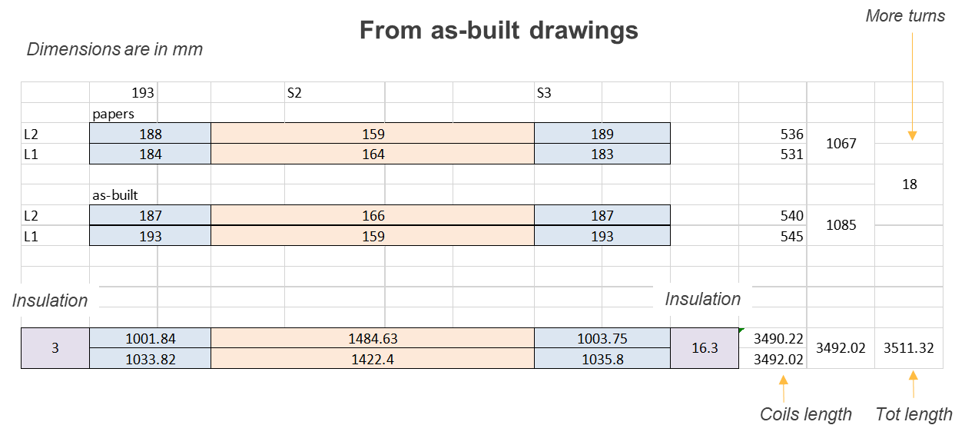
BaBaR Dimensions / Marco Dimensions
Dimensions / n° of turns as-built differ from the ones reported into papers
BaBar Dimensions
Dimension | Value | Units
R_{in} coil | 1509.5 | mm
Coil Axial length | 3492 | mm
We adopted these dimensions for MARCO as reference

Slide 6
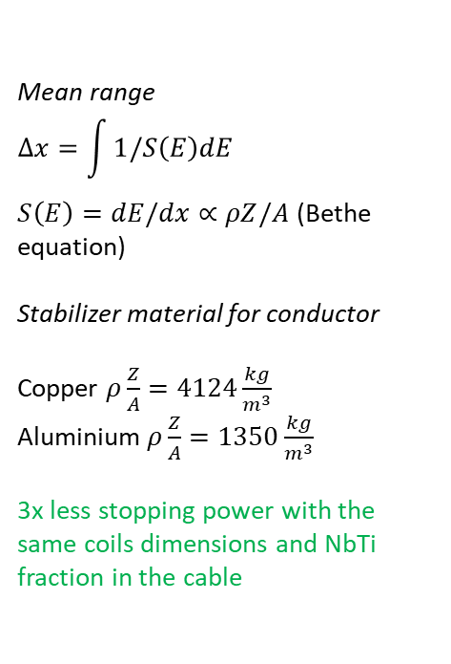
Interaction length limits
TRANSPARENCY
for the transverse momentum
THUMB RULE
Overall coil thickness have to be around 1/3 of BaBar’s coil
Mean range
$$∆x=\int{1/S\left(E\right)dE }$$
$S\left(E\right)=dE/dx∝ρZ/A$ (Bethe equation)
Stabilizer material for conductor
Copper $ρ\frac{Z}{A}=4124\frac{kg}{m^{3}}$
Aluminium $ρ\frac{Z}{A}=1350\frac{kg}{m^{3}}$
3x less stopping power with the same coils dimensions and NbTi fraction in the cable
First calculations
23.88 mm Cu+40 mm SS in New
136.72 mm Al in BaBar
0.42 interaction length in New
0.36 interaction length in BaBar
1.26 interaction length in SOCRATE
By R. Rajput-Ghoshal

Slide 7
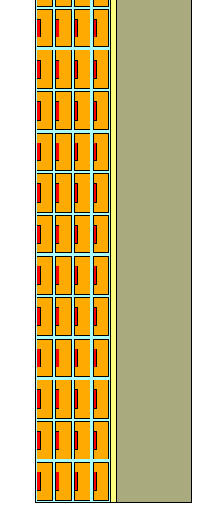
Marco Dimensions (v.4.3.1.0.0)
Dimension | Value | Units
R_{in} magnet | 1420 | mm
R_{out} magnet | Tbd | mm
R_{in} coil | 1509.5 | mm
R_{out} coil | 1531.9 | mm
R_{in} mechanical structure |  | mm
R_{out} mechanical structure | 1535 | mm
R_{out} magnet | Tbd | mm
Coil Axial length | 3492 | mm
Magnet Axial length | 3850 | mm
Z = 3492
22.5
22.4
R =1557.4
R =1509.5
R =1420
Dimensions are in mm
They may slightly vary according to the design progress
Coil + mechanical structure thickness = 48 mm vs 110 mm (+30mm inner structure for BaBar)

Slide 8
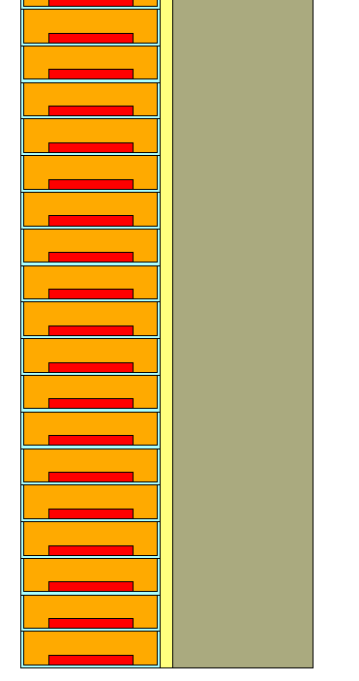
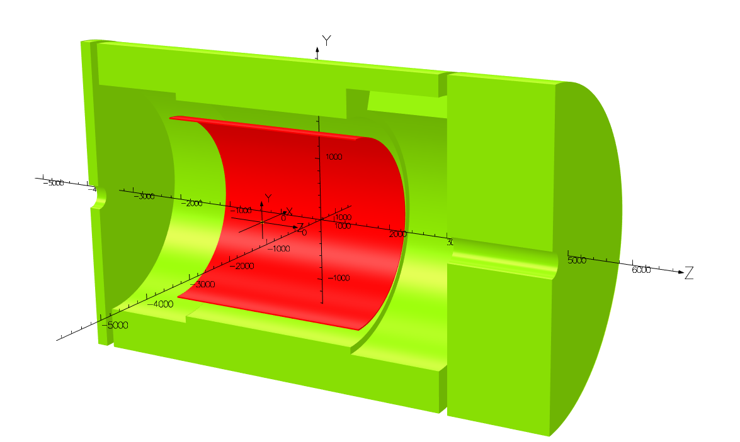
Marco Magnetic Design
1 layer solenoid
4 layers solenoid
Z
Z
R
R

Slide 9
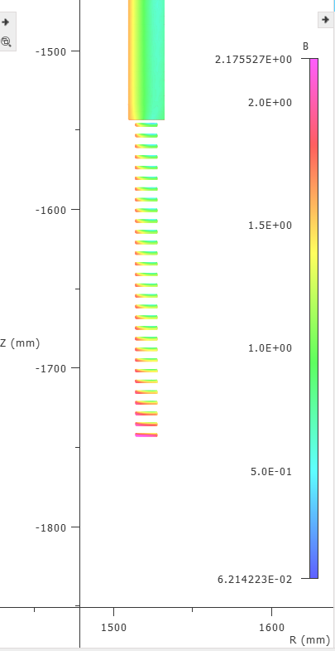
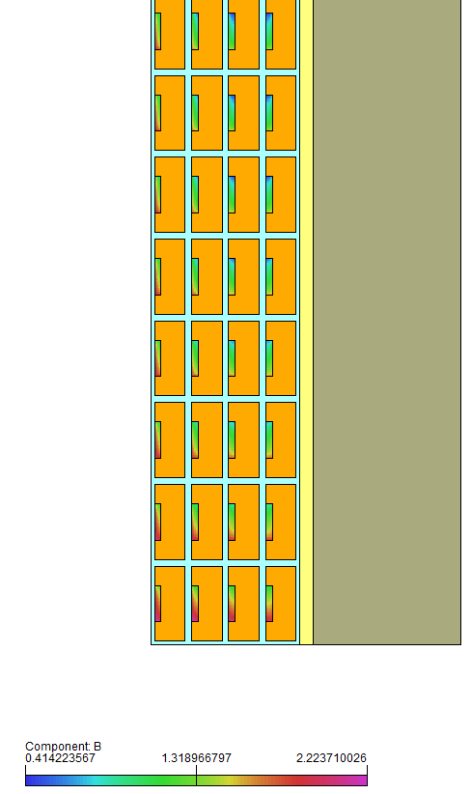
Marco Magnetic Design
1 layer solenoid
4 layers solenoid
Same magnetic results
In terms of energy/peak field
4 layers solenoid reference solution
(See F.Stacchi talk)

Slide 10
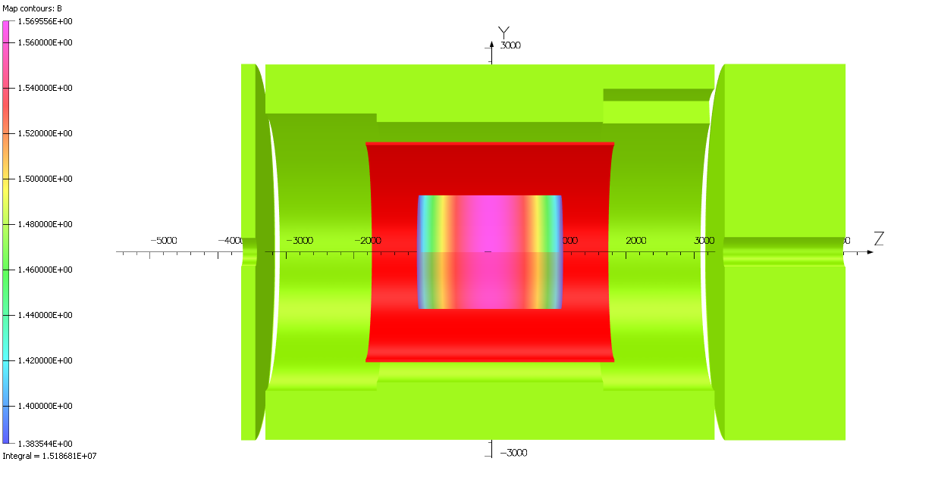
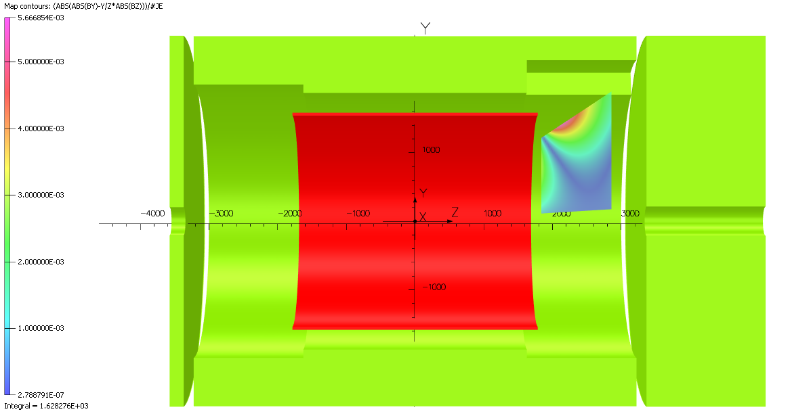
3D Magnetic Preliminary Design Results
1.56 T
Parameter | Parameter Value | Units | Validation
Coil R_{in} | 1509.5 | mm | OK
Coil R_{out} | 1532.0 | mm | OK
Coil Length | 3492.0 | mm | OK
3D RESULTS
B @ (0,0,0) | 1.502 | T | OK
Bpeak+self field | 2.226 | T
Stored Energy | 25.076 | MJ
B @ (0,0,-5300) | 29 | G | Tbd
B @ (0,0,7200) | 18 | G | Tbd
B @ (3400,0,0) | 17 | G | Tbd
Projectivity | 1.63 | T/Amm² | OK
Homogeneity | 12.342 | % | Validated by physics group
Homogeneity region
1.38 T
B field along Z axis
3D Results are the same as 2D
RICH Projectivity

Slide 11
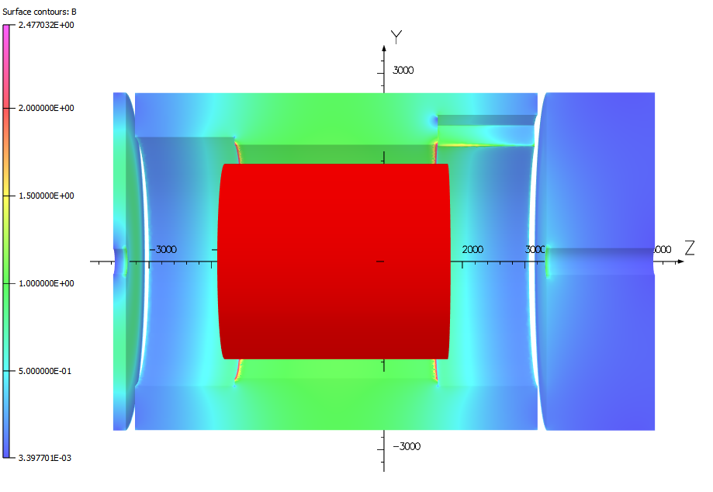
Yoke effect on the fringe field
Increased thickness
Small effect
Do not satisfy the requirement (0.5 mT)
Very expensive
Discussions needed with the accelerator group

Slide 12
What’s Next
Discuss possible solutions about the fringe field
Validate the Magnetic Design
Detailed Yoke Geometry and materials
Forces on the magnet and on the Yoke at nominal operation and during ramp-up/down

Slide 13
Summary
Today the magnetic design respects almost all the specifications:
B = 1.5 T @ IP
Homogeneity = 12.3% validated from the Physic Group
Projectivity = 1.63 T/Amm²
Coil dimensions within the specs
The fringe field is between 17 G / 29 G

Slide 14
Back up Slides

Slide 15
2D Magnetic Preliminary Design Results
Parameter | Parameter Value | Units | Validation
Coil Rin | 1509.5 | mm | OK
Coil Rout | 1532.0 | mm | OK
Coil Length | 3492.0 | mm | OK
2D RESULTS
B @ (0,0,0) | 1.500 | T | OK
Bpeak+self field 4.3.1.0.0 | 2.226 | T
Stored Energy | 24.952 | MJ
B @ (0,0,-5300) | 2.88 | mT | To be discussed
B @ (0,0,7200) | 1.84 | mT
B @ (3400,0,0) | 1.66 | mT
Projectivity | 1.63 | T/Amm² | OK
Homogeneity | 12.342 | % | Validated by physics group

