Slide 1
Detector 1 DAQ WG
Agenda
Presentations :
SRO/Data Aggregation using an Arista switch & discussion – David Abbott [JLAB]
More DAQ WG Topics [ Global timing, Timing word definitions ] – Jeff Landgraf [BNL]
Preparation for July 26 EICUG presentation of DAQ summary – Discussion [ALL]

Slide 2
Backup Info Slides

Slide 3
Useful Links Worth Repeating (Thanks Jo!)
Mailing list: eic-projdet-daq-l@lists.bnl.gov
Indico page: https://indico.bnl.gov/category/409/
Wiki: https://wiki.bnl.gov/eic-project-detector/index.php/DAQ
Schedule: alternating between Tue 3p EDT and Thu 9a EDT every 1.5 weeks, next meeting 6/14 at 15:00 EDT
Agenda item “Electronics Progress Reports from Detector Groups” is meant for written bullets in the minutes of the indico timetable presenting for each detector group any plans, tests, progress on detector readout and electronics
Mattermost channel: https://eic.cloud.mattermost.com/main/channels/det1-daq (signup: https://eic.cloud.mattermost.com/signup_user_complete/?id=i8gnmob4stdrpjfrezhegxs3ew)
Talks from last Streaming Readout Workshop: https://indico.jlab.org/event/519/timetable/#all.detailed
Live Notes from SRO workshop: https://docs.google.com/document/d/1vFz1Z9c4Ck7eaE_eMcJgzg_UNUsYwC1OnygzlX95yic/edit#heading=h.175xdrpf8ddv
A summary report for the SRO workshop is here: https://docs.google.com/document/d/1X6Ms_oubcWx-8DUiExMFIJdCC6svWNbWKiz7OQjMCeQ/edit?usp=sharing
Next workshop likely organized by this WG, with single-topic agenda (one day meeting at BNL?): first pressing item is definition of the electrical-optical interface for FEEs, both hardware and logical (protocol); next item: timing distribution system
schambachjj@ornl.gov

Slide 4
•
Streaming Data Acquisition System (SRO)
o
o o o
Widely recommended by experts: EiC Computing Consortium, EiC
Yellow
Report
No need to wait for all signals from single crossing to read
Removes nearly all deadtime
out
data
Less
restrictions for filter criteria
and
potentially
less bias

Slide 5
Front
End Electronics
Requirement: Digitize analog signals with appropriate dynamic range
Solution: Mixture of AS/Cs and COTS modules that individually address specific needs of each detector
o Nalu SoC
AC-LGAD development (based on CMS eTROC) - TOF (high-res)
o ATLAS ALTIROC - Far forward, Roman pots, etc.
Requirement: Does not require external triggering
Solution: All FEE modules implement continuous sampling modes
Requirement: Preserve high resolution capability of calorimeters
Solution: Implement common waveform digitizer design for all calorimetry
Requirement: Zero suppression+ Feature extraction
Solution: All FEE modules implement zero suppression.
Requirement: Interface with DAM
Solution: All FEE modules optical link compatible with FELIX
Optical link selection not specific to IpGBT ASIC[CERN]
ASIC= Application Specific Integrated Circuit
COTS= Commercial Off The Shelf
DAM= Data Aggregation Module

Slide 6
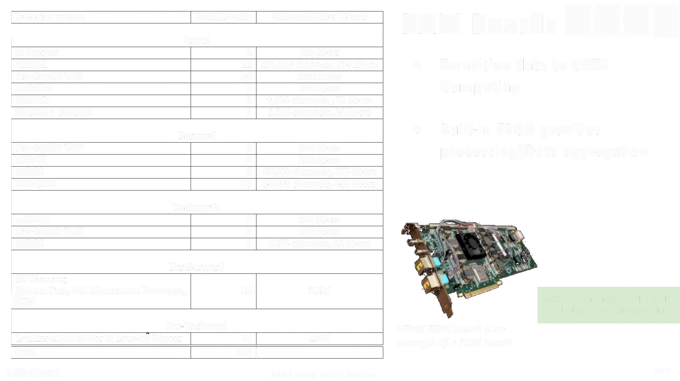
Detector system
DAM boards
Channel/Fiber Count
Data Acquision Module
I
Barrel
Si Tracker
uRWell
AC-LGAD TOF
hpDIRC
BECAL
iHCAL + oHCAL
4
12
30
5
2
1
100 fibers
278,000 channels, 576 fibers
1400 fibers
200 fibers
9,088 channels , 72 fibers
3,264 channels, 26 fibers
•
Transition data to COTS
Computing
I
Forward
•
Built-in FPGA provides
AC-LGAD TOF
dRICH
FEMC
LFHCAL
6
5
8
10
300 fibers
220 fibers
47,850 channels, 375 fibers
58,590 channels, 460 fibers
processing/Data
aggregation
•
Considering Arista equipment as COTS DAM
Backwards
mRICH
AC-LGAD TOF
EEMC
7
3
1
288 fibers
150 fibers
2878 channels, 24 fibers
Far-Forward
BO Detector,
Roman Pots, Off-Momentum Detectors,
ZDC
26
7.4M
COTS= Commercial Off The Shelf
DAM= Data Aggregation Module
Far-Backward
Luminosity Monitor & Low-Q Tagger
I Sum
ATLAS FELIX board is an
example of a DAM board
18
138]
4.9M
Ediited from ECCE OPAP Panel Review

Slide 7
DAQ:
Timing System
•
Each beam crossing identified with unique 64-bit value
•
Communicated to DAM boards which distribute to
FEE
o
Data transferred at multiple of accelerator clock (e.g. x6)
■
16bits per transfer {16x6 = 96bits/crossing)
sPHENIX ZCU102 Timing module
o
Additional data embedded across transfers
■
"mode" bits can indicate different actions to FEE
o
Crossing number used to stamp all data from front end
■
Specifics of timing will be detector dependent
o
System modeled after working sPHENIX system
FEE = Front End Electronics
DAM = Data Aggregation Module
DPAP Panel Review

Slide 8
Summary
•
Fully Streaming DAQ system
o Experiment-wide, improves performance, reduces risk, cost effective
•
Candidate Front End Electronics identified for each detector system
o
Leverage community and commercial solutions as much as possible
ASIC selections progressing. eRD programs working on specific solutions
•
Multiple stages of data aggregation and reduction
o heterogeneous hardware solutions (FPGA, CPU, GPU, ... )
•
Federated Computing Model to decentralize computing
•
Latency (e.g. 3weeks) between acquisition and fully
calibrated/aligned/reconstructed data ready for physics analysis

