Slide 1
Agenda
Introduction
DAM Roadmap
  FELIX Roadmap (Hao Xu)
  Do we need custom development, or custom ownership (cheap version for prototyping or low bandwidth detectors, higher performance version)
Streaming Readout Requirements (Jeff)
Streaming Model discussion
Preparation for 26-July EICUG summary
(Electronics Progress Reports from Detector Groups)
(Remind myself to start recording…)
schambachjj@ornl.gov

Slide 2
Useful Links Worth Repeating
Mailing list: eic-projdet-daq-l@lists.bnl.gov
Indico page: https://indico.bnl.gov/category/409/
Wiki: https://wiki.bnl.gov/eic-project-detector/index.php/DAQ
Mattermost channel: https://eic.cloud.mattermost.com/main/channels/det1-daq (signup: https://eic.cloud.mattermost.com/signup_user_complete/?id=i8gnmob4stdrpjfrezhegxs3ew)
Talks from last Streaming Readout Workshop X: https://indico.jlab.org/event/519/timetable/#all.detailed
Live Notes from SRO workshop: https://docs.google.com/document/d/1vFz1Z9c4Ck7eaE_eMcJgzg_UNUsYwC1OnygzlX95yic/edit#heading=h.175xdrpf8ddv
A summary report for the SRO workshop is here: https://docs.google.com/document/d/1X6Ms_oubcWx-8DUiExMFIJdCC6svWNbWKiz7OQjMCeQ/edit?usp=sharing
Next workshop likely organized by this WG, with single-topic agenda (one day meeting at BNL?): first pressing item is definition of the electrical-optical interface for FEEs, both hardware and logical (protocol); next item: timing distribution system
Agenda item “Electronics Progress Reports from Detector Groups” is meant for written bullets in the minutes of the indico timetable presenting for each detector group any plans, tests, progress on detector readout and electronics
Schedule: move to Thursday 9a weekly?
schambachjj@ornl.gov

Slide 3
GD/I WG meeting: Muon Detection with Detector 1
The last “Global Detector/Integration” WG meeting discussed Muon Detection with Detector 1
Maria Zurek discussed muon detection in hadron endcap region: (https://indico.bnl.gov/event/16445/contributions/66075/attachments/42203/70677/GD_I_Muons_Zurek.pdf)
John LaJoie’s email in response to this:
Maria gave a nice presentation on muon ID using the hadronic calorimeters in simulations, especially the forward and barrel calorimeters. I raised the point during the meeting that while this all looks nice in simulations based on energy deposit in the scintillators, it is non-trivial to maintain the full dynamic range required by the hadronic calorimeters *and* at the same time maintain the ability to measure energy deposits at the level of a MIP. I think this can become especially troublesome as the SiPM’s accumulate radiation dose as well.
The reason I wanted to call this to your attention is that I don’t want people to get the idea that this “just happens”, but if this is going to be a requirement on the hadronic calorimeters it will need to be factored into the electronics and readout design, and may involve constraints that affect the direction we take with the electronics and readout design that we should be aware of sooner rather than later.
Comments? ....

Slide 4
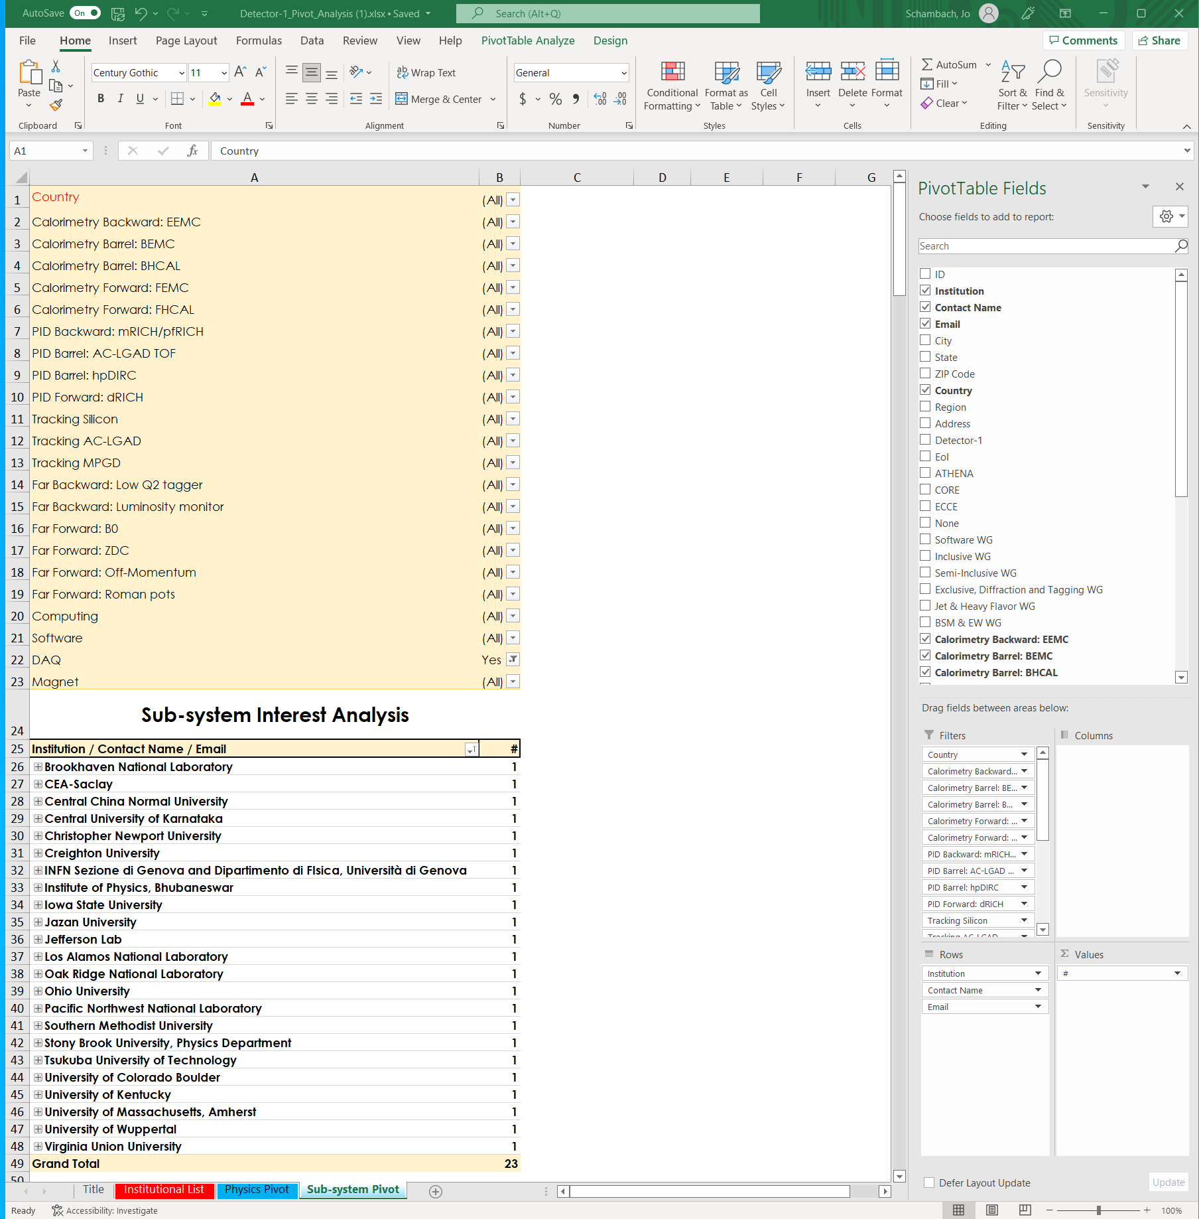
WGs Convener’s meeting Or Hen:

Slide 5
D. Abbott: Hardware alternatives for DAM

Slide 6
EICUG Meeting
20+5 minutes

Slide 7
AOB …

