Slide 1
Light Yield Measurement of SiPM-on-tile with Cosmic Rays
Miguel Rodriguez
Notes:
explain context more ,calorimeter
Leve out osciliscope
Why is it that the wrapping works- collecting more photons how Sipms and scintillators work.

Slide 2
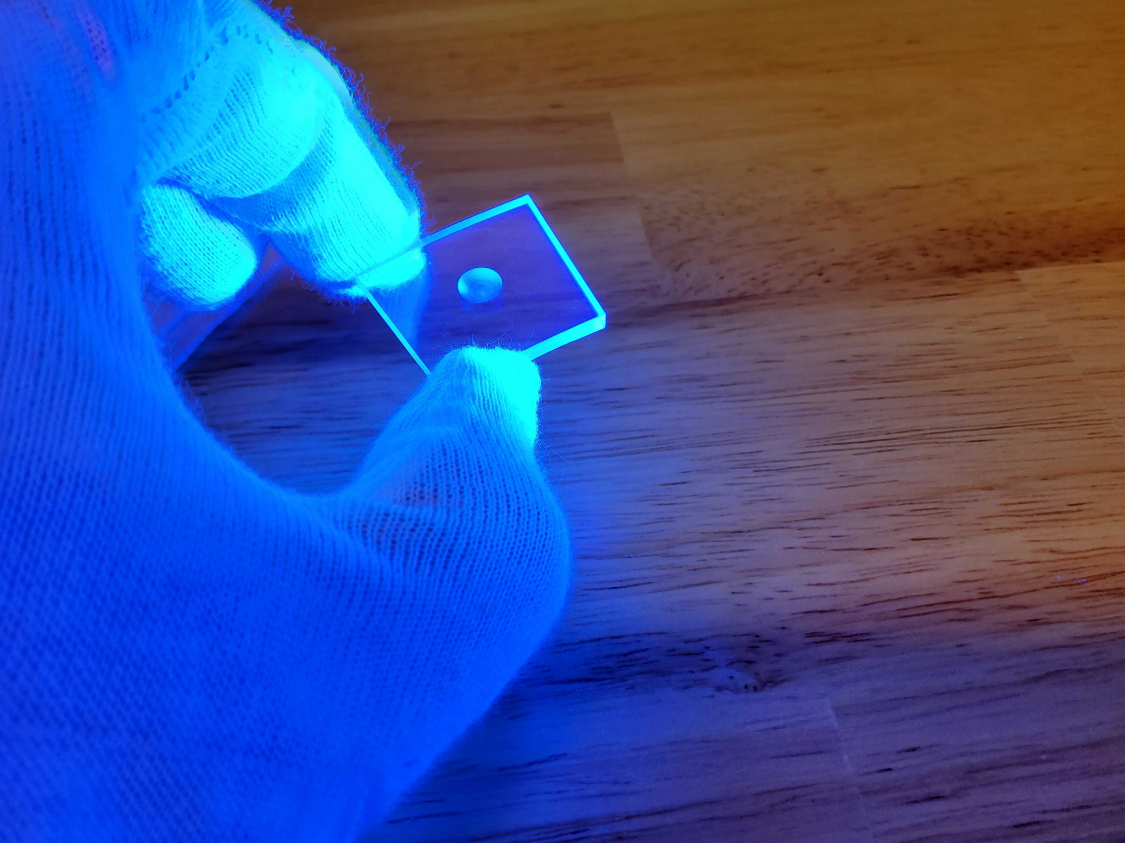
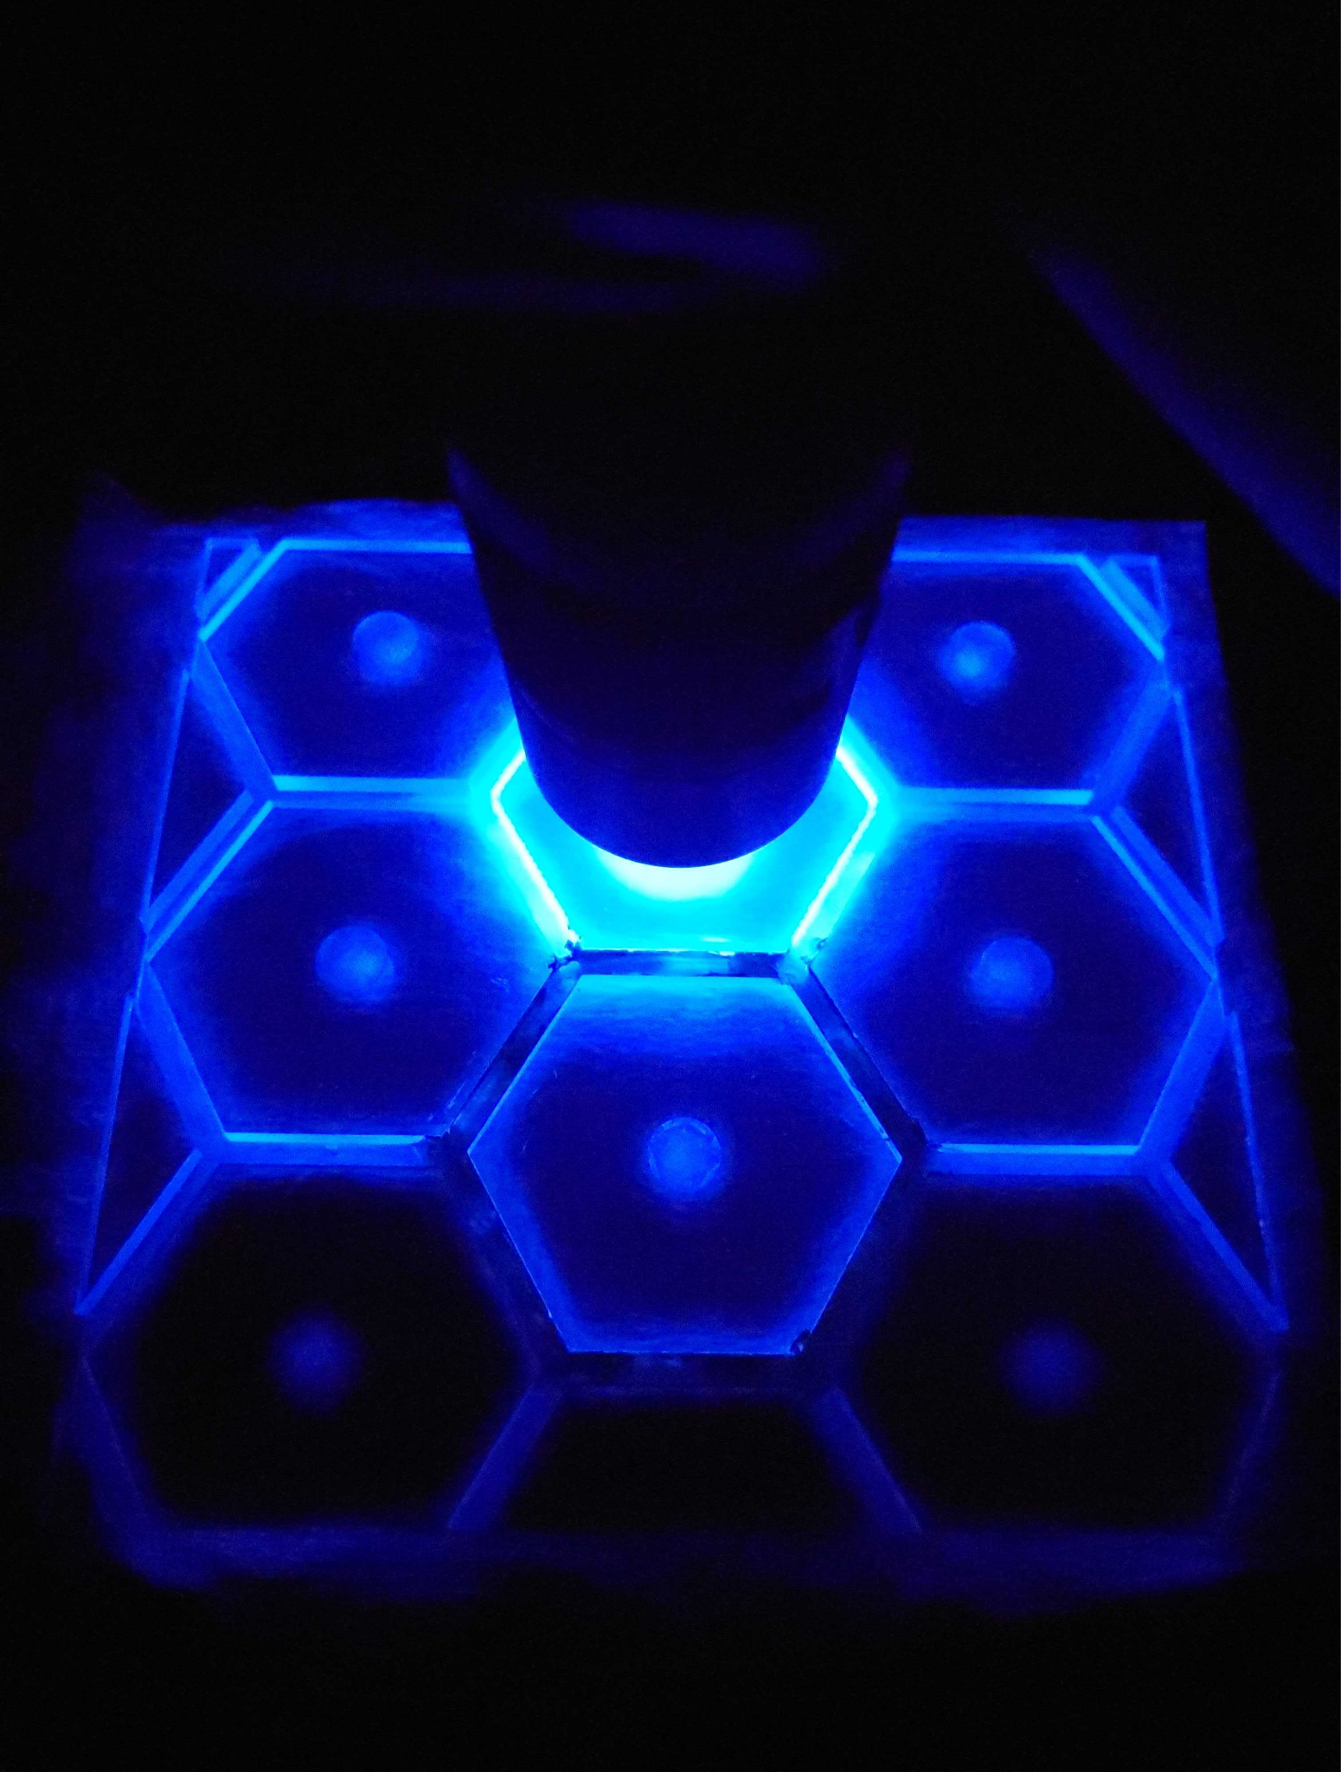
What I Used: Scintillator
Notes:
Add pick to explain noise

Slide 3
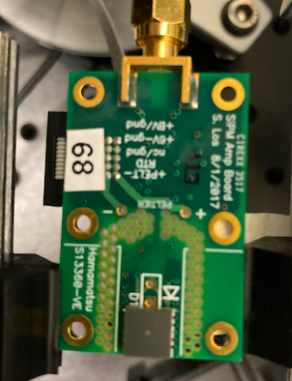
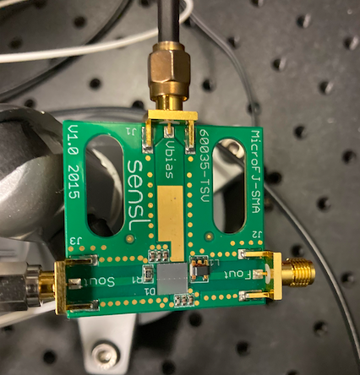
What I Used: SiPM
A SiPM also requires a amplifier.
Notes:
Add pick to explain noise

Slide 4
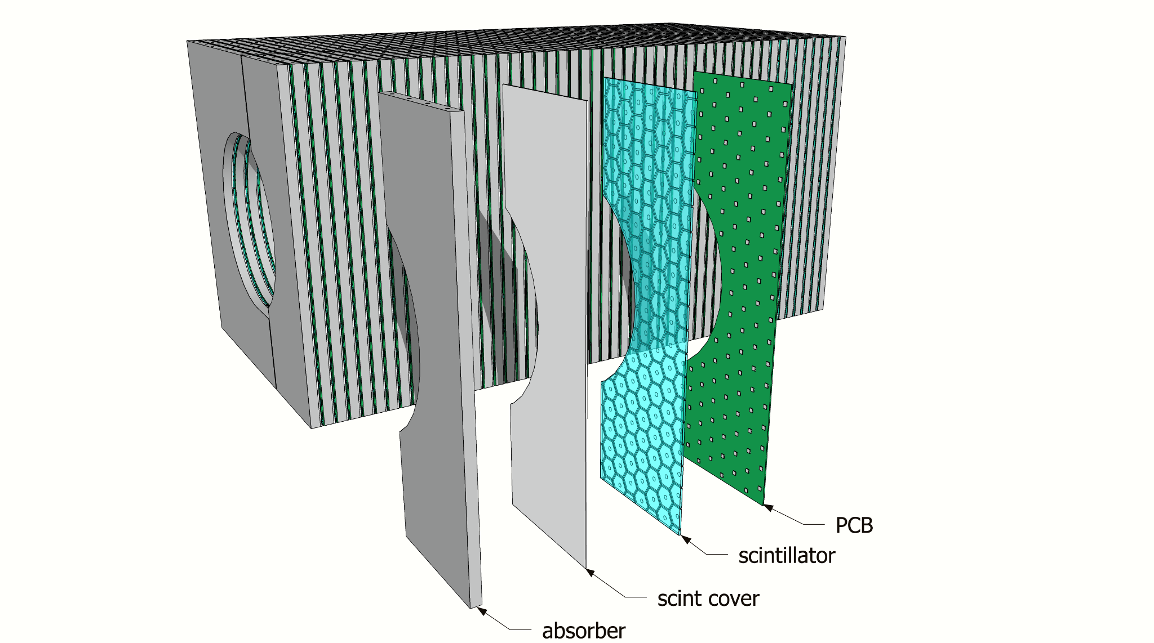
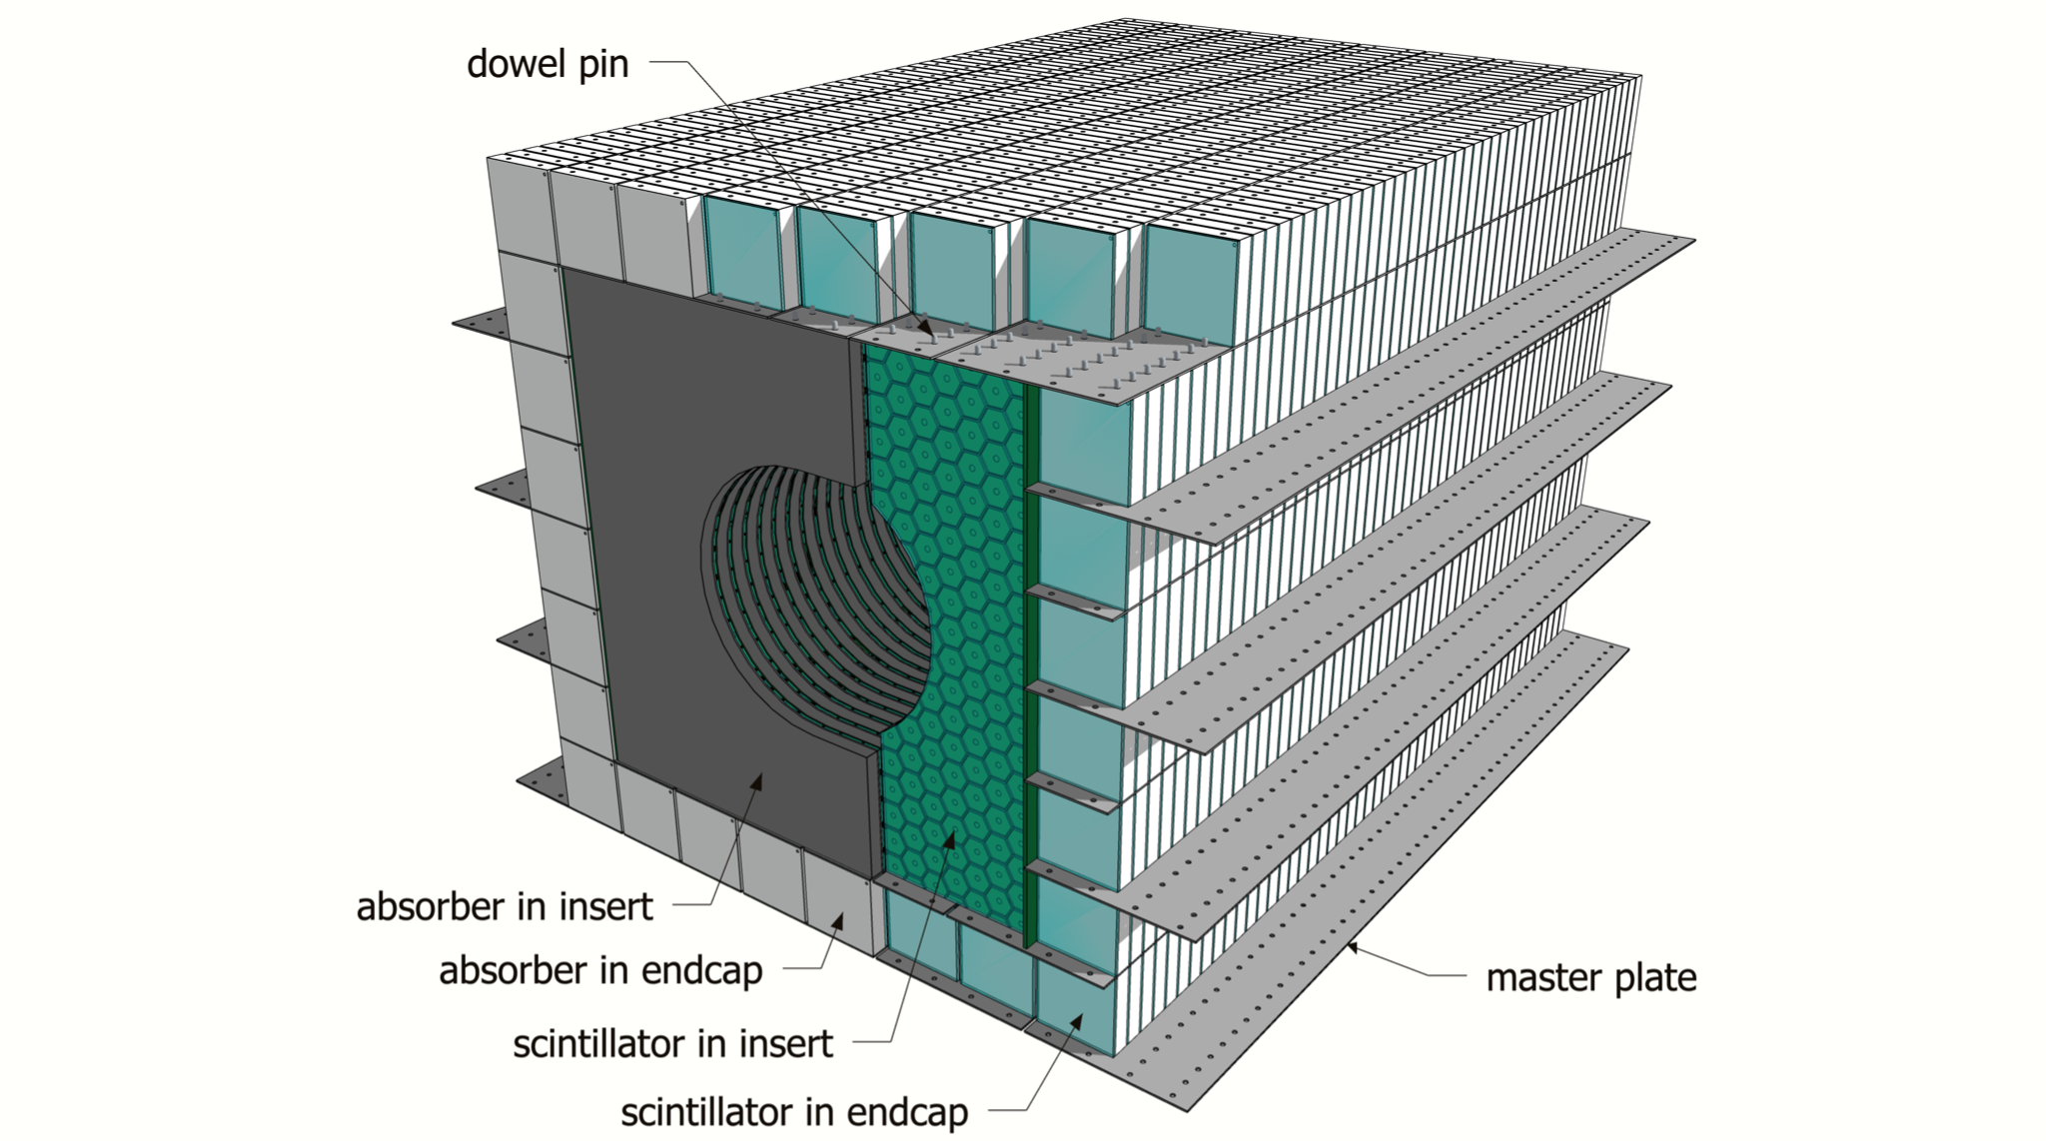
How will this be used?
Notes:
Add pick to explain noise

Slide 5
How much photoelectrons are emitted from scintillators during a cosmic ray event?
What can we do to improve a SiPM to catch more photons?

Slide 6
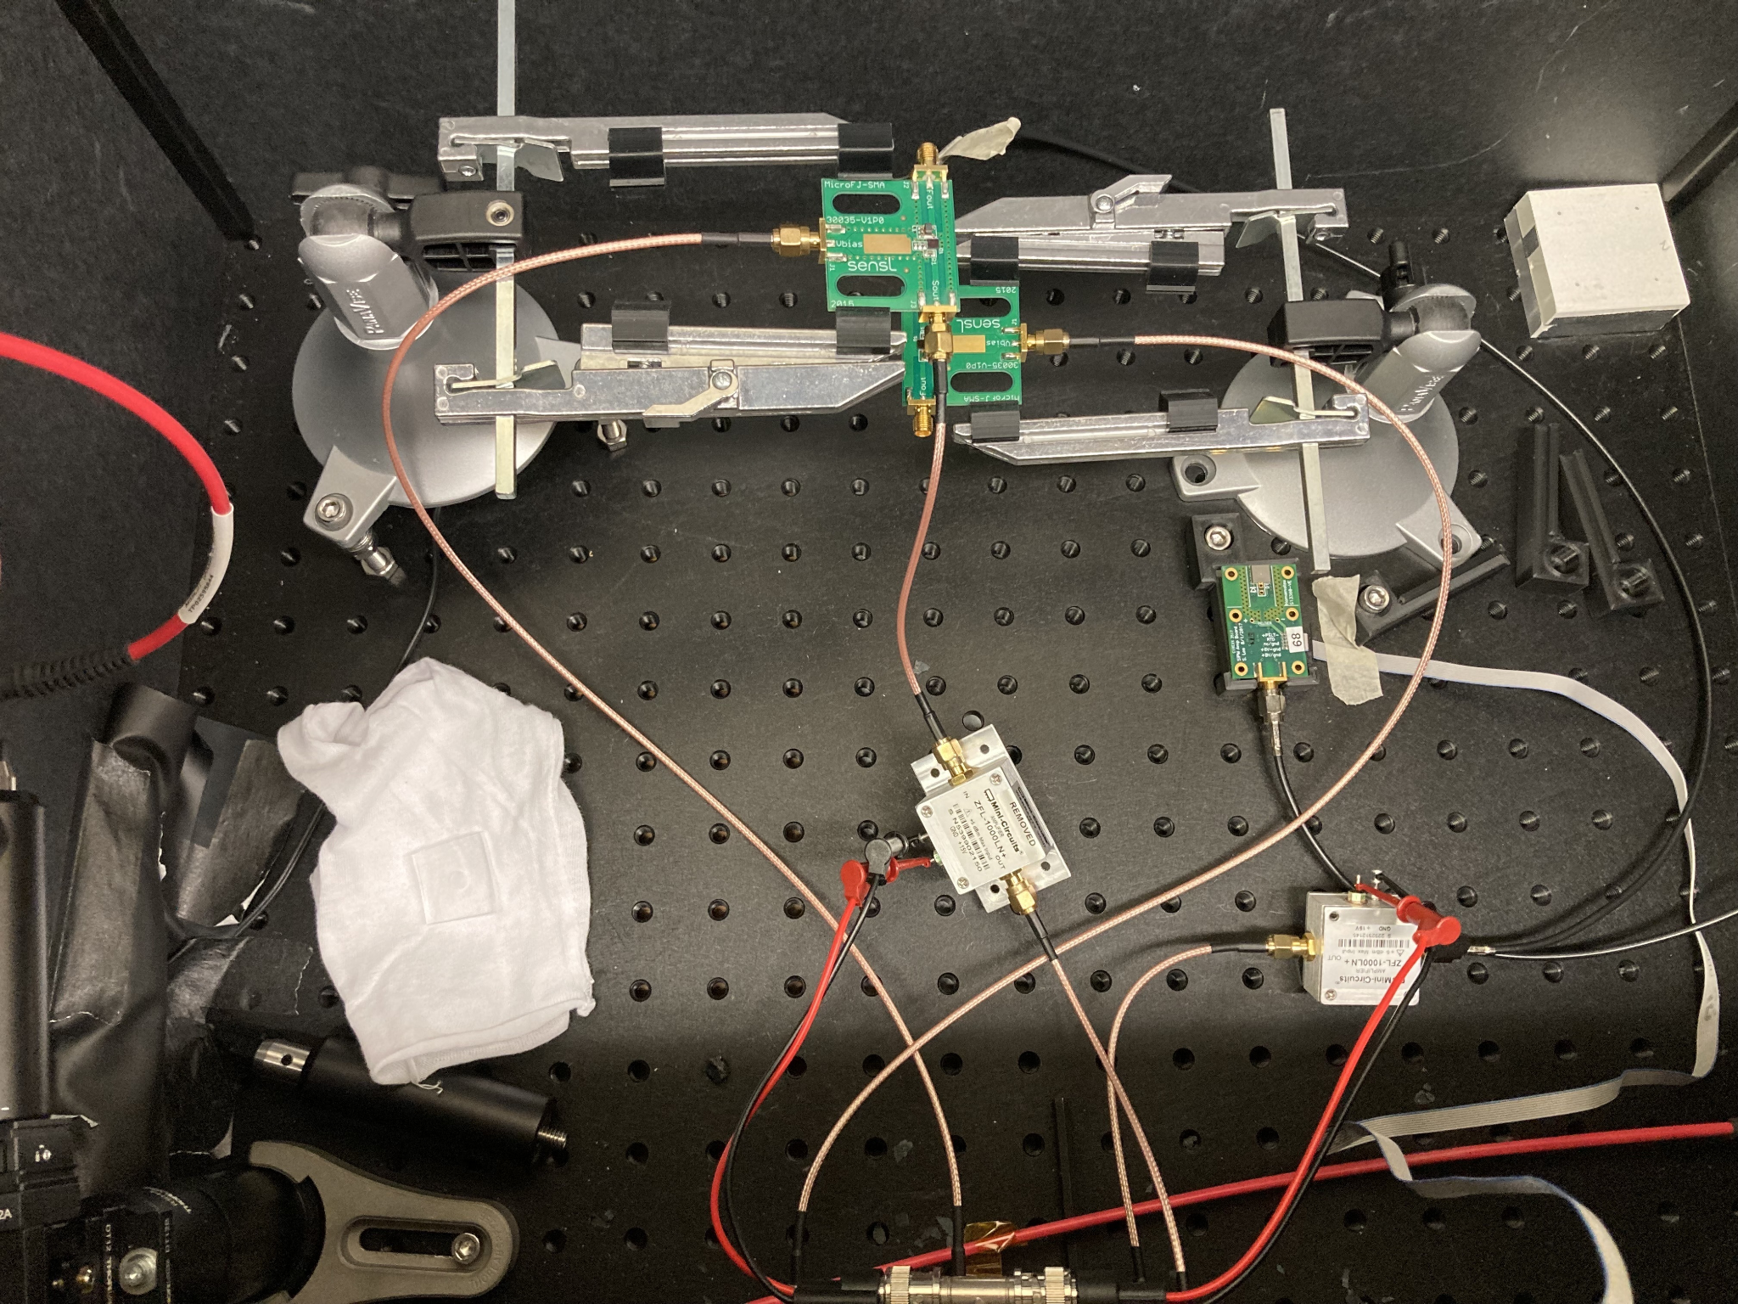
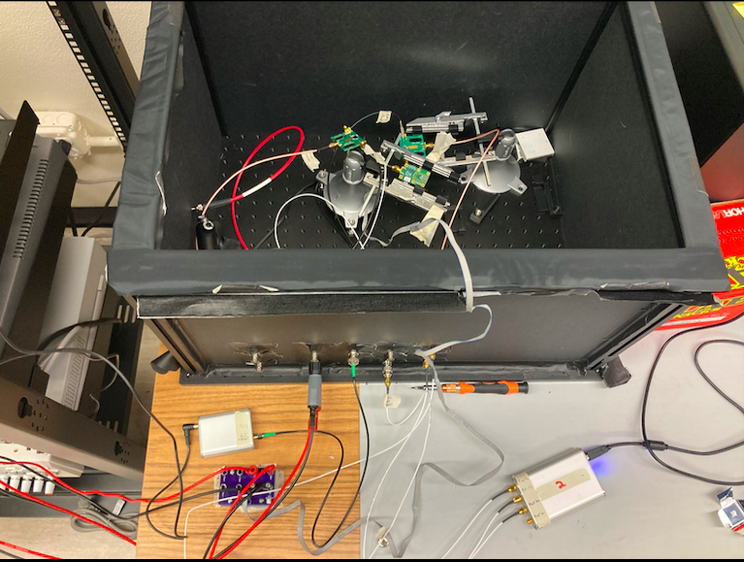
Example of How We Used SiPMs in a Darkbox
Three SiPMs placed and connected inside a darkbox

Slide 7
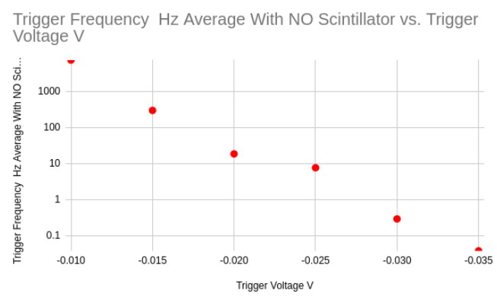
Using Just the SiPM (Fermilab Board).
A SiPM was placed and connected inside a darkbox
A frequency reader was connected to the SiPM. The values of the frequency were recorded, as the trigger voltage was lowered.
The frequency reader failed to find any more values after the trigger voltage was moved lower than -0.035 Volts.
Notes:
Add pick to explain noise

Slide 8
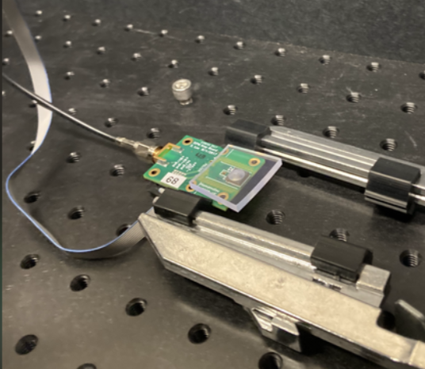
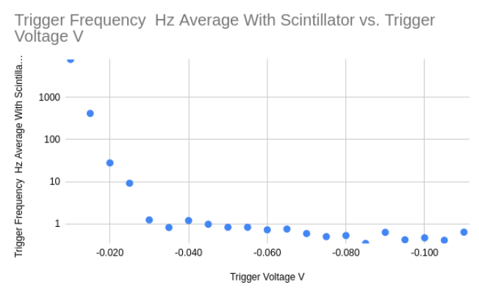
Using a SiPM and
Scintillator Tile.
Next, a SiPM was placed and connected inside a darkbox exactly as before, only this time a scintillator tile was attached.
The values of the frequency were recorded, as the trigger voltage was lowered, same as before
The frequency reader begins to flatten and continues reading a frequency after the trigger level is -0.035 Volts.

Slide 9
What does this mean?
Using a SiPMs with a scintillator tile attached is working as expected.
The SiPM with a scintillator tile will start to detect cosmic rays at a trigger level below -0.035 volts.
-0.035 Volts
-0.035 Volts

Slide 10
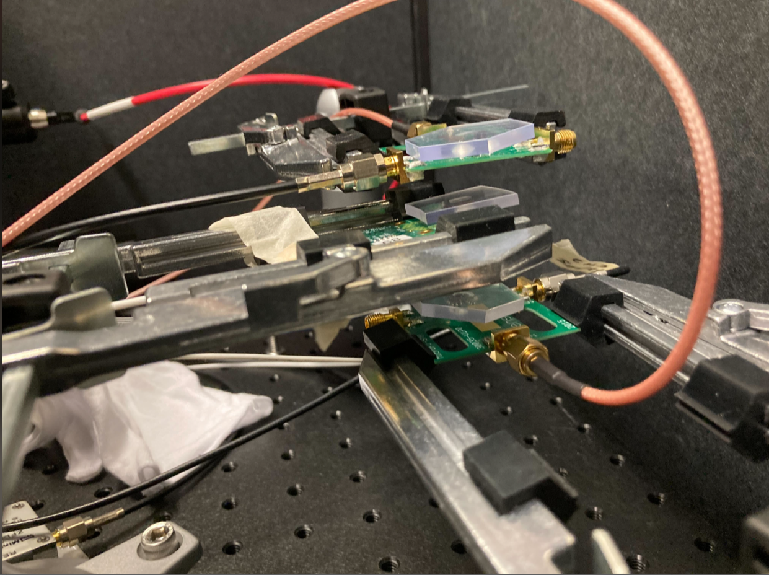
Using 3 SiPMs with
Scintillator Tiles Attached.
Inside the darkbox, 3 SiPM boards were placed directly above one another. Making sure all three SiPMs were directly aligned with each other
Software (“drsosc”) was used to see these three SiPMs on the computer.
It was configured on the drsosc software so that it would measure every time there were coincidences amongst all three of them.

Slide 11
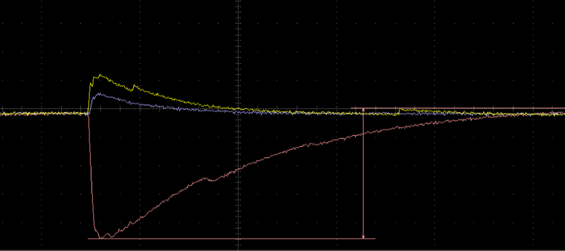
Cosmic Ray
Light emitted by scintillator from cosmic ray

Slide 12
Using 3 SiPMs with
Scintillator Tiles Attached.
We can see that this is a cosmic aray.
Data was collected and analyzed using software for the middle SiPM.

Slide 13
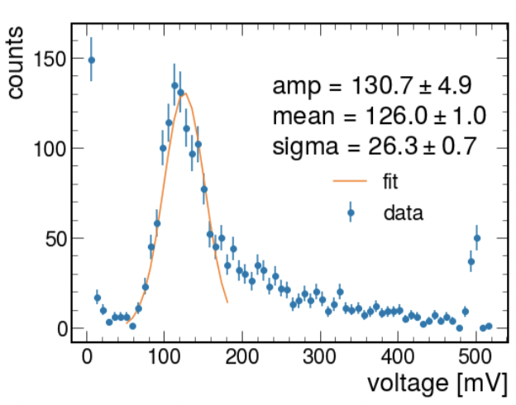
Using 3 SiPMs with
Scintillator Tiles Attached.
Here we see a Landau Curve which is expected.
The landau curve is caused by energy loss in the silicon from the SiPM.
The energy deposited by muons passing through the scintillator is expected to follow a Landau distribution.
The number of photons that you measure in the SiPM is proportional to the energy deposited by muons, so it is also a Landau distribution

Slide 14
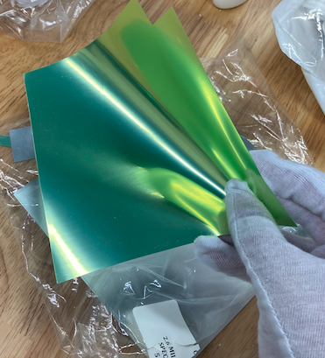
Using 3 SiPMs with
Scintillator Tiles Attached While One is Wrapped in ESR.
The ESR is a reflective paper that prevents light emitted from a scintillator, from escaping and allows more of it to reach the SiPM.

Slide 15
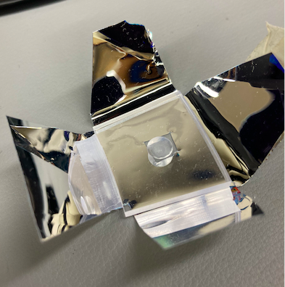
Using 3 SiPMs with
Scintillator Tiles Attached While One is Wrapped in ESR.
The ESR needs to be cut in a way so that it will wrap around the scintillator tile.
A hole must be created, that must be the same size as the SiPM that it will be attached to.

Slide 16
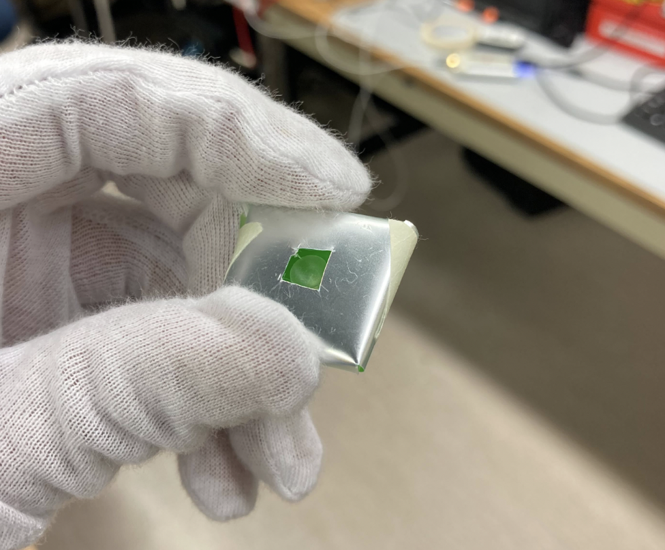
Using 3 SiPMs with
Scintillator Tiles Attached While One is Wrapped in ESR.
This test was repeated exactly the same, only this time the middle scintillator tile was wrapped with ESR.
The chart with the ESR wrapping will be compared to the chart without the ESR wrapping.

Slide 17
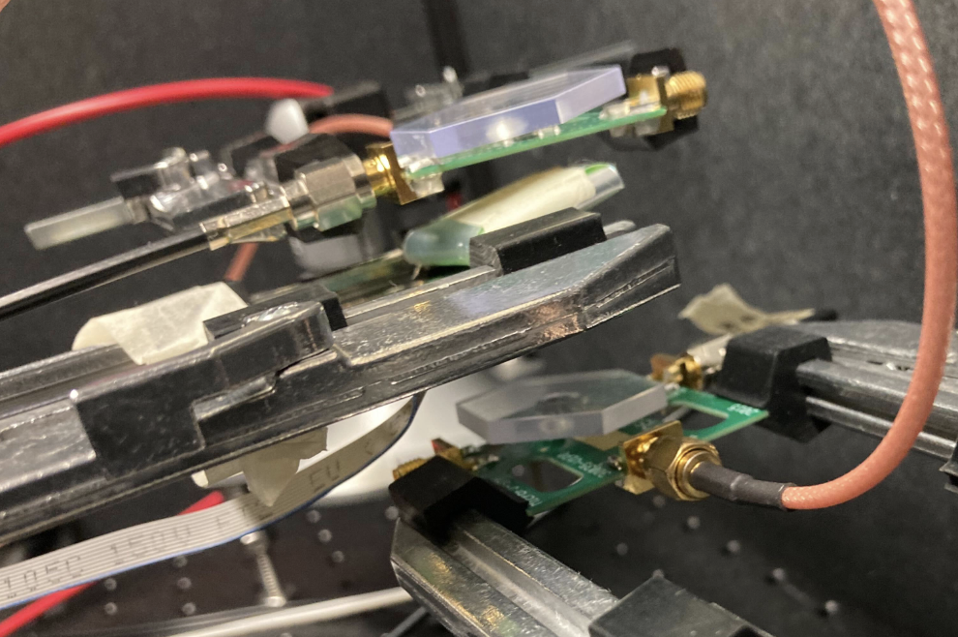
SiPM #1 with Scintillator Tile attached
SiPM #2 with wrapped Scintillator Tile attached
SiPM #3 with Scintillator Tile attached

Slide 18
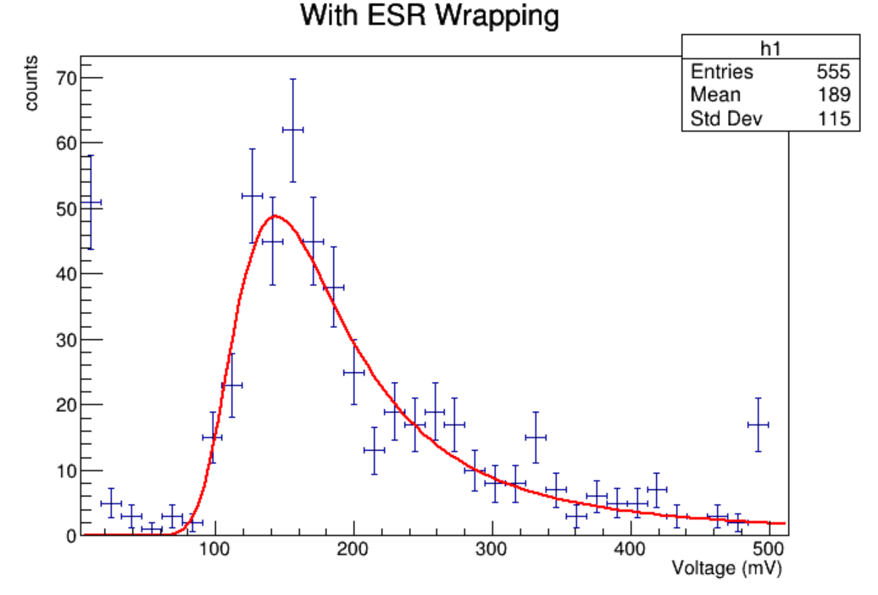
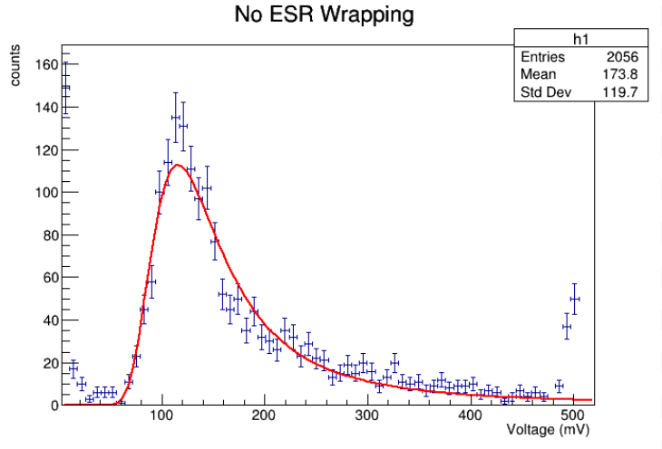
Comparing With and Without ESR wrapping
Notice the mean increased as expected.

Slide 19
What’s Next
The scintillator dimple will be polished and tested exactly as before. We will then compare our results like we did before.
Find what the ratio is for Voltage to Photoelectron.

Slide 20
Questions?

