Slide 1
My Laboratory Report
and
Future Plans
JiaJun Huang

Slide 2
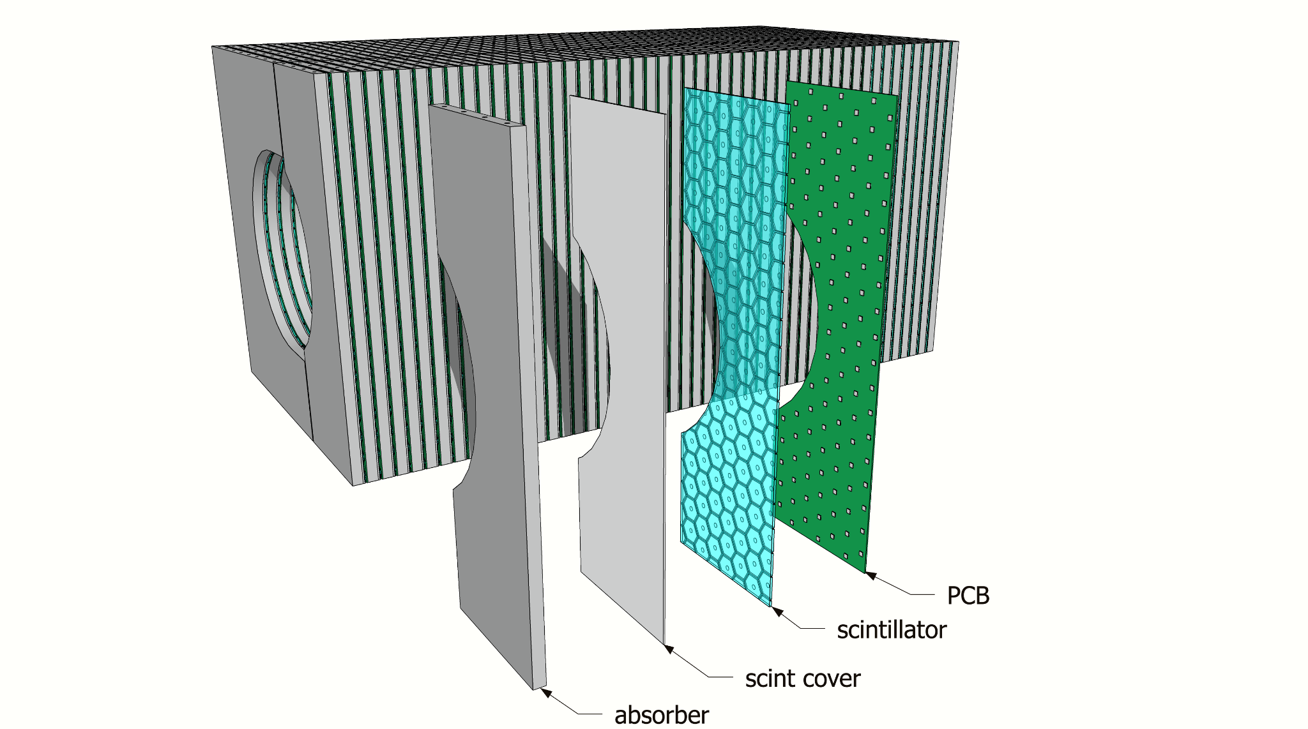
Lab Purpose
Calorimeters
Scintillators
Sipm
Notes:
Scintillator bar with scintillating fiber or clear hexagon scintillating bar, Sipm properties and functions

Slide 3
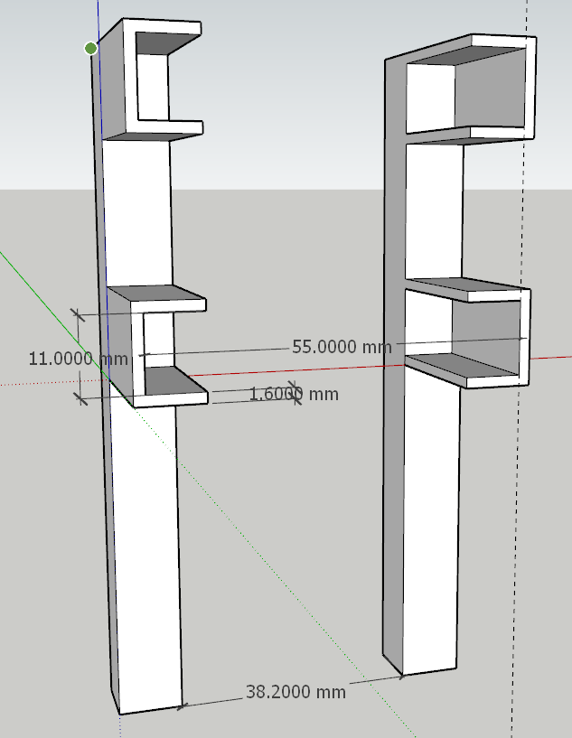
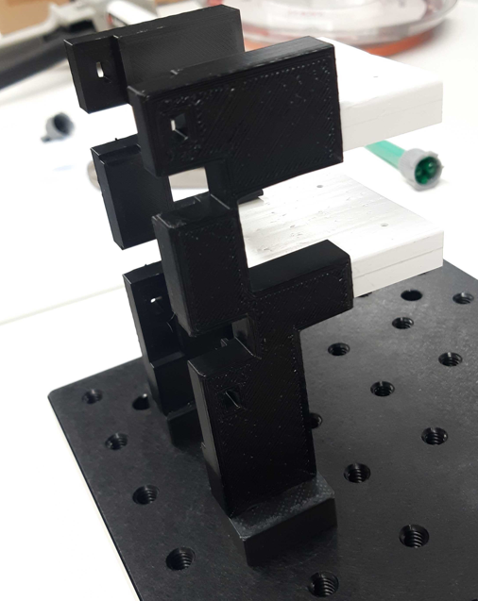
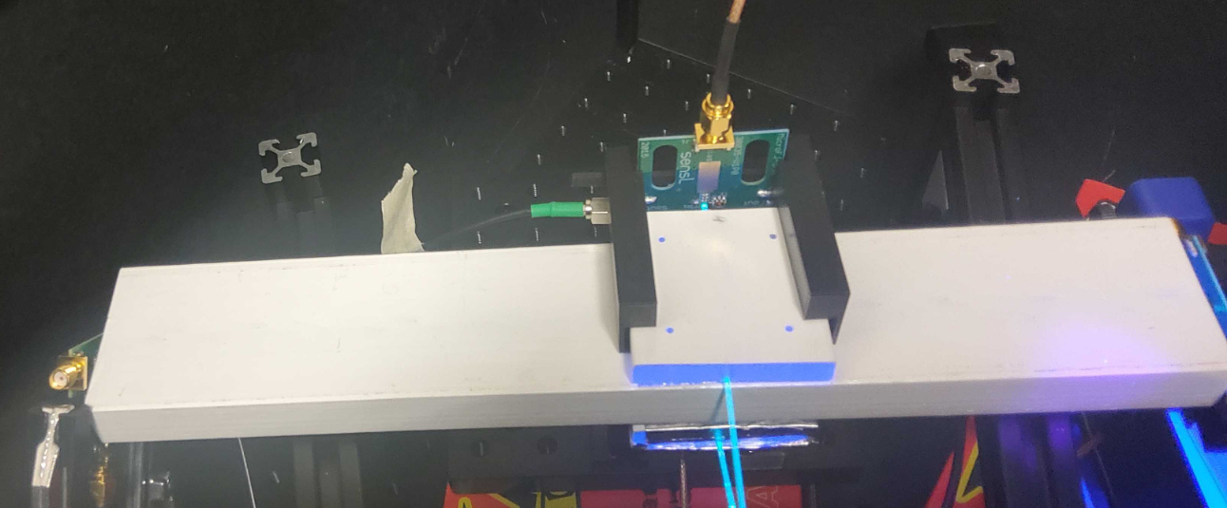
Early Stage
Learning
Laboratory Setup
SketchUp
Notes:
Describe SketchUp, Welding, Setup of Dark Box, Setting up Sipm, Two fold coincidence,

Slide 4
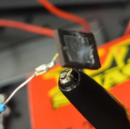
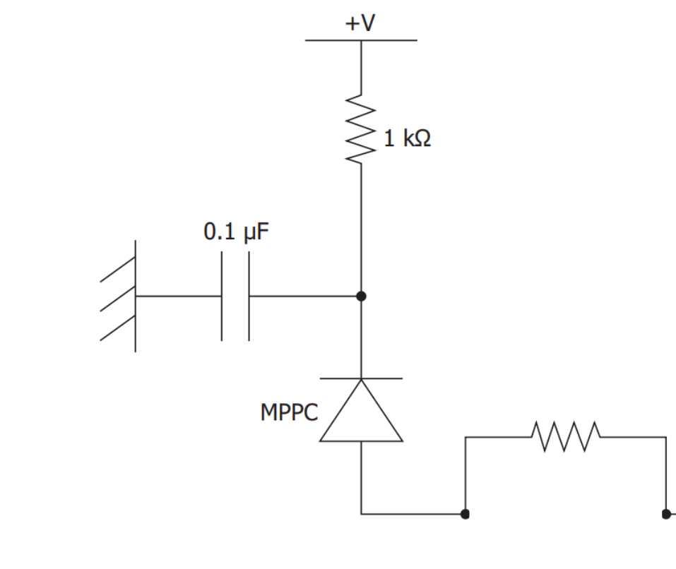
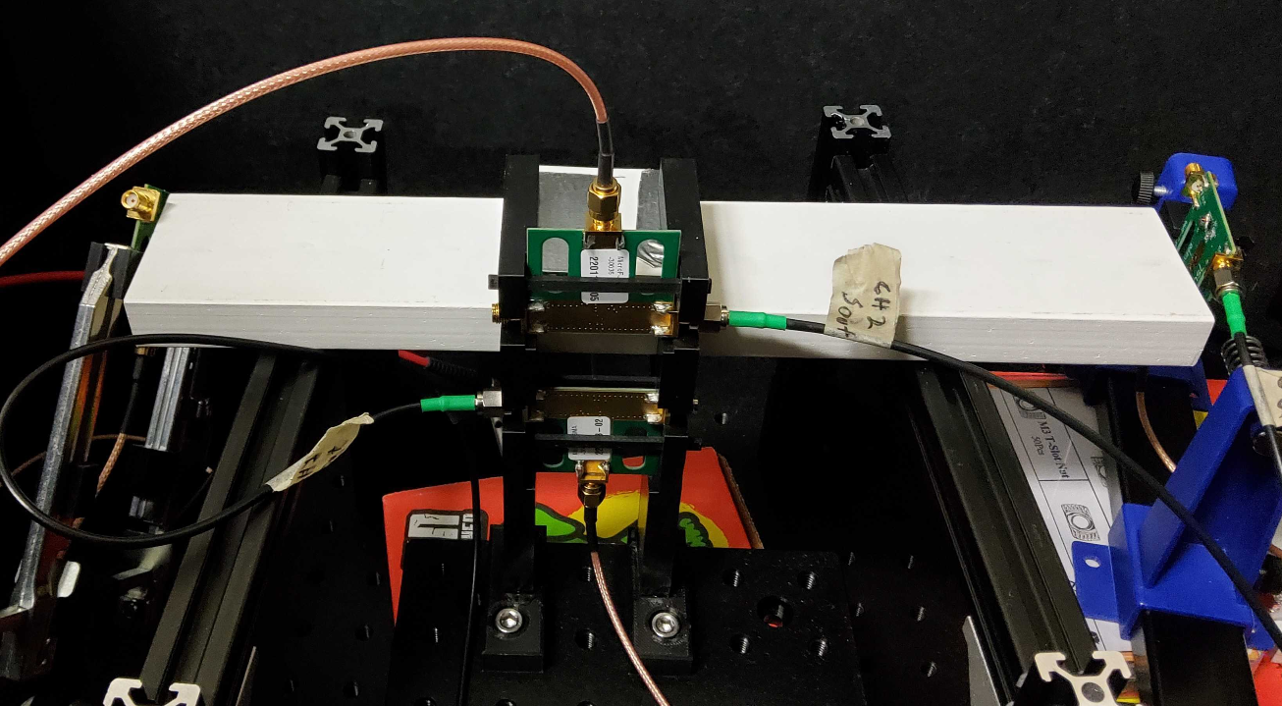
Sipm Characteristics
Various Models
Break down voltages
Waveform analysis
Notes:
Different Sipm setups, testing out different models

Slide 5
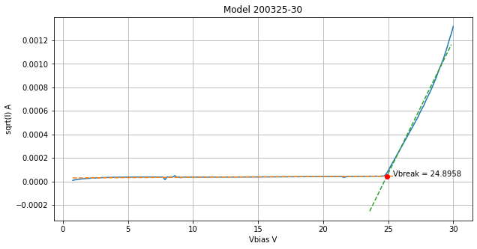
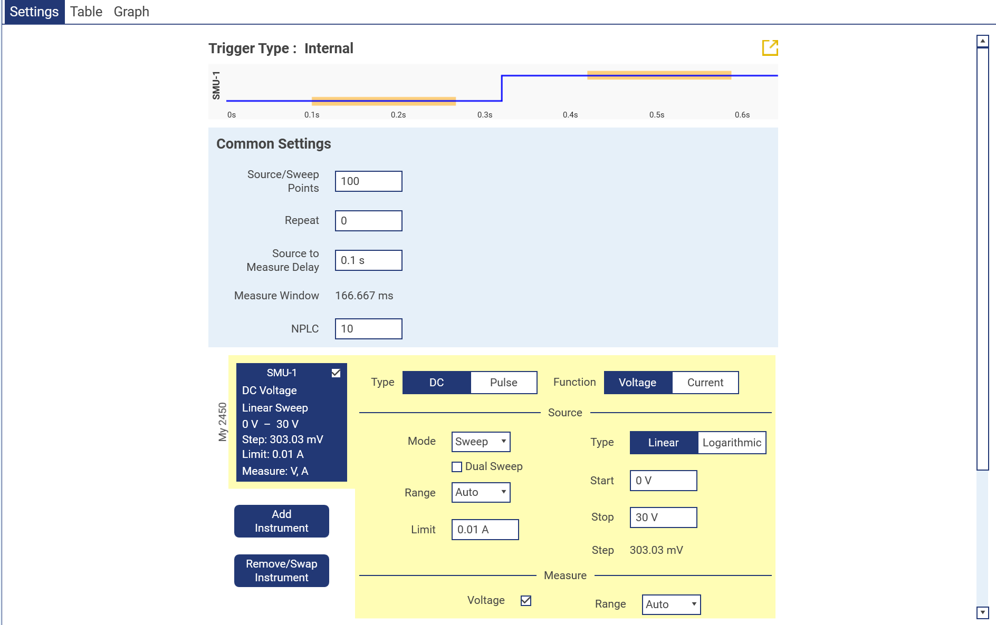
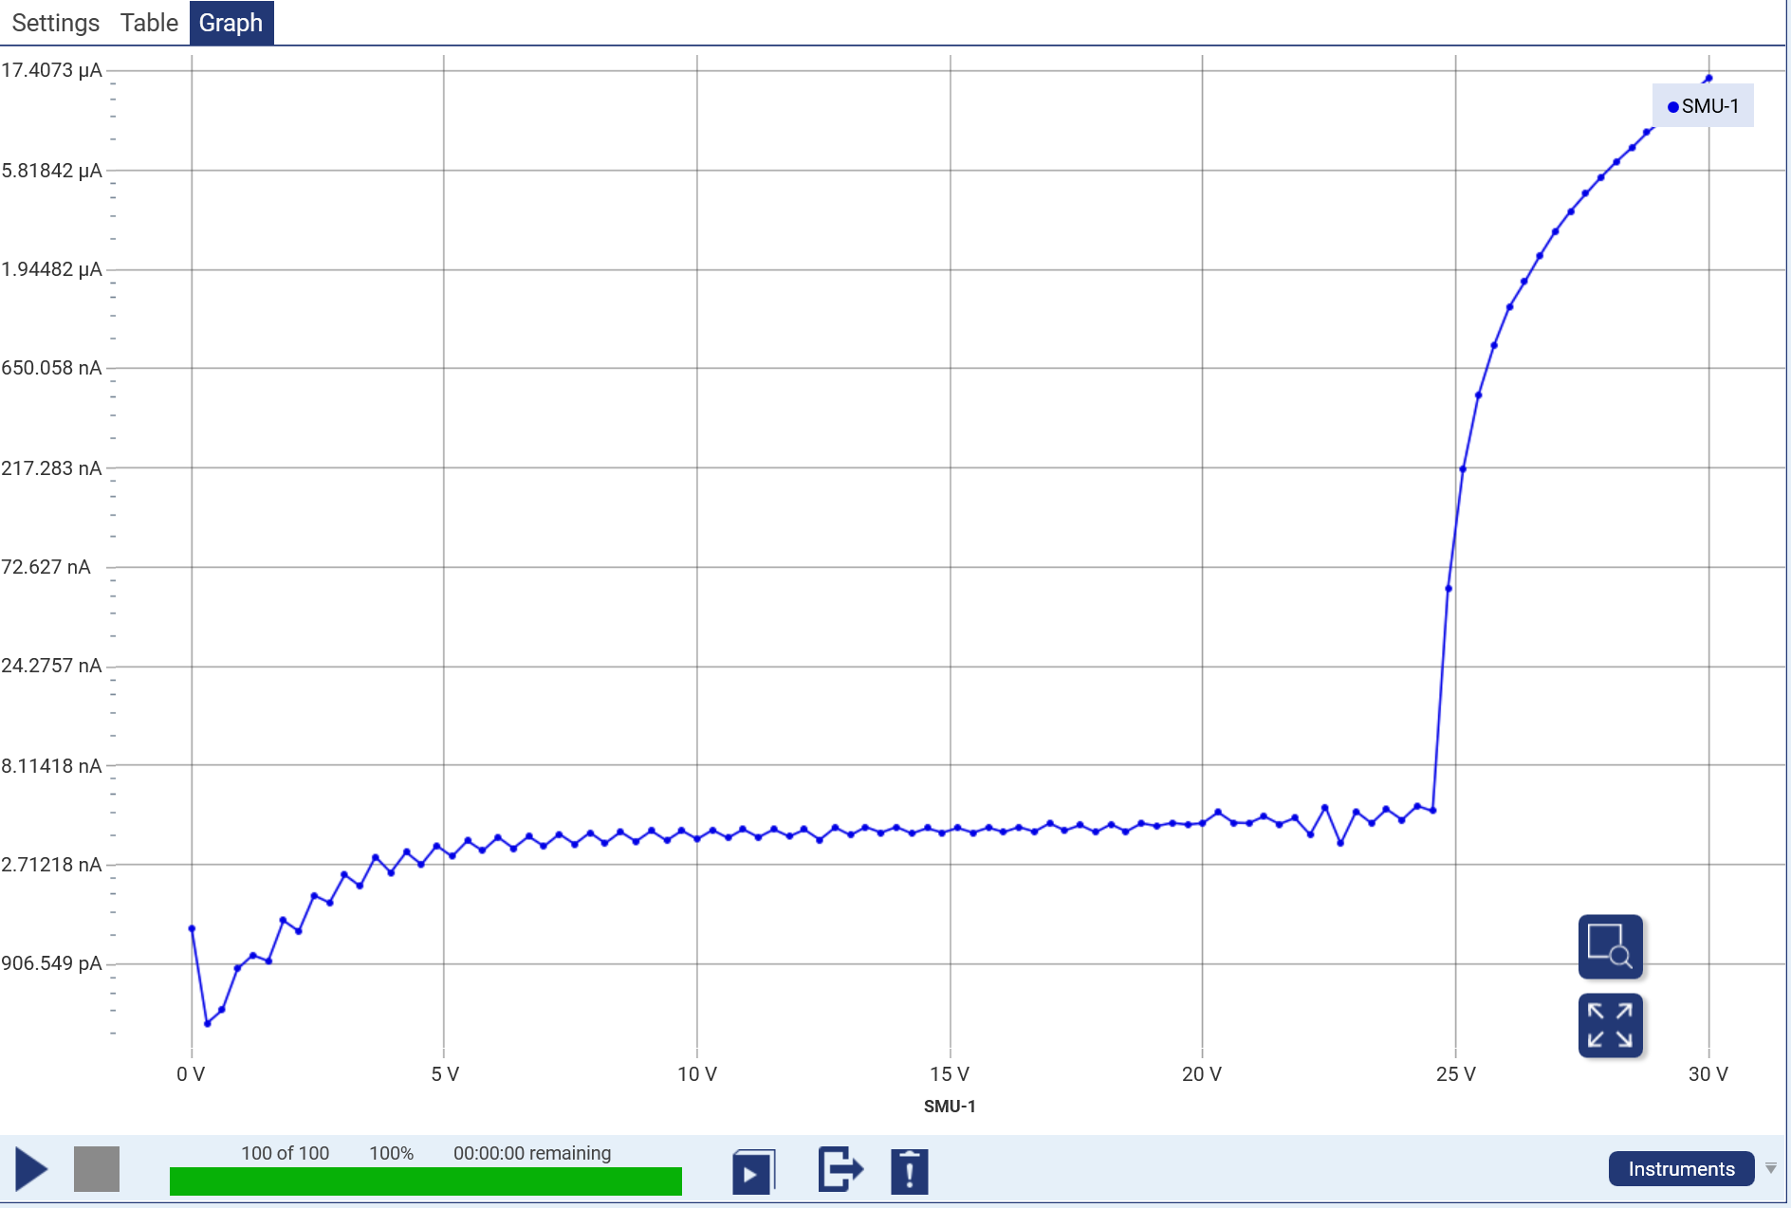
Break Down Voltage Measurement
Voltage Generator and Readout Software
Python
Data fitting
Notes:
Keithley Equipment, Kick Start 2 software, IV Curve, Precise measurements for cosmic rays, variation in Sipm

Slide 6
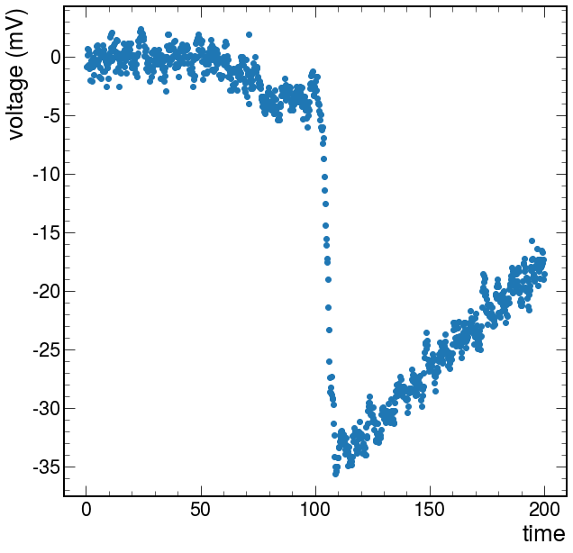
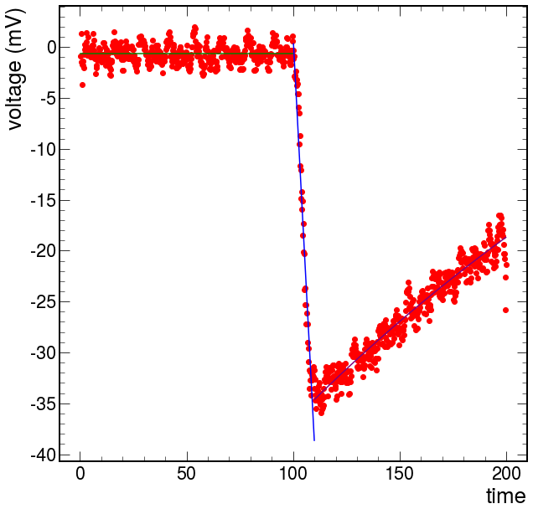
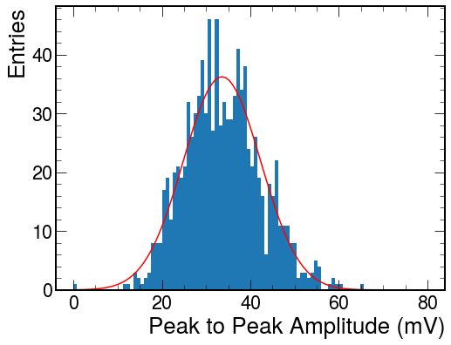
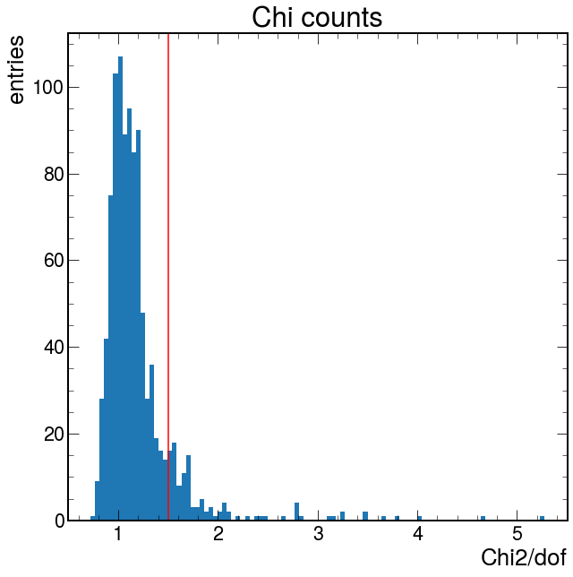
Waveform Analysis
Individual Pulse
Peak to Peak
Gaussian
Notes:
Three separate sections of line fits, constant, linear, exponential, intersections, histogram fit of gaussian, chi2 analysis, filtering bad pulse

Slide 7
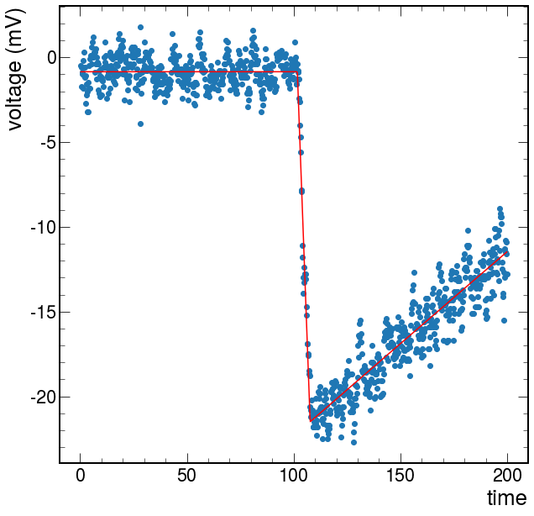
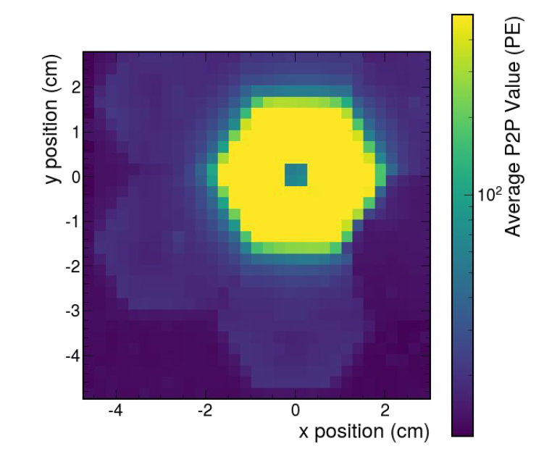
Improvements
Concise Code
Step functions
‘iminuit’
Chi2 analysis
Notes:
One single function and code, more efficient code, chi2 of other parts

Slide 8
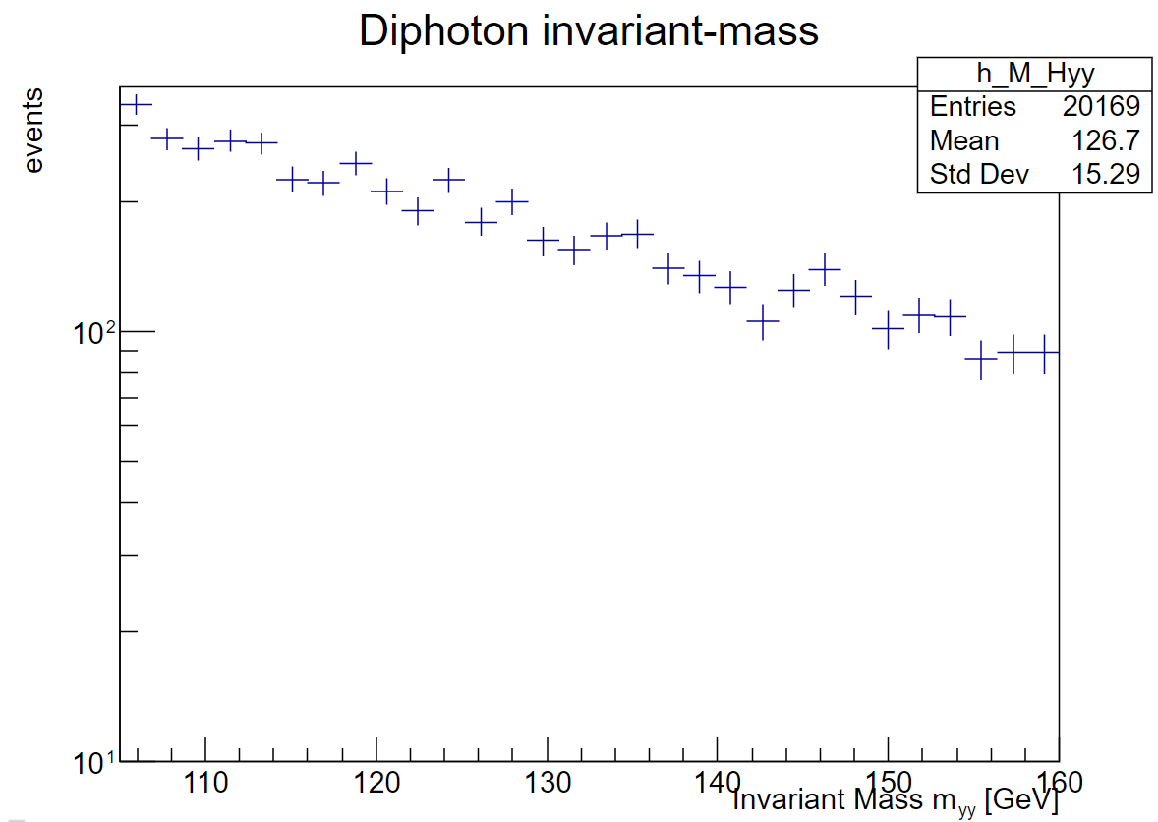
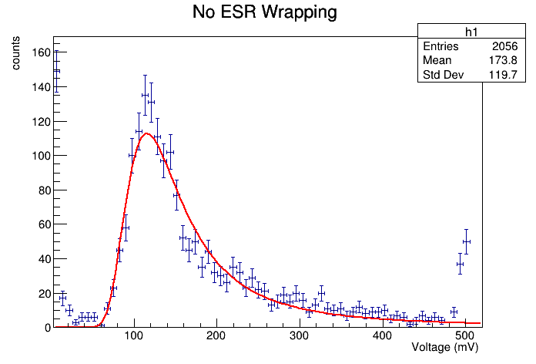
Plans
Data Analysis
Chi2 of other parts
Learning ROOT
Learning Simulation of EIC Events
Notes:
ROOT using ATLAS open data notebooks, using ROOT fitting of Landau

Slide 9
Acknowledgement
Dr. Arratia
Alec
Sean
Sebouh
LLNL

