Slide 1
Studies of Scintillators with Wavelength-Shifting Fiber Readout
By Luis Garabito Ruiz

Slide 2
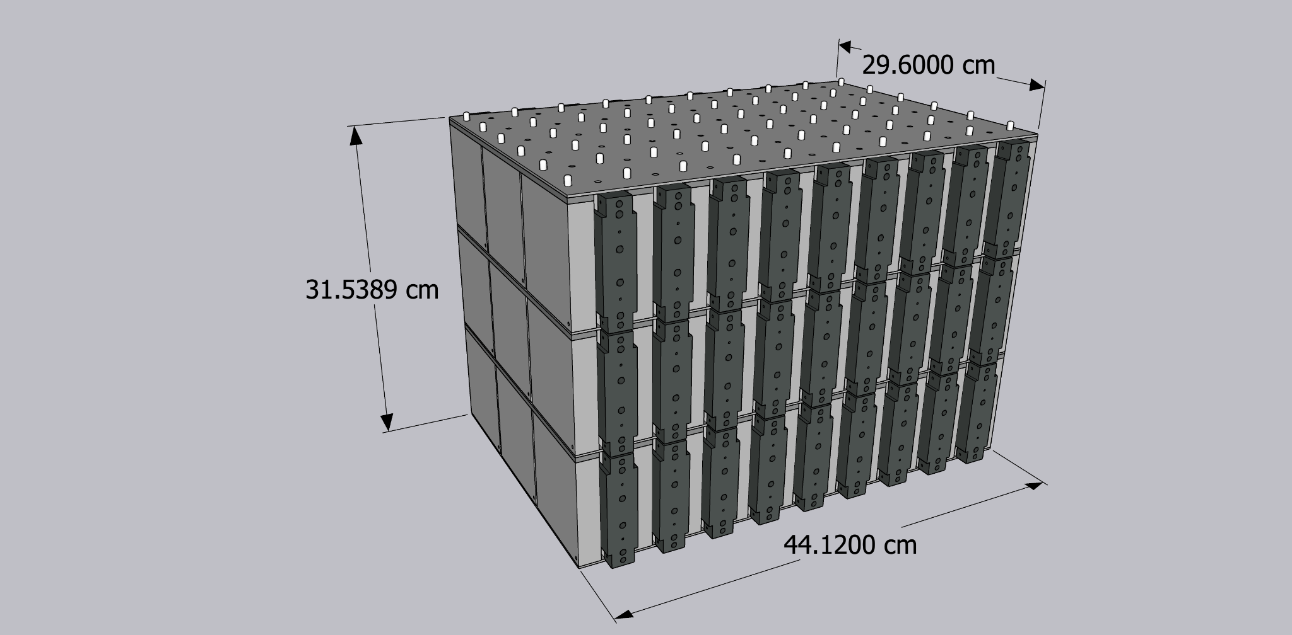
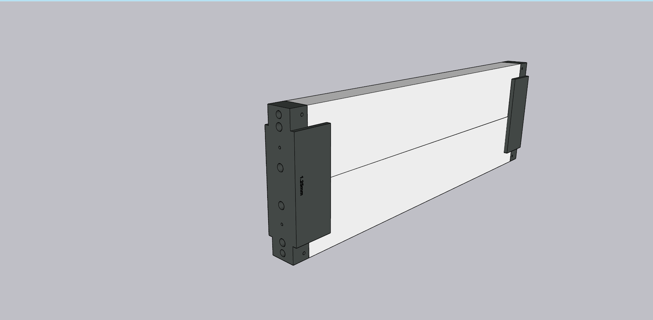
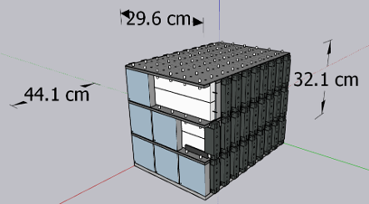
The Purpose Of this Lab:
Scintillating fibers and Scintillating Tiles
prototype calorimeter designs for EIC
Study SiPMs to be used in Calorimeter

Slide 3
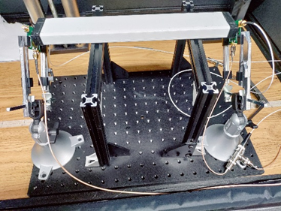
How the Bars are used With SiPMs
Initial Steps require miniature set ups to detect cosmic rays.
Coincidence experiments (2 fold and 4 fold coincidence).
Silicon Photomultipliers (SiPM) are arrays of avalanche photodiodes. Operated a little bit above breakdown voltage.

Slide 4
Initial work in Polishing Scintillating Fibers (Also known as WLS Fibers)

Slide 5
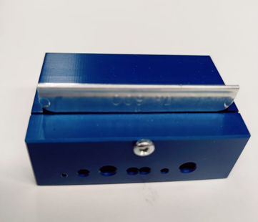
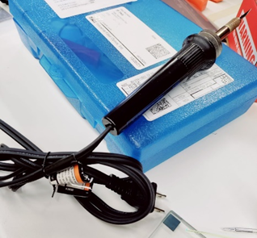
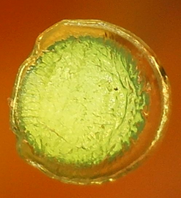
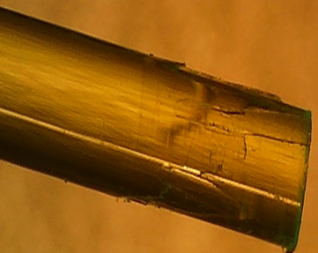
Polishing WLS Fibers
Initial task was to find a way to polish the WLS fibers.
There were two methods of cutting the fibers, cutting board or hot knife.
Depending on what method you used the resulting cut varied in damage to the fiber.
Cladding: Surrounding coat on the fiber.

Slide 6
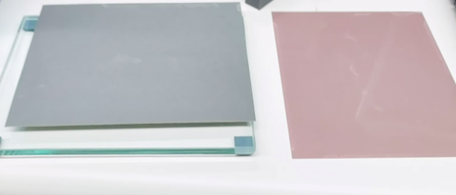
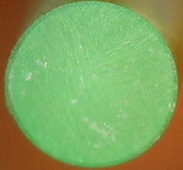
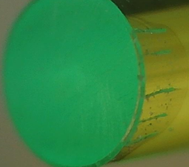
Polishing WLS Fibers
Second task was to find a way to polish the fiber tip.
One method produced the pattern we desired after polishing.
Materials: Water, Polishing Table, and different girt paper.

Slide 7
Secondary stage of work in Polishing WLS Fiber

Slide 8
Second Stage: Putting WLS Fiber with fiber guide
After Successfully completing the first task, I had to combine the WLS Fiber with the Tile and the Fiber Guide.
Damage to cladding occurred, so we designed a hole table to test several diameters printed from out 3d printer.
We used Sketchup to design the table.
Sketchup is a 3d design software used to model objects.
Creality program to create the files need to 3d print

Slide 9
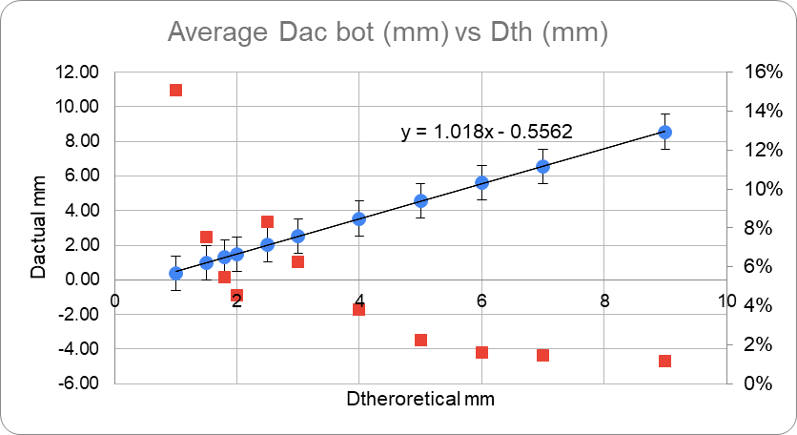
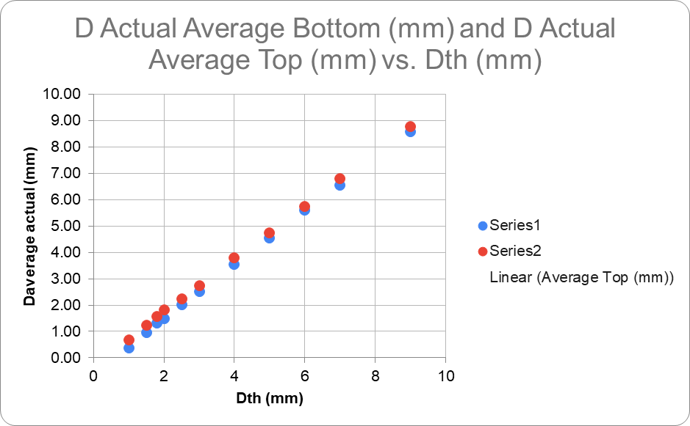
Data Acquired From Testing Diameters
Figure1: Shows the relationship of Actual hole Diameter thats printed vs the theoretical diameter desired. Equation of line is used to find the theoretical diameter needed.
Figure 2: Shows linear relationship between actual hole and theoretical diameters for bottom and top.

Slide 10
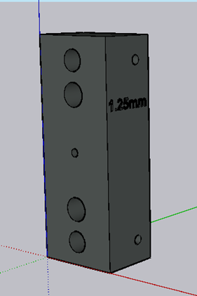
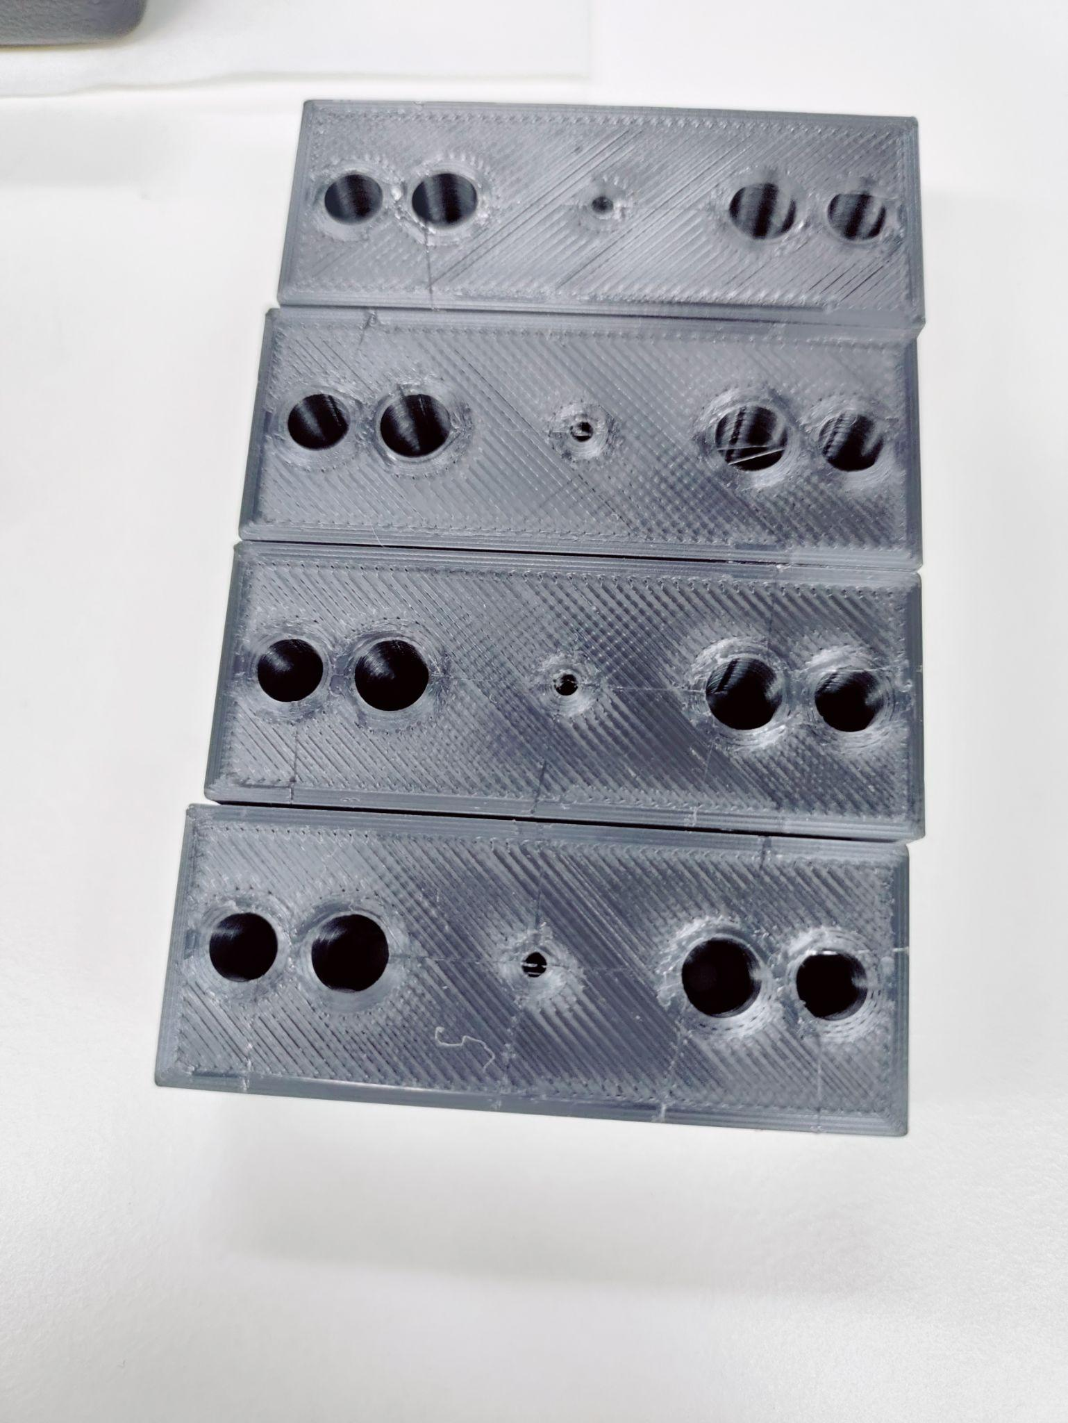
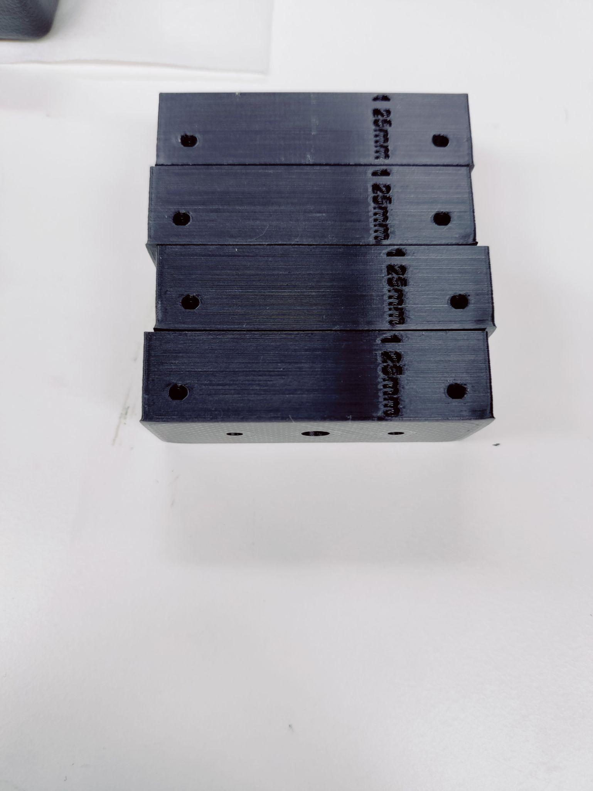
New Fiber Guide Design

Slide 11
Tertiary/Intermediate Stage of WLS Fiber and Bar

Slide 12
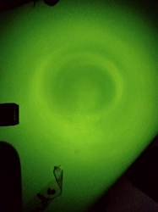
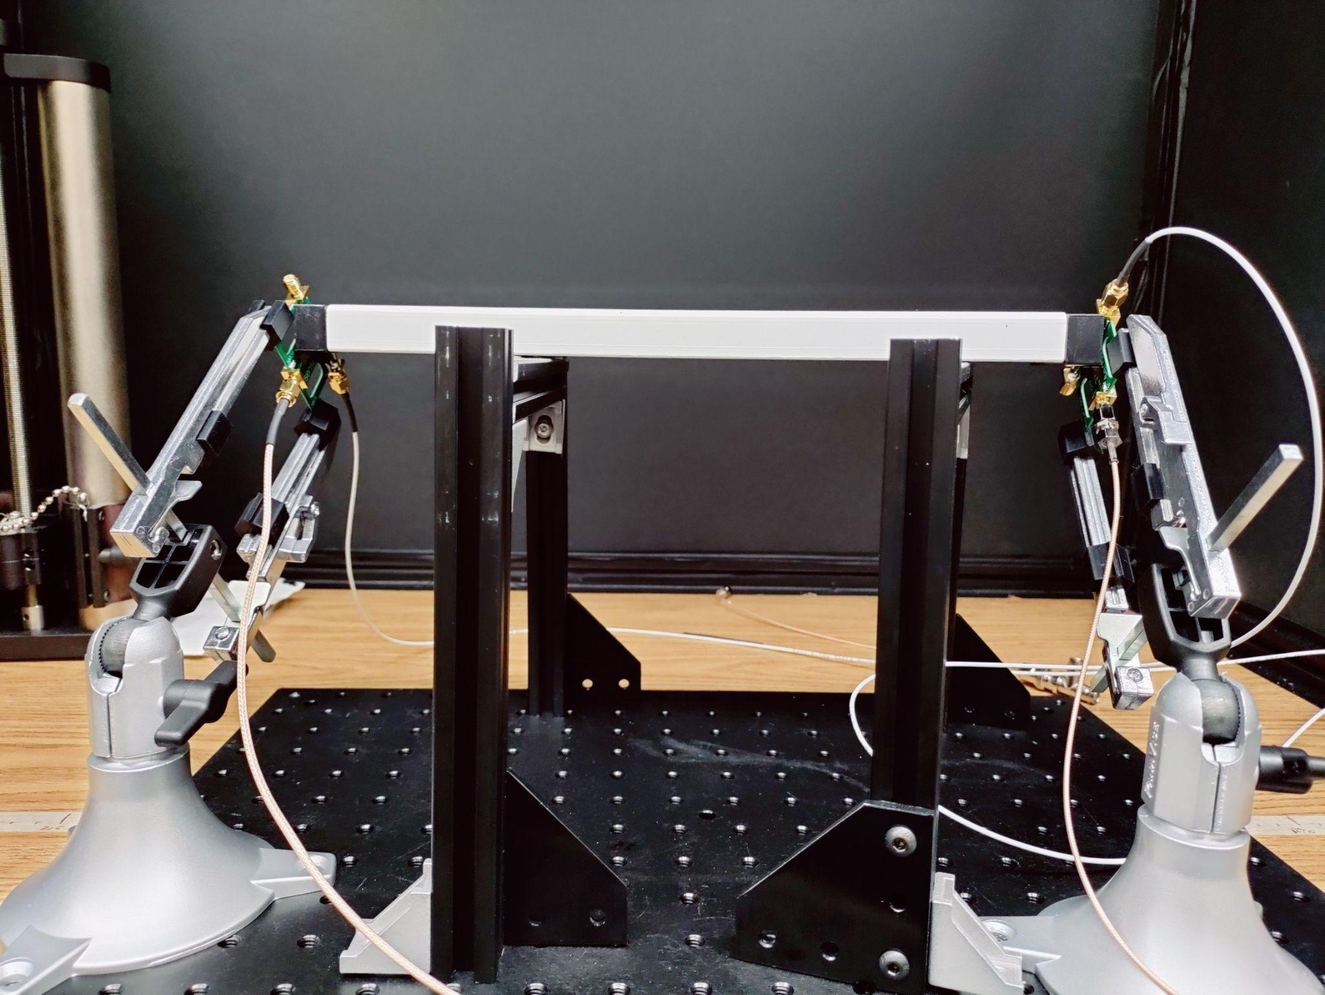
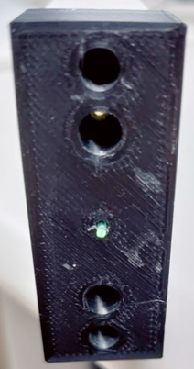
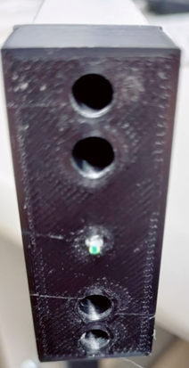
Tertiary/Intermediary Stage: Combining what was Learned to Make Particle Detector
Final Product:
Pattern that is shown from bar plus WLS fiber:

Slide 13
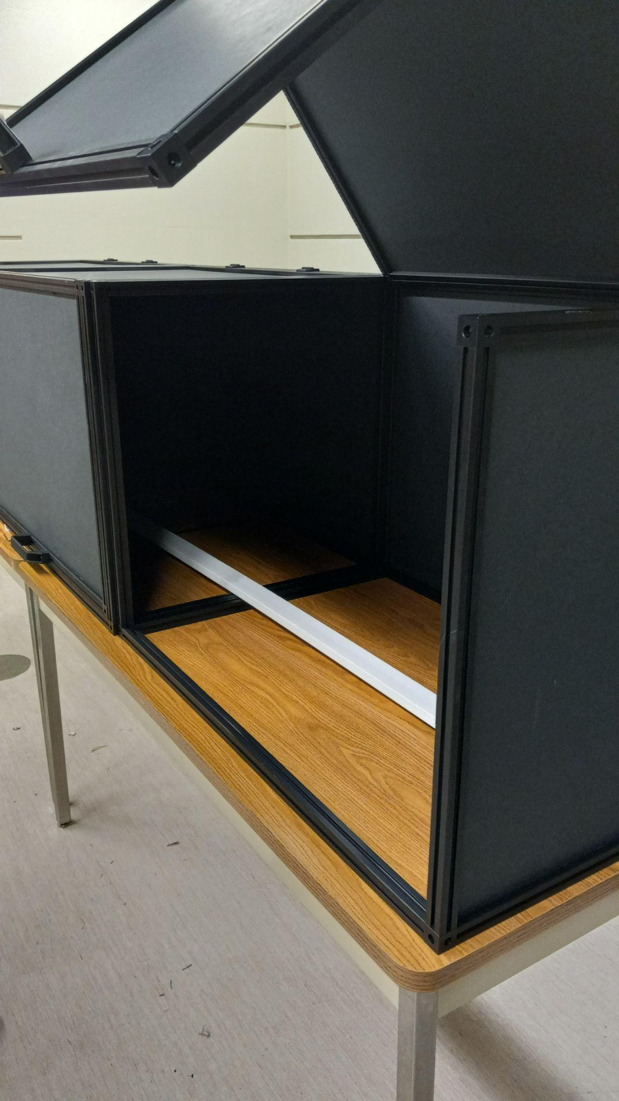
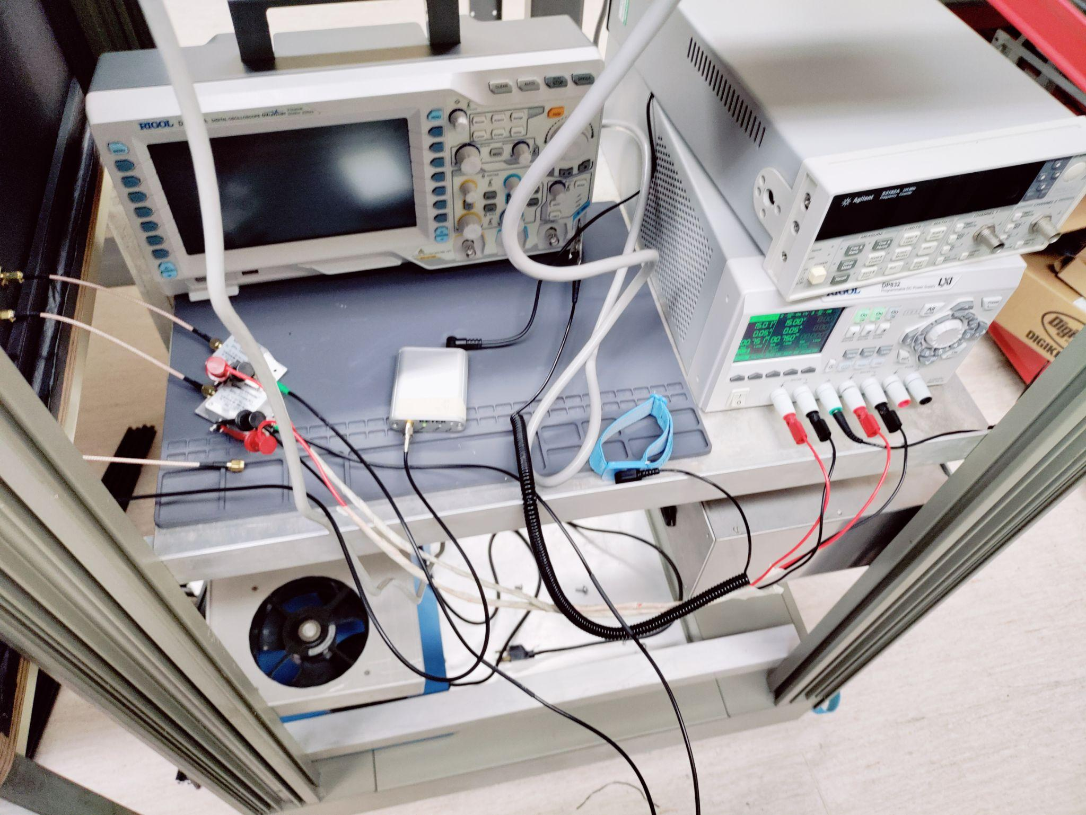
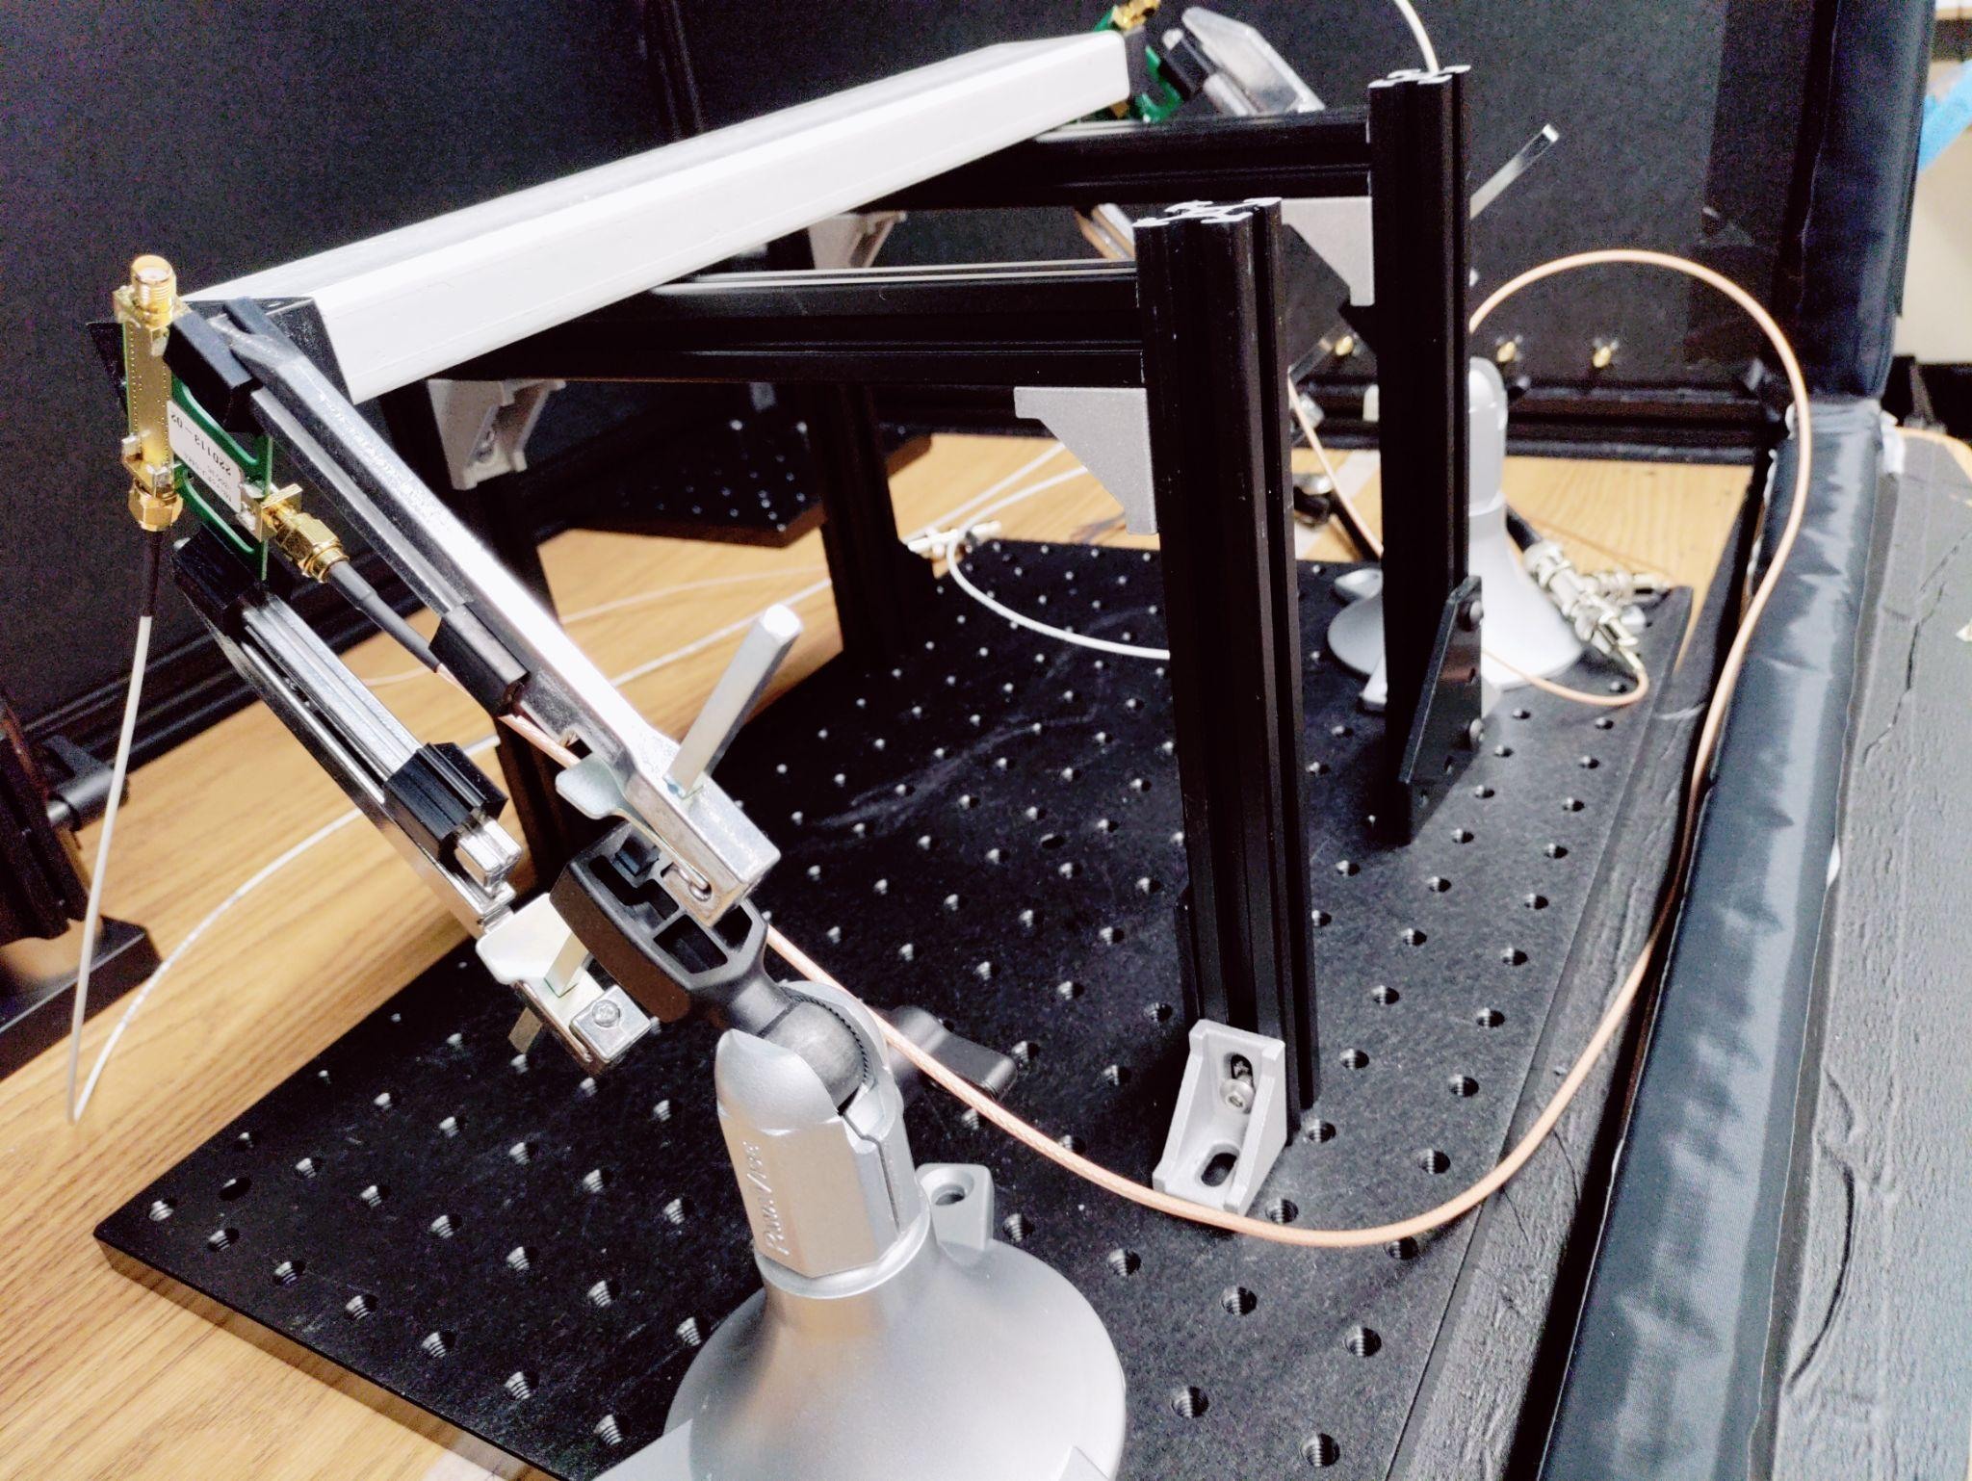
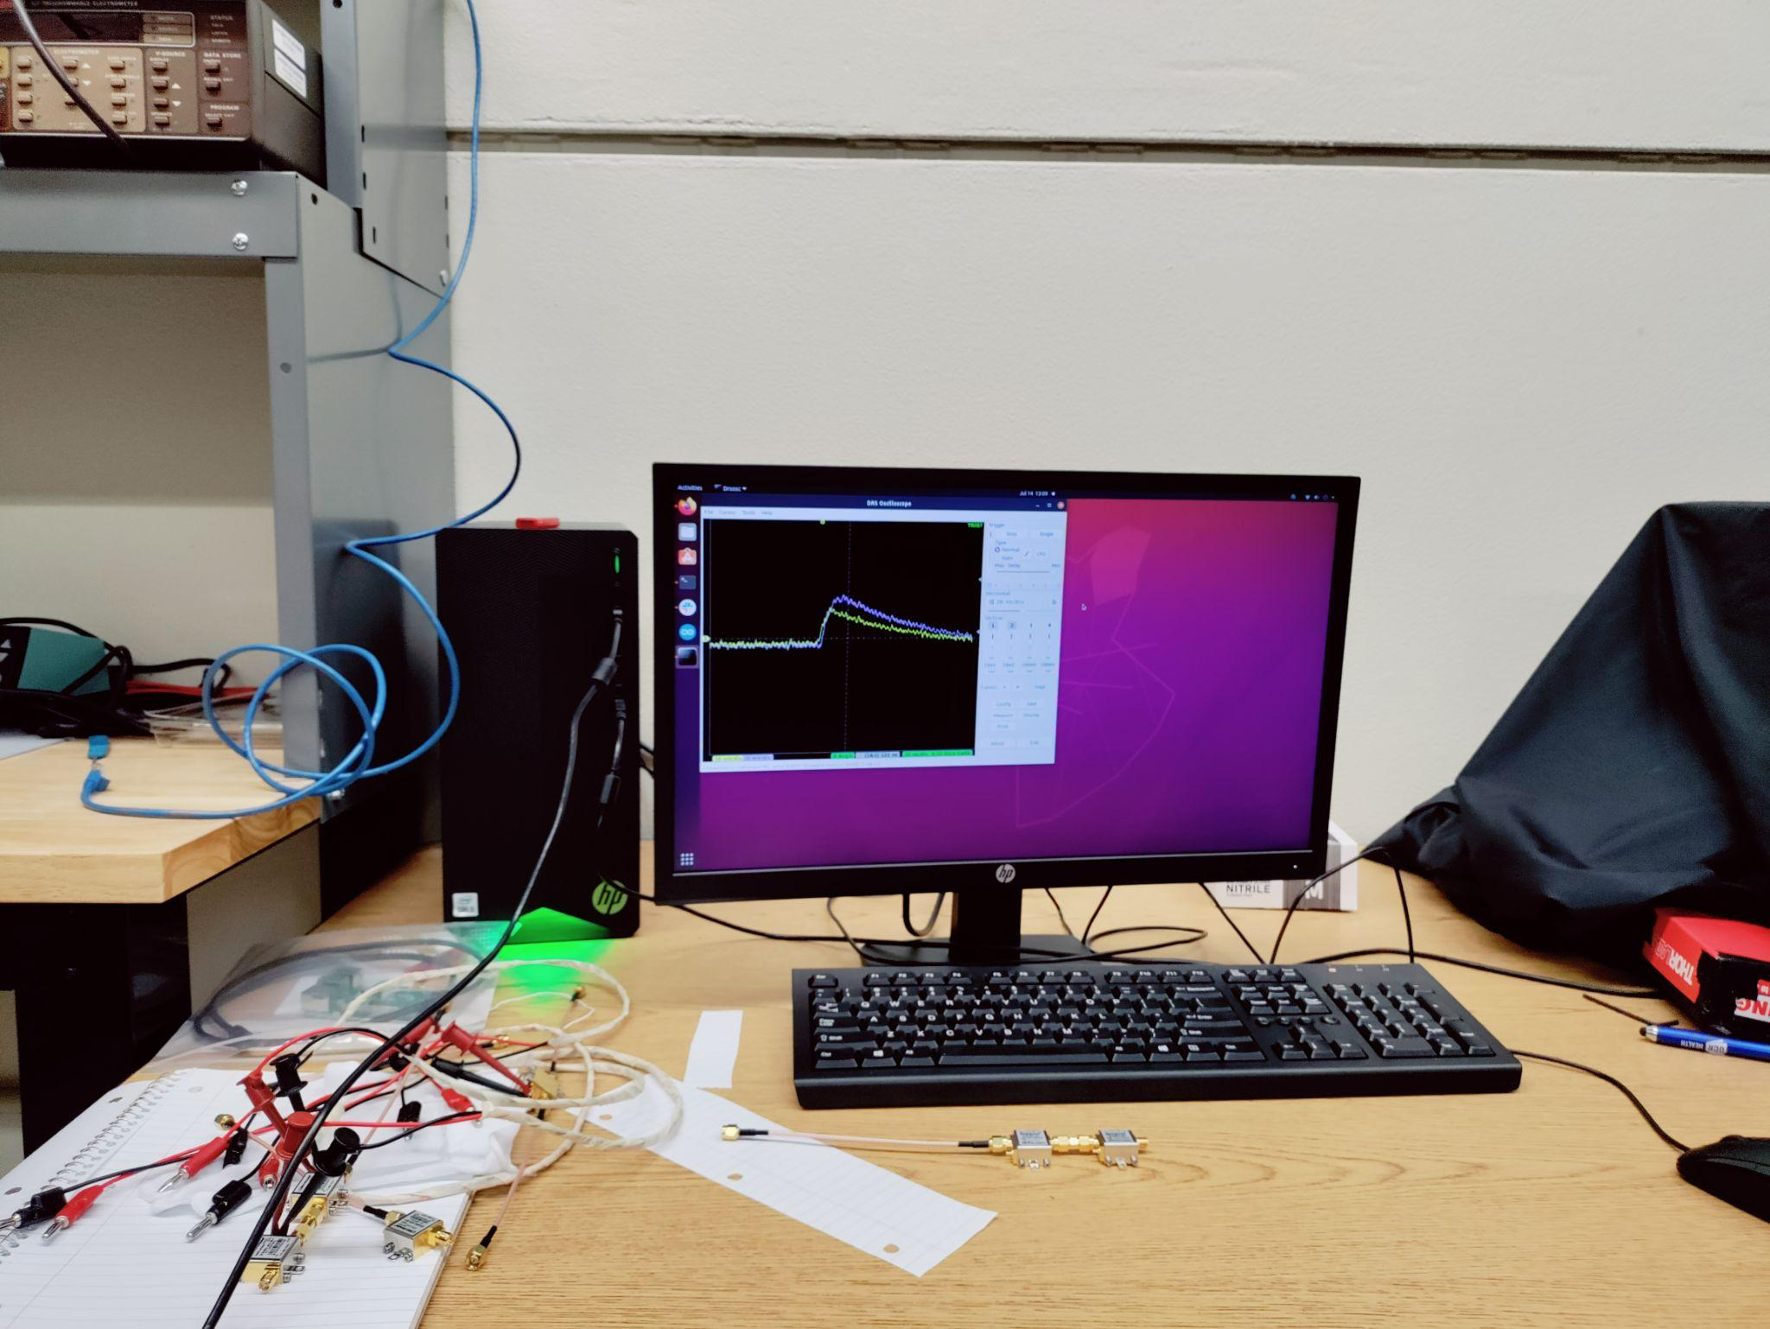
Setup/Threshold tests
Set up for two for coincidence experiment:
Frequency Counter Bar set up with SiPMs Black Box RCSOSC
Oscilloscope , Amplifiers,
Voltage Bias Source

Slide 14
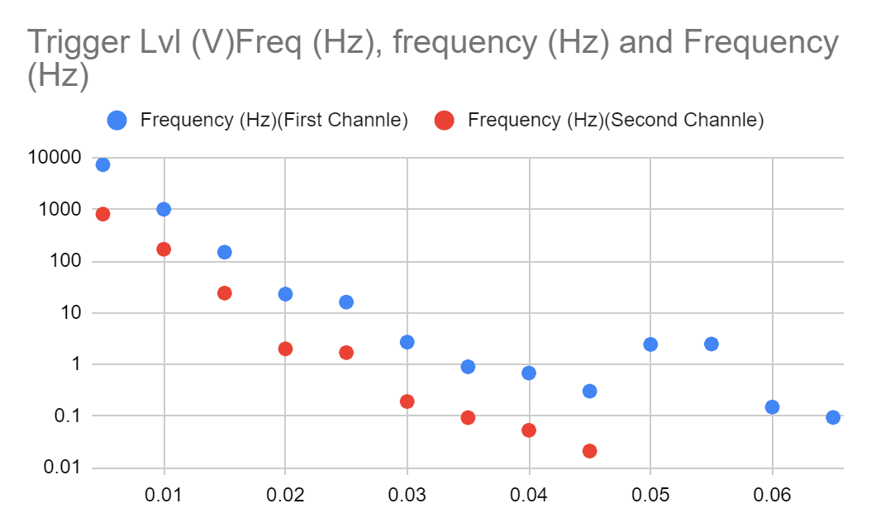
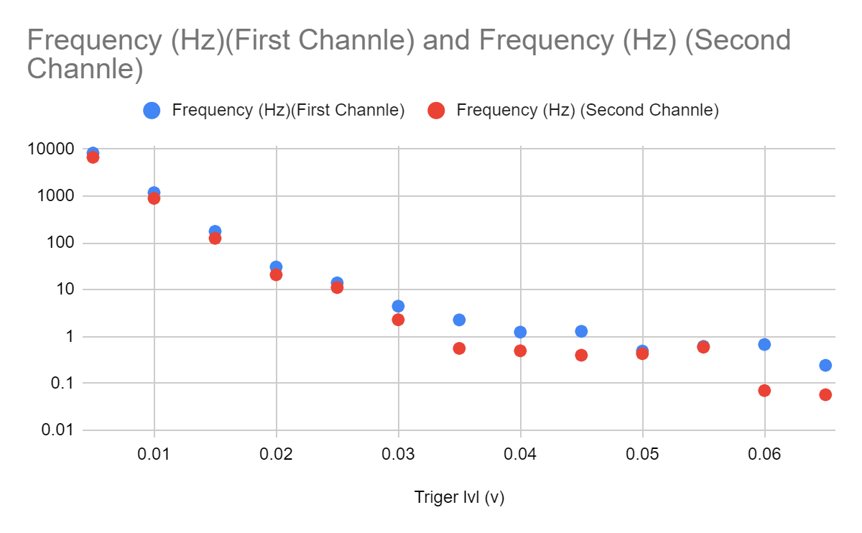
Threshold Test Data
Figure 1: First test did not provided desired pattern or behavior. SiPMs and Bar set was not working so further calibration was needed.
Figure 2: Shows the correlation between noise and cosmic particle(muons). As the trigger is increased it demonstrates that it starts to flatten out a bit which means that these are cosmic particles and not noise

Slide 15
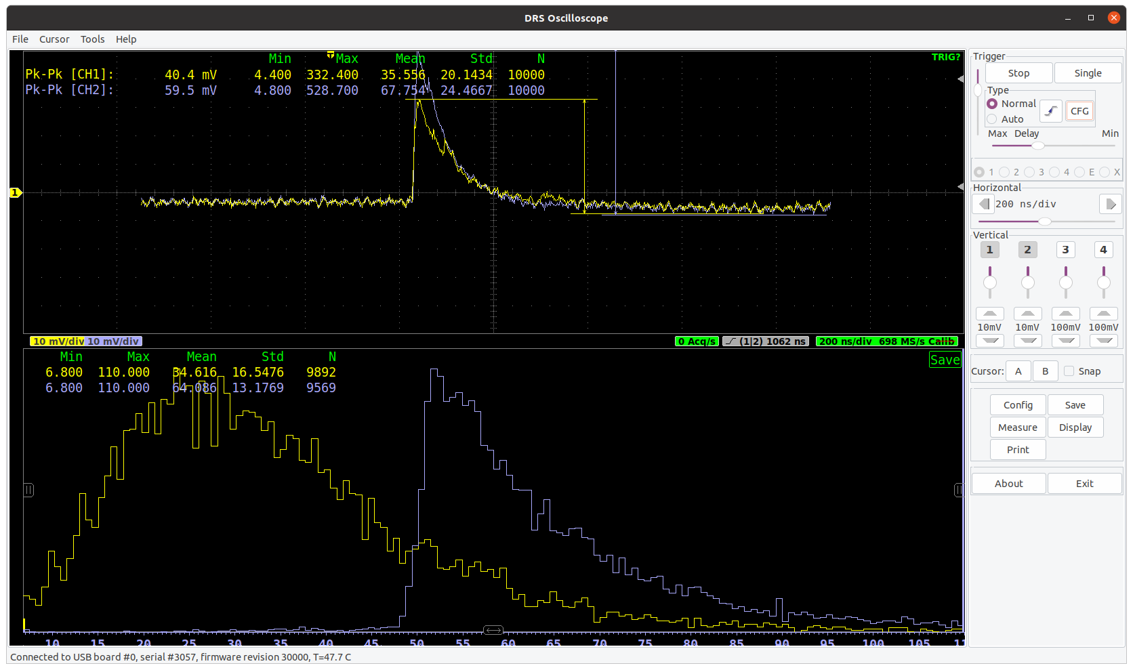
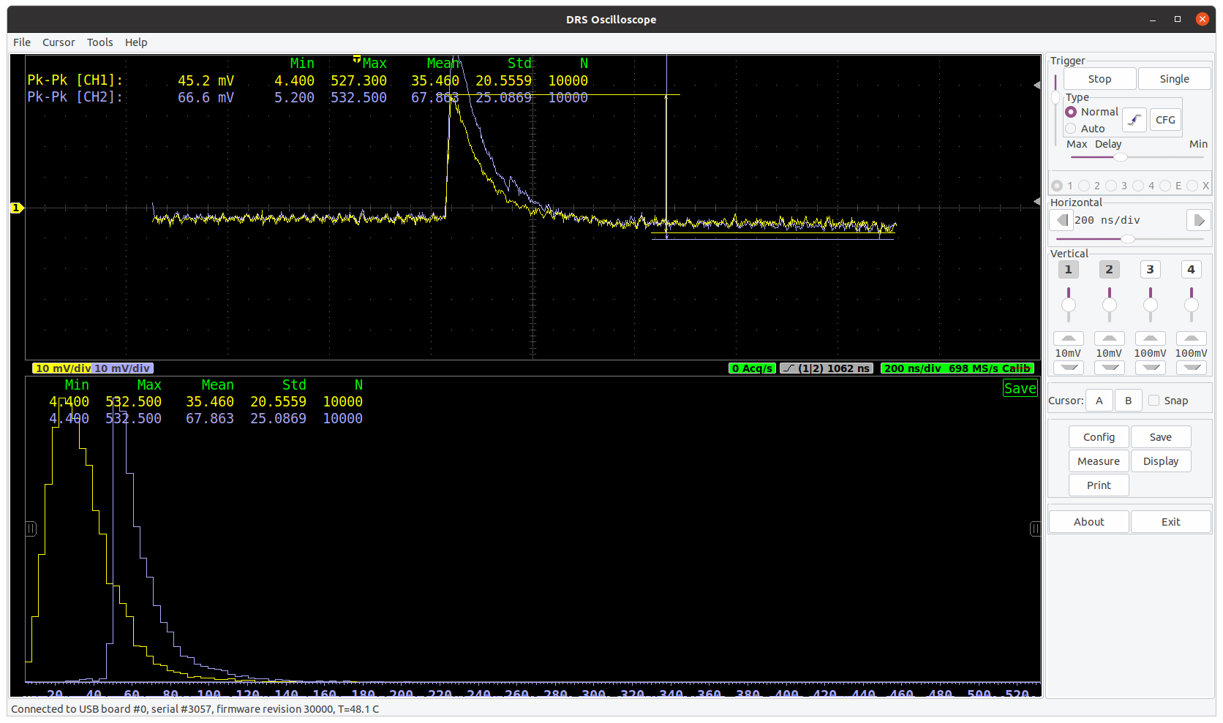
Running DRSOSC to detect Cosmic Rays
Shows simultaneous events occurring and the histograms of the cosmic particles detection.

Slide 16
Further Research Plans/Goals
Continue to iterate on the bar plus fiber. Improve on polishing technique.
Carry out the four fold coincidence experiment, using four SiPMs instead of two.
Learn Programs such as Python, Root, PyRoot, and Jyupter for my summer internship at Lawrence Livermore National Laboratory (LLNL).
Learn to simulate EIC events using the programs I learn.
Learn other Data Analysis methods.

Slide 17
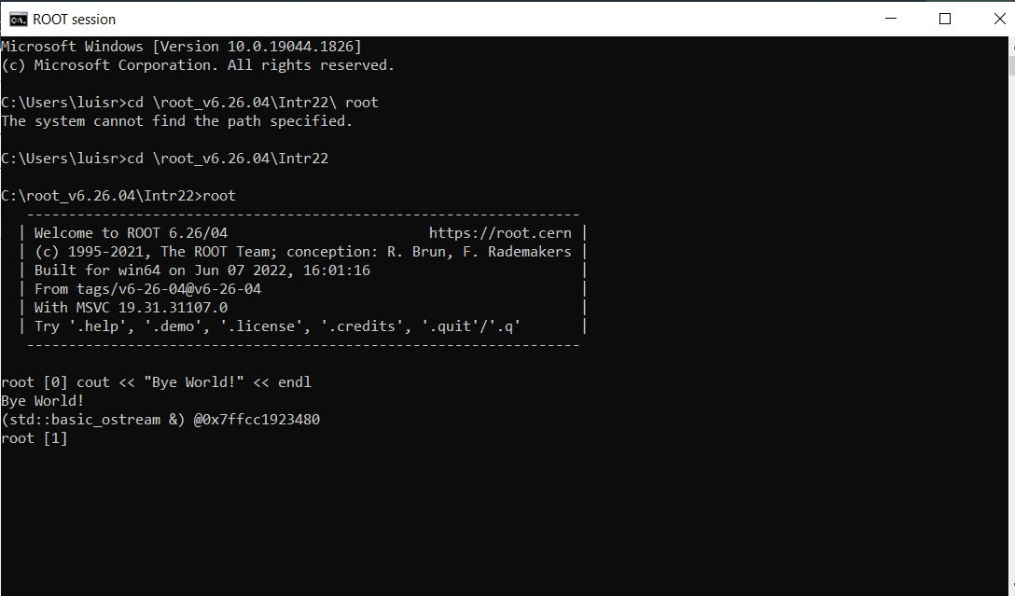

Slide 18
References
Peck Aleck, “Development of Future Forward Calorimeter for CLAS12”, Presentation.

Slide 19
Acknowledgement
Dr.Miguel Arratia, Aleck Peck, Sean Preins, Sebouh, and UCR.
Thanks to the California EIC Concortium.
Also thank you to the Department of Energy (DOE) for funding this research.

Slide 20
Questions?

