Slide 1

Jet Physics at the EIC
@ZhongboK
California EIC Consortium Collaboration Meeting
July 18, 2022

Slide 2

UCLA QCD Theory Group
1 faculty, 3 postdocs, 4 graduate students, ~ 10 undergrads

Slide 3
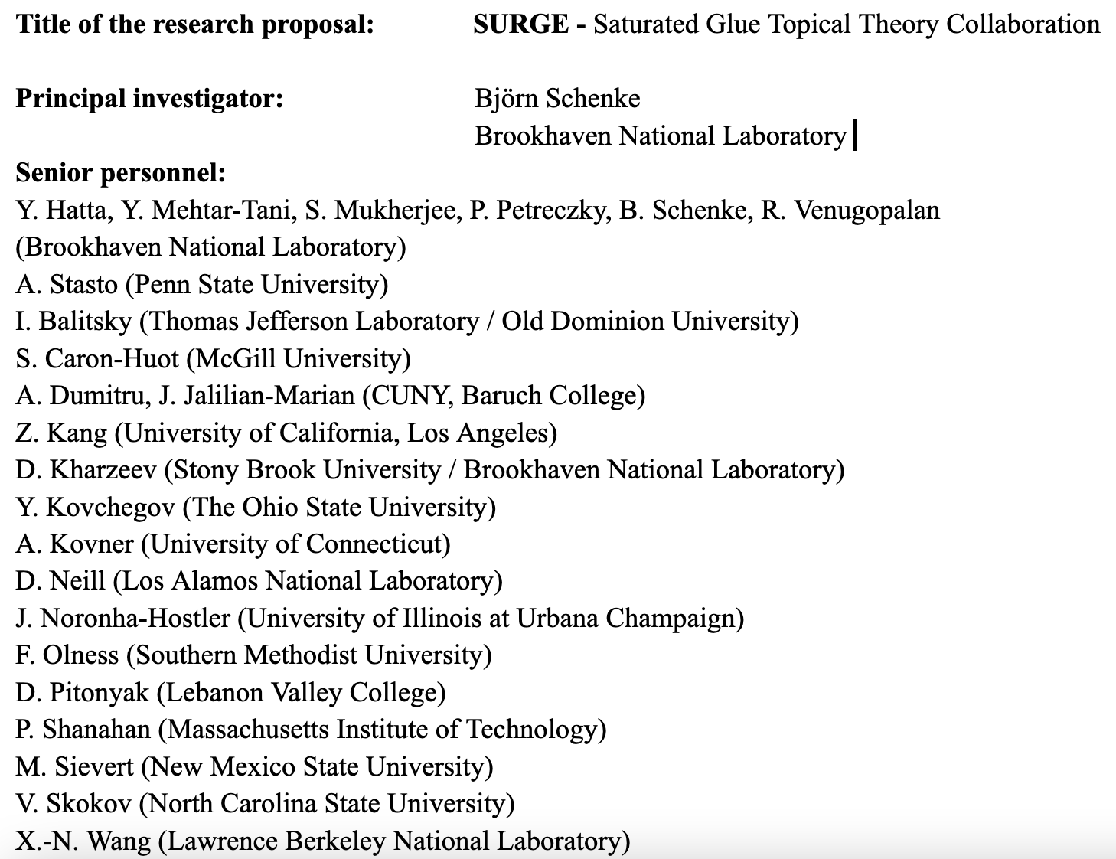

We love joint/collaborative efforts
Joint with LBNL
  joint postdoc: Farid
  Future joint postdoc: if funded by DOE topical collaboration
  Integrated into their weekly seminar (HIT, nuclear theory)
Efforts with LANL/LLNL
  Collaboration with Vincent, Ramona
  Project Scientist: possibility to hire a project scientist

Slide 4


Our Cal-Bridge EIC scholars
Grace Garmire (Cal Poly SLO)
  Mentors: Zhongling, Ryan, Ernst, Zhongbo, Huang, Jennifer
  Jets for 3D imaging type
Jeisson Pulido (CSU Dominguez Hills)
  Mentors: Farid, John, Zhongbo
  Jets for CGC type

Slide 5
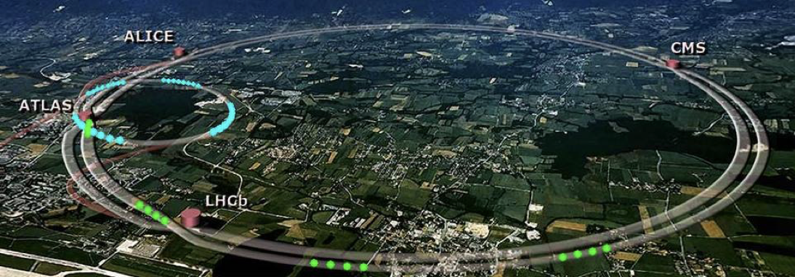
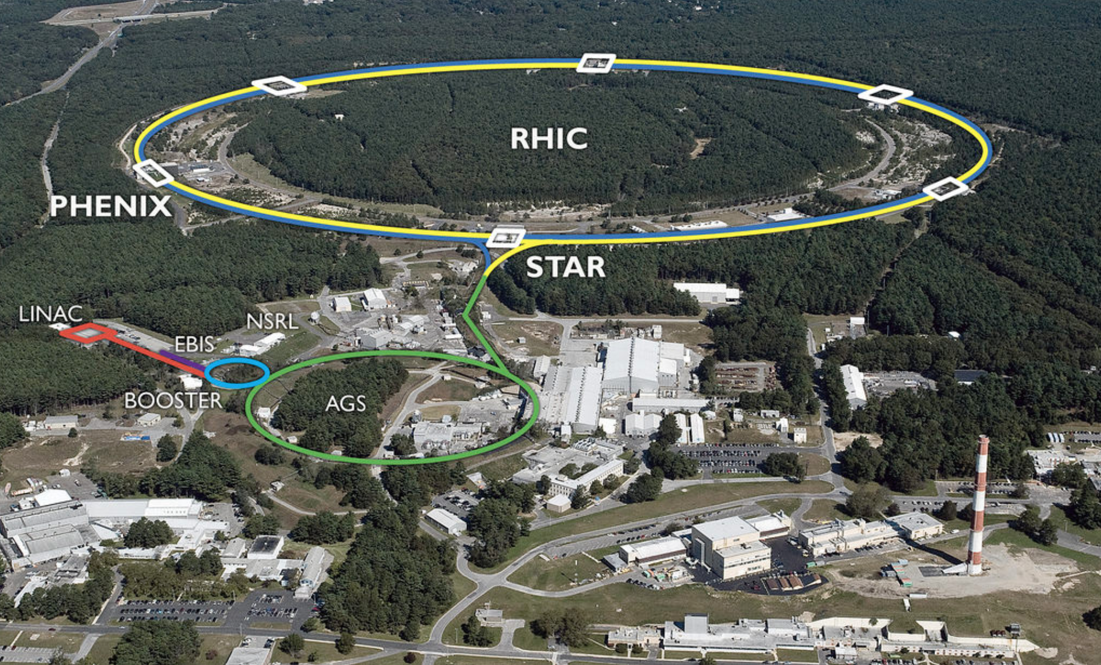
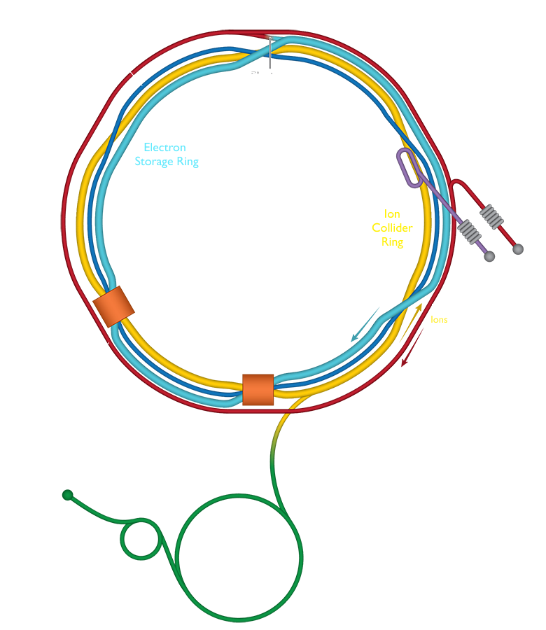
Key facilities: LHC, RHIC, and EIC
Large Hadron Collider (LHC)
~ 2031
Electron Ion Collider (EIC)
Relativistic Heavy Ion Collider (RHIC)

Slide 6
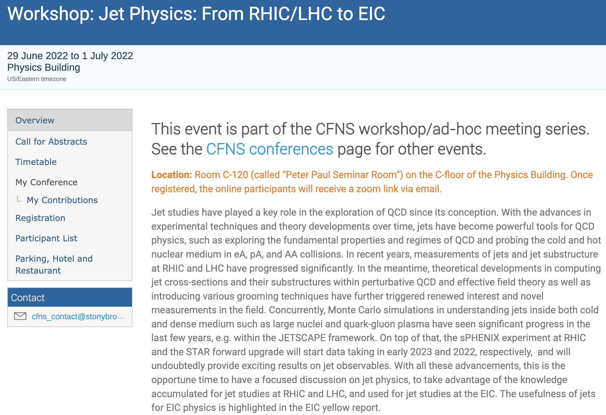
A recent CFNS jet workshop

Slide 7
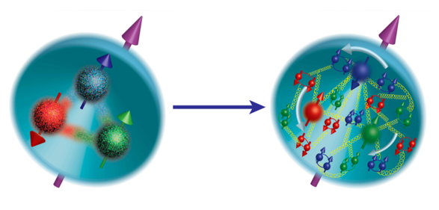
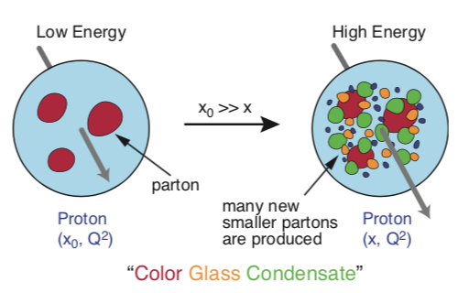
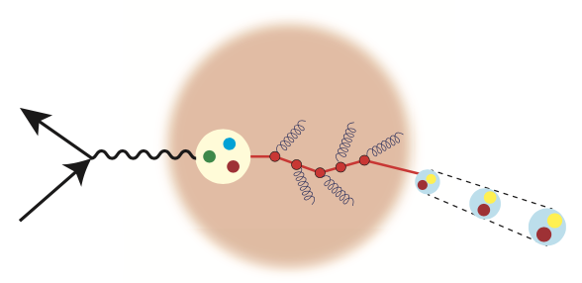
EIC Scientific Pillars
Quantum Imaging of protons and nuclei
A new form of matter - color glass condensate
Jet propagation in cold nuclear matter

Slide 8
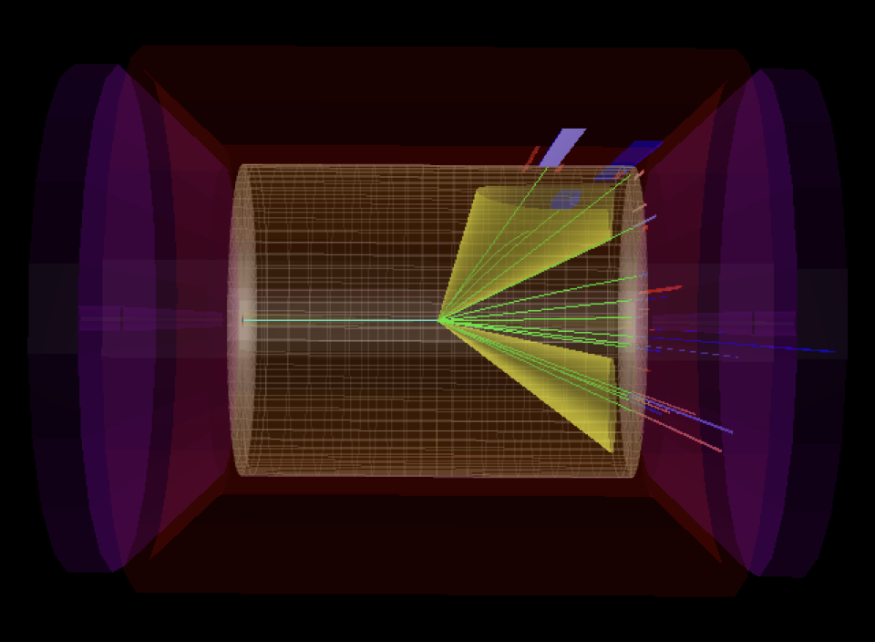
Jets are useful tools in all three directions
Active study at the EIC
  EIC jet papers grow exponentially
EIC

Slide 9
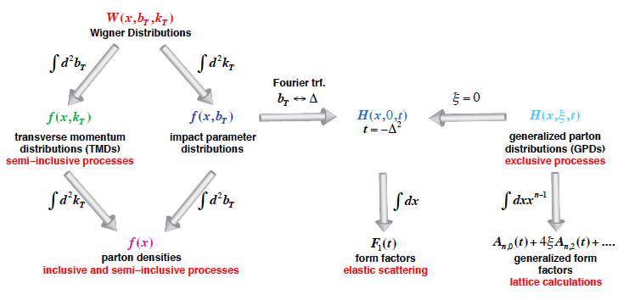
Jets for quantum imaging
Wigner distributions: a quantum version of phase-space distribution
5D
3D
1D

Slide 10
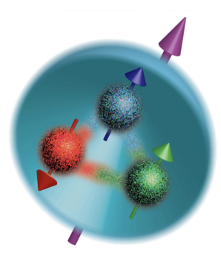
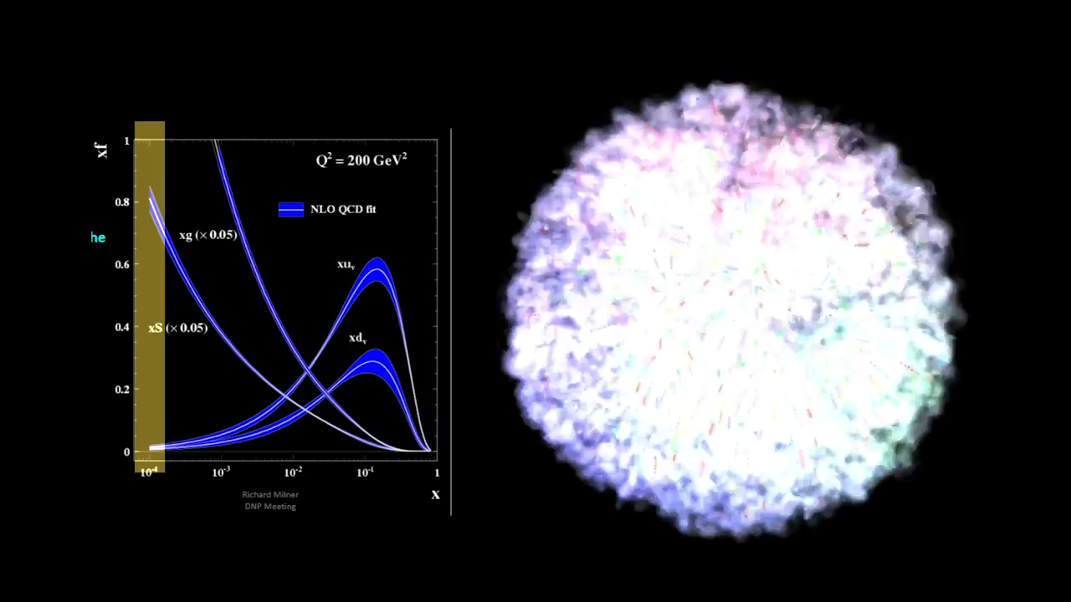
1D: unpolarized PDFs
Longitudinal motion
Physicist: Milner (MIT), Ent-Yoshida (Jlab), 04/2022
Documentary Filmmaker: Boebel-McMaster (MIT), LaPlante (Sputnik Animation)

Slide 11
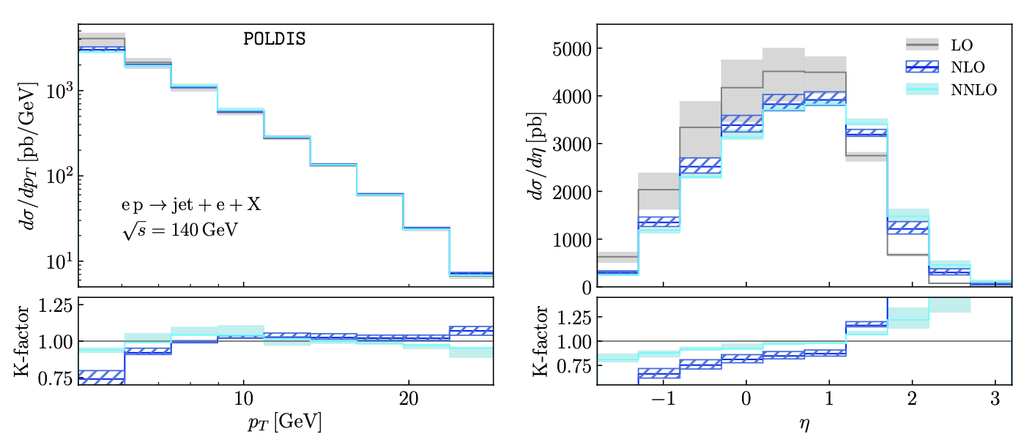
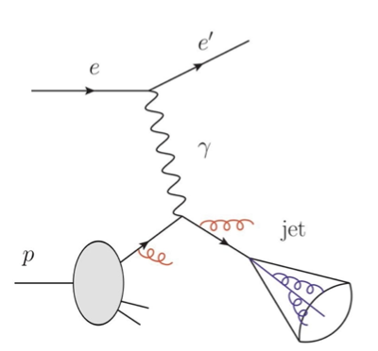
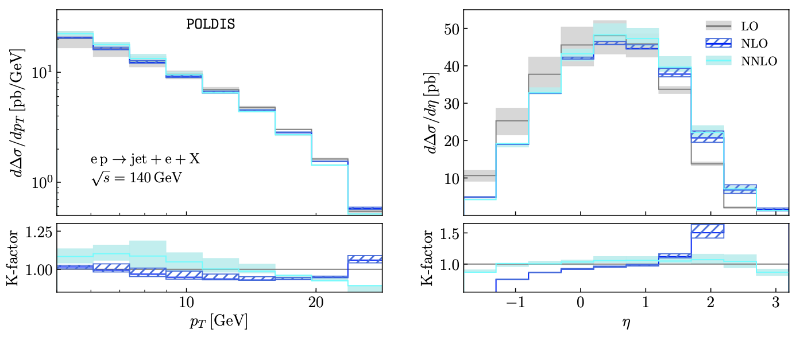
Jet production in e+p collisions
LO, NLO, NNLO frontiers
Borsa, de Florian, Pedron, PRL 20, PRD 21
unpolarized
polarized

Slide 12
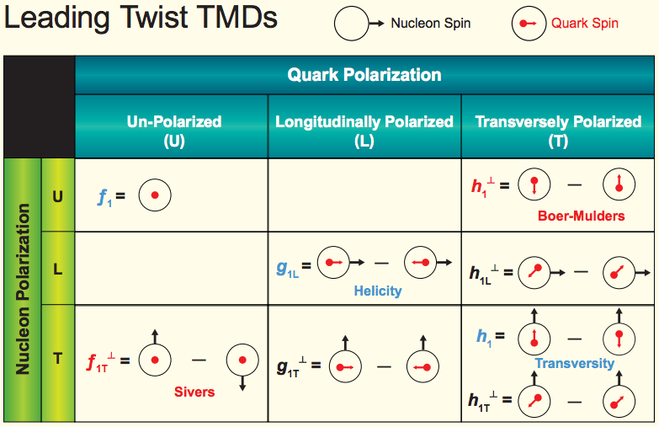
Jets for 3D imaging: TMDs
TMD parton distribution
Transversal Helicity
Quark Polarization
U L T
TMD fragmentation function
Pion
Collins

Slide 13
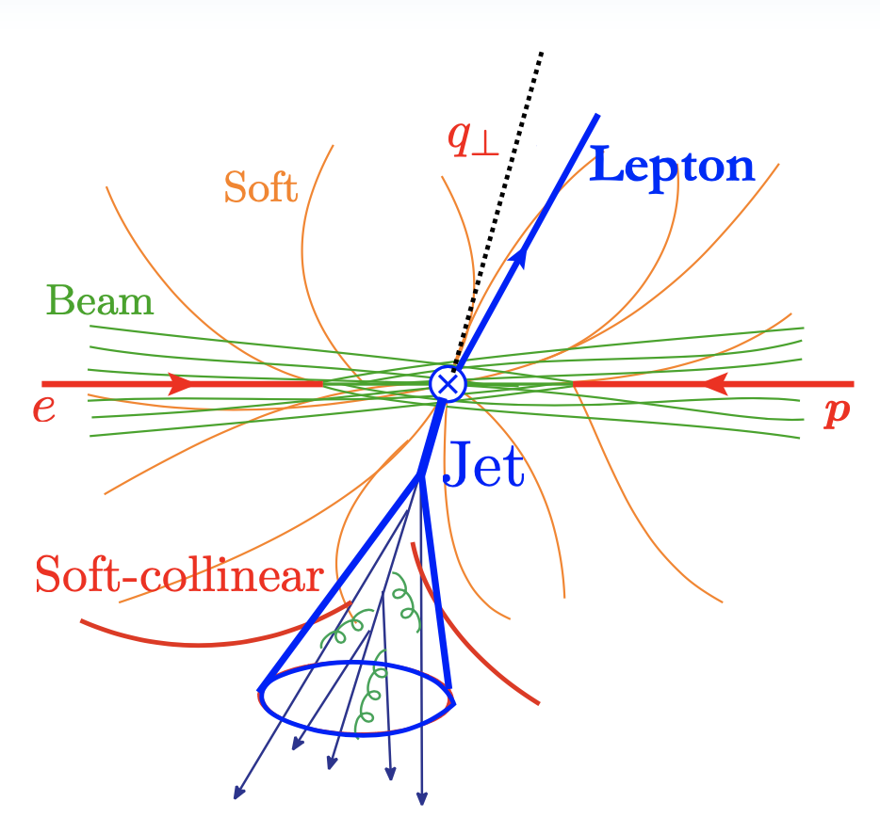
Jet production in e+p collisions
Back-to-back lepton+jet production at ep collisions
  One probes the small imbalance region
Factorization formalism
Two soft functions
    Global: can radiate everywhere
    Collinear-soft: soft radiation inside jet does not affect imbalance
  Because of small imbalance, we are sensitive to small transverse momentum
  We now have TMD PDFs + soft function
Arratia, Kang, Prokudin, Ringer, 2007.07281
Kang, Lee, Shao, Zhao, 2106.15624
Liu, Ringer, Vogelsang, Yuan, 18, 20, …

Slide 14
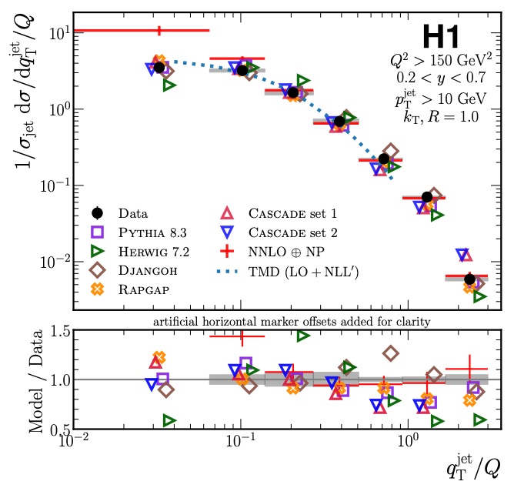
Jets for 3D imaging
Constrain TMDs (without fragmentation function)
  Unpolarized scattering: recent HERA measurement
  Transversely polarized proton scattering: Sivers function (right plot)
HERA, arXiv:2108.12376, PRL 22
Arratia, Kang, Prokudin, Ringer, 2007.07281, PRD

Slide 15
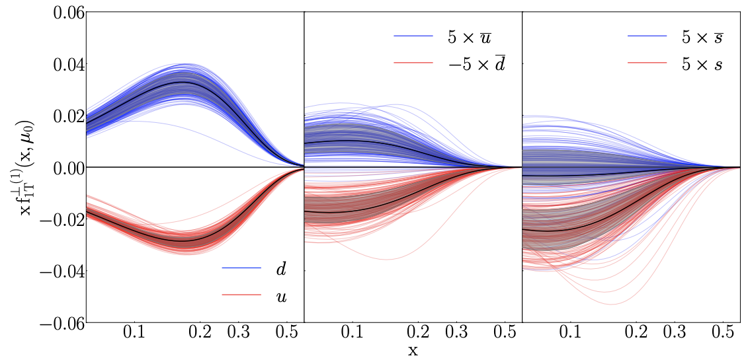
Jet charge
Jet charge is much more useful for polarized scattering
  Because spin-dependent functions tend to flavor dependent, e.g. Sivers function
Echevarria, Kang, Terry, 2009.10710, JHEP (2021)

Slide 16
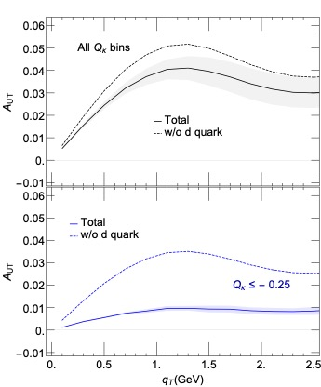
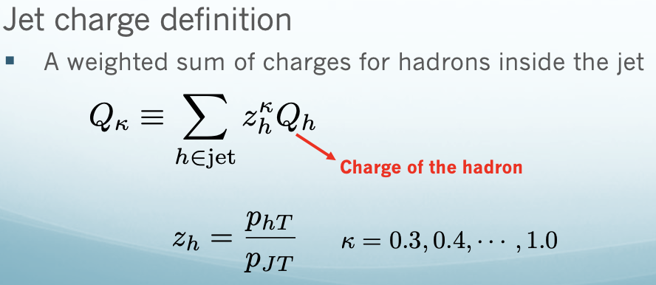
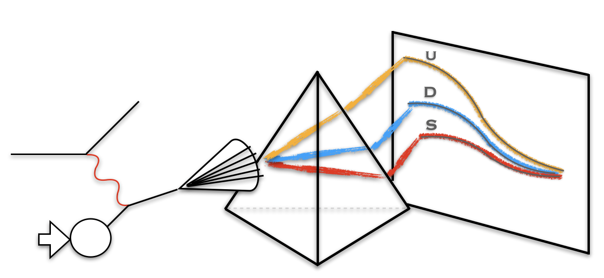
Enhanced sensitivity for d quark
Spin asymmetry in e+p collisions
  No jet charge selection: taking out d quark, small change, thus no sensitivity
  With negative jet charge bin selection: dramatic change, much greater sensitivity
Kang, Liu, Mantry, Shao, PRL, 20

Slide 17
Jet substructure: polarized jet fragmentation function
One can further measure distribution of hadrons inside the jet
  Two axes: imbalance controls TMD PDFs, while the hadron transverse momentum w.r.t jet axis controls TMD FFs
  Advantage over hadron production SIDIS
Kang, Lee, Zhao, PLB 20
Kang, Lee, Shao, Zhao, JHEP 21
quark

Slide 18
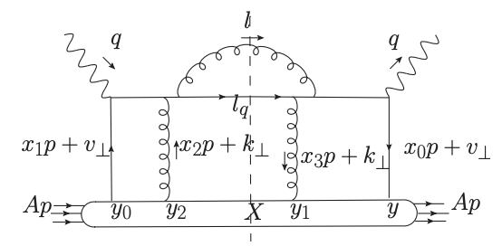
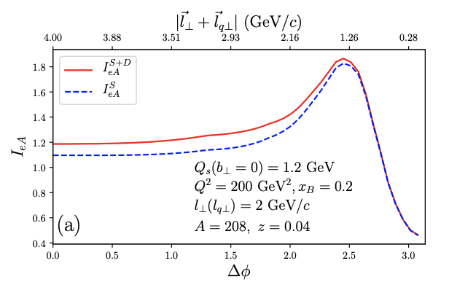
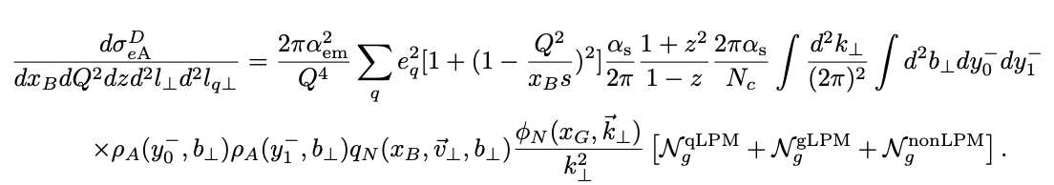
Jets for Color Glass Condensate
Jet production in nucleus: multiple scattering in heavy nucleus
  High-twist
  CGC approach: resum all order rescattering to Wilson lines
A recent high-twist calculation
  Dijet production in e+A at LO
Zhang, Wang, PRD 2022

Slide 19
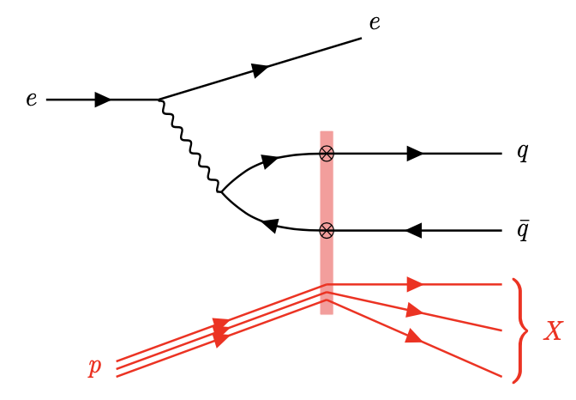
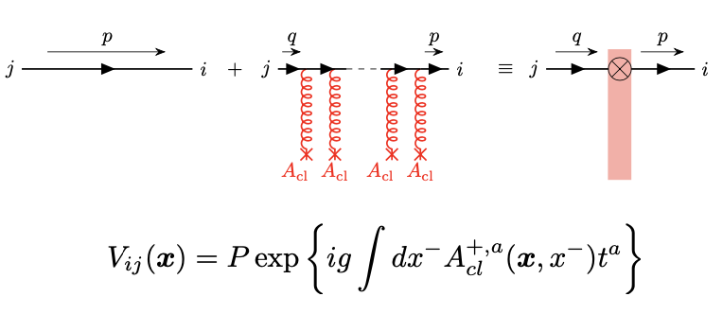
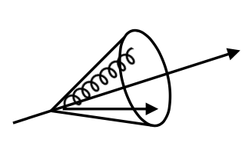
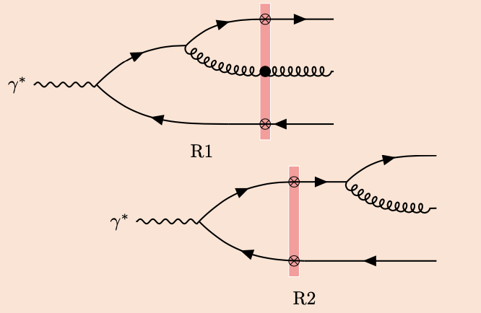
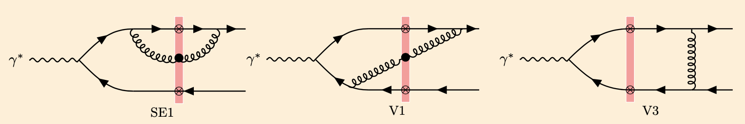
Jet production in CGC
NLO computations just started in very recently
  LO available in 2011
  LO had no jet structure
  NLO available in 2021
    Jet algorithm is simplified
Dominguez, Marquet, Xiao, Yuan, 2011
Caucal, Salazar, Venugopalan, JHEP, 2021

Slide 20
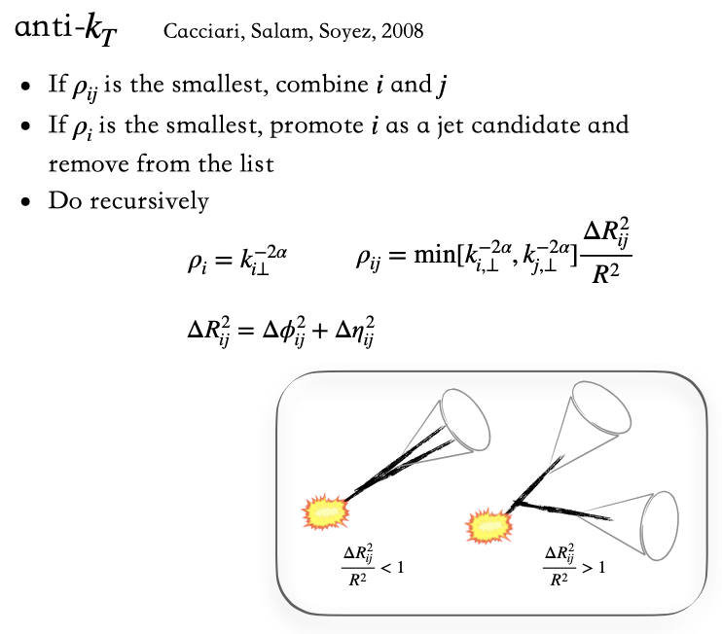
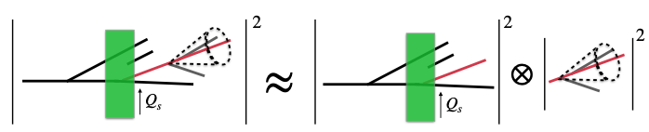
Jet production in p+A
Jet algorithm
  Properly handle jet algorithm on top of complicated CGC computations
  Study its small-R approximation: factorized into a semi-inclusive jet function
  Can be readily used for jet production in e+A: also jet substructure
Liu, Xie, Kang, Liu, 2204.03026, JHEP, 22
CGC factorization in small R
collinear factorization
Kang, Ringer, Vitev, JHEP, 2016

Slide 21
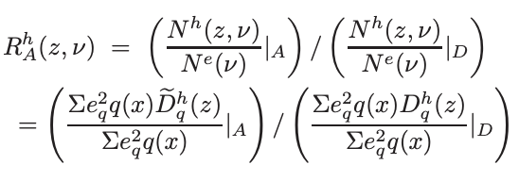
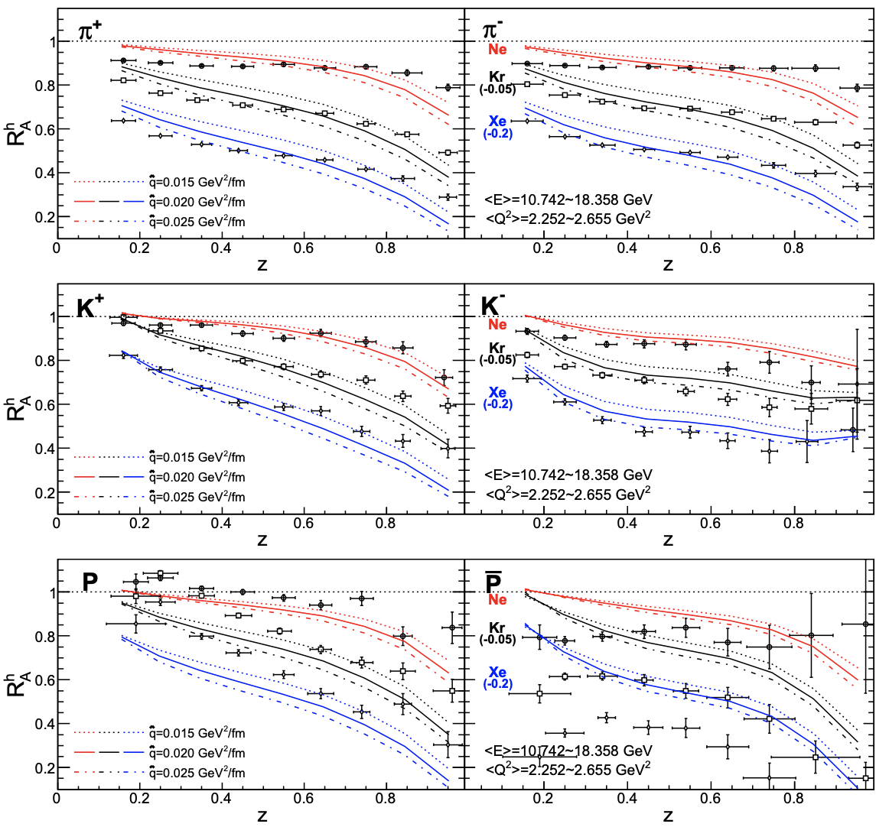
Jets in cold nuclear matter
The early HERMES data: hadron multiplicity modification
  Modified fragmentation function in medium
Chang, Deng, Wang, 2014, PRC
See also Li, Liu, Vitev, 2020, PLB

Slide 22
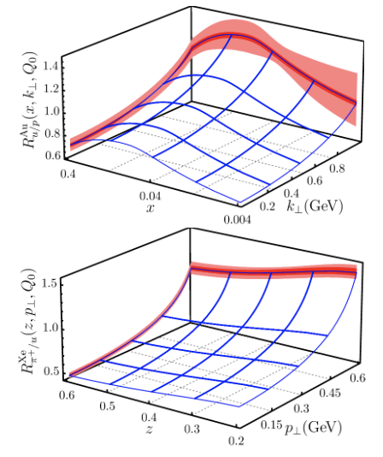
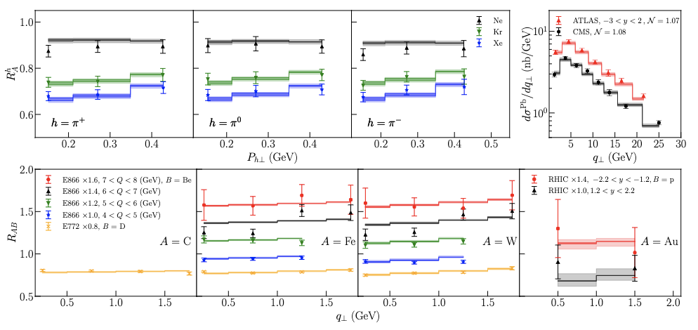
A different interpretation: data-driven approach
Extract TMD PDFs and TMD FFs in a heavy nucleus via global analysis
  Similar to nuclear collinear PDFs idea
  Use the same TMD factorization for hadron production in e+A, except replacing with nuclear TMDs [via broadening parameters]
Alrashed, Anderle, Kang, Terry, Xing, 2021

Slide 23
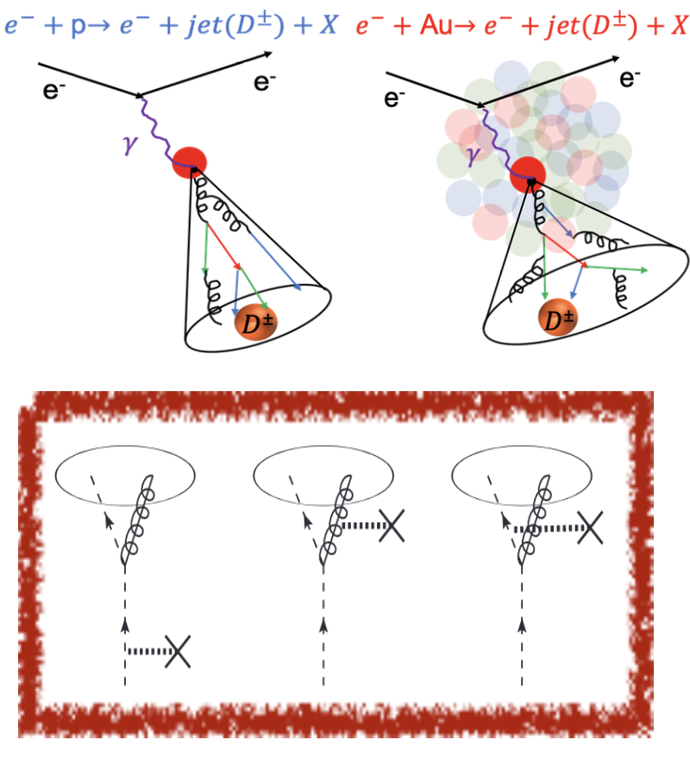
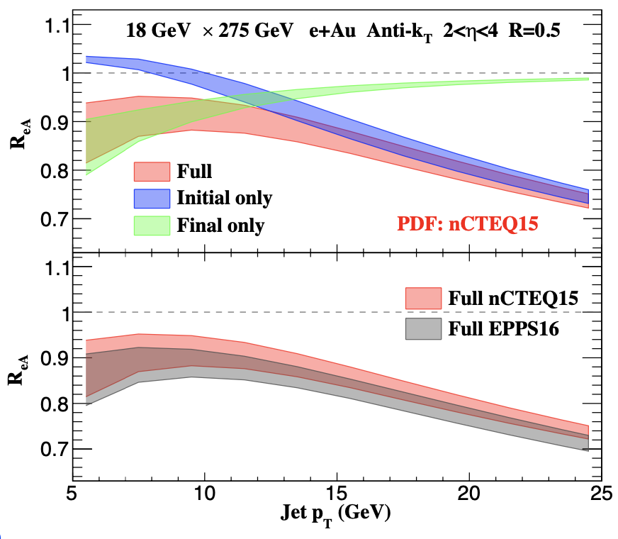
Jet modification in e+A
Similar formalism in A+A applied to e+A collisions
Kang, Ringer, Vitev, PLB 2017
Li, Vitev, 2020

Slide 24
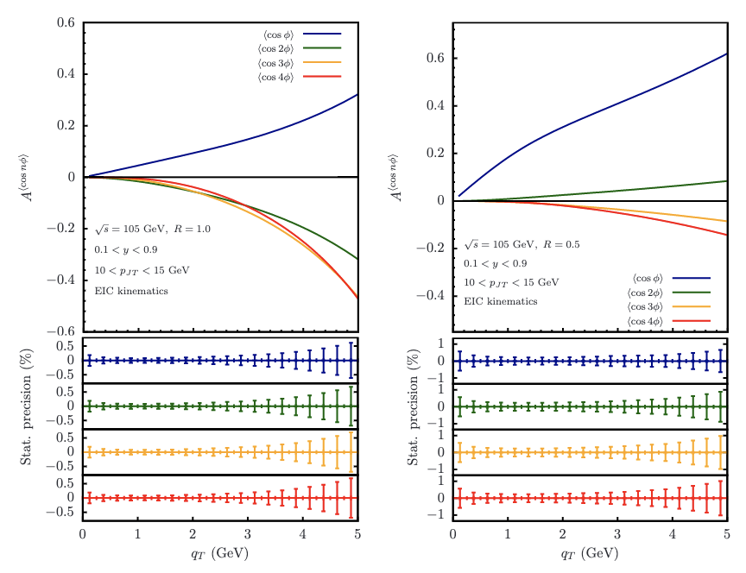
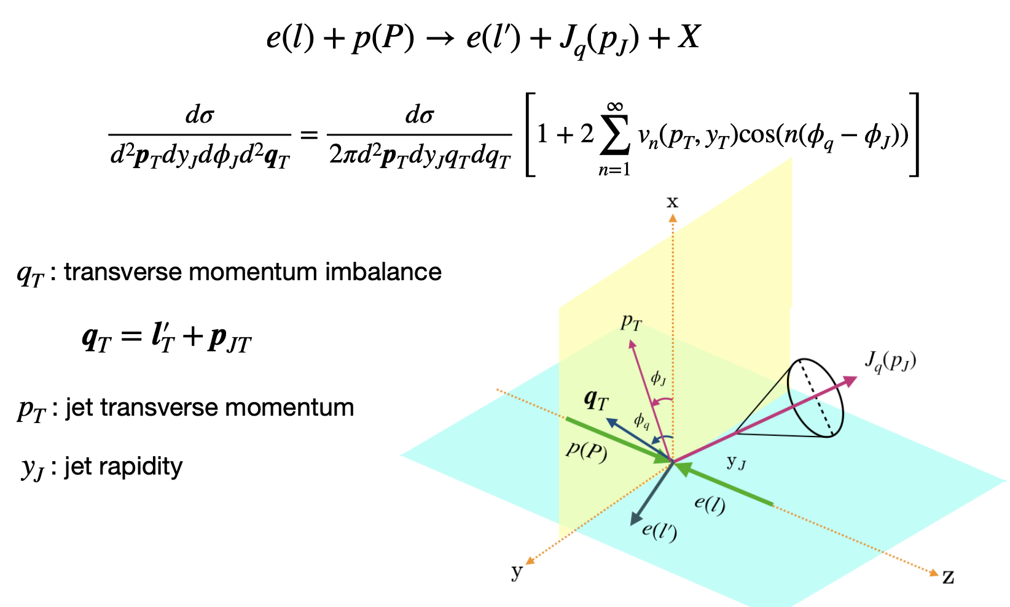
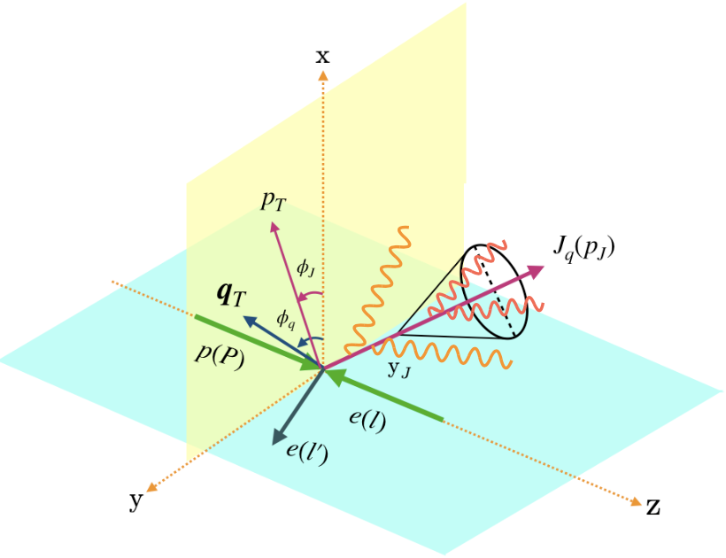
Jet anisotropy in e+p collisions
Such azimuthal anisotropy arises from soft radiation
  Soft radiation outside the jet cone
Esha, Kang, Lee, Shao, Zhao, to appear
See also Hatta, Xiao, Yuan, Zhou, 2021

Slide 25
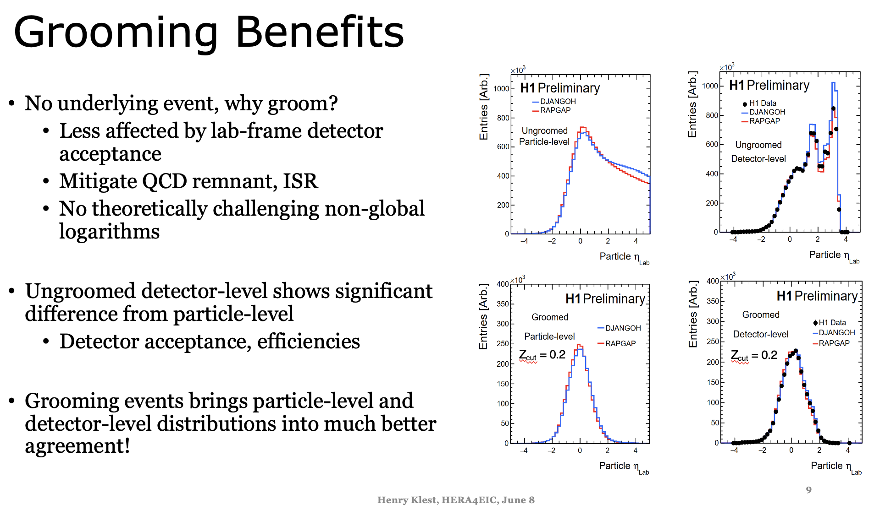
Groomed jet substructure

Slide 26
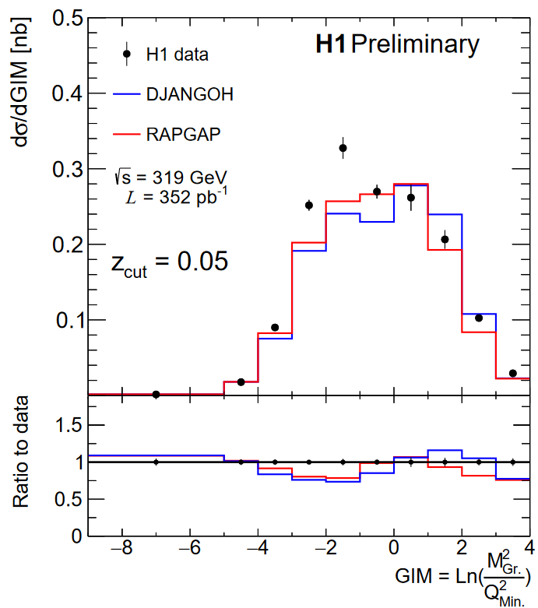
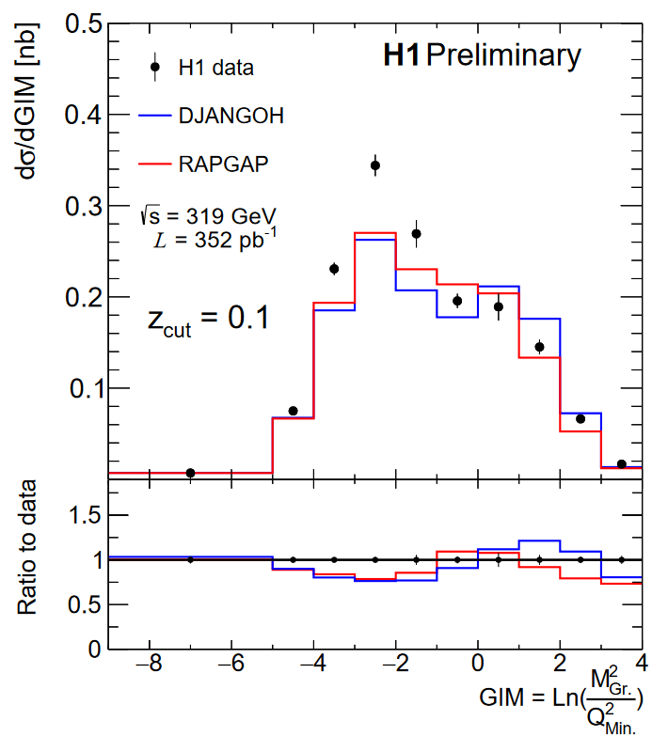
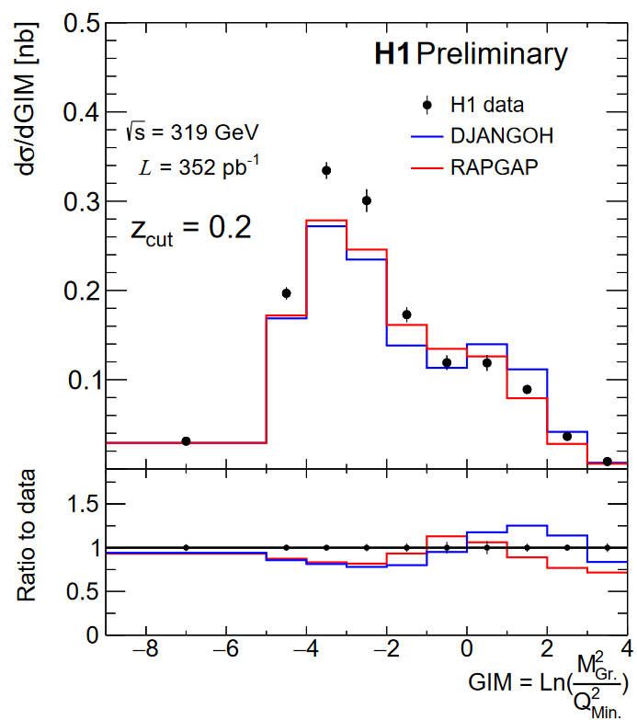
Groomed jet mass from HERA
Most recent results on groomed jet mass in e+p
Klest, June 8

Slide 27
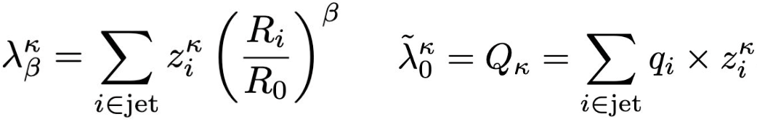
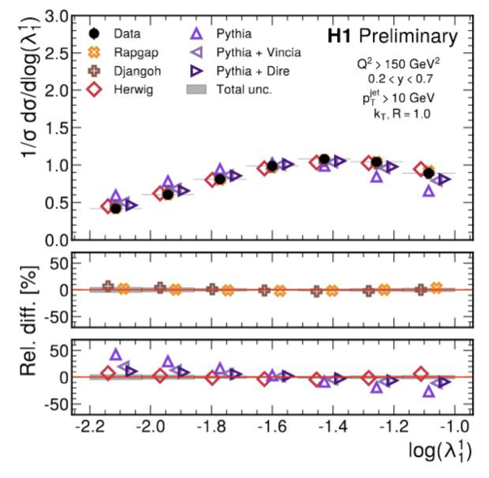
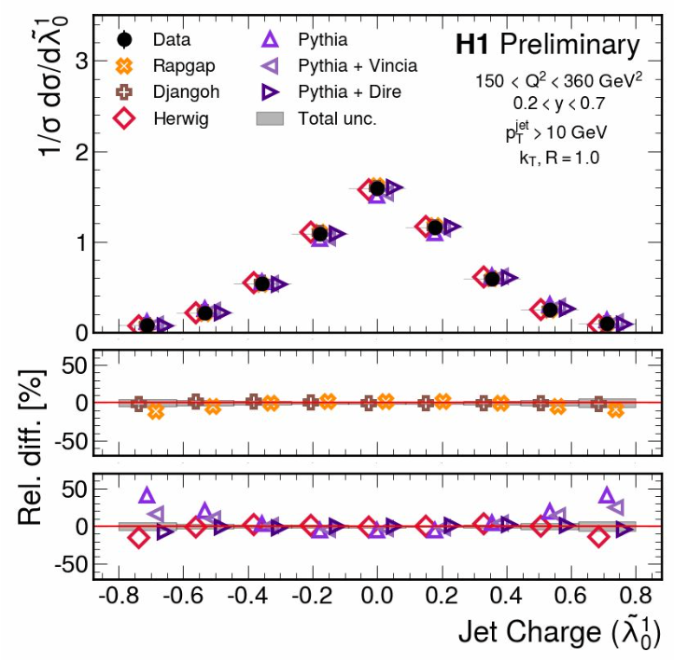
Jet angularity
Recent measurement on jet angularity
Mikuni, Nachman, June 8

Slide 28
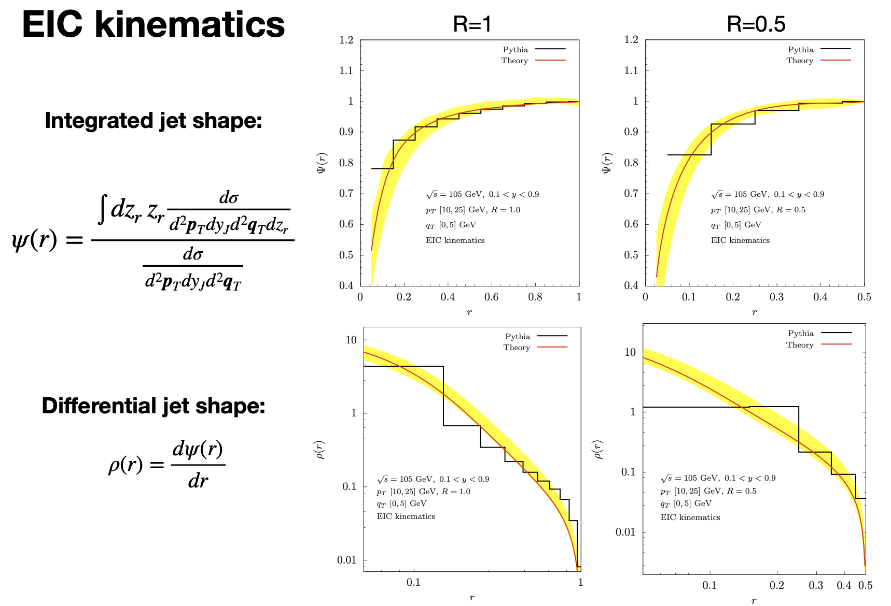
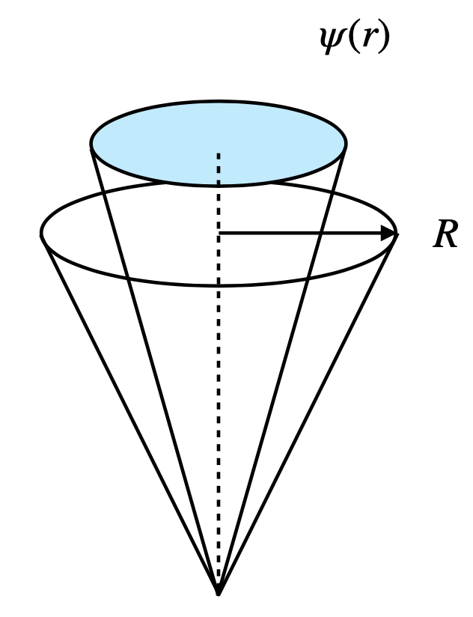
Jet shape
Jet shape at the EIC
preliminary
Esha, Kang, Lee, Shao, Zhao, to appear

Slide 29


UPC vs EIC
Could UPC help jet physics at EIC?
Steinberg, DIS 2022

Slide 30

Summary: jets are powerful tools
Quantum imaging of proton and nuclei
Jets for CGC
Jet propagation in nuclei
Thank you!

