Slide 1
Simulation of Jet Production at the EIC
Grace Garmire
Cal Poly SLO/UCLA/LBNL
California EIC Consortium Collaboration Meeting
Davis, California
July 19, 2022
Supported in part by

Slide 2
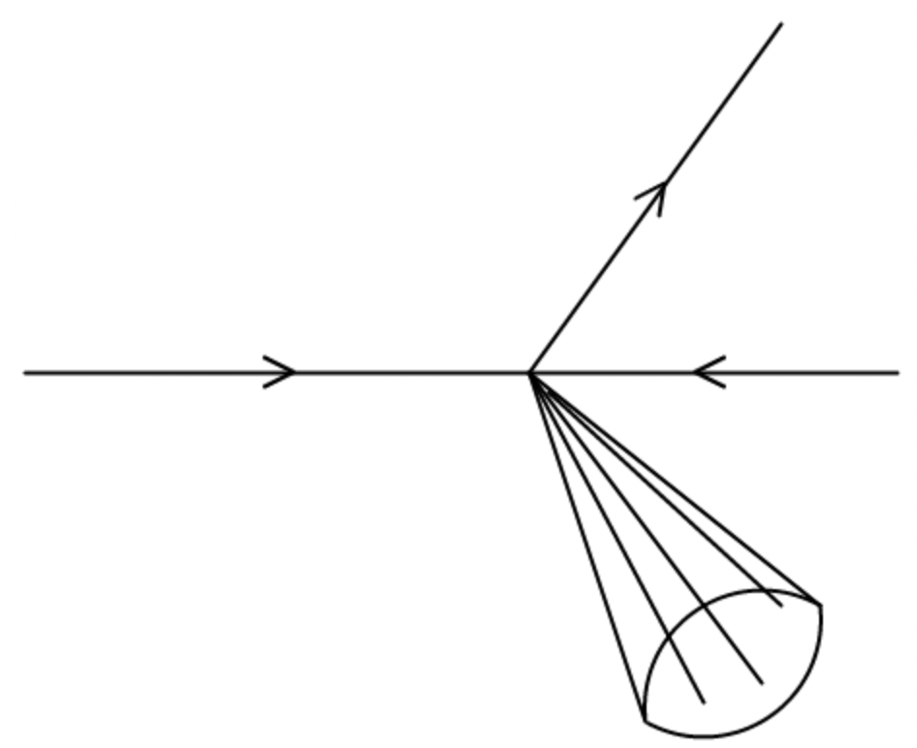
Motivation
e’
The EIC will study transverse momentum dependent distributions in deep inelastic scattering
Jets in high energy particle collisions allow for detailed studies of quantum chromodynamics (QCD)
Jets can be used to study transverse momentum dependent distributions
My longer-term goal is to study quarks and gluons in the initial and final state using jet probes
e
p
jet

Slide 3
Method
Pythia 8 is used to simulate electron-proton collisions with collision energy of 105 GeV (EIC electron energy of 10 GeV, proton energy of 275 GeV)
Fastjet algorithm used with radius 0.5 and anti-k_{T} clustering sequence used to reconstruct jets
Transverse momentum and transverse momentum imbalance of jets with p_{T} > 5 GeV are extracted from simulation

Slide 4
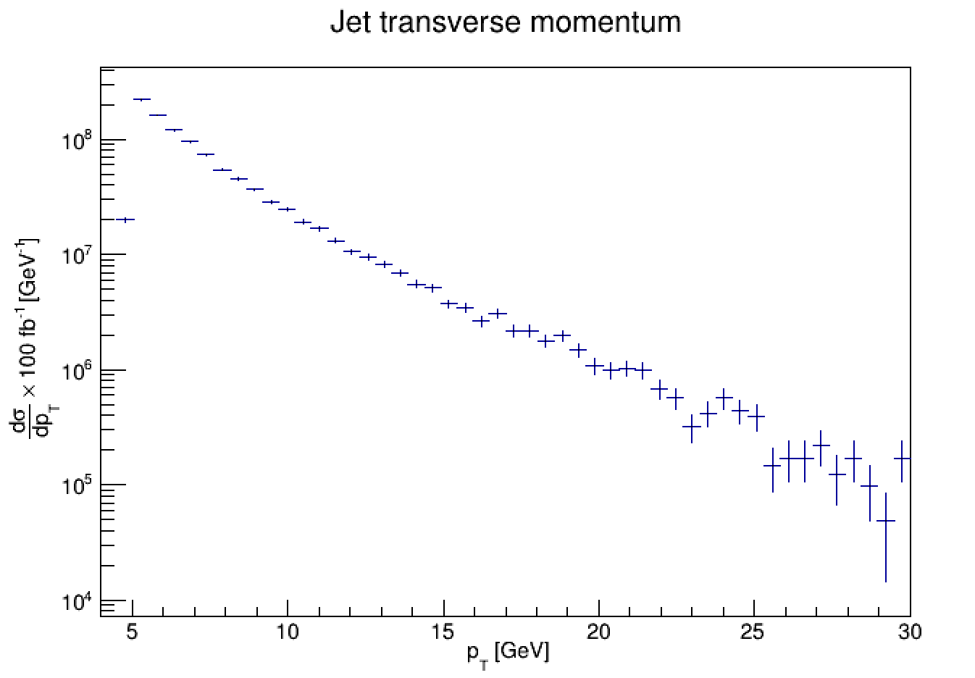
Initial Results
Jet transverse momentum
Jets reconstructed with anti-kt cluster sequence and jet radius of 0.5
Distribution of transverse momentum with respect to beam axis of jets generated over $\text{3×}{\text{10}}^{\text{5}}$ collision events
Normalized to 100 $\text{f}{\text{b}}^{\text{−1}}$ integrated luminosity
Distribution of transverse momentum is near exponential
$${\text{p}}_{\text{T}}^{\text{2}}\text{=}{\text{p}}_{\text{x}}^{\text{2}}\text{+}{\text{p}}_{\text{y}}^{\text{2}}$$

Slide 5
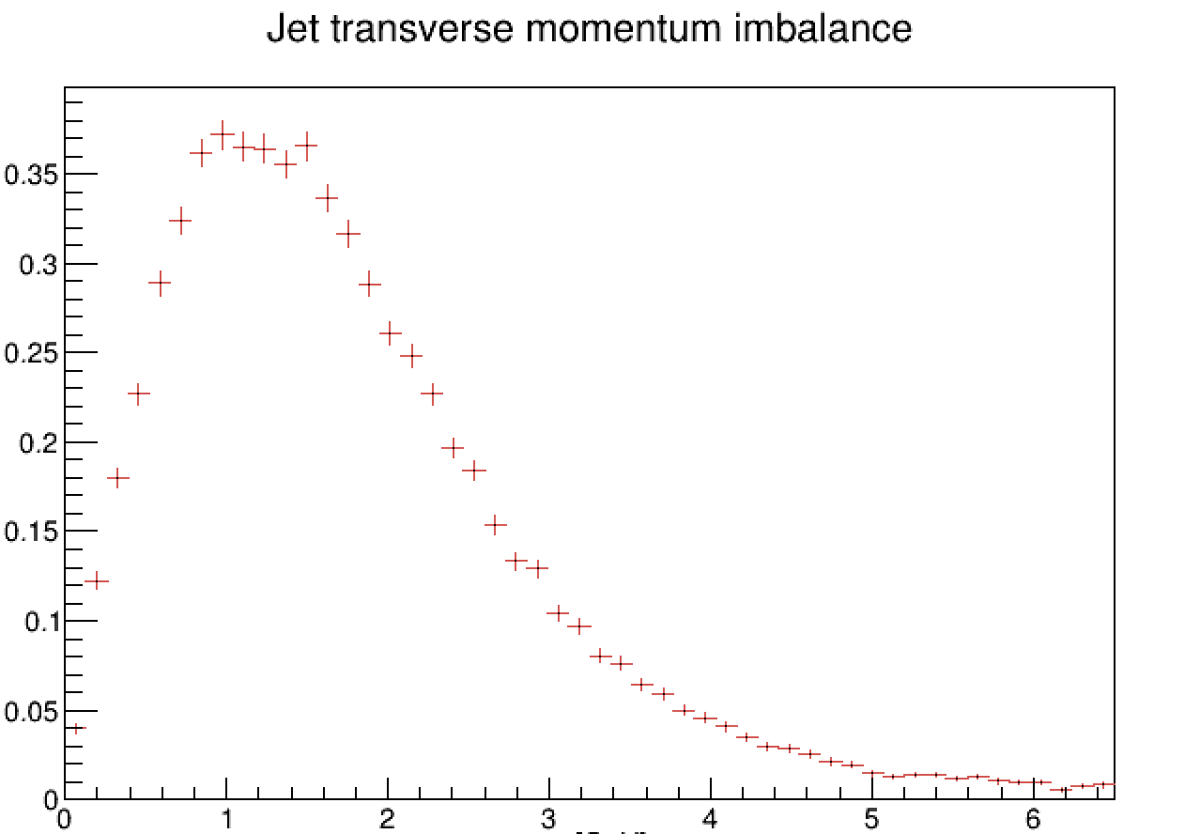
Initial Results
Jet transverse momentum imbalance
Transverse momentum imbalance distribution for jets reconstructed with anti-kt cluster sequence and jet radius of 0.5
Distribution of transverse momentum imbalance of jets generated over $\text{3}\text{×}{\text{10}}^{\text{5}}$ collision events
Transverse momentum imbalance extracted from the same simulation as jet transverse momentum
Demonstrates the expected Gaussian behavior centered around 1.2 GeV with an extended tail into values of q_{T} > 3 GeV
$${\text{q}}_{\text{T}}\text{=}\left|{\vec{\text{p}}}_{\text{T}}^{\text{e}}\text{+}\vec{{\text{p}}_{\text{T}}}\right|$$

Slide 6
Next Steps
Using jet charge to differentiate between quark flavors
Continuing previous work done using jets to probe nucleon structure
Demonstrating the use of jet charge to increase u- and d-quark flavor sensitivity

Slide 7
Thank you!

Slide 8
Thank you!
Notes:
Applications/next steps: jet charge discussion

