Slide 1
SiPM on Tile Uniformity and Cross-Talk Measurements
7/19/2022
Sean Preins

Slide 2
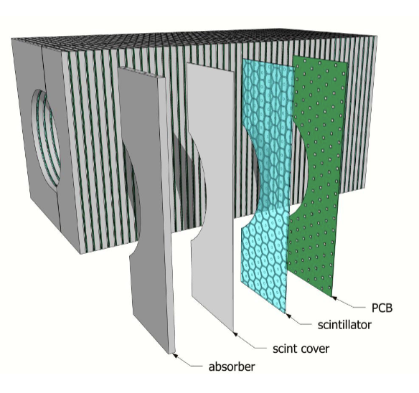
Scintillating Tiles for the HCAL Insert
The high granularity insert design uses a scintillating tile segmented into hexagonal cells
Each cell is centered on a silicon photomultiplier
To properly characterize the performance of these tiles for simulations, we must determinize uniformity and cross-talk
We will also investigate methods of improving these properties
Photo Credit: Sebouh Paul

Slide 3
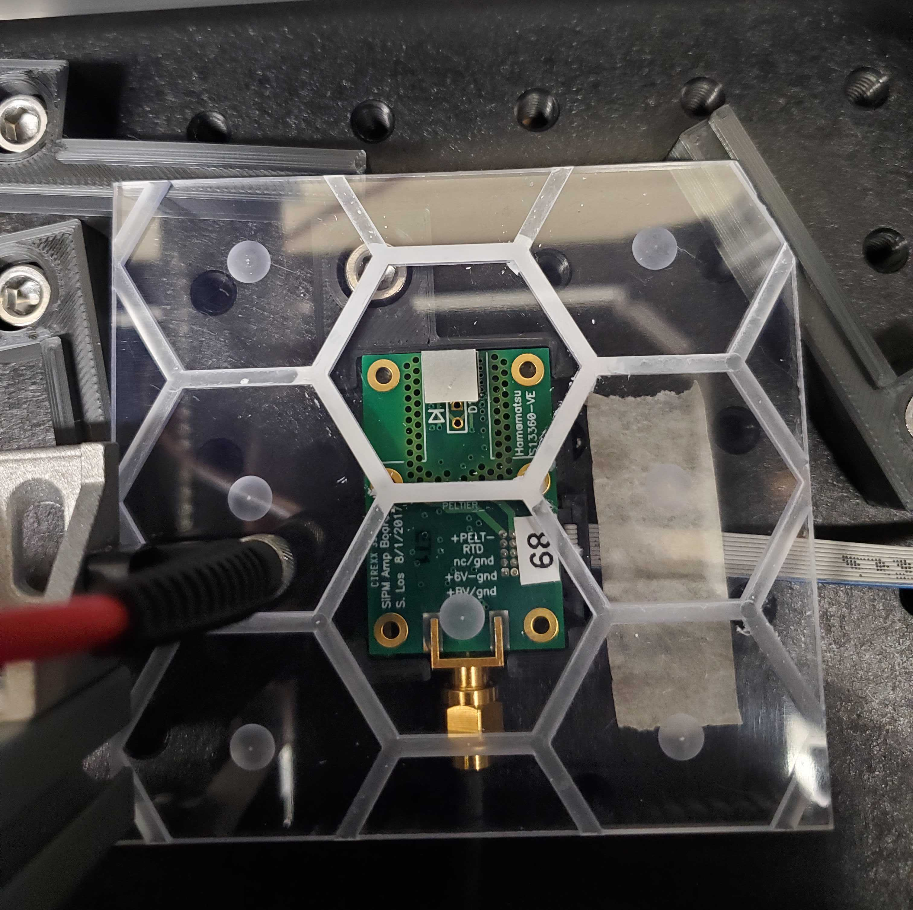
Methodology Overview
Within a darkbox, place a scintillating tile on top of a SiPM
Adjust the UV LED intensity / SiPM bias voltage for the dynamic range to cover the portion of the tile of interest
Using a low intensity LED, calculate the signal voltage to photoelectron conversion factor
Use XY stage stepper motors to scan the surface of the tile
Scan the surface of a non-scintillating tile to determine background

Slide 4
Apparatus Overview

Slide 5
Dark Box
Arduino and CNC Shield
2D Stage Stepper Motors
41.5 V
Bias
Tile
SiPM
Amp
6 V
DRS4 Digital Oscilloscope
Ch 1
UV Fiber-Optic Cable
Ch 4
Computer
CAEN SP5601 Led Driver

Slide 6
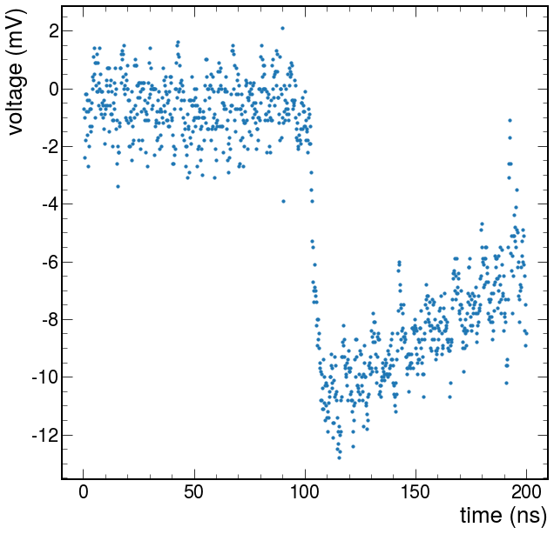
Data Acquisition
Used a DRS4 Digital Oscilloscope for SiPM readout, and recorded the waveforms using the RCDAQ data acquisition software
Triggered the data acquisition using a pulsed UV LED source
Recorded the waveforms at a sampling rate of 5 GS/s

Slide 7
Signal Strength Calculation
The way we defined the signal strength has evolved over time, with three main definitions
Definition 1: The absolute difference between the highest and lowest value in the entire waveform (peak to peak)
Definition 2: The absolute difference between the average baseline value, and the lowest value of the entire waveform (baseline to peak)
Definition 3: The absolute difference between the baseline value and the peak value of a fitted piecewise function, rejecting waveforms that don’t converge (fitted signal)

Slide 8
Signal Strength Definitions
Definition 1 (peak to peak)
Definition 2 (baseline to peak)

Slide 9
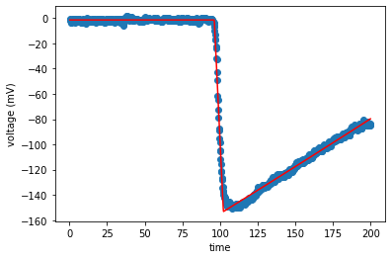
Signal Strength Definitions
Defined as a constant value, followed by a constant slope, followed by exponential decay
This method is much more sophisticated, but requires a long amount of time
Until this method can be optimized, for the following data we will use Definition 2 (baseline to peak)

Slide 10
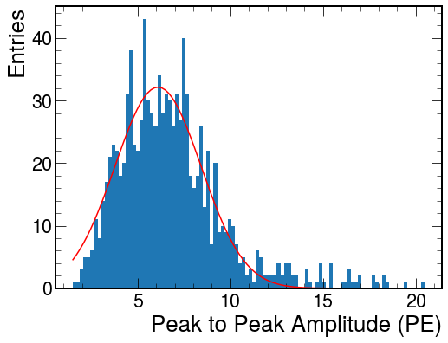
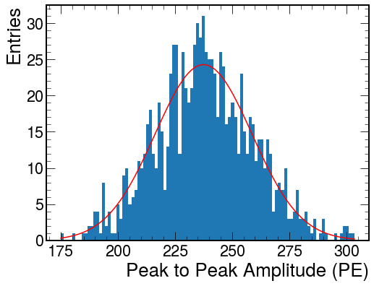
Average Signal Strength Definition
Using either of the three definitions, we calculated the average signal strength at a single position by sampling 1,000 waveforms, and fitting it to a gaussian distribution
With this, we get a dynamic range of approximately 1 PE – 310 PE

Slide 11
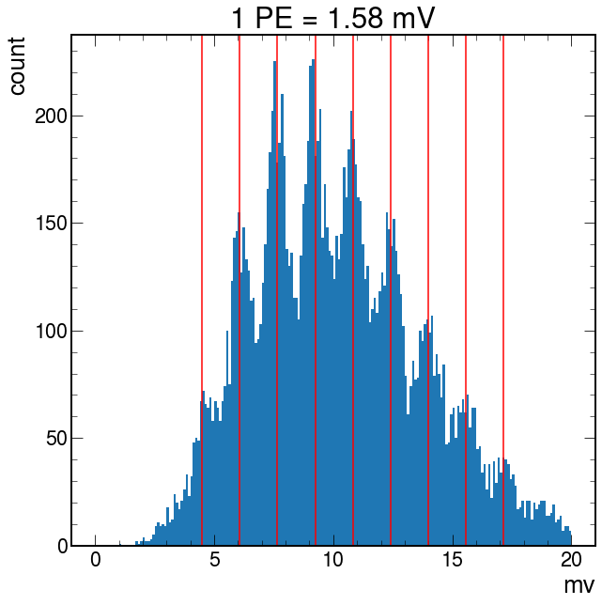
Photoelectron Conversion
Once a bias voltage is determined, we converted the voltage output from the SiPM to photoelectrons by analyzing a finger spectrum
We pulsed the UV LED onto the SiPM, and observed the discretization of baseline-to-peak values

Slide 12
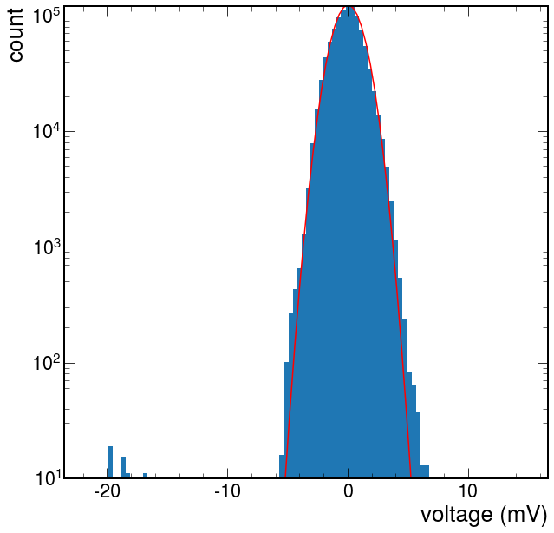
Noise Runs
Before each scan, we recorded noise runs with the SiPM bias turned off, and the LED moved far off to the side
The voltage distributions were measured as the difference between the value at a point in the waveform, and the average voltage for the entire waveform, across 1k waveforms
The noise was found to be gaussian, with sigma = 1.2 mV (converts to 0.76 PE)

Slide 13
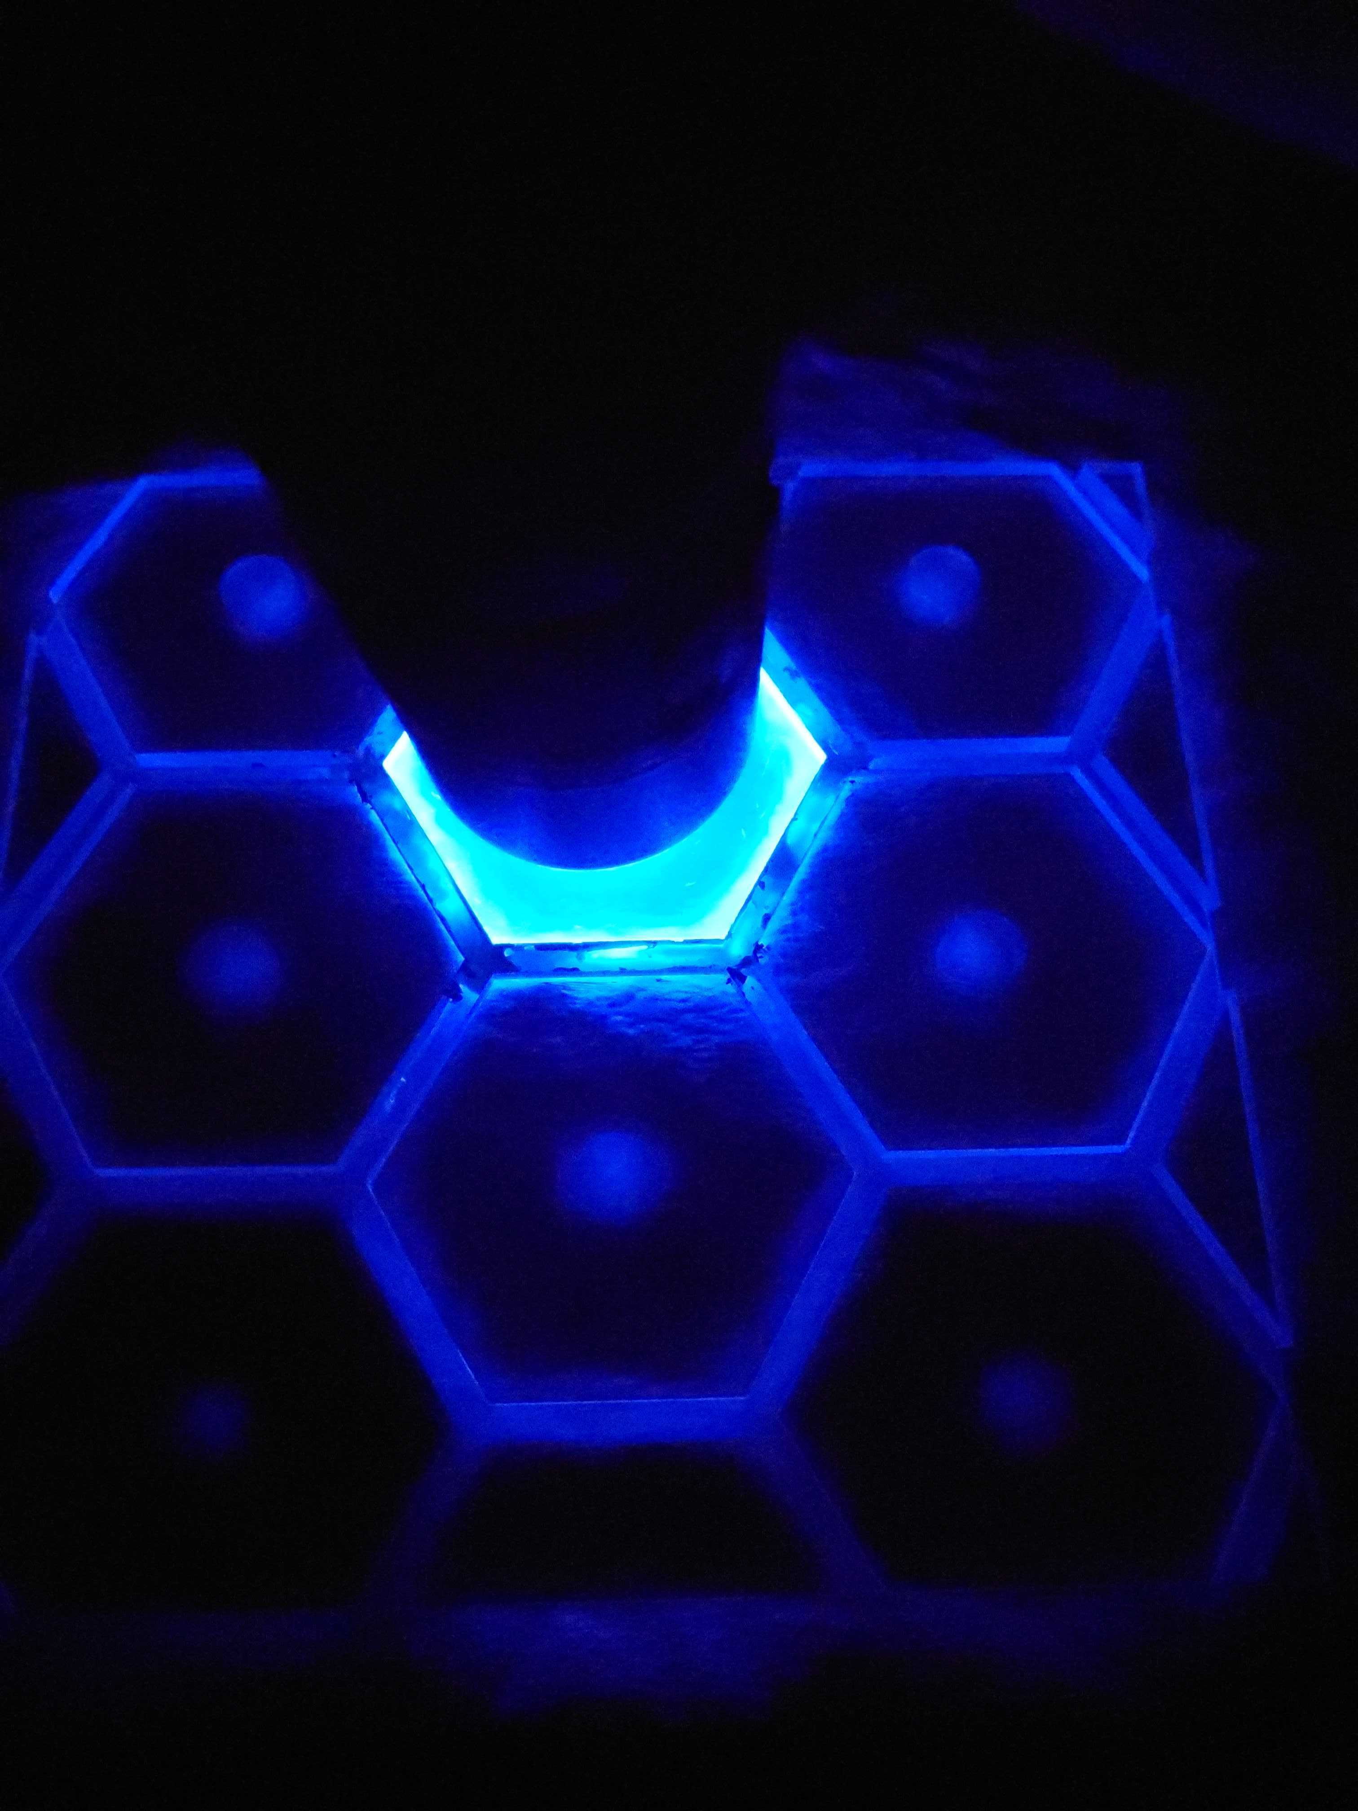
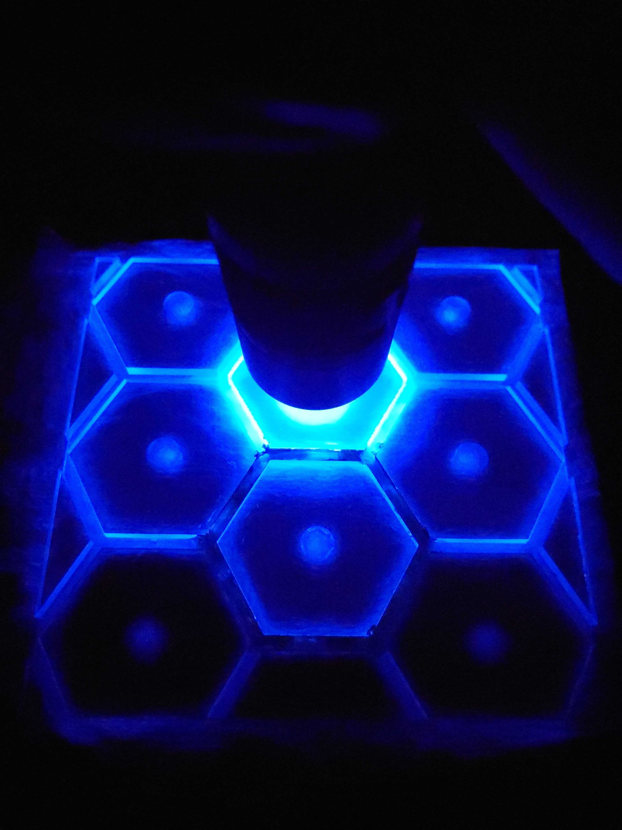
Tile Boarder Painting
We painted the boarder of a single cell to test how this improves signal containment and yield
We used highly reflective white SAINT-GOBAIN paint

Slide 14
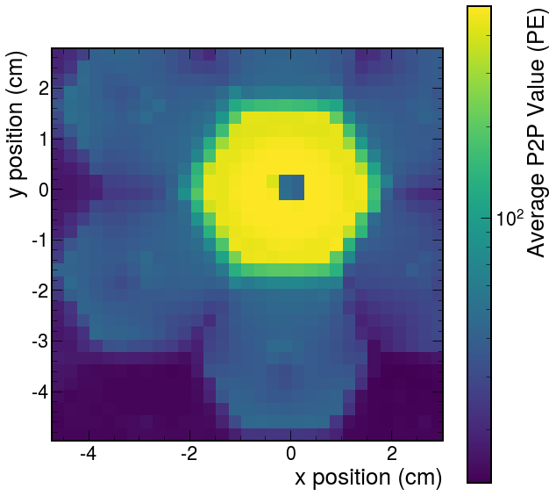
Comparison
Before paint
After paint

Slide 15
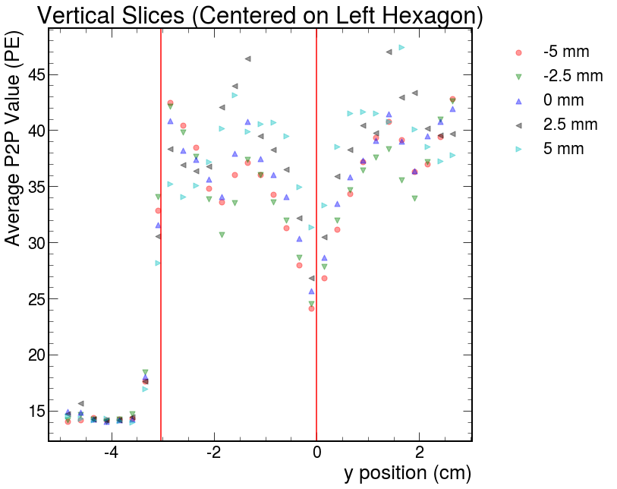
Before Paint
(mV)
Averages ~37 PE within adjacent cells

Slide 16
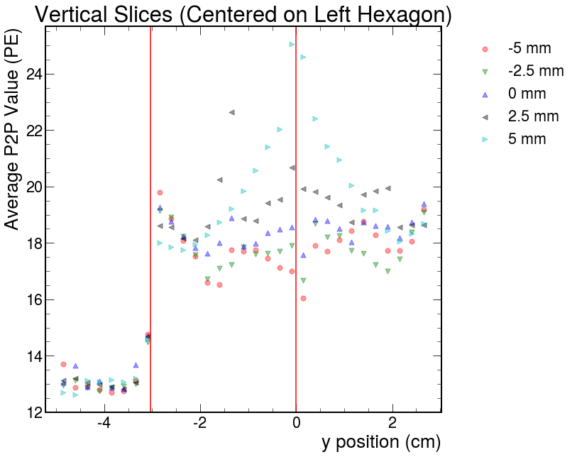
After Paint
(mV)
Averages ~19 PE within adjacent cells
~ 46% decrease in crosstalk from adjacent cells

Slide 17
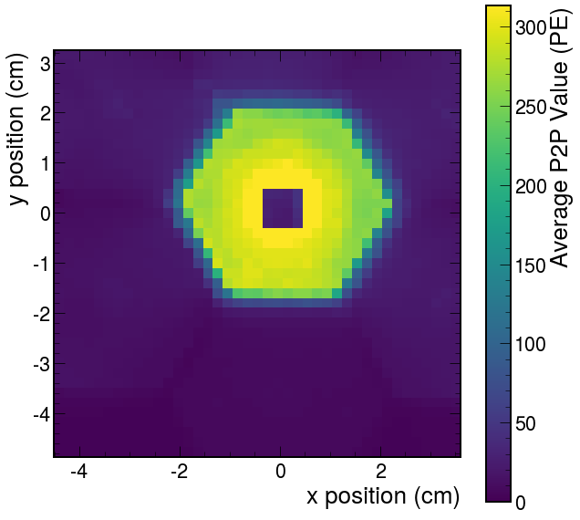
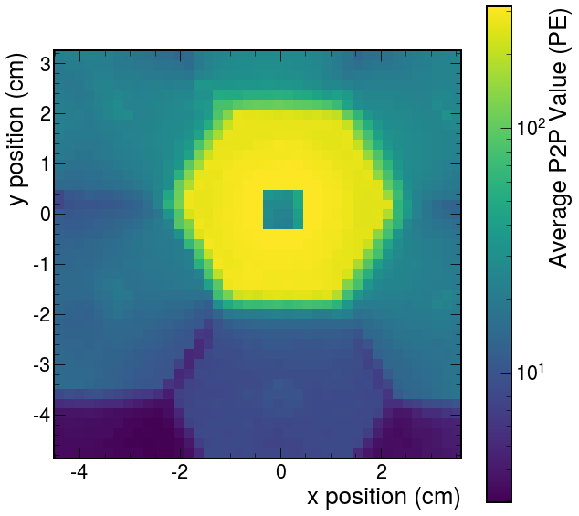
SiPM Centered on Unpainted Cell
Adjusted the LED intensity to not max out the signal within the center cell

Slide 18
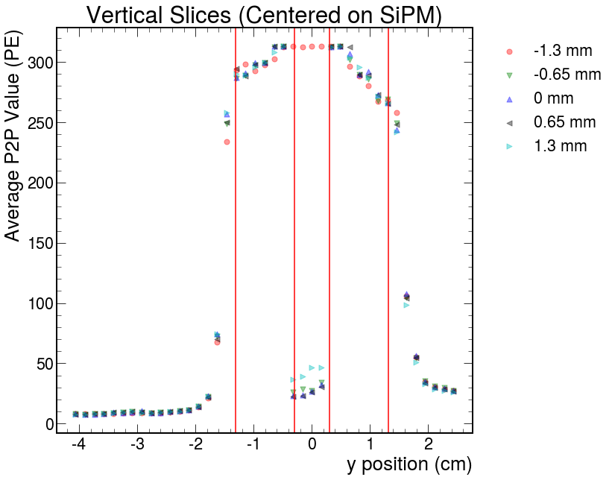
SiPM Centered on Unpainted Cell
Nonuniformity: 280 +/- 30 PE (excluding SiPM region)

Slide 19
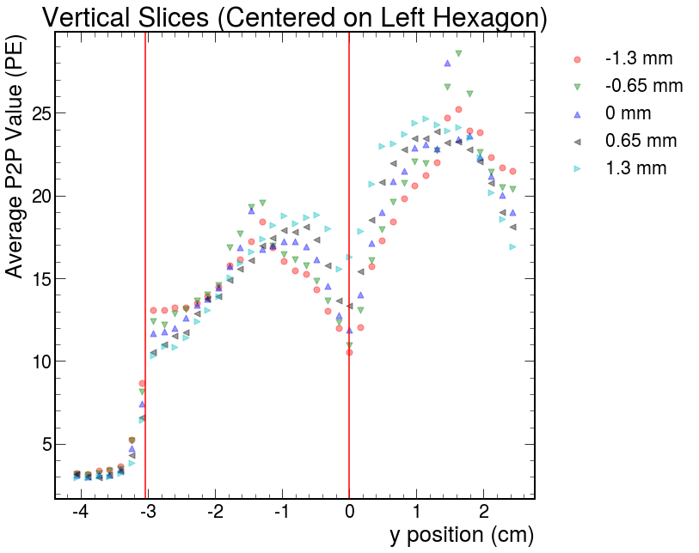
SiPM Centered on Unpainted Cell
280 PE -> 21 PE or 14 PE
7.5% or 5% crosstalk
The significant difference in signal strength is likely caused by the nonuniform application of paint

Slide 20
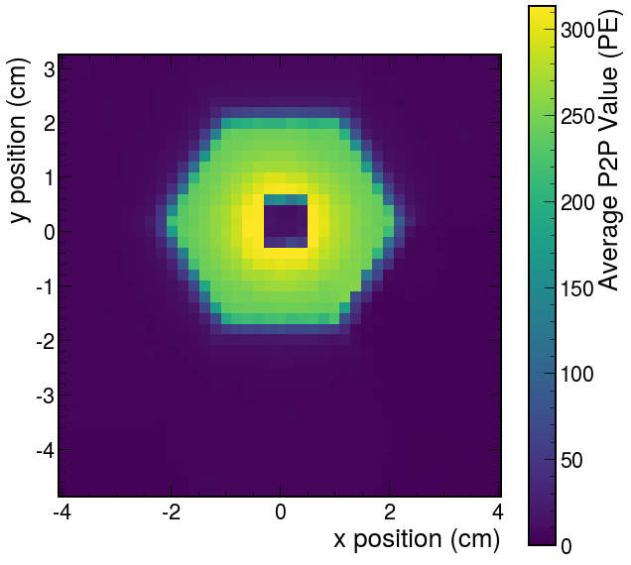
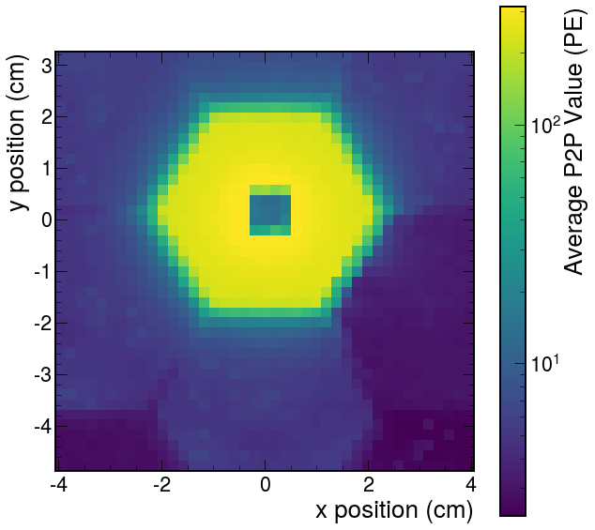
SiPM Centered on Painted Cell

Slide 21
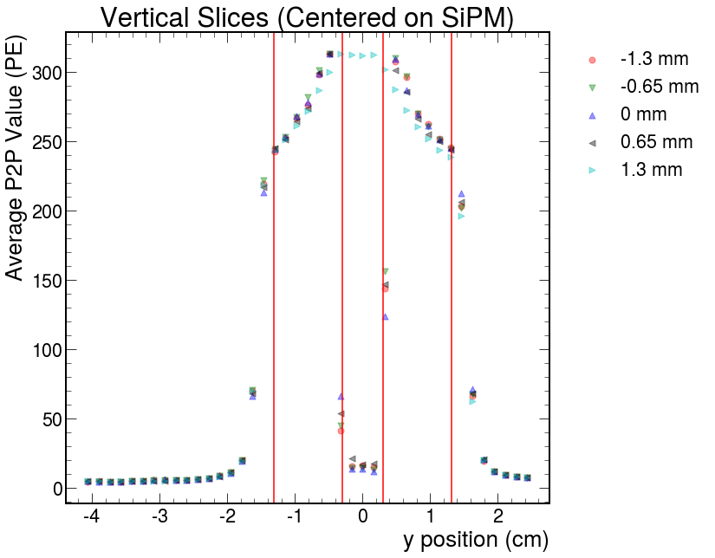
SiPM Centered on Painted Cell
Nonuniformity: 280 +/- 30 PE (excluding SiPM region)

Slide 22
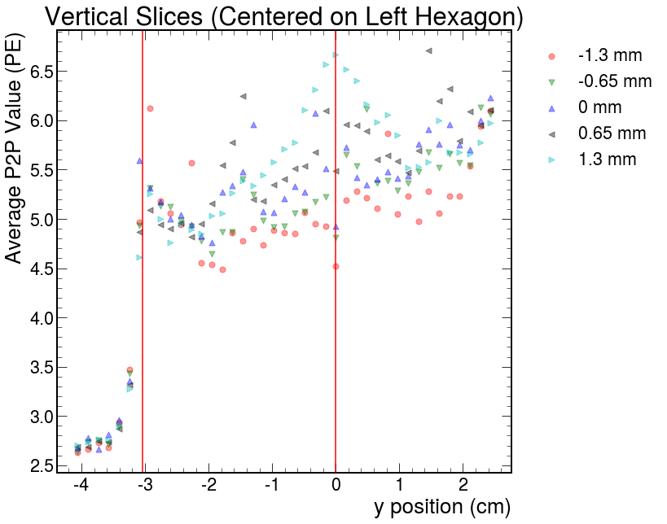
SiPM Centered on Painted Cell
280 PE -> 5.5 PE
2% crosstalk

Slide 23
Unpainted
Painted

Slide 24
Preliminary Painted Tile Results
Painting the tile resulted in a ~46% decrease in signal strength from adjacent cells
When including the gain improvements within the painted cell, the crosstalk decreased by ~60% to ~73%
The total nonuniformity within the painted cell did not measurably improve, although the region directly above the SiPM was not measured, and the area immediately around it was likely influenced by a “spotlight” effect

Slide 25
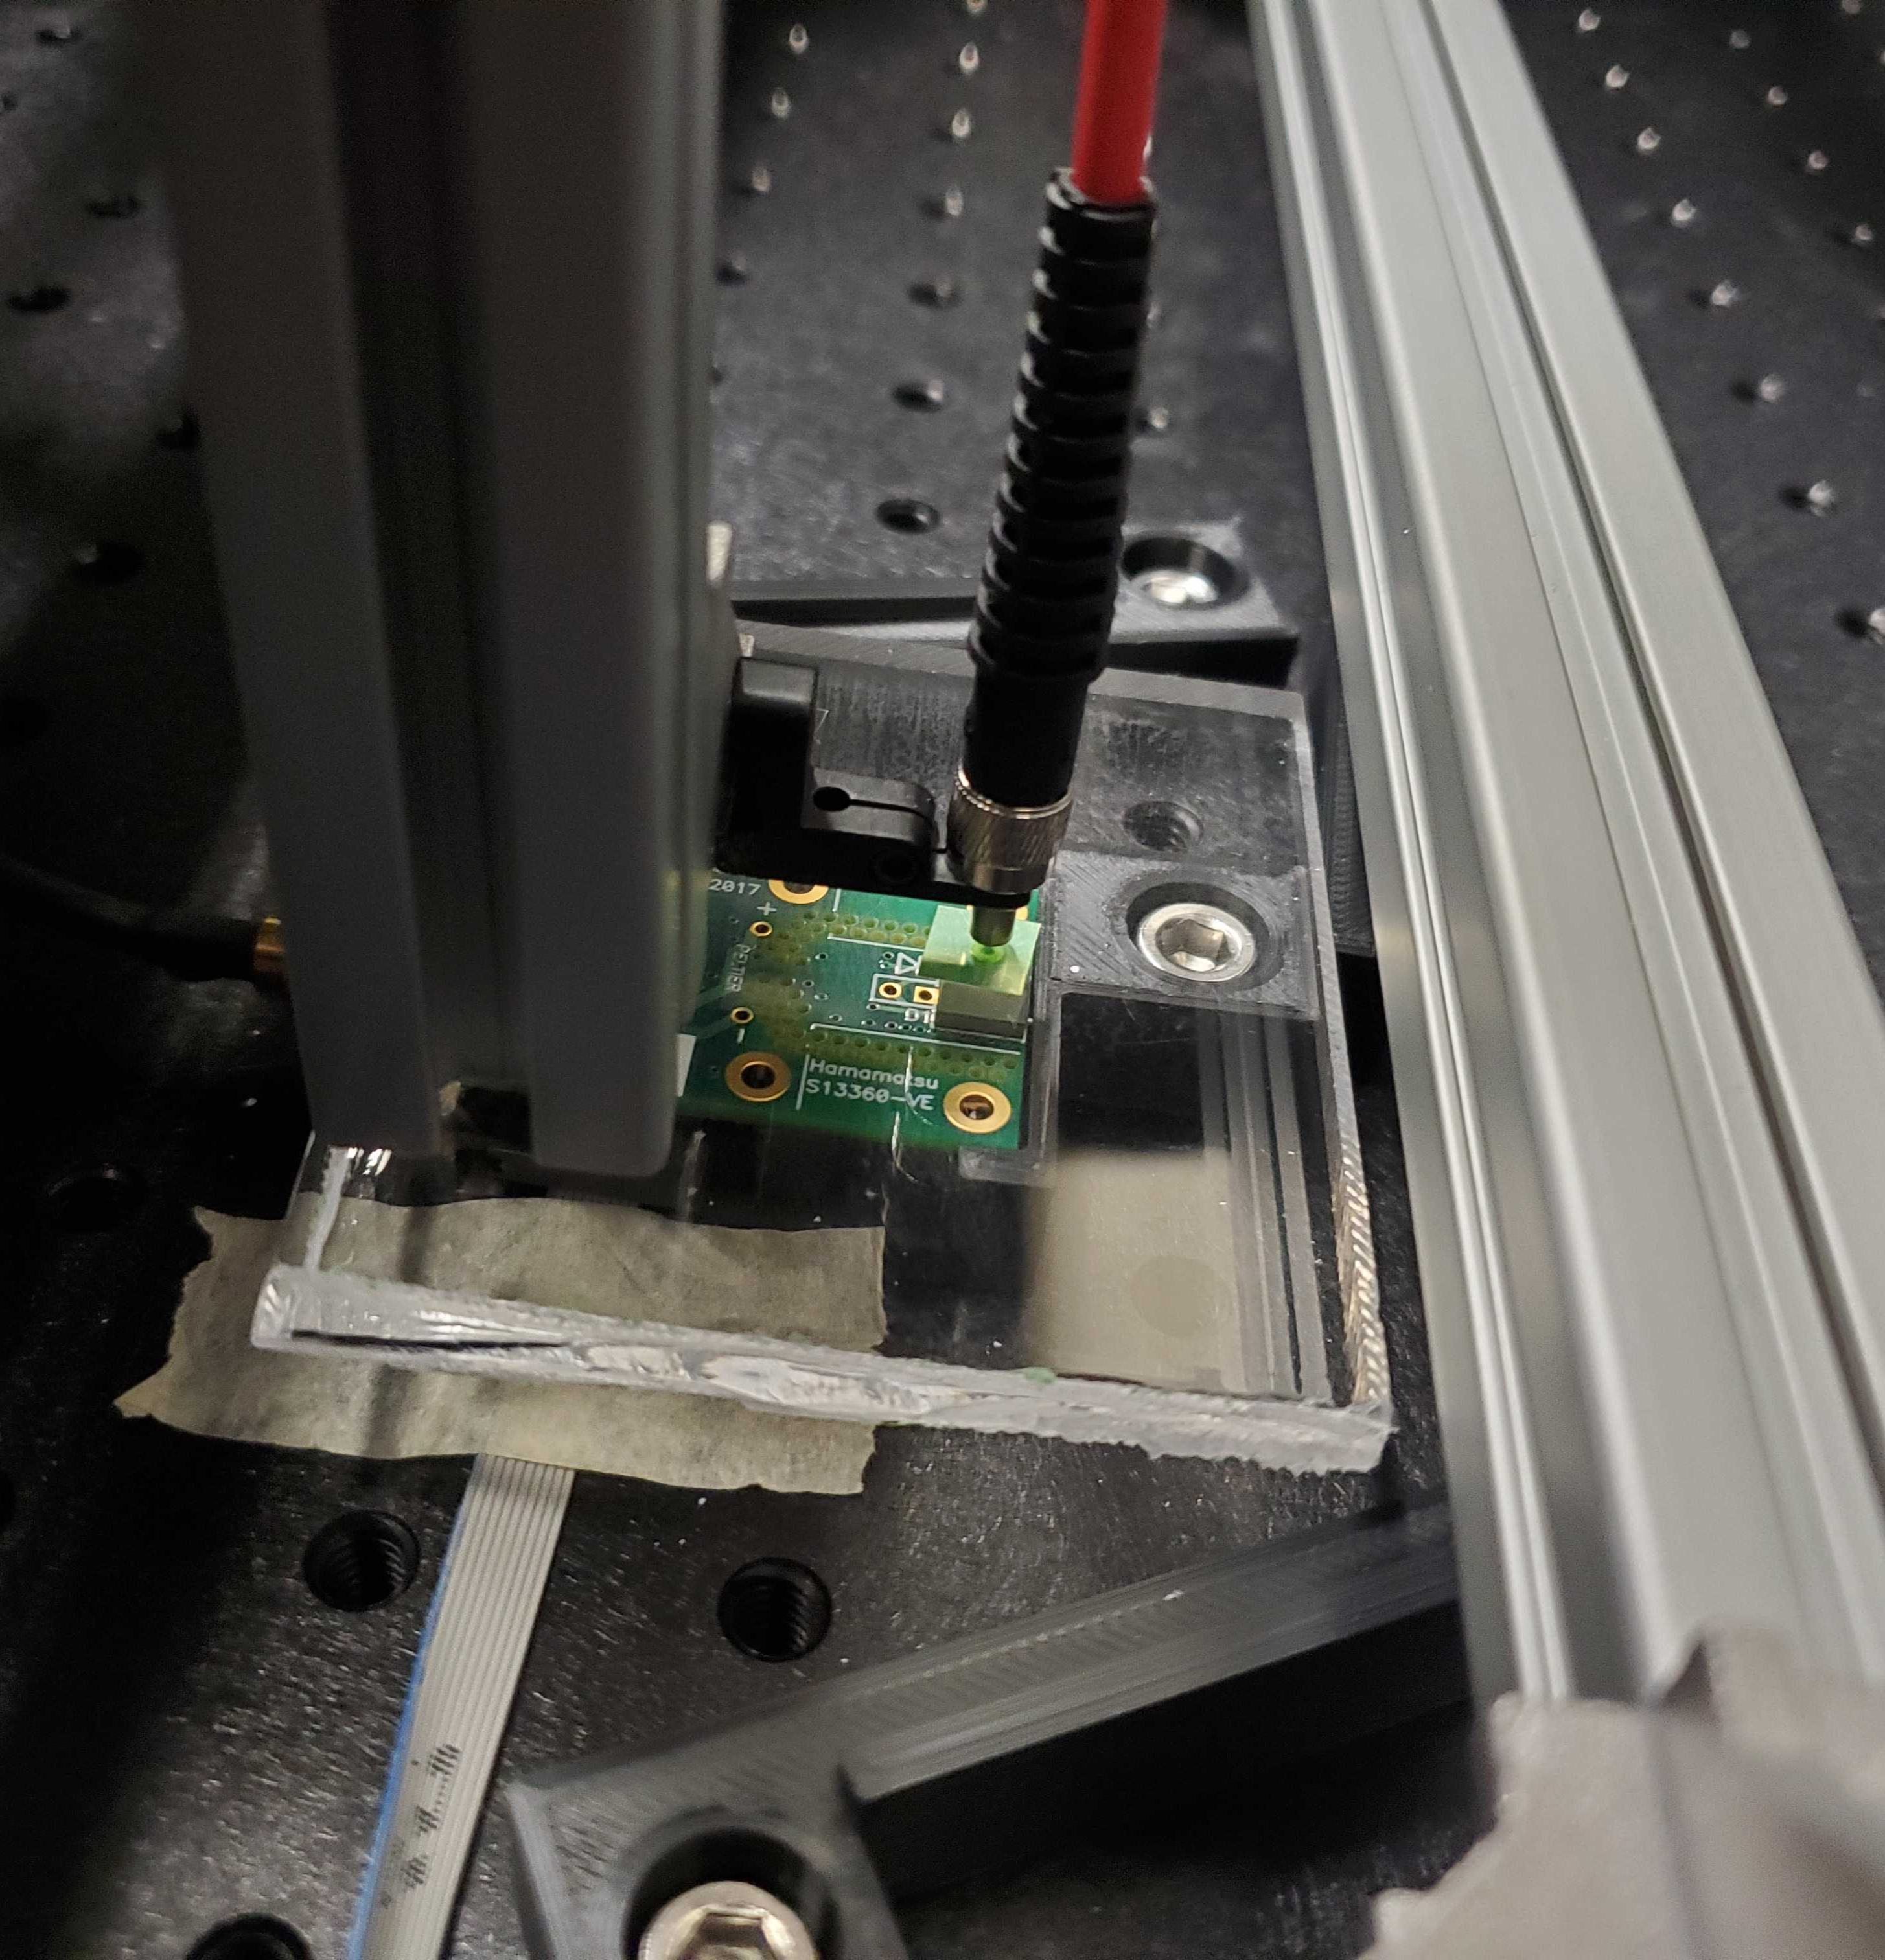
Background Scan
To estimate the effects of a “spotlight effect” from the LED (light traveling directly into the SiPM without scintillating), we scanned an acrylic tile
We will want to repeat this study with a tile of similar thickness to the scintillating tile, and determine the relative opacities between the two materials at the wavelength generated by the UV LED
Once these are determined, we will be able to scale the signals appropriately and subtract out the background generated by this spotlight effect
Before then, this scan determines the affected region

Slide 26
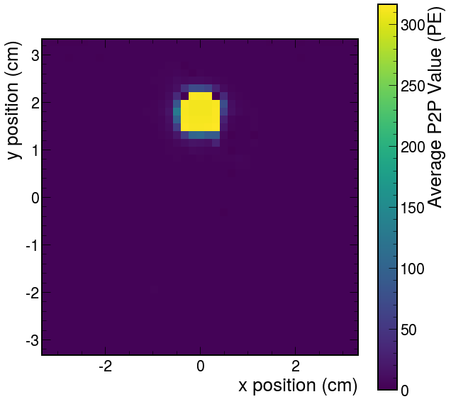
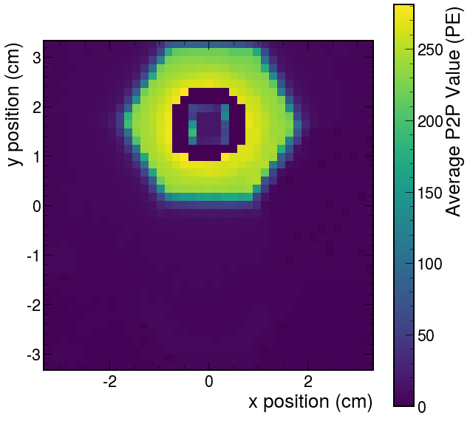

Slide 27
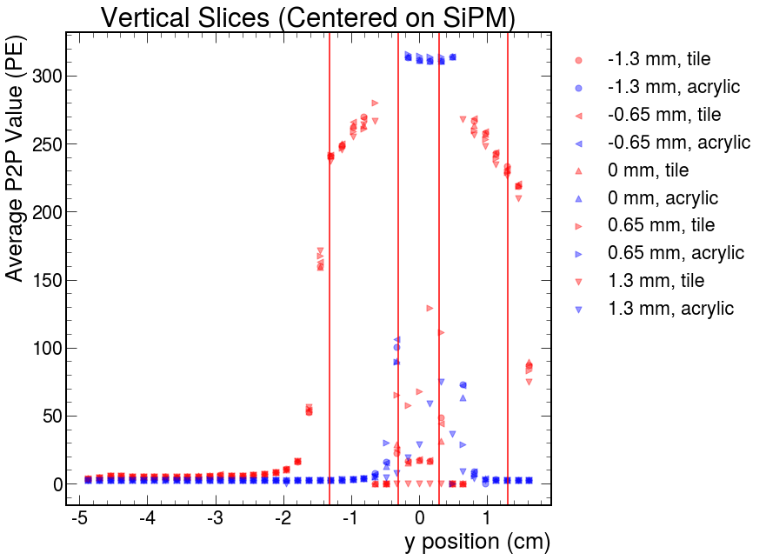
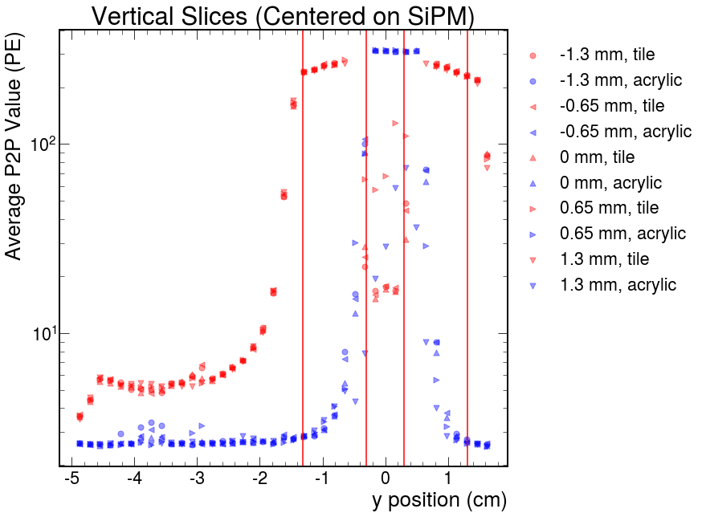
The ”spotlight effect” appears limited to the region directly above the SiPM

Slide 28
Plans
Optimize the new fitting method to determine signal strength values
Add reflecting foil across nearly the entire front and back of the tile, leaving a small slice open to do a vertical scan down the middle
Repeat the acrylic background scan using an appropriate tile, foil, and LED intensity
Adjust the various parameters of the apparatus to achieve a wider dynamic range, or limit the scans to specific regions within the tile
With a clean tile and using foil, study the impacts of painting boarders, and polishing the dimples

