Slide 1
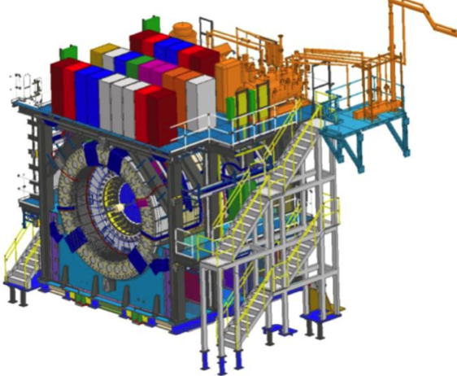
sPHENIX MIE Project Overview
TPC | Project Director | Last CD Achieved | % Complete | CPI | SPI
$27.0M | Edward O’Brien | PD-2/3 | 95.4% BCWP/BAC@ 5/31/2022 | 1.00 | 0.98
Scope
  Detector systems produced, tested and ready for installation: Time Projection Chamber w/ electronics, Electromagnetic Calorimeter w/ electronics, Hadronic Calorimeter w/ electronics, DAQ/Trigger, Minimum Bias Detector, Project Management
Not in scope
  SC-Magnet, Bldg/Det Infrastructure, Installation and System Commissioning
Schedule
  CD-0 received Sept 2016
  CD-1/3A received Aug 2018
  PD-2/3 received Sept 2019
  Early completion in Aug 2022. Four months of float to PD-4
  PD-4 Dec 2022
Cost
  $27.0M AY TPC 70.3% contingency on an ETC of $1.48M
Commitments = $1.79 M
The early completion date moved one month in April

Slide 2
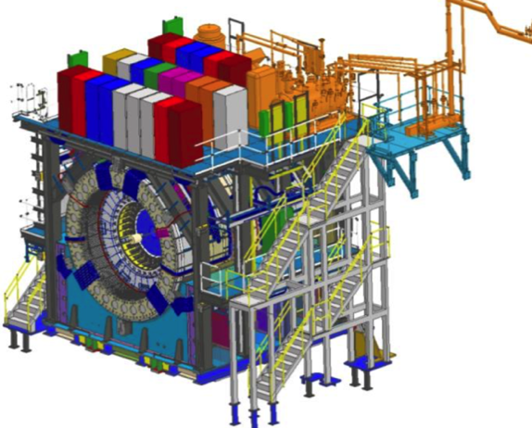
BNL 1008 Infrastructure & Facility Upgrade
TPC | Project Director | % Complete | CPI | SPI
$33.4 M AY | Edward O’Brien | 86.5% BCWP/BAC @ 5/31/2022 | 0.93 | 0.92
Scope
  SC-Magnet support including the Flux Return, Cryogenics into Bldg 1008, Detector Carriage/Cradle, other Bldg 1008 Infrastructure improvements
  sPHENIX Installation, Integration and Commissioning of each Subsystem is part of the scope
Not in Scope
  PreOps prior to RHIC collisions
Schedule
  sPHENIX Ready for Operations (Early Completion) 2/22/23
  First RHIC run of sPHENIX Feb 2023
  No float in schedule between sPHENIX “Ready to Operate” &
  nominal start of RHIC-23 run. Looking to recoup schedule contingency
Cost
  $33.4 M AY Total Project Cost with 42.7% contingency on ETC of $4.51M
96.1% Costed and Committed
Commitments = $1.04M

Slide 3
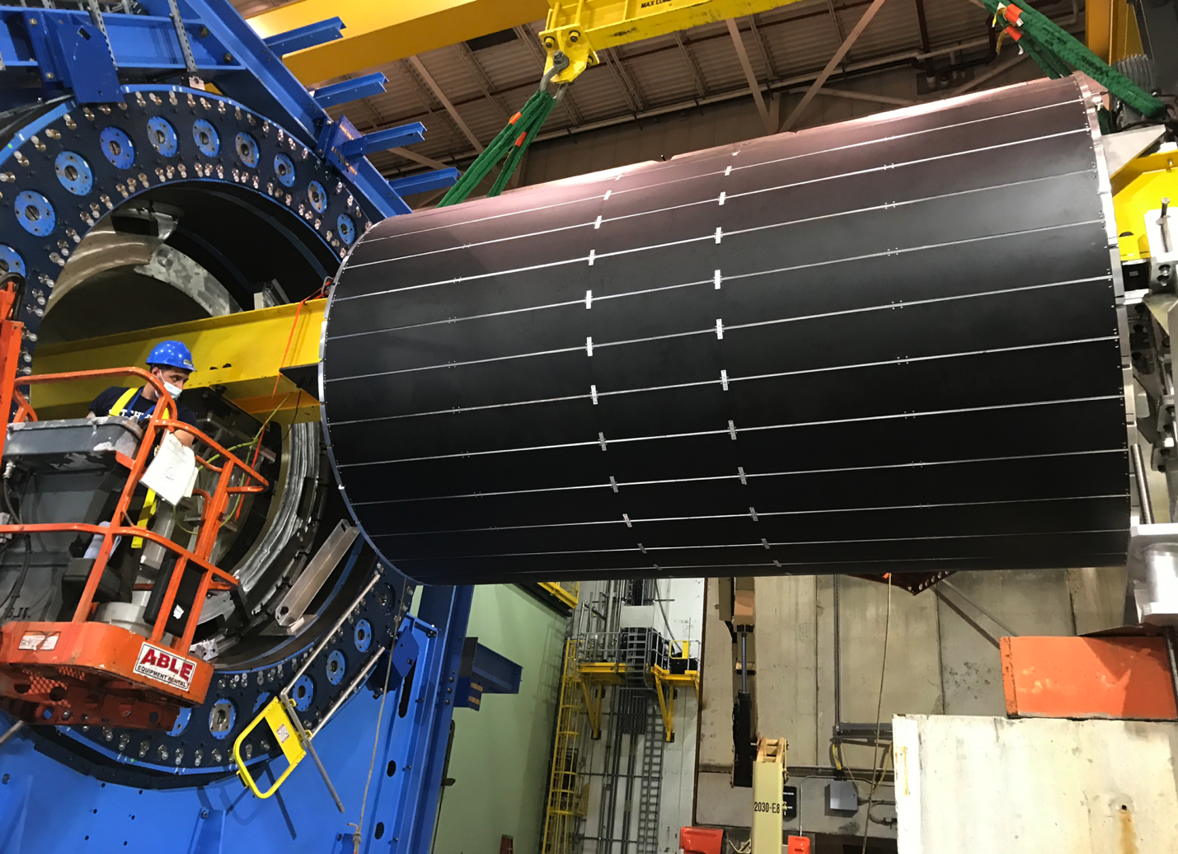
IHCal Installation 6/8/22

Slide 4
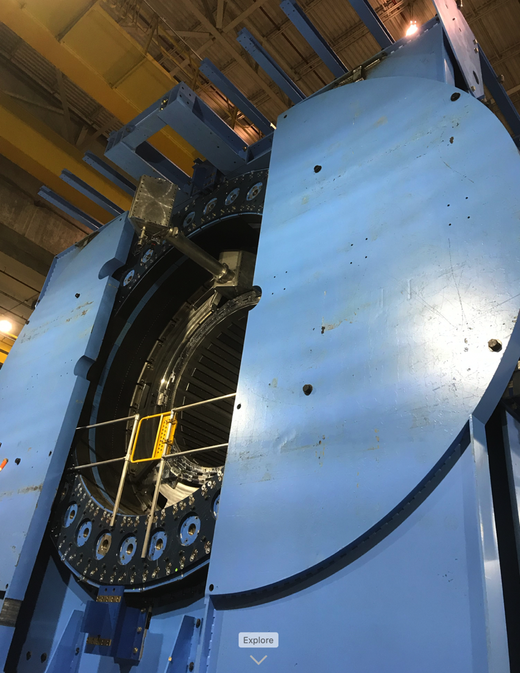
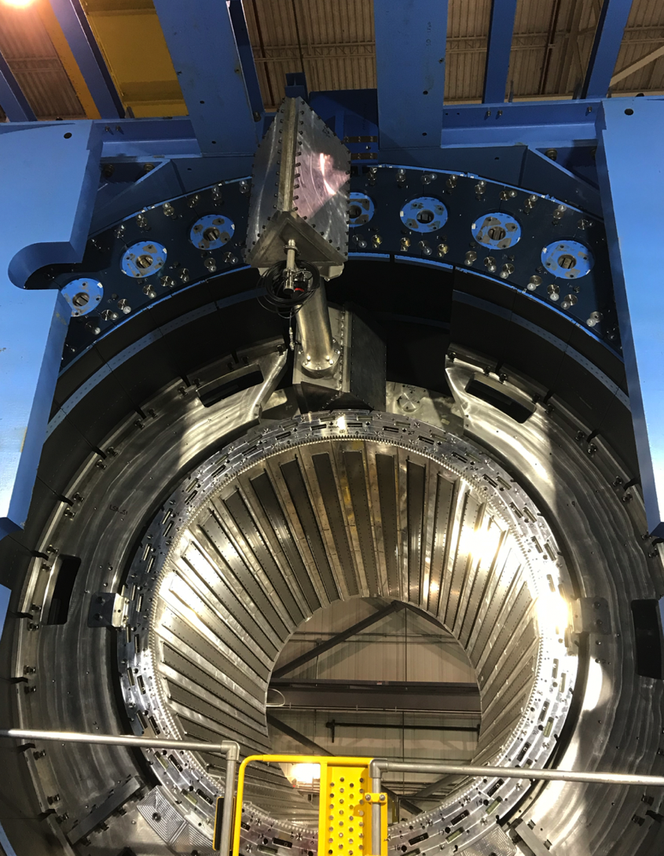
sPHENIX Status- South Pole Tips Installed

Slide 5
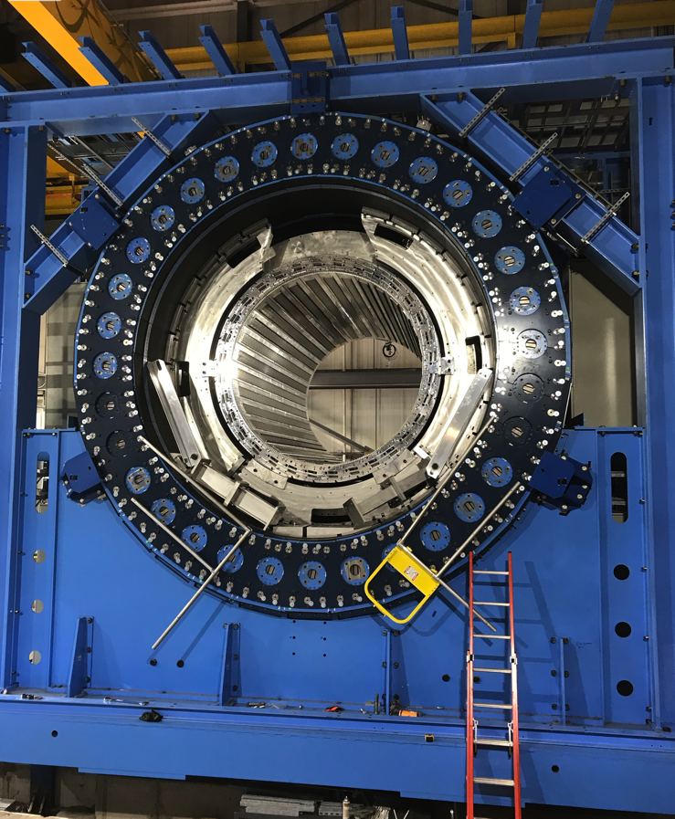
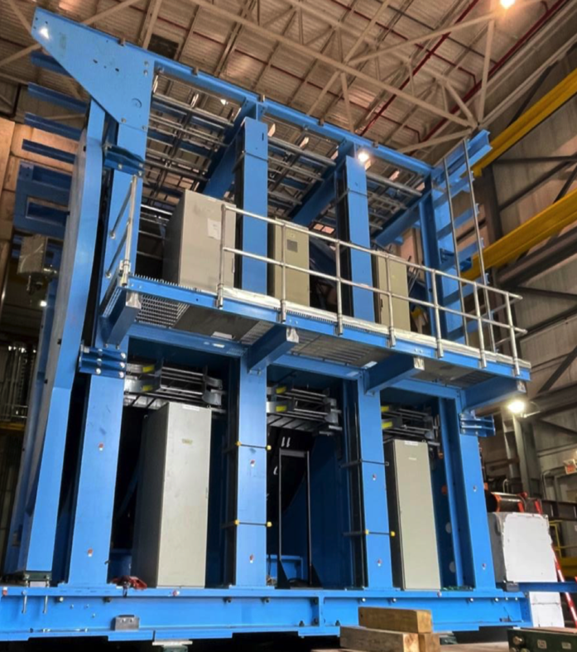
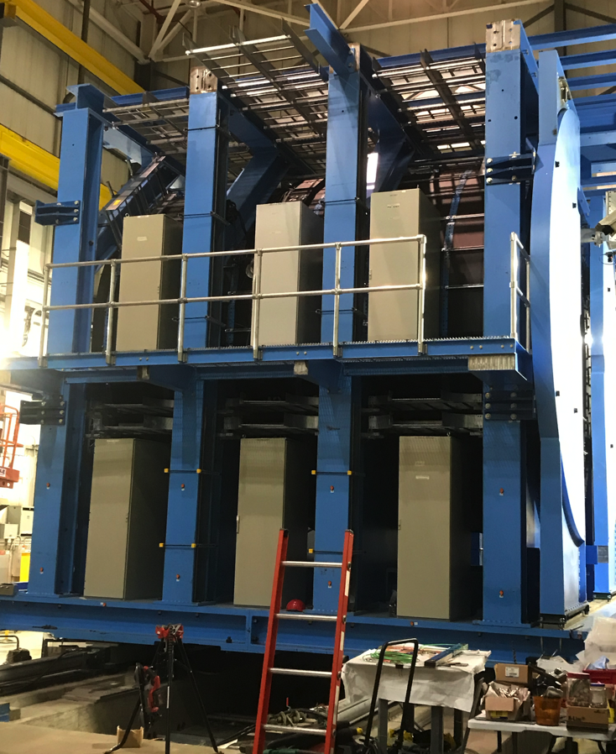
sPHENIX Progress
West side of Carriage w/ Racks installed
East side of Carriage w/ mid-level platform
North side of sPHENIX w/ IHCal installed
We are making good progress, but there are many challenges ahead

Slide 6
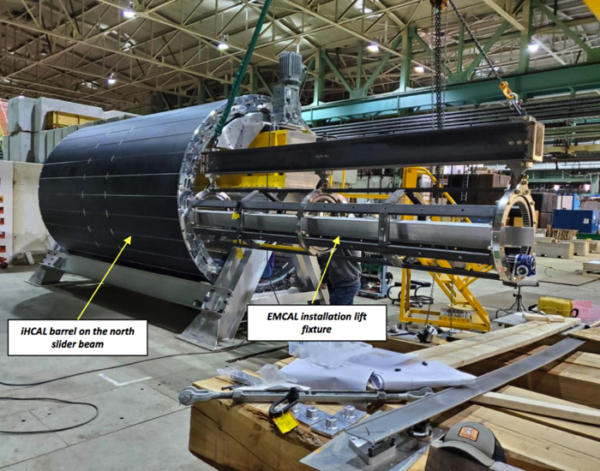
sPHENIX MIE Status
All OHCal sectors complete, installed, tested. 100% good channels
All IHCal sectors complete, installed, tested. 100% good channels
All EMCal sectors complete. Burn-in complete. Ready to install.
All Calorimeter on-detector electronics complete, tested.
Calorimeter digitizers 100% assembled. Testing advanced.
All TPC det components at SBU w/ exception of laser system. All 72 quad-GEM modules assembled, tested, gain and IBF mapped. 72+ quad-GEMs ready for installation. Prep for central membrane assembly underway.
TPC FELIX boards complete. TPC Fee boards needs 1 chip (PLL) added, minor FEE assembly mod and testing. TPC Fee at assembler for mod. JACK board waiting for 1st article before production order.
DAQ/Trigger: Large switch, DAQ computers, Buffer boxes, GTM/GL1 complete. Waiting on GL1 (Oct) and DCMII (missing FPGA chip).
MBD detector complete. MBD D/S board delivery late due to late chip delivery. Projected delivery of assembled D/S boards Nov
Installation tests of EMCal
.

Slide 7
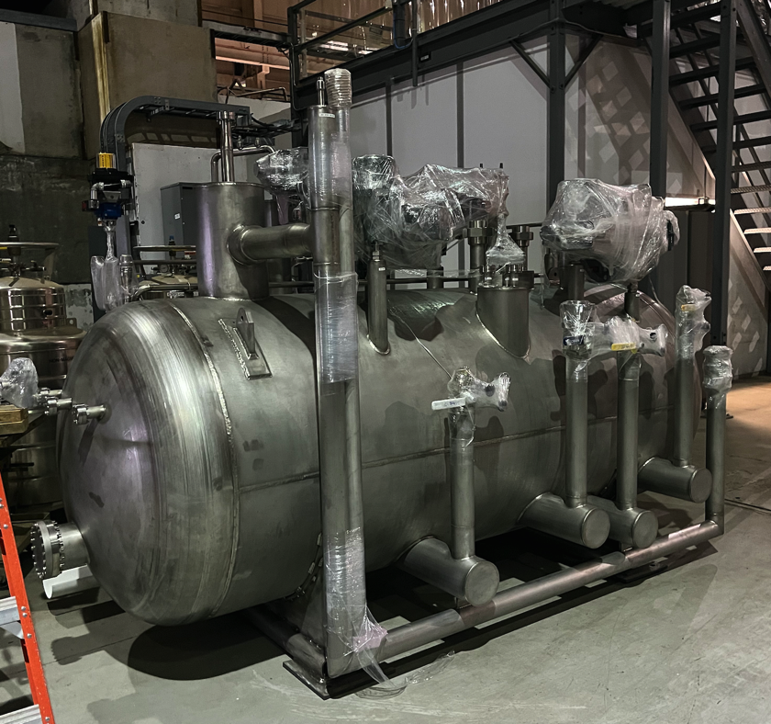
1008 Infrastructure & Facility Upgrade Status
Carriage/Cradle assembled in 1008
XY Carriage tables, Carriage Hydraulics installed
IR track reinforcement complete.
Outer HCal and Large Support Rings installed
SC- Magnet installed
IHCal assembly complete. IHCal installed
EMCal ready for installation. Installation procedure set.
Most LHe cryo components delivered including Coldbox.
LN2 & warm piping part delivered, installation begun
S Magnet pole tips installed. N Magnet pole tip installation starting.
Rack Platform installation underway.
Chiller platform, TPC/MVTX/INTT installation fixtures & brackets in fab
Order placed for brackets and supports for Beam pipe, MBD, MVTX
Be recovered from STAR. Transition Beam pipe design complete by sPHENIX+CAD Vacuum group. Orders being placed.
Working on Magnet Mapping contract w/ CERN
Lehigh will place sEPD bracket/supports order w/ NSF funds
sPHENIX Coldbox in 912

Slide 8
High Priority Issues
Installation in 1008.
  Magnet pole tips, platform, cryo work in June-July.
  EMCal Installation July-August
  IR Roll-in, Cryo Hook Up Jul-Aug
  Magnet Cool down, Magnet mapping Aug-Oct
Maintain the sPHENIX technical work force.
Assemble and install TPC, MVTX, INTT
Complete TPC Fee production board testing. Complete development of TPC FELIX and Fee firmware.
Keep remaining electronics on schedule: LL1, MBD D/S, DCMIIs, JACK(TPC controller) board
Get BHSO approval of USI. Prep for IRR and ARR.
Place Remaining procurements

Slide 9
sPHENIX PEMP Notable for 2022
Notable Outcome - BHSO/SC: Effectively plan, execute, and successfully deliver SC projects equal to or less than $50 million that have been delegated to the Laboratory Director by SC under DOE O 413.3B [Super Pioneering High Energy Nuclear Interaction (sPHENIX)]. Clearly demonstrate successful accomplishment of key milestones in FY 2022 (adjusted for schedule impacts created by the COVID-19 pandemic) in accordance with SC guidance. (Objective 7.2)
PEMP notable associated with the sPHENIX MIE L2 completion
  IHCal mechanical sectors complete - Jan 1, 2022 ✔ Completed ahead of schedule
  EMCal sectors complete - May 15, 2022 ✔ Completed ahead of schedule
  DAQ/Trigger GL1/GTM production complete - June 1, 2022 ✔ Completed ahead of schedule
  Calorimeter electronics complete - July 1, 2022 ✔ Completed ahead of schedule
All milestones associated with 2022 sPHENIX PEMP notable complete. All completed ahead of schedule.

Slide 10
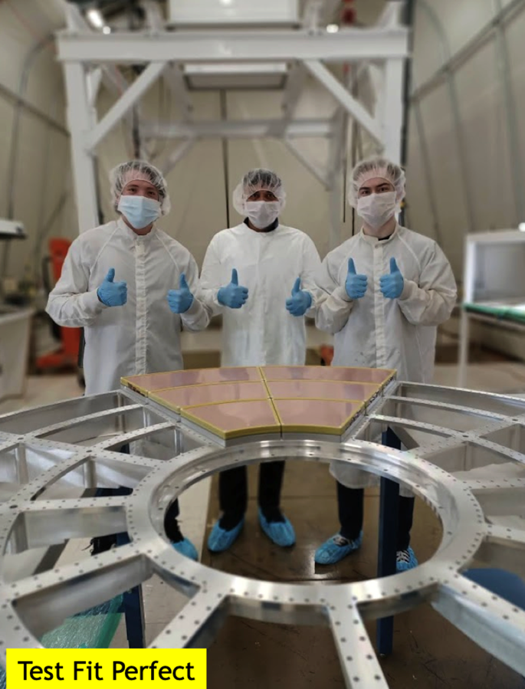
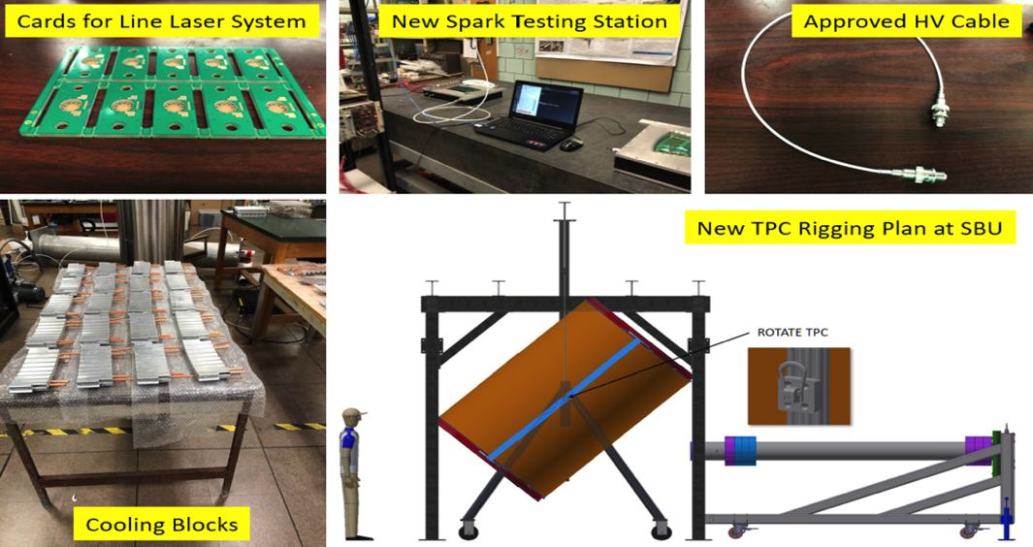
TPC Status
Most mechanical components complete. Central membrane assembly in June-July
Inner field cage complete
Outer field cage complete in July
All 72 quad GEM modules complete. HV tests good. Gain and IBF mapped good.
TPC chamber assembly August.
All TPC Front End electronics cards at assembly house for added PLL plus minor mods. Back at BNL in July.
All FELIX cards build and tested. Firmware development ongoing.
All line lasers at BNL. Awaiting attenuators due in Sept.
Laser calibration system components arriving from vendor. Diffuse laser delivery by Nov.

Slide 11
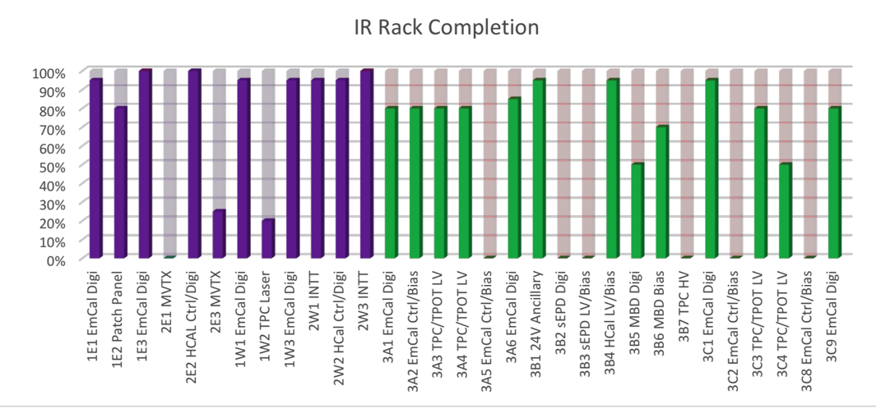
Calorimeter Electronics
All frontend components, cables and fiber optics have been received at BNL, tested and delivered to EMCal, HCal and Infrastructure
All major components for the EMCal and HCal Bias and LV distribution systems delivered to BNL.
All trunk fibers, fiber patch panels ordered. Deliveries on schedule.
Digitizer board assembly complete. Yield looks good (90-95%). Able to repair boards in house at BNL.
The Univ Colorado group continues to do QA tests on digitizer electronics received from Nevis Labs prior to shipping to BNL.
Electronic rack assembly for Cal digitizer ongoing and on schedule at BNL.
Digitizer Rack
Need 31 racks in 1008 IR

Slide 12
Overall MIE Electronics Status
Completed or underway:
All on-detector calorimeter electronics delivered and tested
All calorimeter digitizers assembled. Testing nearly complete.
All LV and Bias supplies delivered
All fibers and patch panels delivered or on order.
GL1/GTM complete.
All FELIX cards for TPC, MVTX, INTT delivered. Firmware development underway.
All TPC Fee boards assembled. Recently arrived PLL chip being added at assembly house.
Parts for LL1, MBD D/S available. Need assembly & testing. Assembled boards due Oct-Nov.
Missing chips needed to complete electronics:
DAQ/Trigger: Need 6 DCMIIs - Stratix III FPGA. No delivery date.
DAQ: GL1/GTM

Slide 13
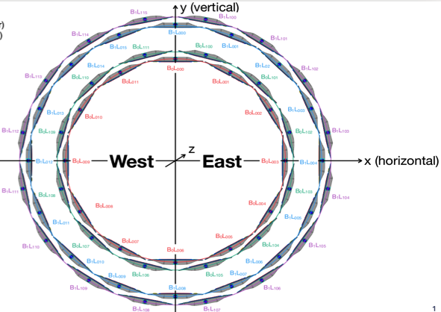
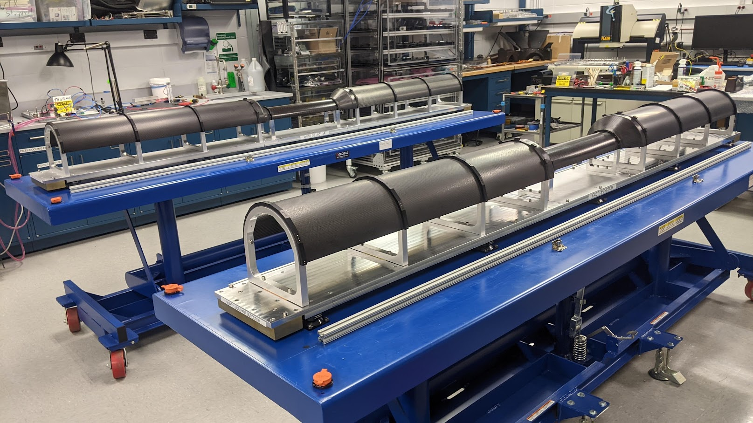
Status of the Intermediate Silicon Tracker (INTT)
Ladder mass production (84) at BNL achieved successfully: done
LV/HV systems made and installed in the sPHENIX-IR successfully: done
Cooling system made and tested successfully using barrels: done
Carbon-Fiber-Composite (CFC) inner parts fabricated and delivered (05/25) successfully: done
CFC inner parts mounted and fit properly on the INTT support structure
Two layers B0L0 and B0L1 (50% of INTT) achieved successfully 06/22: done
  Ladders assembled in barrels,
  cables/cooling tubes mounted and fully tested with final cooling system
  All ladders in B0 barrel fully tested with pulse and full bias voltage, and they are working 100%.
  B0 fully surveyed by BNL surveyors.

Slide 14
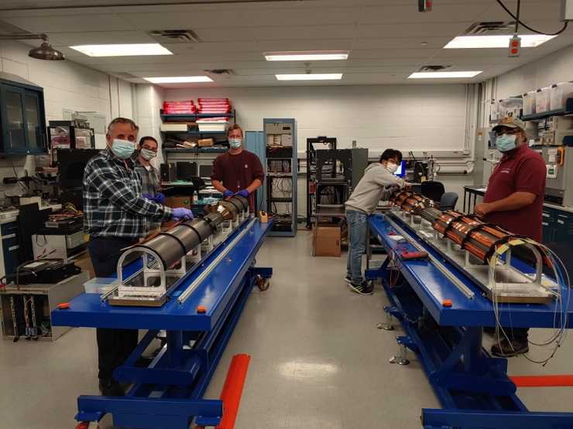
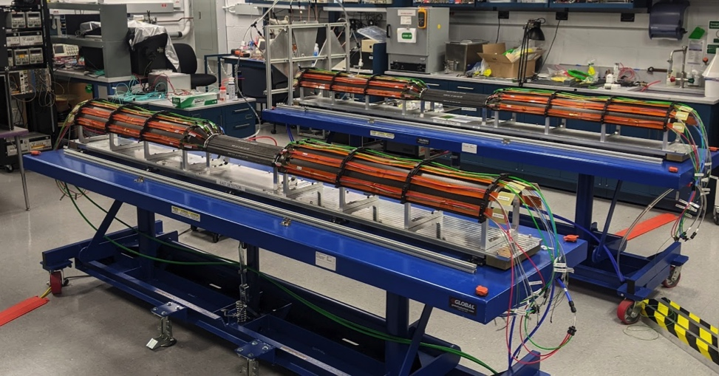
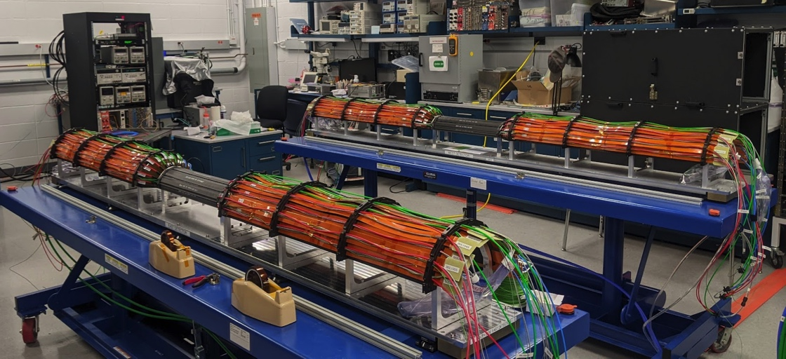
Status of the Intermediate Silicon Tracker (INTT)
Layer B0L0 : assembled, tested, surveyed
Layer B0L1: assembled, tested, surveyed
INTT has two barrels with four layers:
- B0 (two layers B0L0, BoL1): done
- B1(two layers B1L0, B1L1): waiting for bus extender cables delivery soon to start the assembly of B1

Slide 15
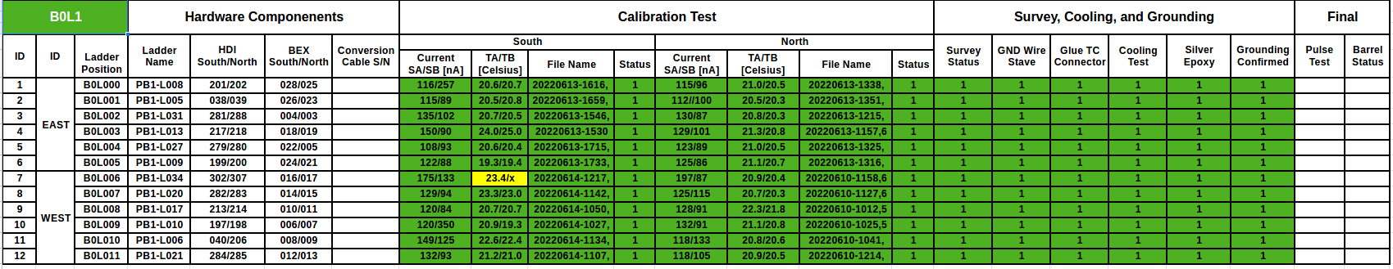
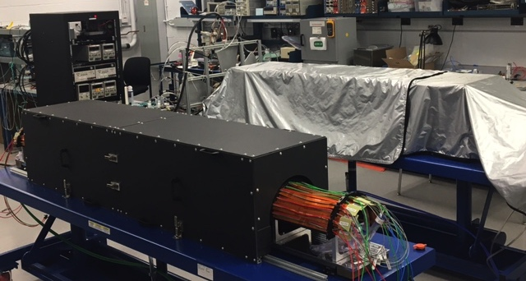
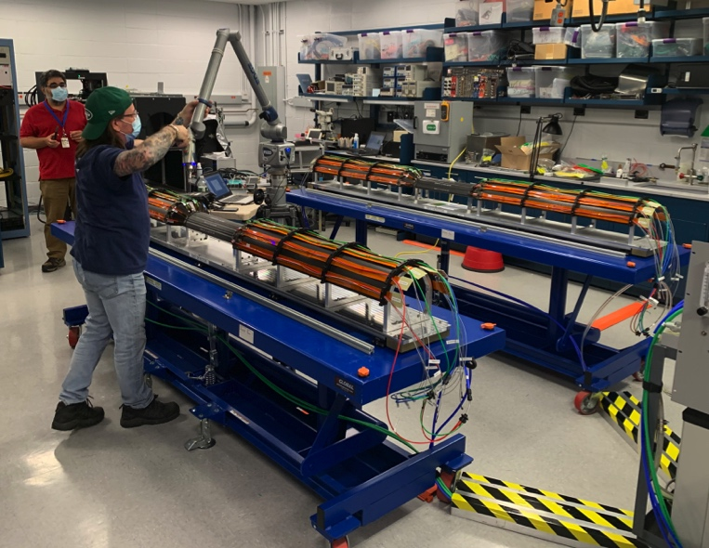
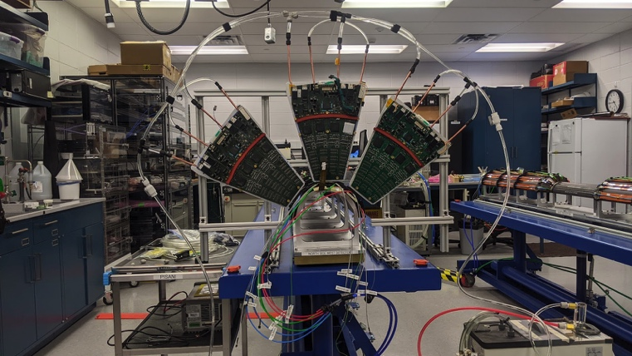
Status of the Intermediate Silicon Tracker (INTT)
Barrels Survey
Barrels Testing with ROCS

Slide 16
Risks and Challenges
Maintaining labor force for the next 9 months. Especially important are:
  Technicians for fab and assembly and installation
  Visiting students, postdocs and scientists for QA, testing and commissioning.
  We have been successful in borrowing techs from other parts of BNL.
Global issues may affect the cost and schedule of the project going forward
  Missing one electronic chip (FPGA for DMCIIs). However late deliveries of other electronics components have negatively impacted the overall schedule MIE and early completion date.
Need USI approval for He flow and Magnet Mapping in Aug-Oct ( helium cool down in August). Need ASE/SAD approval via IRR and ARR, for sPHENIX Operations in RHIC Run-23 beginning Feb 2023.

Slide 17
Summary
sPHENIX installation is proceeding well.
  IHCal barrel is installed.
  South Magnet Pole Tips installed. North Pole Tips to be installed this week. Platform assembly is ongoing
  EMCal sectors are complete and ready to install.
The sPHENIX CPI continues to be excellent at 1.00. The SPI is very good at 0.98 and continuing to improve as orders arrive. The MIE is 95.4% complete. ETC = $1.5M. Contingency 70.3%.
The 1008 I&F CPI is good 0.93. The SPI is good at 0.92 and continues to improve. The I&F is 86.5% complete. ETC=$4.5M. Contingency = 42.7%.
Continued great progress in sPHENIX: OHCal sectors complete, EMCal sectors complete, IHCal barrel complete. TPC: GEM modules, Inner field cage, central membrane petals complete. 100% TPC FELIX cards complete. 100% TPC Fee production boards complete except PLL. All Calorimeter electronics, bias and LVPS complete. Remaining electronics, DAQ/Trigger, MBD all making good progress.
The TPC detector assembly is on the critical path.
We have been successful in securing technicians and engineers from other parts of BNL: CAD, IO, SMD, NSLSII
  Need to maintain this level of technical support until the start of RHIC run 2023.
  sPHENIX Collaborators continue to make critical contributions in the factories and home institutions.
  sPHENIX has been fully funded by DOE and strongly supported by BNL Management including CAD, ATRO.
Challenges remain: Missing one electronic chip (FPGA) and parts for laser calibration system. Some electronics is late.

Slide 18
Back Up

Slide 19
Project Status
Four months of float from early completion to PD-4 based on P6 (end Aug – end Dec 2022)
  Outstanding project deliverables are lasers(including fibers) and electronic chips (Stratix III FPGA).
TPC stays on Critical Path.
EVMS processing complete.
Variance reports approved.
Have completed an EAC in May. Will repeat EAC exercise each month until project is done .
Trends in May are that we now have delivery dates for all but one chip (FPGA for DCMII). The prices of raw materials and electronics are increasing.
No PCR’s in May
Continue monthly EVMS process and Change Control.
Implementing corrective actions to improve schedule performance. Maintaining technical labor by securing it from other BNL departments and divisions.
sPHENIX PEMP notable met for 2022.

Slide 20
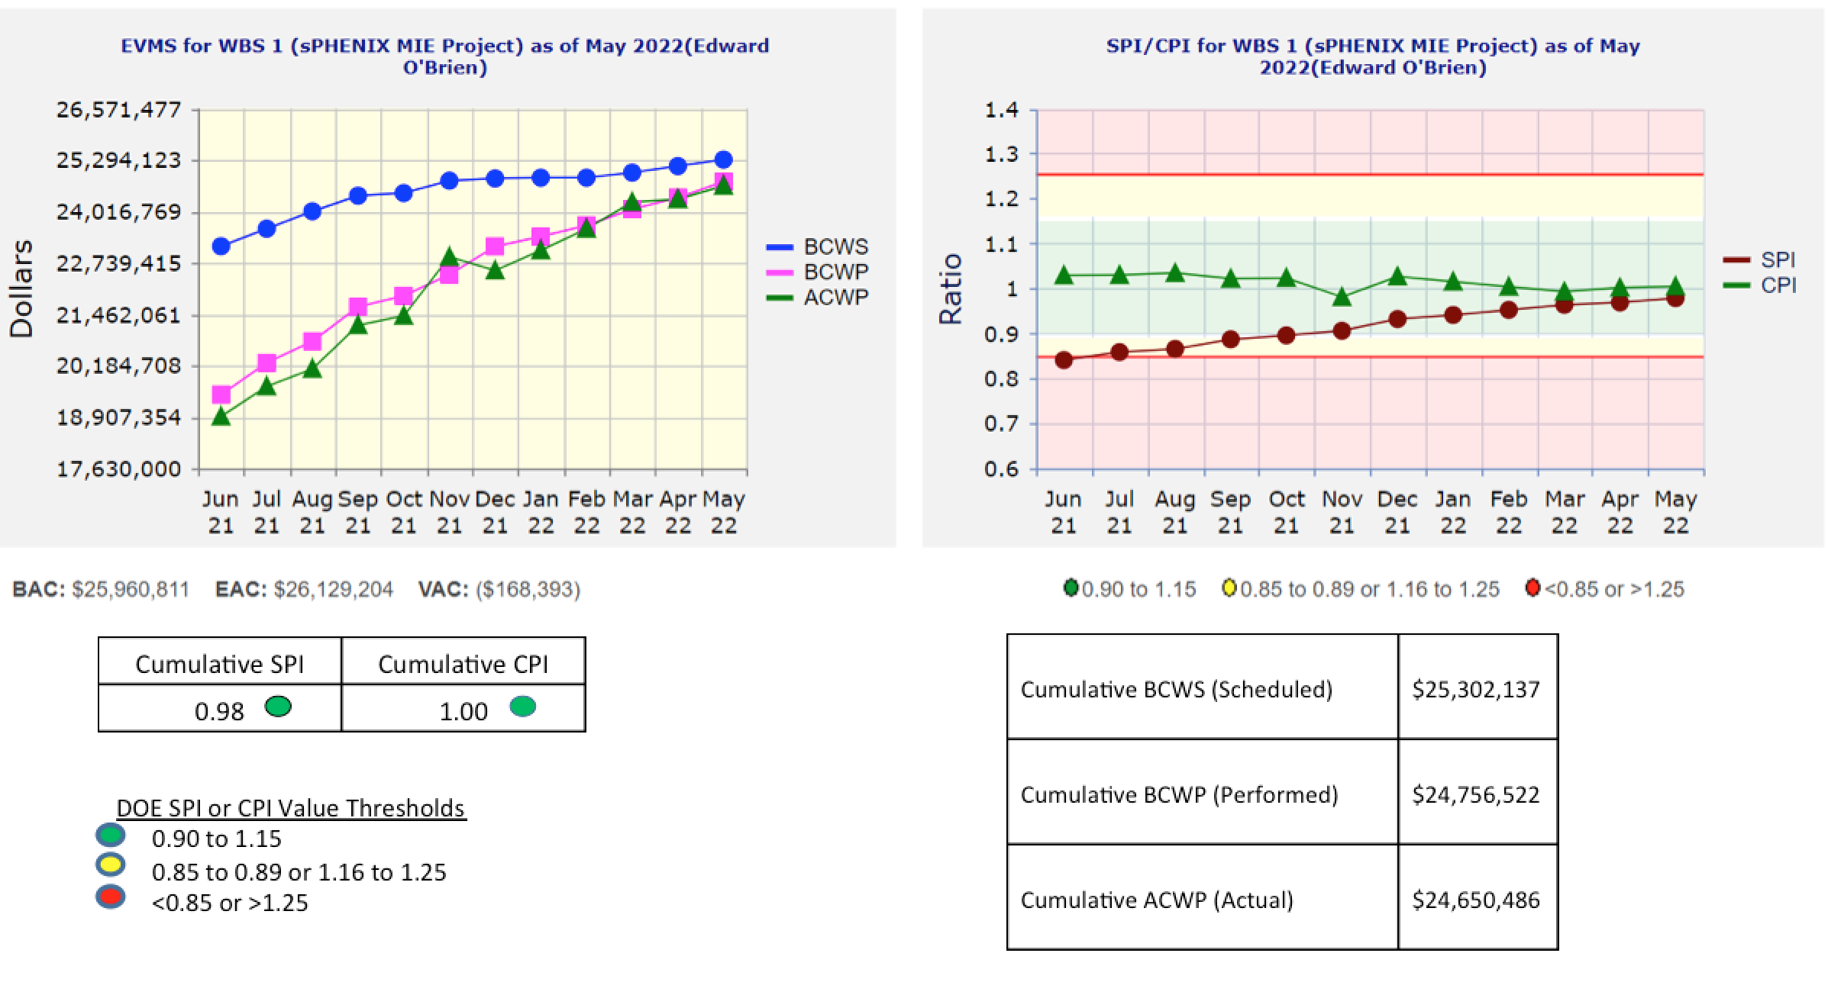
Performance Indices – sPHENIX MIE

Slide 21
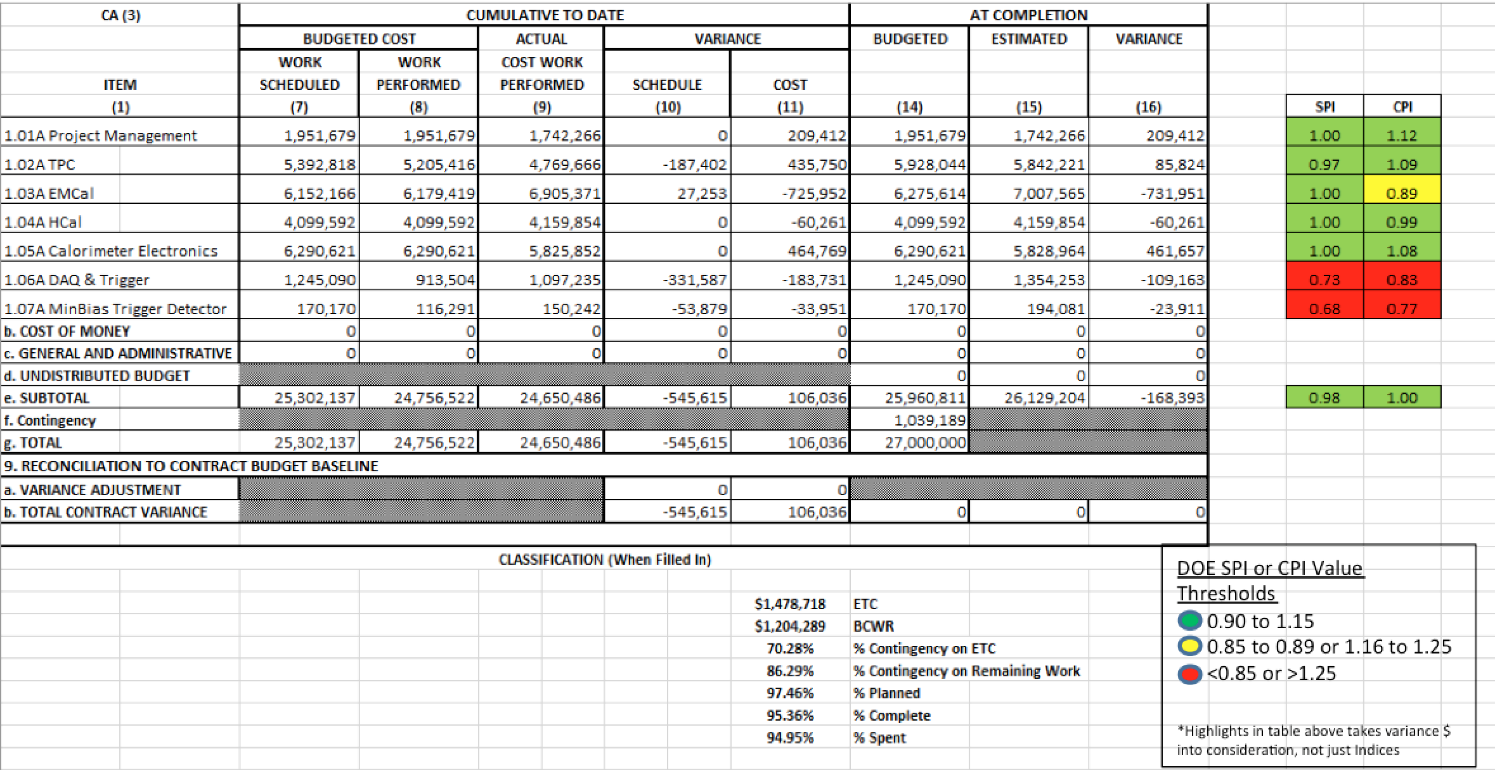
Cost Performance Report (CPR) – sPHENIX MIE

Slide 22
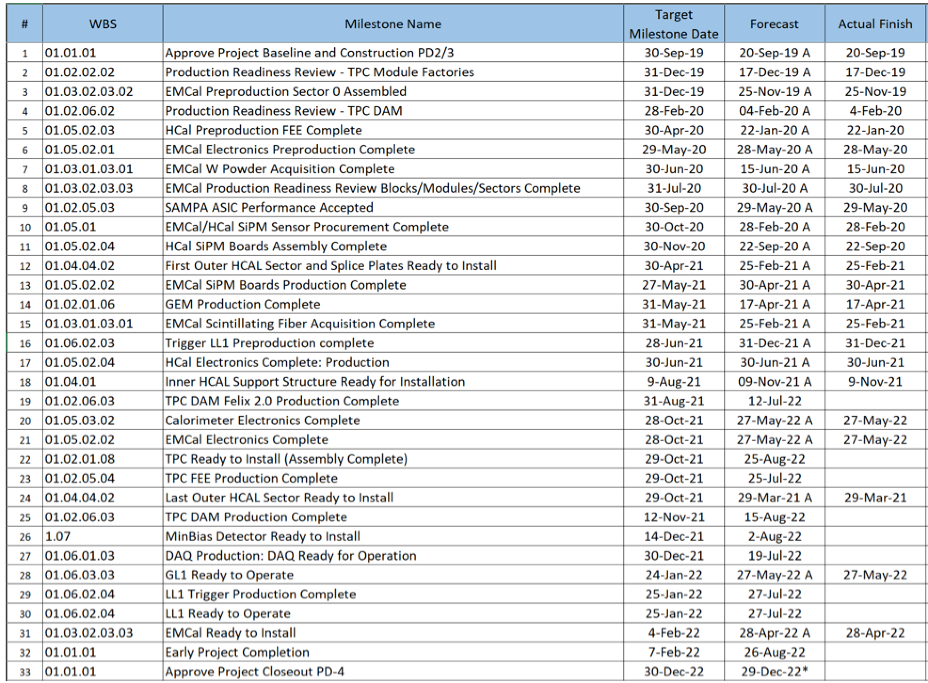
Milestones Status – sPHENIX MIE

Slide 23
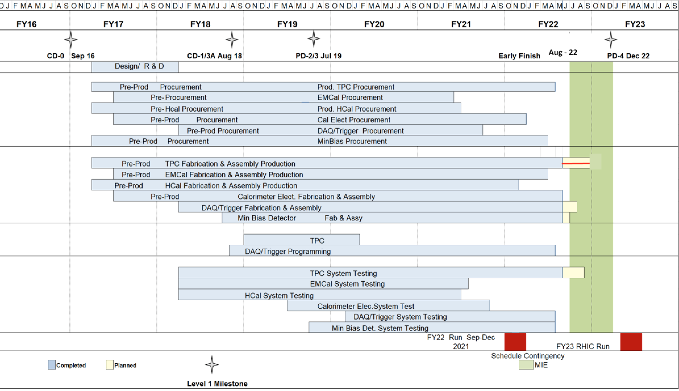
Summary Schedule – sPHENIX MIE

Slide 24
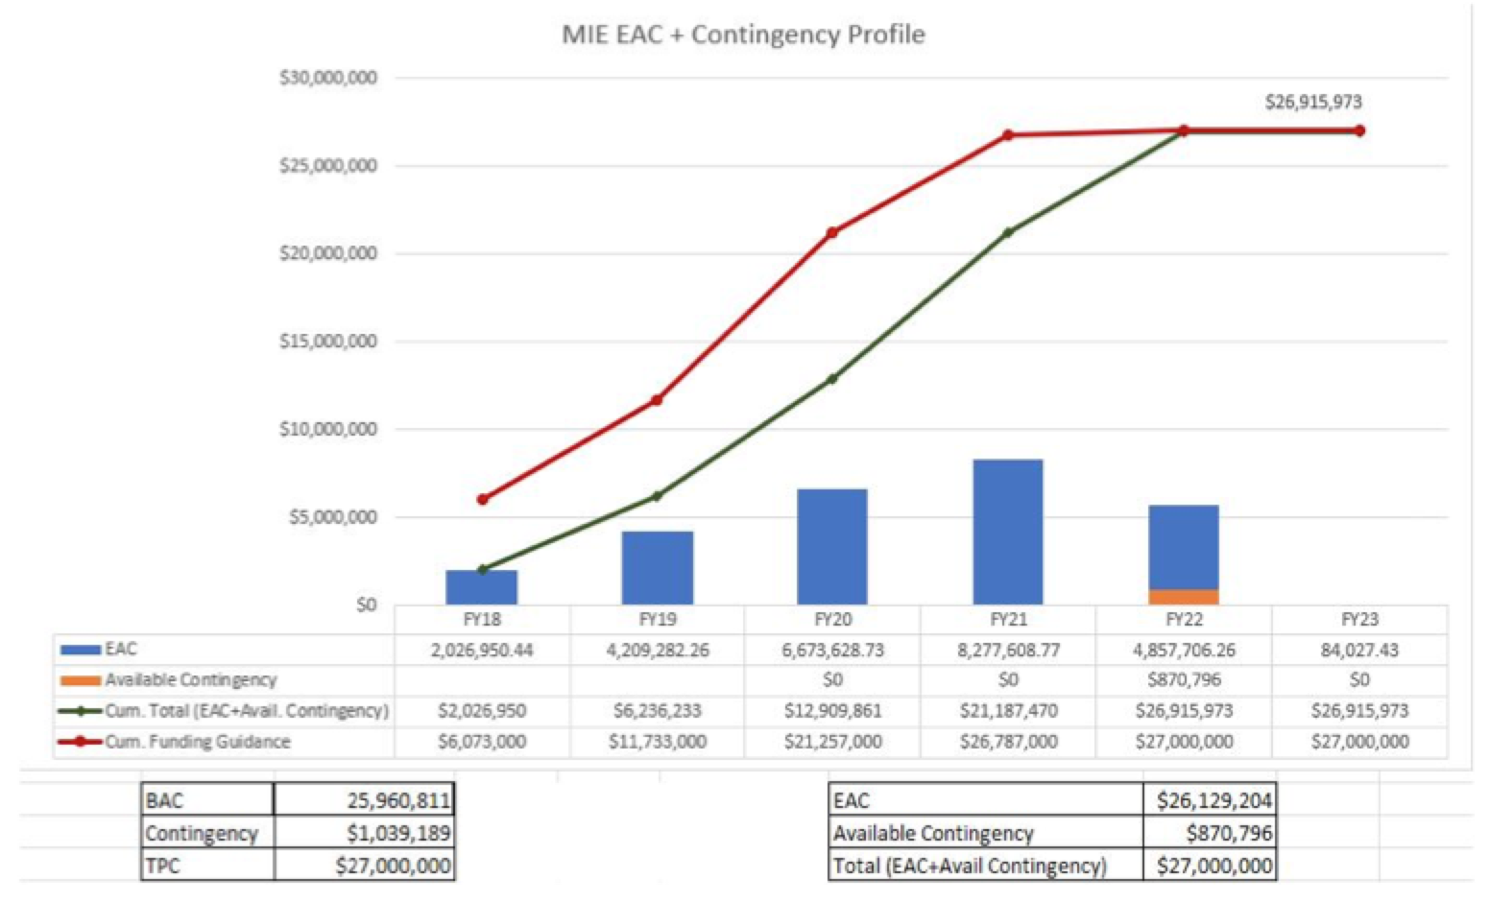
EAC and Contingency Profile – sPHENIX MIE

Slide 25
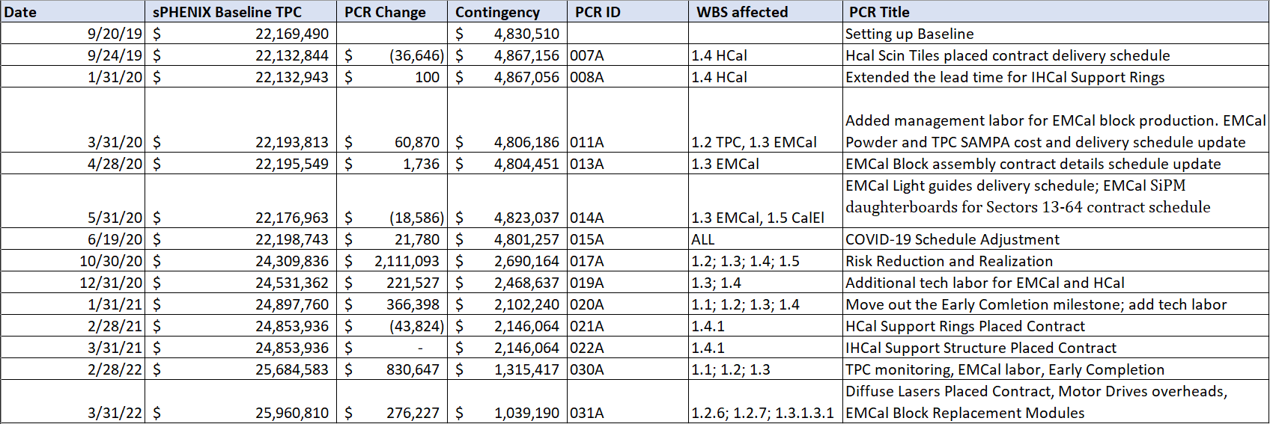
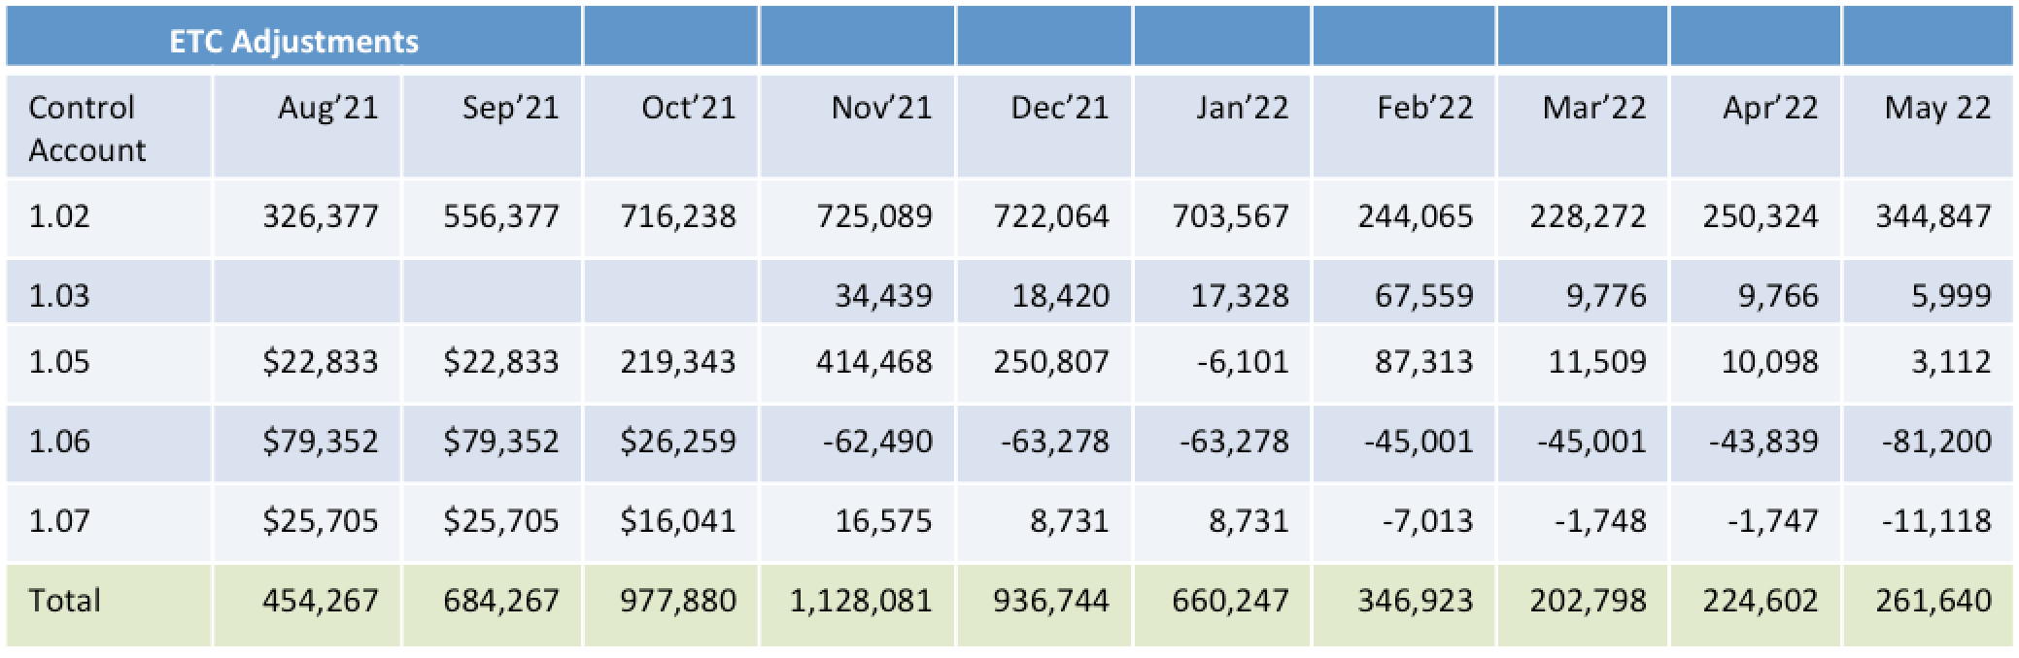
Baseline/Contingency Log and ETC adjustment Log - MIE

Slide 26
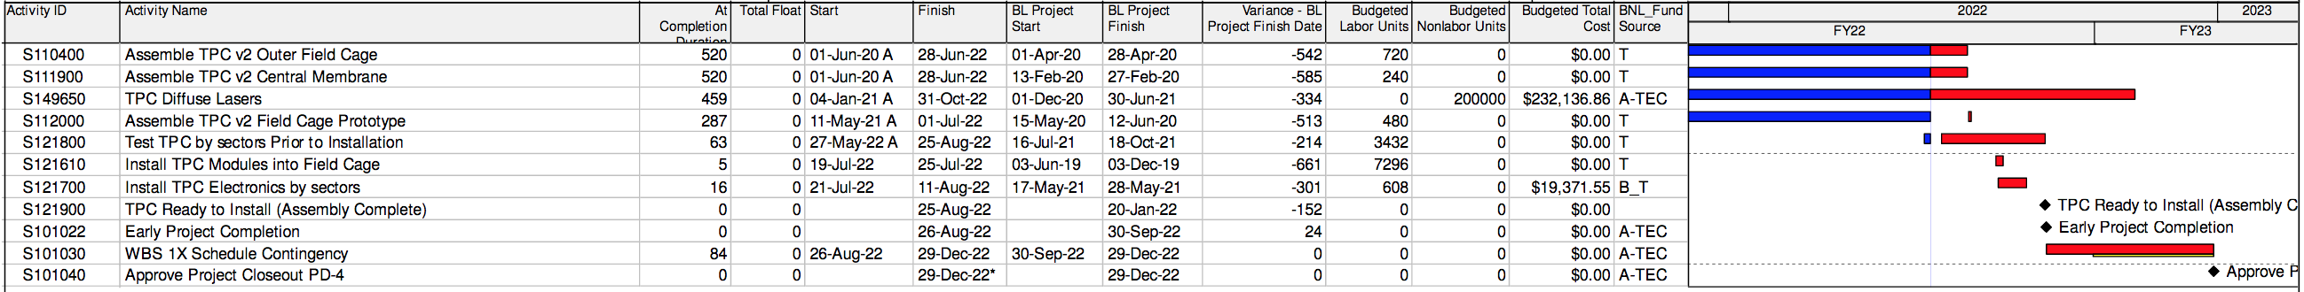
Critical Path – May 2022

Slide 27
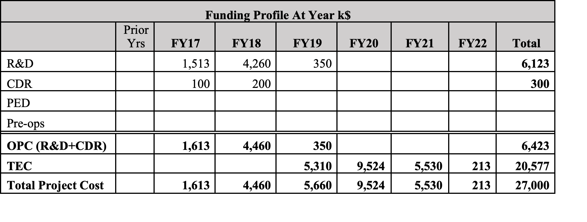
Budget Profile
All MIE funds now received

Slide 28
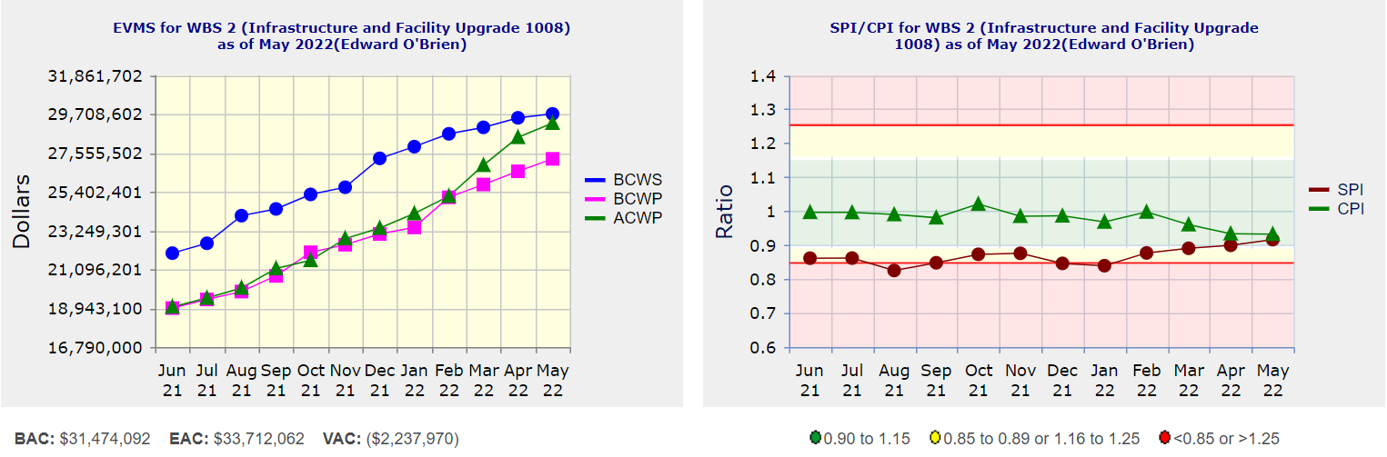
Performance Indices – 1008 Infra and Facility Upgrade
Cumulative SPI | Cumulative CPI
0.92 | 0.93
Cumulative BCWS (Scheduled) | $29,716,684
Cumulative BCWP (Performed) | $27,222,650
Cumulative ACWP (Actual) | $29,204,558
DOE SPI or CPI Value Thresholds
0.90 to 1.15
0.85 to 0.89 or 1.16 to 1.25
<0.85 or >1.25

Slide 29
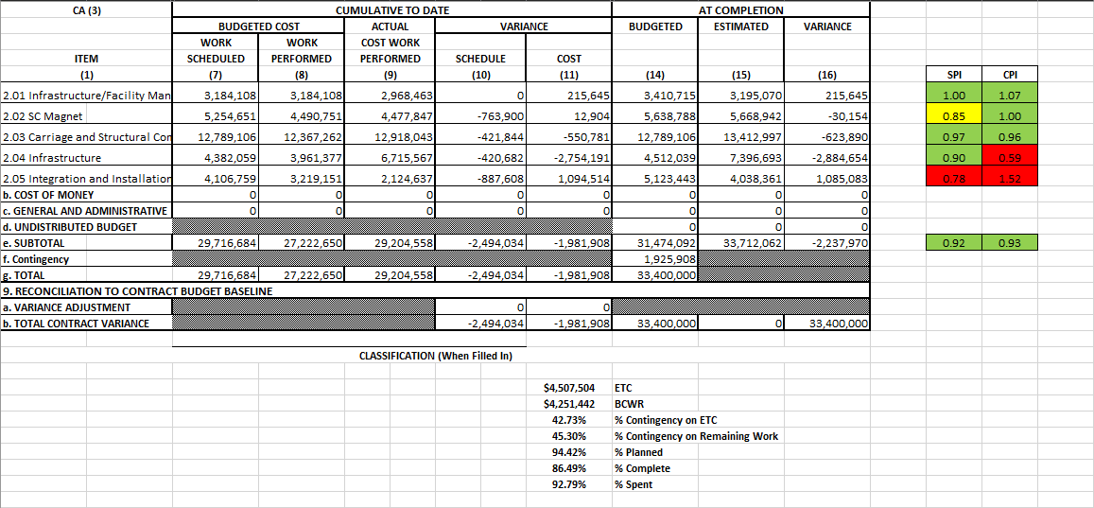
Cost Performance Report (CPR) – 1008 Infra and Facility Upgrade
DOE SPI or CPI Value Thresholds
0.90 to 1.15
0.85 to 0.89 or 1.16 to 1.25
<0.85 or >1.25
*Highlights in table above takes variance $ into consideration, not just Indices

Slide 30
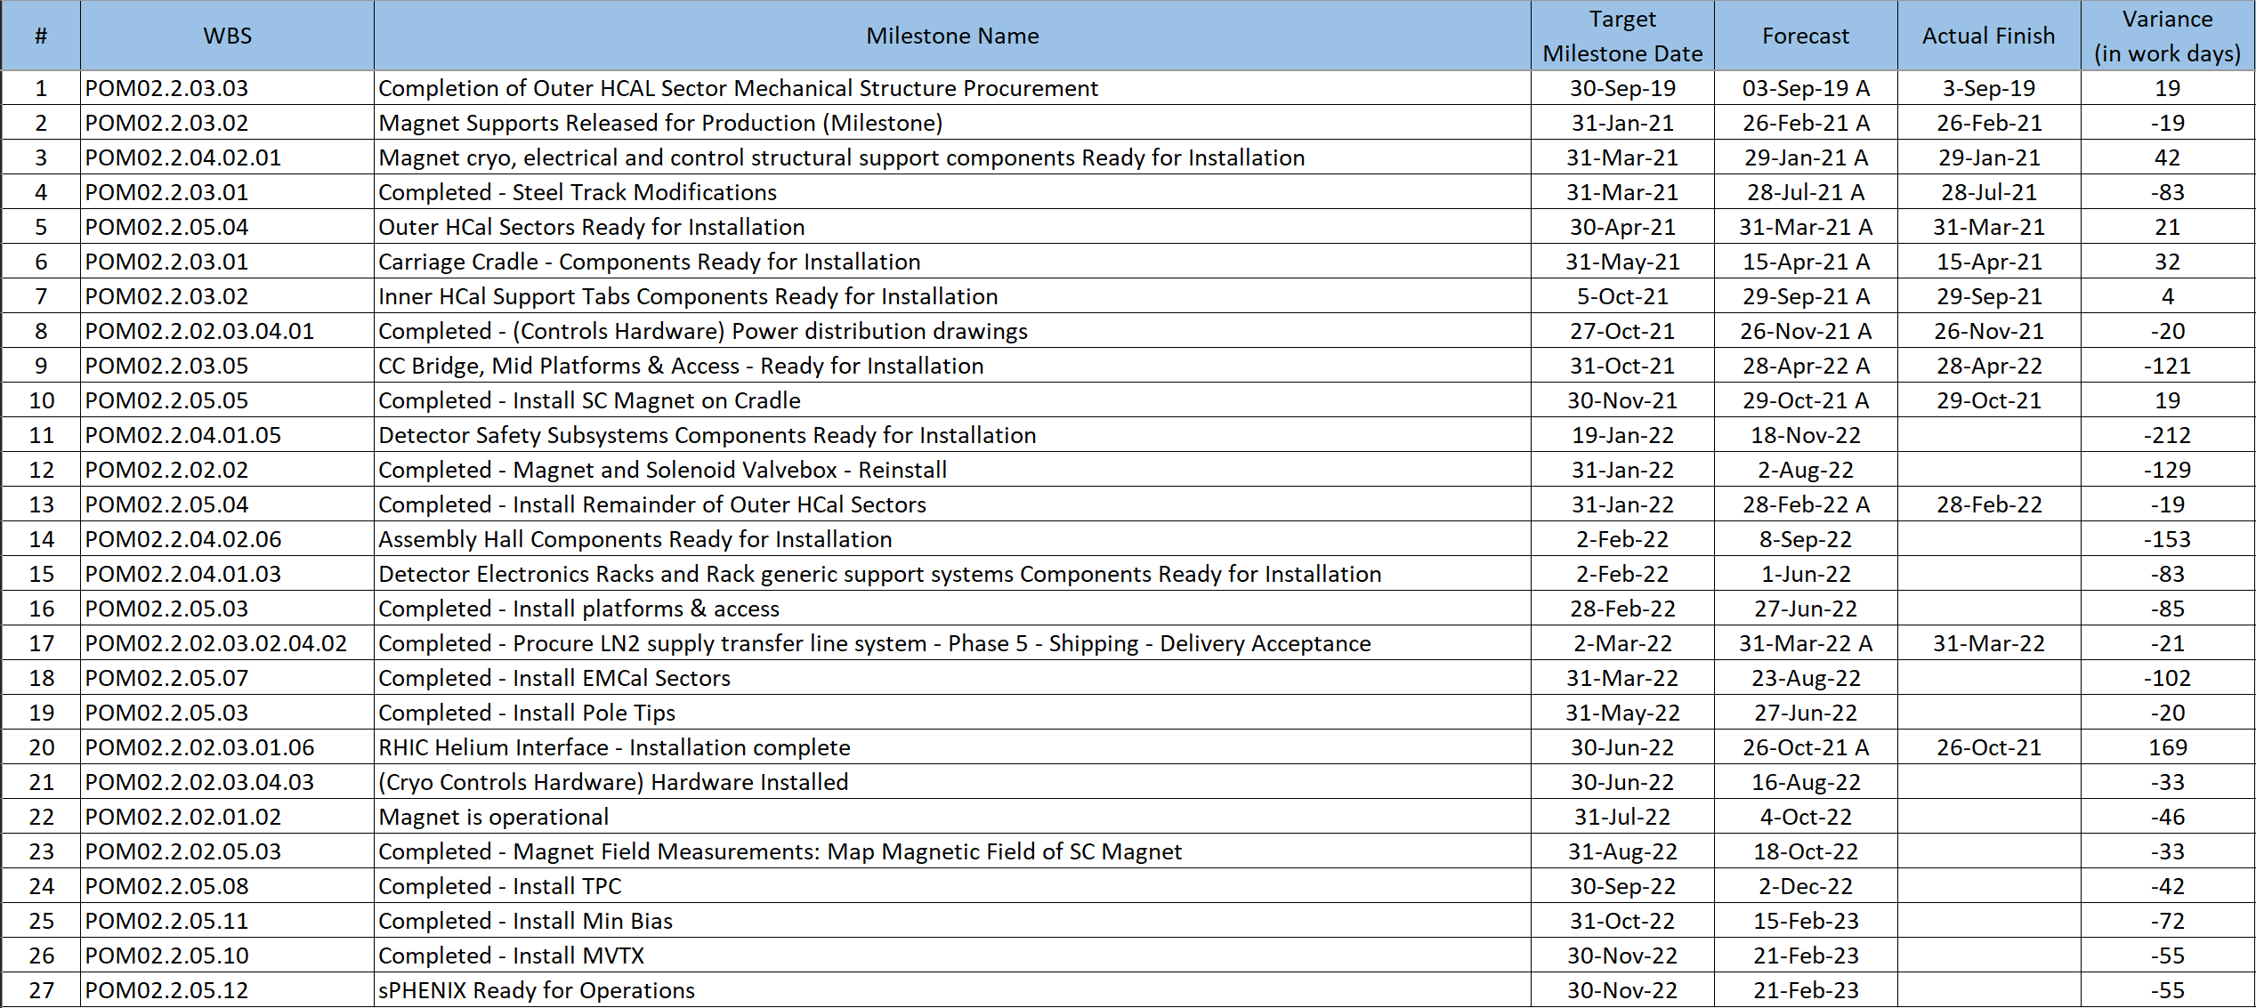
Milestones Status – 1008 Infra and Facility Upgrade

Slide 31
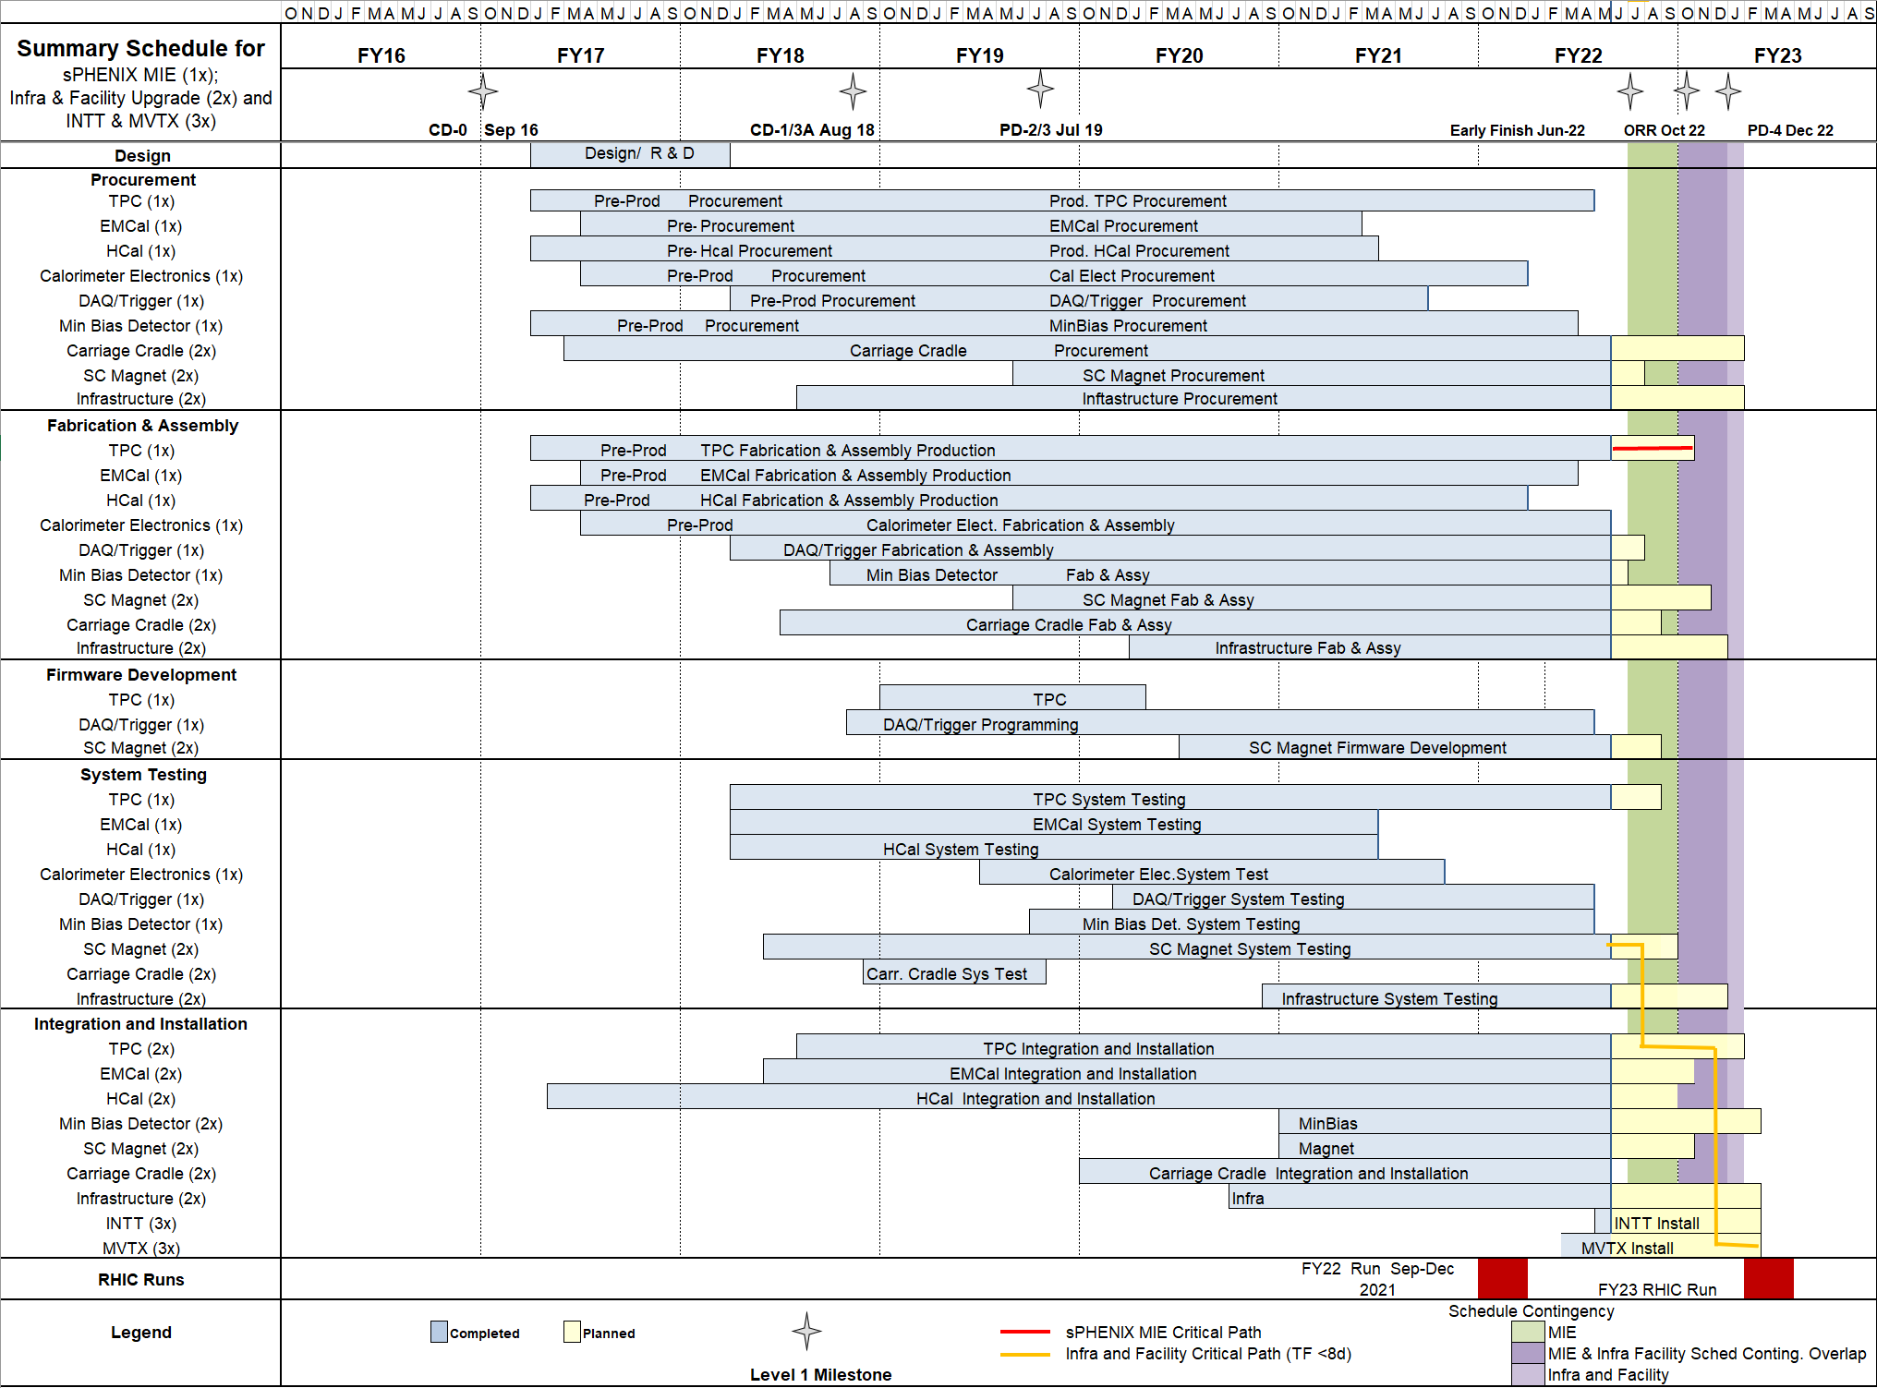
Summary Schedule – sPHENIX MIE and 1008 Infra and Facility Upgrade

Slide 32
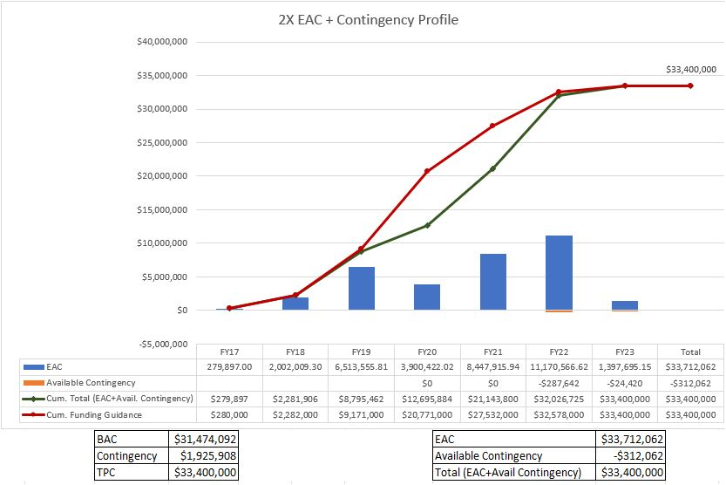
EAC and Contingency Profile – 1008 Infra and Facility Upgrade

Slide 33
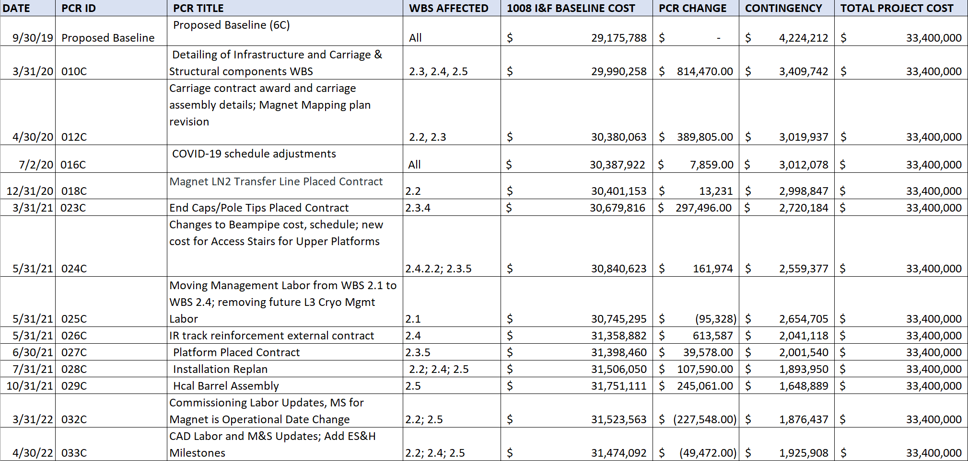
Baseline/Contingency Log and ETC adjustment Log – 2.X
ETC Adjustments
Control Account | Sep’21 | Oct’21 | Nov’21 | Dec’21 | Jan’22 | Feb’22 | Mar’22 | Apr’22 | May 22
2.2 | - | - | - | - | 20,551 | 14,635 | 8,407 | 15,713 | 32,069
2.3 | 90,775 | 70,349 | 125,472 | 102,957 | 117,533 | 102,161 | 138,461 | 57,622 | 57,458
2.4 | 70,160 | 350,388 | 152,069 | 69,283 | 23,810 | 296 | 52,663 | 92,478 | 121,081
2.5 | - | 73,413 | 63,117 | 161,496 | 208,816 | 136,000 | - | - | -
Total | 160,935 | 494,150 | 340,658 | 333,737 | 370,709 | 253,092 | 199,530 | 165,812 | 210,609

Slide 34
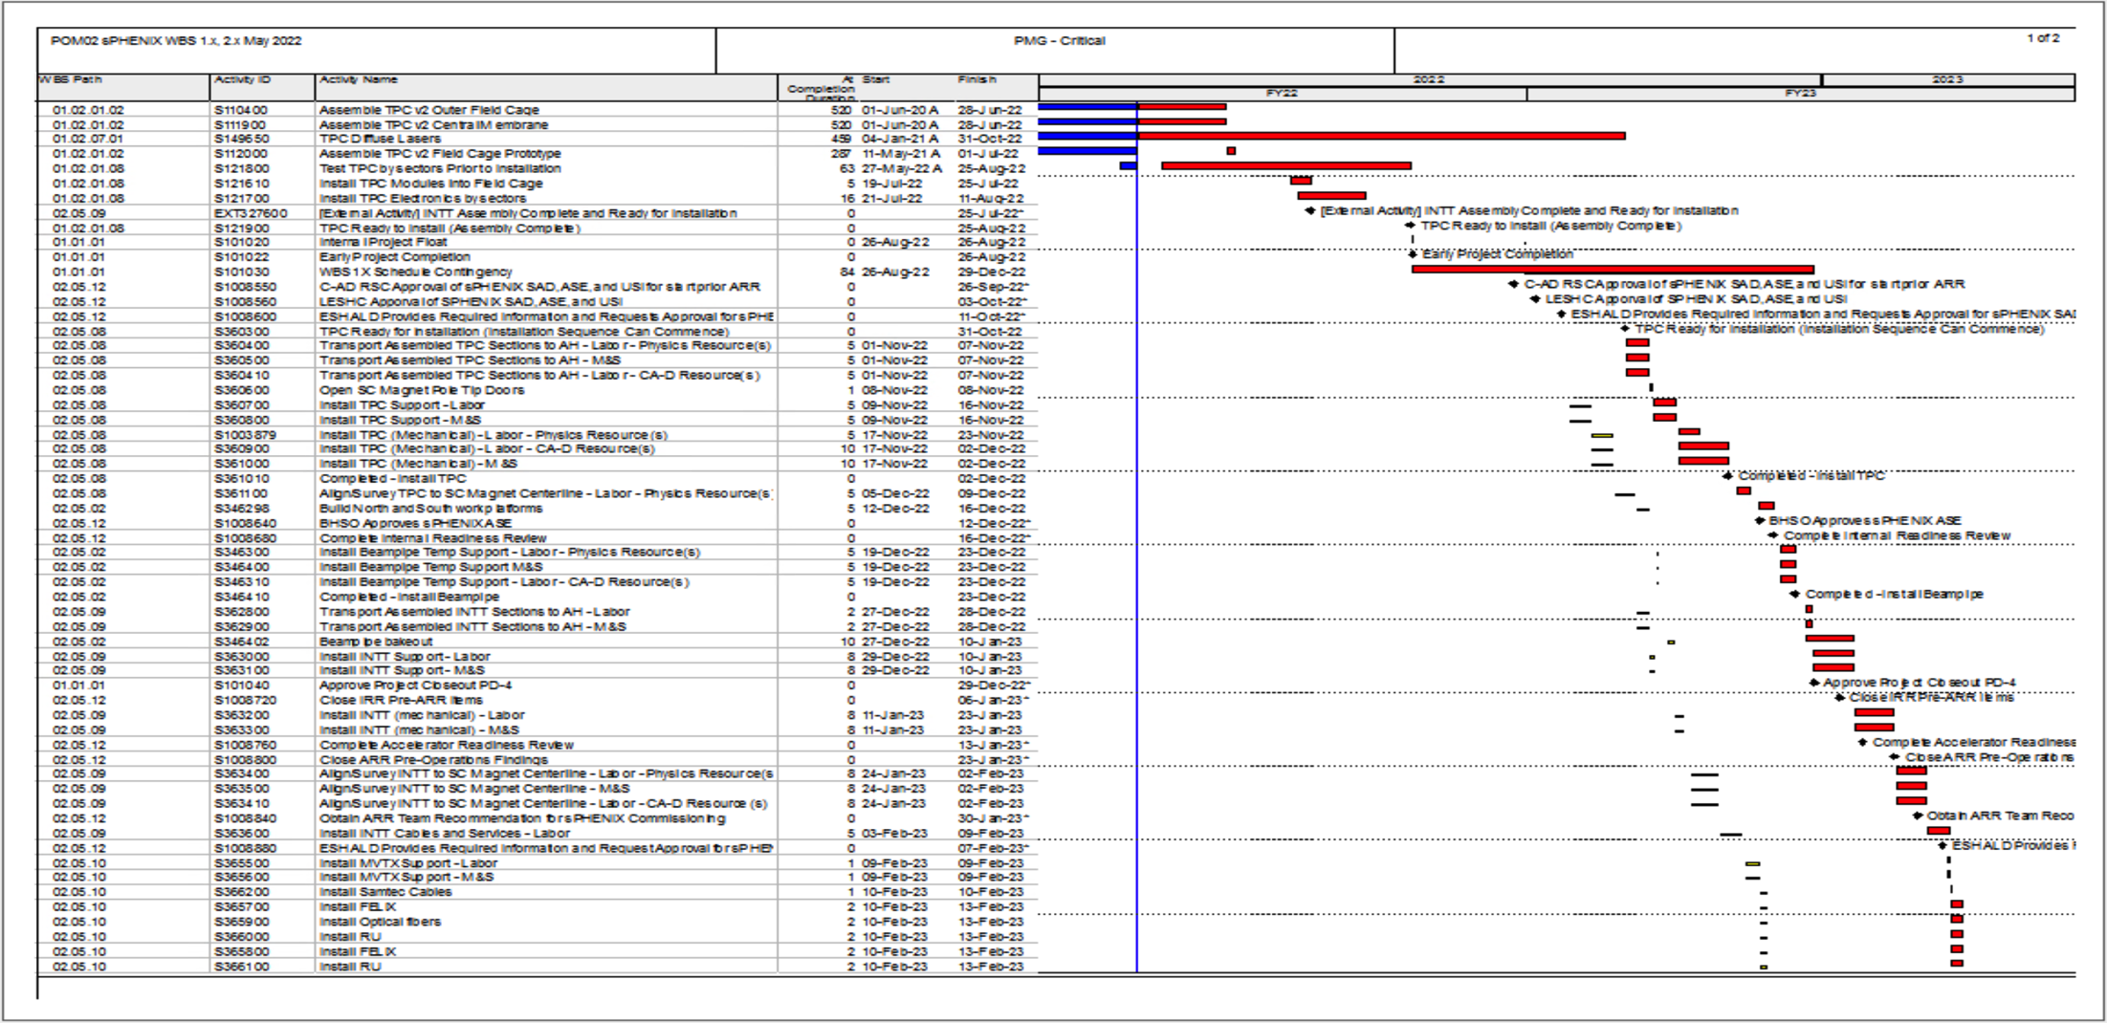
Critical Path (1x, 2x and 3x Combined)

Slide 35
MIE Variance Report
sPHENIX MIE Project (Edward O'Brien [18368])
Reporting Period: 5/1/2022 – 5/31/2022
SV Report for WBS 1.0 sPHENIX MIE Project
May 2022
Cumulative BCWS $25,302,137
Cumulative BCWP $24,756,522
Cumulative ACWP $24,650,486
SV = -$545,615
CV = +$106,036
SPI = 0.9784
CPI = 1.0043
The following report discusses the major sources of schedule variance, including all items comprising 1% of the total schedule variance, plus a few select other items, and discusses the impact as well as the corrective actions taken. The analysis is done at level 3 of the Work Breakdown Structure.

Slide 36
MIE Variance Report - TPC
WBS 1.2.1 TPC Mechanics
Description – None.
Impact – None.
Corrective – None.
WBS 1.2.2 TPC GEM Modules R1
WBS 1.2.3 TPC GEM Modules R2
WBS 1.2.4 TPC GEM Modules R3
Description – None.
Impact – None.
Corrective – None.

Slide 37
MIE Variance Report -TPC
WBS 1.2.1 TPC Mechanics
Description – None. The activity, S120100 Production of GEM foils, which has had prior SV, is now complete.
Impact – None.
Corrective – None. The order is complete.
WBS 1.2.2 TPC GEM Modules R1
Description – Two activities were delayed by late arrival of TPC R1 padplanes. These are S125500 TPC R1 modules build, with SV = -$18,320 and S125600 TPC R1 Modules test, with SV = -$18,320. The total SV resulting is -$36,641. The R1 padplane, the smallest of the three types, were all delivered last month.
Impact – None as yet. The rest of R1 module construction is proceeding. Pad planes are to be attached to the modules as a late step in the module assembly sequence. Positive float remains.
Corrective – The R1 pad planes have been delivered. The two above activities are now proceeding and will not impede overall TPC construction.
WBS 1.2.5 TPC Front End Electronics.
Description – There are six activities with significant SV. They are:
activity S136500 TPC FEE Cooling System, SV = -$57,393,
activity S141500 TPC FEE Production components (optical transceivers), SV =-$22,999,
activity S141800 TPC FEE Production Components, SV = -$46,432
activity S142500 TPC FEE Low Voltage Power system, SV = -$123,533,
activity S143200 TPC FEE Production boards and assembly, SV = -$175,244,
and
activity S143250, TPC FEE components, SV = -$116,301.
The net SV is -$541,901.
Impact – None as yet.
Corrective – All the items covered by these activities are being ordered, with one exception, the optical transceivers. The manufacturer announced in February that it is replacing this part with a newer and less expensive version; the new variant will have to be the one purchased by sPHENIX and thus also will need to be tested in magnetic field, although no issues are expected based on technical input from the manufacturer. The required design and procurement reviews are complete. The cooling system requires a series of machined parts, for which the procurement is placed, and manufacturing is ongoing. The TPC FEE production components are on order and around 80% in hand. The TPC FEE Low Voltage power supplies are under contract and partially delivered, with the vendor scheduling all remaining deliveries over the next month. The TPC production board and assembly procurement is progressing, with a vendor identified. The TPC FEE components, mostly the quad transceivers, will be ordered later in the spring because they are added to the assembled boards by hand after the automatic board assembly is complete, thus their delivery schedule does not impede that for the boards.
WBS 1.2.5 TPC Front End Electronics.
Description – There is one activity with significant SV:
activity S142500 TPC FEE Low Voltage Power system, SV = -$30,883.
Impact – None as yet.
Corrective – All the items covered by this activity are on order. The TPC FEE Low Voltage power system remaining work is procurement of conductor wire and connectors and the fabrication of the cable assemblies for the LV system, all of which are on order. The vendor reports that they have all wire of one gauge in hand and are fabricating those LV cables. The vendor notes that the wire of the other gauge is now on order. These last LV cables will be fabricated upon receipt of this wire. Again, the root problem is obtaining sufficient insulating material by the cable vendor. We maintain weekly contact with this vendor.

Slide 38
MIE Variance Report - TPC
WBS 1.2.6 TPC Data Aggregator Modules
Description – Three activities contribute to the SV:
activity S143280 JACK board parts (complete), SV = +$31,769
activity S147440 Fiber Trunk cables, SV = -$24,843, and
activity S147450 Fiber Sort-out box, SV = -$22,338.
The total is SV = -$15,412.
Impact – The first production JACK board is needed for testing and the release of full production of the JACK boards. The software is being developed using a prototype, but the full board is needed to be sure the software works on the production units. The fiber trunk cables are needed just after sPHENIX is moved in to the 1008 IR.
Corrective – The fiber trunk cables are on order. These will be installed once all the cable race is in place on sPHENIX and the detector has been rolled in to the 1008 IR, since these fiber trunk cables run from the IR to the 1008 Rack Room.
A first Fiber Sort-out Box, out of an eventual production total of thirty Fiber Sort-out Boxes, was received from an outside vendor, tested, and shown to work properly and meet specifications. The box distributes fibers to FELIX cards and JACK boards in the Rack Room.
The JACK board parts are all in hand. The JACK board first article assembly at BNL was delayed by receipt of the first printed circuit boards, which needed to have a layout error corrected. Two initial boards with this error corrected were received in early June and prepared for component mounting.

Slide 39
MIE Variance Report - TPC
WBS 1.2.7 TPC Support Systems
Description – We provide a breakdown of the TPC laser SVs. The gas system items noted in earlier reports are in hand. The TPC Lasers delivery has started but only the line lasers have been delivered, with the diffuse lasers and various optical items remaining on order, SV =-$141,106.
The remaining laser items are:
laser custom attenuator SV = +$2,715
Diffuse lasers SV = -$116,068
Diffuse laser fiber coupling SV = +$16,298
Laser optics and mirrors SV = -$33,455
Light pipes SV = +$5,507
Fibers and splitters SV = -$37,938
Custom motor drives and controls SV = +$21,834
Impact – The delivery of only one diffuse laser is needed to test the TPC during the current assembly phase. The delivery of all six diffuse lasers is needed for operations with RHIC collisions.
Corrective –The delivery schedule for the six diffuse laser units will stretch into at late Fall 2022. The first diffuse laser has been fabricated by the vendor and meets specifications for the laser. It has now been shipped as of early June. The initial type of fiber light guide chosen for the splitter exhibited rapid damage, on a timescale of a few hours, when exposed at the vendor to light from the first article diffuse laser. A fiber-bundle type light guide, which reduces the power density per fiber, has been studied at the vendor during May as a possible solution for the fiber splitter. Tests over a 15-day exposure show encouraging levels of fiber damage; procurement of these fiber bundles using solarization-resistant fibers is now underway.
Procurements for remaining items are underway.

Slide 40
MIE Variance Report - EMCal
WBS 1.3.1 EMCal Blocks
Description – None.
Impact – None.
Corrective – None. There is a positive SV = +$41,676 due to U. Illinois finishing block work ahead of schedule. This positive SV will gradually reduce to zero as FY2022 concludes.
WBS 1.3.2 EMCal Modules and Sectors
Description – The S196920 Technical Support Labor for EMCal Assembly is a bit behind schedule, SV = -$14,424.
Impact – None.
Corrective – None. Testing and burn-in of sectors prior to their installation in sPHENIX will continue until late summer 2022.

Slide 41
MIE Variance Report - HCal
WBS 1.2.1 TPC Mechanics
Description – None. The activity, S120100 Production of GEM foils, which has had prior SV, is now complete.
Impact – None.
Corrective – None. The order is complete.
WBS 1.2.2 TPC GEM Modules R1
Description – Two activities were delayed by late arrival of TPC R1 padplanes. These are S125500 TPC R1 modules build, with SV = -$18,320 and S125600 TPC R1 Modules test, with SV = -$18,320. The total SV resulting is -$36,641. The R1 padplane, the smallest of the three types, were all delivered last month.
Impact – None as yet. The rest of R1 module construction is proceeding. Pad planes are to be attached to the modules as a late step in the module assembly sequence. Positive float remains.
Corrective – The R1 pad planes have been delivered. The two above activities are now proceeding and will not impede overall TPC construction.
WBS 1.2.5 TPC Front End Electronics.
Description – There are six activities with significant SV. They are:
activity S136500 TPC FEE Cooling System, SV = -$57,393,
activity S141500 TPC FEE Production components (optical transceivers), SV =-$22,999,
activity S141800 TPC FEE Production Components, SV = -$46,432
activity S142500 TPC FEE Low Voltage Power system, SV = -$123,533,
activity S143200 TPC FEE Production boards and assembly, SV = -$175,244,
and
activity S143250, TPC FEE components, SV = -$116,301.
The net SV is -$541,901.
Impact – None as yet.
Corrective – All the items covered by these activities are being ordered, with one exception, the optical transceivers. The manufacturer announced in February that it is replacing this part with a newer and less expensive version; the new variant will have to be the one purchased by sPHENIX and thus also will need to be tested in magnetic field, although no issues are expected based on technical input from the manufacturer. The required design and procurement reviews are complete. The cooling system requires a series of machined parts, for which the procurement is placed, and manufacturing is ongoing. The TPC FEE production components are on order and around 80% in hand. The TPC FEE Low Voltage power supplies are under contract and partially delivered, with the vendor scheduling all remaining deliveries over the next month. The TPC production board and assembly procurement is progressing, with a vendor identified. The TPC FEE components, mostly the quad transceivers, will be ordered later in the spring because they are added to the assembled boards by hand after the automatic board assembly is complete, thus their delivery schedule does not impede that for the boards.
WBS 1.4.1 Inner HCal Mechanics
Description – None.
Impact – None.
Corrective – None.
WBS 1.4.2 Outer HCal Mechanics
Description – None.
Impact – None.
Corrective – None.
WBS 1.4.3 Outer HCal Scintillating Tiles
Description – None.
Impact – None.
Corrective – None.
WBS 1.4.4 Outer HCal Sector Assembly and Testing
Description – None.
Impact – None.
Corrective – None.

Slide 42
MIE Variance Report – Cal Electronics
WBS 1.5.1 Silicon Photomultipliers
Description – None.
Impact – None.
Corrective – None.
WBS 1.5.2 Calorimeter Front End Electronics
Description – The calorimeters electronics are now complete.
Impact – None.
Correctives – None.

Slide 43
MIE Variance Report – Cal Electronics
WBS 1.2.1 TPC Mechanics
Description – None. The activity, S120100 Production of GEM foils, which has had prior SV, is now complete.
Impact – None.
Corrective – None. The order is complete.
WBS 1.2.2 TPC GEM Modules R1
Description – Two activities were delayed by late arrival of TPC R1 padplanes. These are S125500 TPC R1 modules build, with SV = -$18,320 and S125600 TPC R1 Modules test, with SV = -$18,320. The total SV resulting is -$36,641. The R1 padplane, the smallest of the three types, were all delivered last month.
Impact – None as yet. The rest of R1 module construction is proceeding. Pad planes are to be attached to the modules as a late step in the module assembly sequence. Positive float remains.
Corrective – The R1 pad planes have been delivered. The two above activities are now proceeding and will not impede overall TPC construction.
WBS 1.2.5 TPC Front End Electronics.
Description – There are six activities with significant SV. They are:
activity S136500 TPC FEE Cooling System, SV = -$57,393,
activity S141500 TPC FEE Production components (optical transceivers), SV =-$22,999,
activity S141800 TPC FEE Production Components, SV = -$46,432
activity S142500 TPC FEE Low Voltage Power system, SV = -$123,533,
activity S143200 TPC FEE Production boards and assembly, SV = -$175,244,
and
activity S143250, TPC FEE components, SV = -$116,301.
The net SV is -$541,901.
Impact – None as yet.
Corrective – All the items covered by these activities are being ordered, with one exception, the optical transceivers. The manufacturer announced in February that it is replacing this part with a newer and less expensive version; the new variant will have to be the one purchased by sPHENIX and thus also will need to be tested in magnetic field, although no issues are expected based on technical input from the manufacturer. The required design and procurement reviews are complete. The cooling system requires a series of machined parts, for which the procurement is placed, and manufacturing is ongoing. The TPC FEE production components are on order and around 80% in hand. The TPC FEE Low Voltage power supplies are under contract and partially delivered, with the vendor scheduling all remaining deliveries over the next month. The TPC production board and assembly procurement is progressing, with a vendor identified. The TPC FEE components, mostly the quad transceivers, will be ordered later in the spring because they are added to the assembled boards by hand after the automatic board assembly is complete, thus their delivery schedule does not impede that for the boards.
WBS 1.5.3 Calorimeter Digitizers
Description – The digitizers are now complete.
Impact – None.
Corrective – None.

Slide 44
MIE Variance Report – DAQ/Trigger
WBS 1.2.1 TPC Mechanics
Description – None. The activity, S120100 Production of GEM foils, which has had prior SV, is now complete.
Impact – None.
Corrective – None. The order is complete.
WBS 1.2.2 TPC GEM Modules R1
Description – Two activities were delayed by late arrival of TPC R1 padplanes. These are S125500 TPC R1 modules build, with SV = -$18,320 and S125600 TPC R1 Modules test, with SV = -$18,320. The total SV resulting is -$36,641. The R1 padplane, the smallest of the three types, were all delivered last month.
Impact – None as yet. The rest of R1 module construction is proceeding. Pad planes are to be attached to the modules as a late step in the module assembly sequence. Positive float remains.
Corrective – The R1 pad planes have been delivered. The two above activities are now proceeding and will not impede overall TPC construction.
WBS 1.2.5 TPC Front End Electronics.
Description – There are six activities with significant SV. They are:
activity S136500 TPC FEE Cooling System, SV = -$57,393,
activity S141500 TPC FEE Production components (optical transceivers), SV =-$22,999,
activity S141800 TPC FEE Production Components, SV = -$46,432
activity S142500 TPC FEE Low Voltage Power system, SV = -$123,533,
activity S143200 TPC FEE Production boards and assembly, SV = -$175,244,
and
activity S143250, TPC FEE components, SV = -$116,301.
The net SV is -$541,901.
Impact – None as yet.
Corrective – All the items covered by these activities are being ordered, with one exception, the optical transceivers. The manufacturer announced in February that it is replacing this part with a newer and less expensive version; the new variant will have to be the one purchased by sPHENIX and thus also will need to be tested in magnetic field, although no issues are expected based on technical input from the manufacturer. The required design and procurement reviews are complete. The cooling system requires a series of machined parts, for which the procurement is placed, and manufacturing is ongoing. The TPC FEE production components are on order and around 80% in hand. The TPC FEE Low Voltage power supplies are under contract and partially delivered, with the vendor scheduling all remaining deliveries over the next month. The TPC production board and assembly procurement is progressing, with a vendor identified. The TPC FEE components, mostly the quad transceivers, will be ordered later in the spring because they are added to the assembled boards by hand after the automatic board assembly is complete, thus their delivery schedule does not impede that for the boards.
WBS 1.6.1 Data Acquisition
Description – Two activities contribute to this SV:
activity S255900 Production Boards not complete, SV = -$121,503,
and
activity S256700 Crates not complete, SV = -$74,284,
for a total SV = -$195,787.
Impact – None. These items do not affect the production schedule for any other MIE items.
Corrective – The contract has been placed with the vendor for the final items. The vendor is now ordering parts and PCBs for this effort. These activities construct more of existing designs from the PHENIX experiment thus need no development or preproduction cycle. Parts delivery schedule continues to be an issue, paralleling the general issues of fabricating electronics globally. Our vendor has placed orders with many known electronics parts dealers and brokers to locate the needed parts. One last part remains to be found for the Production Boards. The assembled crates are expected in the next month.
WBS 1.6.2 Local Level-1 Trigger
Description – Activity S264900 Production LL1 trigger is not complete, SV = -$135,800.
Impact – None
Corrective – The production manufacture started in February 2022 with orders for parts. That production will complete this level-3 WBS. The final parts have now been located. The vendor is starting preparation for production.

Slide 45
MIE Variance Report – DAQ/Trigger
WBS 1.6.3 Global Level-1 Trigger
Description – The GL1 fabrication is complete.
Impact – None
Corrective – None.
WBS 1.6.4 Timing System
Description – The Timing System fabrication is complete.
Impact – None
Corrective –None.

Slide 46
MIE Variance Report – Min Bias Det
WBS 1.7 Min Bias Trigger Detector
Description – Activity S273600 MBD Shaper/Disc Board is not complete, SV = -$53,879.
Impact – None
Corrective – Three specific types of parts are on back order. One type is expected by early summer. However, the last two type of parts, a key low-time-jitter fanout chip and a precision Op amp, are not expected until as late as November. Because there are only 16 production boards and these last parts can be added by hand, a discussion is planned to proceed with all the rest of the assembly once the more-readily-obtained parts are in hand. This would bring this activity near completion to where the last work can be done at BNL on the bench in a few days.

Slide 47
MIE Variance Report- EM Calorimeter
CV Report for WBS 1.0 sPHENIX MIE Project
May 2022
The following report discusses the major sources of cost variance and discusses the impact as well as the corrective actions taken. The analysis is done at level 2 of the Work Breakdown Structure.
WBS 1.5 Electromagnetic Calorimeter
Description – The WBS 1.3 Electromagnetic Calorimeter has BCWP = $6,179,419, ACWP = $6,905,371, CV = -$725,952 and CPI=0.89.
There are two sources of negative CV. The first occurred when the MIE Project was baselined in September 2019. At this point all completed activities were removed from the baseline and actual costs to the date of the baselining substituted. However, invoices came in from a contractor for the EMCal blocks after this time, resulting in $300K of negative CV. In effect this is a false negative because the activities removed totaled about this amount, but due to the break in the accounting and EVMS indices at the time of baselining, it will persist. The second amount, about $300K comes from extending the efforts of three technicians added to the effort in the middle of FY2021 to regain the schedule for the EMCal sectors in light of various delays incurred with COVID-19 absences, inability to procure epoxies at both the block factory and the sector factory in light of the slowdown in the national chemical industry due to the freeze during February 2021, and increased effort needed to produce the sectors compared to the baseline.
Impact – The cost overrun reduces the contingency available.
Corrective – None planned. The EMCal sector fabrication work is complete. A remaining task is completing testing and pre-installation burn-in of the sectors. This task has progressed to where testing the last of eight groups of sectors is underway; the task remains ongoing.

Slide 48
MIE Variance Report- Calorimeter Electronics
WBS 1.5 Calorimeter Electronics
Description – The WBS 1.5 Calorimeter Electronics has BCWP = $6,290,621, ACWP = $5,825,852, CV = +$464,769 and CPI=1.08.
There are about $115K of late invoices for the digitizer system.
Several major components cost somewhat less than budgeted for this WBS for their production orders. These include EMCal SiPM boards (about $10K less), HCal SiPM boards (about $30K less), EMCal interface boards (about $130K less), and EMCal preamp boards (about $230K less), for a total of $400K on some $950K worth of orders.
Impact – The cost savings will help offset some of the expected cost overruns for cable orders.
Corrective – None planned. The Calorimeter Electronics work is complete. The companies have been contacted to provide the needed invoices.

Slide 49
MIE Variance Report – DAQ/Trigger
CV Report for WBS 1.0 sPHENIX MIE Project
WBS 1.6 DAQ/Trigger
Description – The WBS 1.6 DAQ/Trigger has BCWP = $913,504, ACWP = $1,097,235, CV = - $183,731, and CPI = 0.83.
There have been about $90K of development costs for the GL1 and Timing systems that were not included in the baseline plan. The baseline solution was found not to support the needed level of timing and trigger signal fanout needed to support the entire sPHENIX electronics complex. These are fast signals that must align to within a few nanoseconds and reach all channels of the sPHENIX front-end electronics. The development of a fanout board to provide the necessary large number of timing fibers has required about one year of development. This includes both labor and electronics parts and assembly purchases.
There is paid invoice for $120K of parts and production labor for the LL1 trigger system, but to date no claimable delivery of production units.
Impact – The overspending reduces overall contingency for sPHENIX.
Corrective – None. The development cost was necessary to produce a GL1 and Timing system meeting the design requirements. The GL1 and Timing system work was completed in May. The LL1 trigger cost variance will be recuperated when the units are delivered.

Slide 50
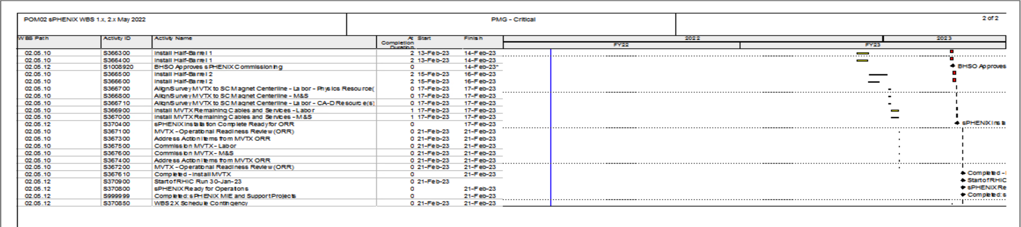
Critical Path (1x, 2x and 3x Combined)

