Slide 1
TPC Completion Schedule
TK Hemmick

Slide 2
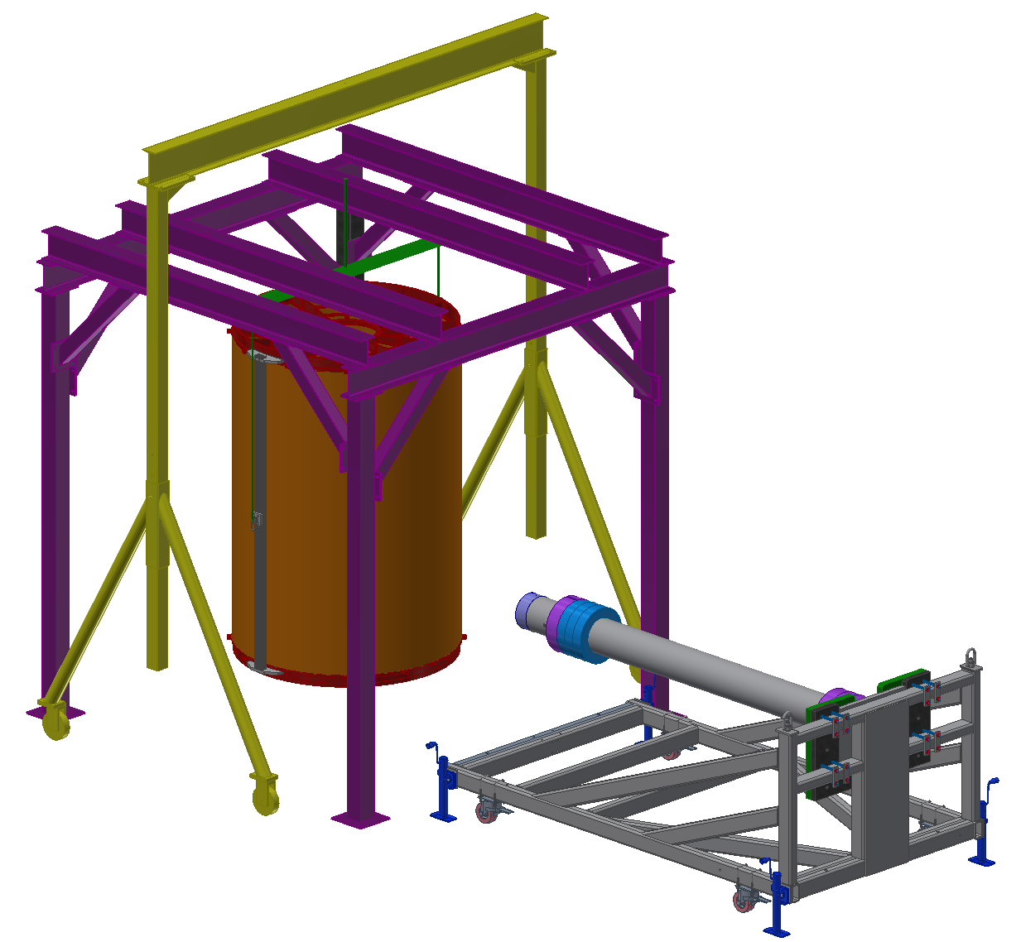
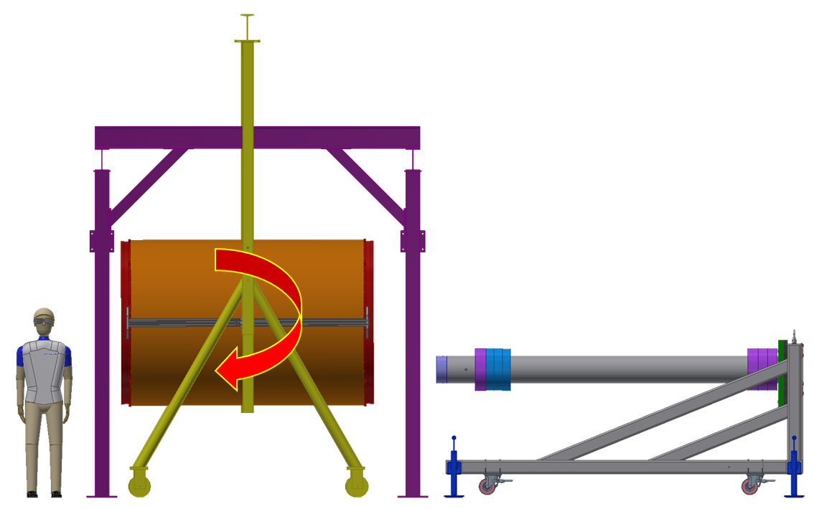
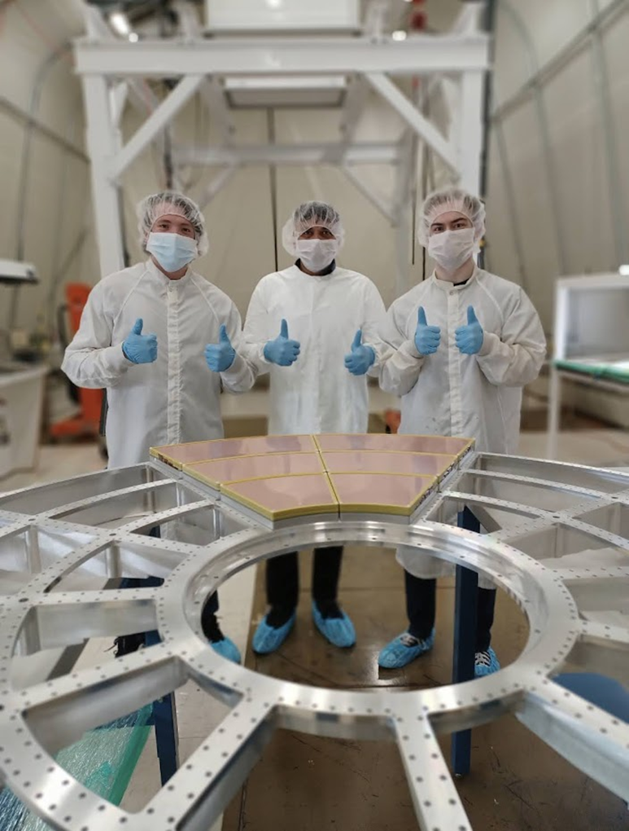
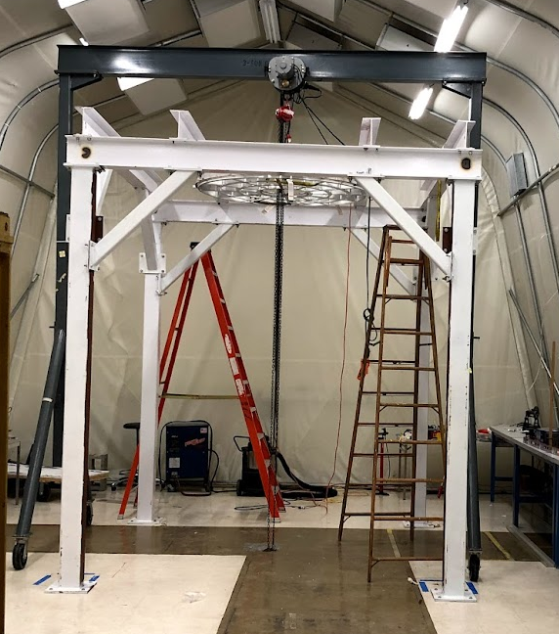
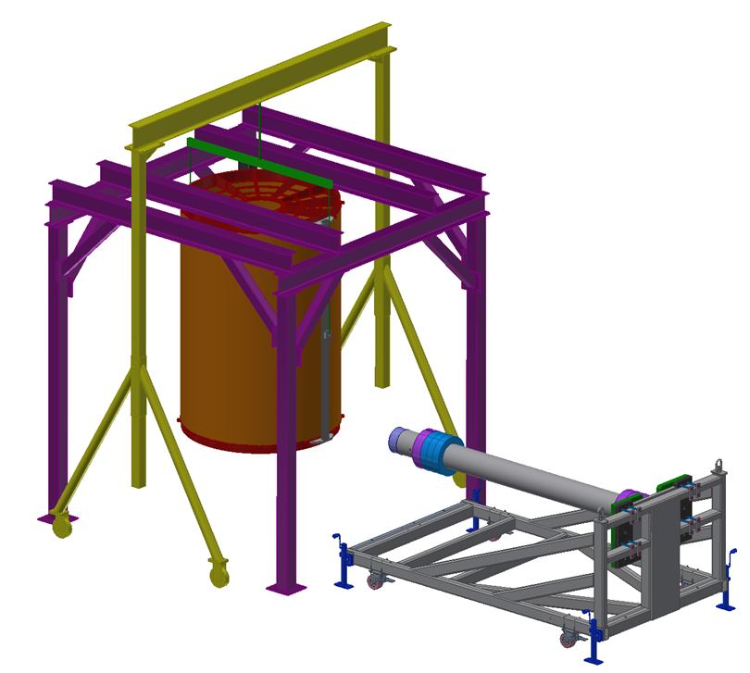
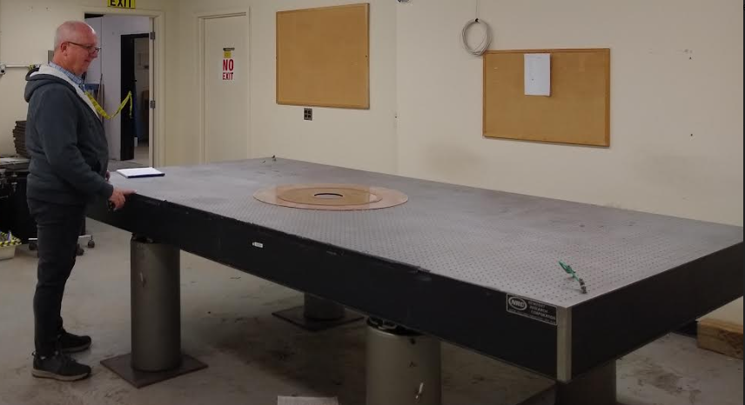
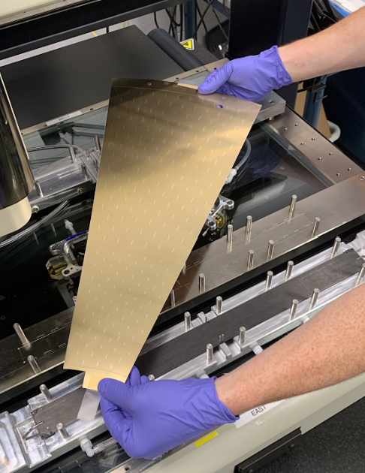
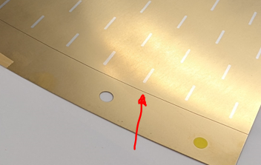
Overview: Time Saving Assembly
Rigging Plan (Rich Ruggiero)
Install Populated Wagon Wheels
Installation Frame
Five Pieces: Wheel 1, Wheel 2, Outer FC, Inner FC, Central Membrane
Ancillary: Gas (complexity off detector), Cooling, High Voltage, FEE (optical, LV)
Process:
5 pieces assembled vertically
Moved to Assembly Cart
Ancillary Added
System Test
Deliver fully cabled to disconnects @ TPC outer perimeter.

Slide 3
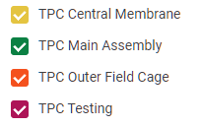
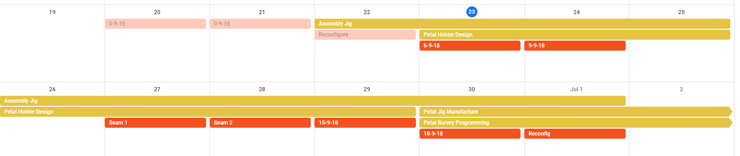
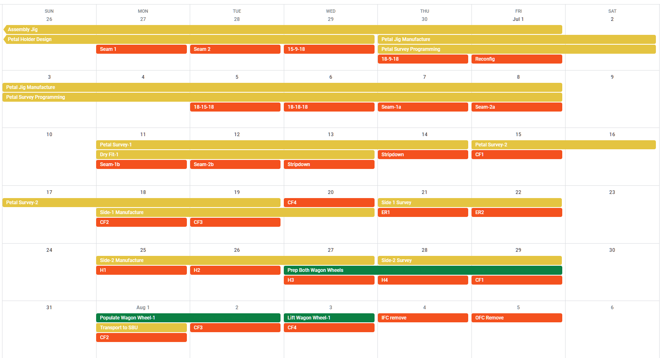
Schedule Overview
June
Philosophy:
Marathon not sprint
Each Day is filled with a half-day doable task.
Any additional float is weekend.
Google Calendars accessible and editable by group.
FEE Drives the Schedule
FEE installation driven by rework completion.
July

Slide 4
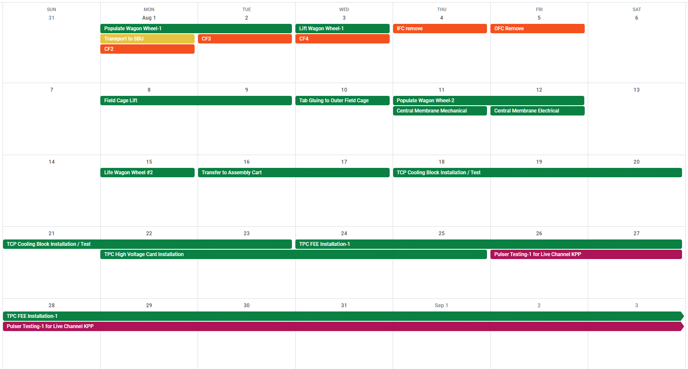
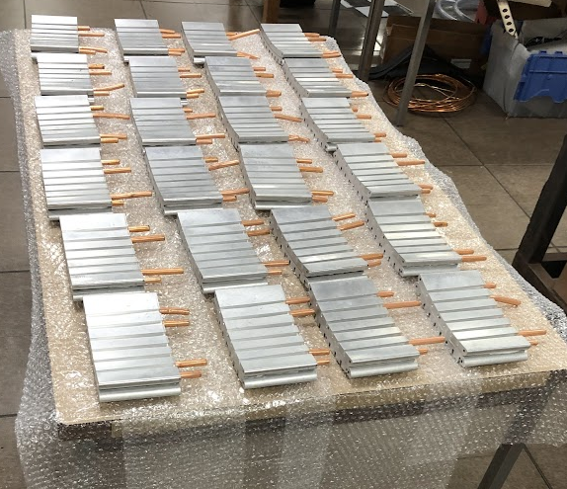
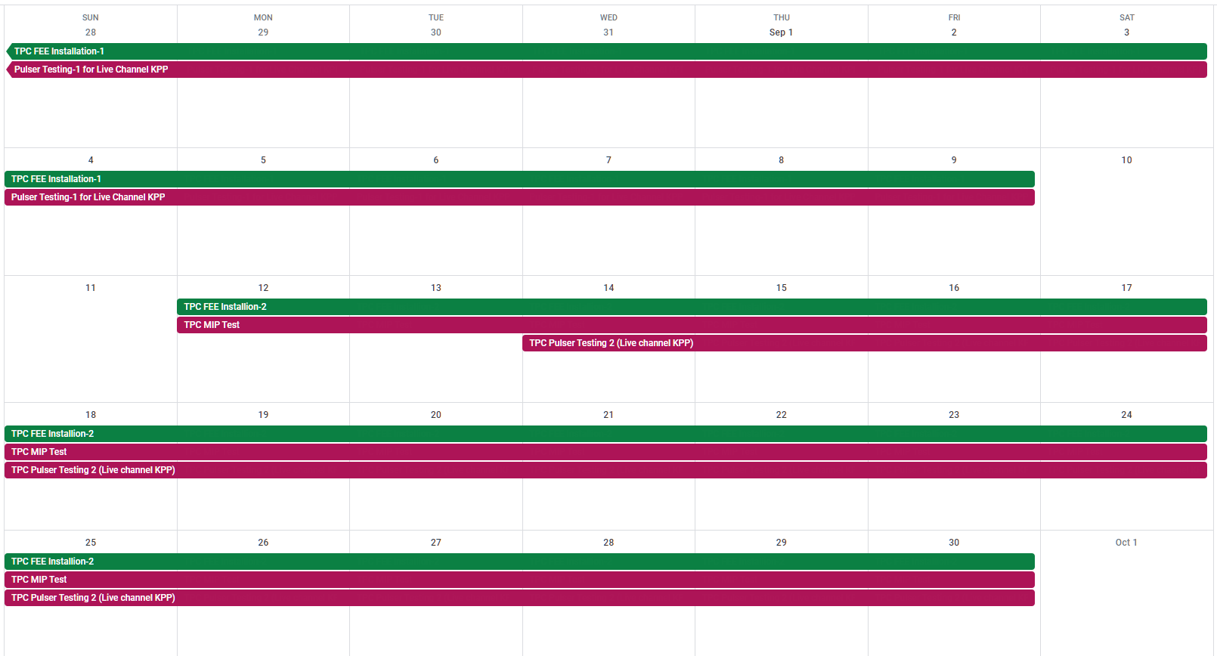
August
Present Schedule Completes all KPP by Sept 30.
IBF: Done (from Xray tests)
Crosstalk: from FEE characterization
Live channels: pulser on detector
Efficiency: 3 weeks running time
September

Slide 5
High Level Overview
June
July
August
Sept
Oct
Nov
Central membrane
Outer field cage
Main Assembly
Testing
Float
ship
 | Start | End | Milestone | Milestone | Milestone | Milestone | Milestone | Milestone
Central Membrane | ongoing | August 1 | Petal Survey 1 July 13 | Petal Survey 2 July 19 | Side 1 Setup July 20 | Side 2 Setup July 27 | Delivery August 1
Outer FC | ongoing | August 5 | Kapton Done July 12 | Honeycomb August 3 | Delivery August 5
Main Assembly | July 27 | September 30 | WW1 Up August 3 | Field Cages August 9 | Membrane August 15 | WW2 August 15 | Cart move August 17 | Cooling August 23
Testing | August 26 | September 30 | Pulser Test 1 Sept 9 | Pulser Test 2 Sept 30 | MIP Sept 30
Red means KPP

