Slide 1
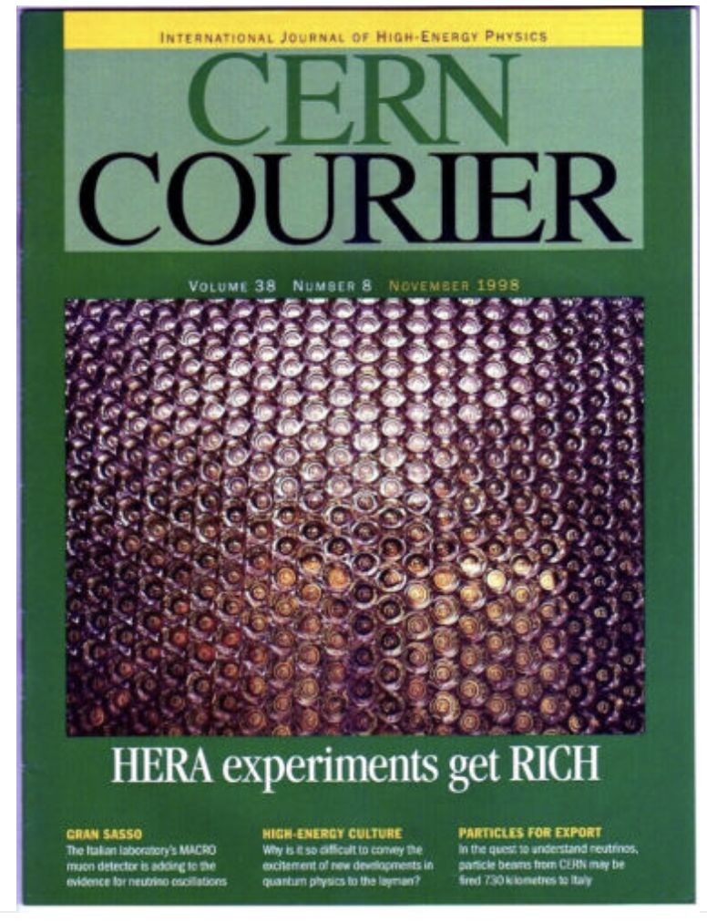
HERMES
Particle Identification

Slide 2
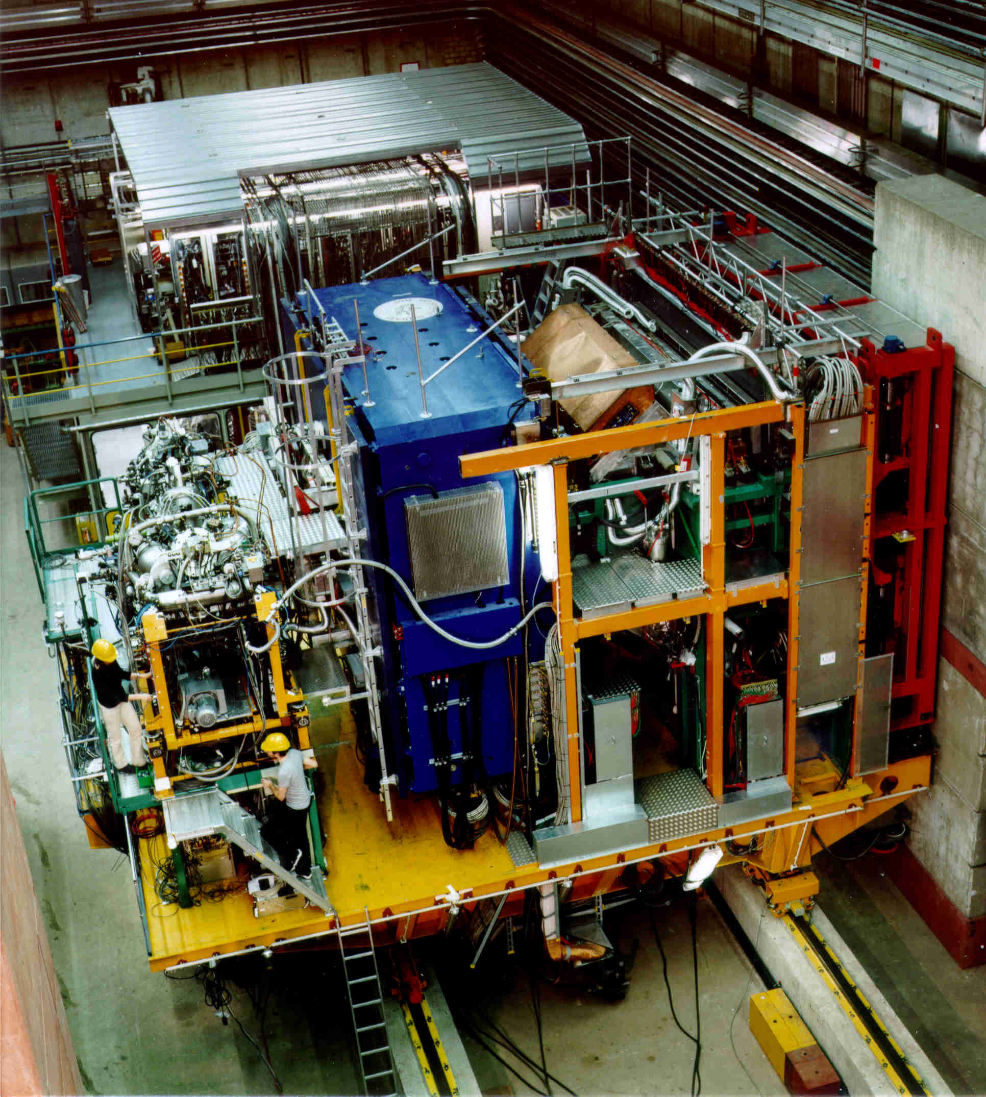
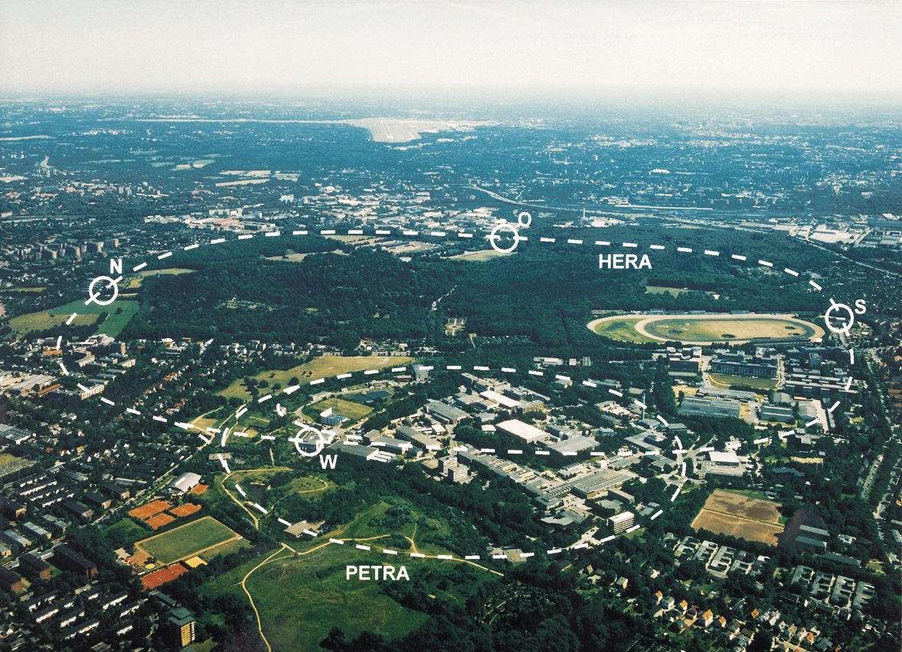



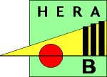
HERA @ DESY
HERMES @ HERA
HERA: e⁺/e⁻ (27GeV) - proton (920 GeV) collider

Slide 3
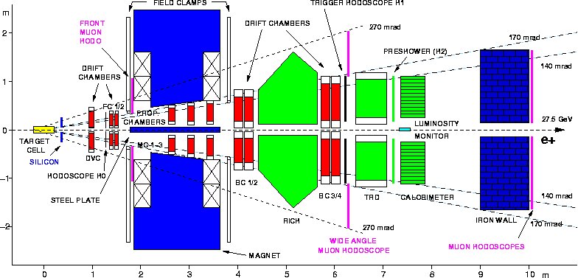
The HERMES Spectrometer
Internal Gas Target: He , H , D , H unpol: H₂,D₂,He,N₂,Ne,Kr,Xe
Particle ID:
ECal: E for leptons and γ
Preshower, TRD
→1997: Cherenkov,
→ 2007: RICH + Muon-ID

Slide 4
Which Particle is Which
Physics requirement: Need lepton hadron separation over wide momentum range
EM-Calorimeter
Leptons
Hadrons
Preshower
In worst case factor 10⁵ hadron
suppression is needed
combined suppression 10³
Factor 100 still needed

Slide 5
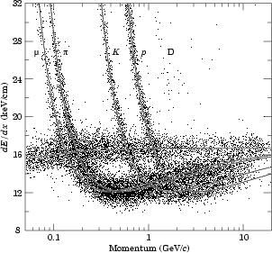
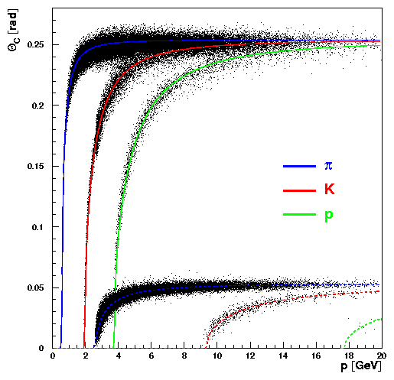
What is the best Detector concept
Energy loss dE/dx
Cerenkov Radiation
Aerogel; n=1.03
e
C₄F₁₀; n=1.0014
Too small p lever arm
Impossible to cover full p-range of leptons
Transition Radiation:
sensitive to particle γ (γ>1000)

Slide 6
The HERMES TRD
Single Module Response
combining all 6 modules

Slide 7
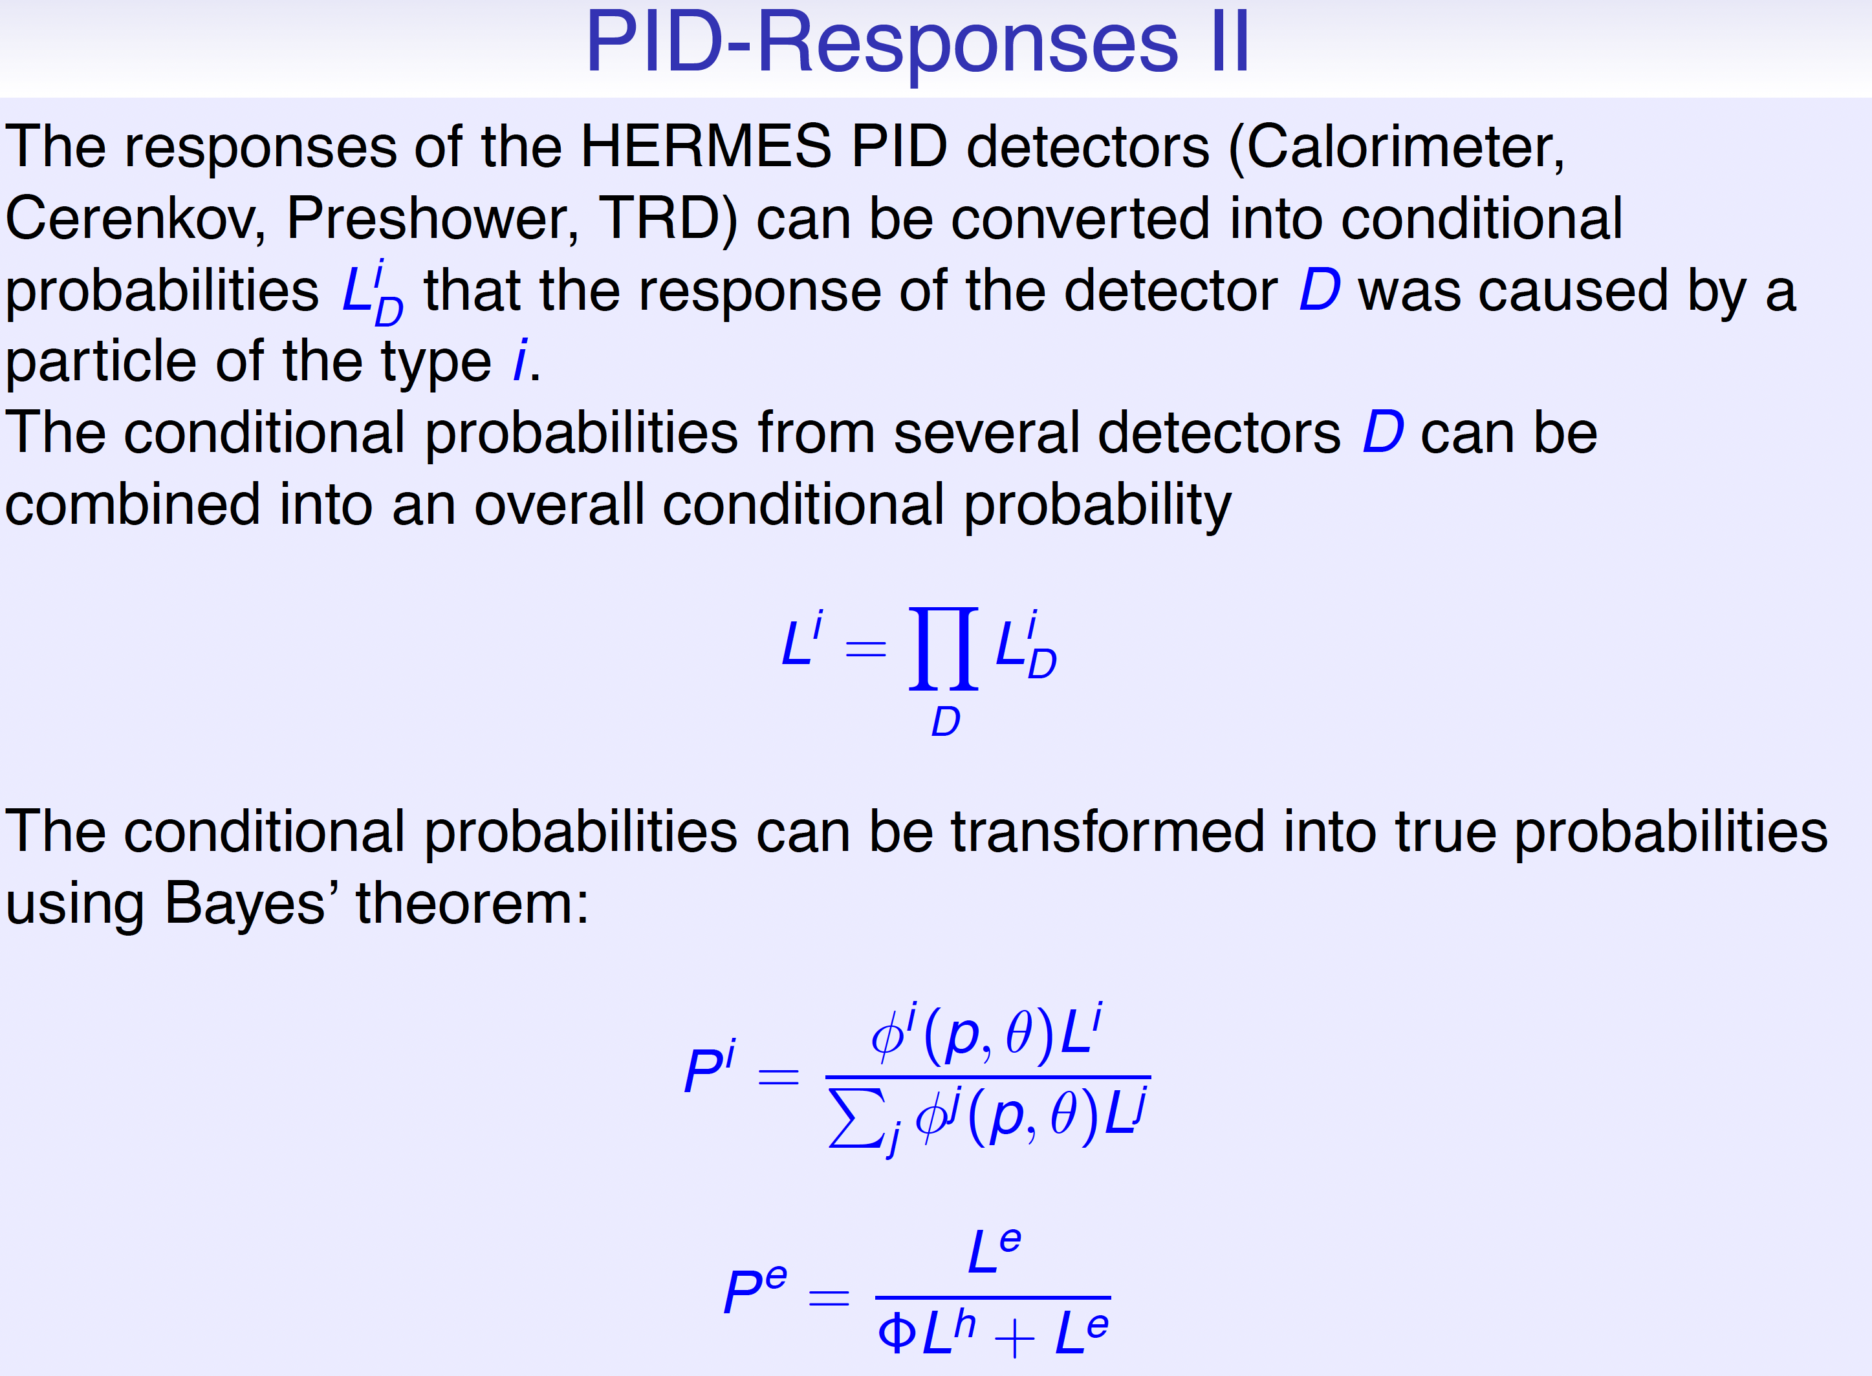
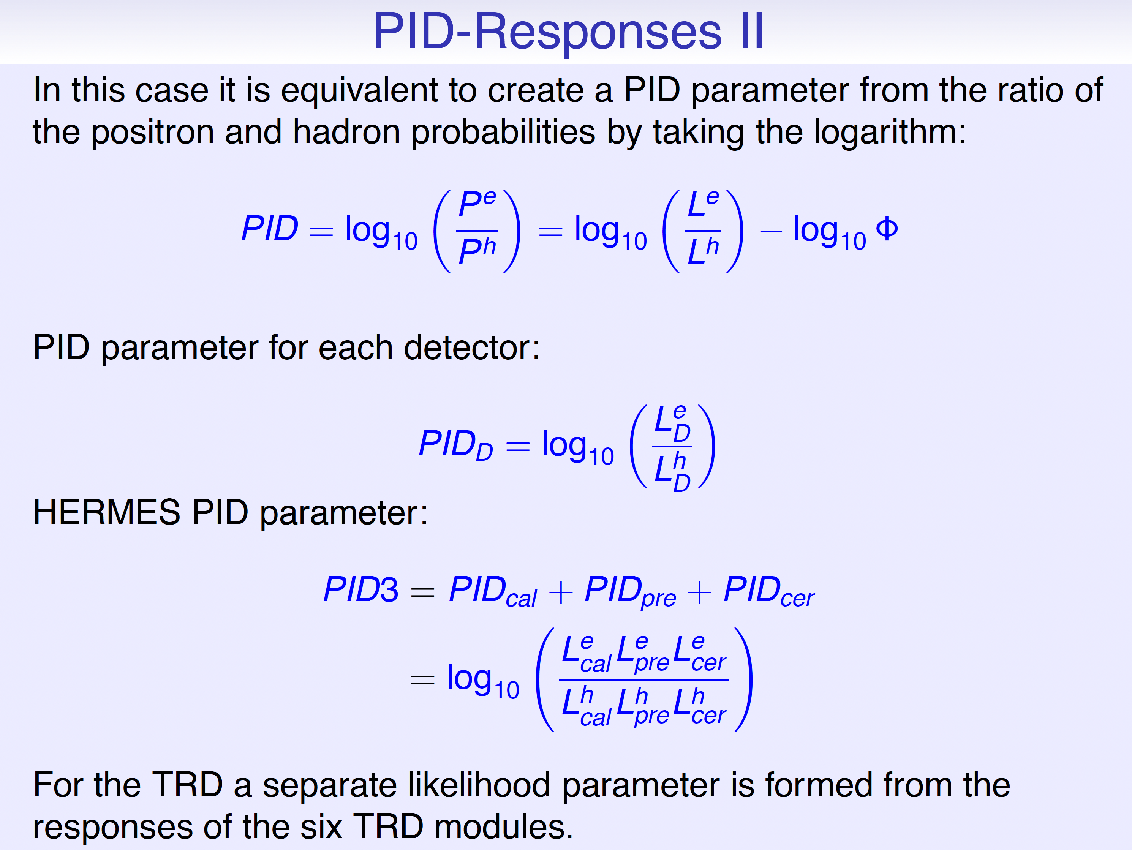
Which Hadron (π,K,p) is Which
hadron/positron separation
combining signals from: TRD, calorimeter, preshower
→ to cut on single responses very inefficient or high contamination
→ different method

Slide 8
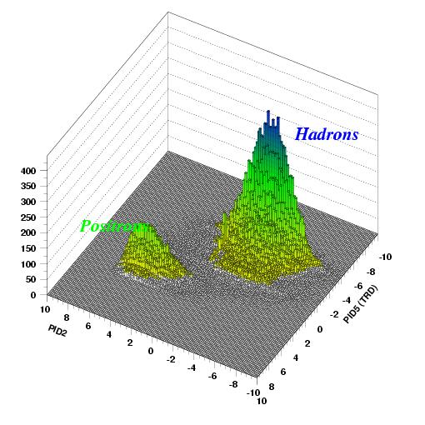
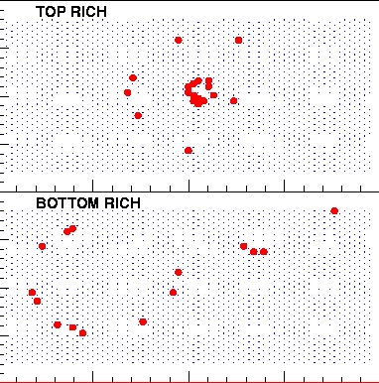
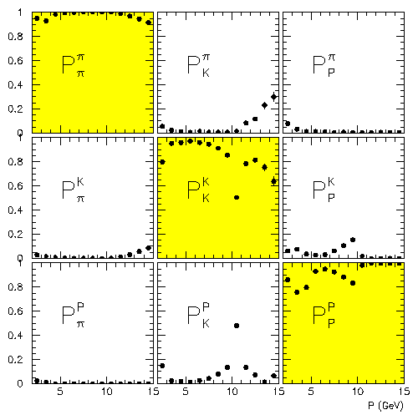
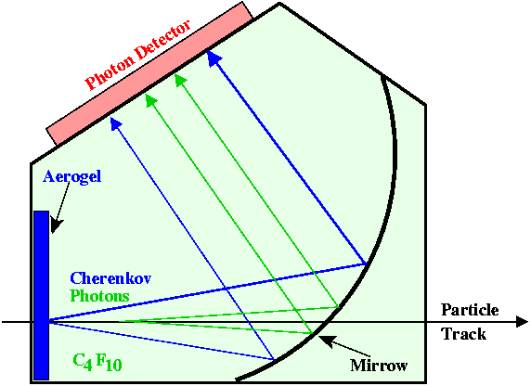
Which Hadron (π,K,p) is Which
PID-response separating hadrons and leptons combining ECal + Preshower + TRD
hadron separation
Dual radiator RICH for π, K, p
What about lepton identification?
Aerogel; n=1.03
π
C₄F₁₀; n=1.0014
K

Slide 9
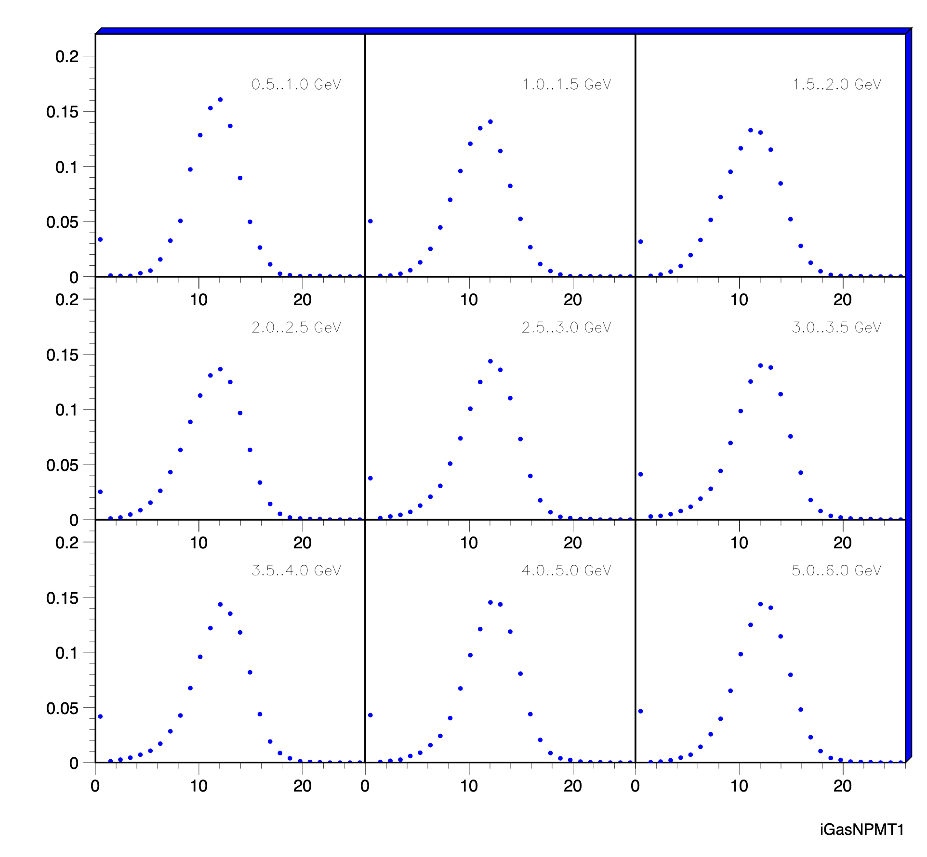
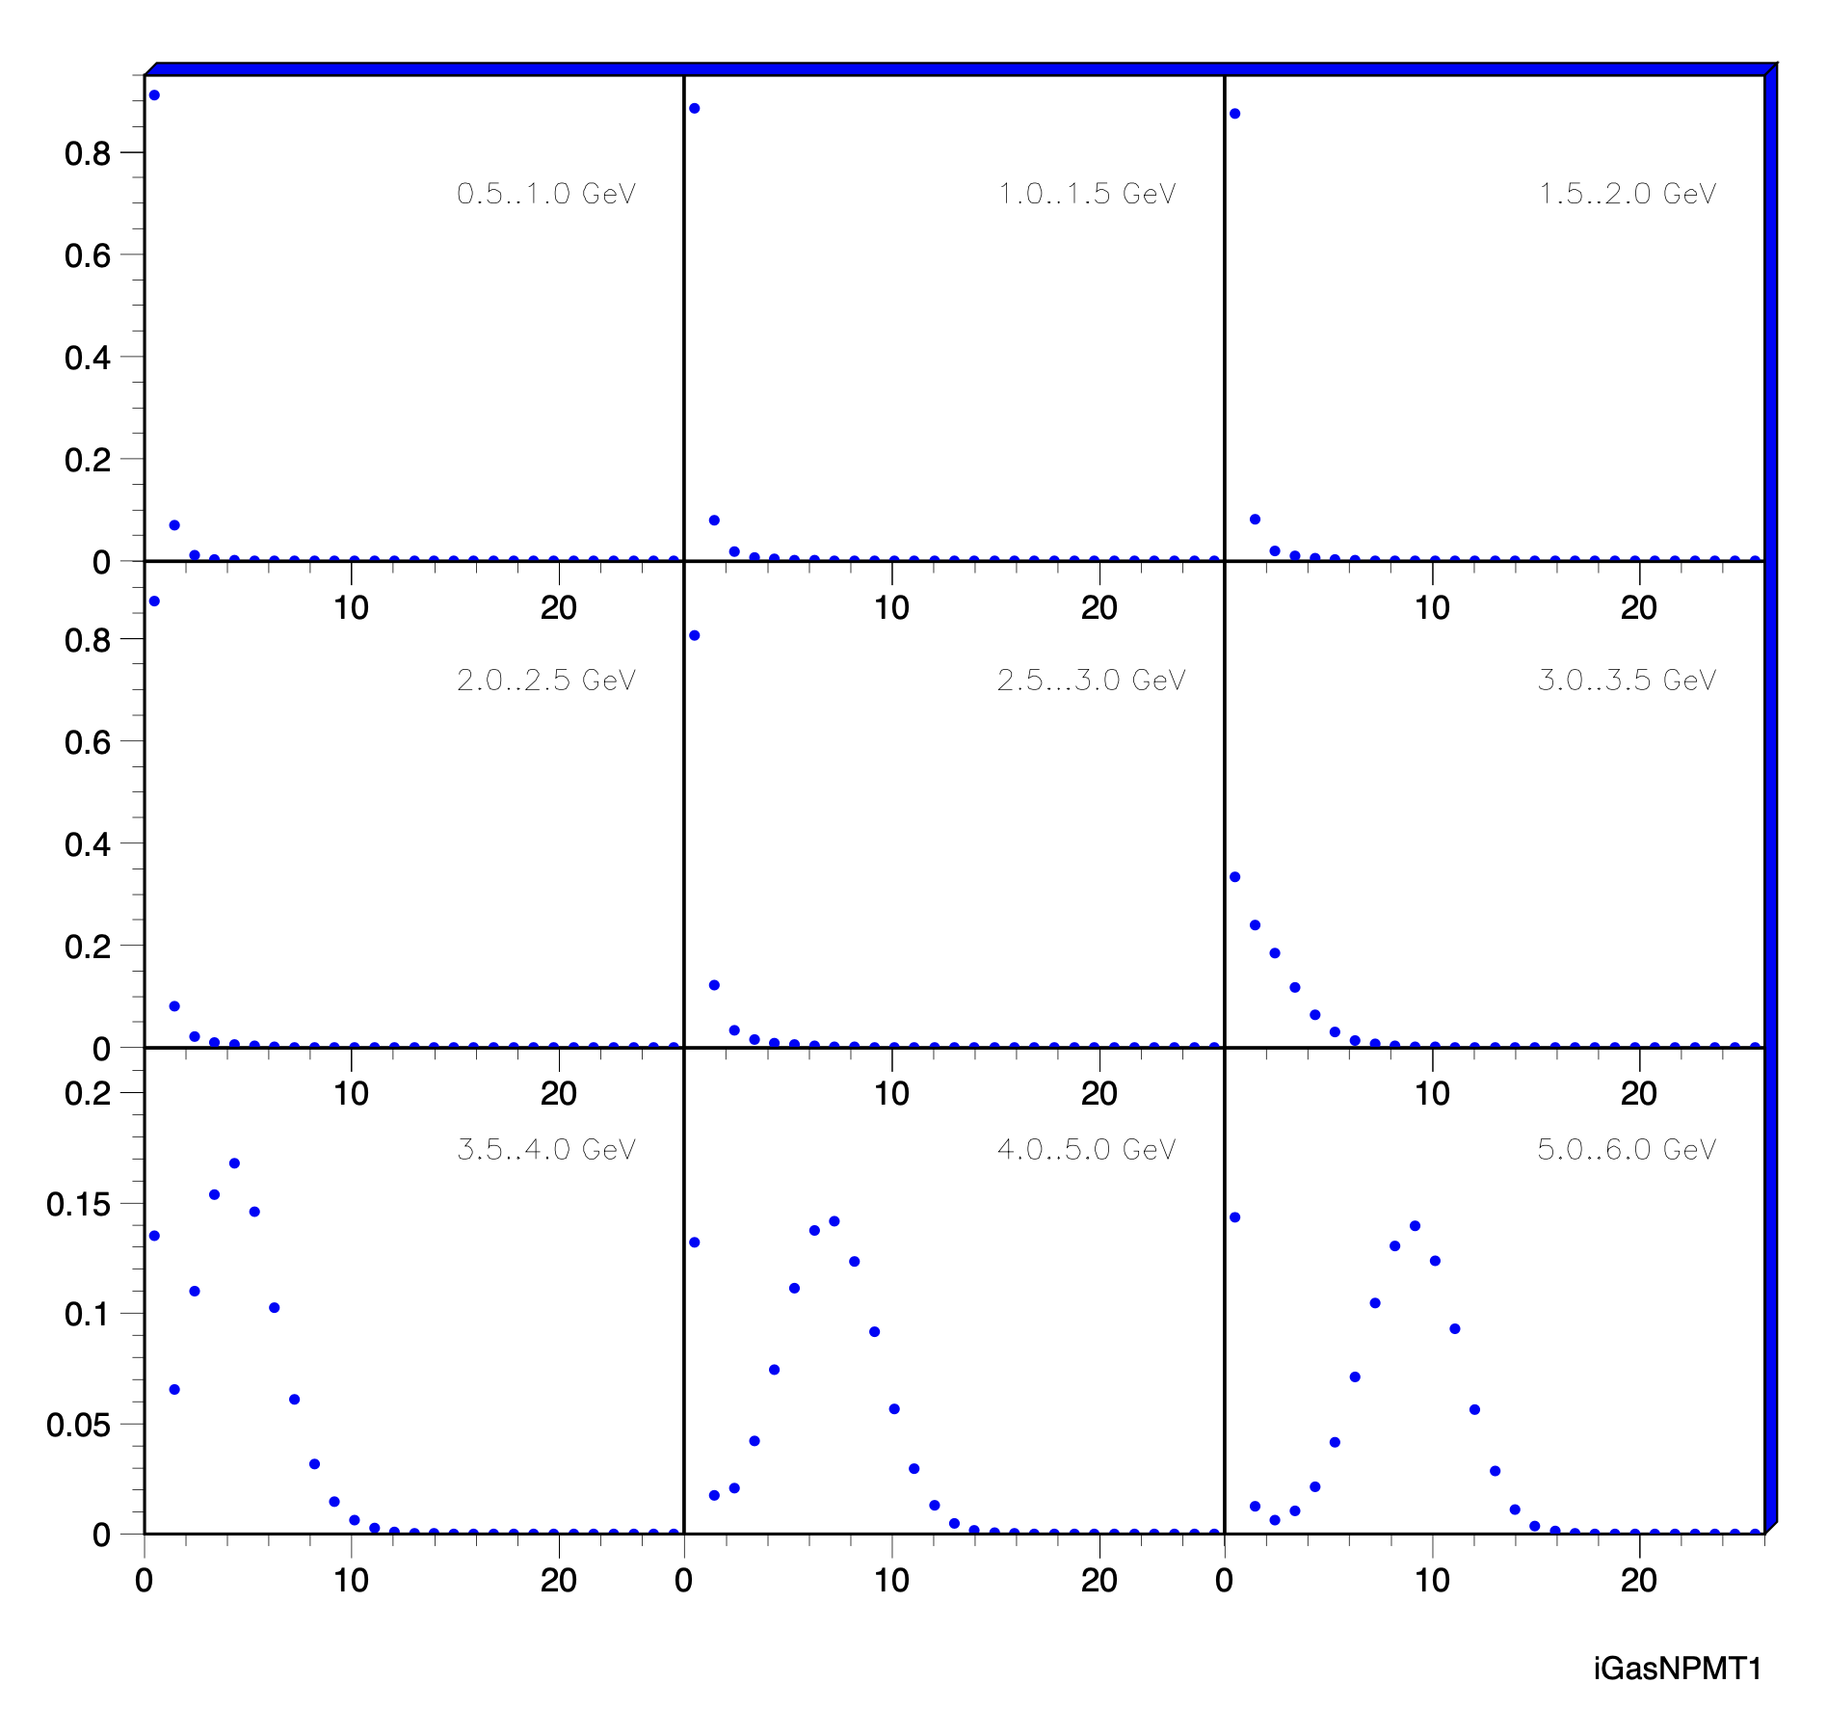
Lepton ID using the RICH
Variable used to form a PID probability #PMTs fired as fct. of momentum
RICH response for lepton hypothesis
for leptons selected by other PID detectors
RICH response for lepton hypothesis
for hadrons selected by other PID det.
Norm. #PMTs

Slide 10
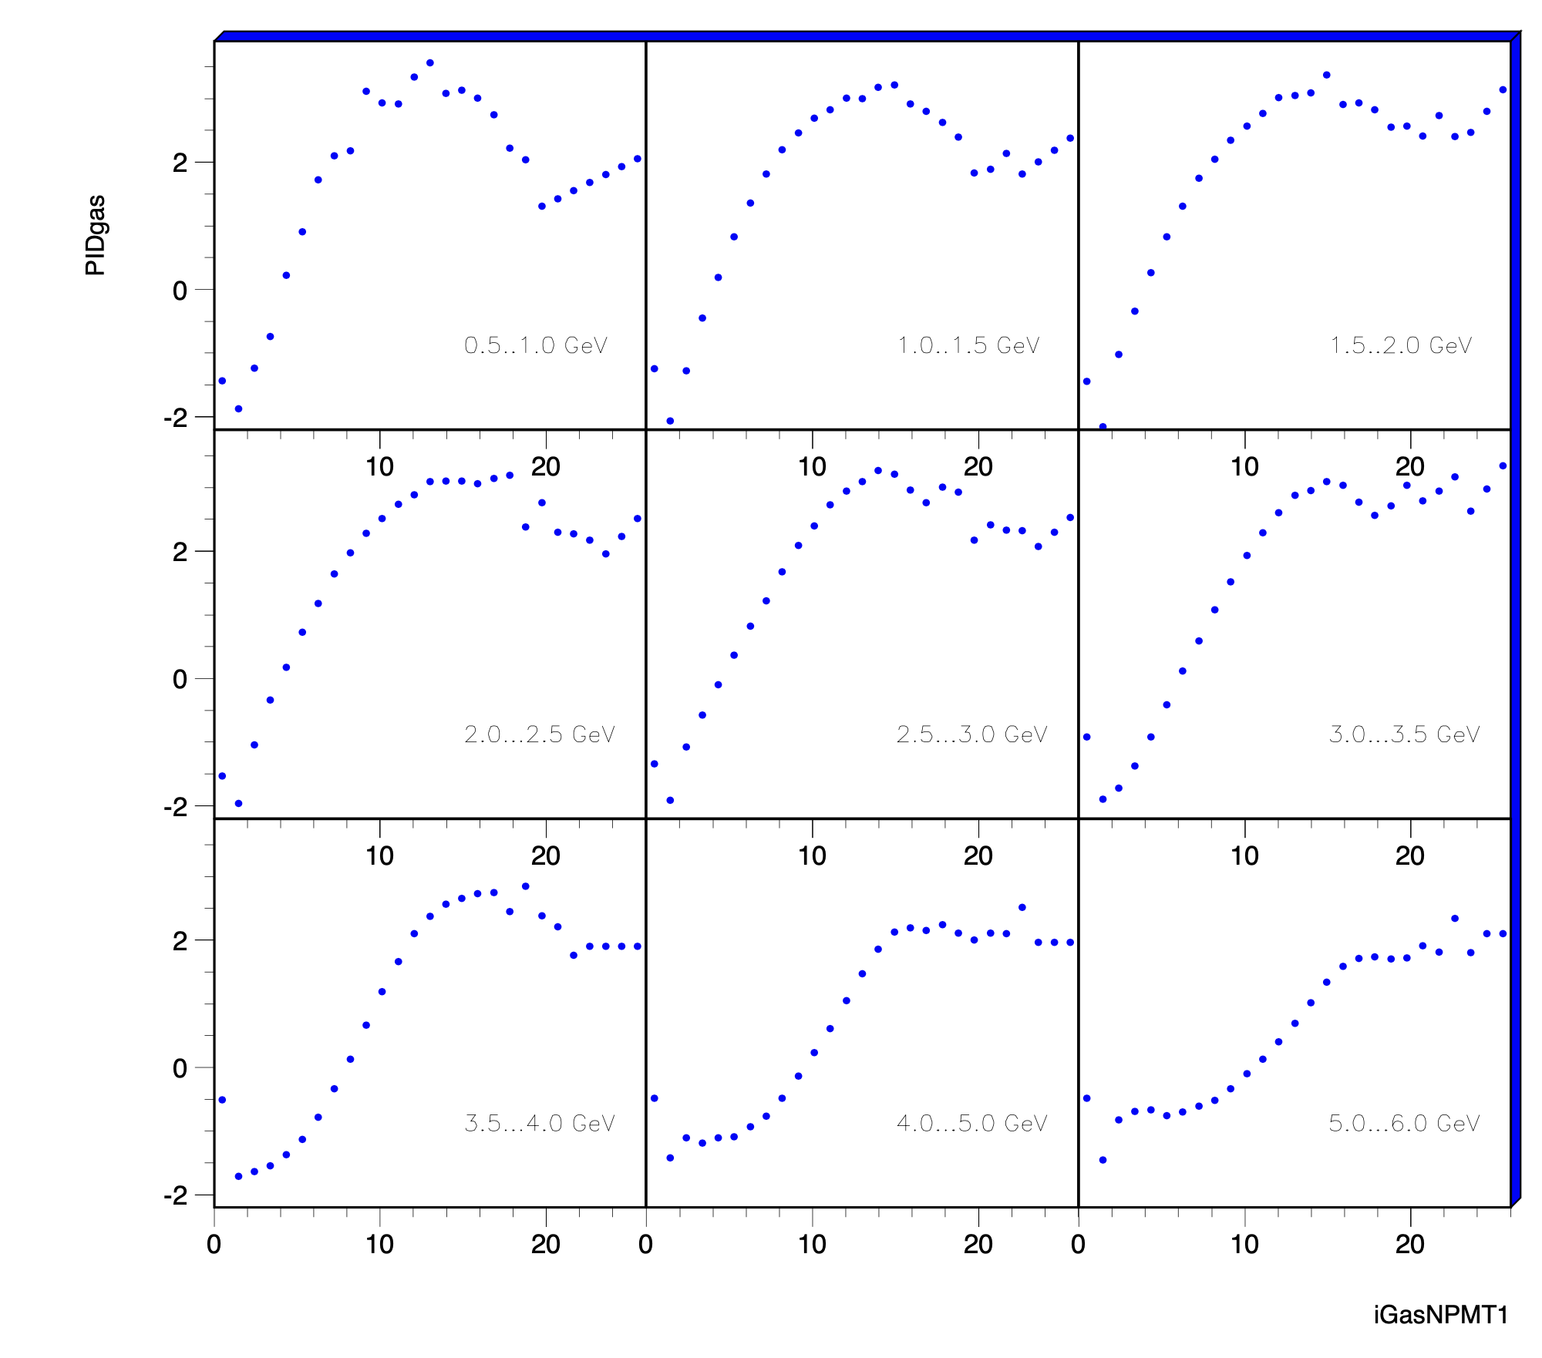
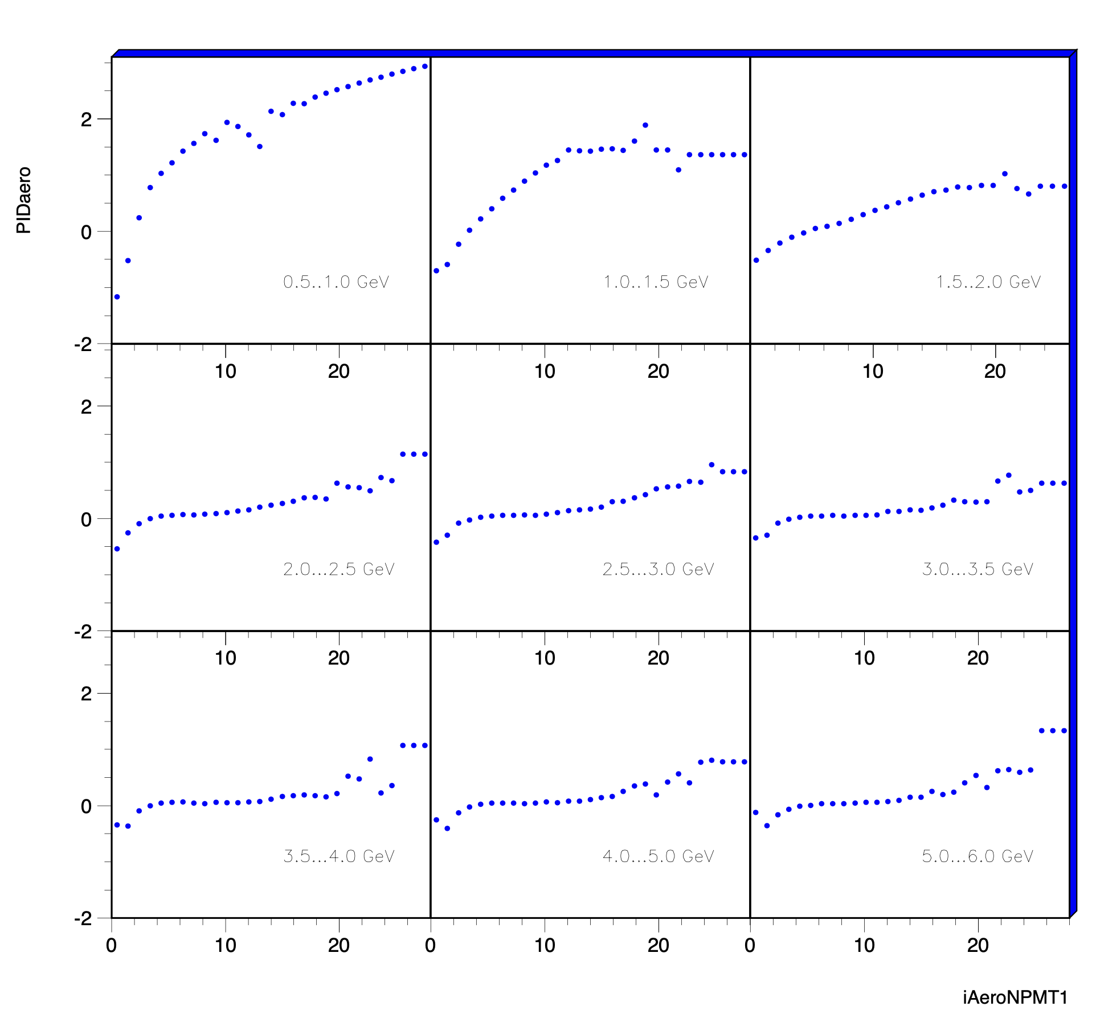
Lepton ID using the RICH
Gas
Aerogel
Gas radiator more powerful
over a wider p-range

Slide 11
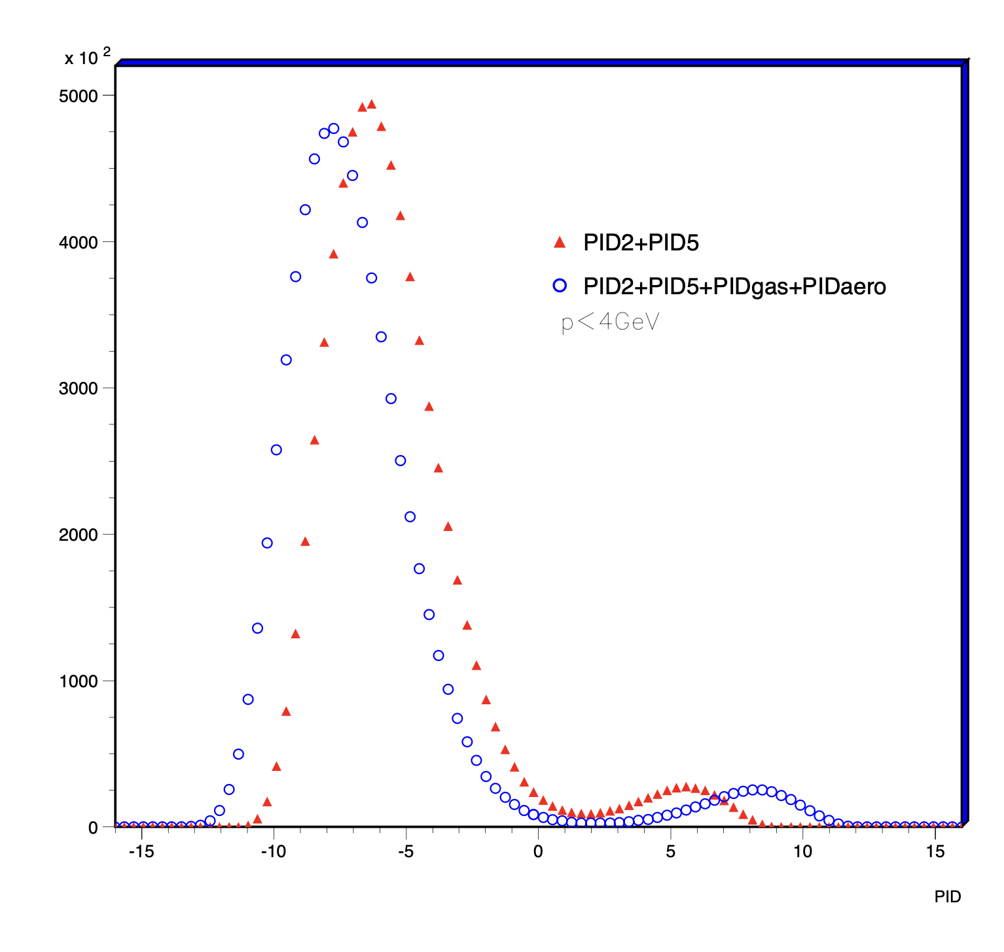
Summary
ECal+PreShower+TRD
Simple response on threshold
behavior of radiator
significantly improved lepton hadron separation
→ one can do similar things for EIC
p<4GeV

Slide 12


Slide 13
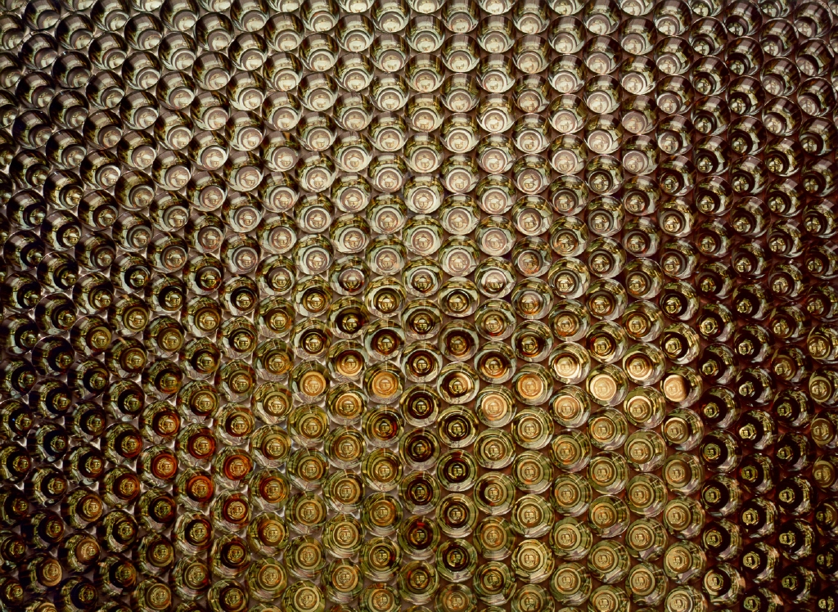
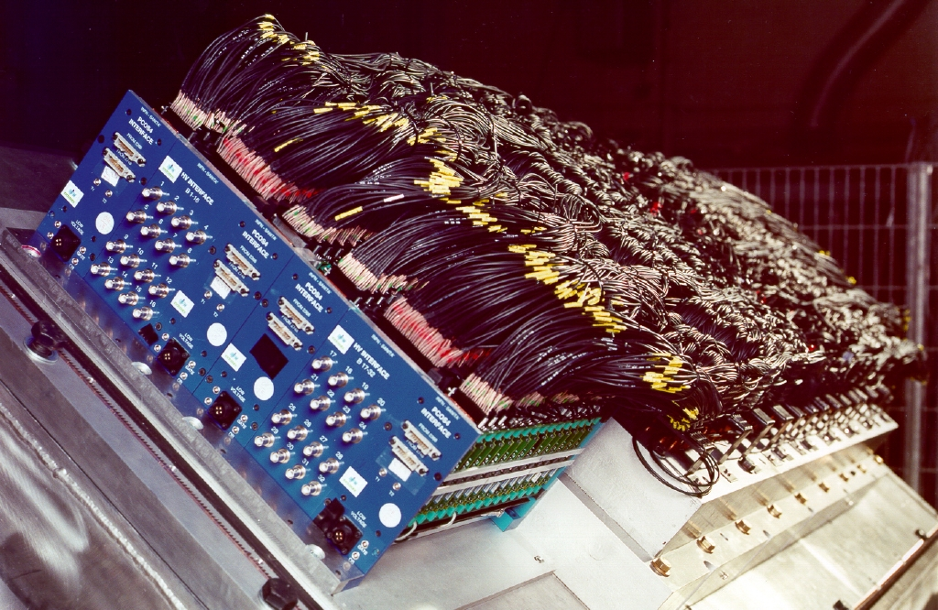
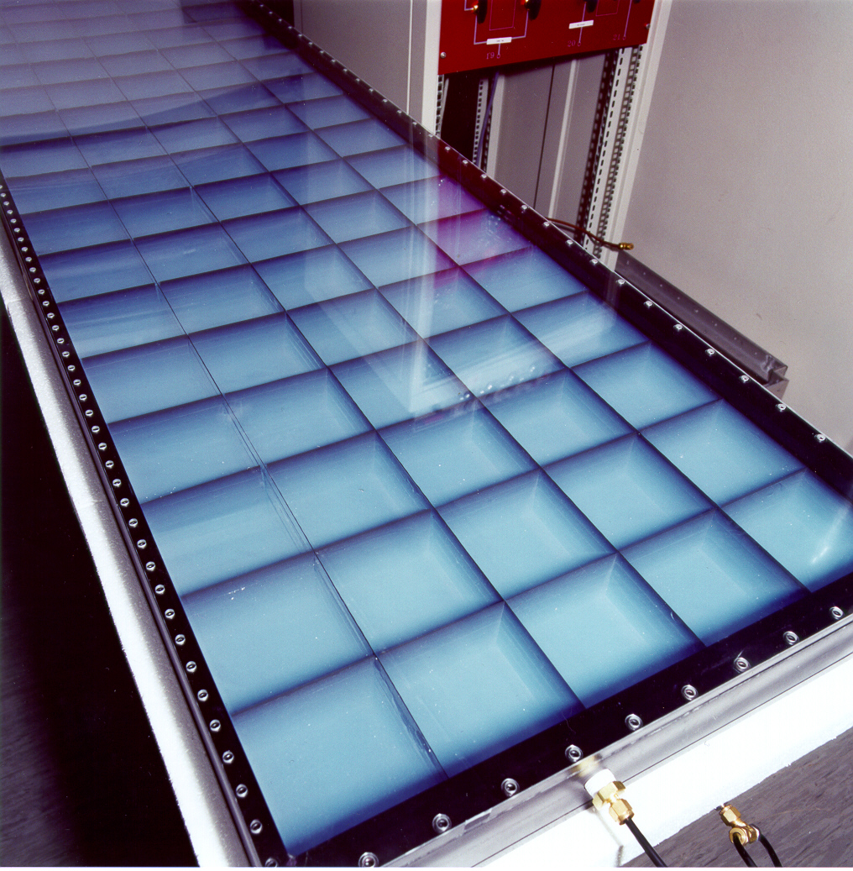
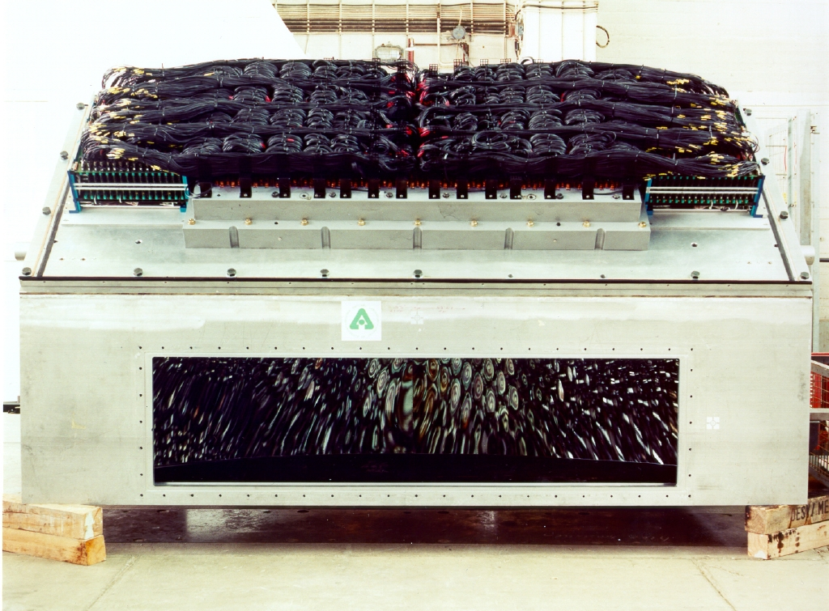
The HERMES RICH Detector
2000 0.75’’ PMTs
6km cables on
60cm x 120cm
Aerogel-Wall

Slide 14
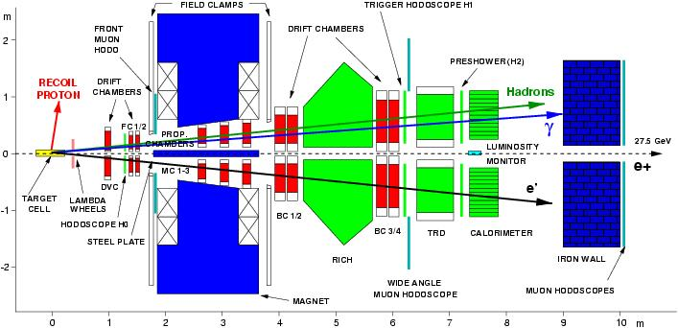
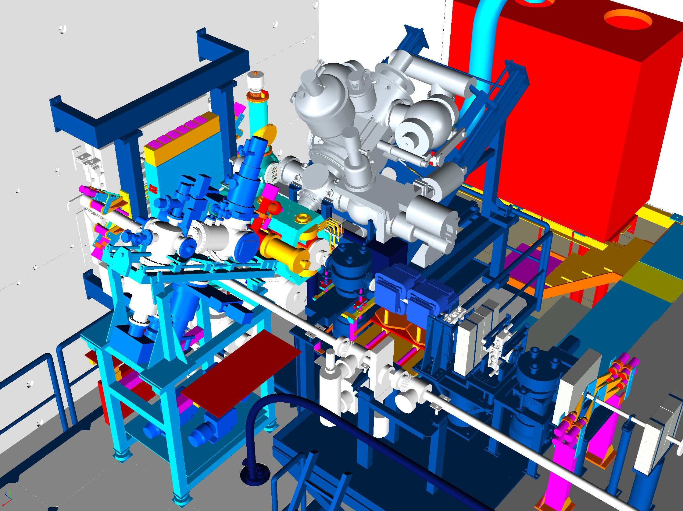
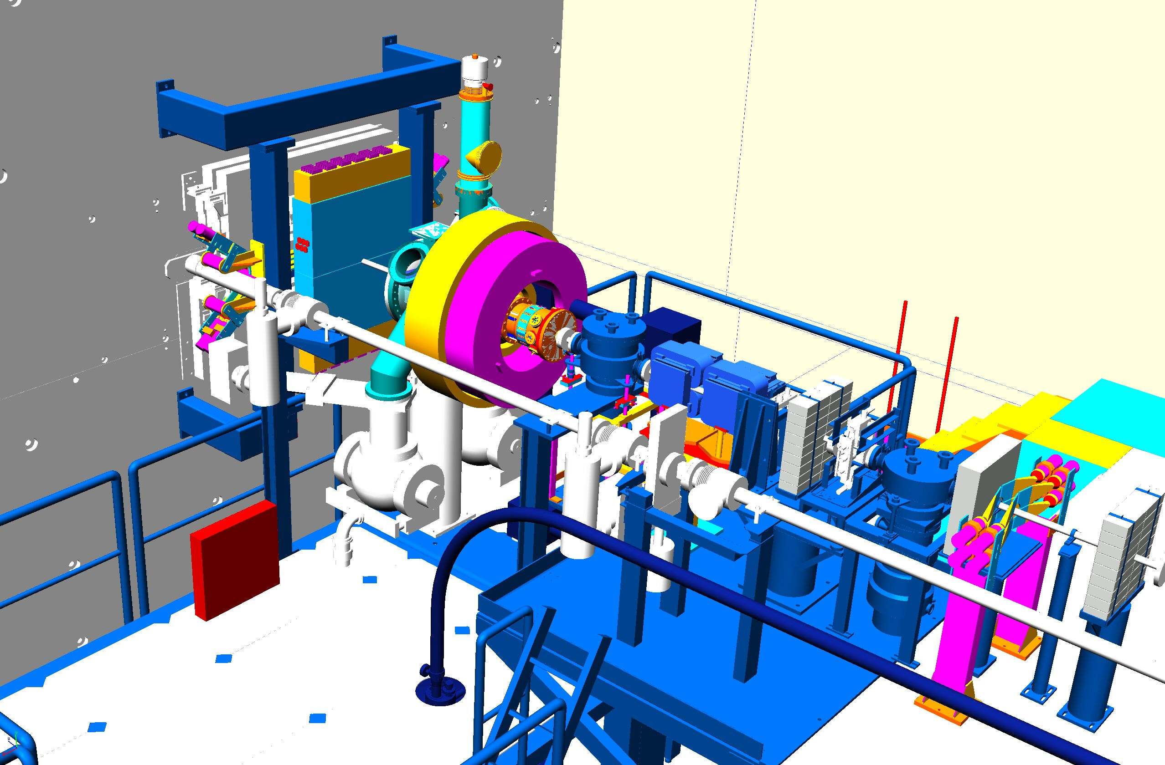
The end of polarized targets at HERMES
DVCS exclusivity by missing mass M_{x}
Improve Exclusivity
Detect recoiling proton
modify target region
Detector to measure recoiling proton

Slide 15
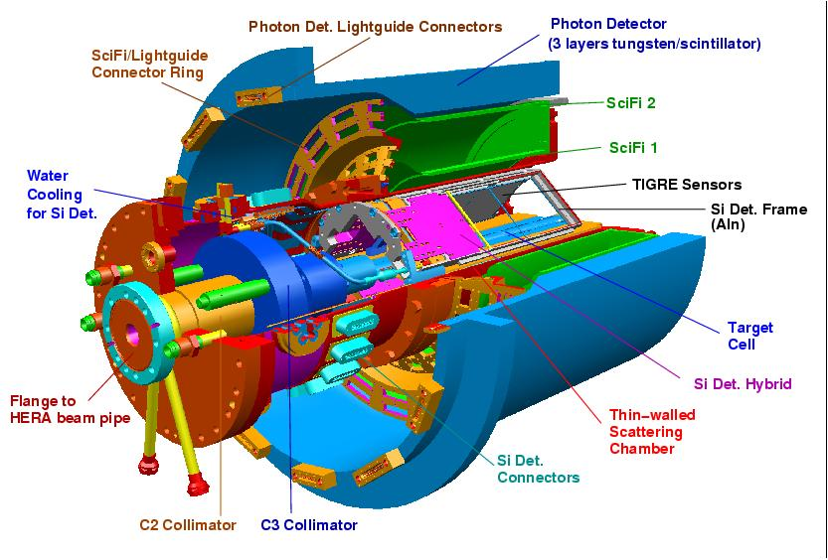
The HERMES Recoil Detector
detection of the recoiling proton
  p; 135 -1200 MeV/c
  76% φ acceptance
  π/p PID via dE/dx
improved t-resolution
  study kinematical
  dependences
SciFi
background suppression
  semi-incl.: 5% a <<1%
  associated: 11% a ~1%
Silicon
Build by DESY, Erlangen, Ferrara, Frascati,
Gent, Giessen and Glasgow

Slide 16
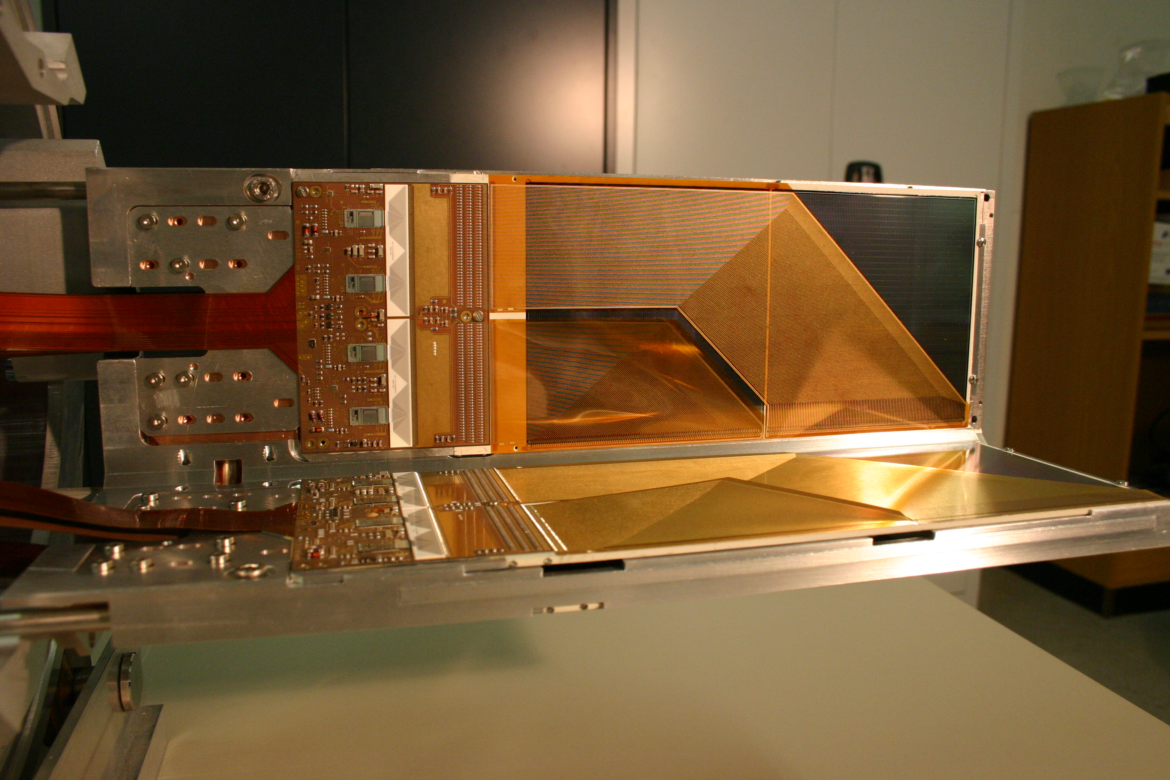
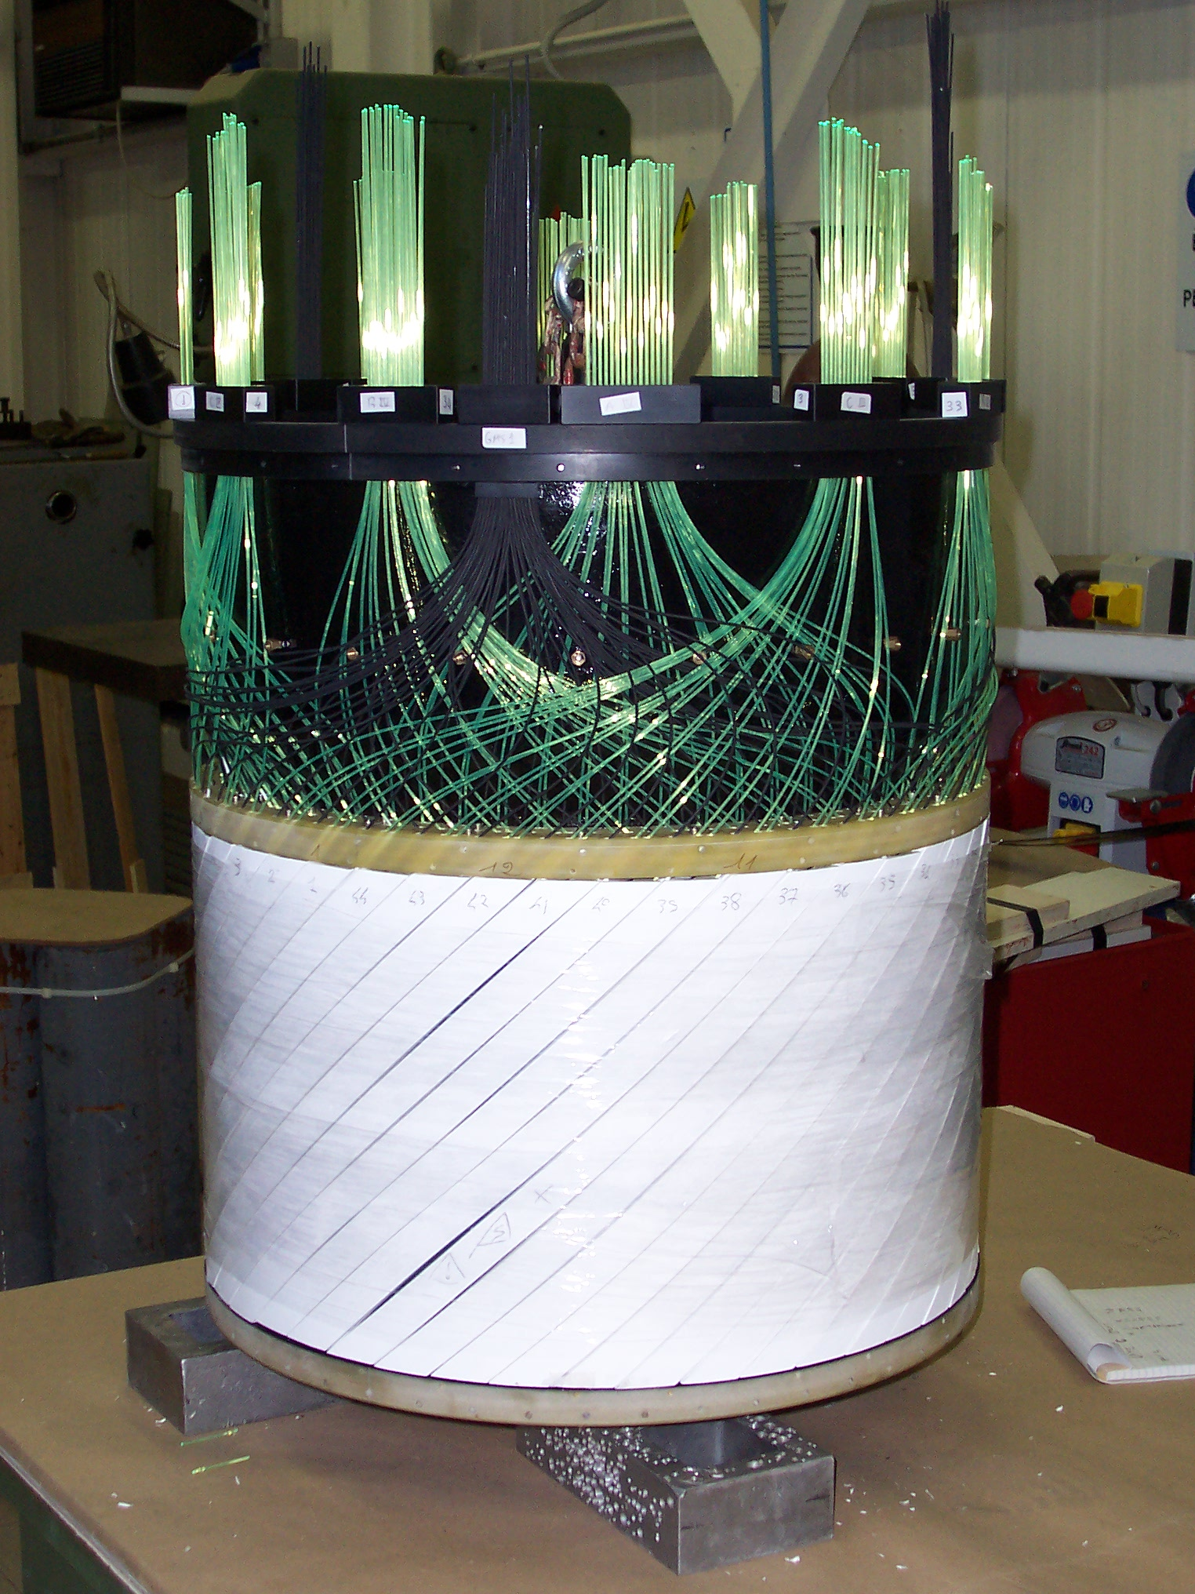
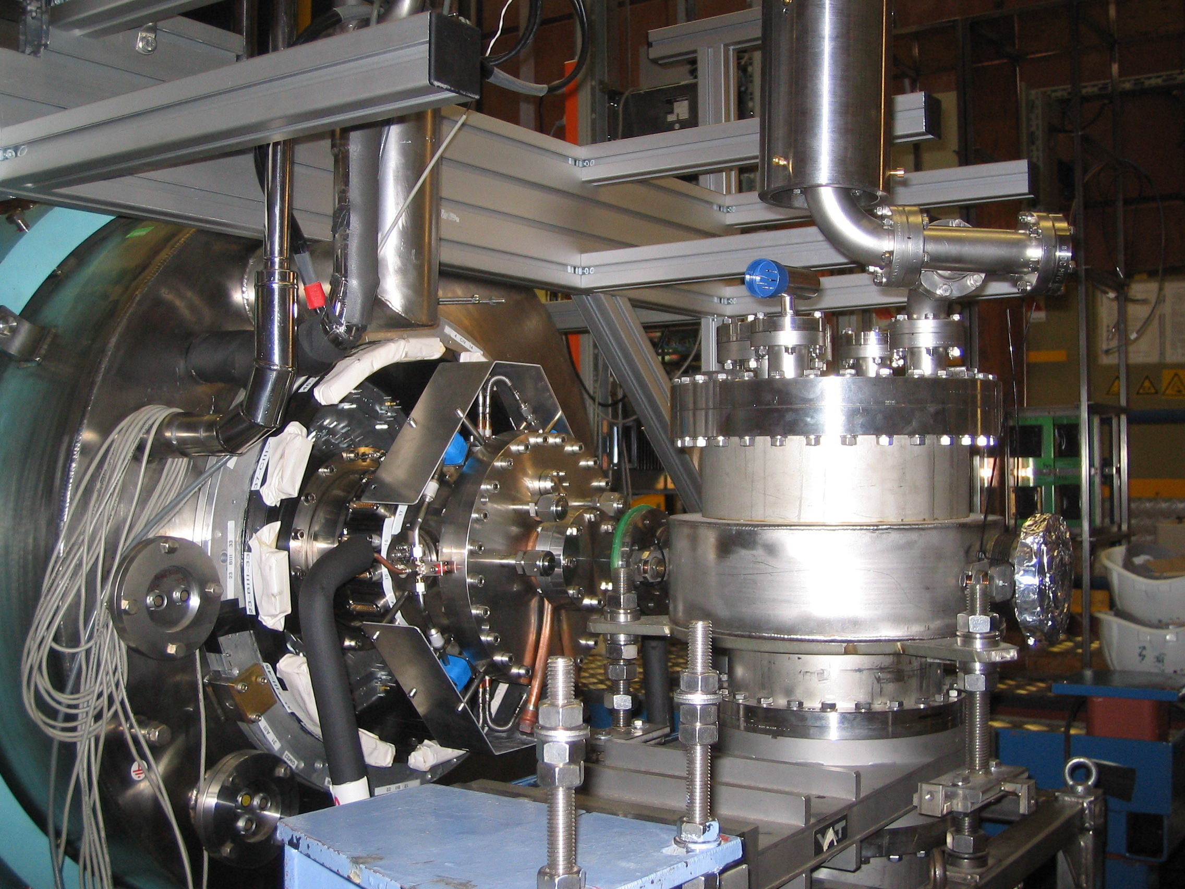
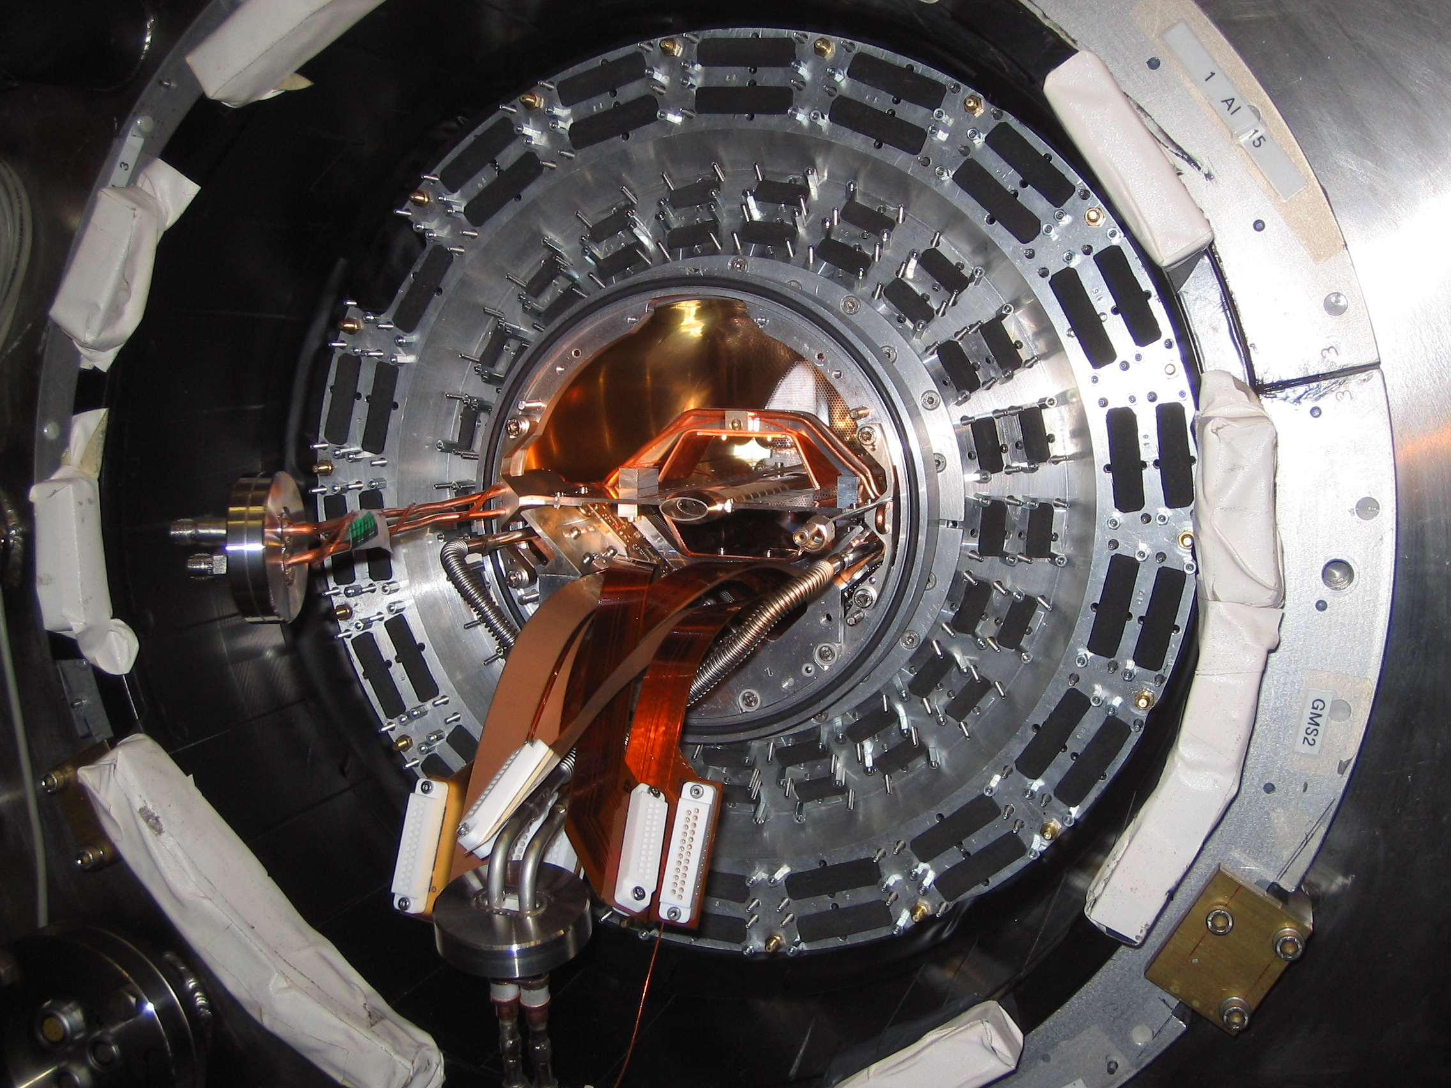
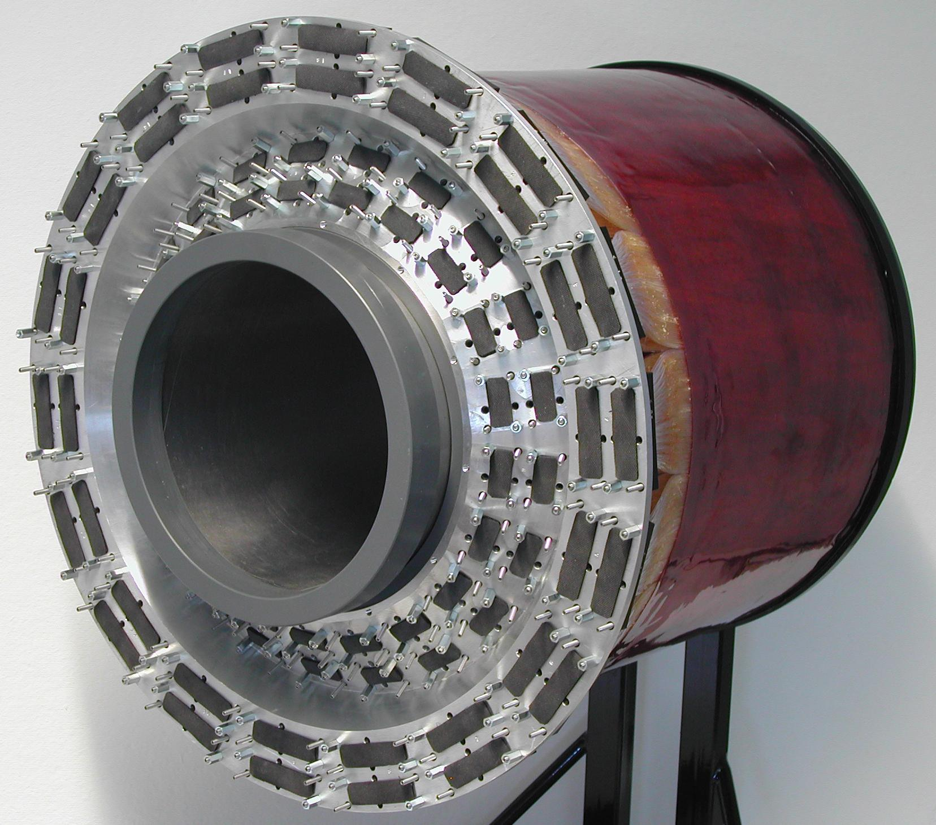
The sub-detectors of the recoil
Silicon Detector
Photondetector
SCIFI-Detector

Slide 17
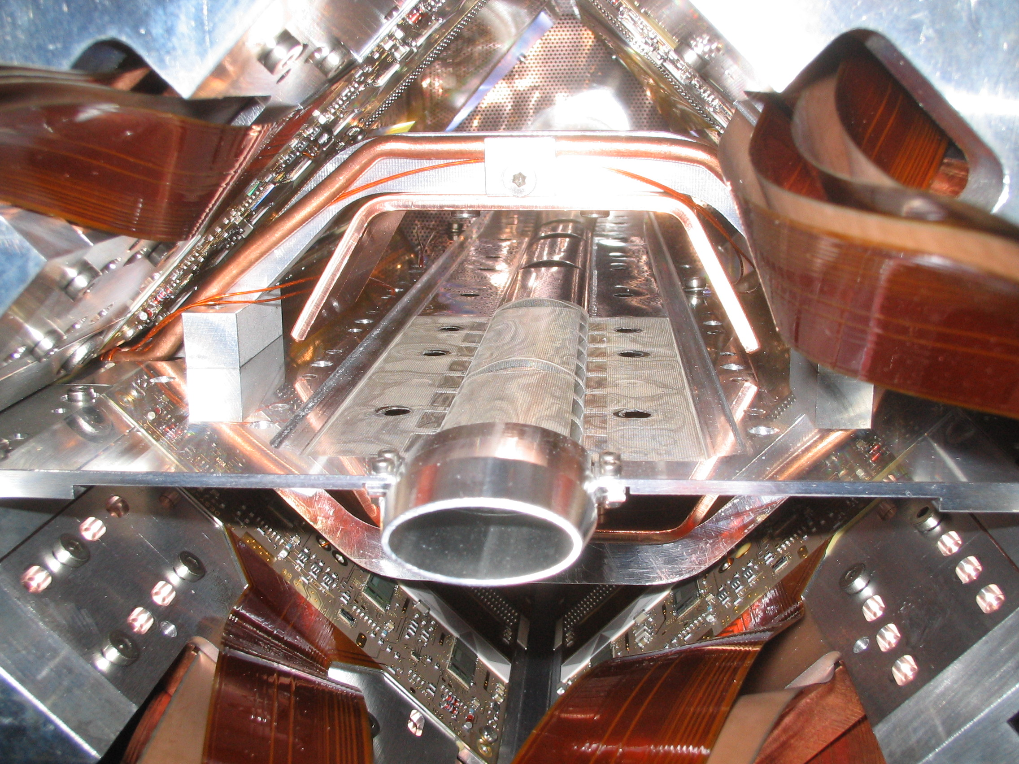
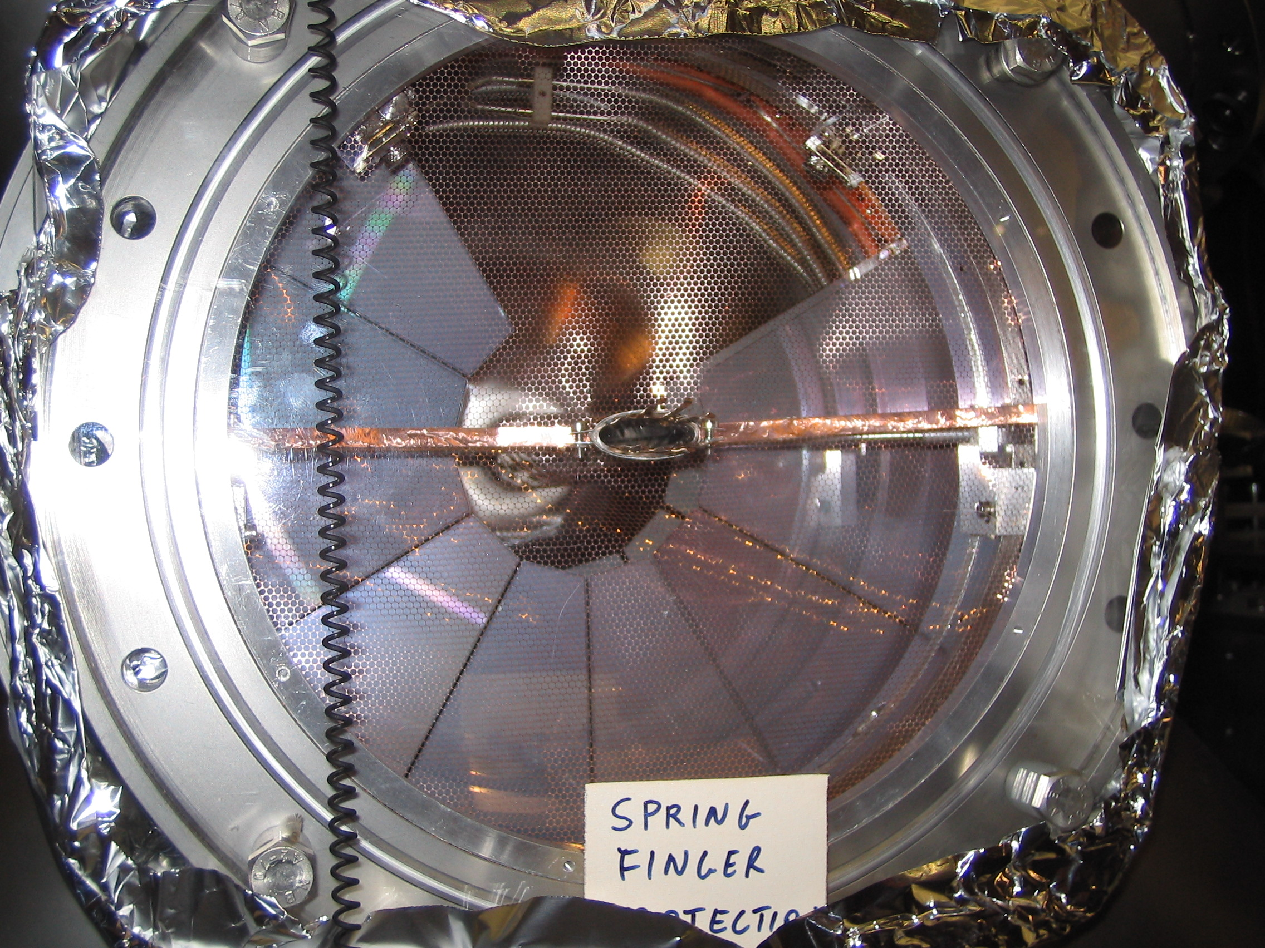
The HERMES Silicon detectors
first Si-detectors in high energy
experiments, which sit directly in
beam vacuum
normally roman pot technology
special attention to background rates
during injection and the fill
BeamLossMonitor connected
to fast e-dump

Slide 18
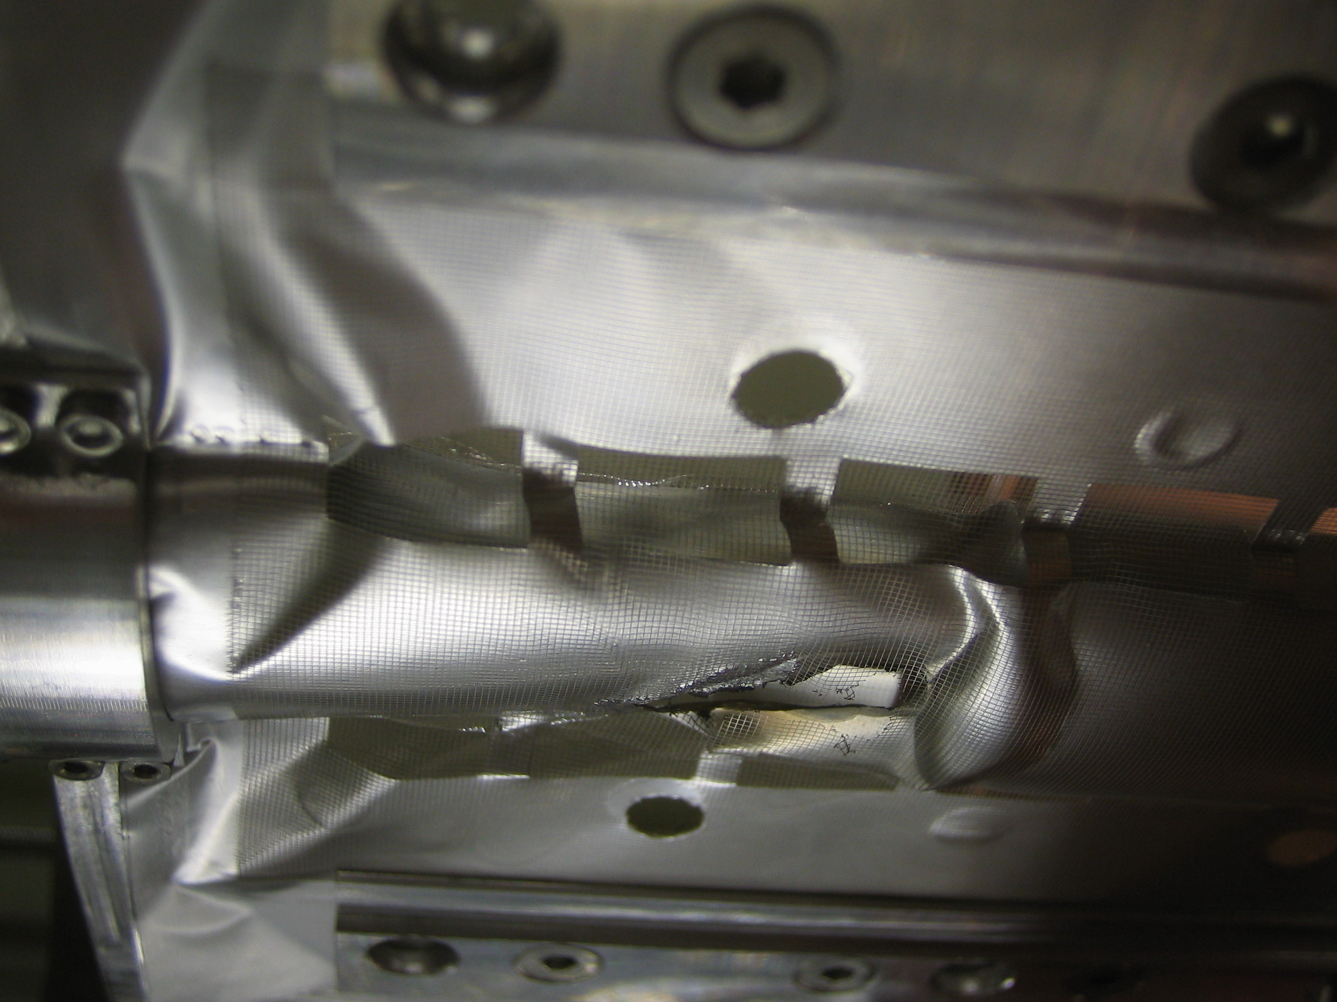
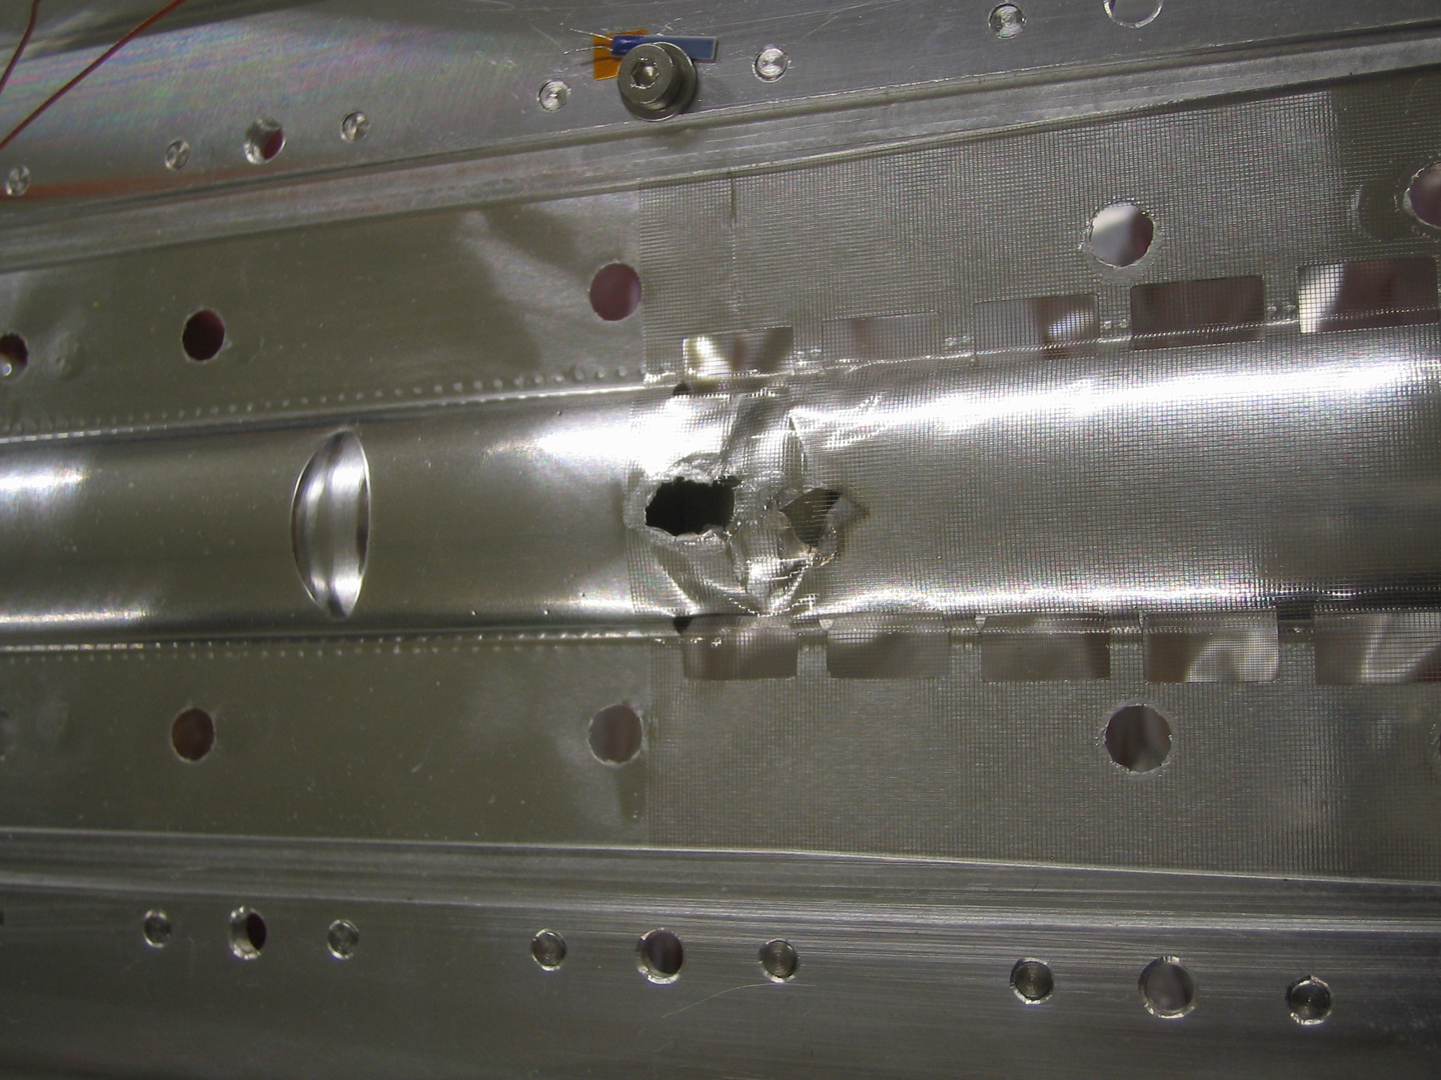
Unfortunate Accident
March:
  Target Cell got damaged properly by accidental beam loss
  caused big problems due to RF for the silicon
May:
  Silicon got severe radiation damage due to second incident with
  the target cell
Silicon-Detector:
  removed for repair
  re-installation end of June in shutdown for HERA e⁻/e⁺ switch

