Slide 1
Some comments to Detector 1 tracking /PID optimization discussion. What is the reason to utilize miniTPC with GridPix readout
T. Hemmick, N. Smirnov
SBU, YU
July 14, 2022.

Slide 2
To start the discussion connected to BARREL tracking / PID setup.
Are all statements / request in YR correct ?
If YES:
-- all charge particles with P (0.1 - 10.0) GeV/c should be reconstructed with PID known
-- spectrum of charge particles are correct ones.
-- primary and secondary vertexes should be reconstructed (s- and c- Physics)
If NO:
What should be used for the tracking and PID optimization?

Slide 3
Does current “EIC Detector 1” proposal fit the YR guidance?
“Detector 1 Collaboration Proposals: Experiments must address the EIC White Paper and NAS Report science case. The collaboration should propose a system that meets the performance requirements described in the EIC CDR and EICUG YR.”
Barrel setup (+/- 1.5 pseudo-rapidity): reconstruct ALL charge particle tracks with PID and requested momentum resolution performance for P in 0.1 – 10. GeV/c limits.

Slide 4
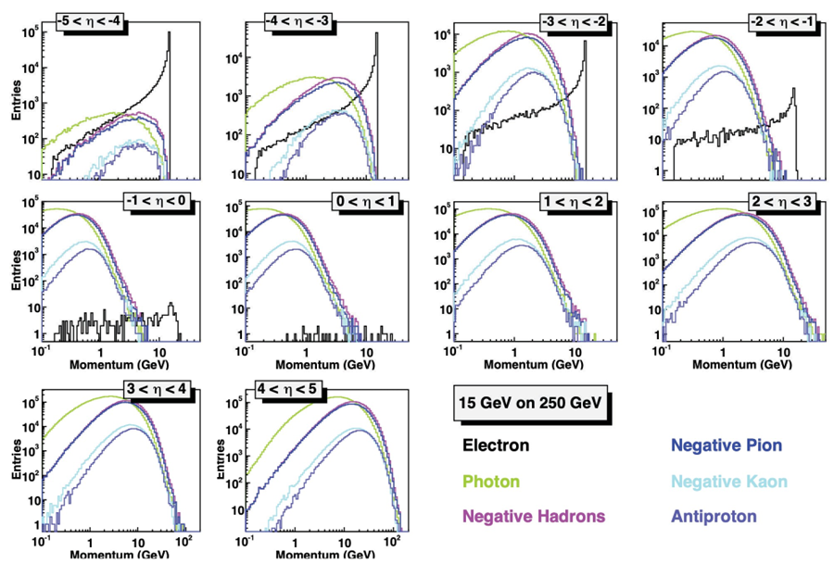

Slide 5
Tracking – PID -- EMCAL: optimization together
DIRC team “promised” perfect PID started 0.6 GeV/c
So, it is crucial to “cover” 0.1 – 0.6 GeV/c part of the spectrum. (where practically all particles are; see YR simulation data).
It was proposed to consider AC-LGAD as (fantastic) 4D detector.
But is it optimal option for Detector 1?
-- it needs a lot of R&D, see last presentation of the ToF team. What is the detector response for “huge” particle crossing angle.
-- It is unclear that pre-production detector will be ready at TDR presentation time.
-- it is extremely expensive.
R position ?
-- for R=63 cm position there is probability that it is no PID for particles with momentum up to 0.3 GeV/c.
Is it acceptable !?

Slide 6
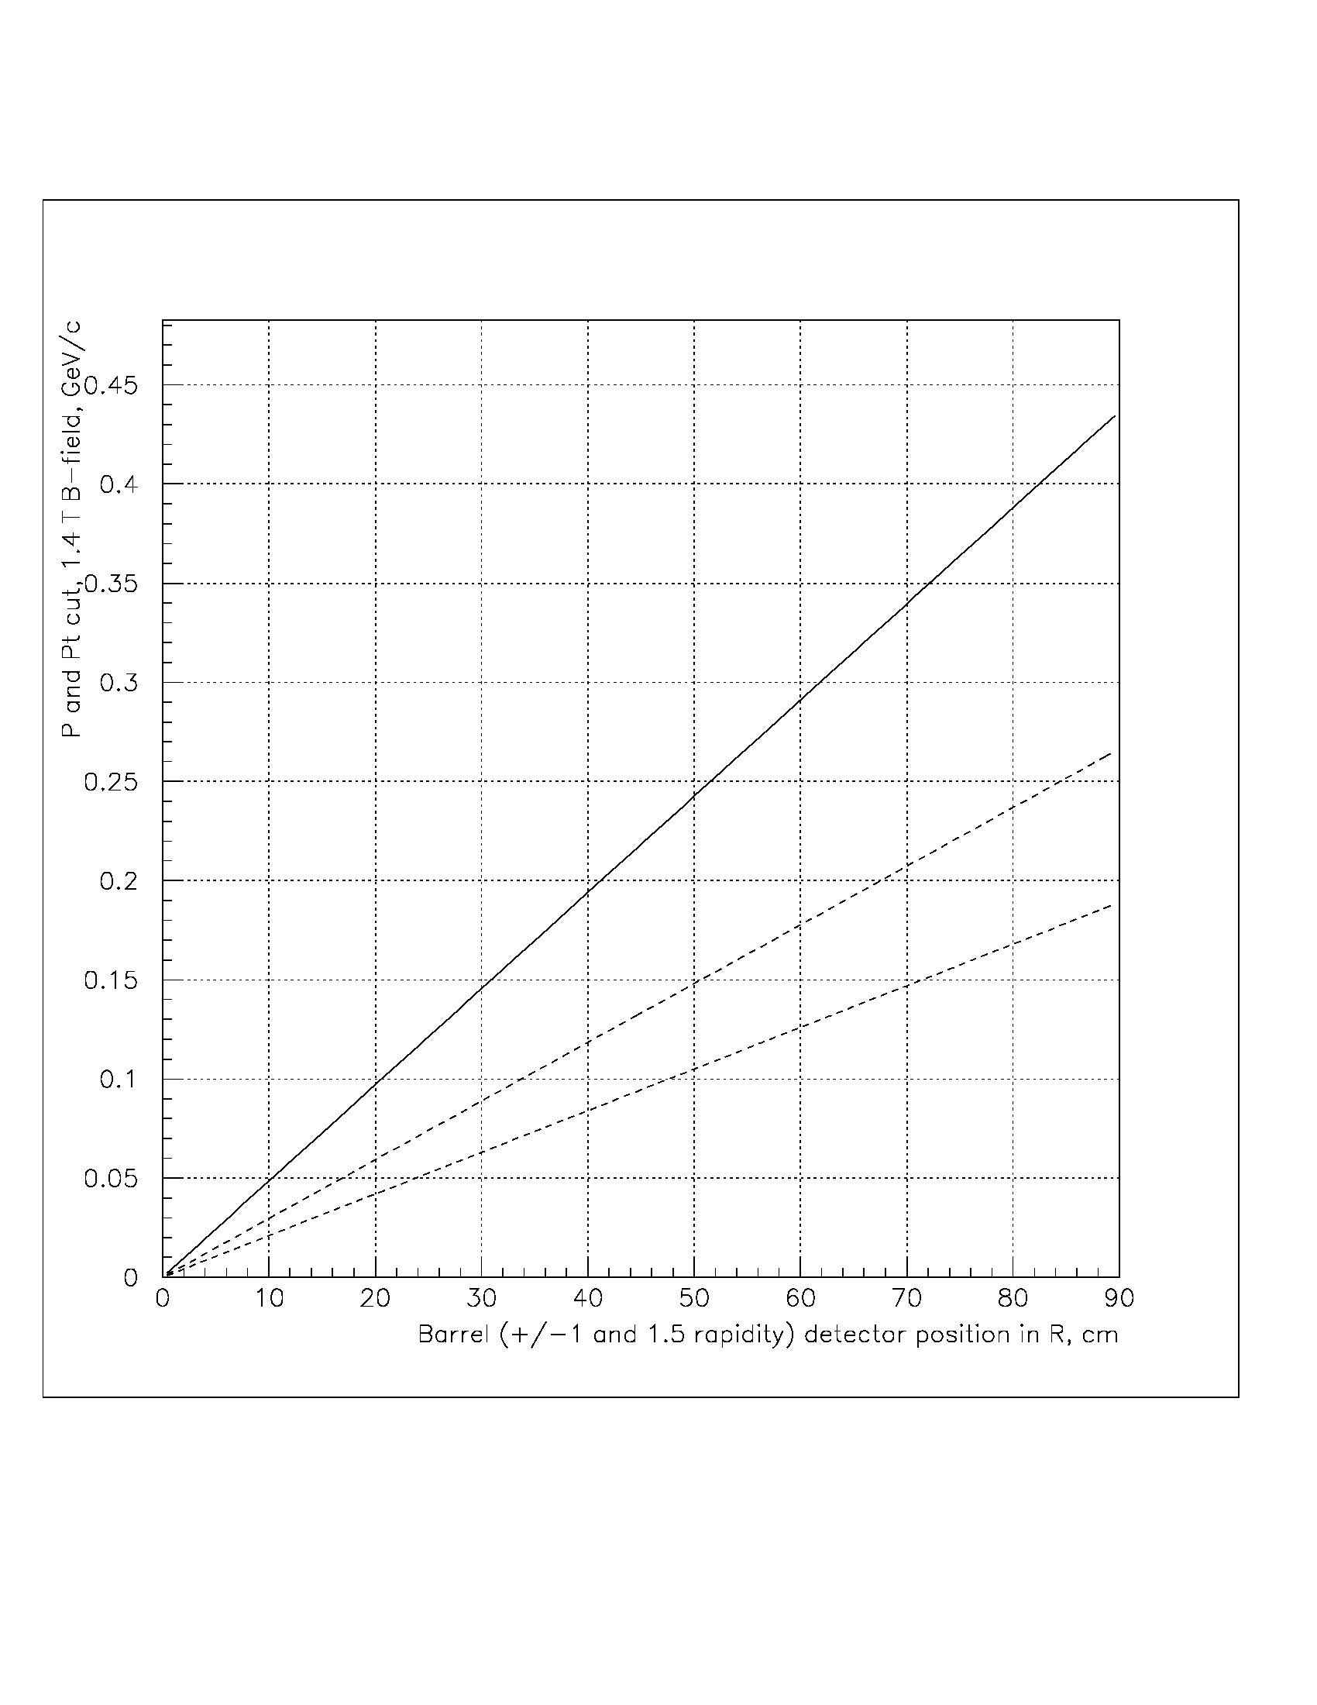
-- Change R to ~35 cm position? But keep In mind: beams crossing timing, clock distribution precision, and 8-12% of X0 material.
P cut. +/- 1.5
P cut, +/- 1.0
Pt cut
ToF
Si
MPGD
MPGD
MPGD

Slide 7
For the D1 BARREL setup questions are;
-- PID for hadrons momentum smaller 0.3 GeV/c (~25 % of all particles)
-- Number hits / track for reliable track finding / reconstruction
-- Primary and secondary vertexes reconstruction
-- Lambda and K0 Physics, Vertex finding / reconstruction
-- Tracking detectors hit precision as a function of the momentum (Pt, Pz, angles),
One possible solution is the miniTPC with GridPix readout.
-- low mass,
-- best for track finding /reconstruction, ~3000 hits / track, robust in the “backgrounds environment”,
-- guaranty high quality PID up to 0.6 GeV/c, (dN/dX, truncated procedure), exactly fits all demands for low momentum particle track finding and reconstruction,
-- all “components” were tested and utilized in experiments and R&D activities,
-- “needs” minimum but R&D: optimization including the cooling options.
-- Cost effective, save a lot of funding. It can be used for more Si detectors.

Slide 8
PID (dN/dX) for P < = 0.6 GeV/c
~3000 hits / track with precision (60-120 µm)
Cost effective (~4.0 M$).
Minimum R&D (cooling (X0), gas mixture optimization)
Main question:
Realistic response simulation,
All background included.
P cut. +/- 1.5
P cut, +/- 1.0
miniTPC
With GridPix readout.
One drift direction
Pt cut
Si
Si
MPGD
MPGD

Slide 9
Cartoon, as an idea for possible D1 setup
100
η = +1.
η = -1.
MPGD
η = -1.5
η = +1.5
DIRC
ToF
50
pfRICH
AC-LGAD
dRICH
AC-LGAD
Si / MPGD
ToF
µiniTPC
Si
Si
-200 -150 -100 -50
50 100 150 200

