Slide 1
Agenda
Cryo field-joint progress / Heat Shield arrived / Linear Pot. Installed (?)
Two travelers available for the low-power test, please check : https://collab.external.bnl.gov/sites/sPHENIX-Magnet/Shared%20Documents/Forms/AllItems.aspx?RootFolder=%2Fsites%2FsPHENIX%2DMagnet%2FShared%20Documents%2F100%20A%20Test
7 out of 13 PCSS/ATS items have been checked off (see next page):
  I’ll make sure every safety procedure is done before we raise to 100 A
  ASSRC/ESRC also have a checkoff list in MCR (which is ~similar)
BaBar refrigerator ?
  Field mapping scope and the future Cryo schemes (standalone vs tapping-into-RHIC) ?
  AOB

Slide 2
Completed items:
July 24, 2015:
Closed ATS 8498 1.2
Closed ATS 8498 1.5
Aug. 7, 2015:
Closed ATS 8498 1.4
Nov. 13, 2015:
Closed ATS 8498 1.3
Dec. 4, 2015:
Closed ATS 8498 1.6
Dec. 11, 2015:
Closed ATS 8498 1.10
Dec. 15, 2015:
Closed ATS 8498 1.1
Remaining LESHC 15-05 Review the sPHENIX Magnet Testing items:
8498.1.7 - Action Item 7: Ensure carbon steel anchored properly
8498.1.8 - Action Item 8: Develop Green Sheet
8498.1.9 -Action Item 9: Provide OP for new LN2 system
8498.1.11 - Action Item 11: Have ESR/ASSRC reviews
8498.1.12 -Action Item 12: Perform Magnet Safety Review
8498.1.13 - Action Item 13: Verify piping installed
zefoicfe

Slide 3
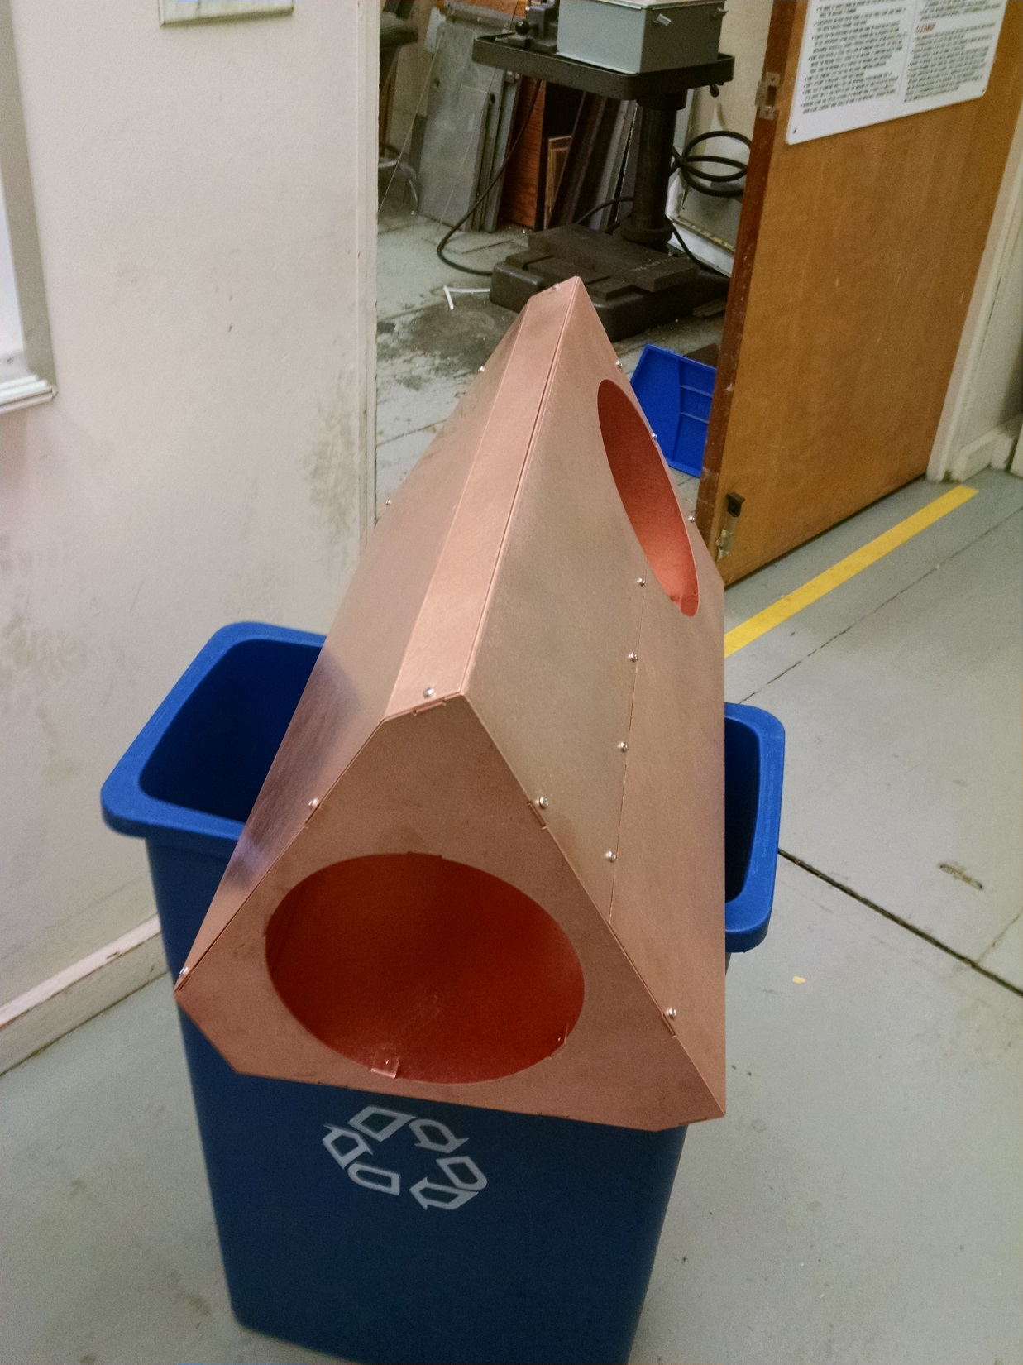
BNL made Heat Shield

Slide 4
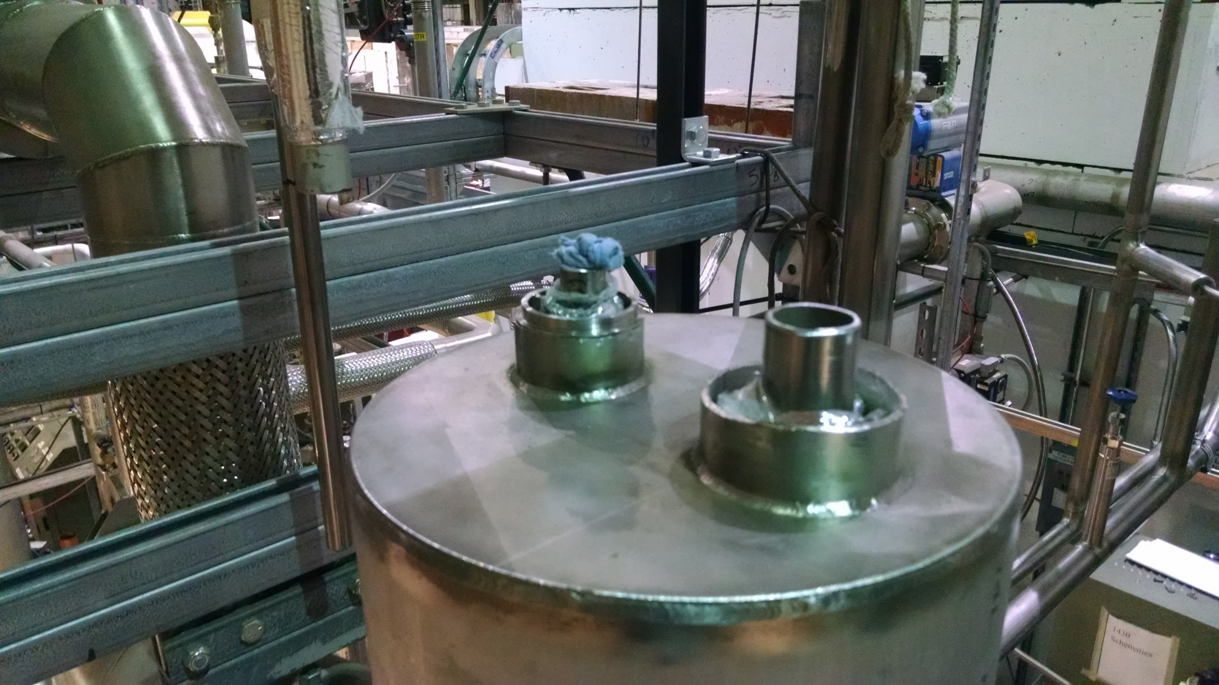
Field Joints

Slide 5
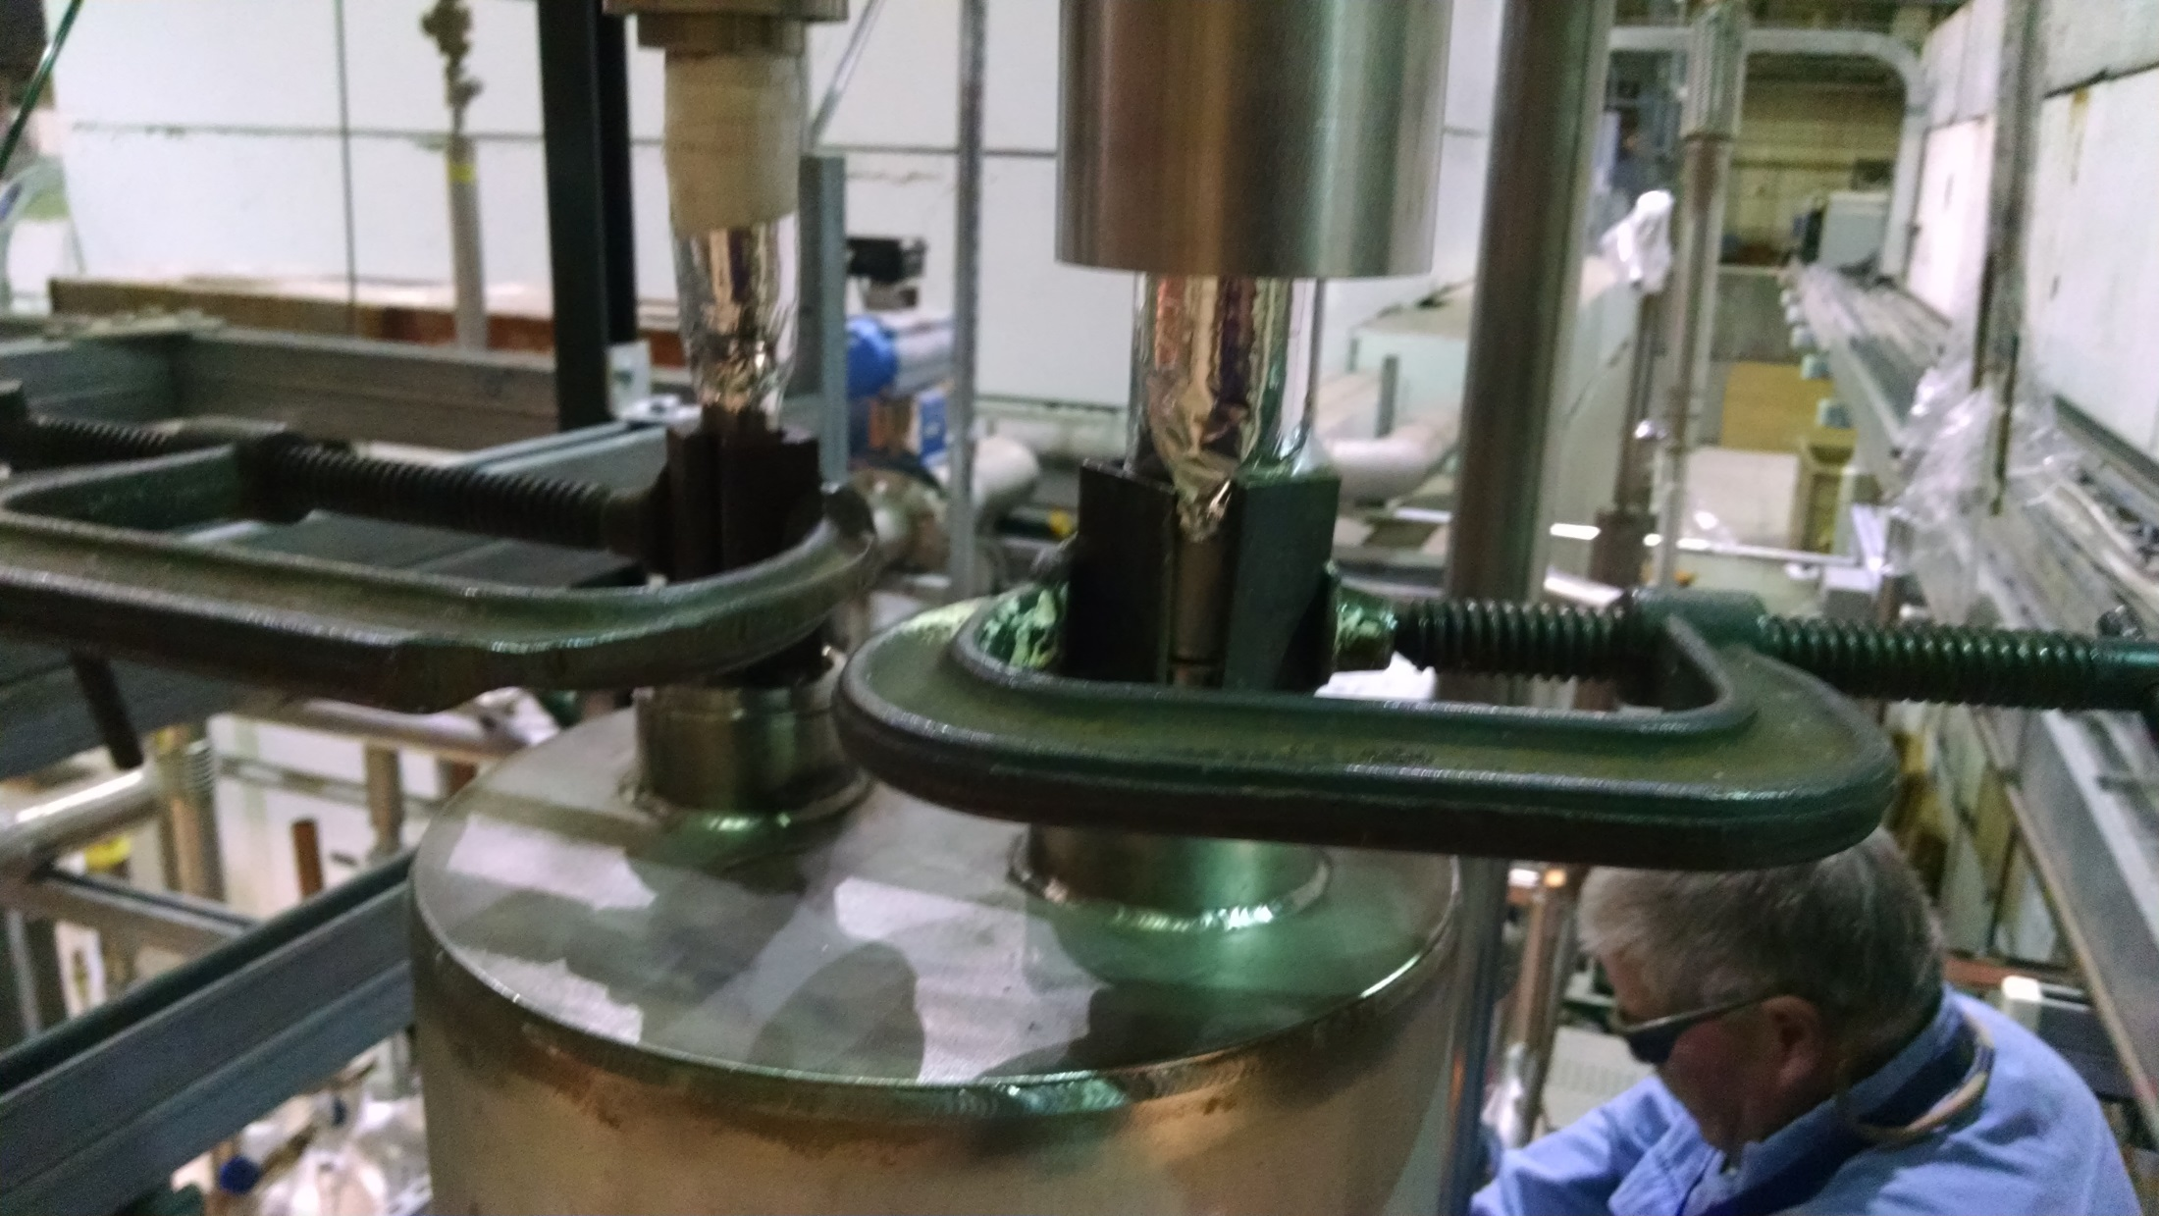
Field Joints

Slide 6
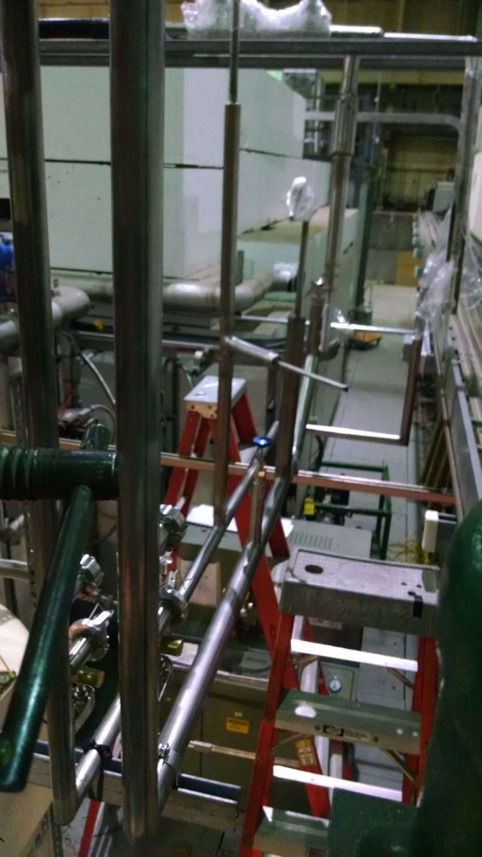
Field Joints

