Slide 1
Hardware opportunities for PO
E.C. Aschenauer (BNL)

Slide 2
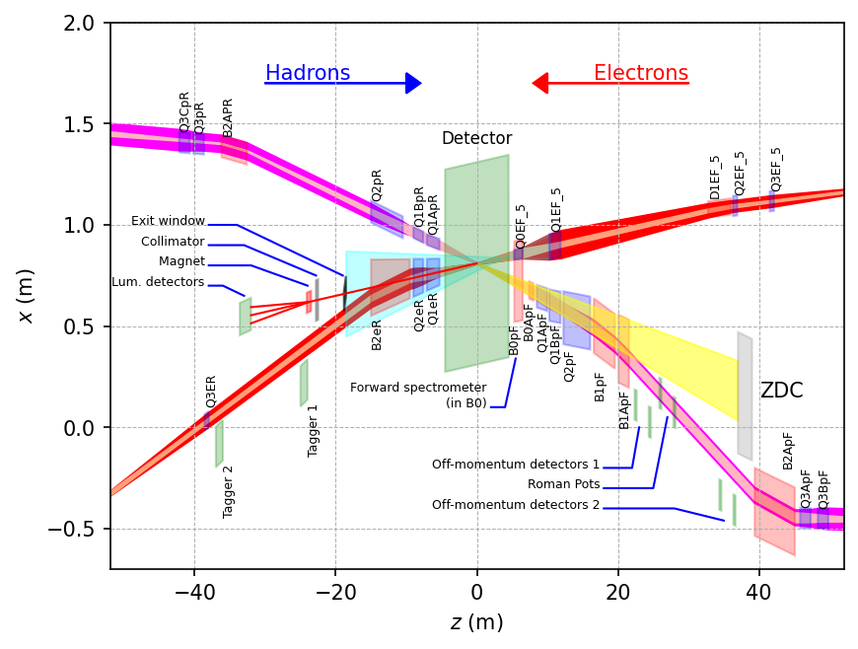
Scope Experimental Equipment
hadronic calorimeters
Solenoidal Magnet
e/m calorimeters
ToF, DIRC,
RICH detectors
MPG trackers
MAPS tracker
25 Subdetectors
incl. Polarimeters
provides coordination that
2nd detector remains possible
Moved from WBS 6.06,
incl. lepton, hadron polarimetry and luminosity monitor

Slide 3
The Path to CD-2/3A
Form collaboration and define subsystem responsibilities
→ in-kind contributions need to be identified and agreements need to be in an advanced state (close to final)
→ Integrate collaboration in WBS – structure of detector
Finalize scope of EIC Project Detector
all subsystem technologies defined by end of CY2022
Continuous refinement of subsystem requirements and interfaces
Refine cost, schedule and labor needs for each subsystem
detailed documentation of basis – of – estimates
Long Lead Procurement (LLP) items of the detector will be further refined
define scope contingency items
Bring level of design on average to 50-60% @ CD2/3A, with LLP items needing to be at final design stage (~90%)
Produce pre-TDR*: 1st version of by May 2023
→ final version by October 2023
Technologies need to be defined by end of CY22

Slide 4
What can we do and what we must do
The must do for BNL not necessarily PO:
Hadron polarimetry
Integration in the IR for the all the ancillary detectors and the main detector – some shared with Jlab
building pot-less roman pots will be a really new novel design in a high current beams, as the EIC hadron beams
Silicon in the electron vacuum (low-Q2 tagger) will be a novelty as well
Infrastructure
Involvement in the DAQ

Slide 5
What can we do and what we must do
The should do for PO / BNL
BNL is a national lab so we should do detector design and construction, which goes beyond what a university group can do.
PO is a large group, so maybe more than one subdetector involvement is possible
→ PID -- pfRICH:
involves new photon sensors → LAPPDs
currently BNL is ahead on this R&D → we should build on this
can integrate 2 functions in one detector low (ToF) and high momentum PID
in collaboration with Japan (Chiba University), built on our transition from RHIC could
push R&D on Aerogel
Barrel tracking:
It might soon become clear that the tracking needs significantly more planes to deal
with beam backgrounds in the track finding
→ Many years of R&D in MPGDs
→ MAPS tracker:
First MAPS tracker in collider experiment was operated at RHIC
IO is involved in designing the chips
collaboration with IO could make BNL a real powerhouse for MAPS
PO could look into service reduction, cooling, integration, ……
new tracking methods could be developed → synergy with NPPS

Slide 6
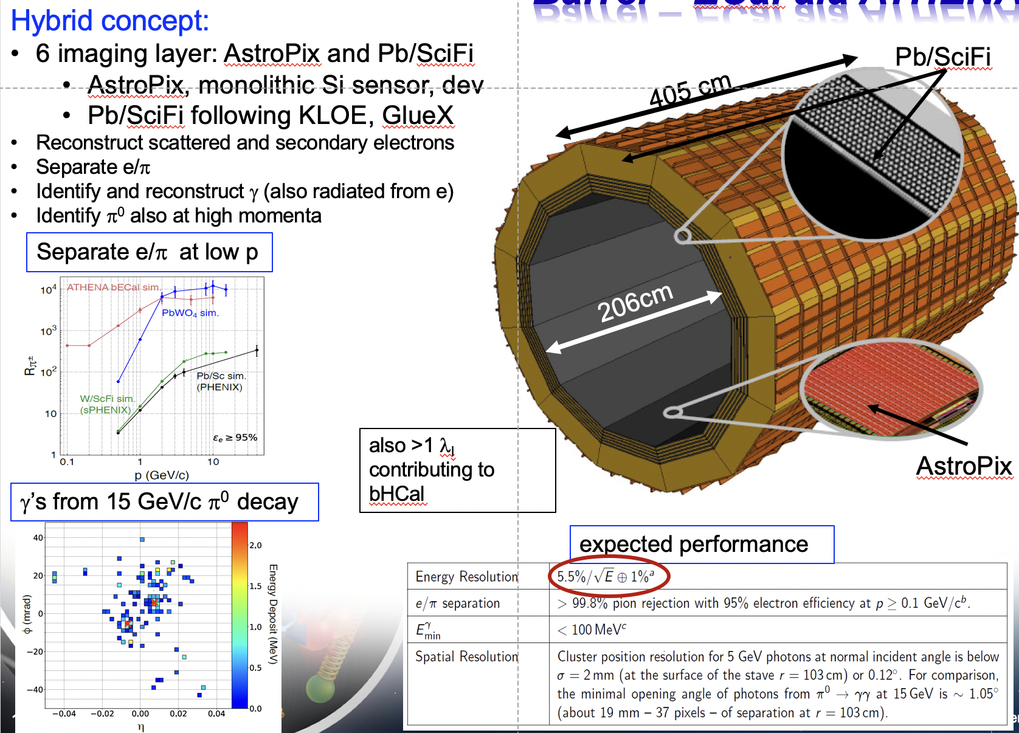
What can we do and what we must do
The should do for PO / BNL
Barrel ECal: if imaging ECal will be chosen complex calorimeter with interesting physics opportunities → collaboration with Argonne

Slide 9
Experimental Equipment Technical Progress
Defined and documented system requirements down to L4
Consolidation of ECCE and ATHENA in full swing, make integration of all groups as welcoming as possible
Combined Leadership Team formed
Combined Physics and Technical WG formed
Define ASIC needs based on ECCE as reference detector
rolling out R&D contracts
Updating P6 & integrate milestones
Next Streaming readout workshop to develop requirements based on community input
develop a technical solution to bake-out beam pipe with μ-vertex in-situ
develop beam pipe support to allow 1st μ-vertex layer as close to the IP as possible
Document the existing infrastructure at 1006, i.e. water, electricity, grounding
detail all the requirements for the next phase of the technical design
investigate a pressurized Argon based RICH can be realized
Full 3d layout of extended IR region including all auxiliary detectors
Technical Subsystem Review April 27th
work on next phase of technical design on eEndcap ECal in collaboration with Orsay technical team
work on next phase of technical design of barrel SciGlass ECal
Move in parallel on 2nd IR layout and ensure all the experimental equipment can fit
Contract with Saclay to continue design for a 1.5 T BaBAR like Solenoid as Risk mitigation
Eased design as can use Cu-stabilized conductor
Update risk assessment of BaBAR Solenoid
ePol: Compton polarimeter is integrated in IR and layout and technical definition are further refined
HPol: new location at IP-4 integration underway

Slide 10
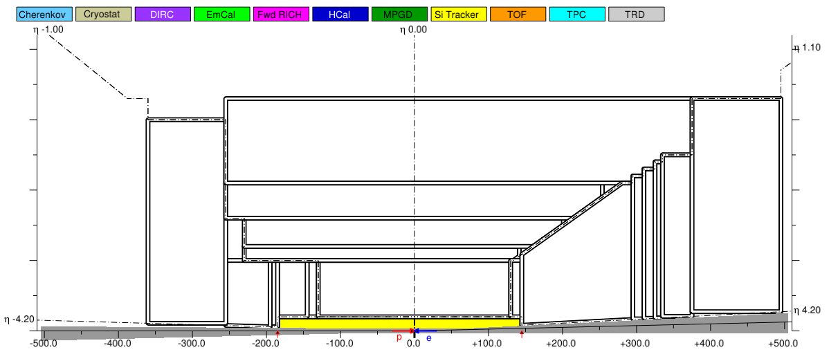
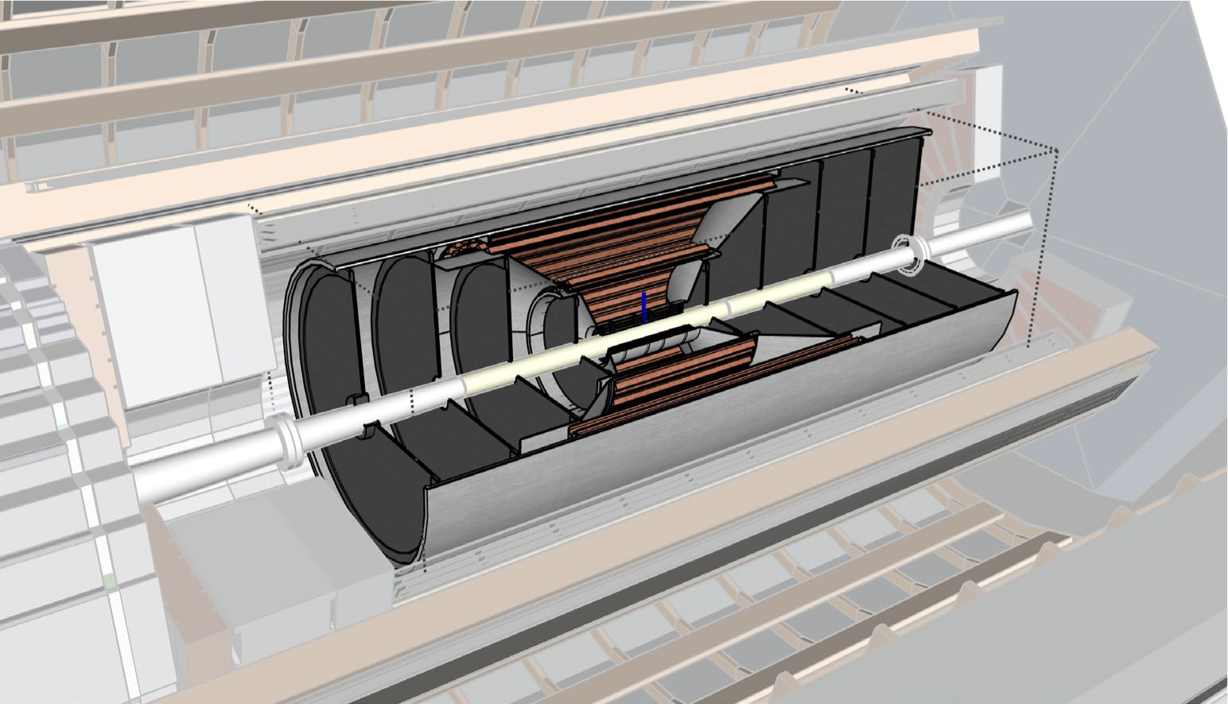
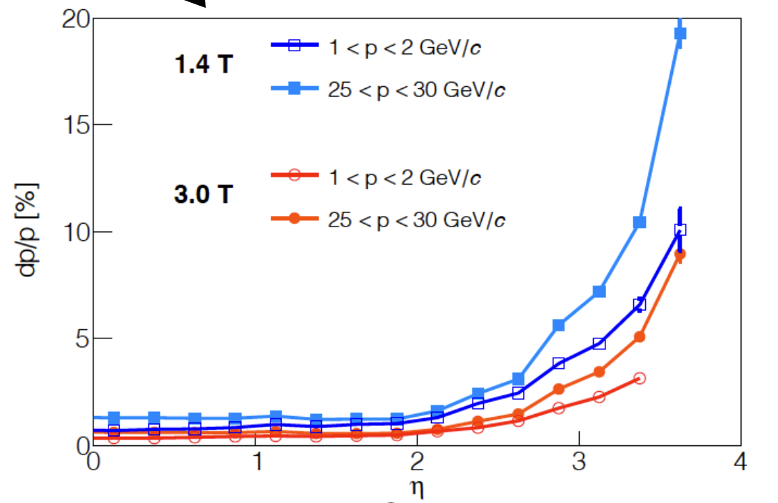
MAPS μVertex
For primary and secondary vertex reconstruction
Low material budget: 0.05% X/X₀ per layer
High spatial resolution: 10 μm pitch MAPS
→ ref. Alice ITS3
Compromise:
20 μm (or smaller) pixels and ~0.3% X/X₀ per layer
Configuration: Barrel+ Disks for endcaps

Slide 11
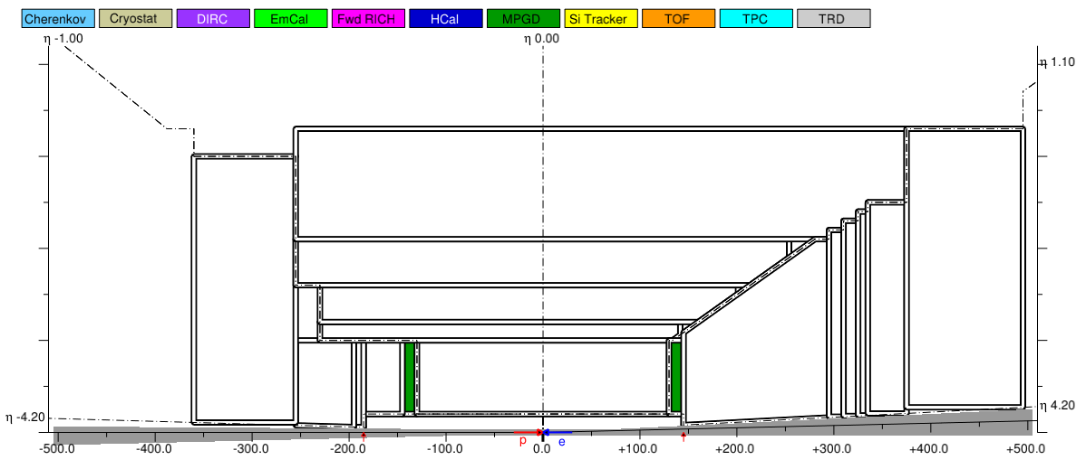
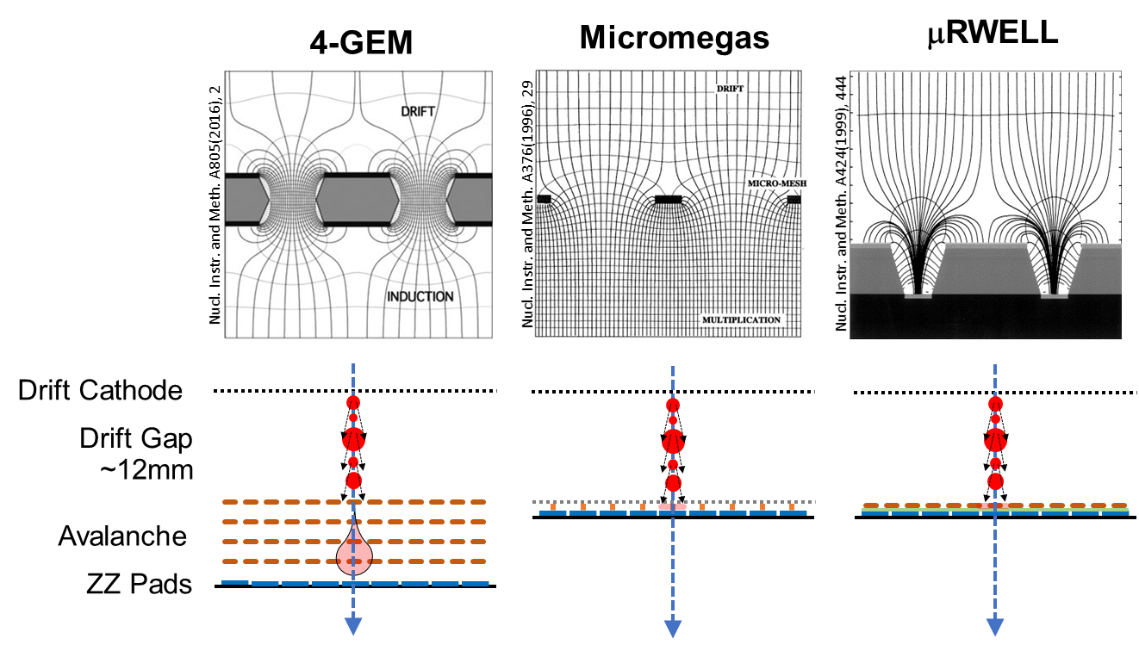
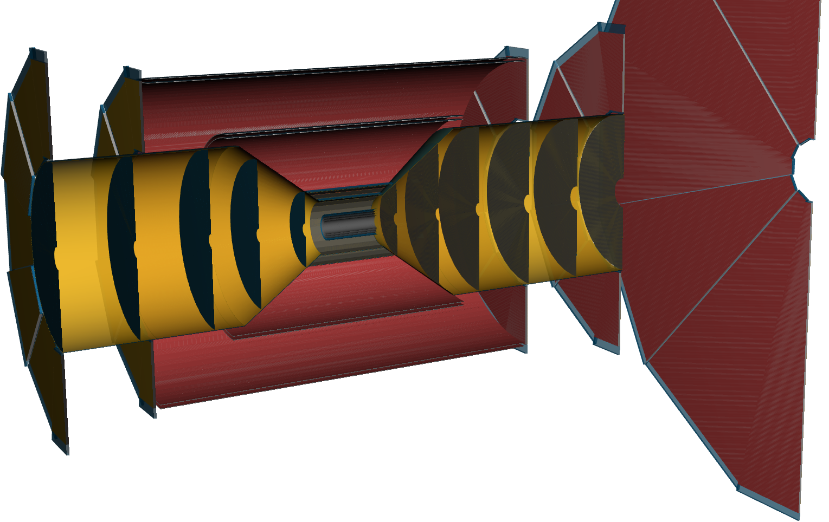
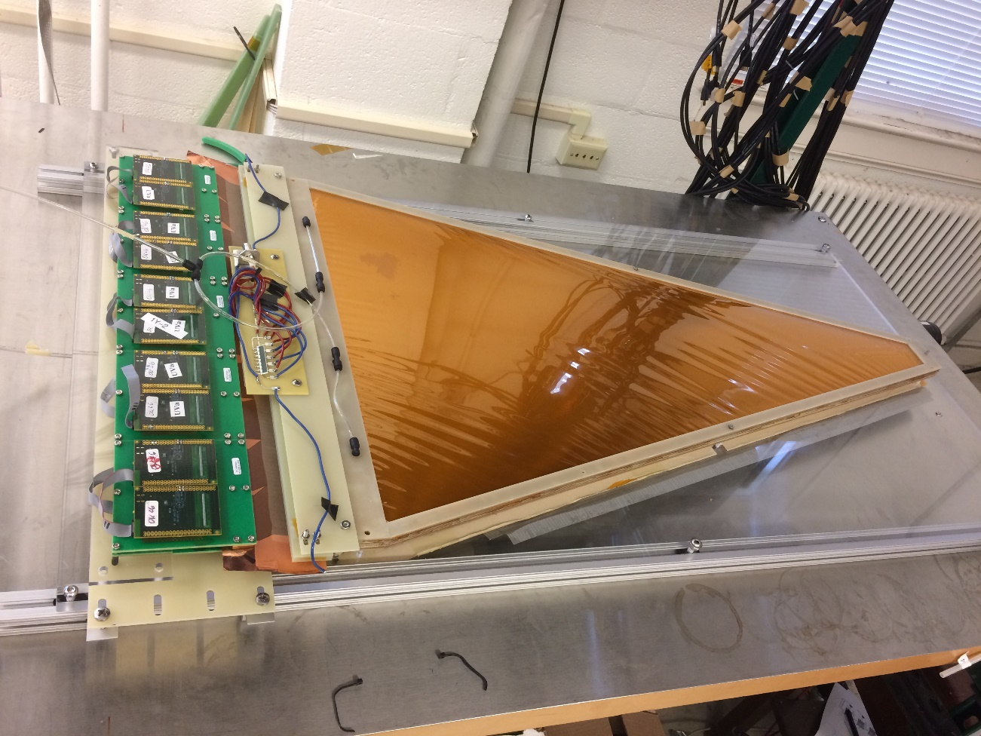
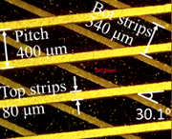
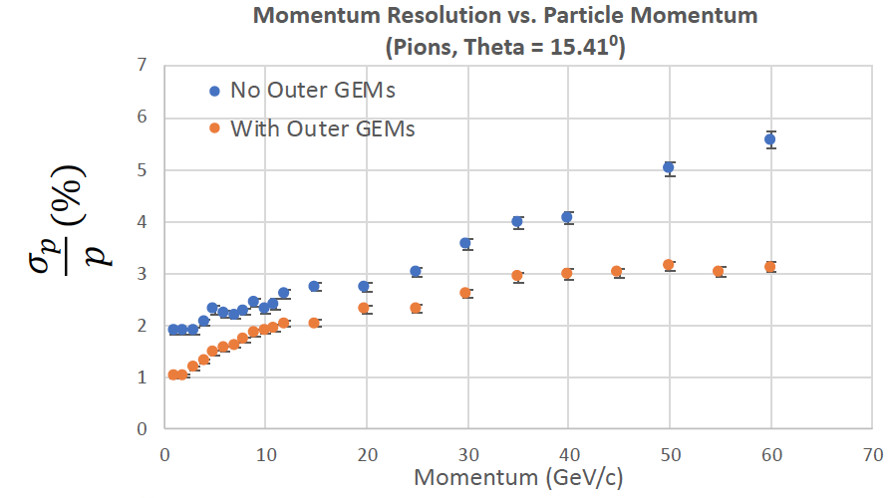
Micro Pattern Gas Detectors
To improve momentum resolution at large rapidities.
Spatial resolution well below 100 μm
Large-area detectors possible
Cost efficient compared to silicon
MPGDs
~900mm
EIC R&D: large 2D GEM module

Slide 12
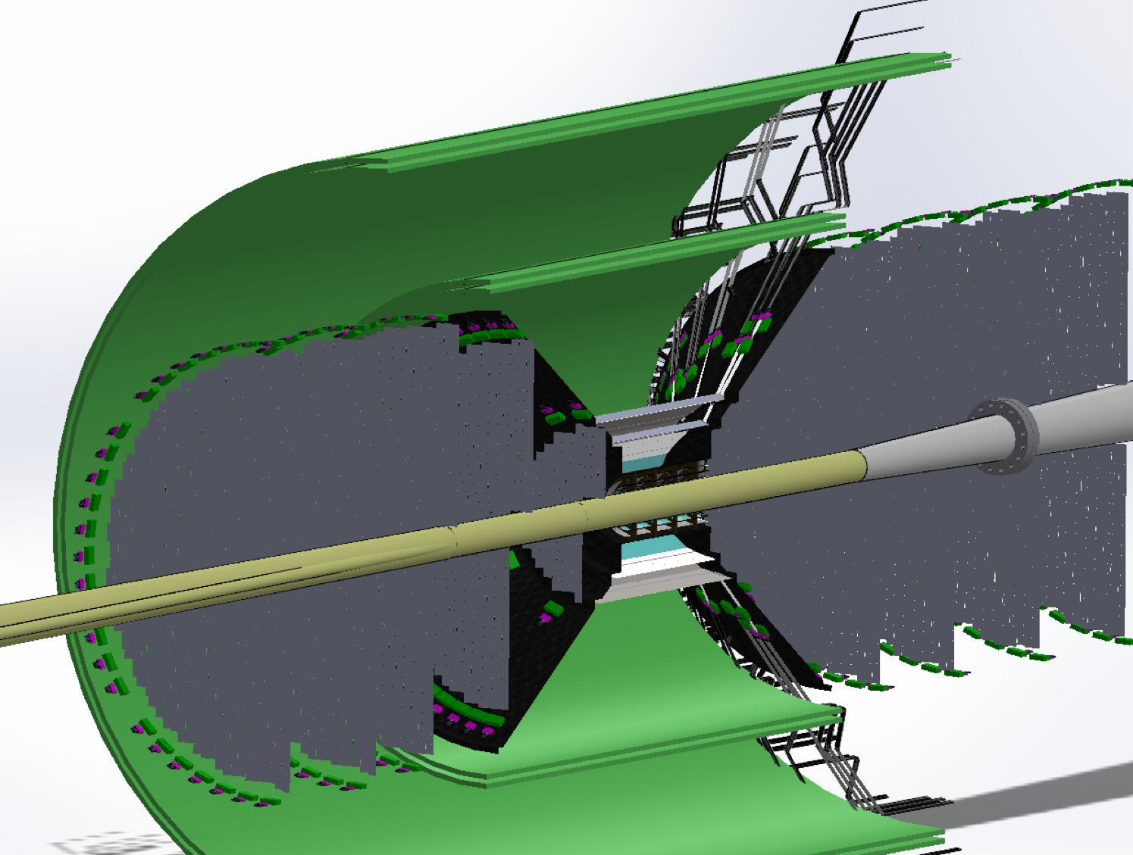
Areas of Possible Synergy: Detector
Tracking:
Silicon – MAPS
already ongoing R&D collaboration with CERN/ALICE ITS
development
low mass EIC ITS-3 based forward disks
new development
existing ALPIDE alternative
EIC European Groups from UK and Italy
AC-LGAD
EIC triggered the formation of consortium between HEP and NP groups
Goal: push technology and readout development for many applications (tracking, ToF, …)
EIC European Groups from France
MPGDs – GEMs
GEM foils typically come from CERN for QA
clear synergy with CERN RD-51 and
ALICE new TPC GEM readout and COMPASS
EIC European Groups from Italy
~900mm
EIC R&D: large 2D GEM module

Slide 13
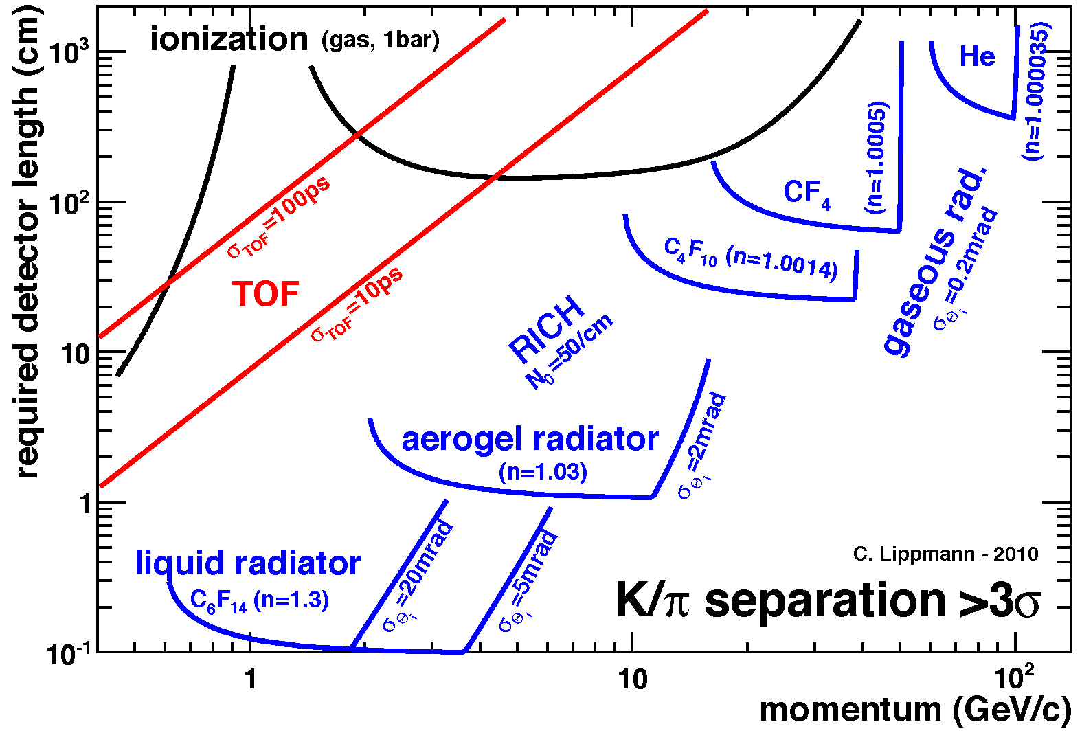
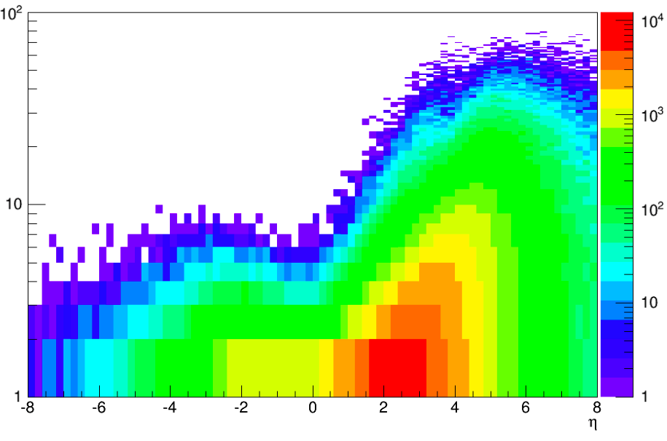
Particle ID
In general, need to separate:
Electrons from photons → 4π coverage in tracking
Electrons from charged hadrons → mostly provided by calorimetry
Charged pions, kaons and protons from each other → Cherenkov detectors
Cherenkov detectors, complemented by other technologies at lower momenta
Challenges:
photon sensors in high magnetic field → SiPMs impact on streaming DAQ
high performance aerogel radiator
Illustration of PID detectors achievements:
Pythia MC
P [GeV]
$$π/K±$$
$$η$$
Physics requirements:
Rapidity | π/K/p and π0/γ | e/h | Min pT (E)
-3.5 − -1.0 | 7 GeV/c | 18 GeV/c | 100 MeV/c
-1.0 − 1.0 | 8-10 GeV/c | 8 GeV/c | 100 MeV/c
1.0 − 3.5 | 50 GeV/c | 20 GeV/c | 100 MeV/c
Need more than one technology to cover the entire momentum ranges at different rapidities

Slide 14
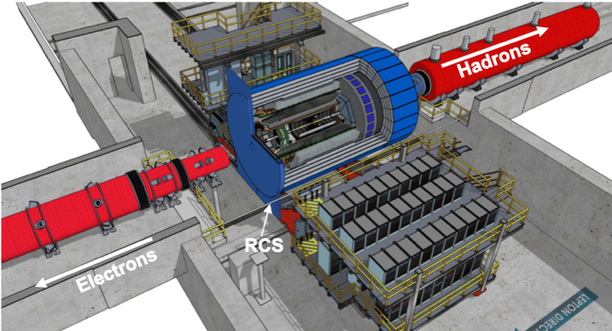
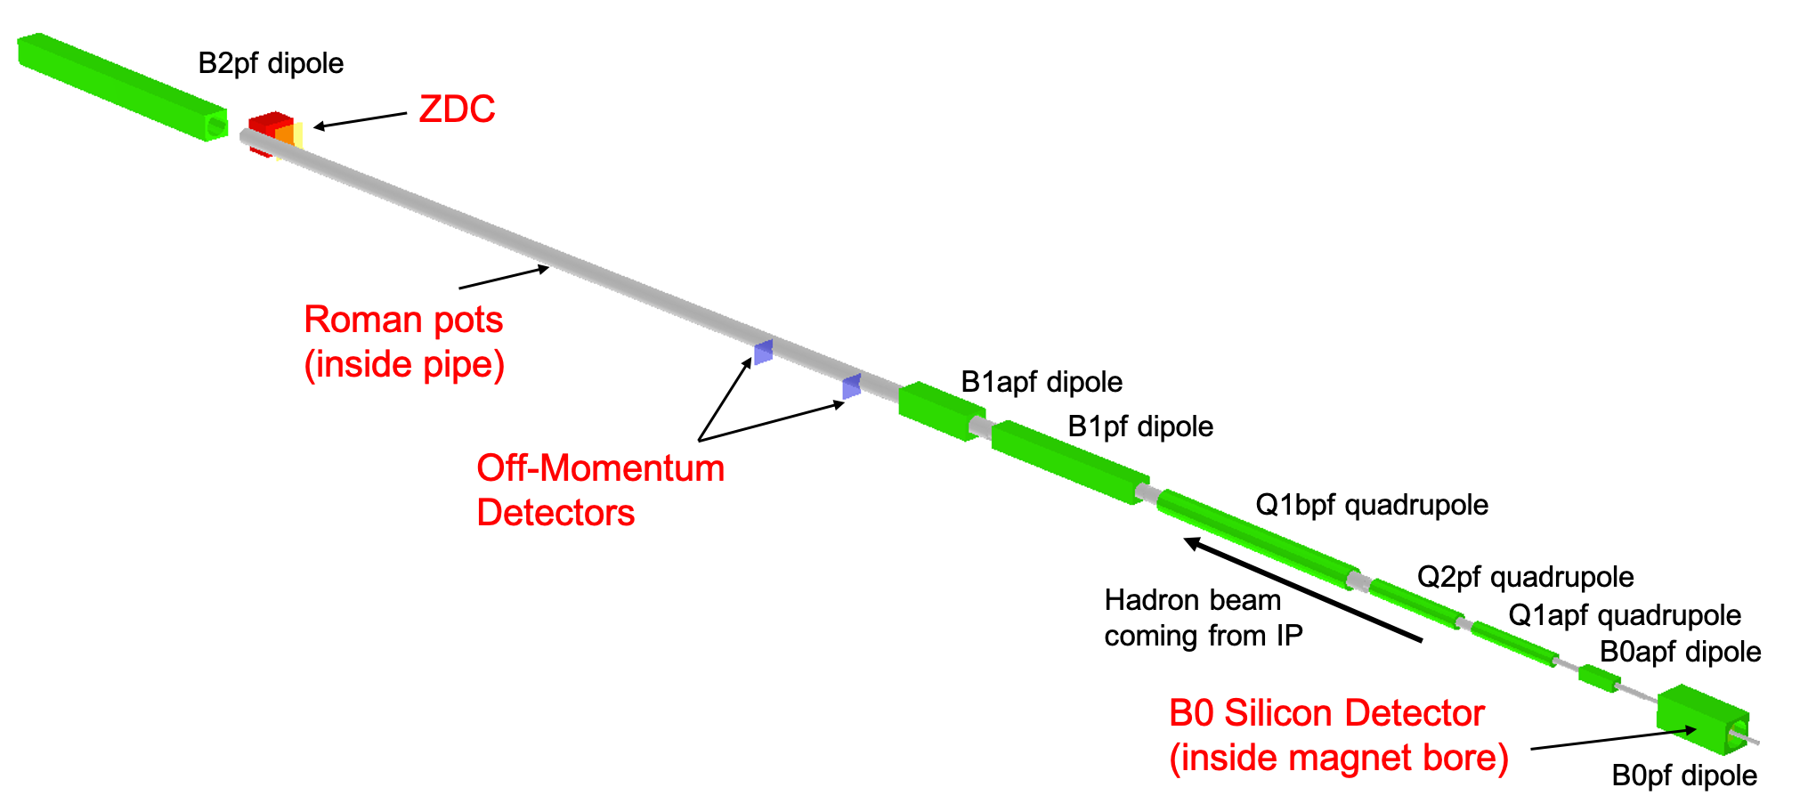
Far forward (hadron going) region
Detector | Angular accept. [mrad] | P_{T} coverage
ZDC @ ~30m | $θ$<5.5 ( $η>6)$ | pT<1.3 GeV
Roman Pots | 0*<$θ$<5.0 ( $η>6)$ | *Low p_{T}(t) cutoff (beam optics)
Off-Momentum Detectors | 0.< $θ$ < 5.0 ( $η>6)$ | Low-rigidity particles from nuclear breakups
B0 forward spectrometer | $$5.5<θ<20.0$$ (4.6< $η<5.9)$ | High p_{T}(t)
p/A
IP
$$x_{L}=\frac{p_{z, nucleon}}{p_{z, beam}}$$

