Slide 1
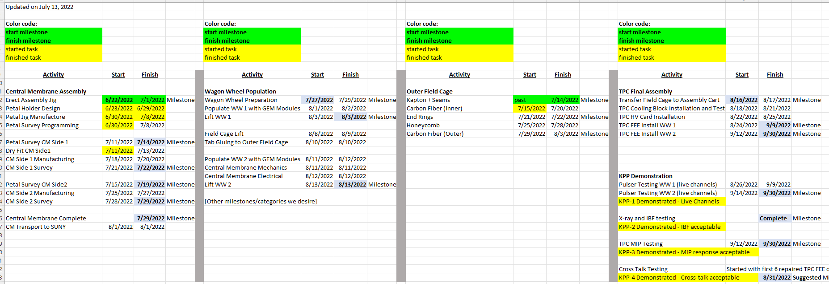
TPC Completion Schedule
TK Hemmick

Slide 2
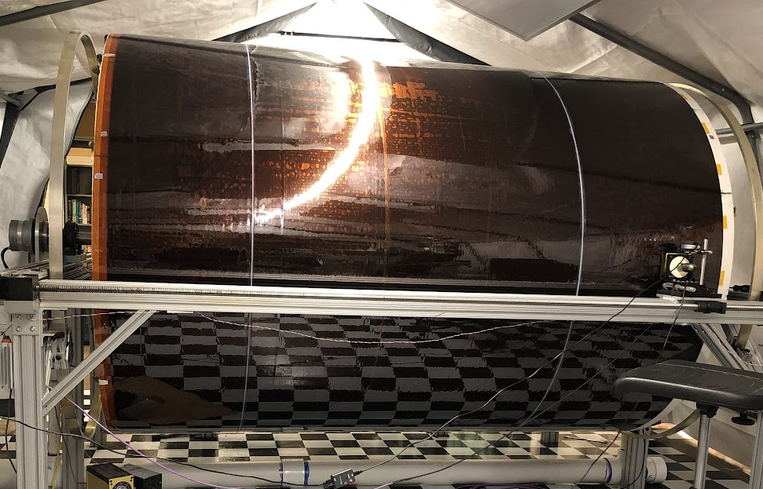
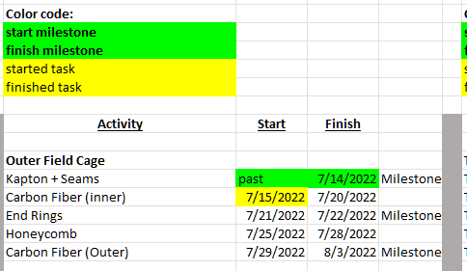
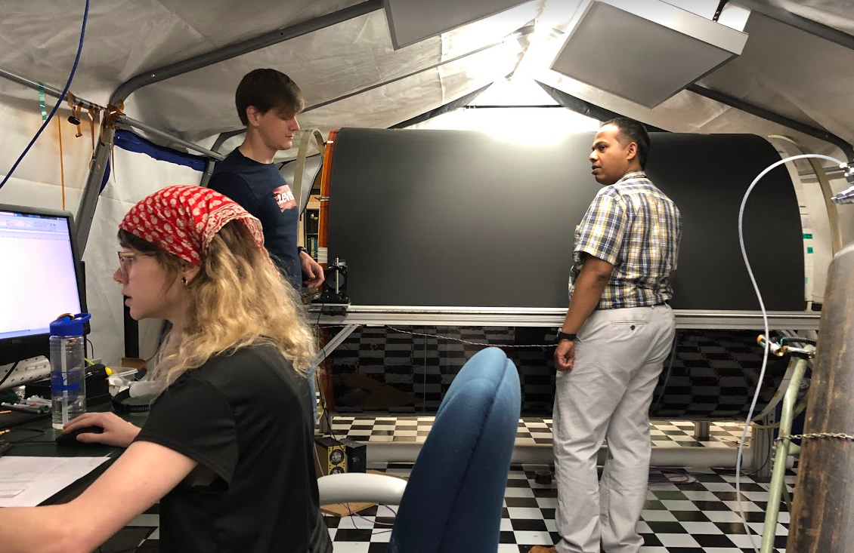
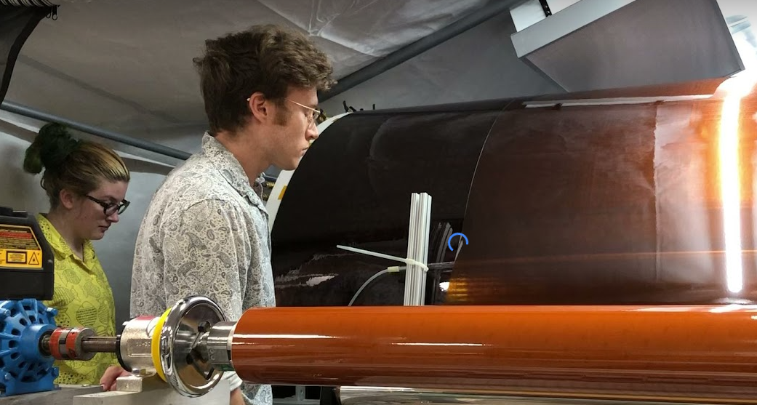
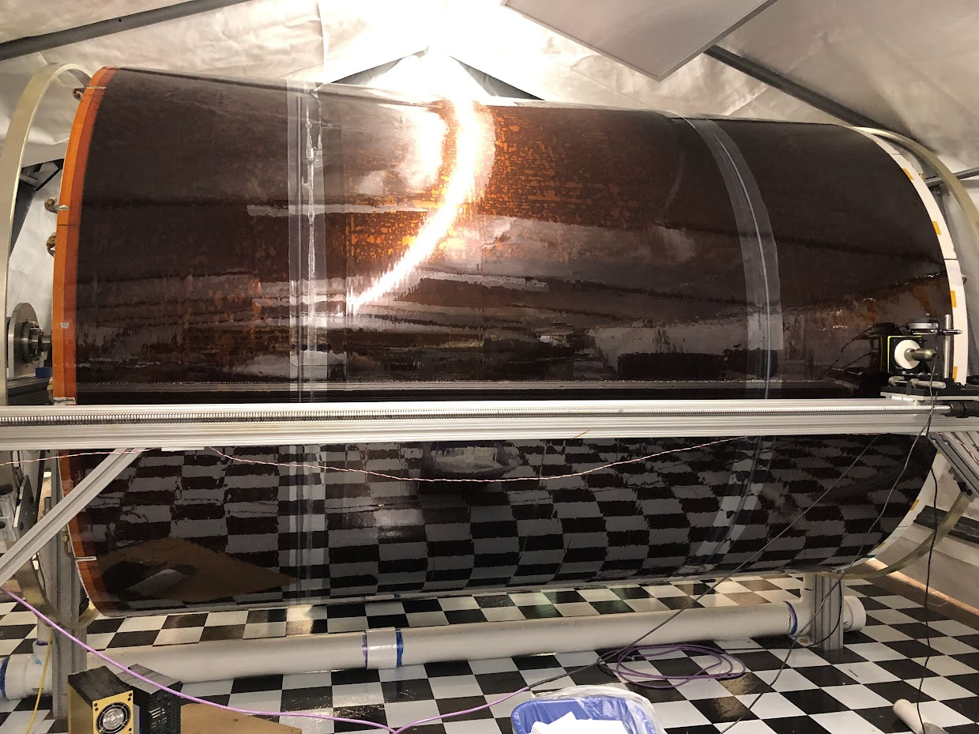
Outer Field Cage Completion
Early Finish by two days
Using weekends to keep weekly schedule.
Henry Klest reconfigured tensioner to meet first deadline early.
Early Start by two days
Tensioner Work
Two Seams at Once

Slide 3
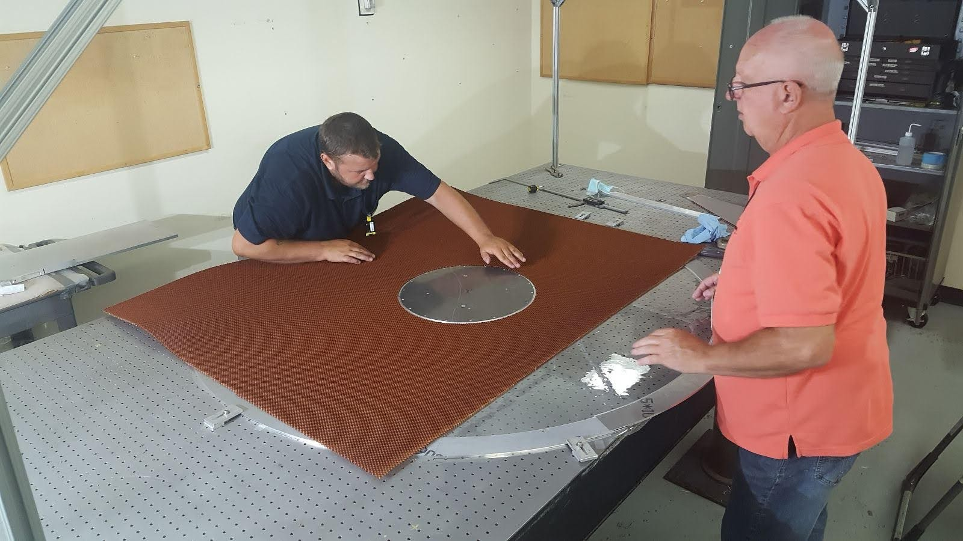
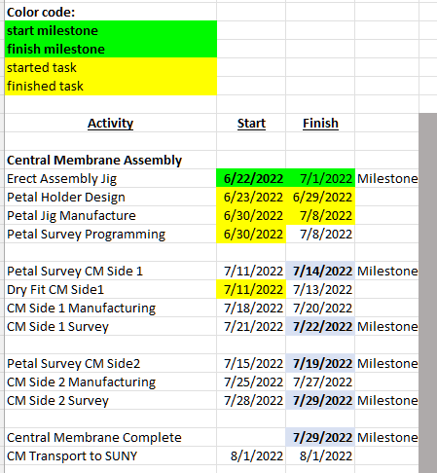
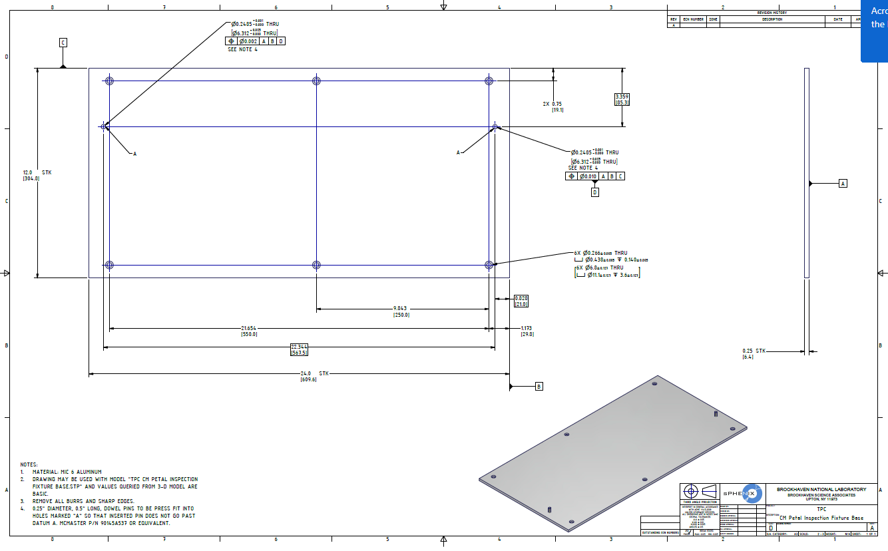
Central Membrane
Jig Assembled and In Use
Petal Holder Design
No picture (sorry)
Holder already at BNL
Programming Today
Mediation for Schedule Slip:
  Machined Petal Holder on a Saturday.
  Add Prakhar Garg to BNL Team.
  Petal Programming is shorter than estimated
    Not CODE.
    Machine memorizes Joystick.

Slide 4
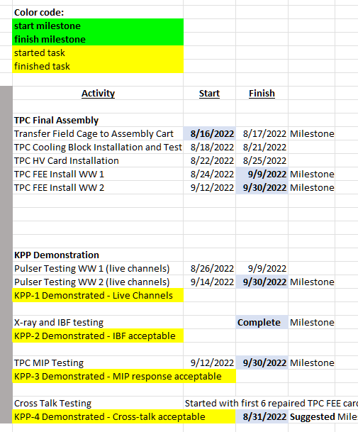
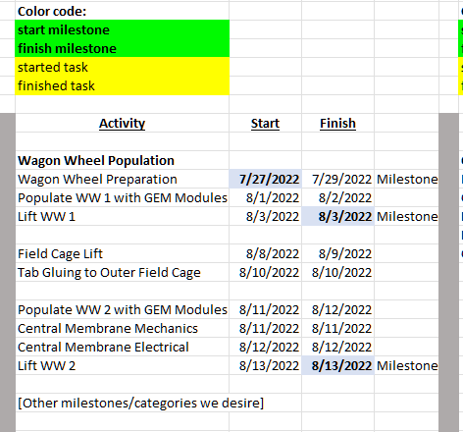
Not Yet Scheduled to be Started.
CM slip has not pushed the completion (yet) due to 11 days float

