Slide 1
PMG Topics
USI, ASE/SAD Status
Electronics Status
Status of INTT, MVTX
KPPs
AOB

Slide 2
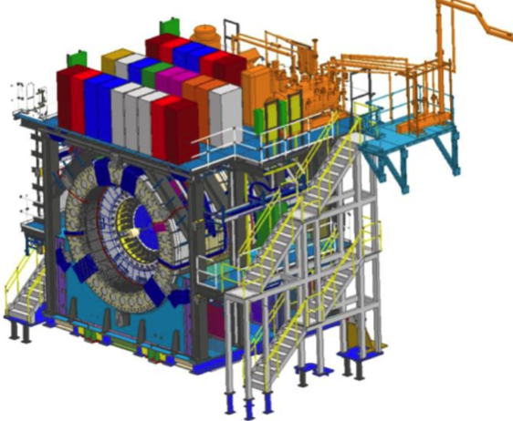
sPHENIX MIE Project Overview
TPC | Project Director | Last CD Achieved | % Complete | CPI | SPI
$27.0M | Edward O’Brien | PD-2/3 | 95.5% BCWP/BAC@ 6/30/2022 | 1.00 | 0.97
Scope
  Detector systems produced, tested and ready for installation: Time Projection Chamber w/ electronics, Electromagnetic Calorimeter w/ electronics, Hadronic Calorimeter w/ electronics, DAQ/Trigger, Minimum Bias Detector, Project Management
Not in scope
  SC-Magnet, Bldg/Det Infrastructure, Installation and System Commissioning
Schedule
  CD-0 received Sept 2016
  CD-1/3A received Aug 2018
  PD-2/3 received Sept 2019
  Early completion in August 2022. Four months of float to PD-4
  PD-4 Dec 2022
Cost
  $27.0M AY TPC 70.3% contingency on an ETC of $1.48M
Commitments = $1.81 M

Slide 3
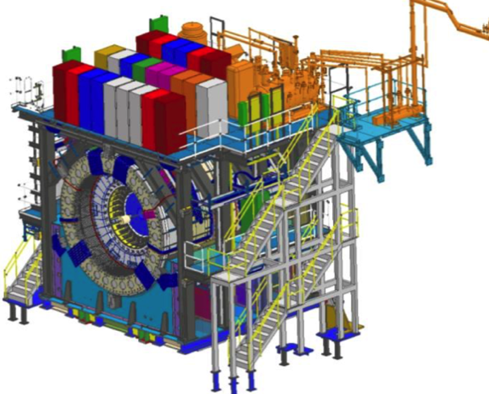
BNL 1008 Infrastructure & Facility Upgrade
TPC | Project Director | % Complete | CPI | SPI
$33.4 M AY | Edward O’Brien | 88.3% BCWP/BAC @ 6/30/2022 | 0.92 | 0.92
Scope
  SC-Magnet support including the Flux Return, Cryogenics into Bldg 1008, Detector Carriage/Cradle, other Bldg 1008 Infrastructure improvements
  sPHENIX Installation, Integration and Commissioning of each Subsystem is part of the scope
Not in Scope
  PreOps prior to RHIC collisions
Schedule
  sPHENIX Ready for Operations (Early Completion) 2/22/23
  First RHIC run of sPHENIX Feb 2023
  No float in schedule between sPHENIX “Ready to Operate” &
  nominal start of RHIC-23 run. Looking to recoup schedule contingency
Cost
  $33.4 M AY Total Project Cost with 48.9% contingency on ETC of $3.94M
Commitments = $1.18M

Slide 4
USI, ASE/SAD Status
The sPHENIX USI that request approval to run cryogens in the 1008 IR prior to ASE/SAD approval was submitted to BHSO the beginning of June. We received 20 comments back ~ 1 week ago and have been working to address them.
The CAD ES&H group is confident that all the comments can be addressed to BHSO’s satisfaction.
The comments included:
  Asking for clarifications on the cryo risk calculation, especially concerning the exhaust and intake fans
  Asking details of other activities in 1008 while the magnet is cold, especially activities that could potential cause an accident that might damage the cryo system, like crane usage.
There is a proposal to extend the USI form Nov 7 to Dec 7. Wolfram asked for this change in case the cryo work gets delayed.
We have begun weeks meetings to plan the ASE/SAD. We also have started generating a list of potential ARR committee members.

Slide 5
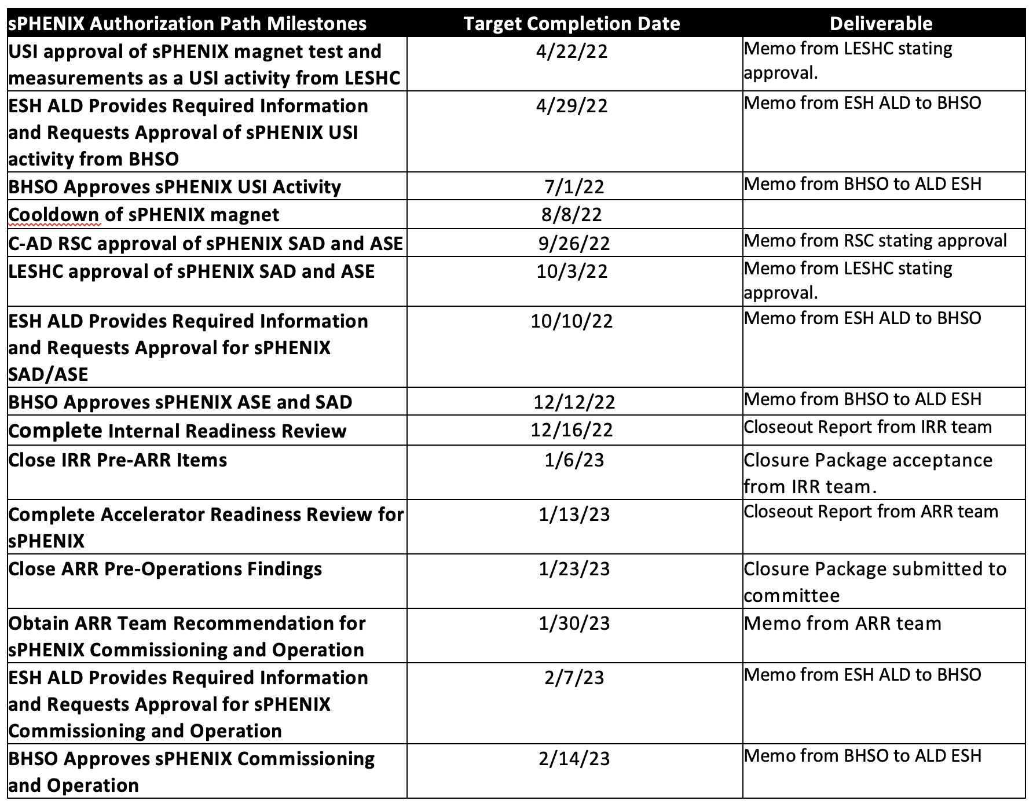
ASE and SAD Schedule from CAD
USI for magnet mapping submitted to BHSO. The sPHENIX project team is working closely with the CAD Safety group to get the ASE and SAD for sPHENIX approved on schedule prior to the 2023 RHIC run.

Slide 6
Overall MIE Electronics Status
All MIE electronics exist with the exception of:
Some Truck fibers and patch panels on order. No schedule issue.
Some LV cables have not yet arrived. No schedule issue.
TPC Fee having PLL added. 450/700 completed to date. Balance in two weeks. No schedule issue.
DAQ/Trigger LL1 production board due in October. All parts on hand at Nevis.
MBD D/S board due in November. All parts now available.
TPC JACK board. First article waiting pcb. All parts but pcb available. Fab of 30 JACK boards due end of September. We have weekly meeting w/ the IO engineers and bi-weekly meeting with the head of IO to make sure that we stay on schedule.
DAQ/Trigger: Need 6 DCMIIs - Stratix III FPGA. No delivery date. Will take off MIE
All MVTX, INTT and TPOT electronics available.
DAQ: GL1/GTM

Slide 7
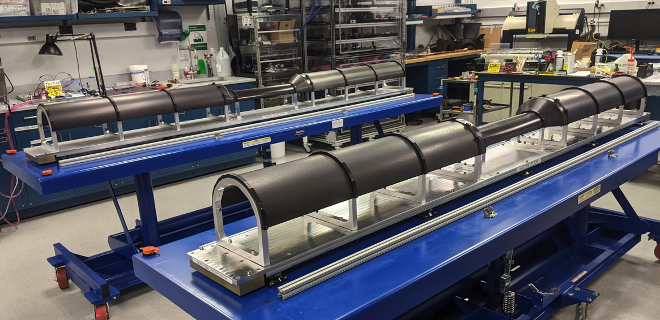
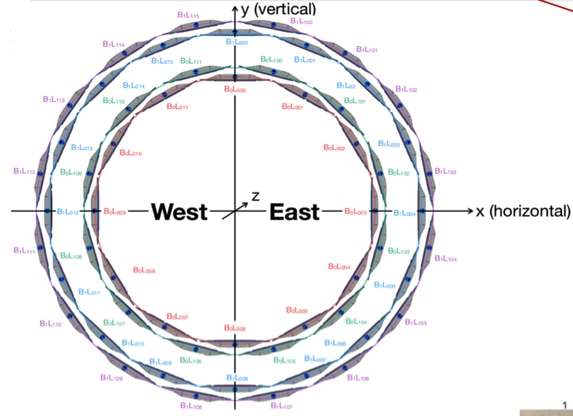
INTT Status
All INTT silicon strip staves complete and tested.
  56 production staves + 66 spares
CF parts for ½ barrel fab manufactured by vendor and at BNL
Aluminum support structure and installation fixture being made at vendors.
INTT Half barrel assembly begun in June.
All electronics available.
Two of four INTT layers assembled at BNL
1st layer tests good. The testing of the 2nd layer underway.
INTT will be ready for installation in January

Slide 8
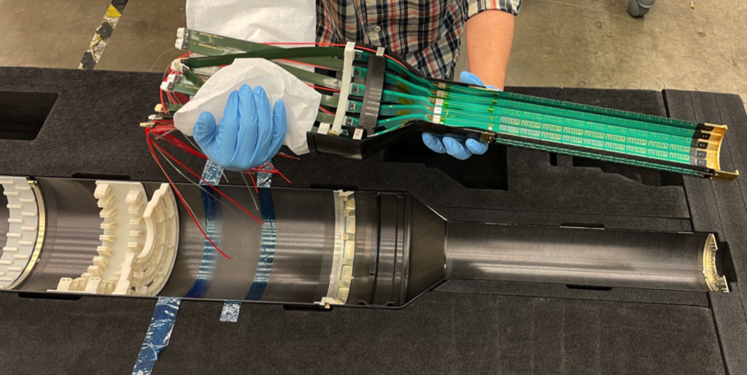
MVTX Status
All MVTX silicon pixel (MAPS) staves complete and tested
  48 production + 36 spares @ LBNL
  Half plane assembly underway at LBNL
Complete:
60 SamTec cables
CFC support
SB power cables
60 Readout Unit
30 Power Units
8 FELIX cards
CAEN power system
Stave cooling system
Insertion system
In progress:
Half-detector assembly
Rack cooling system
Long power cables
FELIX board testing
DCS PLC hardware
Lab + cleanroom being set-up at BNL for the arrival of the MVTX ½ barrels.
½ barrel Layer 3 assembled with 20 micron precision.
Expect both ½ barrels at BNL by the end of August. MVTX gets installed in January.

Slide 9
KPPs
The deliverables are done with the exception of the assembly and lab testing of the TPC, the electronics board listed in the earlier slide.
The L2’s have begun writing up the KPPs. HCal KPP is written. EMCal KPP write up has started. TPC, DAQ and MBD still have tests to do prior to writing up the KPPs. Calorimeter electronics only has deliverables not KPPs.
Glenn is coordinating the preparation of the KPP report.

Slide 10
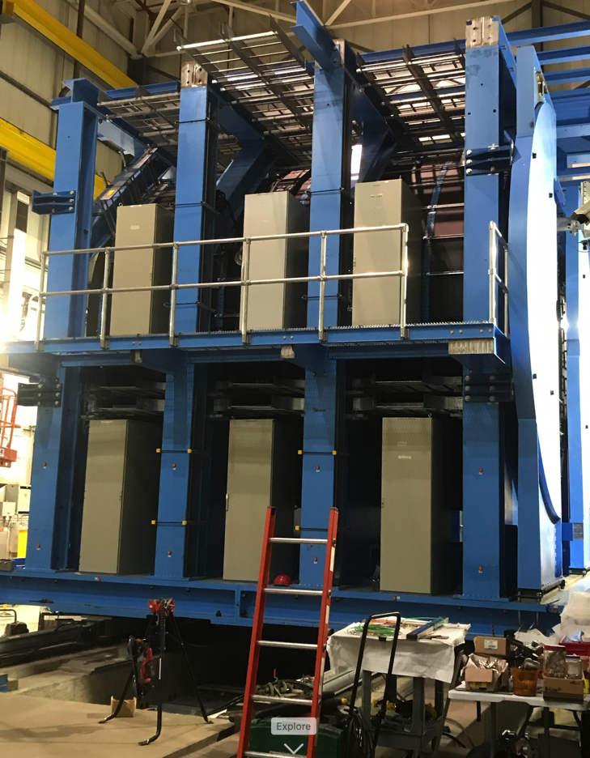
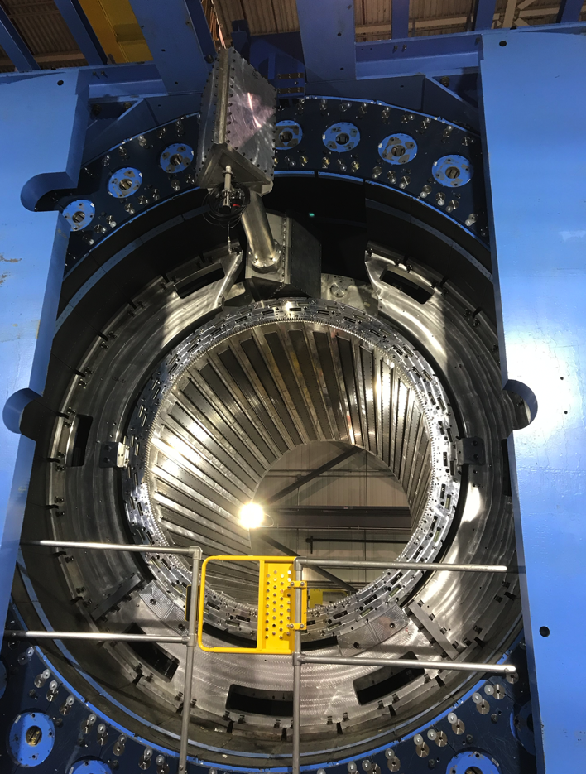
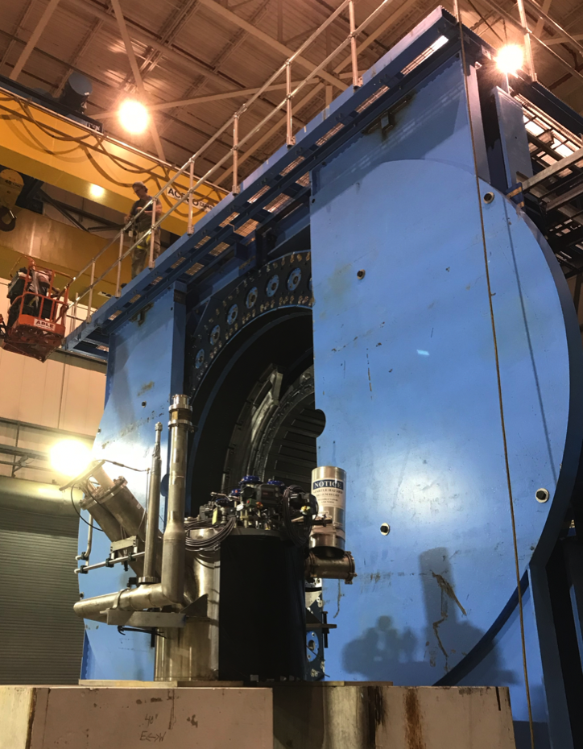
sPHENIX Progress

Slide 11
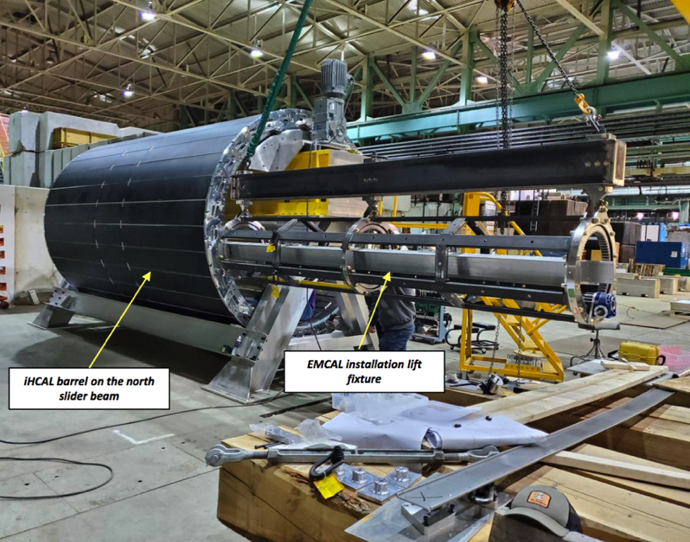
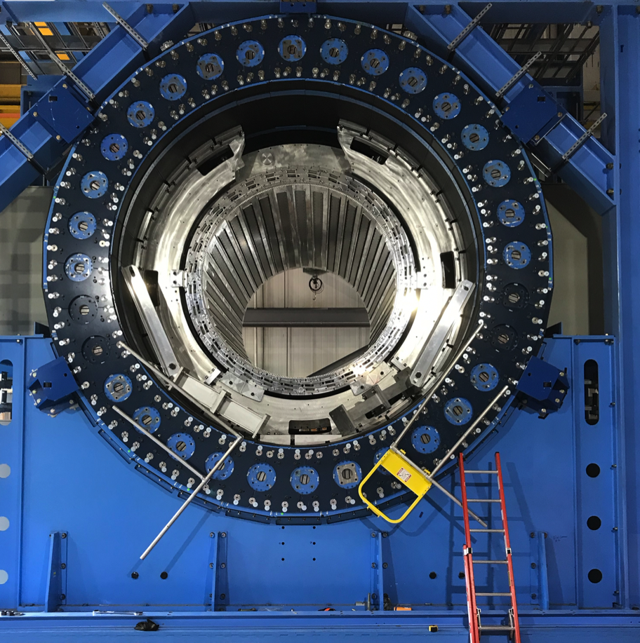
sPHENIX Installation Progress
Test installation of EMCal Sectors into IHCal Barrel prior to installation in 1008
Prior to IHCal installation, the EMCal installation procedure was practiced multiple times with two EMCal “dummy” sectors. The EMCal installation process is good to go.
IHCal tracks ready to receive the EMCal

Slide 12
Risks and Challenges
Maintaining labor force for the next 8 months. Especially important are:
  Technicians for fab and assembly and installation. We need the CAD “cable pullers” back as soon as practical.
  We need to continue to have high priority to the trades. We could really use one electrician to work with the sPHENIX assigned electrician. We have a significant number of jobs where we need a pair of electricians to do it.
  Visiting students, postdocs and scientists for QA, testing and commissioning
Global issues may affect the cost and schedule of the project going forward
  Significant cost increases have been seen on certain raw material and machine shop work potentially impacting the 1008 I&F remaining costs. Fortunately we are almost done.
Need BHSO USI approval for Magnet Mapping in Sept-Oct ( helium cool down begins 2nd half of August). Need BHSO ASE/SAD approval for sPHENIX Operations in RHIC Run-23 beginning Feb 2023.

Slide 13
Back Up

Slide 14
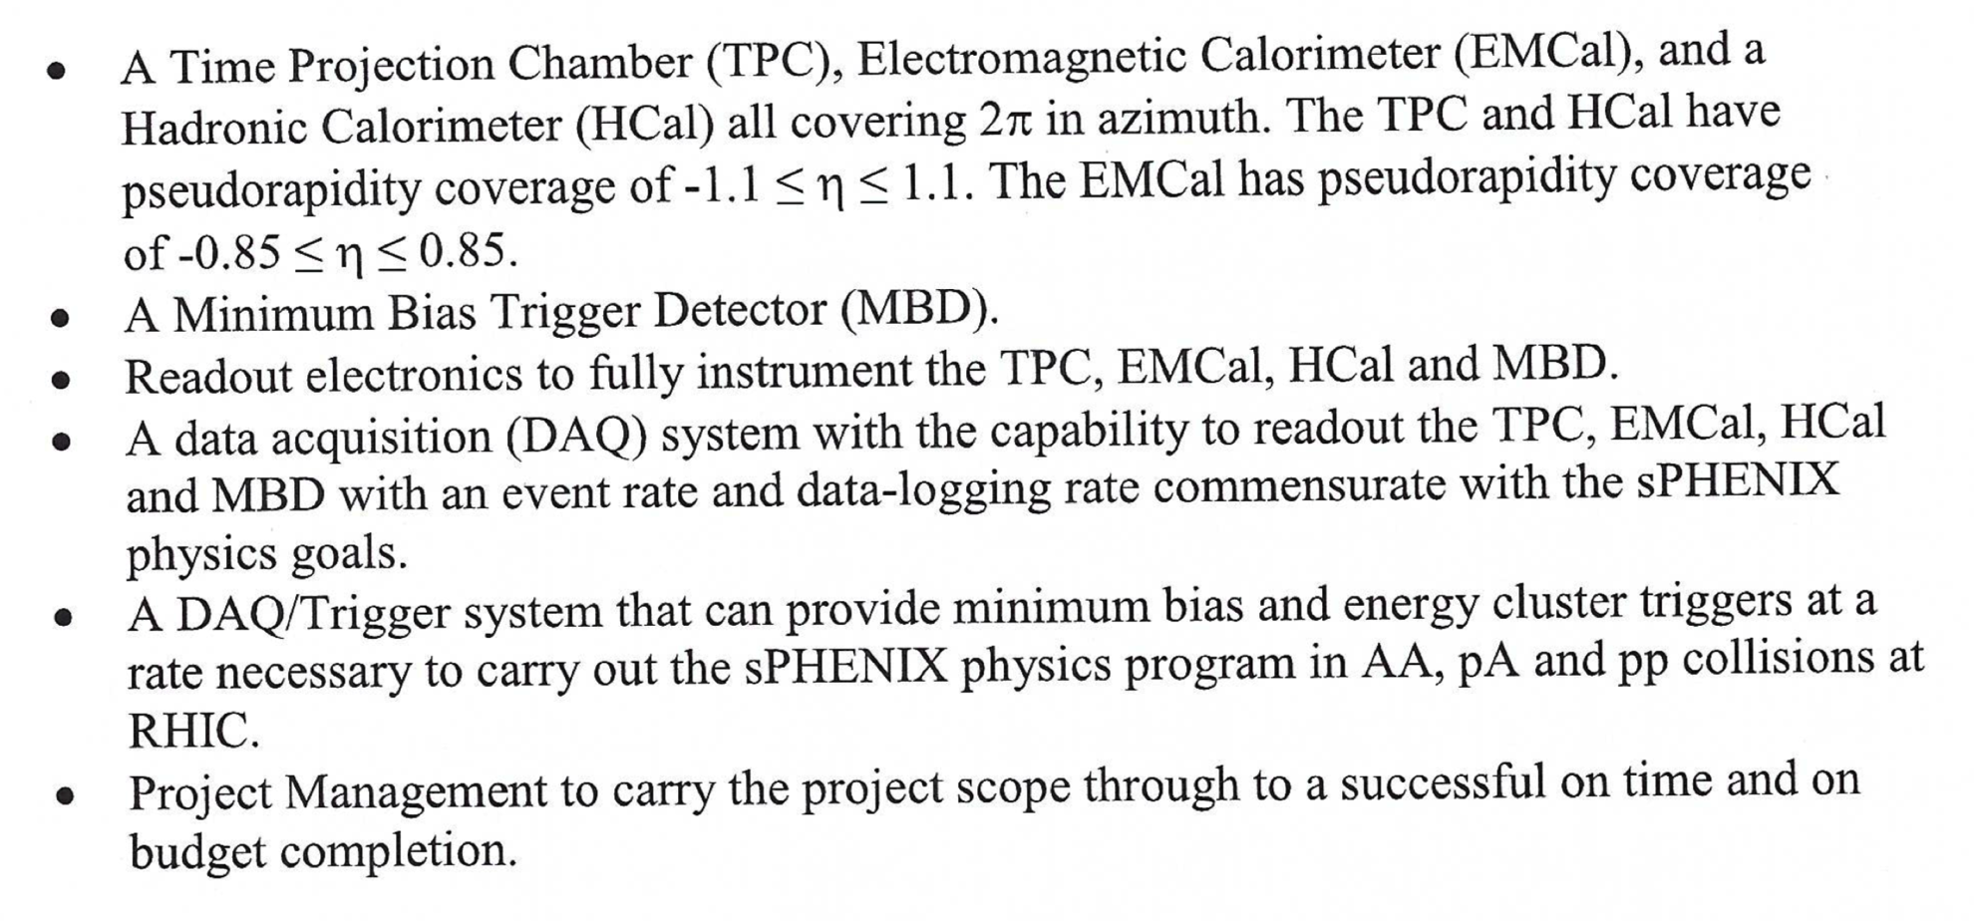
sPHENIX MIE Deliverables

Slide 15
sPHENIX MIE KPP’s
System | Demonstration or Measurement | Threshold KKP’s | Objective KPP’s
Time Projection Chamber | Preinstall, Bench tests | ≥ 90% live channels based on laser, pulser, cosmics | ≥ 95% live channels based on laser, pulser, cosmics
Time Projection Chamber | Preinstall, Bench tests | Ion back flow ≤ 2% per GEM module avgd over active area of ea GEM module | Same
Time Projection Chamber | Preinstall, Bench tests w/ cosmics | ≥ 90% single hit efficiency/mip track, averaged over active TPC volume | ≥ 95% single hit efficiency/mip track, averaged over active TPC volume
Time Projection Chamber Front End Electronics | Preinstall, Fee stand alone bench tests | Cross talk ≤ 2% per channel averaged over all channels | Same
EM Calorimeter | Preinstall, Bench tests | ≥ 90% live channels based on LED, cosmics | ≥ 95% live channels based on LED, cosmics
Hadronic Calorimeter | Preinstall, Bench tests | ≥ 90% live channels based on LED, cosmics | ≥ 95% live channels based on LED, cosmics

Slide 16
sPHENIX MIE KPP’s
System | Demonstration or Measurement | Threshold KKP’s | Objective KPP’s
EM Calorimeter | Preinstall, Bench tests | Each sector w/ an absolute energy precalibration of ≤ 35% RMS | Same
Hadronic Calorimeter | Preinstall, Bench tests | Each sector w/ an absolute energy precalibration of ≤ 20% RMS | Same
Min Bias Trigger Detector | Preinstall, Bench tests | ≥ 90% live channels based on laser. 120 ps/channel timing resolution w/ bench test | ≥ 95% live channels based on laser. 100 ps/channel timing resolution w/ bench test
DAQ/Trigger | Event rate | 10 kHz w/ random pulser | 15 kHz w/ random pulser
DAQ/Trigger | Data Logging rate | 10 Gbit/s with pulser | Same

Slide 17
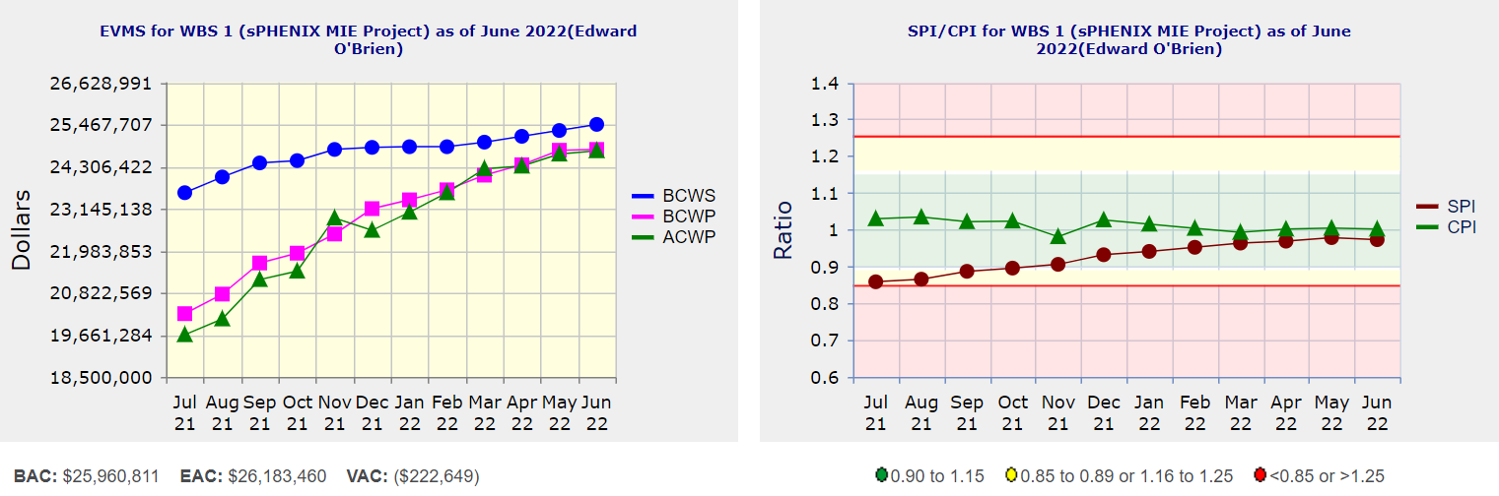
Performance Indices – sPHENIX MIE
Cumulative SPI | Cumulative CPI
0.97 | 1.00
Cumulative BCWS (Scheduled) | $25,470,635
Cumulative BCWP (Performed) | $24,779,418
Cumulative ACWP (Actual) | $24,741,407
DOE SPI or CPI Value Thresholds
0.90 to 1.15
0.85 to 0.89 or 1.16 to 1.25
<0.85 or >1.25

Slide 18
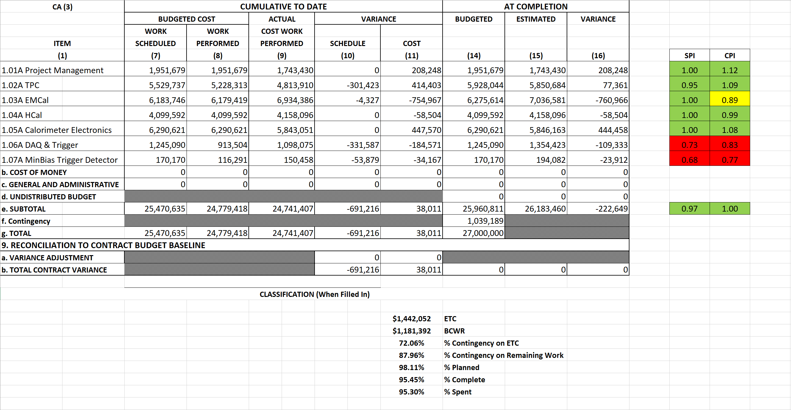
Cost Performance Report (CPR) – sPHENIX MIE
DOE SPI or CPI Value Thresholds
0.90 to 1.15
0.85 to 0.89 or 1.16 to 1.25
<0.85 or >1.25
*Highlights in table above takes variance $ into consideration, not just Indices

Slide 19
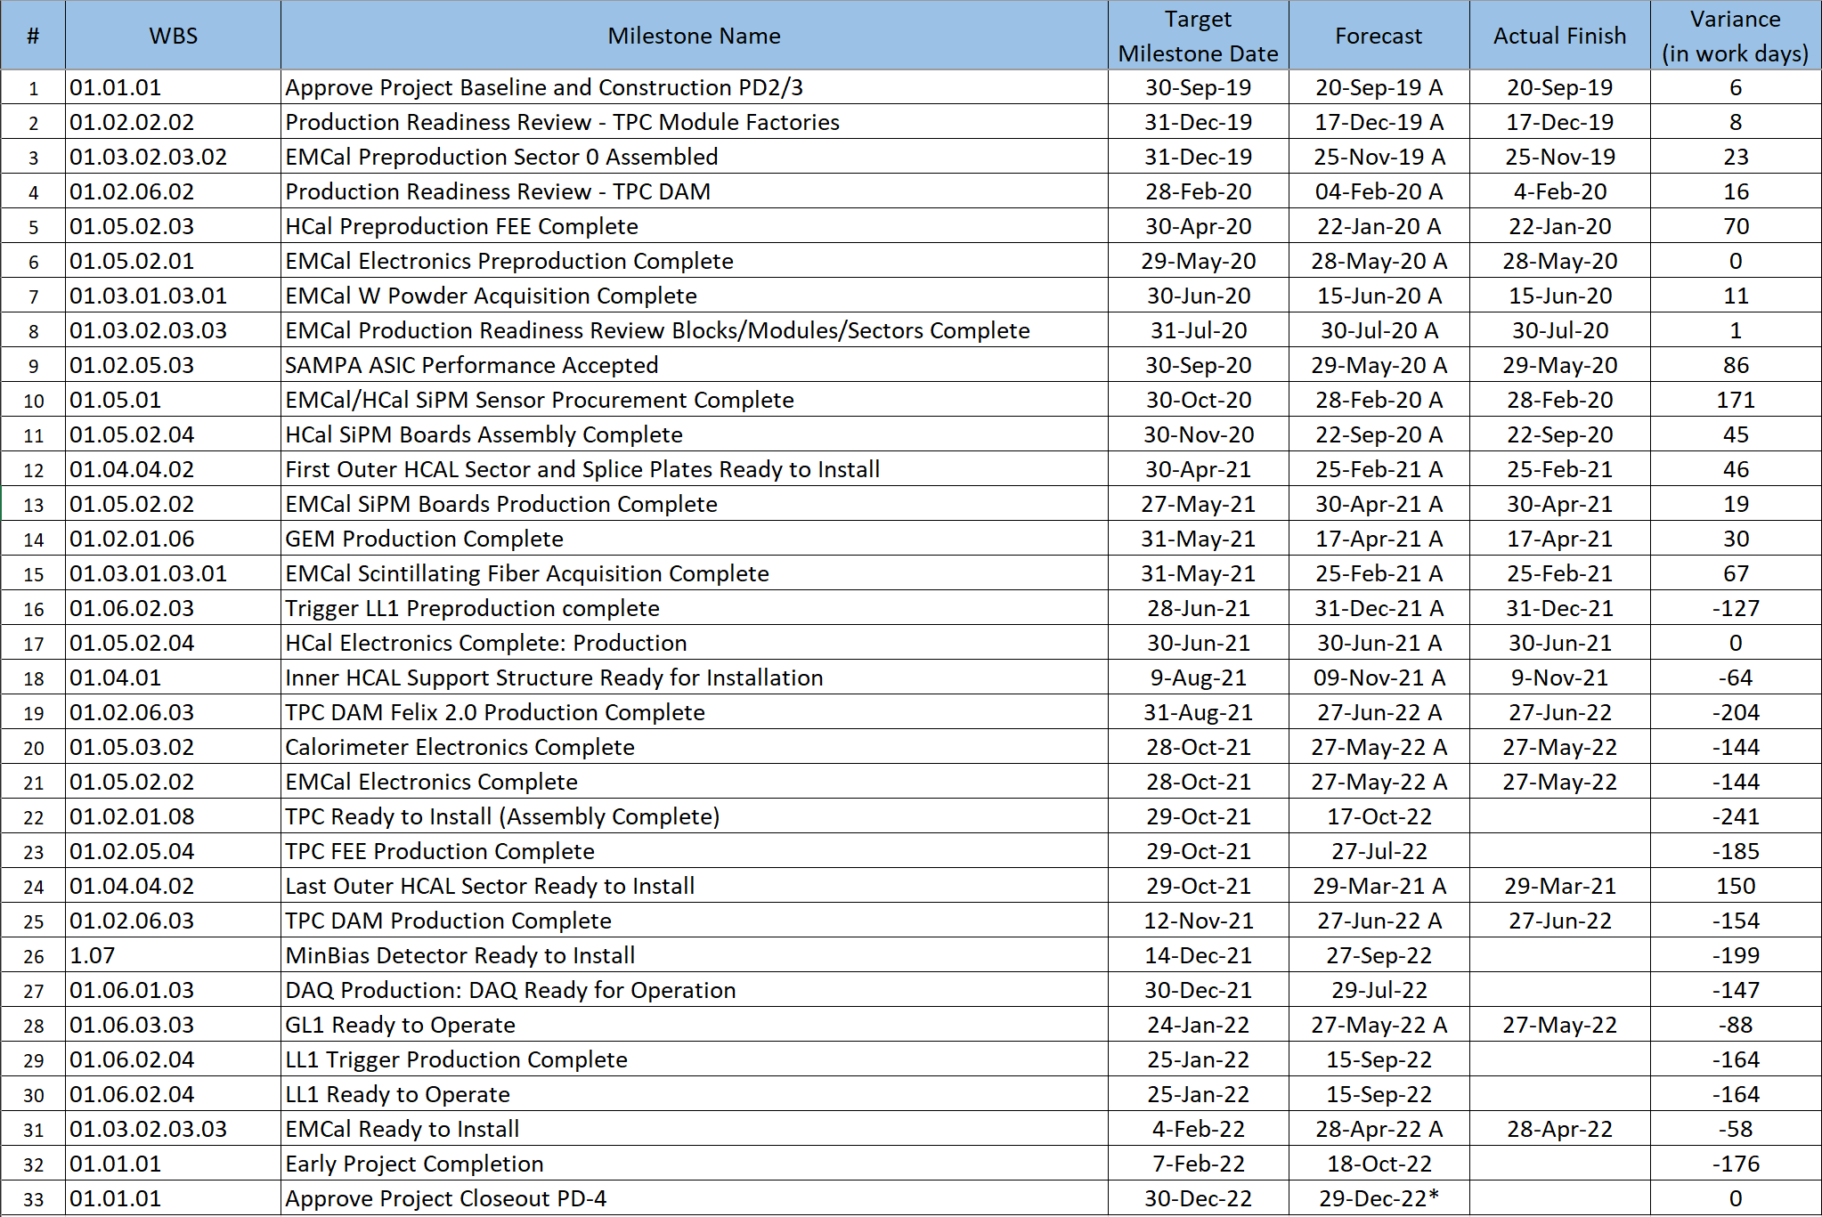
Milestones Status – sPHENIX MIE

Slide 20
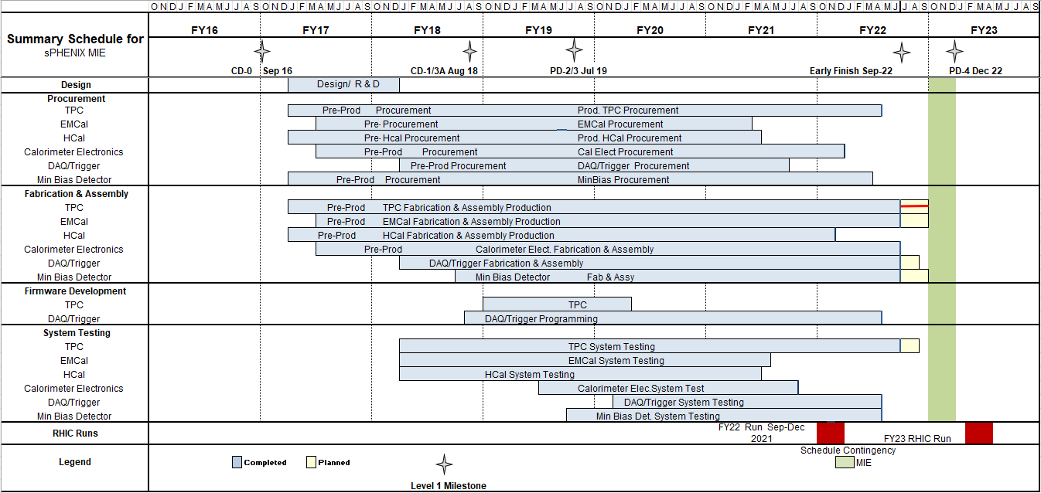
Summary Schedule – sPHENIX MIE

Slide 21
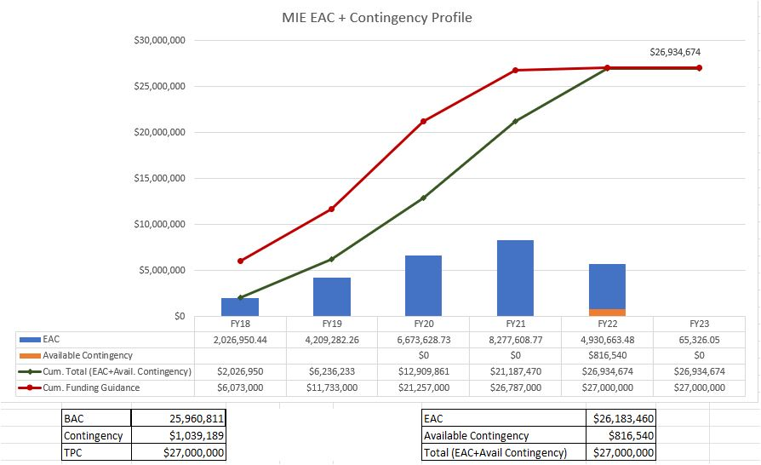
EAC and Contingency Profile – sPHENIX MIE

Slide 22
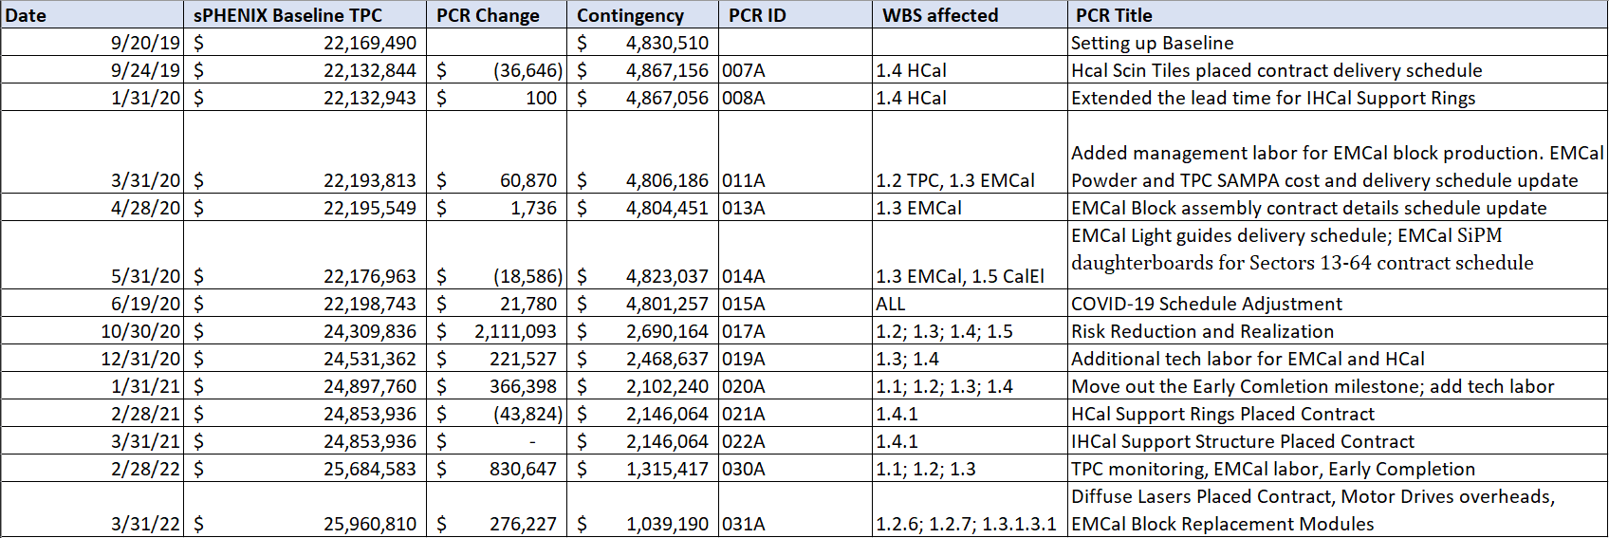
Baseline/Contingency Log and ETC adjustment Log - MIE
ETC Adjustments
Control Account | Aug’21 | Sep’21 | Oct’21 | Nov’21 | Dec’21 | Jan’22 | Feb’22 | Mar’22 | Apr’22 | May’22 | Jun’22
1.02 | 326,377 | 556,377 | 716,238 | 725,089 | 722,064 | 703,567 | 244,065 | 228,272 | 250,324 | 344,847 | 332,160
1.03 |  |  |  | 34,439 | 18,420 | 17,328 | 67,559 | 9,776 | 9,766 | 5,999 | 5,999
1.05 | $22,833 | $22,833 | 219,343 | 414,468 | 250,807 | -6,101 | 87,313 | 11,509 | 10,098 | 3,112 | 3,112
1.06 | $79,352 | $79,352 | $26,259 | -62,490 | -63,278 | -63,278 | -45,001 | -45,001 | -43,839 | -81,200 | -81,870
1.07 | $25,705 | $25,705 | $16,041 | 16,575 | 8,731 | 8,731 | -7,013 | -1,748 | -1,747 | -11,118 | -11,333
Total | 454,267 | 684,267 | 977,880 | 1,128,081 | 936,744 | 660,247 | 346,923 | 202,798 | 224,602 | 261,640 | 248,068

Slide 23
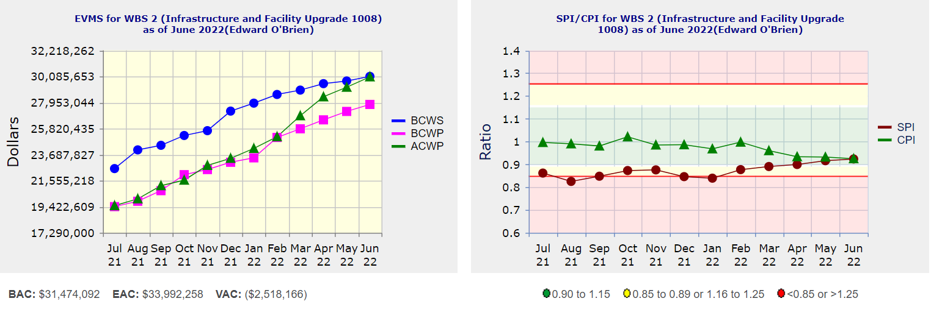
Performance Indices – 1008 Infra and Facility Upgrade
Cumulative SPI | Cumulative CPI
0.92 | 0.92
Cumulative BCWS (Scheduled) | $30,092,302
Cumulative BCWP (Performed) | $27,795,942
Cumulative ACWP (Actual) | $30,054,446
DOE SPI or CPI Value Thresholds
0.90 to 1.15
0.85 to 0.89 or 1.16 to 1.25
<0.85 or >1.25

Slide 24
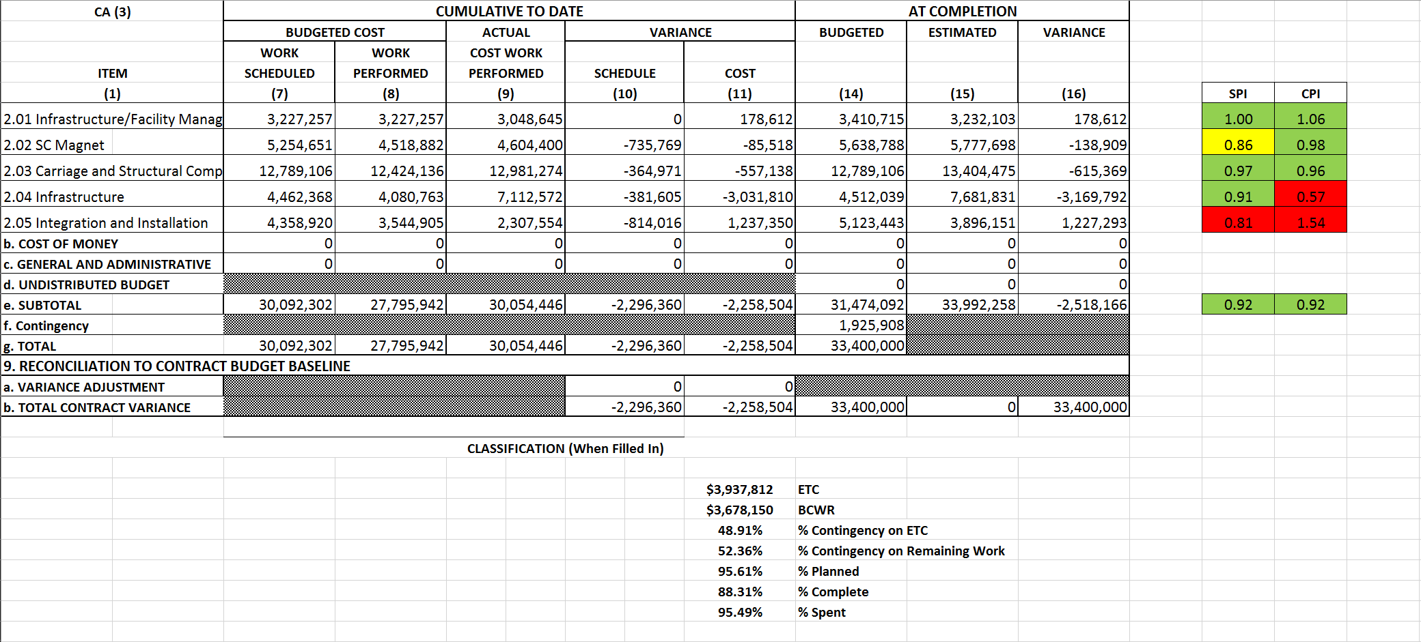
Cost Performance Report (CPR) – 1008 Infra and Facility Upgrade
DOE SPI or CPI Value Thresholds
0.90 to 1.15
0.85 to 0.89 or 1.16 to 1.25
<0.85 or >1.25
*Highlights in table above takes variance $ into consideration, not just Indices

Slide 25
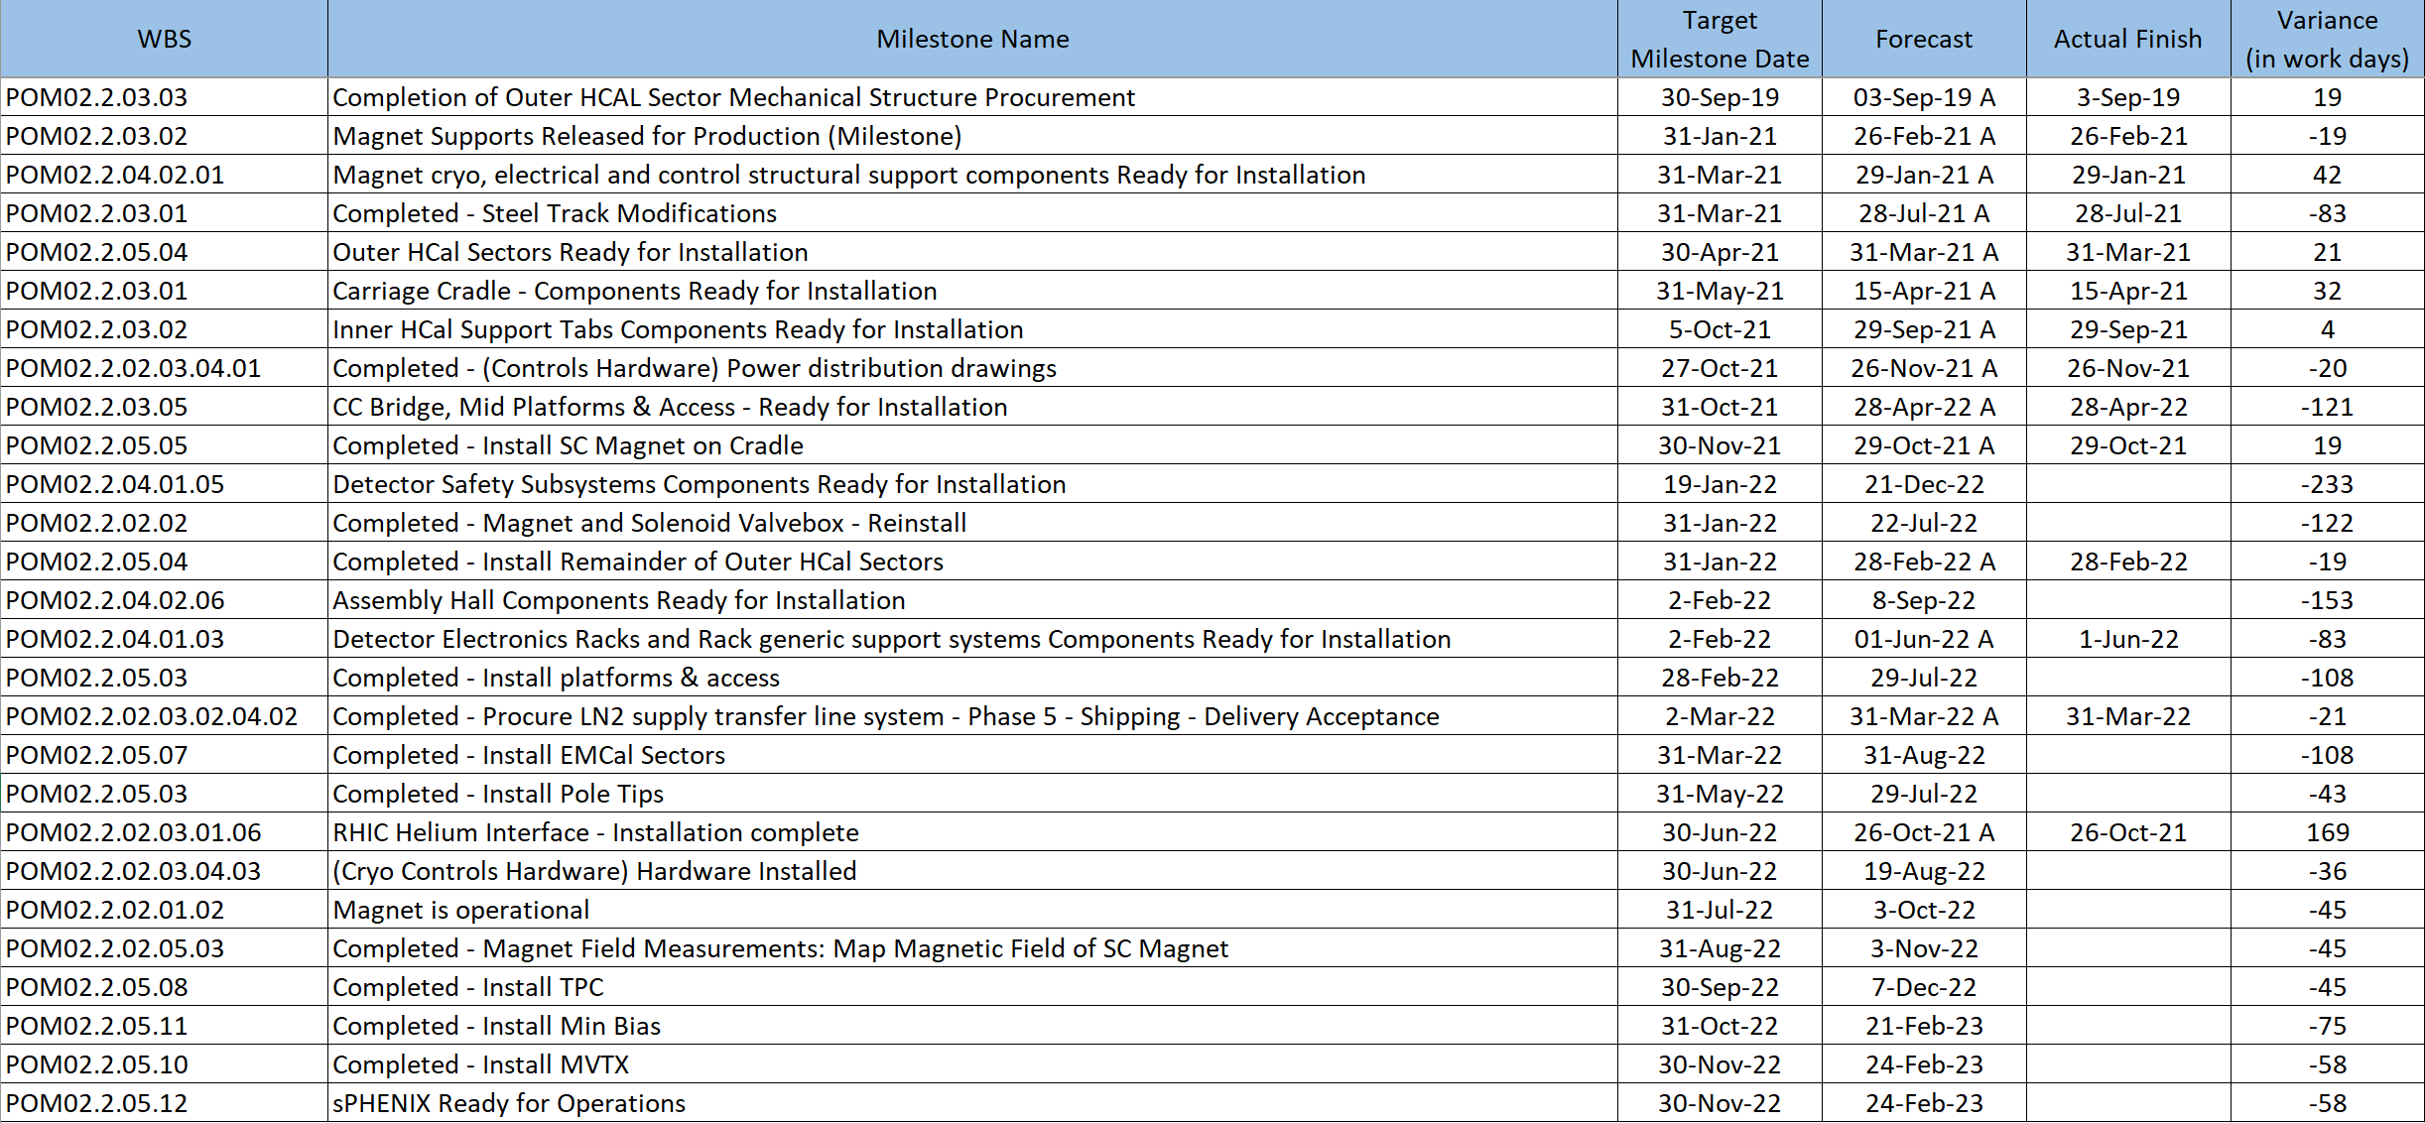
Milestones Status – 1008 Infra and Facility Upgrade

Slide 26
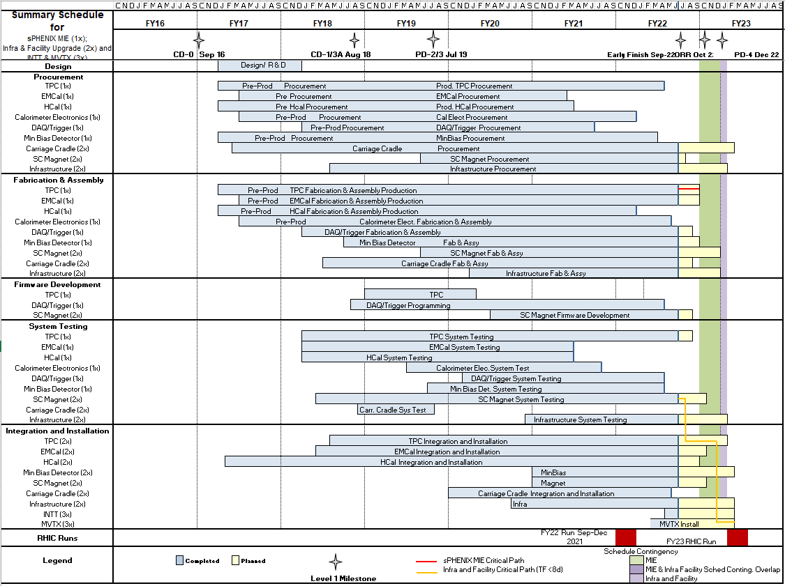
Summary Schedule – sPHENIX MIE and 1008 Infra and Facility Upgrade

Slide 27
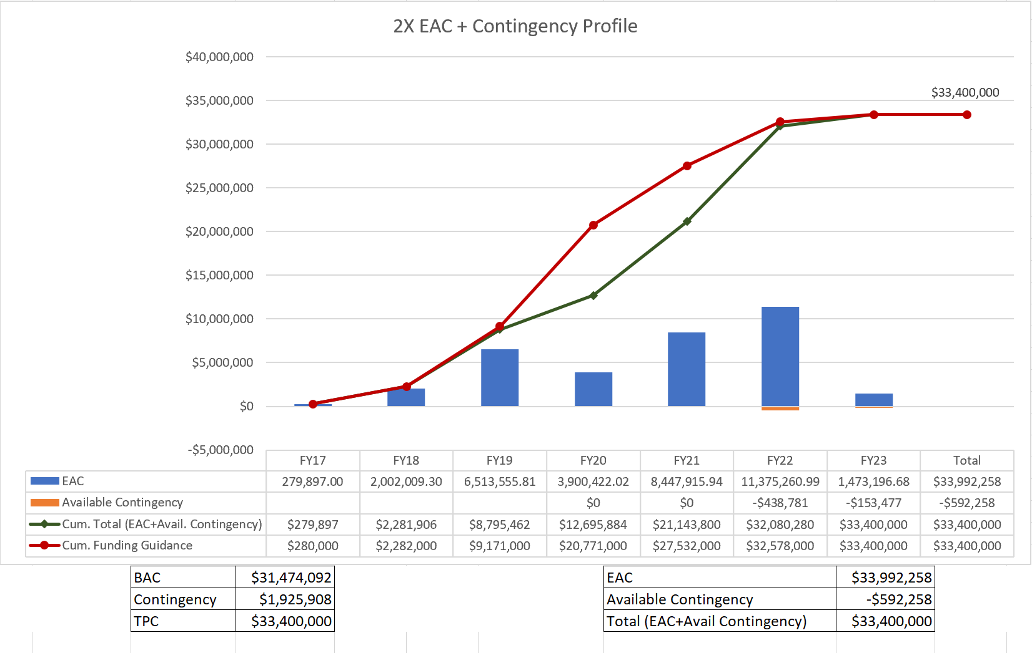
EAC and Contingency Profile – 1008 Infra and Facility Upgrade

Slide 28
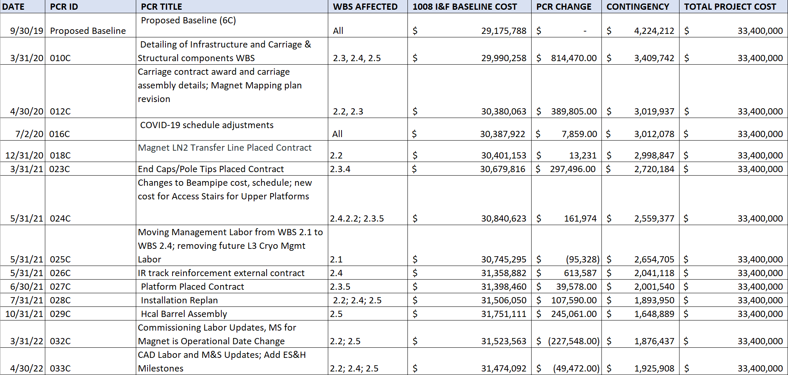
Baseline/Contingency Log and ETC adjustment Log – 2.X
ETC Adjustments
Control Account | Sep’21 | Oct’21 | Nov’21 | Dec’21 | Jan’22 | Feb’22 | Mar’22 | Apr’22 | May’22 | Jun’22
2.2 | - | - | - | - | 20,551 | 14,635 | 8,407 | 15,713 | 32,069 | 44,483
2.3 | 90,775 | 70,349 | 125,472 | 102,957 | 117,533 | 102,161 | 138,461 | 57,622 | 57,458 | 43,393
2.4 | 70,160 | 350,388 | 152,069 | 69,283 | 23,810 | 296 | 52,663 | 92,478 | 121,081 | 127,664
2.5 | - | 73,413 | 63,117 | 161,496 | 208,816 | 136,000 | - | - | - | -
Total | 160,935 | 494,150 | 340,658 | 333,737 | 370,709 | 253,092 | 199,530 | 165,812 | 210,609 | 215,541

Slide 29
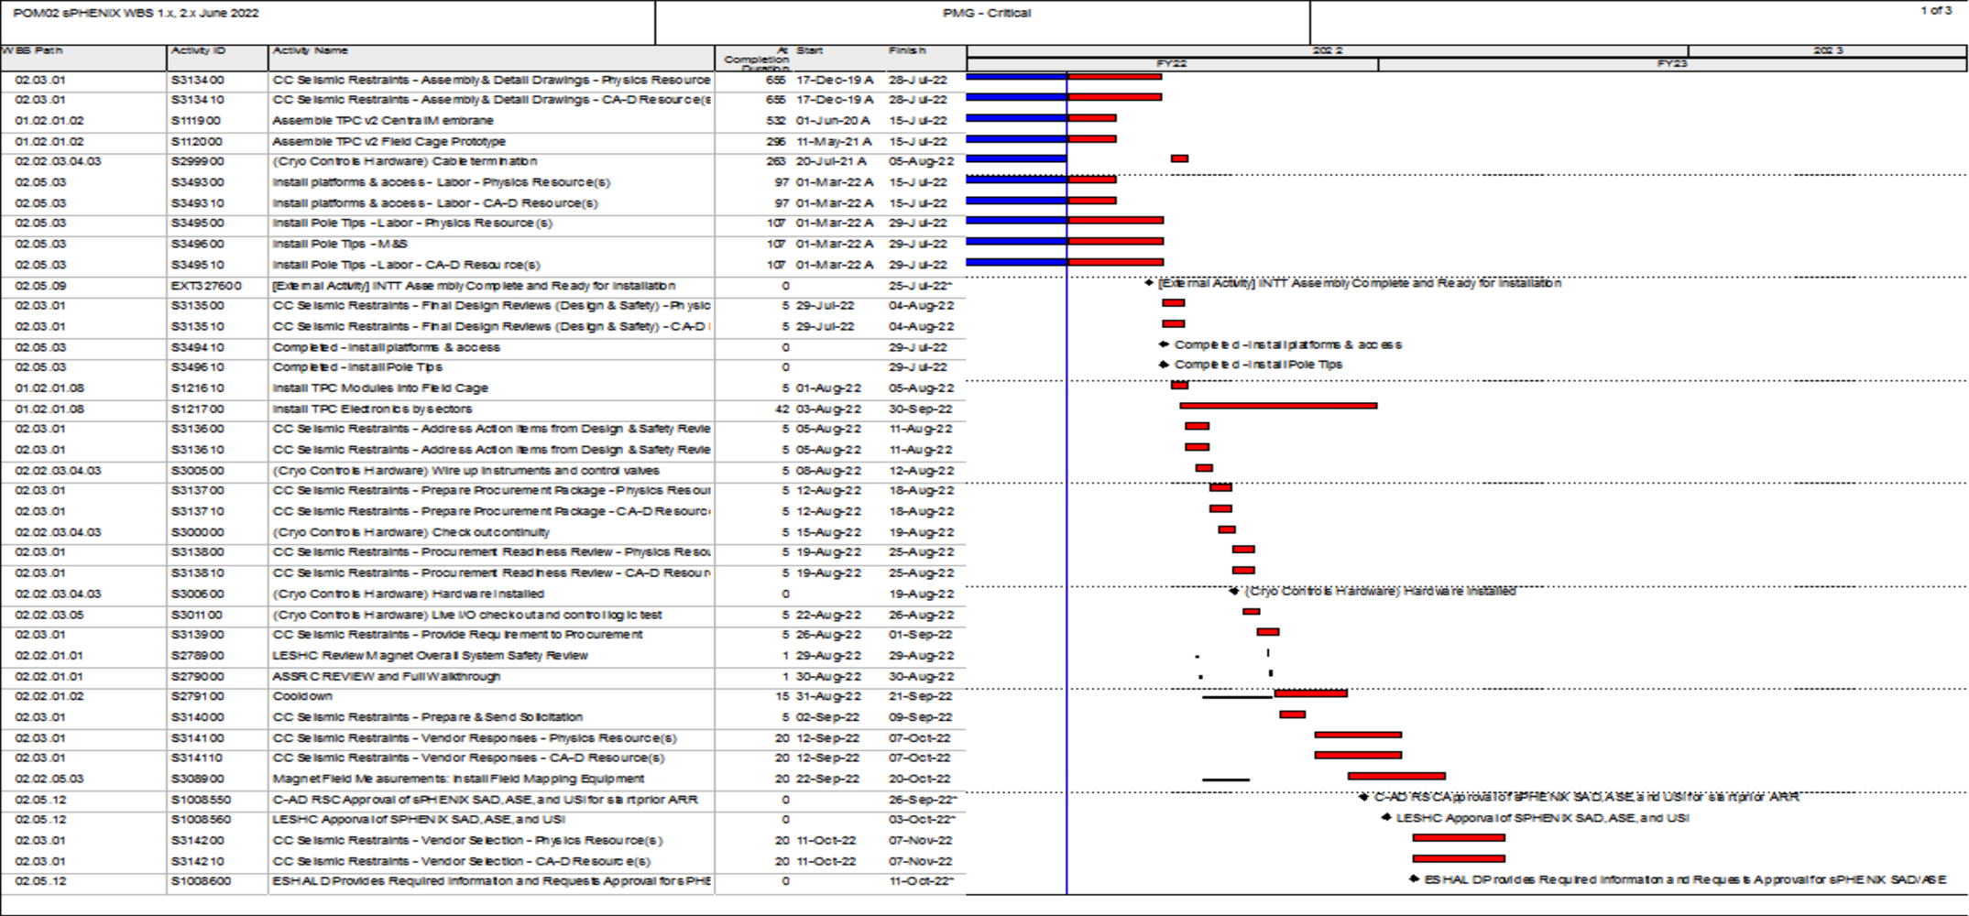
Critical Path (1x, 2x and 3x Combined)

Slide 30
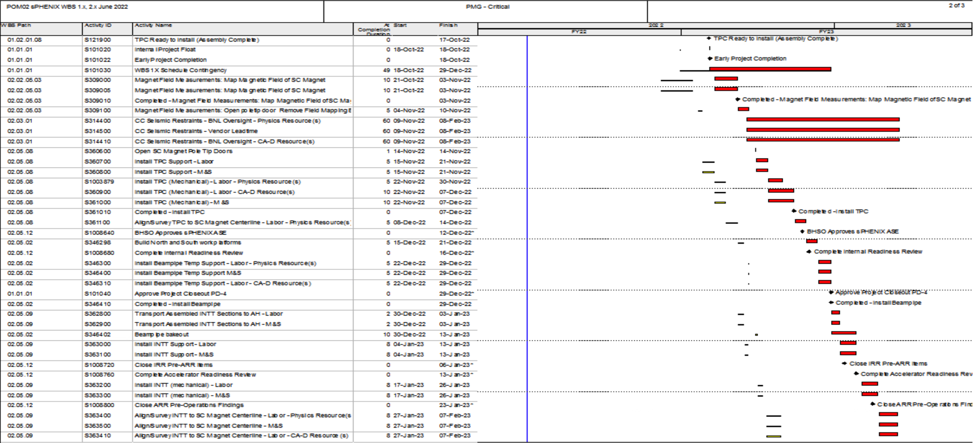
Critical Path (1x, 2x and 3x Combined)

Slide 31
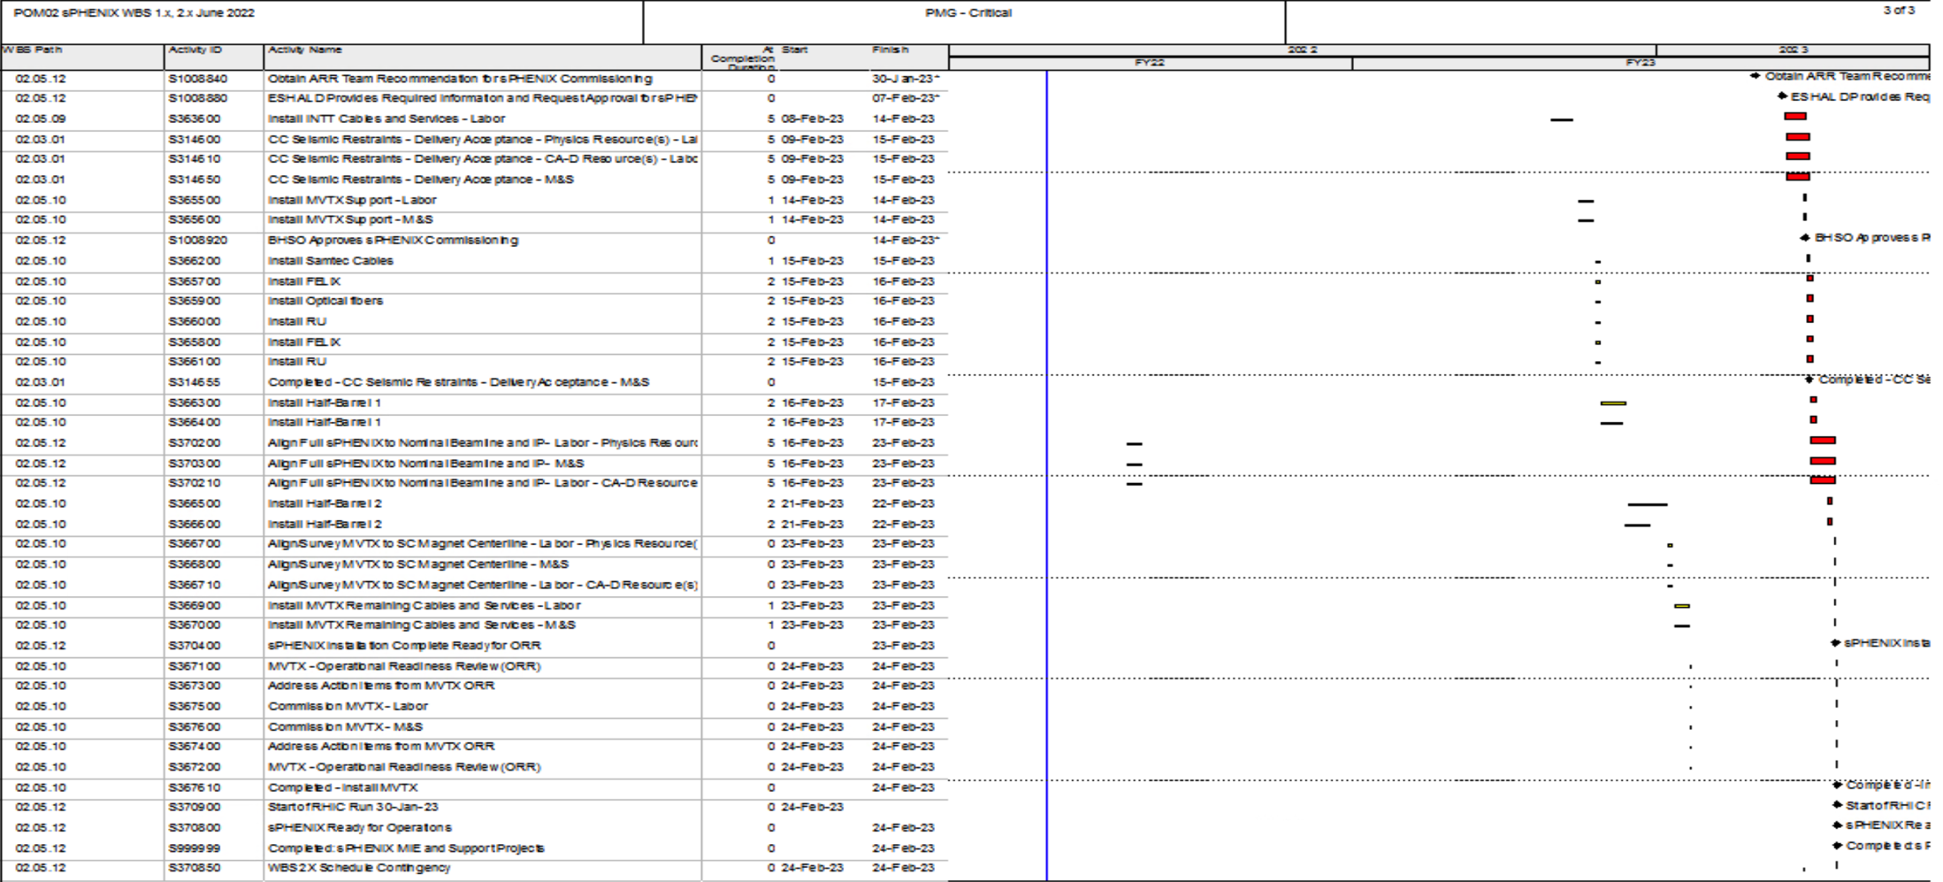
Critical Path (1x, 2x and 3x Combined)

