Slide 1
Configuration changes - LAPPD
Applied for/from | Note
23042 - 23063 | Initial setup: LAPPD 126 with L01e board installed. Most runs are for chamber commissioning
23064 | NIM logic change (using NIM out as veto)
23067 | 16ns delay added to planacons
23068 | 16ns delay removed
23083 | - Board replaced to L03c, lens mounted in the upstream of the LAPPD window, position roughly around the center of 4x4 area - Reduced nim cable length by < ~1m - Planacon upstream is out, LAPPD 0-ch30 is plugged back in
23160 | - LAPPD replaced to the new one (136, 10um) with the same L03c board - center 4x4 area grounded - lens is still in the upstream of the LAPPD
23196 | - LAPPD is upstream to the beam, lens is downstream

Slide 2
Configuration changes - LAPPD
Applied for/from | Note
23196 - 23203 | Digitizer 7-1 and 7-2 adapter cards were not connected to the right places
23205 | 7-1 and 7-2 cards swapped (fixed the issue above)
23196 - 23220 | Chamber gas ran out (no tracker for ref. positions)
23243 | Upstream planacon installed (10um, CaF2), 0-30 is used for the planacon.
23245 | - Planacon re-alignment (upstream lowered by 20mm, downstream up by 20mm) - Acrylic sheet planced
23246 | - Planacon upstream lowered by another 12.5 mm - Planacon channels moved to 7-1 04 (upstream) and 7-1 ch05 - LAPPD 0-30 and 0-31 back in
23341 | Al block (50mm thick) placed in front of the upstream planacon (timing measurements)
23369 | Al block removed Acrylic sheet removed

Slide 3
Configuration changes - LAPPD
Applied for/from | Note
23392 | Planacon channels using 4-02 (upstream), 4-06 (downstream)
23396 | Planacon channels using 7-1-04 and 7-1-05 LAPPD 4-02, 4-06 back in Ground work done for ref. Trackers before chamber dedicated runs
23396 - 23405 | Chamber runs 23402-23405: HV change for uRW (840/540 -> 860/560)
23406 - | LAPPD runs
23409 | Runs with lens y off position (by 25mm)

Slide 4
HV changes
Applied from | LAPPD | PC supply voltage | Entry of Entry | Exit of Entry | Entry of Exit | Exit of Exit | V/MCP | PC voltage
~ 23126 | 126 | 2175 | 2050 | 1225 | 1025 | 200 | 825 | 125
23160 | 136 | 2315 | 2250 | 1375 | 1175 | 300 | 875 | 65
23244 | 136 | 2325 | 2250 | 1375 | 1175 | 300 | 875 | 75
23258 | 136 | 2315 | 2250 | 1375 | 1175 | 300 | 875 | 65
23312 | 136 | 2210 | 2200 | 1300 | 1100 | 200 | 900 | 10
23315 | 136 | 2220 | 2200 | 1300 | 1100 | 200 | 900 | 20
23316 | 136 | 2225 | 2200 | 1300 | 1150 | 250 | 900 | 25
23317 | 136 | 2220 | 2200 | 1300 | 1175 | 250 | 900/925 | 20
23338 | 136 | 2265 | 2190 | 1320 | 1120 | 250 | 870 | 75
23367 | 136 | 2290 | 2170 | 1320 | 1100 | 250 | 850 | 120
23385 | 136 | 2270 | 2170 | 1320 | 1150 | 250 | 850/900 | 100

Slide 5
Configuration changes - chambers
Initial setup: two upstream ref. trackers - MM - uRW – two downstream ref. Trackers
MM replaced to another uRW (effective from run 23059)
HV changes:
Applied from | Ref. Trackers (all four) | Upstream chamber (MM, uRW) | Downstream chamber (uRW) | Note
23049 | 3550
23051 |  | 760/460 (MM)
23052 |  | 800/500 (MM)
23053 |  | 850/550 (MM)
23056 |  | 840/540 (uRW) | 840/540 | MM --> uRW replacement
23402 |  | 860/560 (uRW) | 860/560

Slide 6
Chamber pedestal runs
Reference run | Applied from | Note
23043 | 23045
23071 | 23072 | After replacing the upstream chamber (MM -> uRW)
23338 | 23350
23396 | 23397 | After the gnd work for ref. trackers

Slide 7
LAPPD timing scan runs
23348
23349
23345
23346
23350
23344
23351, 23353
23343
23354
23341, 23342
23355
23366
23356
23365
233567
23360, 23364
23359
23358
23362
23361
23363

Slide 8
Other notes:
Google spreadsheet (run log): detailed info for each run
https://docs.google.com/spreadsheets/d/1sZTYNy9RFuys_R9epN1h0PRgk_XUBqTbfok_JO1TrFQ/edit?usp=sharing
For chamber analysis:
For run 23059, 23121-23340, chamber map for D2 needs to be manually fixed in the script; chamber.cfg was not updated properly. Note: for the dedicated chamber runs taken at the very end, it's correct (no action needed).

Slide 9
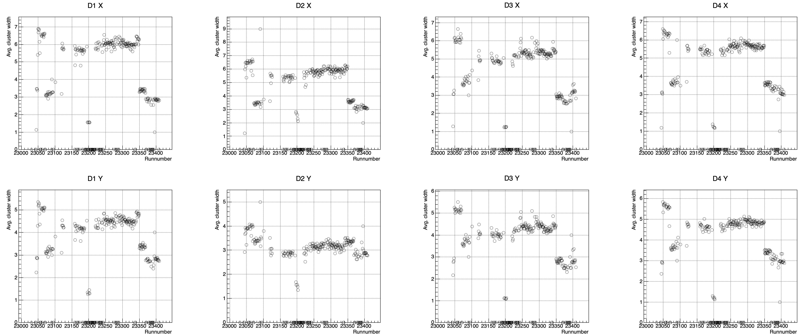
Avg. Cluster Width vs Run#
New pedestal file (23338)
Gas ran out

Slide 10
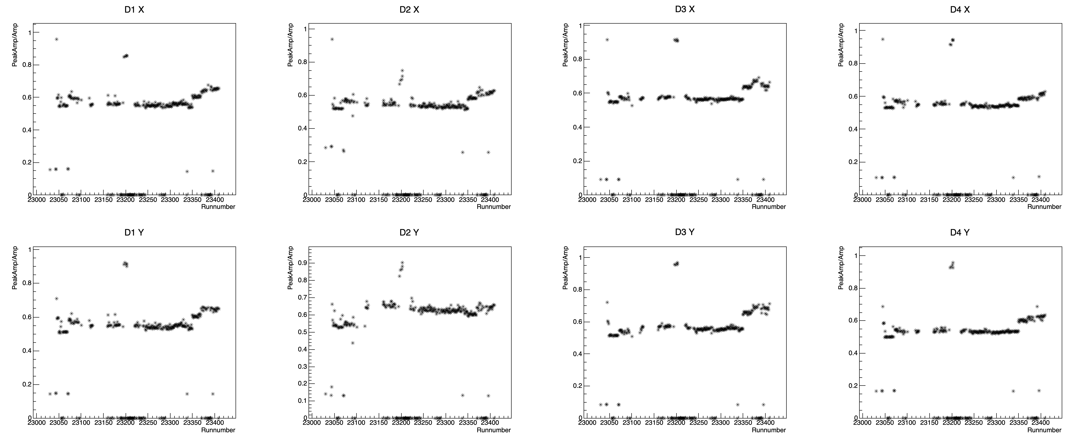
PeakAmp/AmpSum vs Run#

Slide 11
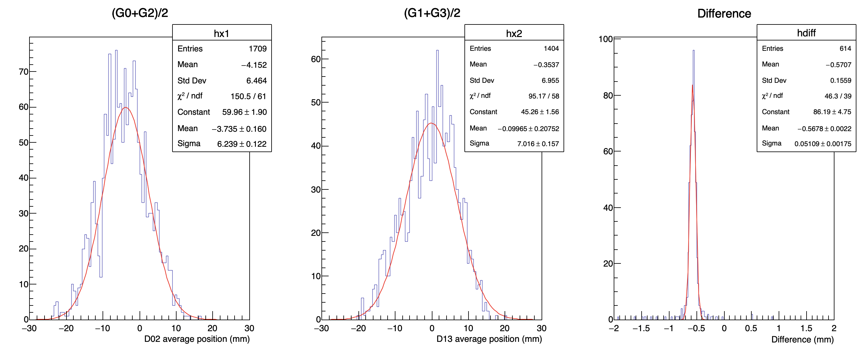
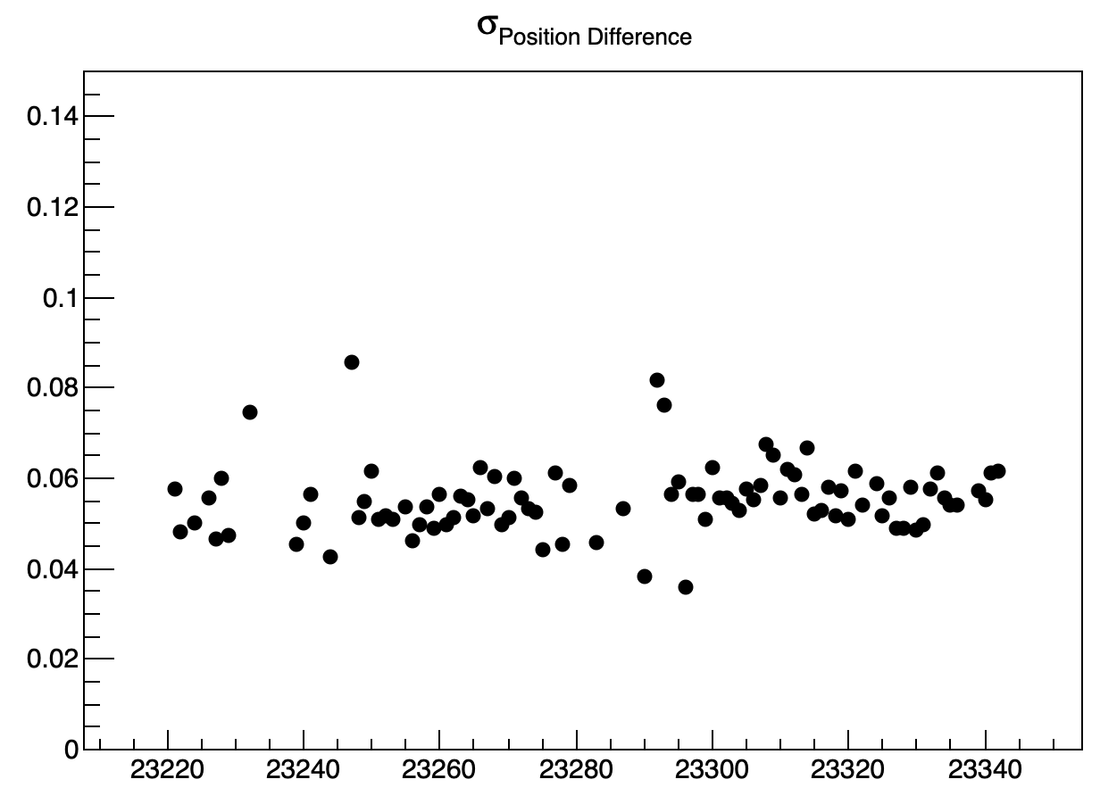
Reference tracker resolution
Example run 23251
Cuts applied:
Cluster width:
wx0 >= 3 && wx0 <= 7
wx2 >= 3 && wx2 <= 6
wx1 >= 3 && wx1 <= 6
wx3 >= 3 && wx3 <= 6
amplitude > 500 for all planes
Looking at the runs in this range
Position differences: a Gaussian fit to the data shows a resolution of ~50-60 um.

Slide 12
