Slide 1
Review of the Gas & Cooling
On Carriage Gas & Cooling Routing
Roland Wimmer
BNL
June 30th , 2022

Slide 2
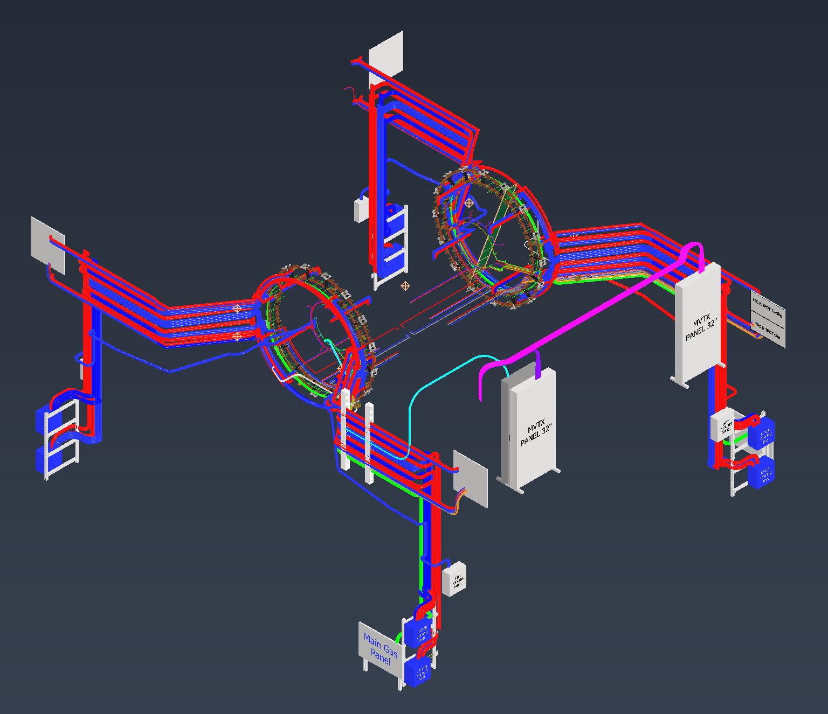
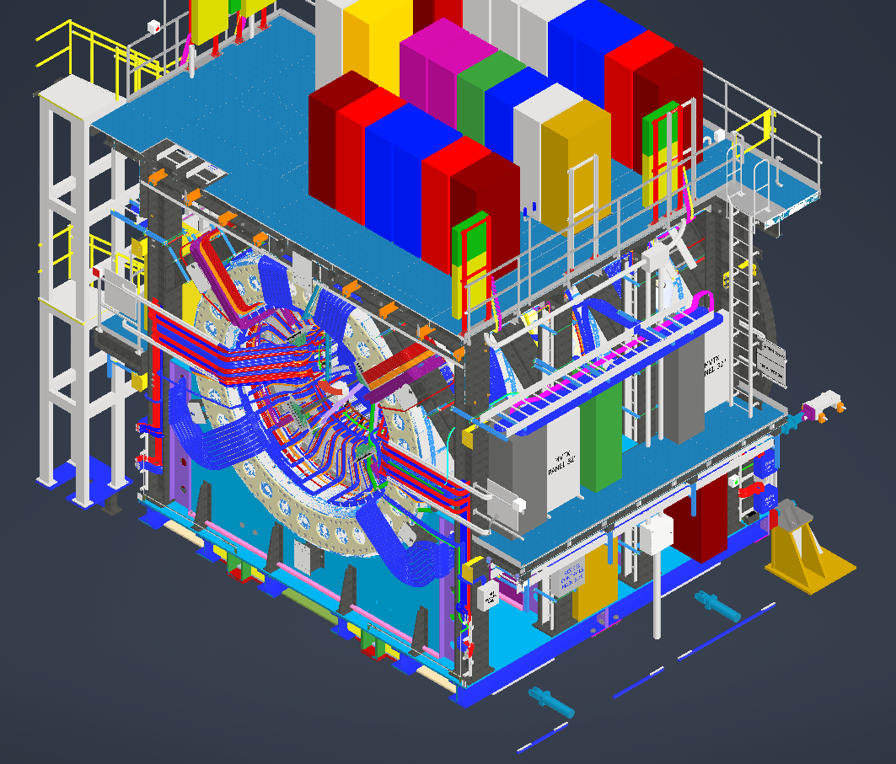
Detector Cooling Layout
North
June 30th, 2022

Slide 3
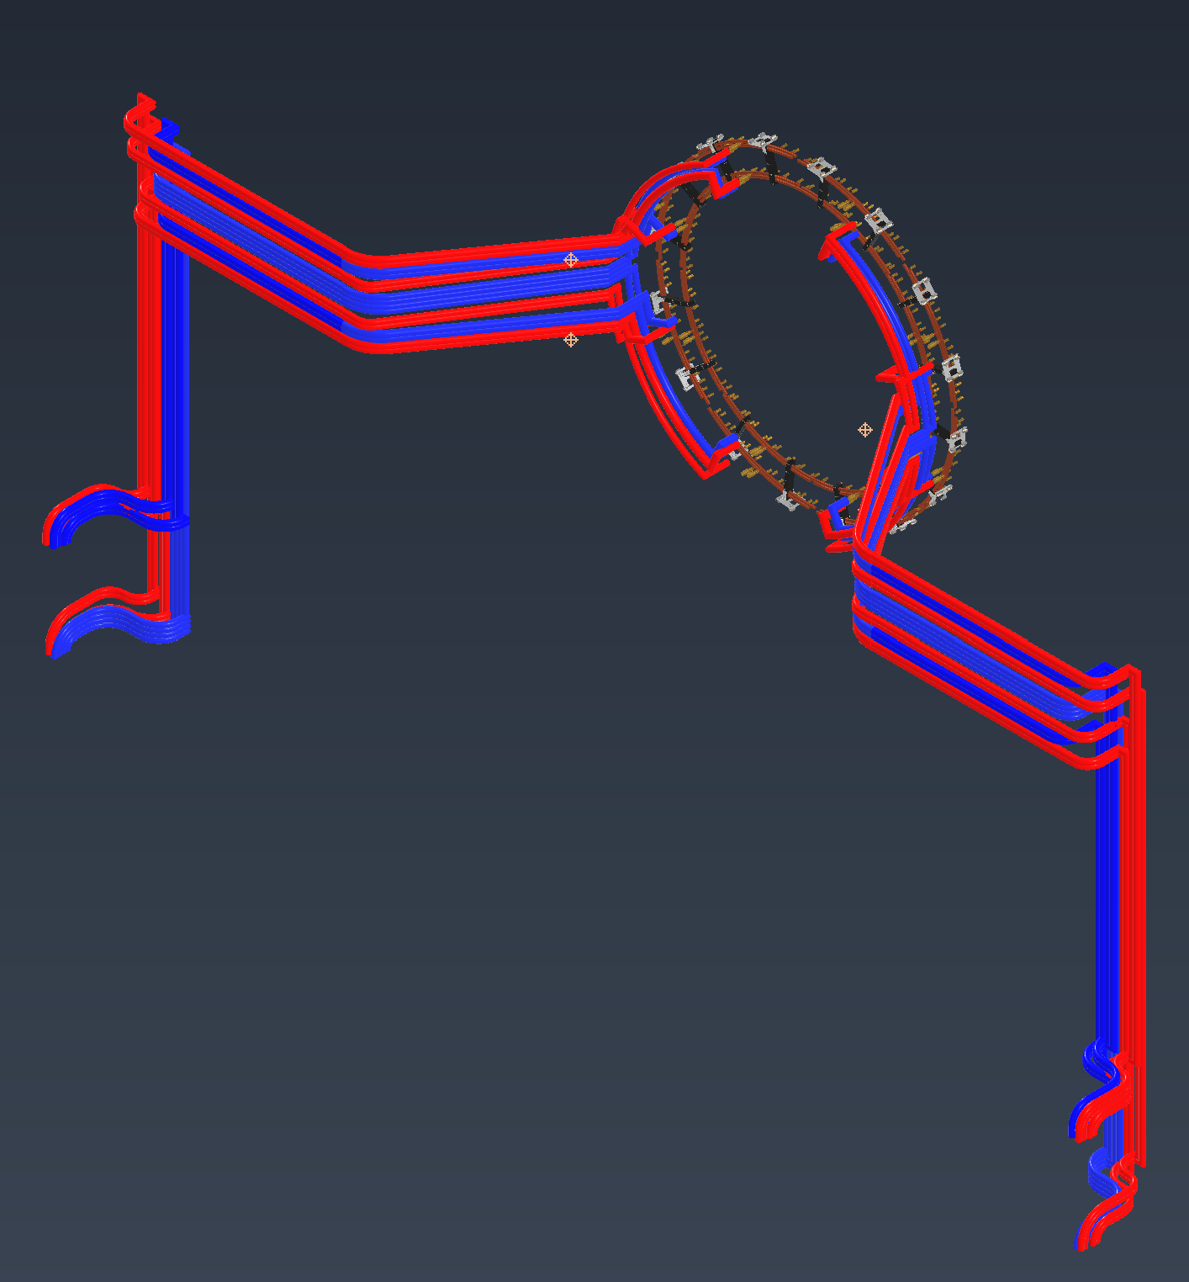
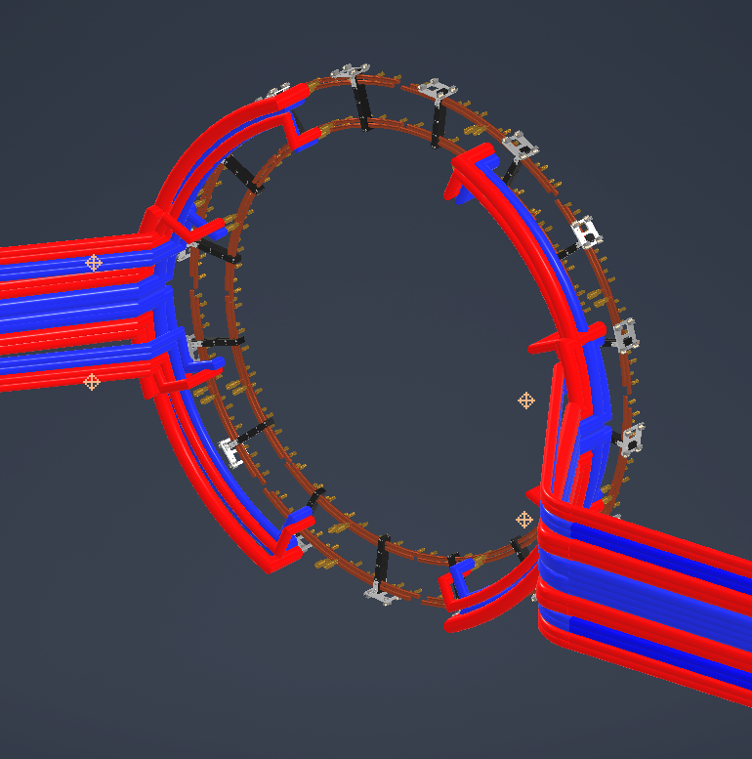
Emcal Cooling Layout
(8) Cooling panels located at each corner on the 1st level, (4) panels for SIPM loop and (4) panels for PreAmp loop
The panels are mounted on a separate frame that will mount to the I-Beams in the corners
Each SIMP panel has (4) 1” supply and (4) 1” return lines. Each one of those lines feed (4) EMCAL sectors
Each PreAmp panel has (4) 3/4” supply and (4) 3/4” return lines. Each one of those lines also feeds (4) EMCAL sectors
June 30th, 2022

Slide 4
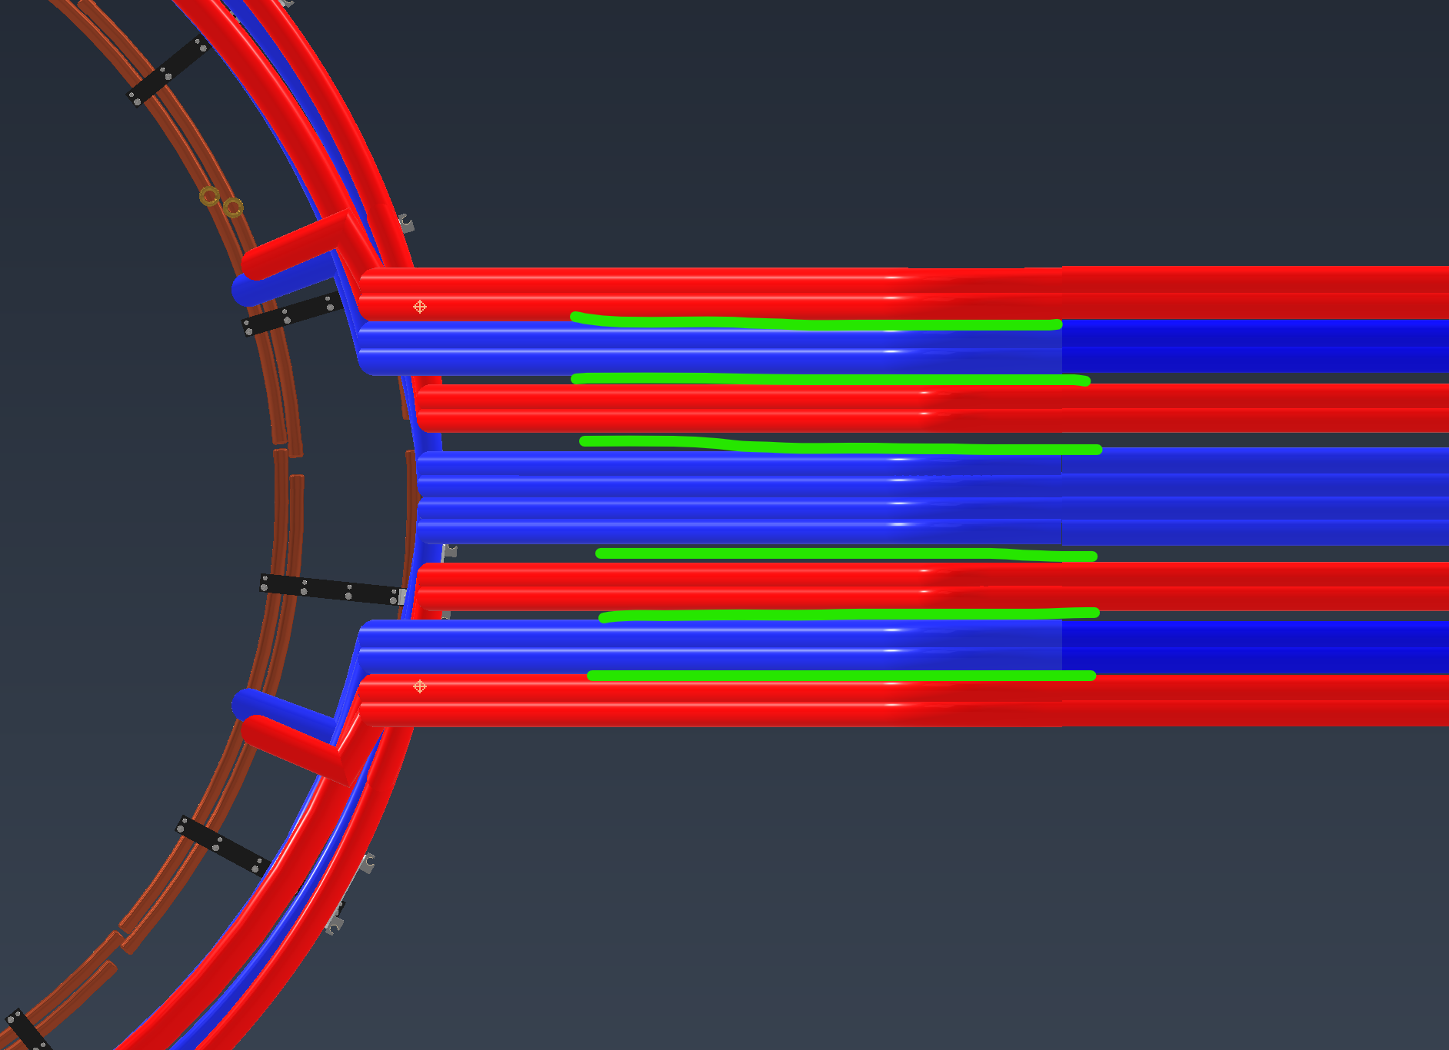
Emcal Cooling Layout
Due to the size of the EMCAL cooling lines similar lines will be insulated together to save space
Total vertical width is ~24” and is made up of (7) insulated “bundles”
Preamp doesn’t need insulation, but SIPM does
Example: 4 SIPM Lines insulated together
June 30th, 2022

Slide 5
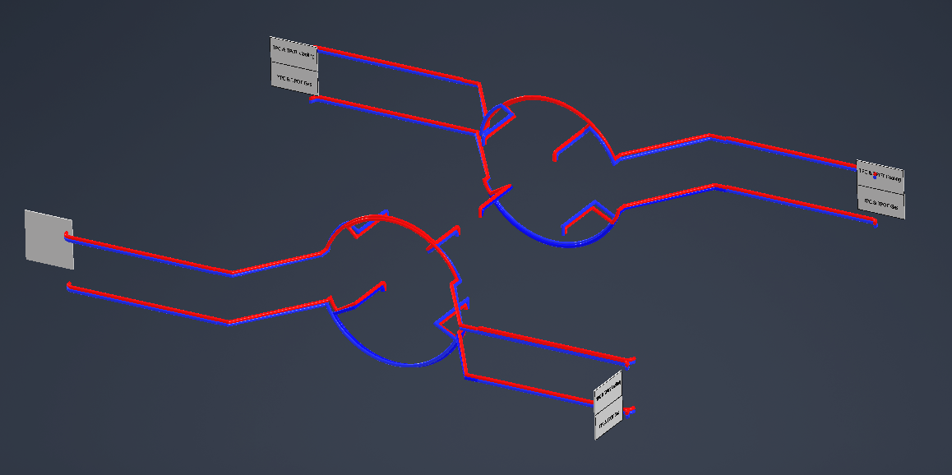
TPC Cooling Layout
(4) Cooling panels located at each corner on the 2nd level, mounted on the railings
The two east panels will also be used for gas
Each panel feeds (2) 1” supply and (2) 1” return lines
The NW panel will be mounted slightly differently to accommodate the altered stairs
June 30th, 2022

Slide 6
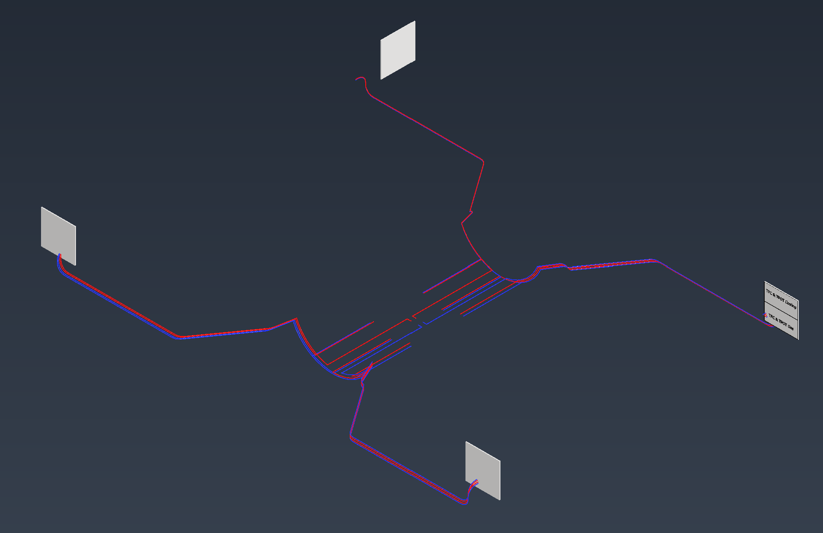
TPOT Cooling Layout
Parasitic to the TPC
TPOT gets (2) ¼” supply and (2) ¼” return lines at each panel
June 30th, 2022

Slide 7
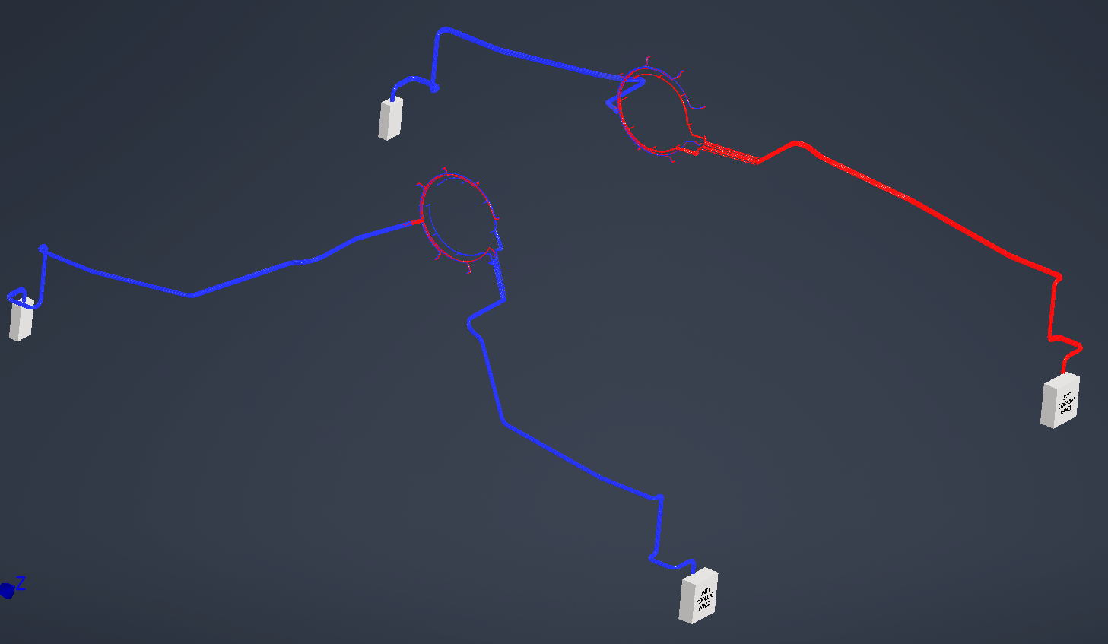
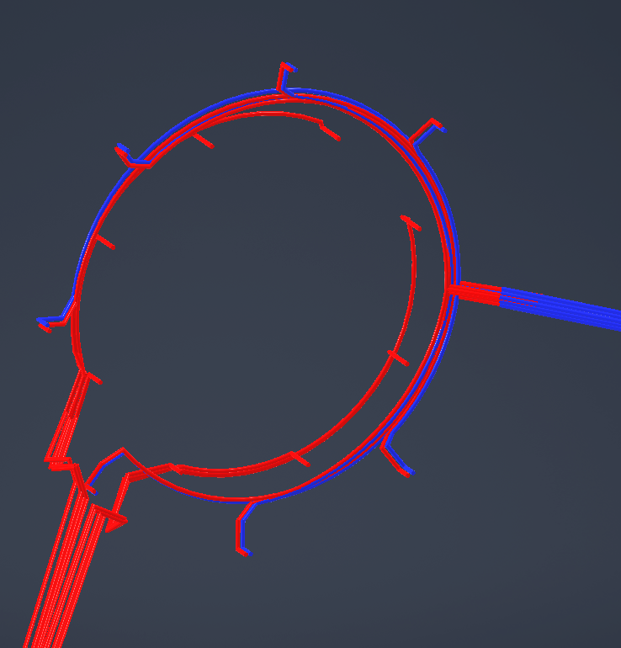
INTT Cooling Layout
(2) Detector cooling panels located on the NE & SE corners on the 1st level
The panels will be mounted to the I-Beams on the corners
The south panel feeds (8) 1/4” supply lines and the north panel receives (8) return lines
(2) ECW cooling panels located on the NW & SW corners on the 1st level
Each panel feeds (8) 1/4” supply lines and (8) 1/4” return lines
June 30th, 2022

Slide 8
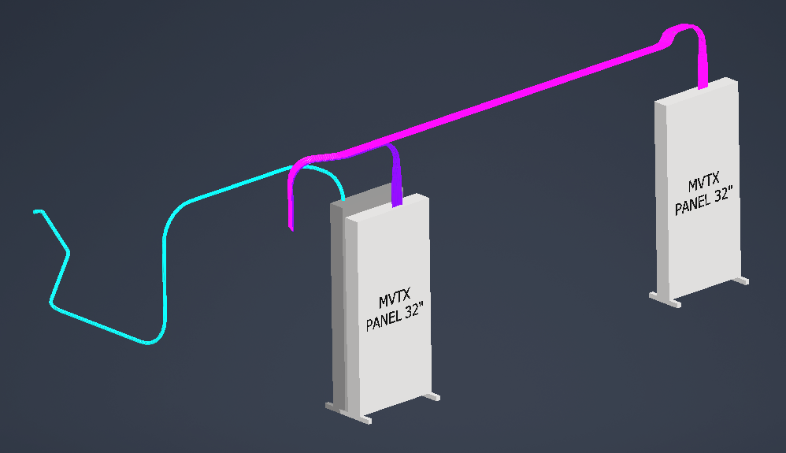
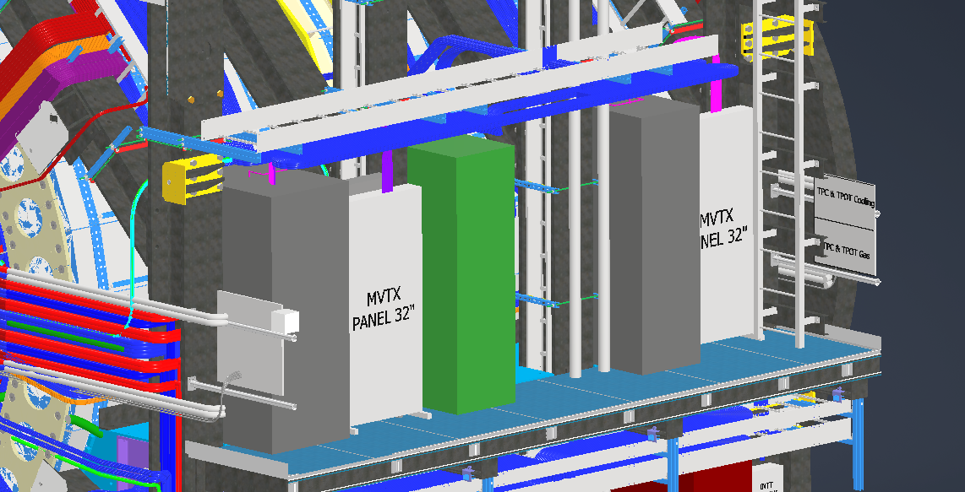
MVTX Cooling Layout
(3) Panels located on the east side mid level platform in between the other racks
(72) ¼” Electronic cooling lines from the two 32” panels
(24) ¼” detector cooling lines
June 30th, 2022

Slide 9
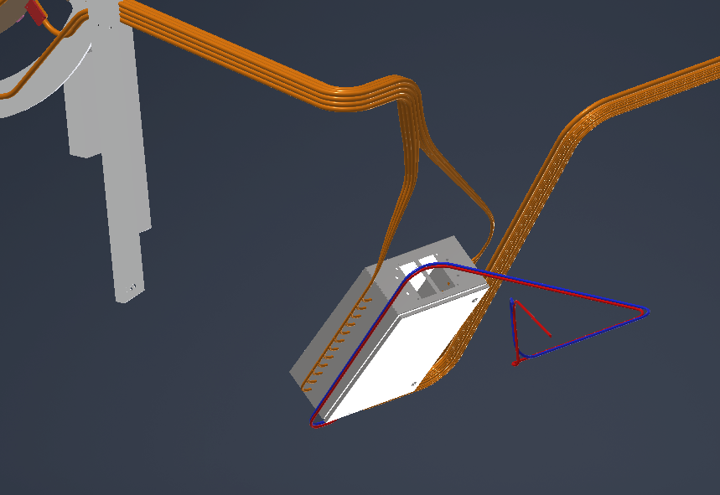
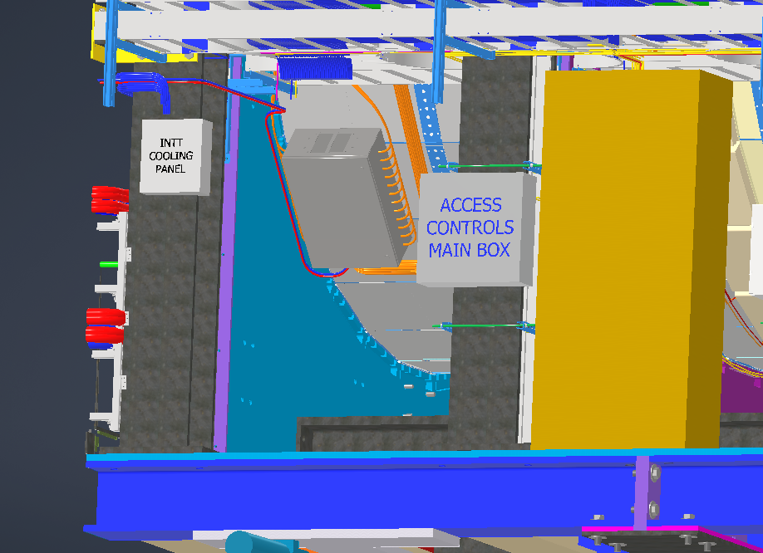
SEPD Cooling Layout
(2) SEPD Connection boxes located under the detector on the east side behind 1E1 & 1E3
Each box feeds (1) ½” supply and (1) ½” return line
Cooling is done via ECW
June 30th, 2022

Slide 10
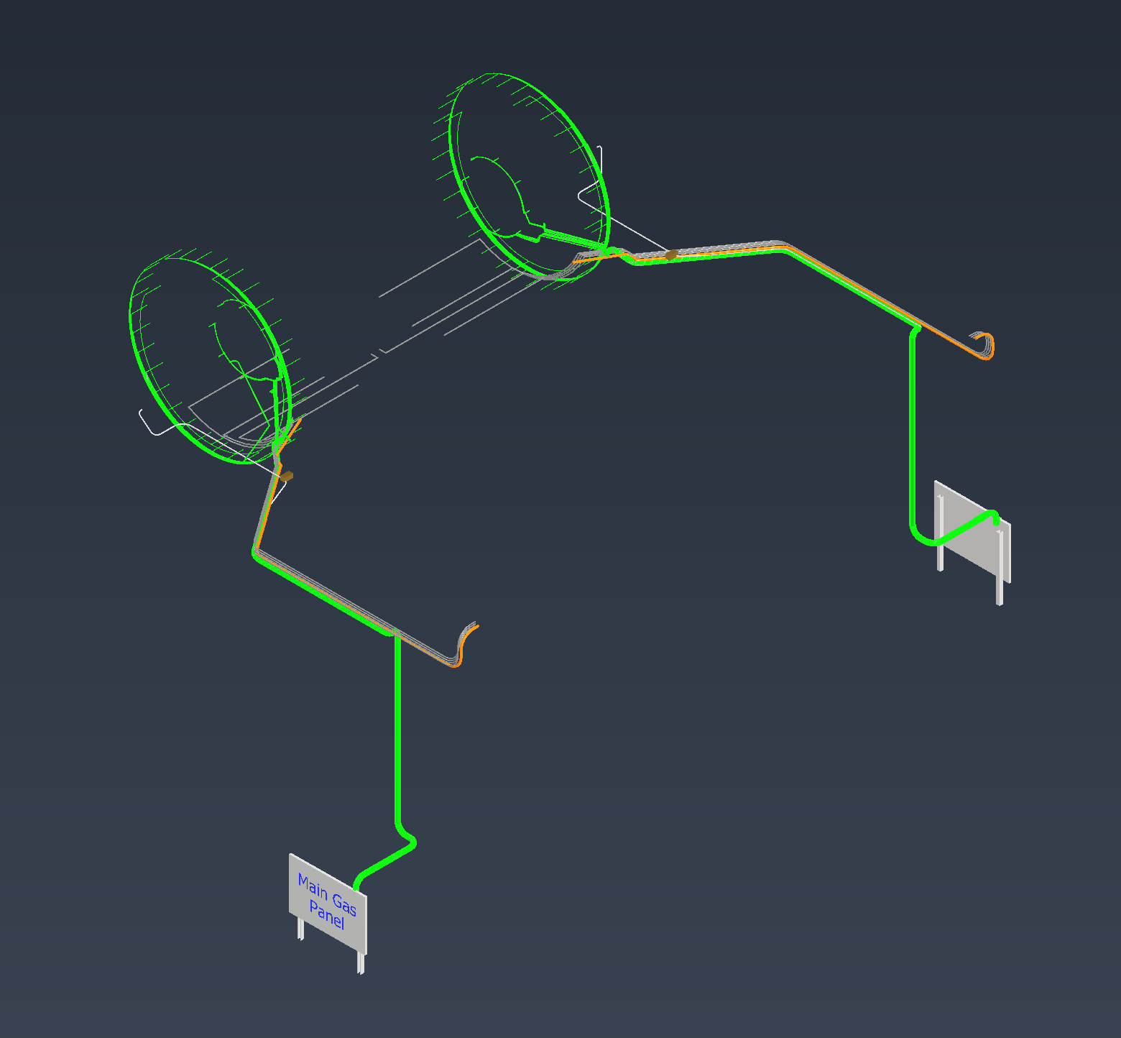
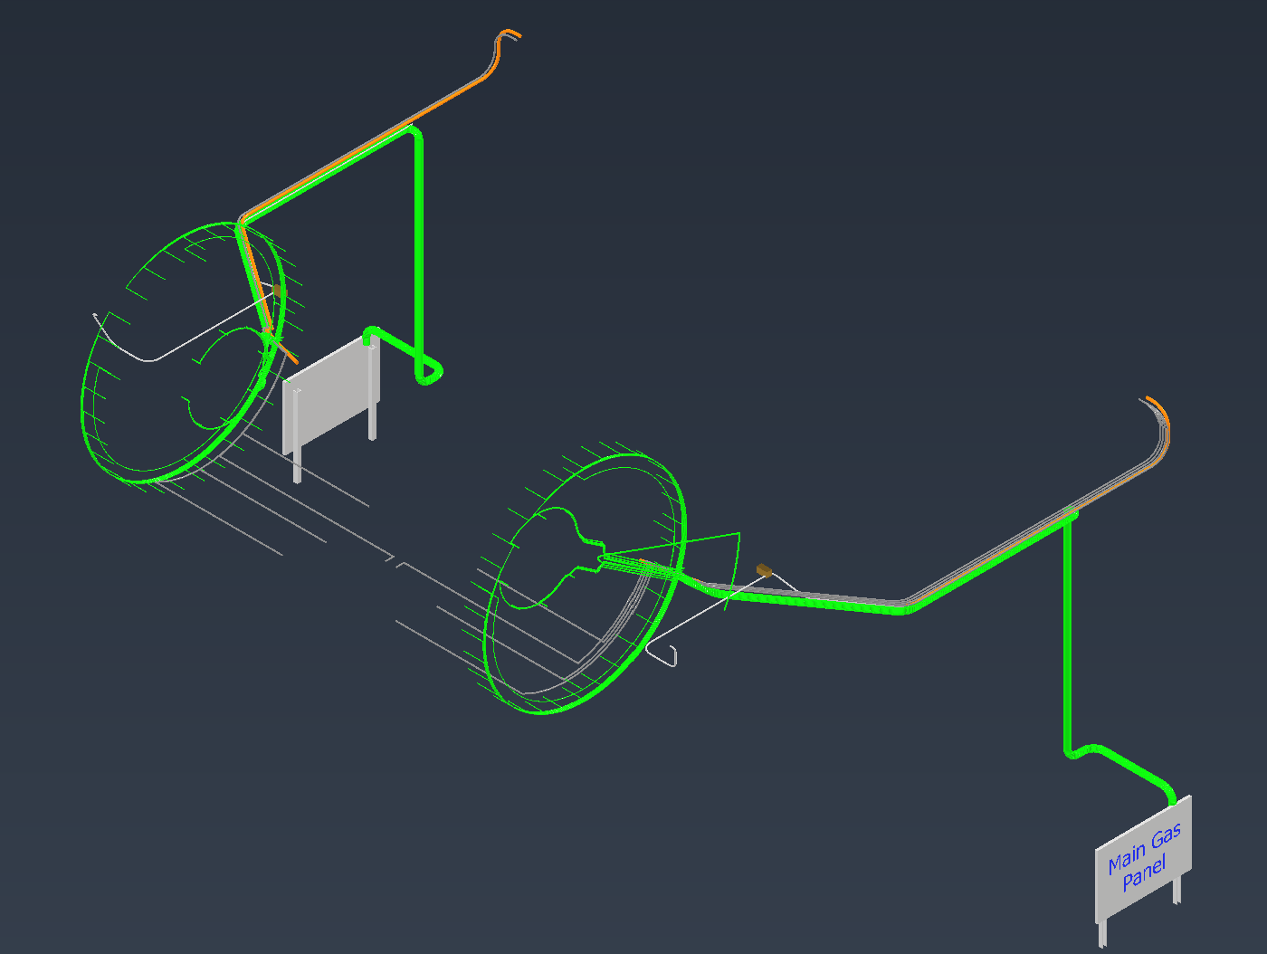
Detector Gas Layout
June 30th, 2022

Slide 11
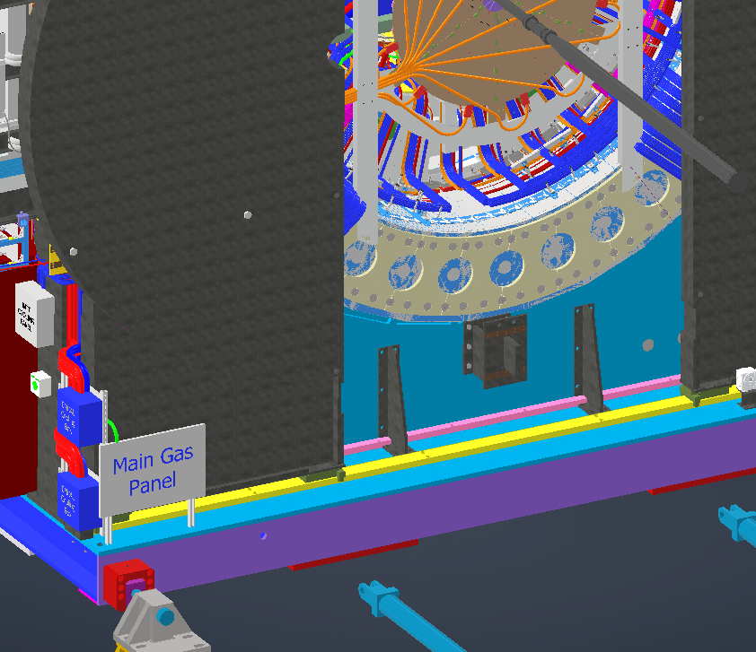
Main N2 Panel
(2) Main gas panels located at the NE & SE corners of the carriage, outside the pole tip doors
Most gas lines will feed into these panels then out to their destinations
Subsystem | Service | Flow Meters | Lines | Sizes I.D.
EMCAL | N2 | 32 | 32 | 1/4"
INTT | N2 | 2 | 2 | 1/4"
MVTX | N2 (air?) | 1 | 12 | 1/4"
TPC Laser | N2 | 4 | 4 | 1/4"
MBD | Dry Air | 2 | 2 | 1/2"
June 30th, 2022

Slide 12
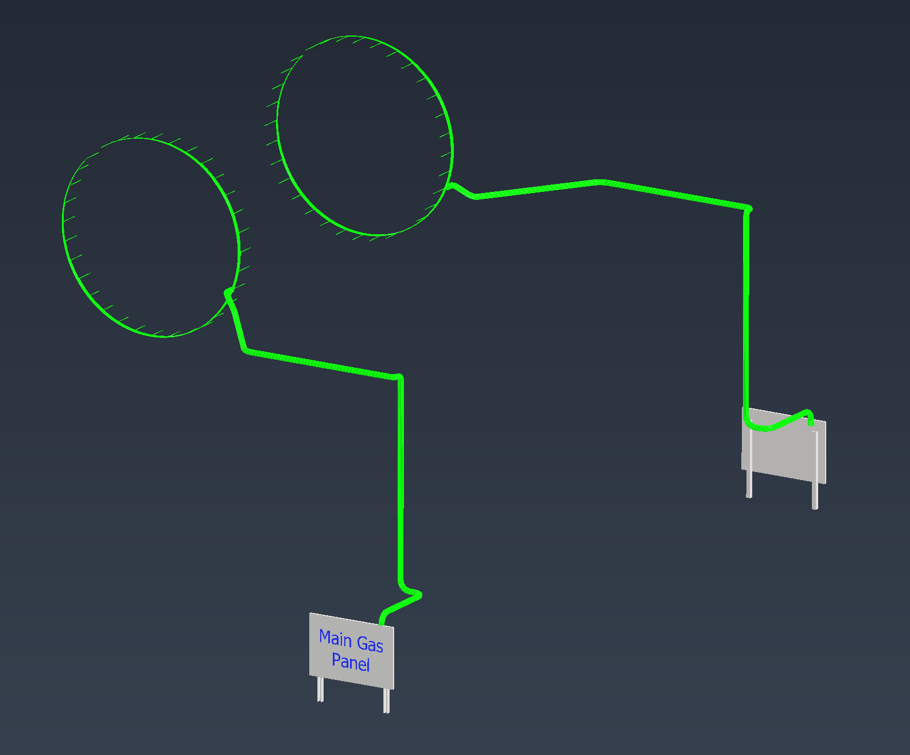
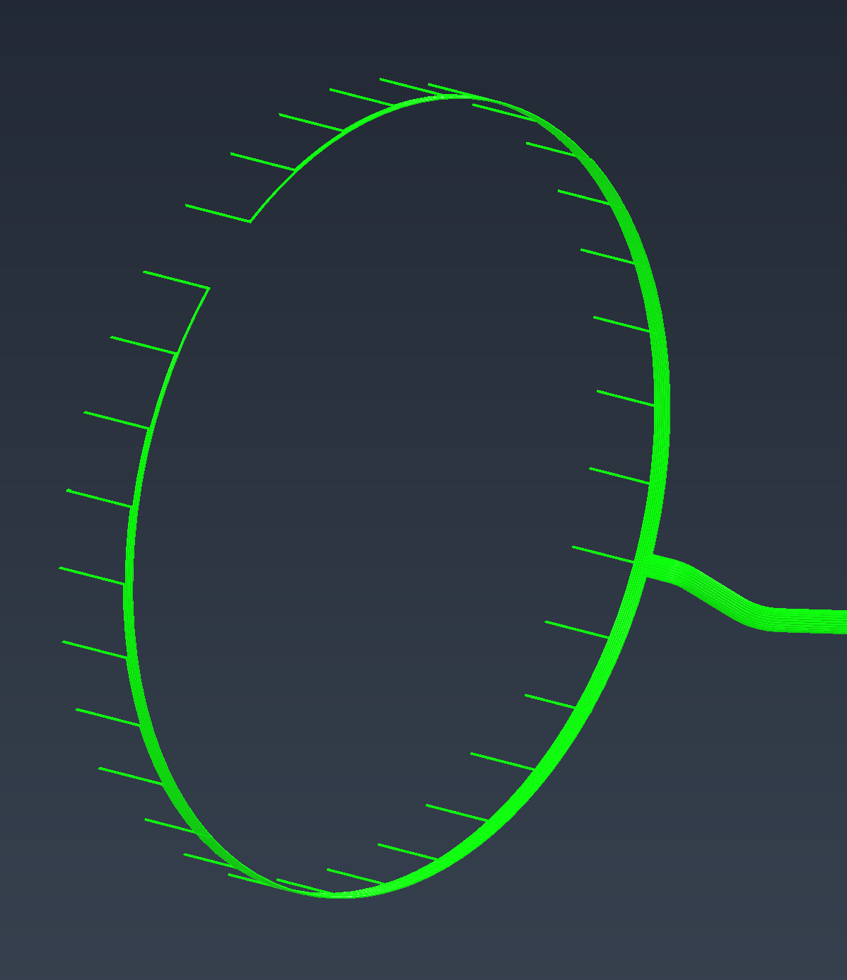
EMCAL N2
Located on the 2 main gas panels on the NE & SE corners of the carriage, outside the pole tip doors
(32) ¼” lines on each end
June 30th, 2022

Slide 13
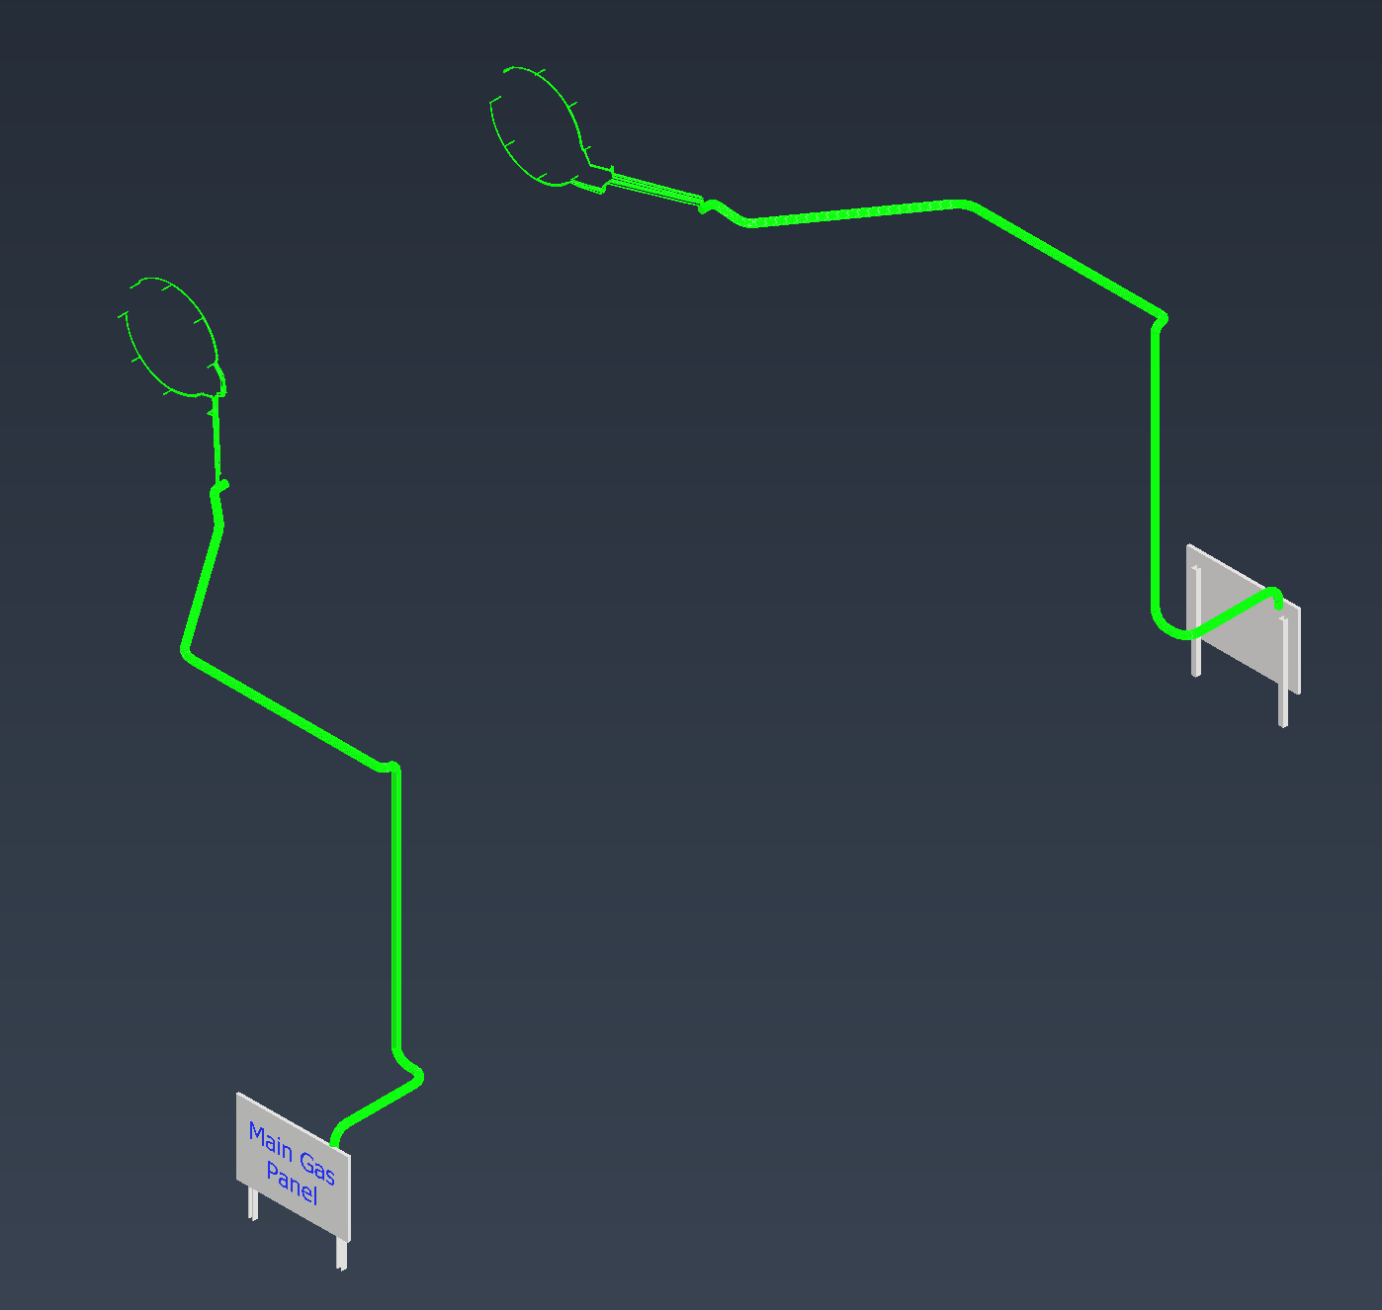
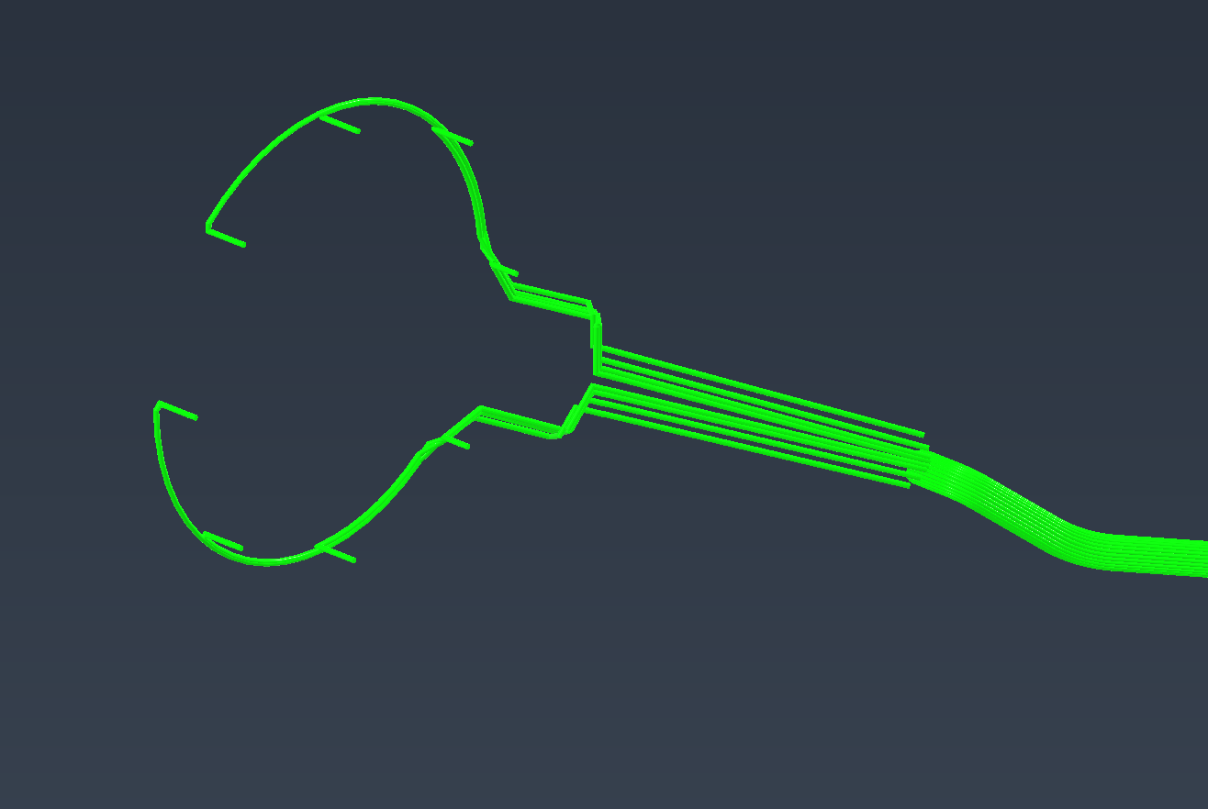
INTT N2
Located on the 2 main gas panels on the NE & SE corners of the carriage, outside the pole tip doors
(8) ¼” lines on each end
June 30th, 2022

Slide 14
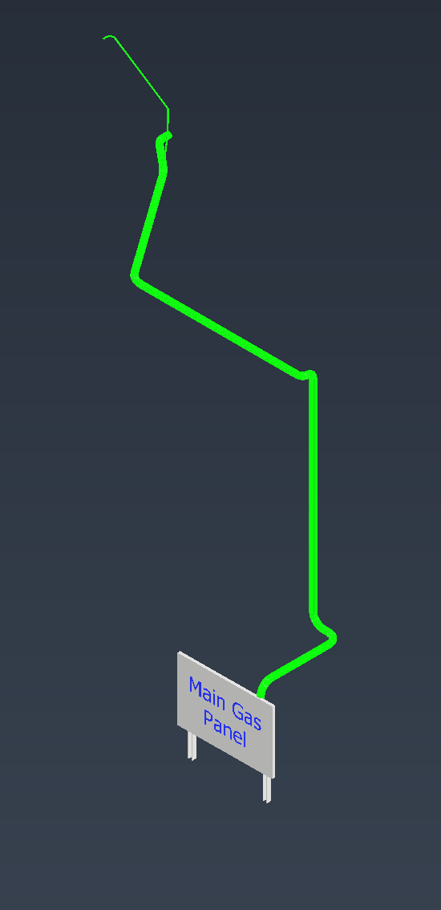
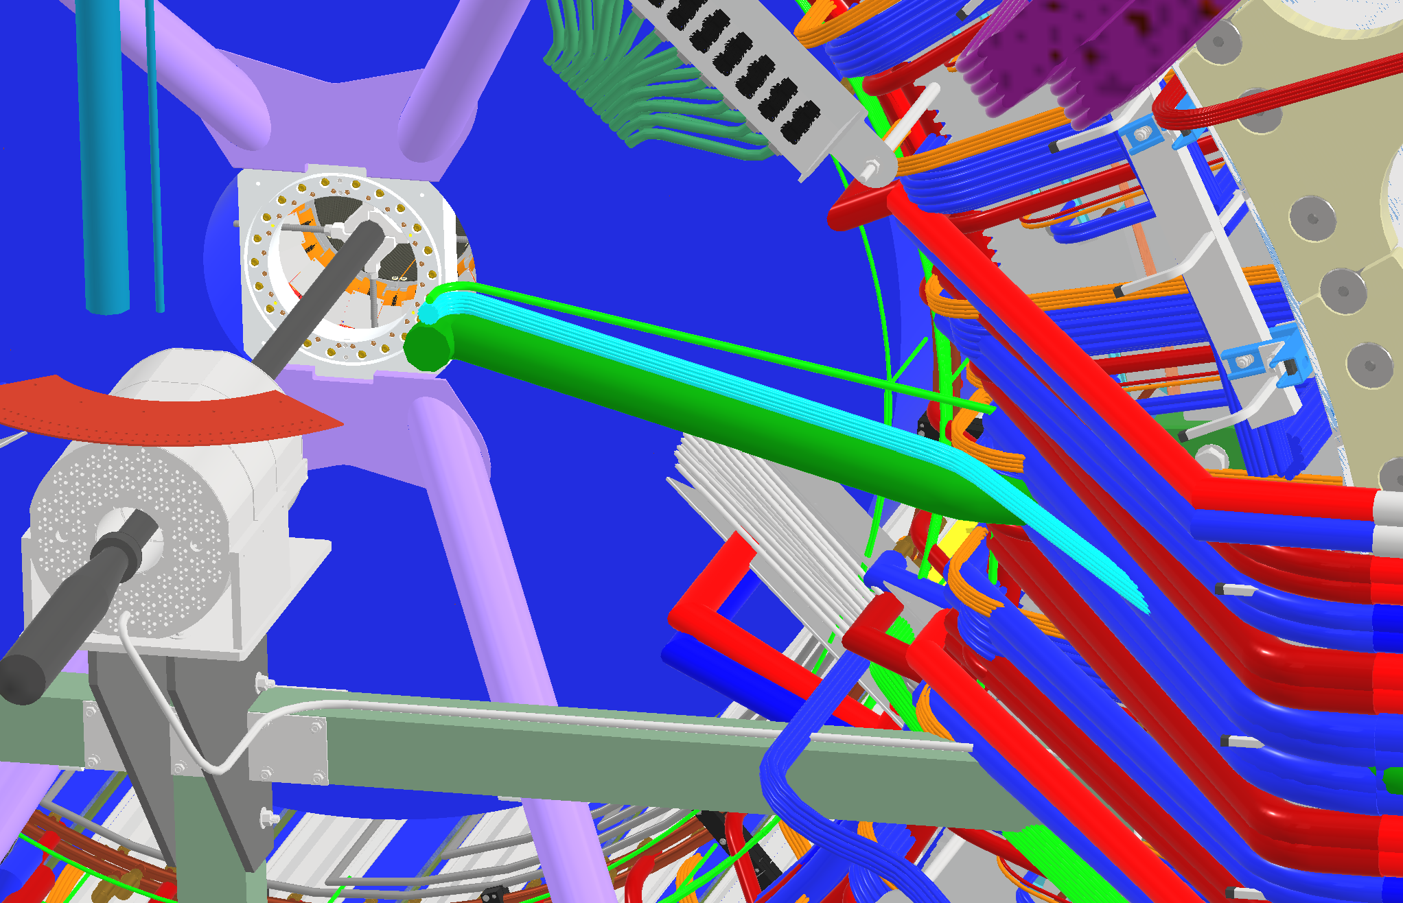
MVTX N2
Located on the 2 main gas panels on the NE & SE corners of the carriage, outside the pole tip doors
(12) ¼” lines on the south end
June 30th, 2022

Slide 15
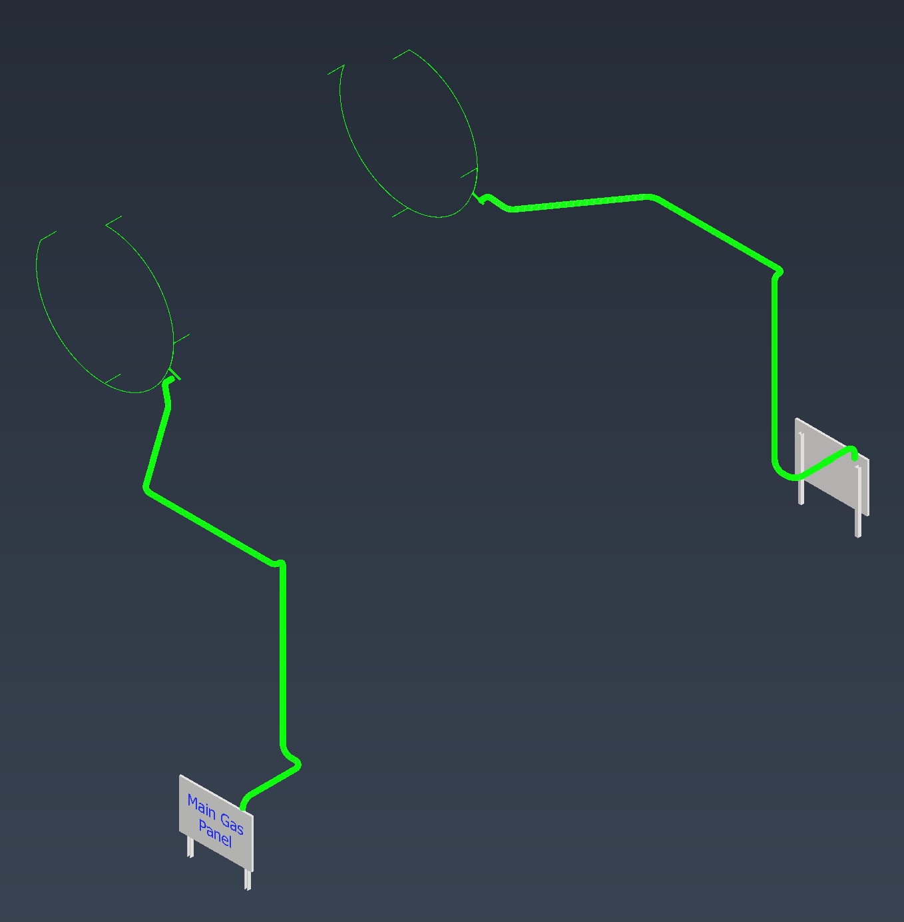
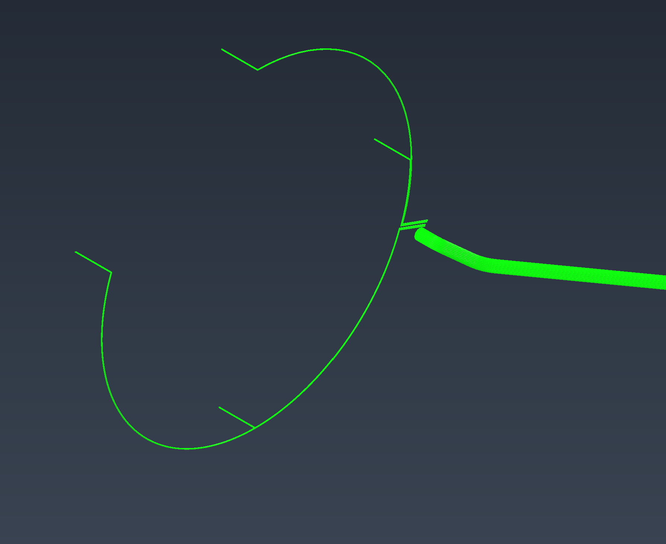
TPC Laser N2
Located on the 2 main gas panels on the NE & SE corners of the carriage, outside the pole tip doors
(4) ¼” lines on each end going to the Laser boxes
June 30th, 2022

Slide 16
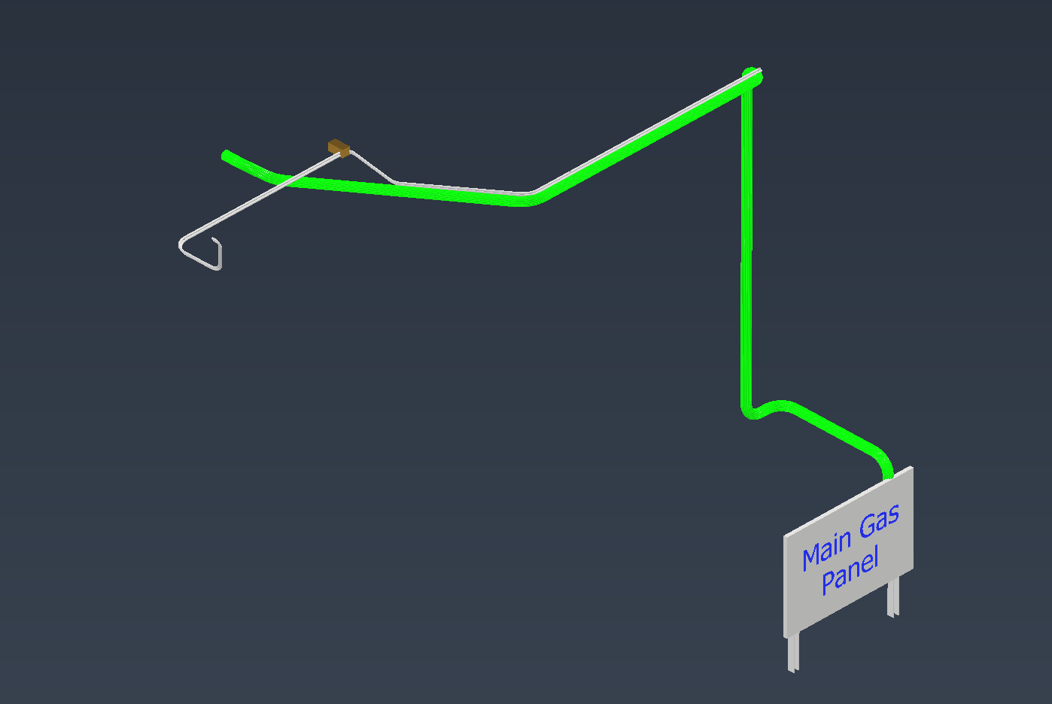
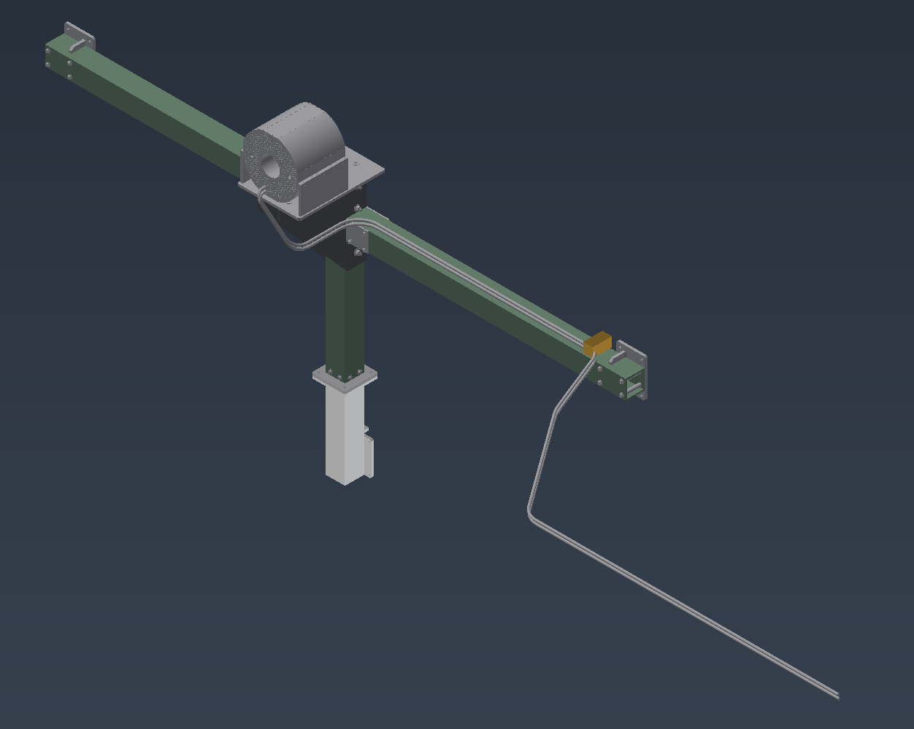
MBD Compressed Air
Located on the 2 main gas panels on the NE & SE corners of the carriage, outside the pole tip doors
(2) ½” lines on each end
June 30th, 2022

Slide 17
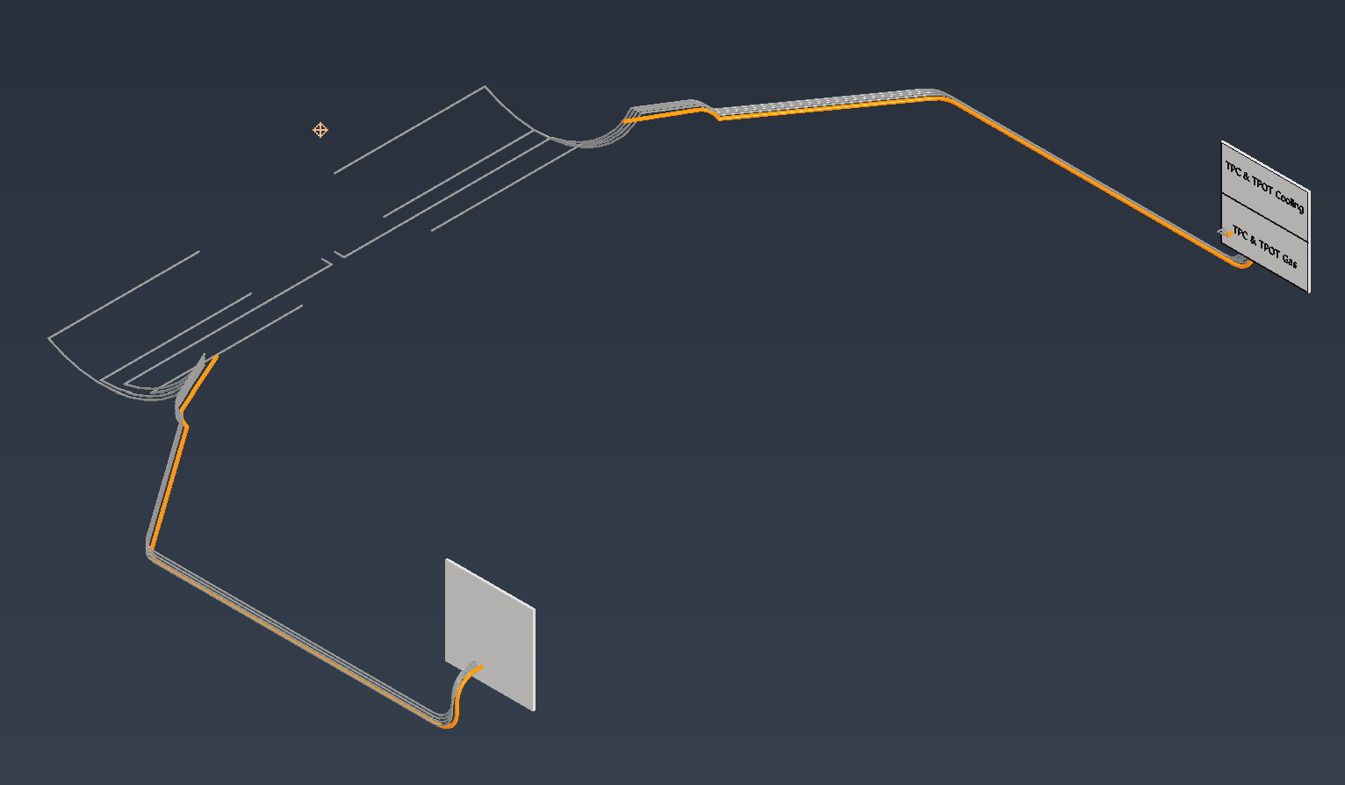
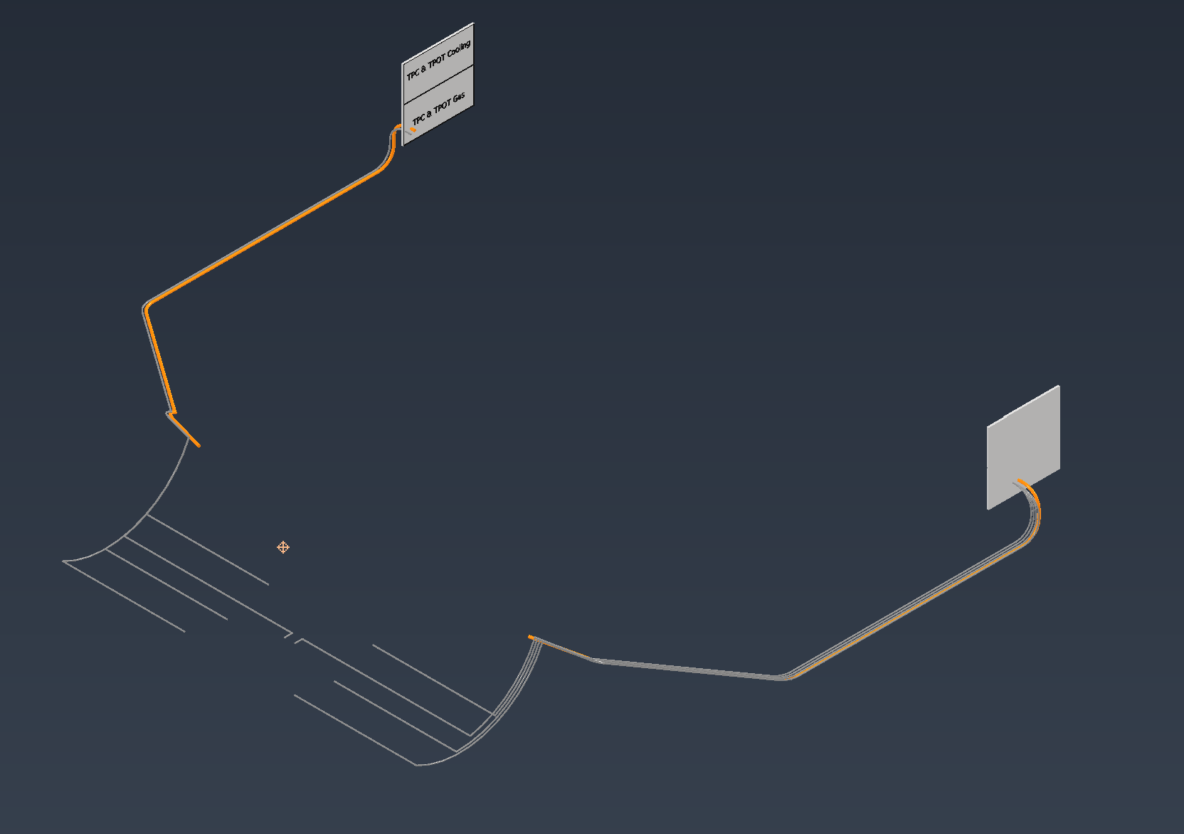
TPC & TPOT Gas Panels
(2) TPC gas panels located at the NE & SE corners of the mid level platform
These panels will be shared between TPC & TPOT cooling and gas
TPC gets (1) 1” line of Ar-CF4 and (1) flow meter at each end
TPOT gets (8) lines of Ar-ISO and (8) flow meters at each end
(4) supply and (4) return lines at each end
June 30th, 2022

Slide 18
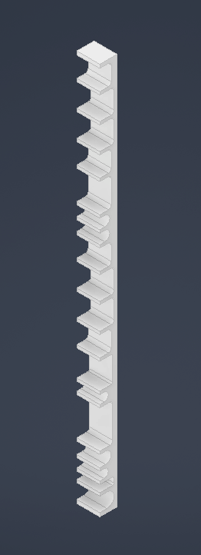
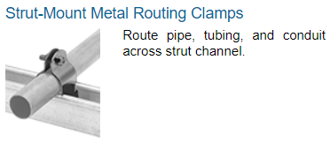
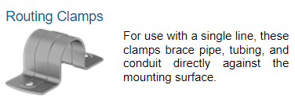
Cooling, Cable & Gas Supports
Delrin supports
5-6 supports needed per corner
Tallest support would be 68”
will be broken up into 2 or 3 parts
Plates will be used to hold cables and tubes in position for installation
Preliminary Xometry quote came in at ~$14,000
Looked at other more standard options but nothing else fit
June 30th, 2022

Slide 19
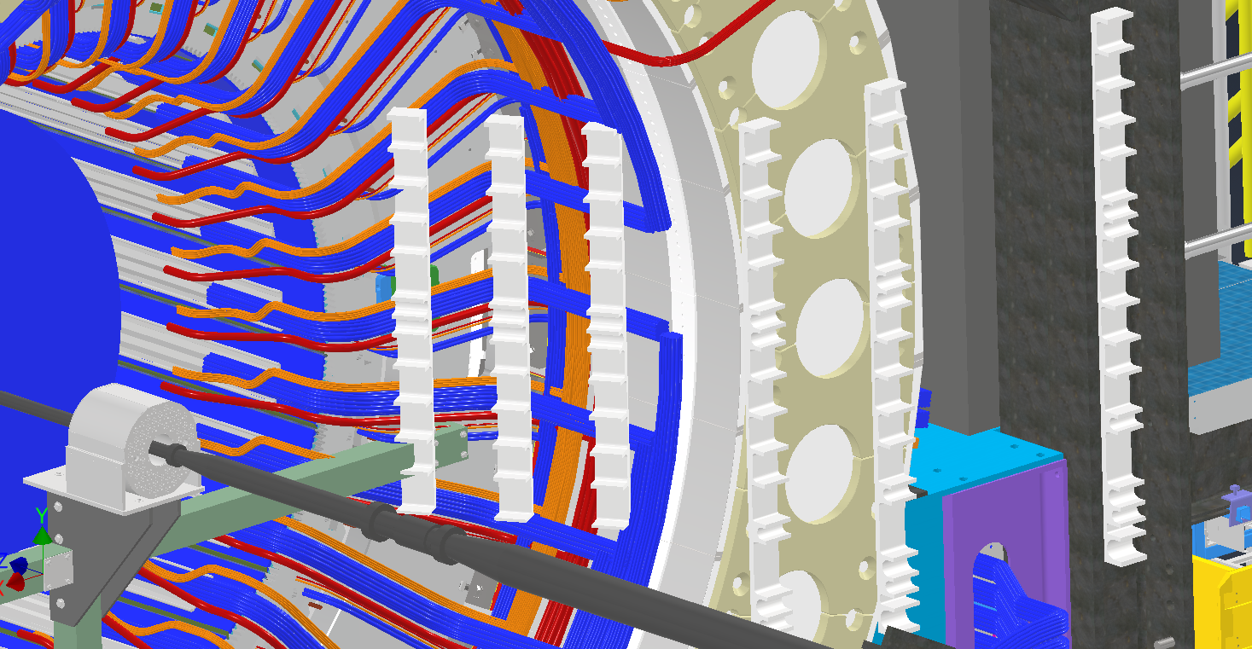
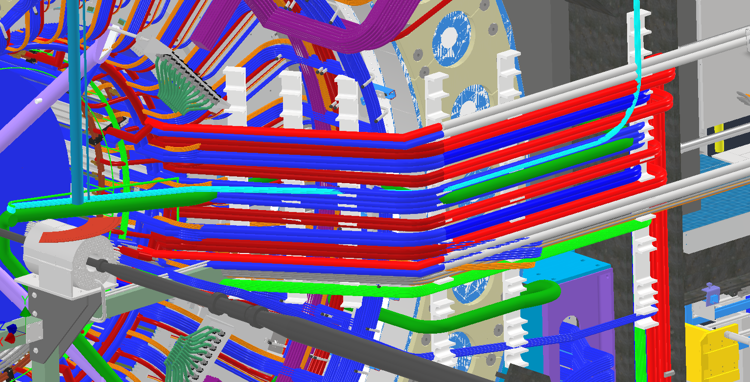
Cooling, Cable & Gas Supports
June 30th, 2022

Slide 20
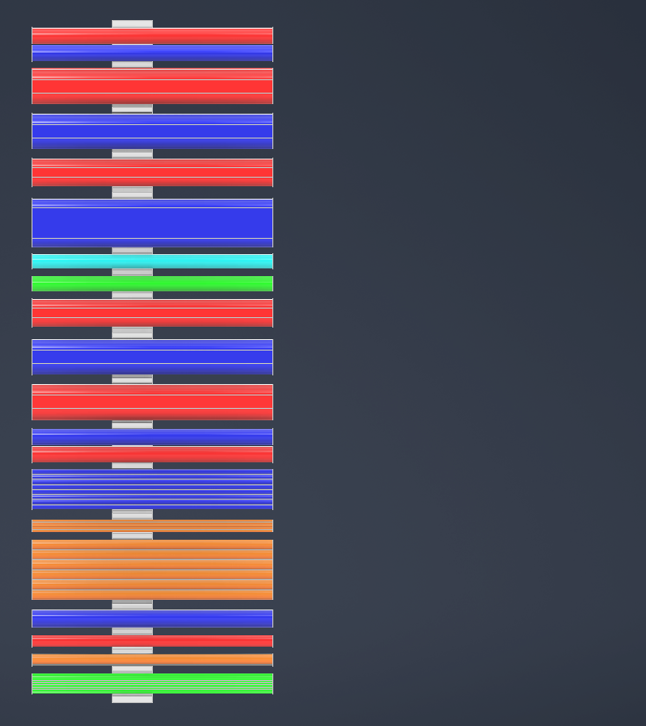
Cooling, Cable & Gas Supports
Southeast corner mock support layout shown
SE corner has MVTX cooling and fibers which no other corner has
East side has the gas lines and SEPD fibers which the west side does not
Approximately 40 lbs/ft at heaviest spot
Yellow is every corner, pink is Southeast corner only, teal is East corners only
TPC Cooling
SIMP Cooling
SIPM Cooling
PREAMP Cooling
PREAMP Cooling
MVTX Cooling
MVTX Fiber
PREAMP Cooling
SIPM Cooling
SIPM Cooling
TPC Cooling
Inner HCAL
Inner HCAL
SEPD Fiber
TPOT Cooling
INTT Cooling
TPC, TPOT, MBD Gas
All N2 Gas
June 30th, 2022

Slide 21
Any Questions?
June 30th, 2022

