Slide 1
TPOT Gas and Cooling System
Robert Pisani*
July 20, 2022
*presented by John Haggerty

Slide 2
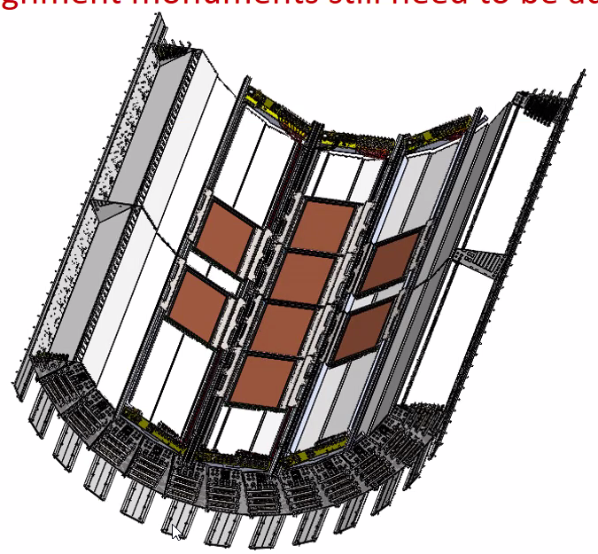
Gas System Technical Overview
TPOT Gas System Requirements
Argon + 5% isobutane : mixture for good gain and stability, slow gas against Lorentz angle
Module Volume 1.4 liters
Total Volume 11.2 liters
Few turns per hour
50ccm per module (3L/hr)
400ccm total for whole system
Slight overpressure above atmosphere (1mBar 0.50”W.C) Max pressure 5mBar
High purity system
Single Pass
Remote monitoring
Alarmed
West
4 FM North
4 FM South

Slide 3
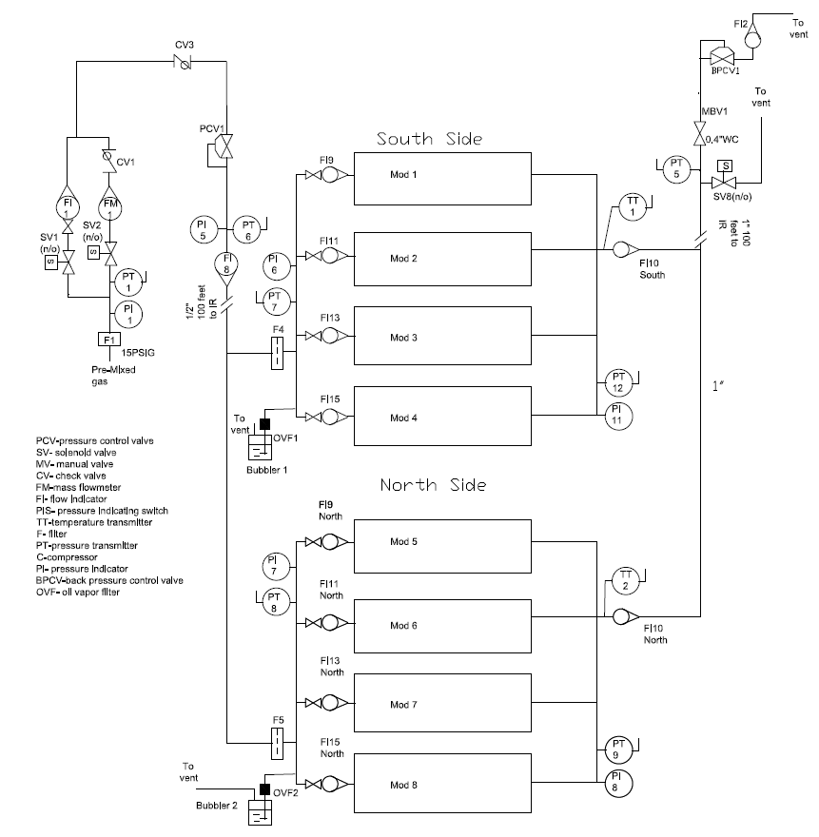
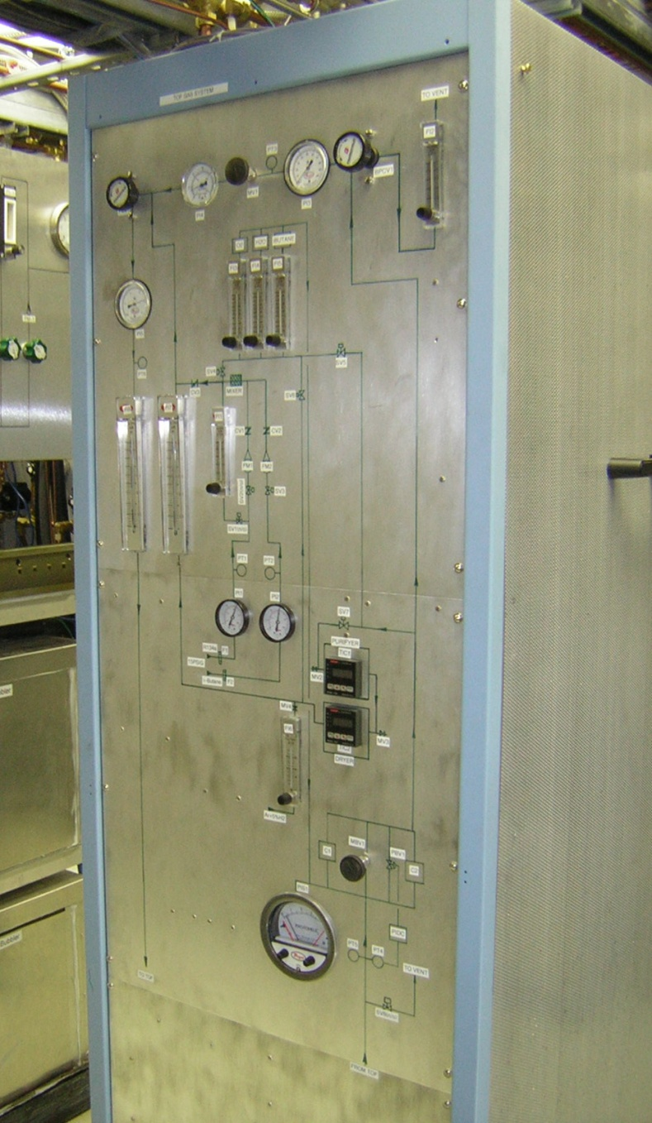
The TPOT Gas System
In IR
Argon mixture (Ar-Iso) (95-5)
Premix gas bought from vendor
The Pre-Mix gas will not be flammable
There will be no flammable gas in the gas house or IR
Flowrate ~ 400ccm
1-2mBar (~0.5” w.c.) above atmosphere
to +/- 1/8 w.c.”
Single Pass system
Max pressure 5mBar (bubbler)
Passive over pressure to separate vent (Bubbler)
Supply pressure from Rack ~ 30” W.C.
Return Pressure –Atmosphere
High purity system
<500 ppm O2
<100 ppm H2O
PC Monitored (reuse PHENIX TOF.W system)
Alarmed
Vented at gas house vent stack

Slide 4
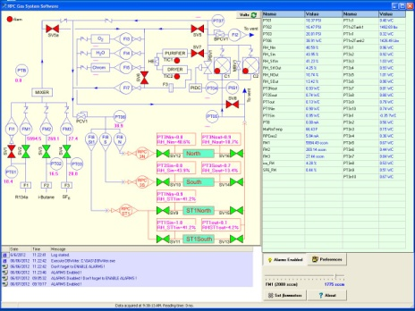
TPOT Gas System Features
Previously Operating PHENIX Gas system (TOF.W)
Basic Features
Using PHENIX TOF.W controller
95% Argon + 5% Isobutane (premix)
Flow controller
Straight through system
Gas Monitoring
Monitors system and chamber pressures,
PC controlled and monitored system
Collects and logs system parameters
Warnings and Alarms
Remote monitoring

Slide 5
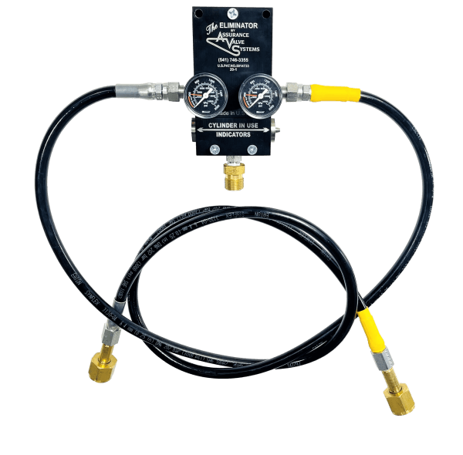
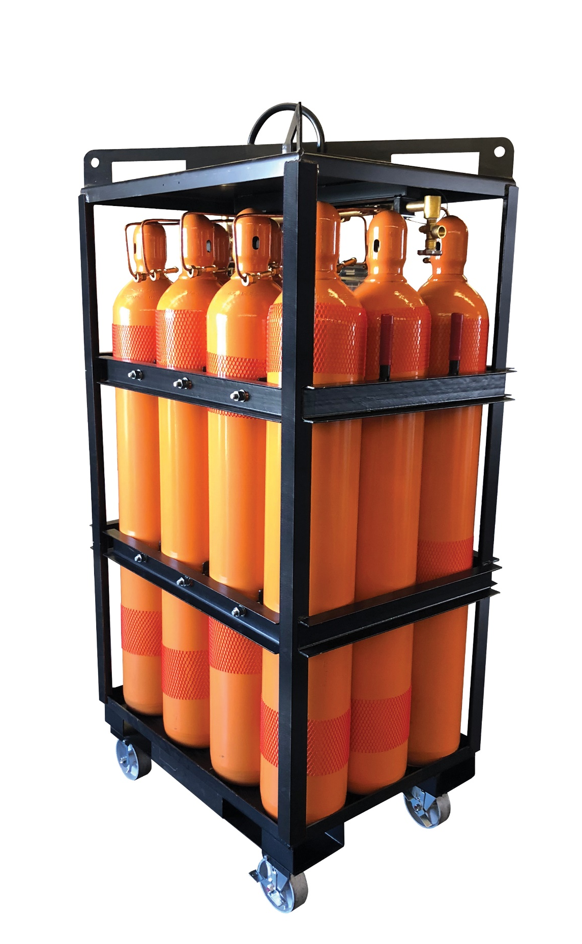
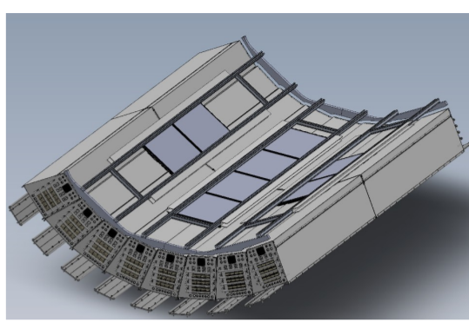
TPOT gas lines to IR
Gas Pad
Interaction Region
South
Tunnel
North
Tunnel
Shield Wall
Gas House
Existing ¾” copper lines from TOF.W
0.025” W.C. anticipated drop on input lines at 400ccm (50m)
0.025” W.C. drop on return lines
We plan to use 12-pack on the gas pad to minimize the number of bottle changes. 1 bottle will last 3 days, so we would change a 12 pack out every 36 days.

Slide 6
Discussion with ESRC
While a component of the gas will be flammable (5% isobutane), when diluted in air to increase the oxygen content to above 12% (the normal oxygen level needed to sustain ignition of a gas), the flammable component goes below the lower flammable limit for isobutane (1.8%).
From the US Bureau of Mines Bulletin 627, it is shown in this chart. It means the blended gas is inert. The safety concern will be ensuring the blend is 95%/5%. If it is purchased from a vendor, it will need QA measures to ensure it is the right mix. If it is blended in house, check precautions will need to be designed into the blending operations to ensure reliable 95%/5% mix.
So, happens I was preparing a document describing protections of physic experiments (passing down the institutional knowledge). I attached a current draft for your info, and feel free to comment.
One item to note, if you use flammable gas detection, it is highly recommended you do not use catalytic bead detection. The technology is subject to poisoning by chemicals, it drifts quickly as it ages and has a poor history of false alarms and high maintenance. IR technology is more expensive but has nowhere near the problems of the catalytic beads.
Sincerely,
Joe [Levesque]
Joe gave us permission to show this. We are now planning on using Pre-Mixed gas from a vendor. The gas in the bottle is not considered flammable

Slide 7
Gas Summary
The TPOT gas system will used a modified PHENIX TOF.W gas system.
Straight Through system (400ccm)
Premixed gas No flammables.
Passively over-pressure protected.
The system will be alarmed with the ability of remote monitoring and data logging.

Slide 8
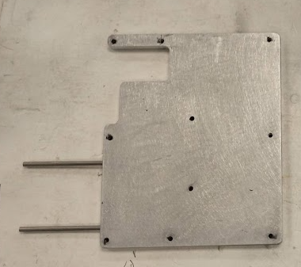
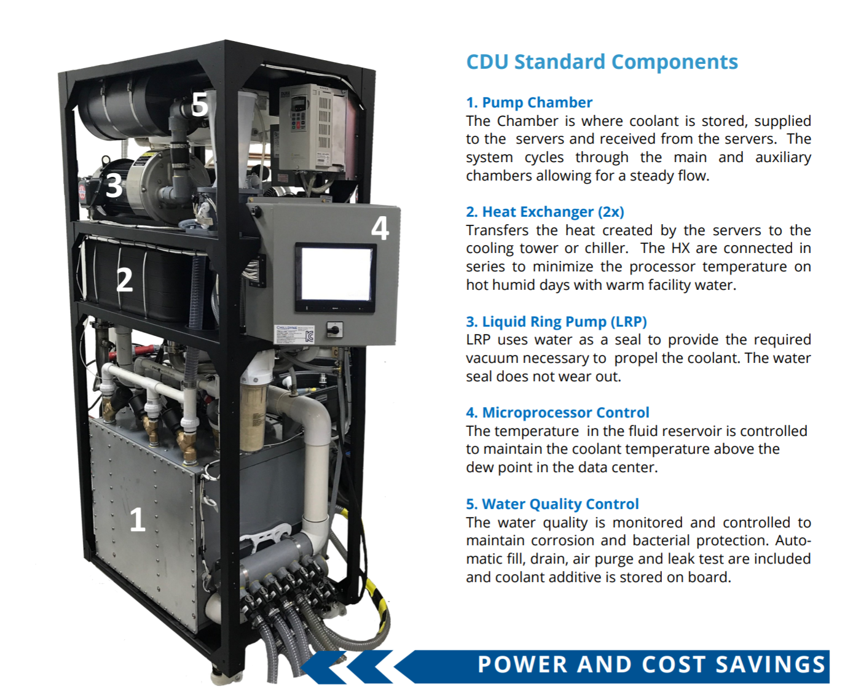
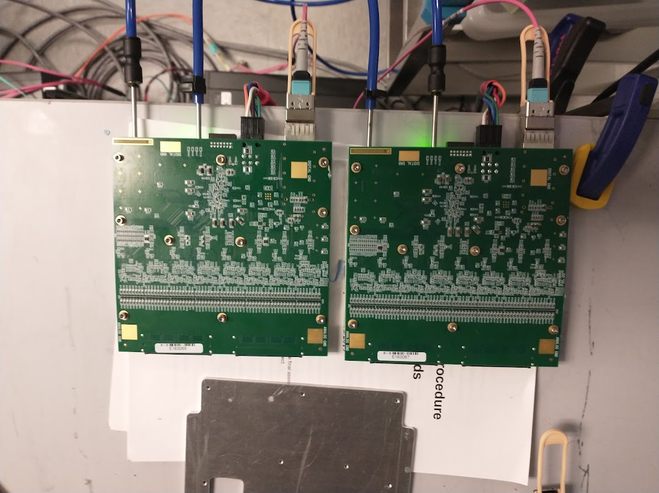
Cooling System
CF-CDU300
The TPOT cooling system will tap of the already reviewed TPC sub-atmospheric cooling system.
https://indico.bnl.gov/event/10922/
TPOT 320 watts total
8 modules each having 2 TPC Fee Boards
Each Board is 20 watts (high estimate)
Plan to flow 50-100ccm to each module
Total flow 400 to 800ccm.
Temperature monitored on each FEE in several places as well as on cooling manifolds
Power will be interlocked. Flow must be on for power to be turned on. (Hard wired)
Fluid is water with a small part of corrosion / algicide additive ( 10% Opti-Shield+)
Flow Capacity of unit is 300lpm, TPC uses 120lpm and TPOT 1 lpm.
Fee hooked up to cooling plated
Cooling Distribution Unit (CDU)
Negative Pressure Chamber Pump System

Slide 9
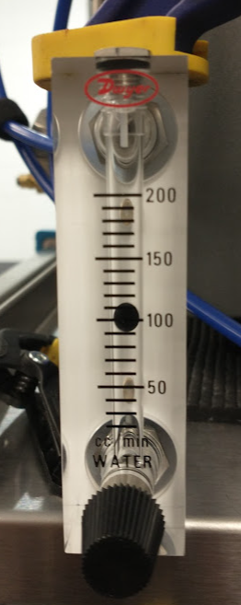
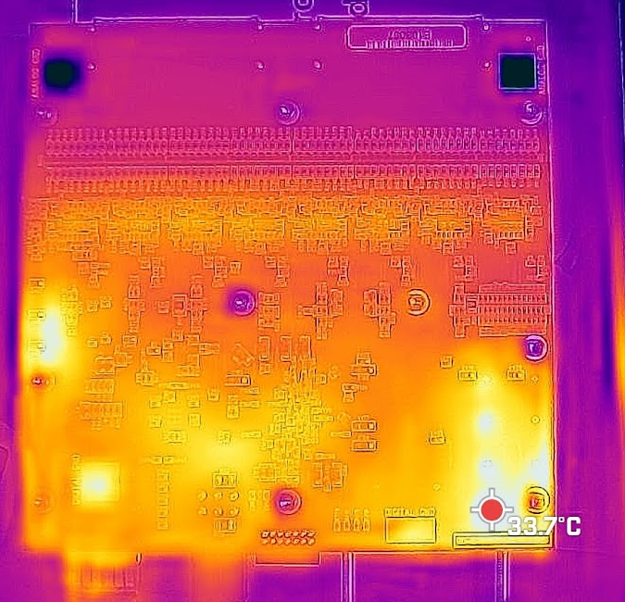
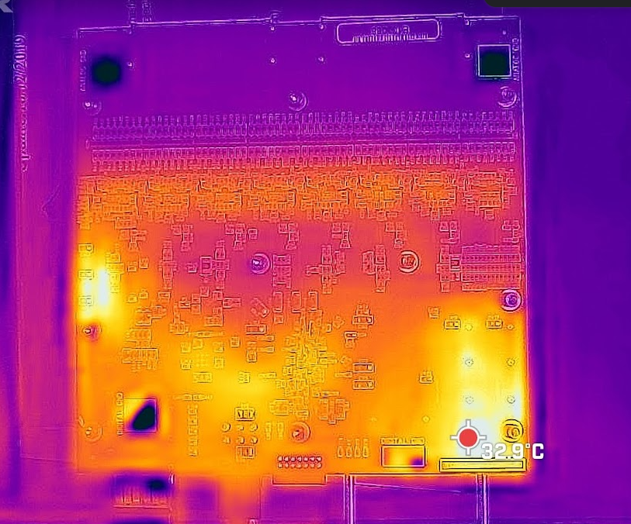
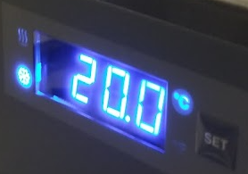
Fee 1
Temp from Chips
Fee 0
Temp from Chips
Flow set to 100 ccm
In
Out
Output Cooling Water
Input Cooling Water

Slide 10
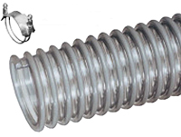
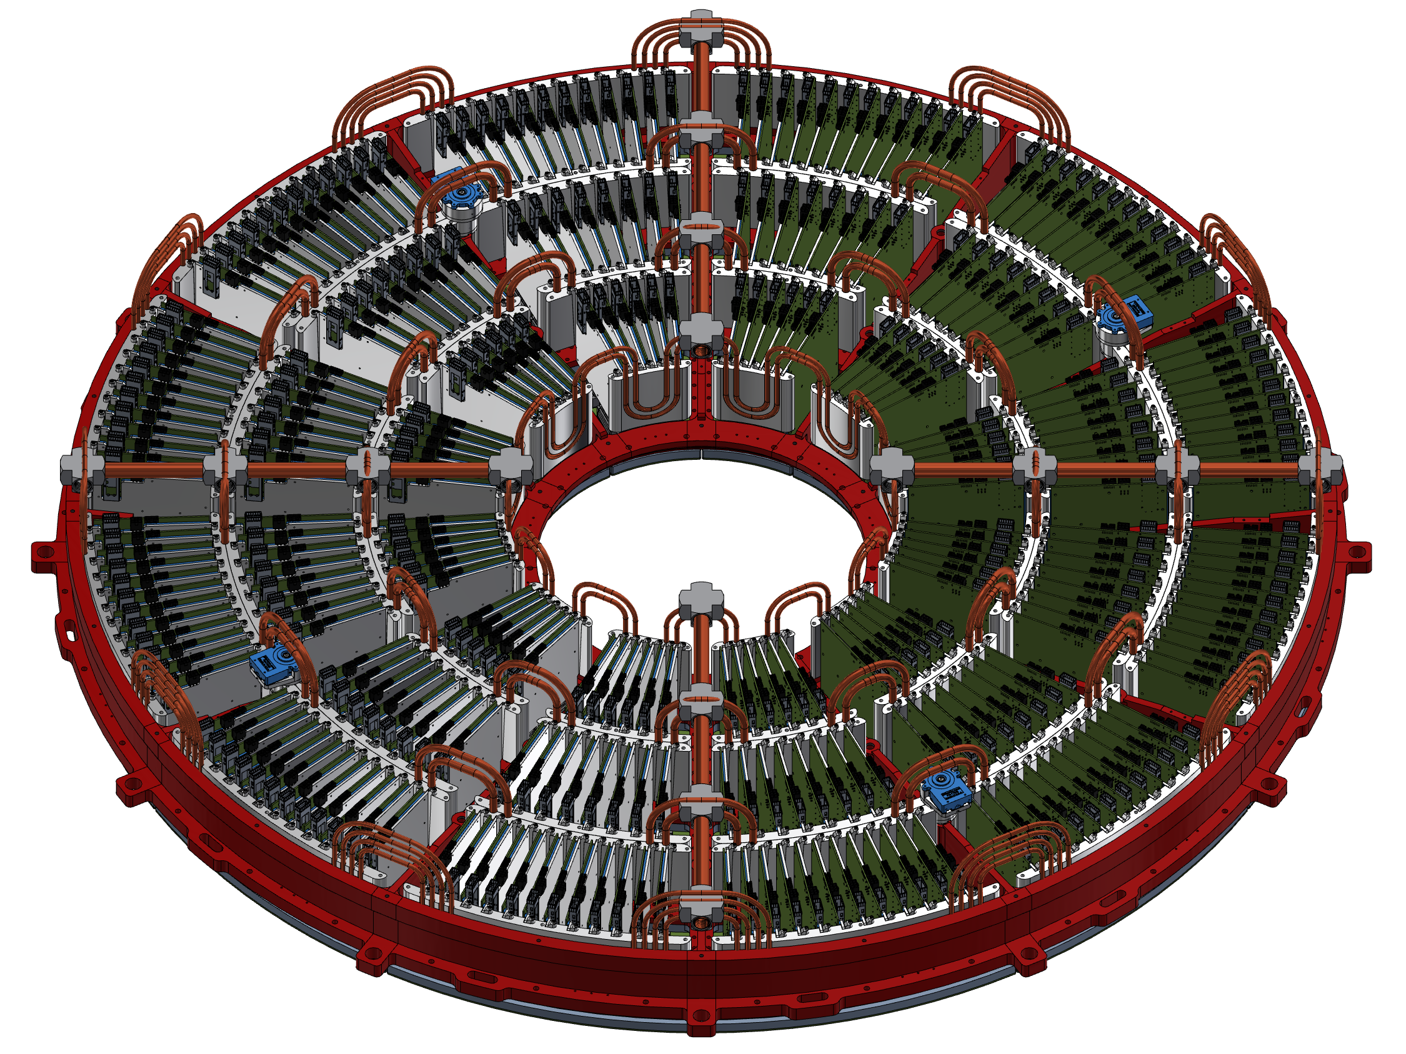
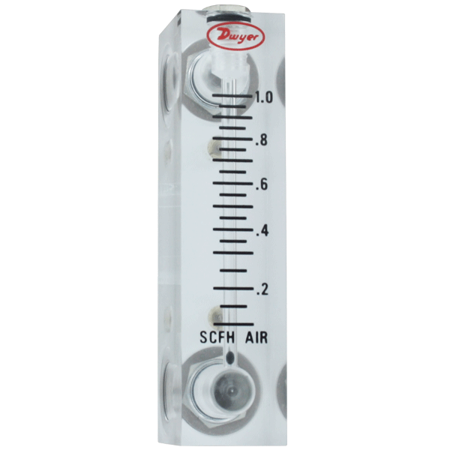
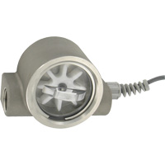
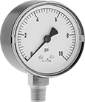
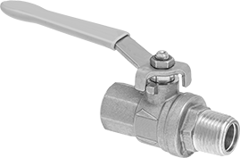
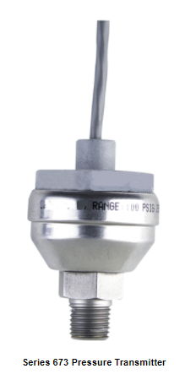
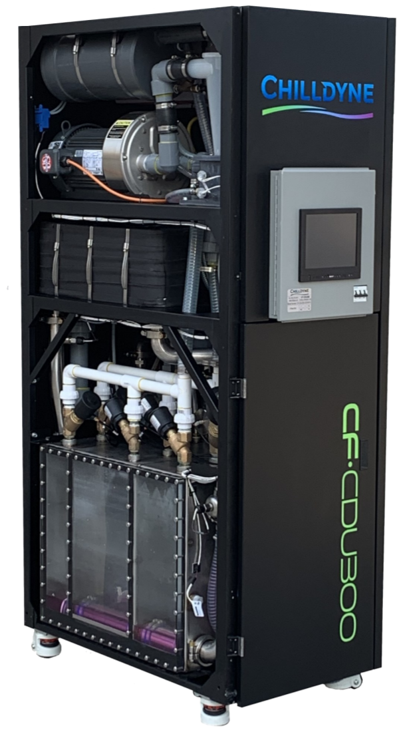
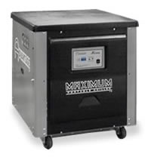
Bypass loops will be added on main trunk lines (not drawn)
30 Feet
Tigerflex® PVC Tubing
30 Feet
14 lpm
1” ID
14 lpm
1” ID, 30ft
Very Few Flowmeters to reduce restrictions. CDU measures total flow of each loop and monitors for leaks and loads
Bottom Loop
Supply
14 lpm
30 Feet
14 lpm
30 Feet
Parflex Polyethylene
Lower Vacuum
(Supply)
High Vacuum
(Return)
3/8” ID
30feet
50-100CCM
3/8” ID
30feet
50-100CCM
90 foot→1.5” ID
30 foot →1.0”ID
TPOT 1 and 2
Flow
Transmitter
Flow
Switch
Pressure Trans
1.5”ID
Temp
Temp
Pressure Trans
28 lpm
90 Feet
1.5”ID
28 lpm
90 Feet
1
External Chiller required to control temp below 18C. Use current Advantage Chiller M1-5W-SP 5 ton capacity at 10C (17kWatt)
Negative Pressure
System
4 channel Unit
2 Feed North
2 Feed South
There are 4 loops
CF-CDU300, 300 lpm total at 1/2bar (7.25psi) 300kW
-Can supply 75 lpm per loop assuming 7.5 psi pressure drop.
-We will need 28lpm per loop and will see less than 3 psi drop on detector. (confirmed in lab and PipeFlow). This will give a temp rise of about 2C in the coolant
sPHENIX Electronics Water
15gpm at 85C
Less at 68C

Slide 11
TPC/TPOT Cooling Panel
TPC
Each Side has 2 loops 2 inputs, 2 outputs,
Each input needs 14
Each Chiller loop has a flow switch to Interlock to LV (Steve’s)
Each Loop has a pressure transmitter
Each Loop has a RTD
Each loop has a return flow transmitter
To Top A
To Top B
To Top A
To Top B
TPOT 1
and 2
TPOT
TPOT will run parasitic to TPC
2 channels per panel feeds 2 modules
Flow 50-100ccm per module
Power is interlocked with flow switch
Remote monitoring of flow, pressure and temperature
TPOT 1 and 2
Flow
Transmitter
Flow
Switch
There will be 4 Sets of the System shown to the left
Loop 1 North Top
Loop 2 North Bottom
Loop 3 South Top
Loop 4 South Bottom
Dwyer 673-6
Temp
Temp
Pressure Trans
Pressure Trans
Dwyer 673-6
Bypass
1 Chiller Loop

Slide 12
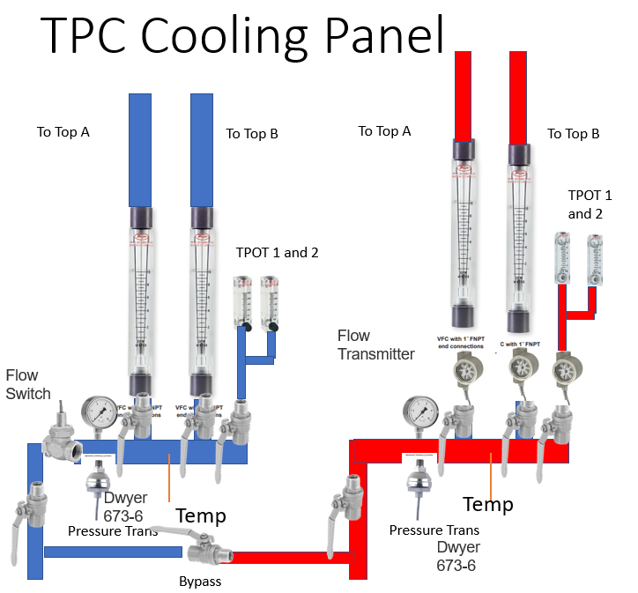
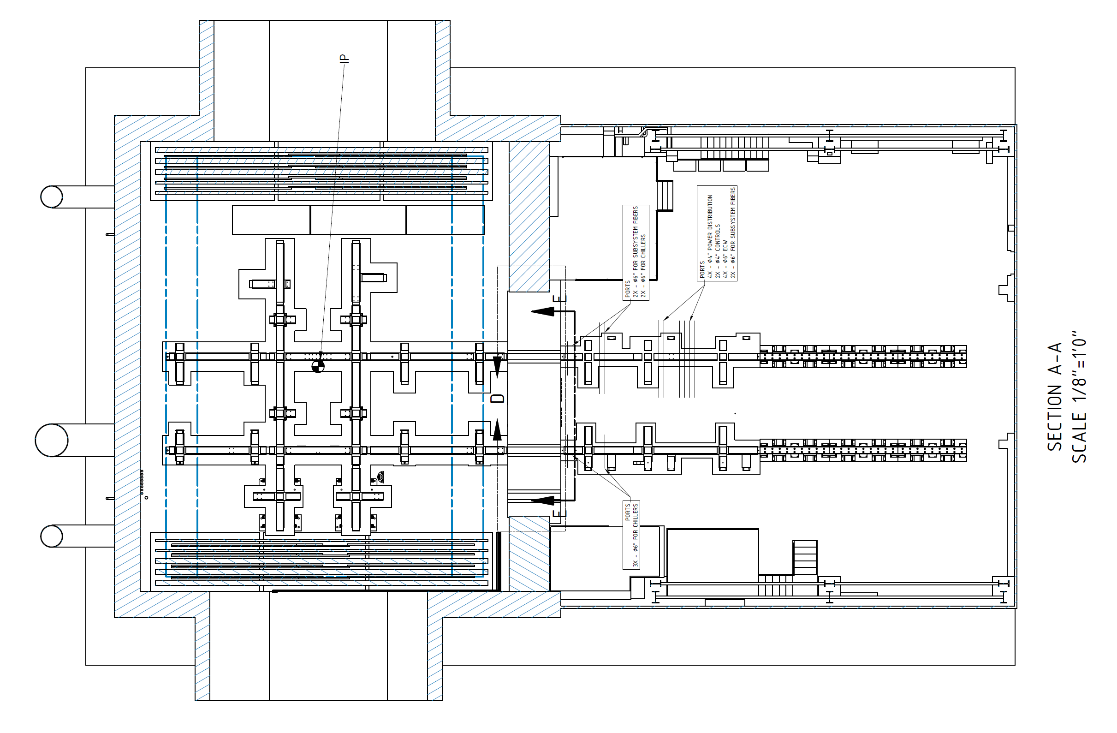
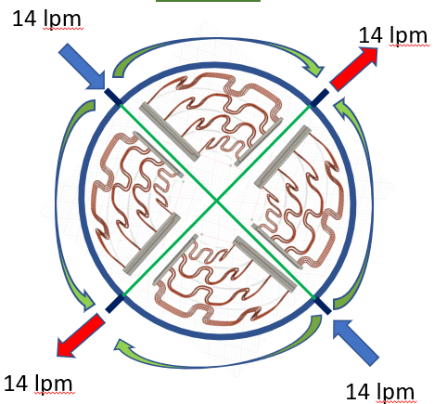
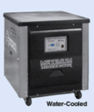
1008 Hall
E/W
50ft
4 panels
One for each chiller loop
At the level of the TPC/TPOT
N/S
45ft
ECW
Location
of Chiller
40ft
Location
of CDU (Cooling Distribution Unit)
Interaction area to Mid Labyrinth
ECW
=Site Electronics cooling
water 18-20C

Slide 13
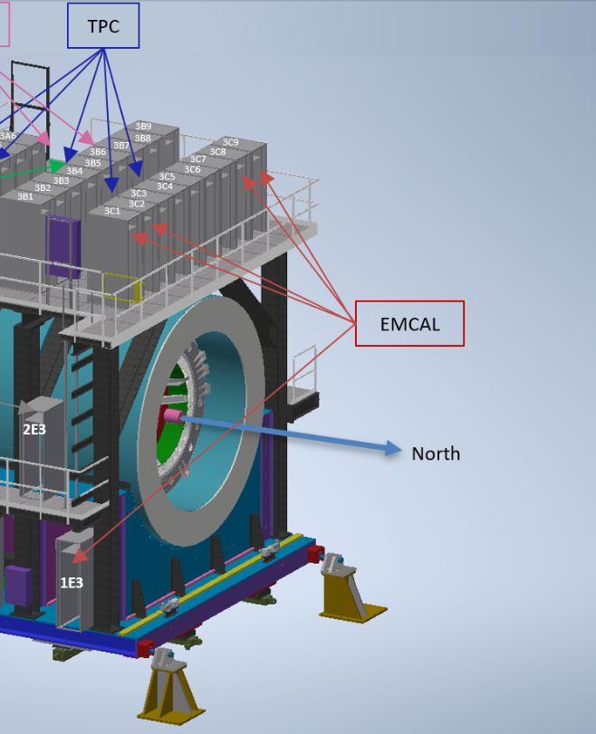
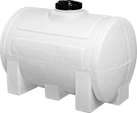
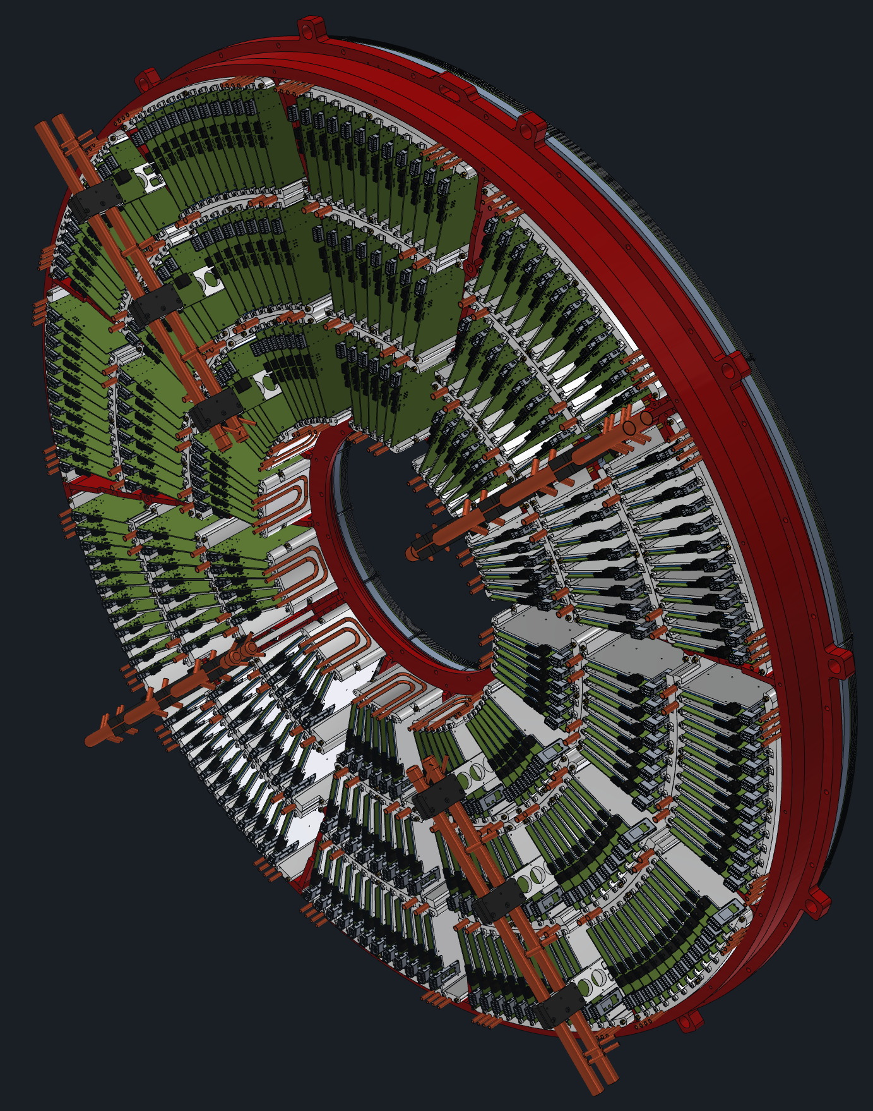
Placed so that CDU's reservoir are below the lowest level of the TPC to help with draining
Secondary Reservoir for draining and filling lines
Using Opti-shield Plus 10% +water
Beam
17ft
On labyrinth
12ft
Chiller Platform
Floor
7ft
Floor

Slide 14
Cooling Summary
The TPOT cooling system uses the TPC cooling system
System parameters are logged and alarmed
Total flow of about 800ccm
Power will be interlocked to flow. Flow must be on to turn on the power.
The system can be monitored remotely.

Slide 15
Answers to charge questions
Are the interfaces and integration with sPHENIX and RHIC well understood?
Yes, the gas and cooling systems are accounted for in the sPHENIX interface documents and plans are thoroughly understood by the sPHENIX engineering team.
Is the gas system properly understood, including safety reviews, as needed for operation in sPHENIX?
Yes, the gas system builds on existing gas infrastructure, and has been presented to the ESRC. Use of premixed gas eliminates the need for flammable gas detection in the IR or Gas Mixing House.

Slide 16
Backup

Slide 17
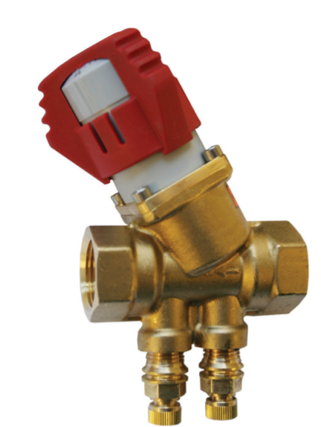
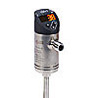
Ball Valve 1” ID
40 Feet
14 lpm
40 Feet
Pressure
Transmitter
This is NORTH
Same for South
Negative Pressure
System
Flowmeters
14 lpm
FlowSetters
Each loop removing 3kWatts
90 Feet
Very Few Flowmeters to reduce restrictions. CDU measures total flow of each loop and monitors for leaks and loads
Bottom Loop
28 lpm
28 lpm
Bypass loops will be added on main trunk lines (not drawn)
14 lpm
90 Feet
1” ID
14 lpm
40 Feet
40 Feet
1.0”ID Tigerflex® WH™ Series Liquid Suction Hose
-20C to 65C,
- 45 PSI rated
-24inHg (Full Vacuum)
-
0.20psi drop over 40 Feet
FROM TPC REVIEW
Poly Core
40 Feet
40 Feet
14 lpm
14 lpm
FROM TPC REVIEW
28 lpm
Top Loop
90 foot→1.5” ID
40 foot →1.0”ID
1.5”ID Tigerflex® WH™ Series Liquid Suction Hose
-20C to 65C,
- 40 PSI rated
-24inHg (Full Vacuum)
-
0.25psi drop over 90 Feet
90 Feet
14 lpm
14 lpm
FlowSetters
40 Feet
40 Feet
90 Feet
28 lpm
Lower Vacuum
(Supply)
1
High Vacuum
(Return)
2
External Chiller required to control temp below 18C. Use current Advantage Chiller M1-5W-SP 5 ton capacity at 10C (17kWatt)
4 channel Unit
2 Feed North
2 Feed South
CF-CDU300, 300 lpm total at 1/2bar (7.25psi) 300kW
-Can supply 75 lpm per loop assuming 7.5 psi pressure drop.
-We will need 28lpm per loop and will see less than 3 psi drop on detector. (confirmed in lab and PipeFlow). This will give a temp rise of about 2C in the coolant
sPHENIX Electronics Water
15gpm at 85C
Less at 68C

Slide 18
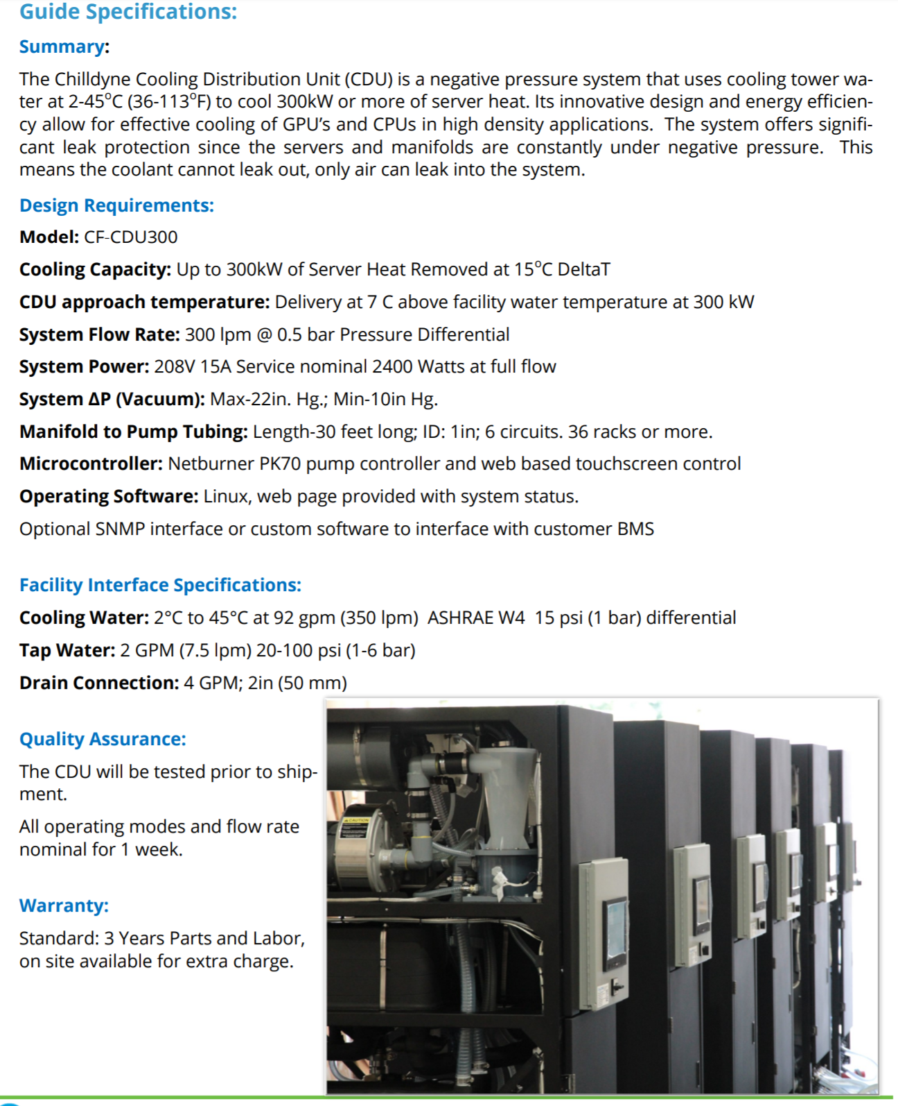
Chilldyne
CF-CDU300
We run at 12kWatts- Delta T < 1-2C
120 lpm at 3psi with Temp rise of 2C
On Board Remote monitoring and control.
Use a traditional chiller to control temperature below ECW—See later slide

Slide 19
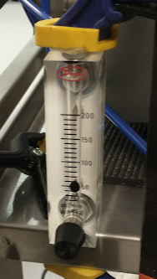
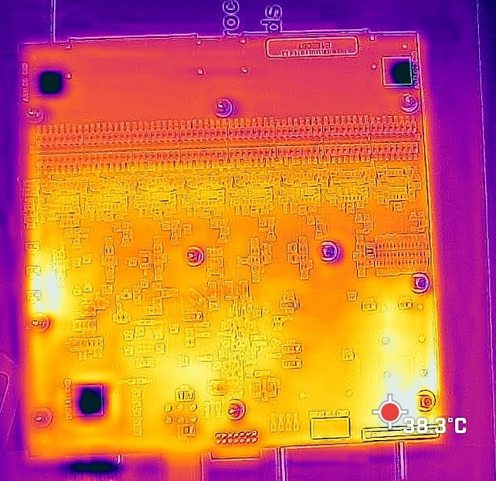
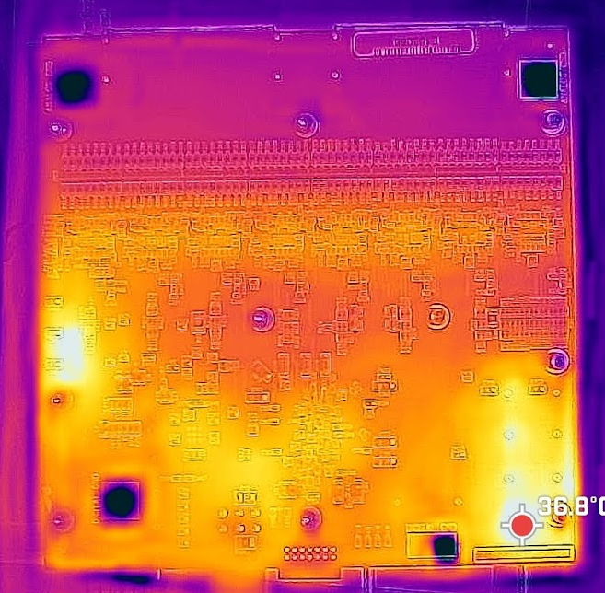
Fee 1C
Temp from Chips
Fee 0C
Temp from Chips
Flow set to 50ccm
In
Out
Output Cooling Water
Input Cooling Water

Slide 20
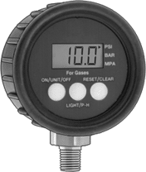
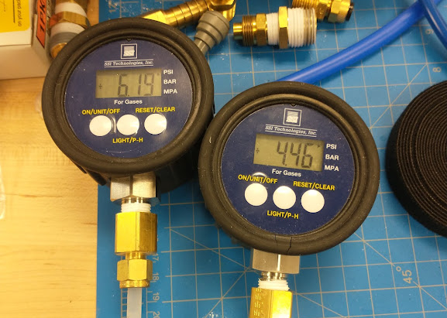
Setup
1% gauges
30psi F.S.
60”
9”
70”
Delta P is 1.75psi
At 100ccm
I have the 2 plates hooked up to a chiller and ready to test. Just have to coordinate with John K to power up and read out temps.
Flow
100CCM
In
Out

Slide 21
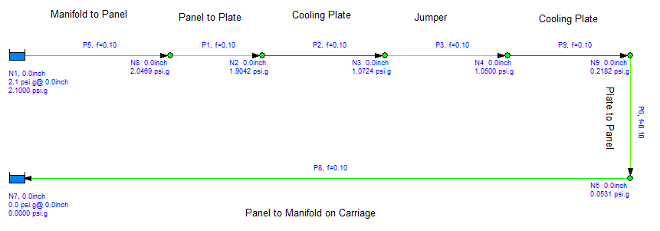
Current Tubing to get 100ccm we need 2.1psi.
30 feet .250 ID
60.5” .125”ID
20” .061”ID
9.5”” .125”ID
20” .061”ID
70” .125”ID
30 feet .250 ID
To get 100ccm, a estimated 2.1psi is needed.

