Slide 1
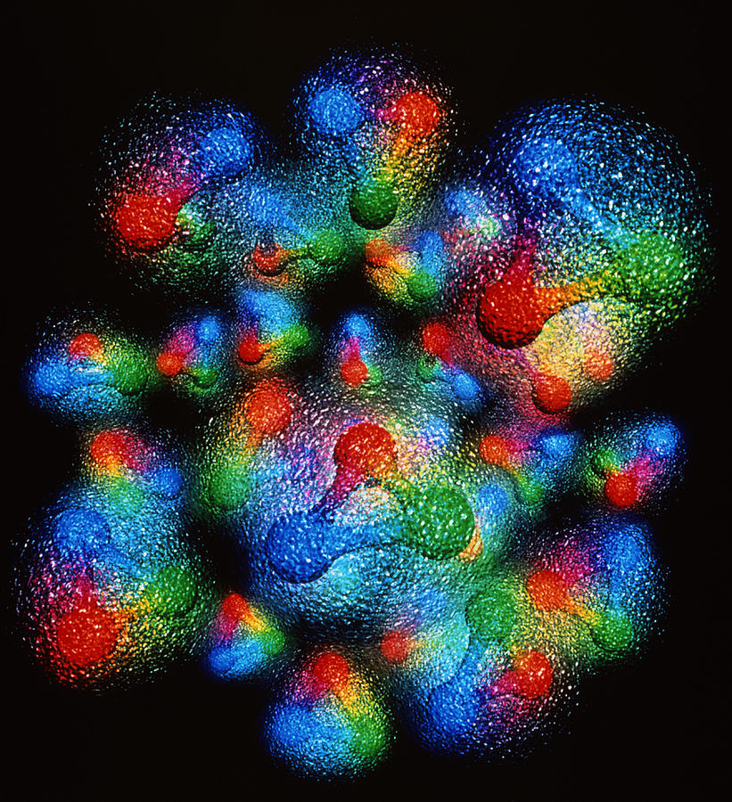

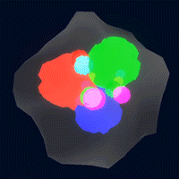


ML for QCD analysis:
3D imaging
Simonetta Liuti

Slide 2

DVES Global Analysis@UVA
DVCS formalism
B. Kriesten et al, Phys.Rev. D 101 (2020)
B. Kriesten and S. Liuti, Phys.Rev. D105 (2022), arXiv 2004.08890
B. Kriesten and S. Liuti, Phys. Lett. B829 (2022), arXiv:2011.04484
ML
J. Grigsby, B. Kriesten, J. Hoskins, S. Liuti, P. Alonzi and M. Burkardt, Phys. Rev. D104 (2021)
Manal Almaeen, Jake Grigsby, Joshua Hoskins, Brandon Kriesten, Yaohang Li, Huey-Wen Lin and S. L
``Benchmarks for a Global Extraction of Information from Deeply Virtual Exclusive Scattering,’’
[arXiv:2207.10766 [hep-ph]].
GPD Parametrization for global analysis
B. Kriesten, P. Velie, E. Yeats, F. Yepez-Lopez and S. Liuti,
Phys. Rev D 105 (2022), arXiv:2101.01826

Slide 3
Charge for this talk and workshop discussion
Address current ML applications in QCD theory while navigating the current “Strategic moment to discuss how to fully take advantage of the new opportunities offered by AI/ML to advance research, design, and operation of EIC.”
Cristiano Fanelli (AI4EIC workshop 2021)

Slide 4
ML is key for discovery
Using statistical methods, ML algorithms uniquely allow us to obtain key insights from the data, through classifications and predictions.
These insights are conducive to:
1. abstracting physics concepts
2. identifying the most relevant physics questions
3. identifying the data which are needed to answer them.
ML applications are currently impacting two main directions in QCD theory
ab initio calculations (lattice QCD+EFT+many body calculations)
phenomenology
phenomenology + lattice QCD (H.-W. Lin)

Slide 5
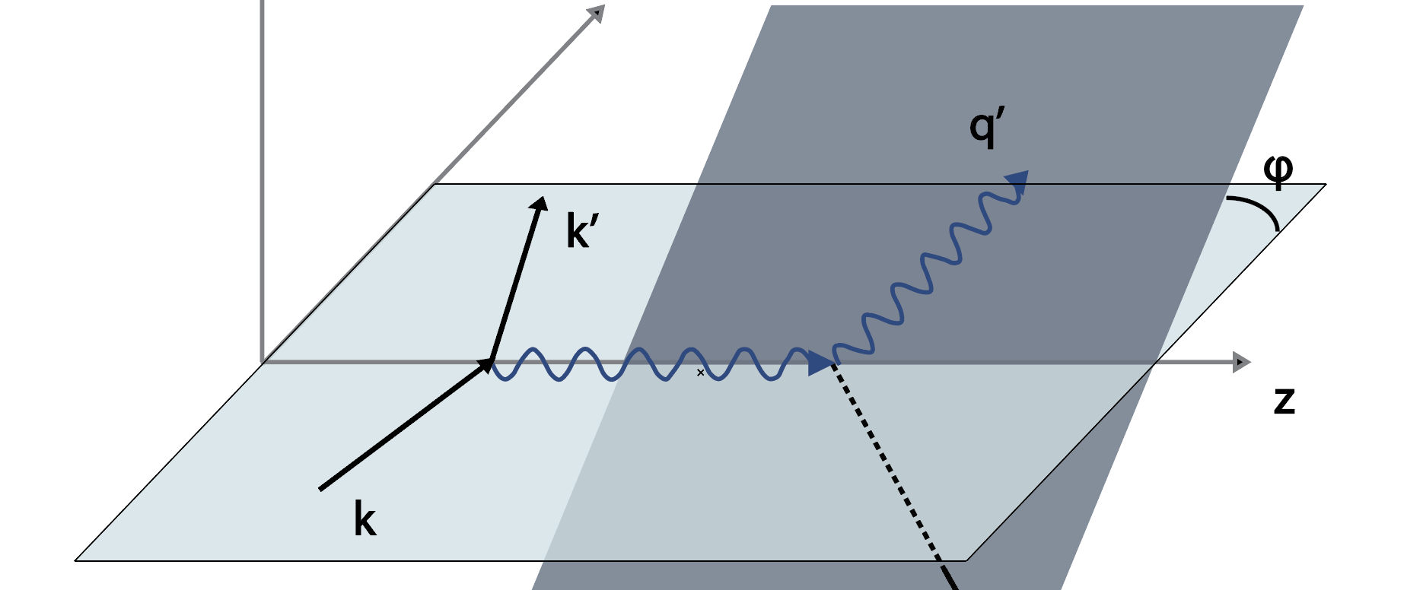
A working example : global fitting of deeply virtual exclusive scattering data
y
y’
z
z’
p
x
x’
e⁻
Notes:
Through the use of statistical methods, algorithms are trained to make classifications or predictions, and to uncover key insights in data mining projects. These insights subsequently drive decision making within applications and businesses, ideally impacting key growth metrics. As big data continues to expand and grow, the market demand for data scientists will increase. They will be required to help identify the most relevant business questions and the data to answer them.

Slide 6
A working example : global fitting of deeply virtual exclusive scattering data
I. Fadelli , Phys.org (2020)
Notes:
Through the use of statistical methods, algorithms are trained to make classifications or predictions, and to uncover key insights in data mining projects. These insights subsequently drive decision making within applications and businesses, ideally impacting key growth metrics. As big data continues to expand and grow, the market demand for data scientists will increase. They will be required to help identify the most relevant business questions and the data to answer them.

Slide 7
Quark/gluon physics observables we hope to extract from DVES
Angular momentum
3D Structure
(X. Ji, 1997)
These distributions are not directly observable!
(M. Burkardt, 2000)

Slide 8
The challenge for QCD phenomenology
Is the information on J_{q,g}(t) in DVES data?
What information is in the data?
Notes:
Through the use of statistical methods, algorithms are trained to make classifications or predictions, and to uncover key insights in data mining projects. These insights subsequently drive decision making within applications and businesses, ideally impacting key growth metrics. As big data continues to expand and grow, the market demand for data scientists will increase. They will be required to help identify the most relevant business questions and the data to answer them.

Slide 9
Cross section
σ_{BH}
σ_{quad}
σ_{BH}
σ_{lin}

Slide 10
Our approach
Precursor: can ML model the cross section? J. Grigsby, B. Kriesten et al. Phys. Rev. D104 (2021)
Introduce ML models with architectures that reflect
physics constraints from the theory : i) less modeling error; ii) reduced demand
on data points; iii) faster training; iv) improved generalization.

Slide 11
Precursor: can ML model the cross section?
J. Grigsby, B. Kriesten et al. Phys. Rev. D104 (2021)
Comparison with baseline models

Slide 12
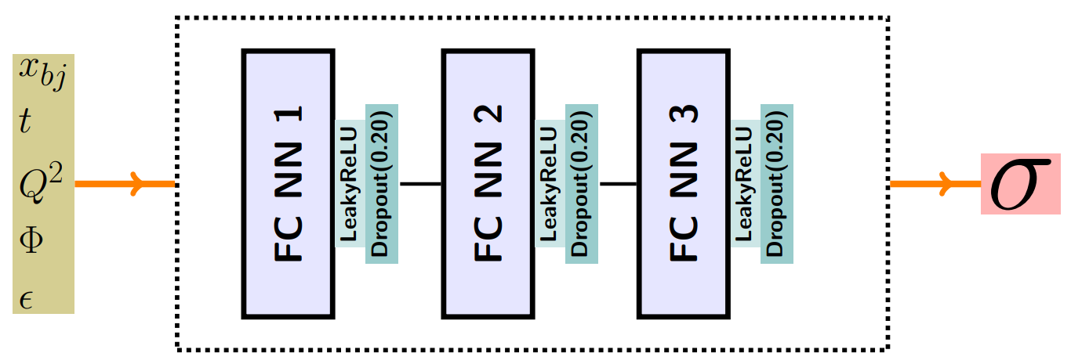
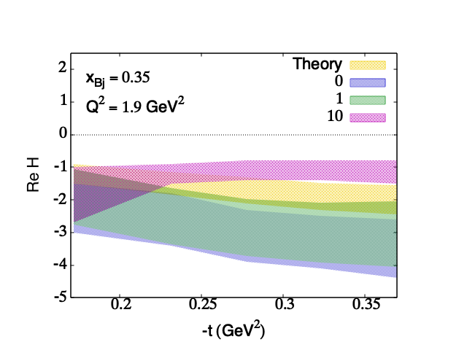
Physics informed ML models
M. Almaeen et al. [arXiv:2207.10766 [hep-ph]].
Including symmetries from theory
Data augmentation from physical x-sec error
Observables extraction

Slide 13
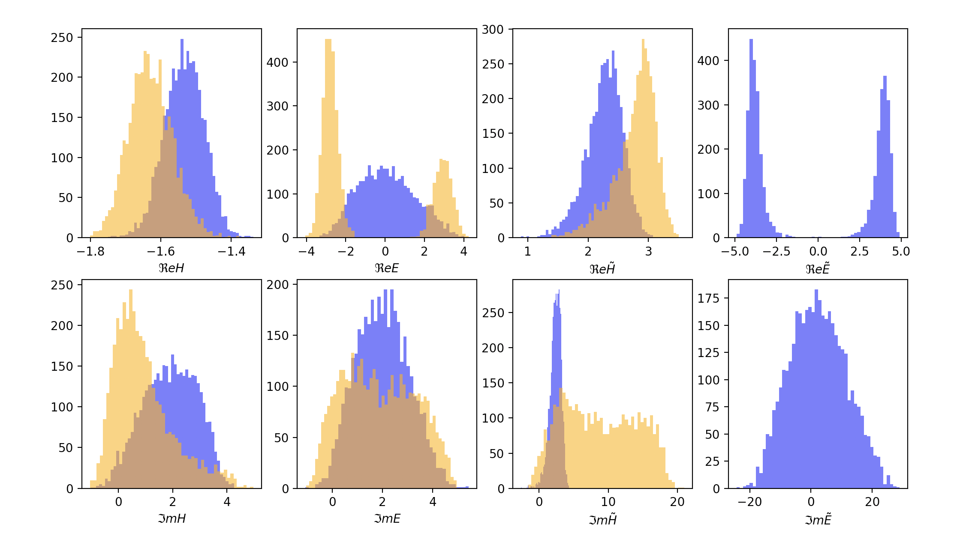
Future
VAIM
Including Lattice QCD constraints
Reinforcement Learning
Uncertainty Quantification
M. Almaeen
First quantitative extraction of observables
(CFFs)
Preliminary

Slide 14
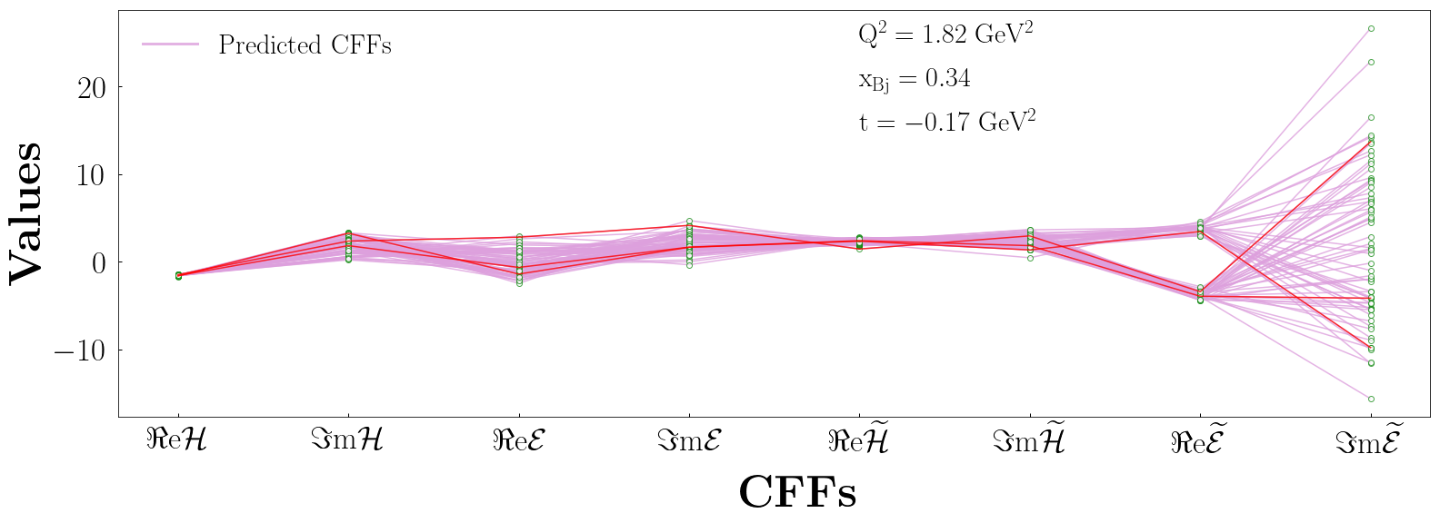
Going beyond standard fitting procedures: Variational Autoenconder example
Preliminary
Graph by Manal Almaeen
M. Almaeen, J. Grigsby, J. Hoskins, B. Kriesten, Y. Li, H. W. Lin and S. Liuti, in preparation

Slide 15
Our team: interdisciplinary workforce
Phenomenology/Theory: B. Kriesten, SL
CS: Y. Li, M. Almaeen, J. Hoskins, (J. Grigsby)
Lattice QCD: H.W. Lin
Experiment: N. Kalantarian

Slide 16
AI/ML for QCD Phenomenology
Information: by extending VAIM/RL/similar methods to all observables, including J_{q} , we will be able to test what type of information can be found in the data.
Data augmentation: VAIM/similar methods can be used for data augmentation. New field of Data-Sparse environments
Uncertainty quantitifcation: distinguishing epistemic from aleatoric origin of uncertainty. ML methods can uniquely address this question differently from standard regression where epistemic uncertainty is given by an unquantifiable dependence on the functional form.
Notes:
The general goal of ML is to recognize patterns in data, which inform the way unseen problems are treated.
focuses on the use of data and algorithms to imitate the way that humans learn, gradually improving its accuracy

Slide 17
For the EIC community: A rigorous benchmarking process
EIC analyses should be based on rigorous benchmarking that allows for quantitative comparison of different approaches.
In our DVES example:
Physics Benchmarks
  number and type of CFFs
  Q² dependence of the cross section and observables: kinematic terms, PQCD evolution (LO, NLO, NNLO), and dynamical beyond LO terms (higher twists)
Machine Learning Benchmarks
ML architectures hyperparameters (number of layers,
size of hidden nodes, activation functions, drop-out
rates, loss functions, gradient descent methods)
Features specific to data-centric analysis (feature selection and transformation,
data augmentation, data synthetics, and data cleansing)
Uncertainty Quantification
  Inherent statistical fluctuations in physics (statistic)
  Errors inherent from measurement system (systematic)
  Errors in ML models
  Errors in the training procedure

Slide 18

Proposal of future workforce organization based on synergy/two ways process
ML enhances and allows physics discovery
Problems posed by physicists tare of interest to ML
.
Examples:
Dealing with small amounts of data/sparse data
Question of how we interpret information
Is adding more data always good? Breaking or going beyond the paradigms of the “standard model of statistics”.
Lets organize it!
https://peaceproject.com/

