Slide 1
EIC Schedule and Overview
Elke Aschenauer (BNL) and Rolf Ent (Jefferson Lab)
EIC Co-Associate Directors for the Experimental Program
2nd Workshop on Artificial Intelligence for the Electron-Ion Collider
College of William and Mary, October 10-14, 2022
Electron Ion Collider

Slide 2
Outline
The Quest to Understand the Fundamental Structure of Matter:
The Emergence of Mass and Structure
The Electron-Ion Collider Science Foundation
The US-Based Electron-Ion Collider Scope and Status
Prospects for AI at the EIC

Slide 3
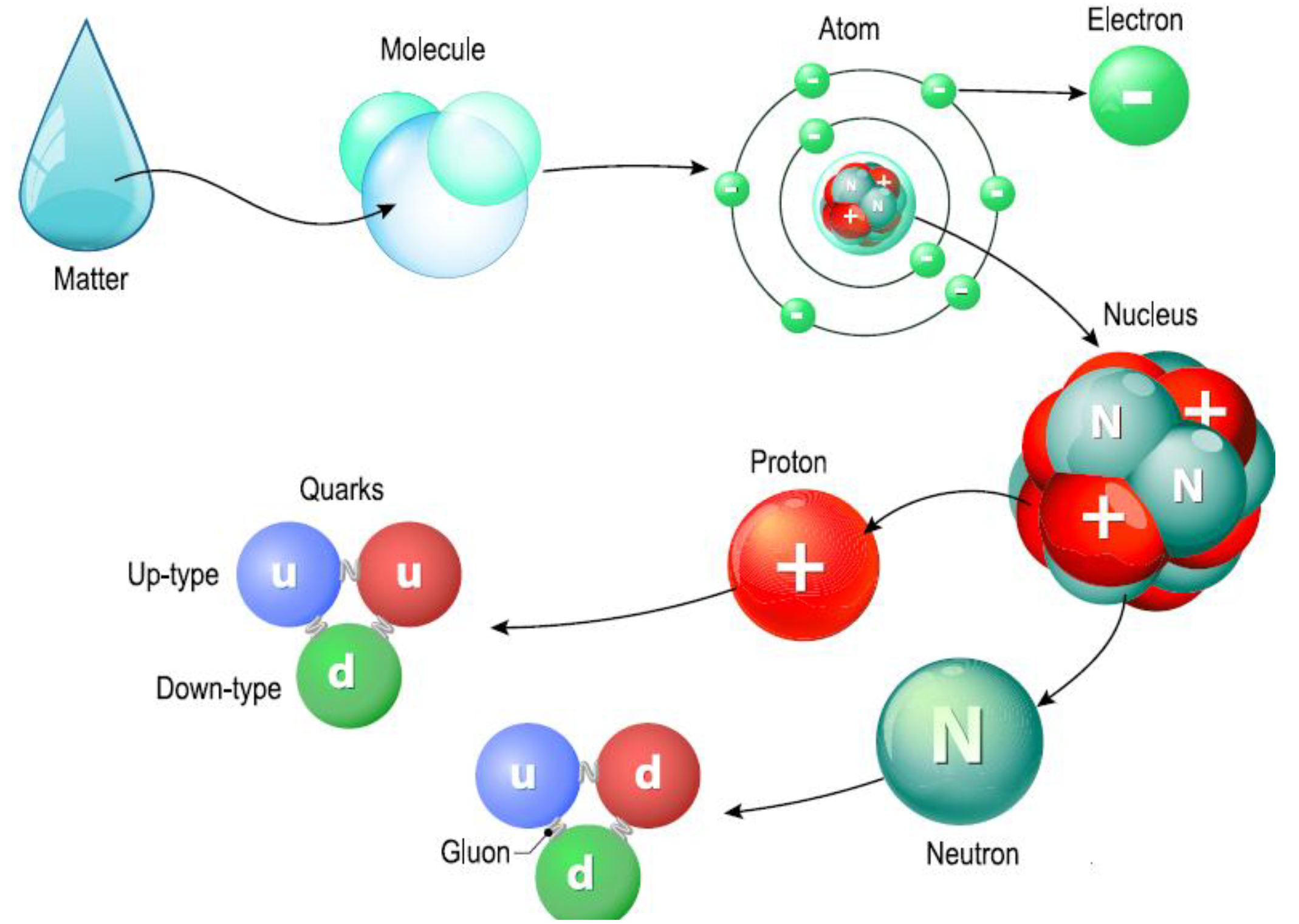
The Quest to Understand the Fundamental Structure of Matter
1808
1874
1911
1913
1968
Towards a new science frontier – Nuclear Femtography
1932
1978
EIC: Understanding the Glue that Binds Us All - Without gluons, there would be no nucleons, no atomic nuclei… no visible world!

Slide 4
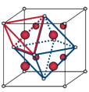
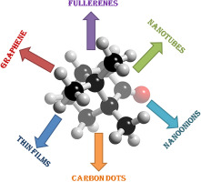
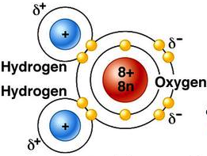
Nuclear Femtography – Subatomic Matter is Unique
Most known matter has localized mass and charge centers – vast “open” space
Molecule:
Crystal:
Nanomaterial:
“Water”
Rare-Earth metal
Carbon-based
Not so in nuclear matter! – unlike the more familiar molecular and atomic matter, the interactions and structures are inextricably mixed up in protons and other forms of nuclear matter, and the observed properties of nucleons and nuclei, such as mass & spin, emerge out of this complex system.
Imaging Physical Systems is Key to New Understanding

Slide 5

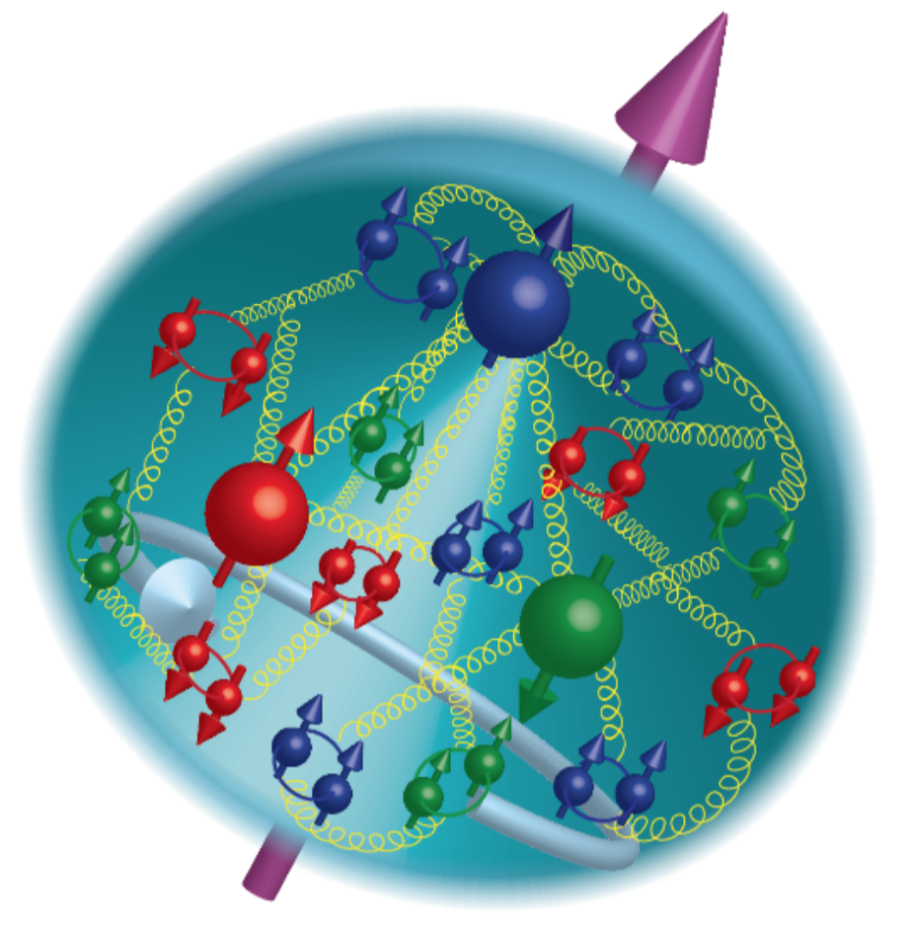
21st Century View of the
Fundamental Structure of the Proton
Elastic electron scattering determines charge and magnetism of nucleon
Approx. sphere with <r> ≈ 0.85 Fermi
The proton contains quarks,
as well as dynamically
generated
quark-antiquark pairs
and gluons.
Quark and gluon
momentum fractions
(in specific Infinite
Momentum Frame)
are well mapped out.
The proton spin
and mass have large
contributions from
the quark-gluon
dynamics.
1961
In fact, the proton mass and structure emerge from the quark-gluon dynamics

Slide 6

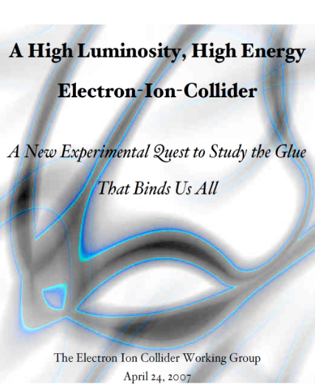


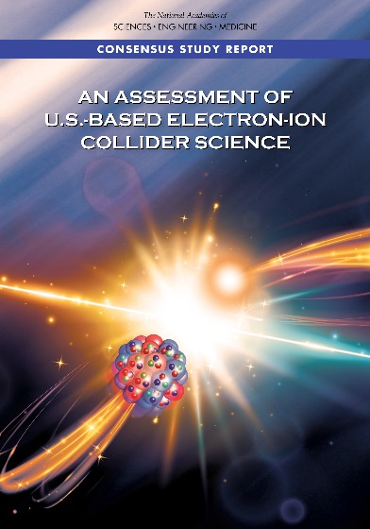
The Scientific Foundation for an EIC was Built Over Two Decades
Electron-Ion Collider..absolutely central to the nuclear science program of the next decade.
2002
“a high-energy high-luminosity polarized EIC [is] the highest priority for new facility construction following the completion of FRIB.”
2007
The science questions that an EIC will answer are central to completing an understanding of atoms as well as being integral to the agenda of nuclear physics today.”
2009
2010
Gluons and the Quark Sea at High Energies
2012
2013
2015
Major Nuclear Physics Facilities for the Next Decade
2018
NSAC
2021
“…essential accelerator and detector R&D [for EIC] should be given very high priority
in the short term.”
“We recommend the allocation of resources …to lay the foundation for a polarized Electron-Ion Collider…”
March 14, 2013
“..a new dedicated facility will be essential for answering some of the most central questions.”
“The quantitative study of matter in this new regime [where abundant gluons dominate] requires a new experimental facility: an Electron Ion Collider..”

Slide 7
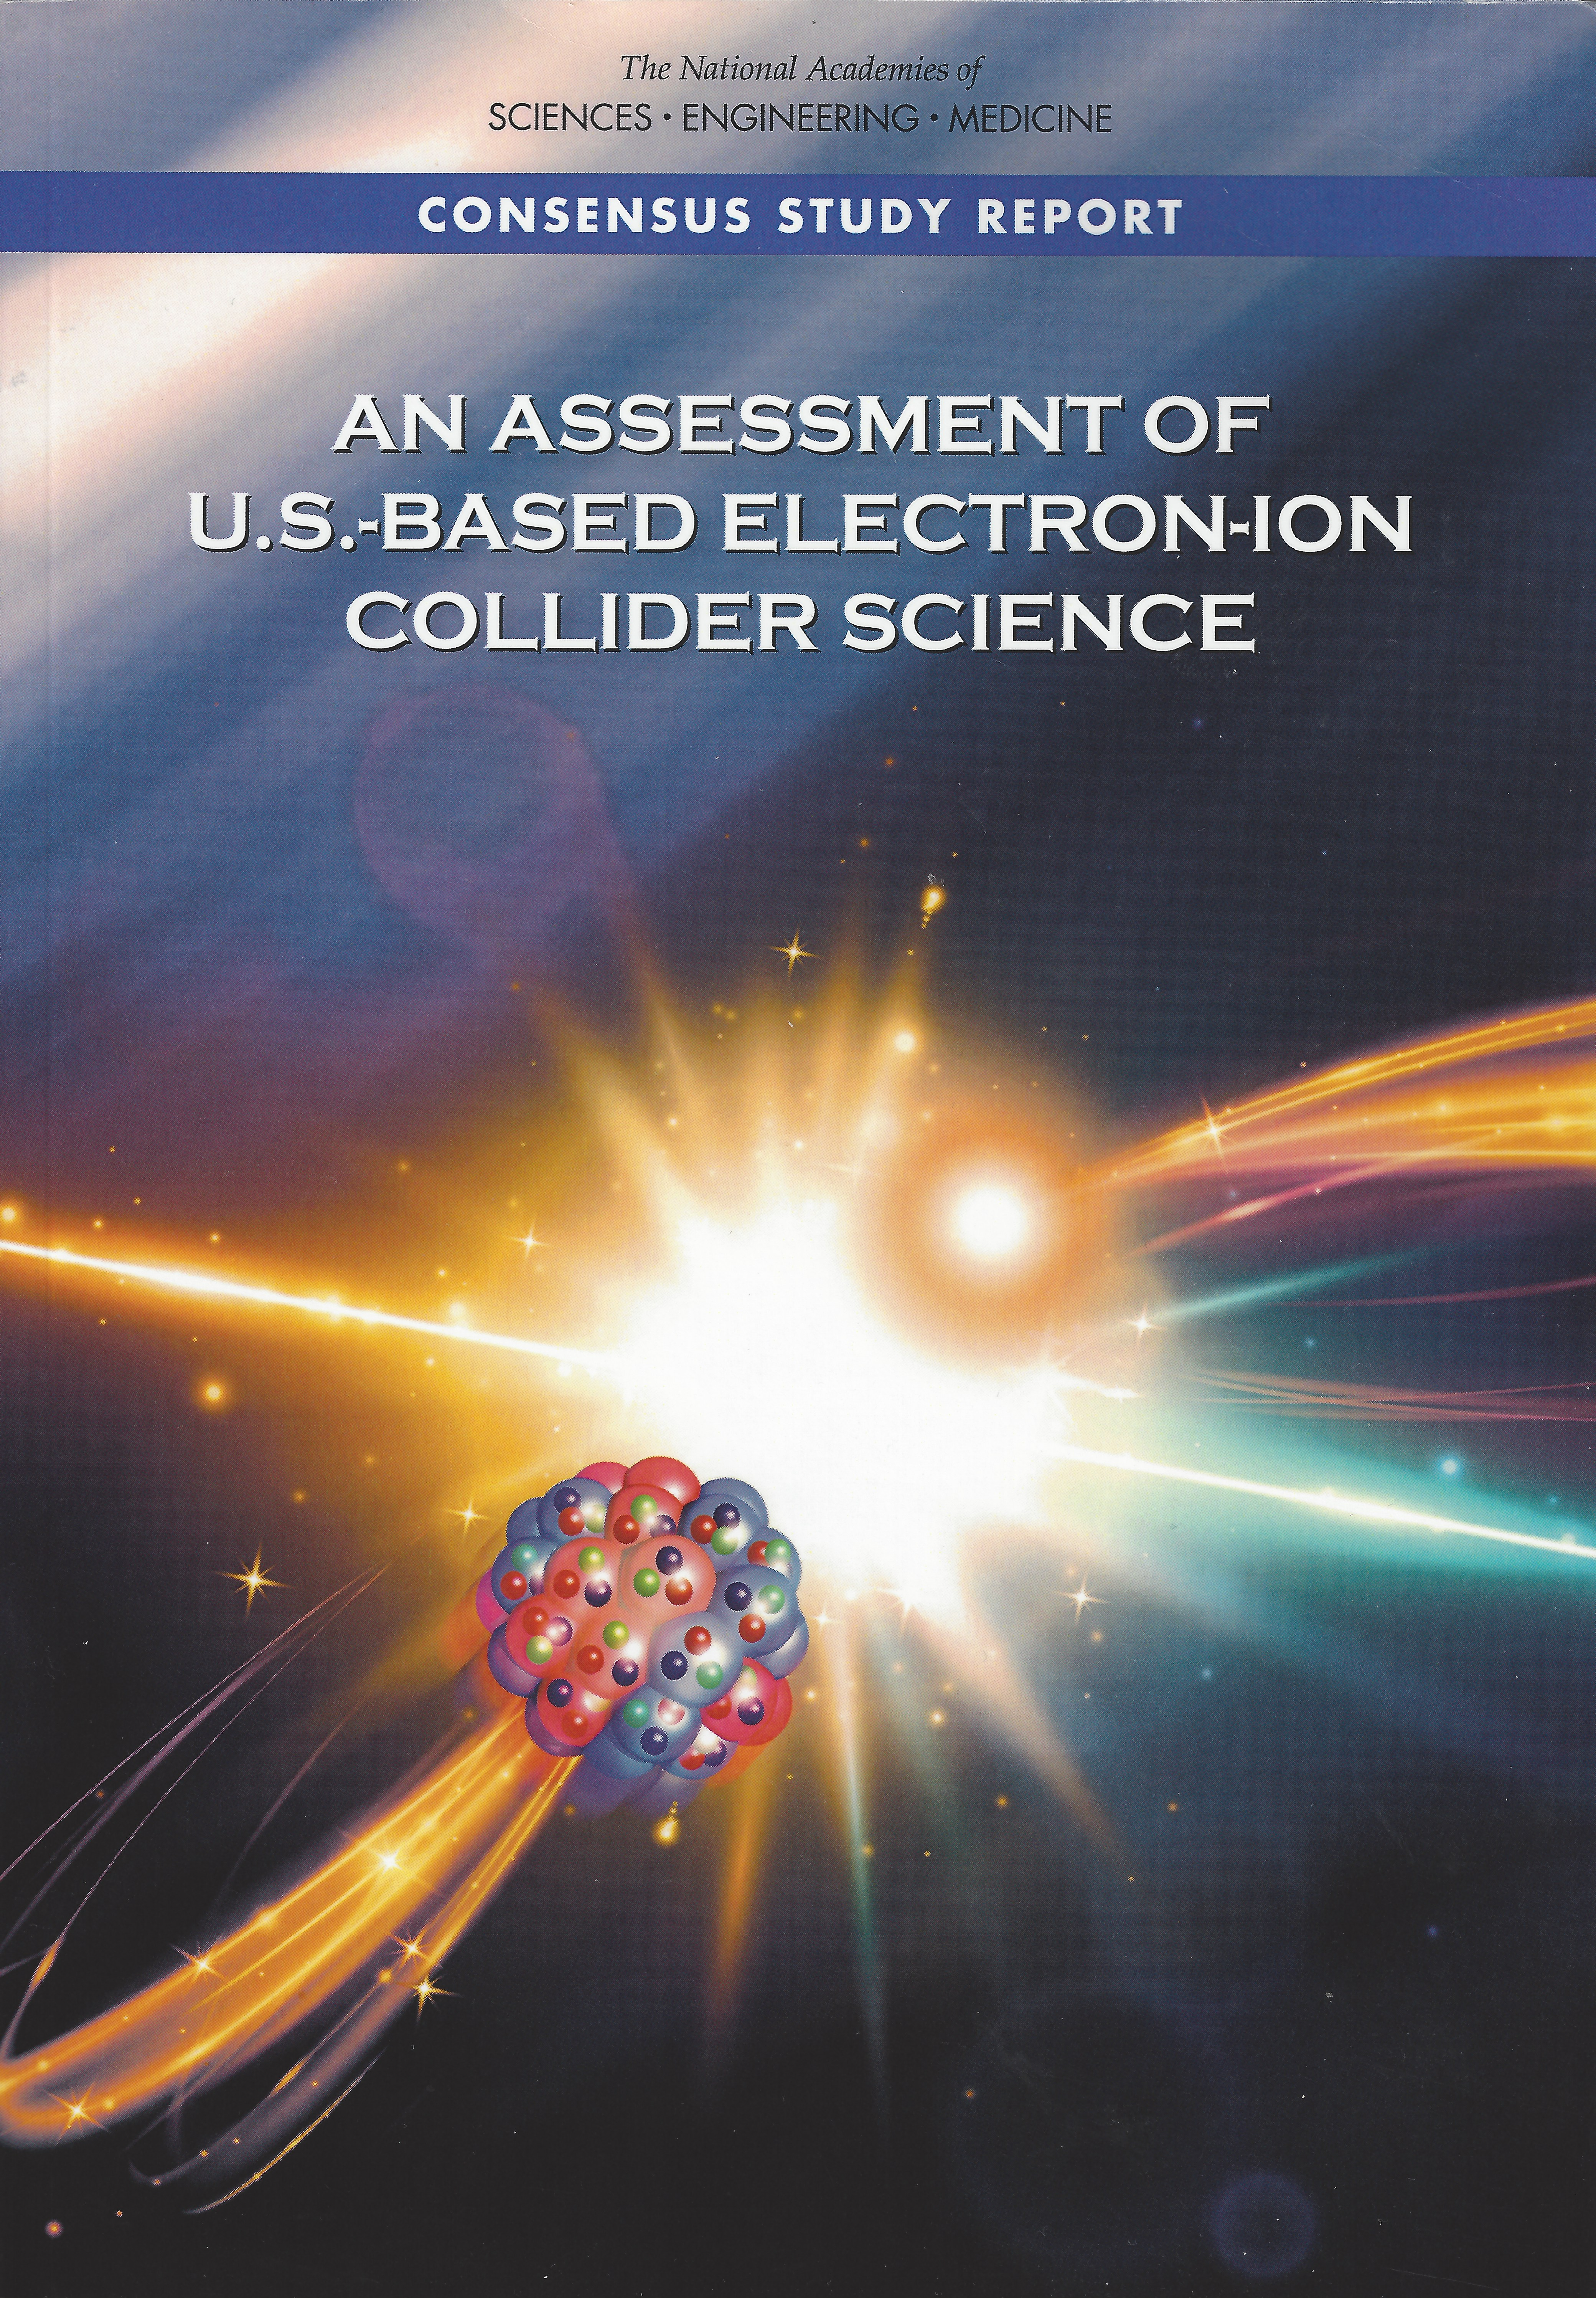
EIC Science – Findings of the NAS Committee
2018
Finding 1: An EIC can uniquely address three profound questions about nucleons — neutrons and protons — and how they are assembled to form the nuclei of atoms:
  How does the mass of the nucleon arise?
  How does the spin of the nucleon arise?
  What are the emergent properties of dense systems of gluons?
Finding 2: These three high-priority science questions can be answered by an EIC with highly polarized beams of electrons and ions, with sufficiently high luminosity and sufficient, and variable, center-of-mass energy.
EIC science is compelling,
timely and fundamental
Developed by NAS committee with broad science perspective

Slide 8


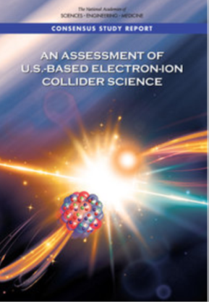
NAS Report on EIC Requirements
The EIC requirements have remained consistent, see e.g., the 2012 white paper and 2015 NSAC Long Range Plan

Slide 9
EIC Science Landscape
EIC: Understanding the Glue that Binds Us All - Without gluons, there would be no nucleons, no atomic nuclei… no visible world!
A huge leap in accessible kinematics landscape (into the land of gluons and the quark sea) for polarized e-N and unpolarized e-A reactions!

Slide 10
EIC Experimental program preparation
Year-long EIC User Group driven EIC Yellow Report activity
  Science Requirements and Detector Concepts for the EIC – Drives the requirements of EIC detectors
  arXiv:2103.05419 & Nucl. Phys. A 1026 (2022) 122447 – 372 citations (10/05/22)
BNL and TJNAF Jointly Leading Efforts Towards Experimental Program | BNL and TJNAF Jointly Leading Process to Select Project Detector
2020 | Call for Expressions of Interest (EOI) https://www.bnl.gov/eic/EOI.php | May 2020
 | EOI Responses Submitted | November 2020
 | Assessment of EOI Responses | On-going&
2021 | Call for Collaboration Proposals for Detectors https://www.bnl.gov/eic/CFC.php | March 2021
 | BNL/TJNAF Proposal Evaluation Committee | Spring 2021
 | Collaboration Proposals for Detectors Submitted | December 2021
2022 | Decision on Project Detector – “ECCE” | March 2022
 | Guide process to joint “Detector-1” Collaboration | Spring 2022
 | EPIC Collaboration* Formed – 160 institutions | July 2022
 | EIC Software Infrastructure Review | August 2022
 | Pre-Resources Review Board Meeting | October 2022
&Remains ongoing until formal agreements are in place – it originally led to confirmation that in-kind level assumed for the EIC detector was in range.
*Merger of two large ATHENA and ECCE proposals

Slide 11
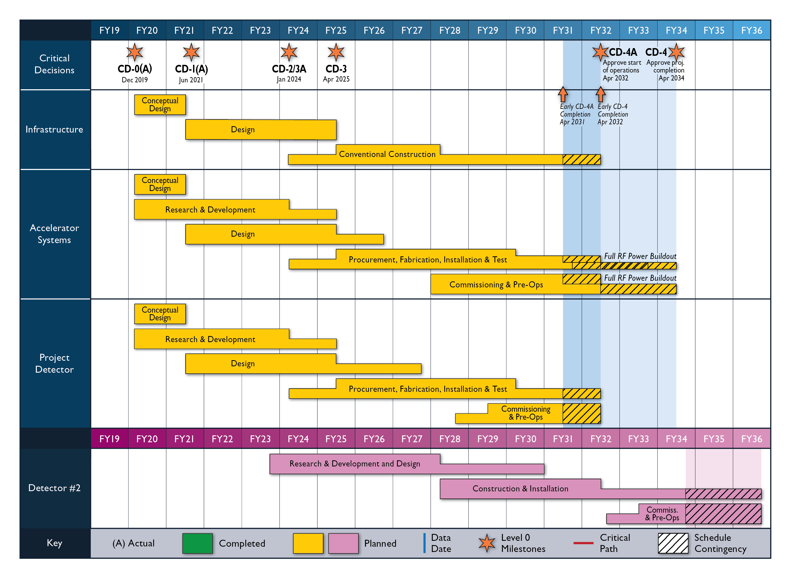
High Level EIC Reference Schedule
Construction Phase
Science Phase
The thinner bars indicate that R&D and design
can continue at a small level beyond CD-2 and CD-3
for LLP construction
starts at CD-2/3A
Notional Schedule
2nd IR and
Schedule
Generic Detector R&D
11

Slide 12
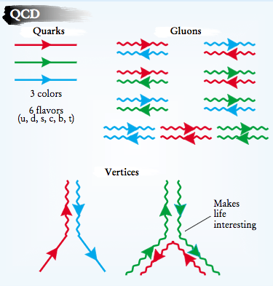
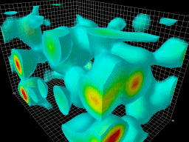
EIC: 21st Century Laboratory of Emergent Dynamics in QCD
Massless gluons & almost massless quarks, through their interactions, generate most of the mass of the nucleons
Gluons carry ~50% of the proton’s momentum, a significant fraction of the nucleon’s spin, and are essential for the dynamics of confinement
Properties of hadrons – composite systems of quarks and gluons – are emergent phenomena and inextricably tied to the properties of the QCD vacuum. Striking examples besides confinement are spontaneous symmetry breaking and anomalies
The nucleon-nucleon forces emerge from quark-gluon interactions: how this happens remains a mystery
The goal is to provide us with an understanding of the internal structure of the proton and more complex atomic nuclei that is comparable to our knowledge of the electronic structure of atoms, which lies at the heart of modern technologies

Slide 13
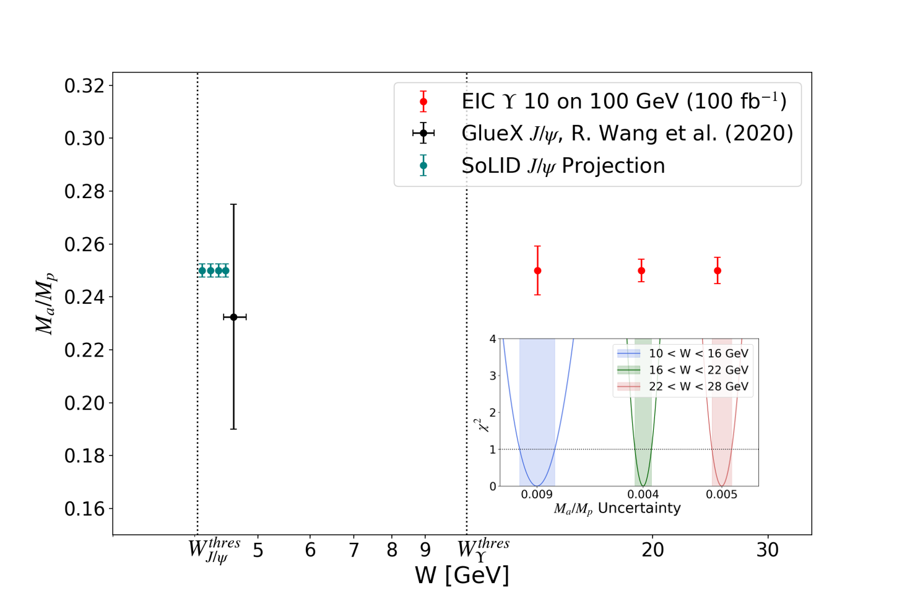
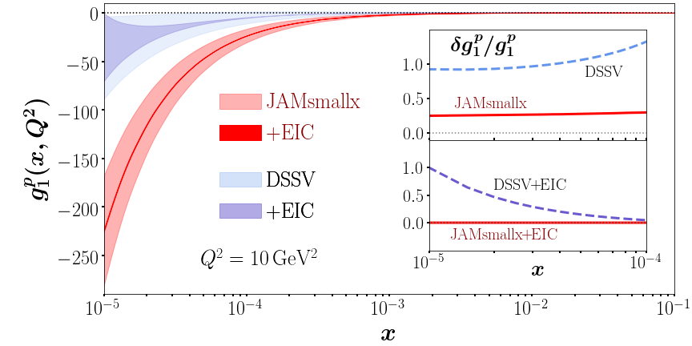
The EIC Will Deliver
Some highlight plots from new EIC White Paper (full draft will be released for EICUG feedback in November)
Mass
Spin
Pion PDF uncertainty ratio
Imaging
Nuclei

Slide 14


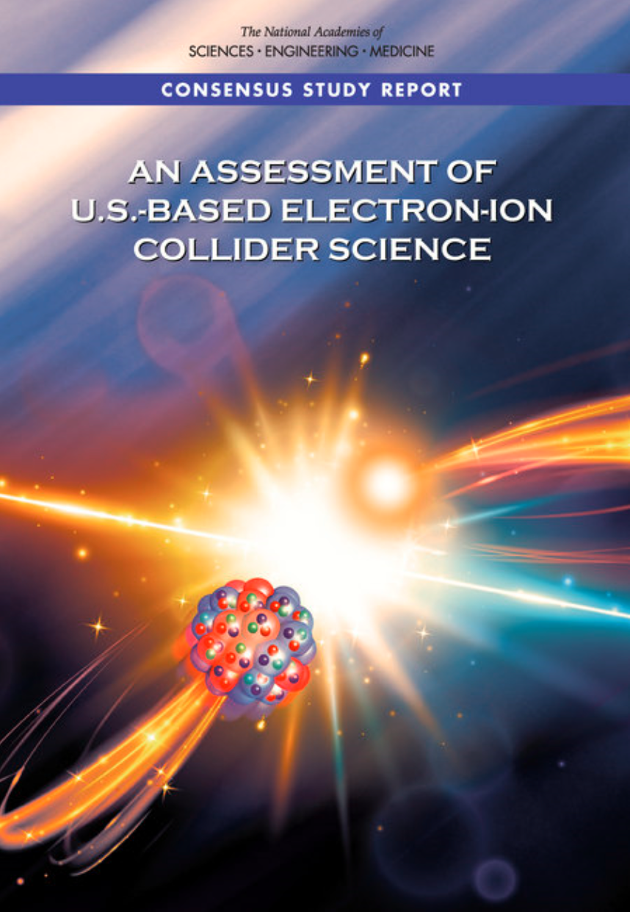

EIC Scope
Project Design Goals
High Luminosity: L= 10³³ – 10³⁴cm⁻²sec⁻¹, 10 – 100 fb⁻¹/year
Highly Polarized Beams: 70%
Large Center of Mass Energy Range: E_{cm} = 29 – 140 GeV
Large Ion Species Range: protons – Uranium
Large Detector Acceptance and Good Background Conditions
Accommodate a Second Interaction Region (IR)
IR-8
IR-6, ePIC Detector
IR-8
p/A beam
e beam
p: 41 GeV, 100 to 275 GeV
e: 5 GeV to 18 GeV

Slide 15
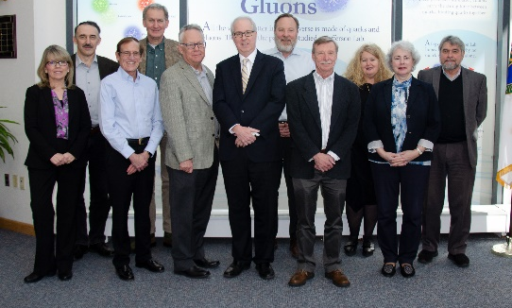
EIC Project Recent History
Event | Date
DOE Mission Need Statement Approved | January 22, 2019
Critical Decision – 0 (CD-0) Approved | December 19, 2019
DOE Site Selection Announced | January 9, 2020
Feb 28, 2020 @ JLab
Integrated partnership in all Project phases, including co-hosting the EIC experimental program.
BNL - TJNAF Partnership Agreement | May 7, 2020
Conceptual Design Review | November 16-18, 2020
DOE Office of Science CD-1 Review | January 26-29, 2021
DOE Independent Cost Review | January - February 2021
CD-1, Alternative Selection and Cost Range, Approved | June 29, 2021
CD-2/3A, Baseline/Long Lead Procurement | January 2024

Slide 16
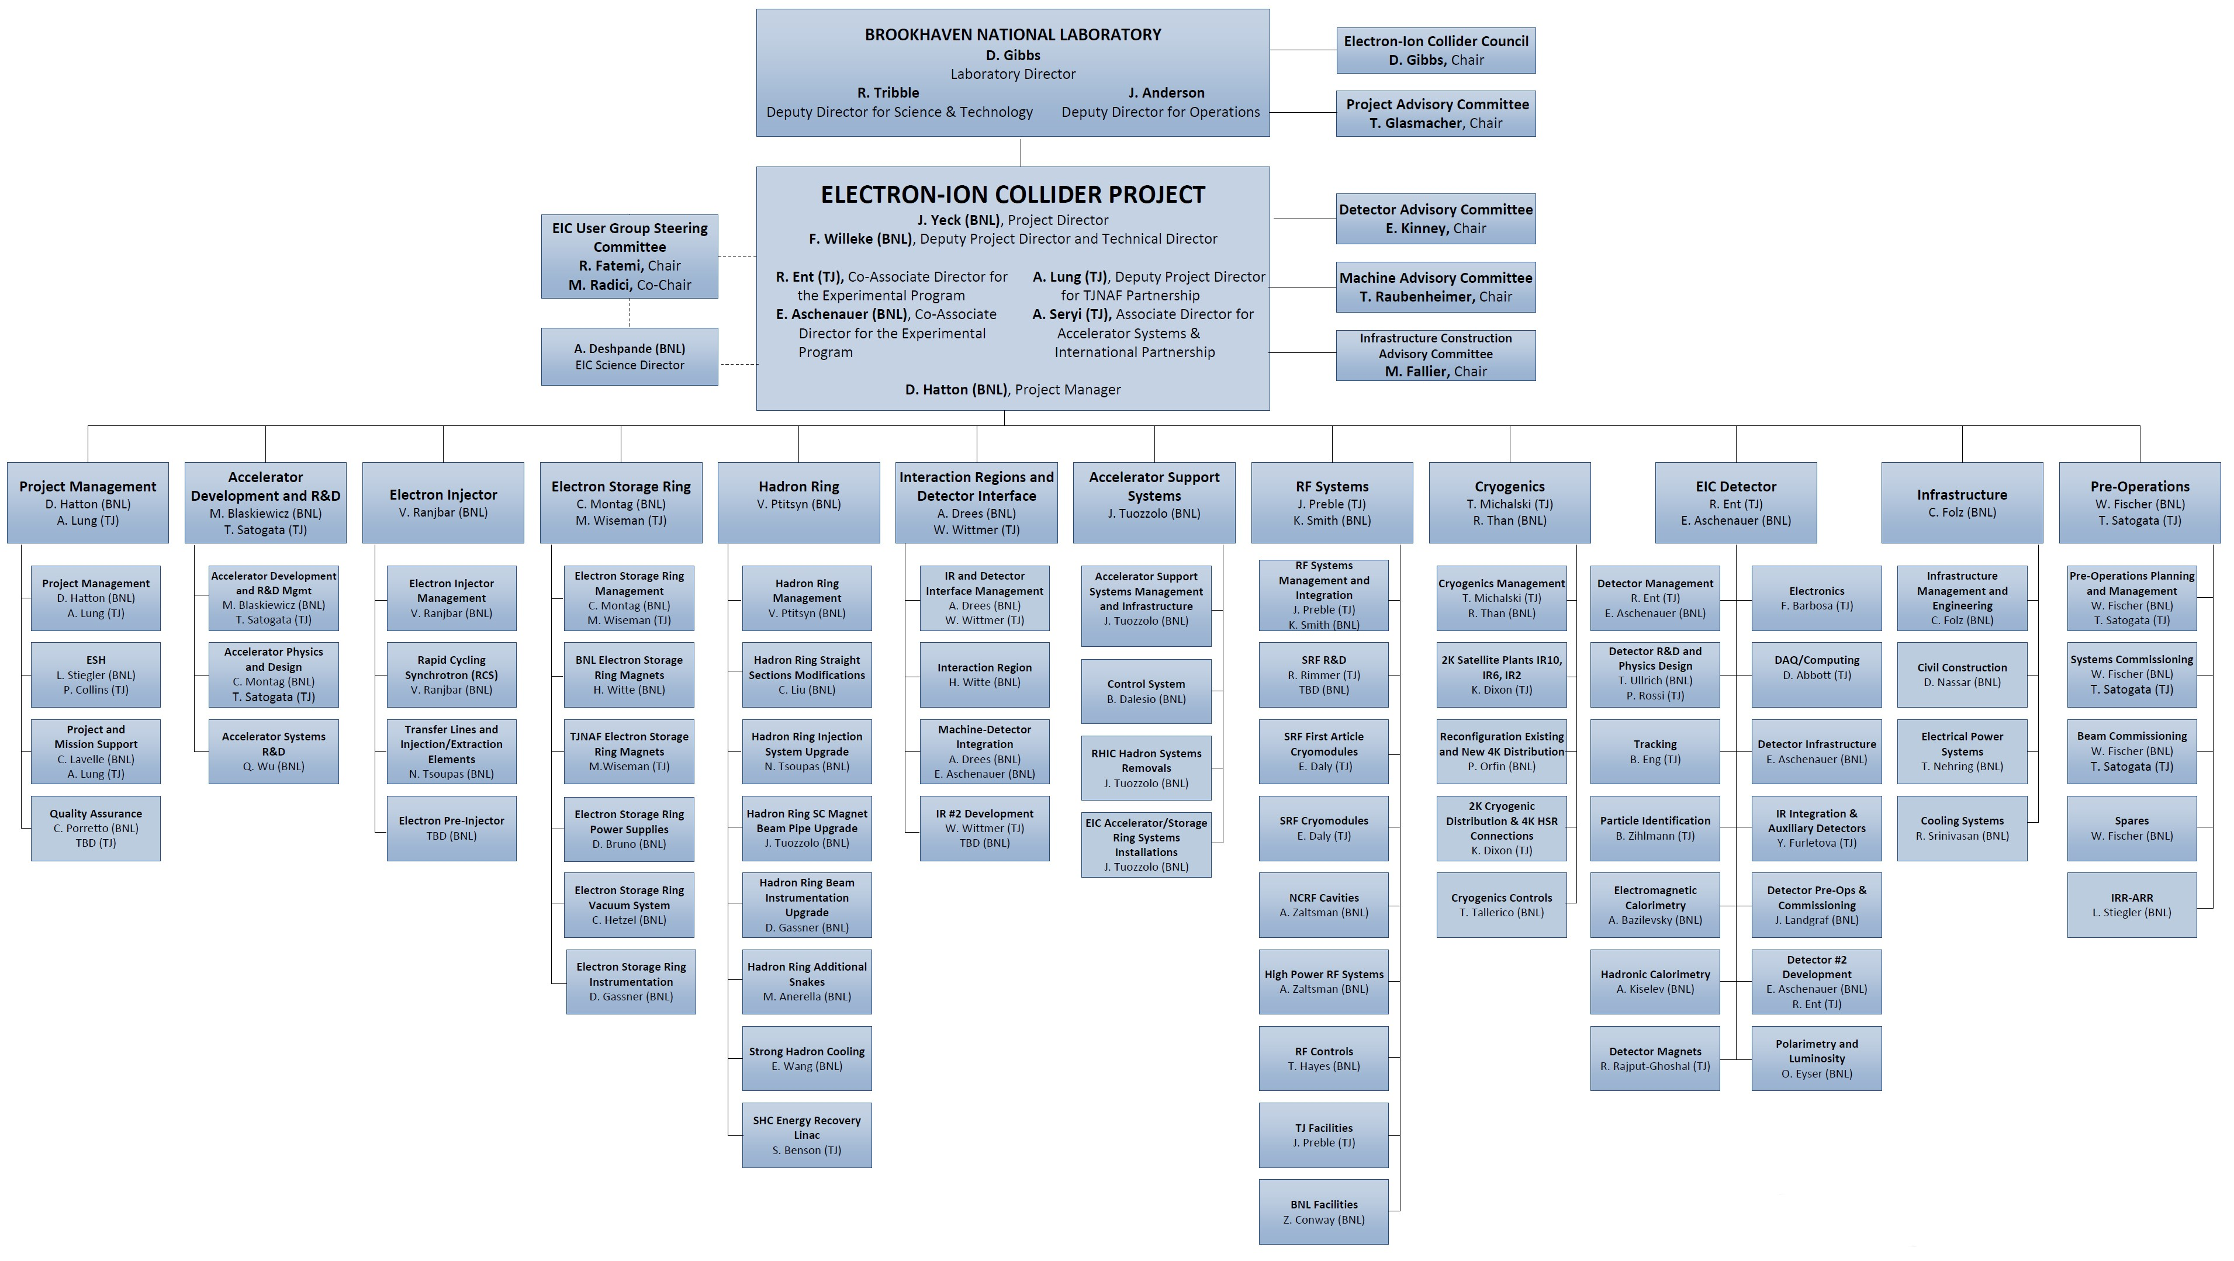
EIC Project – BNL-JLab Partnership
Each Lab has an EIC ‘Division’ or ‘Office’ with org titles/roles
EIC Project Org Chart is fully integrated and mapped to WBS
Partnership roles & responsibilities defined
Responsibilities are tied to relevant expertise
Bring added value to Project
Note: this is not the latest org chart, but it was the easier one to show the integration of BNL and Jlab. A red outlined box indicates JLab is either leading or co-leading with BNL.

Slide 17
EIC Project – Path to CD-2/3A and CD-3
DOE OPA Status Review (Remote) October 19-21, 2021(A)
Funding Discussion at DOE ONP (In-Person) April 26, 2022 (A)
FPD Status Update at BNL (Hybrid) June 28-30, 2022 (A)
Cost and Schedule Scrutiny Meetings July - September 2022
Project Detector Meetings 2022
  Technical Subsystem Reviews Feb. – Dec. 2022
  Pre-Resource Review Board Kickoff Meeting October 2022
DOE OPA Status Review - Confirm CD-2/3A Plans Jan. 30 – Feb. 2, 2023
Preliminary Design and Director’s Reviews June 2023
DOE CD 2/3A OPA Review and ICR, requires pre-TDR October 2023
DOE CD 2/3A ESAAB Approval January 2024
DOE CD 3 OPA Review, requires TDR ~January 2025
DOE CD 3 ESAAB Approval ~April 2025
OPA = Office of Project Assessment
FPD = Federal Project Director
ICR = Independent Cost Review
ESAAB = Energy Systems Acquisition Advisory Board
TDR = Technical Design Report

Slide 18
EIC Science – Findings of the NAS Committee
Finding 3: An EIC would be a unique facility in the world and would maintain U.S. leadership in nuclear physics.
Finding 4: An EIC would maintain U.S. leadership in the accelerator science and technology of colliders and help to maintain scientific leadership more broadly.
EIC science is compelling,
timely and fundamental
Developed by NAS committee with broad science perspective

Slide 19
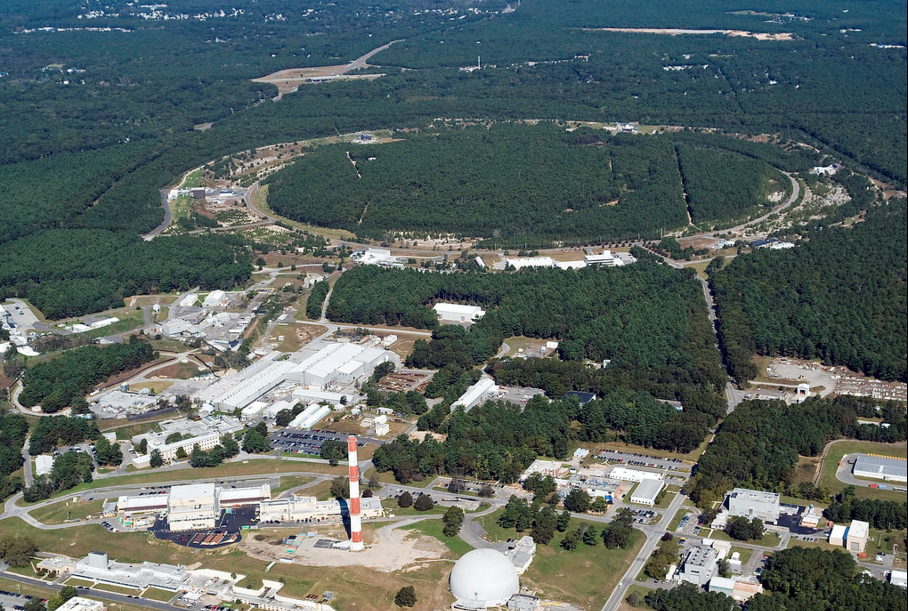

EIC Accelerator Design Overview
Hadron storage ring (HSR): 41, 100-275 GeV (based on RHIC)
  up to 1160 bunches, 1A beam current (3x RHIC)
  bright vertical beam emittance (1.5 nm)
  strong cooling (coherent electron cooling, ERL)
Electron storage ring (ESR): 2.5–18 GeV (new)
  up to 1160 polarized bunches
    high polarization by continual reinjection from RCS
  large beam current (2.5 A) ➔ 9 MW SR power
  superconducting RF cavities
Rapid cycling synchrotron (RCS): 0.4-18 GeV (new)
  2 bunches at 1 Hz; spin transparent due to high periodicity
High luminosity interaction region(s) (new)
  L = 10³⁴ cm⁻²s⁻¹
  superconducting magnets
  25 mrad crossing angle with crab cavities
  spin rotators (produce longitudinal spin at IP)
EIC

Slide 20
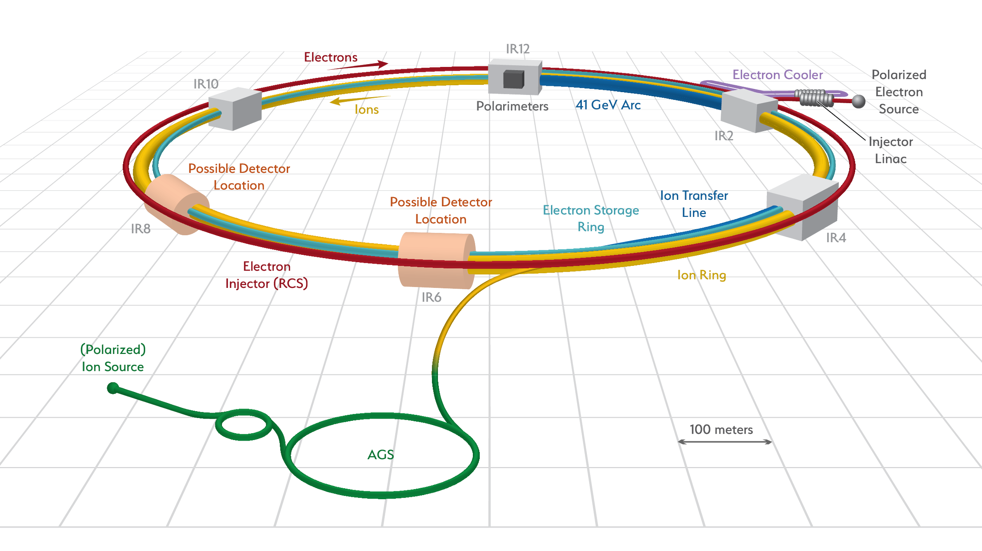
Accelerator Science and Technology – Ongoing EIC R&D
Cooler Electron Source
ESR
Vacuum R&D
Electron Injection
Fast Kicker
Strong Cooling
Polarized e⁻ Source
ESR Cavity
Prototype
HSR Vacuum Upgrade
ESR RF 500kW FPC
2nd IR
ePIC
Hadron Polarimetry
ESR RF HOM Damper
Crab Cavity
Prototype
Proton Injection
Fast Kicker
IR Design and Magnet Prototyping
IR Vacuum Chamber
Existing tunnel and
experiment halls
EIC is the ONLY new collider in foreseeable future. Allows to remain at frontier of Accelerator S&T.
… and enable applications (isotopes, space radiation, water treatment, etc.)

Slide 21
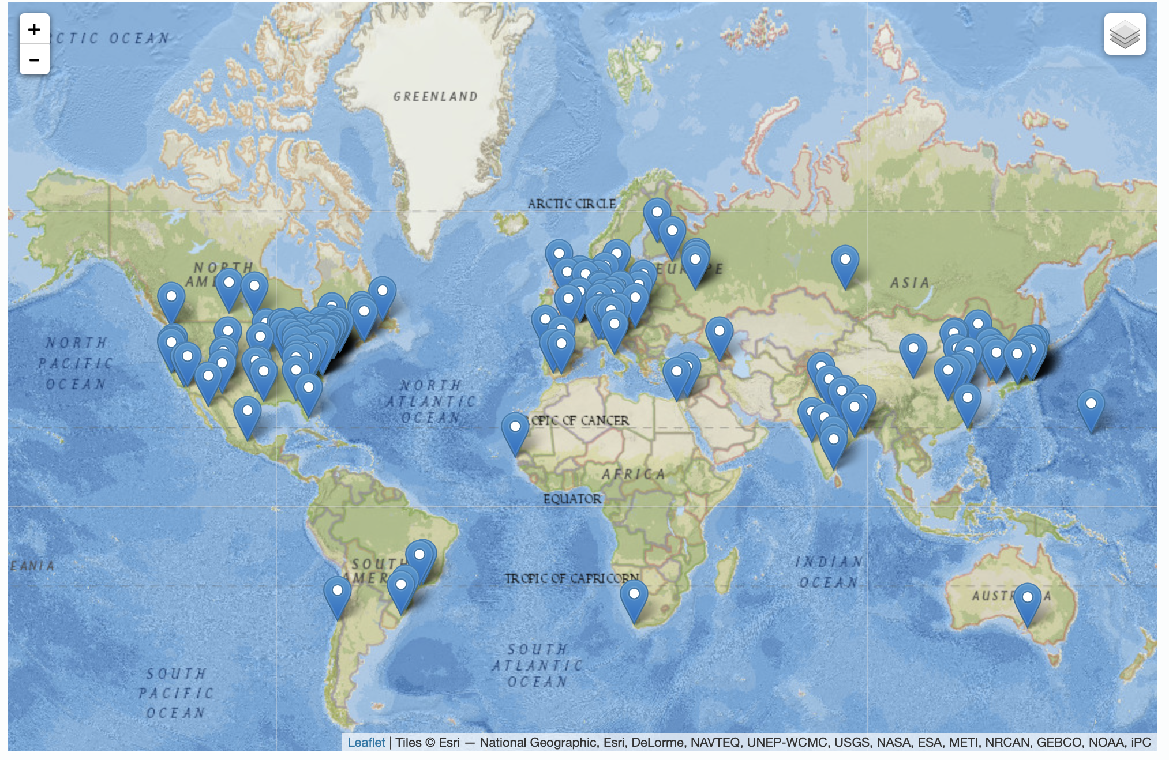
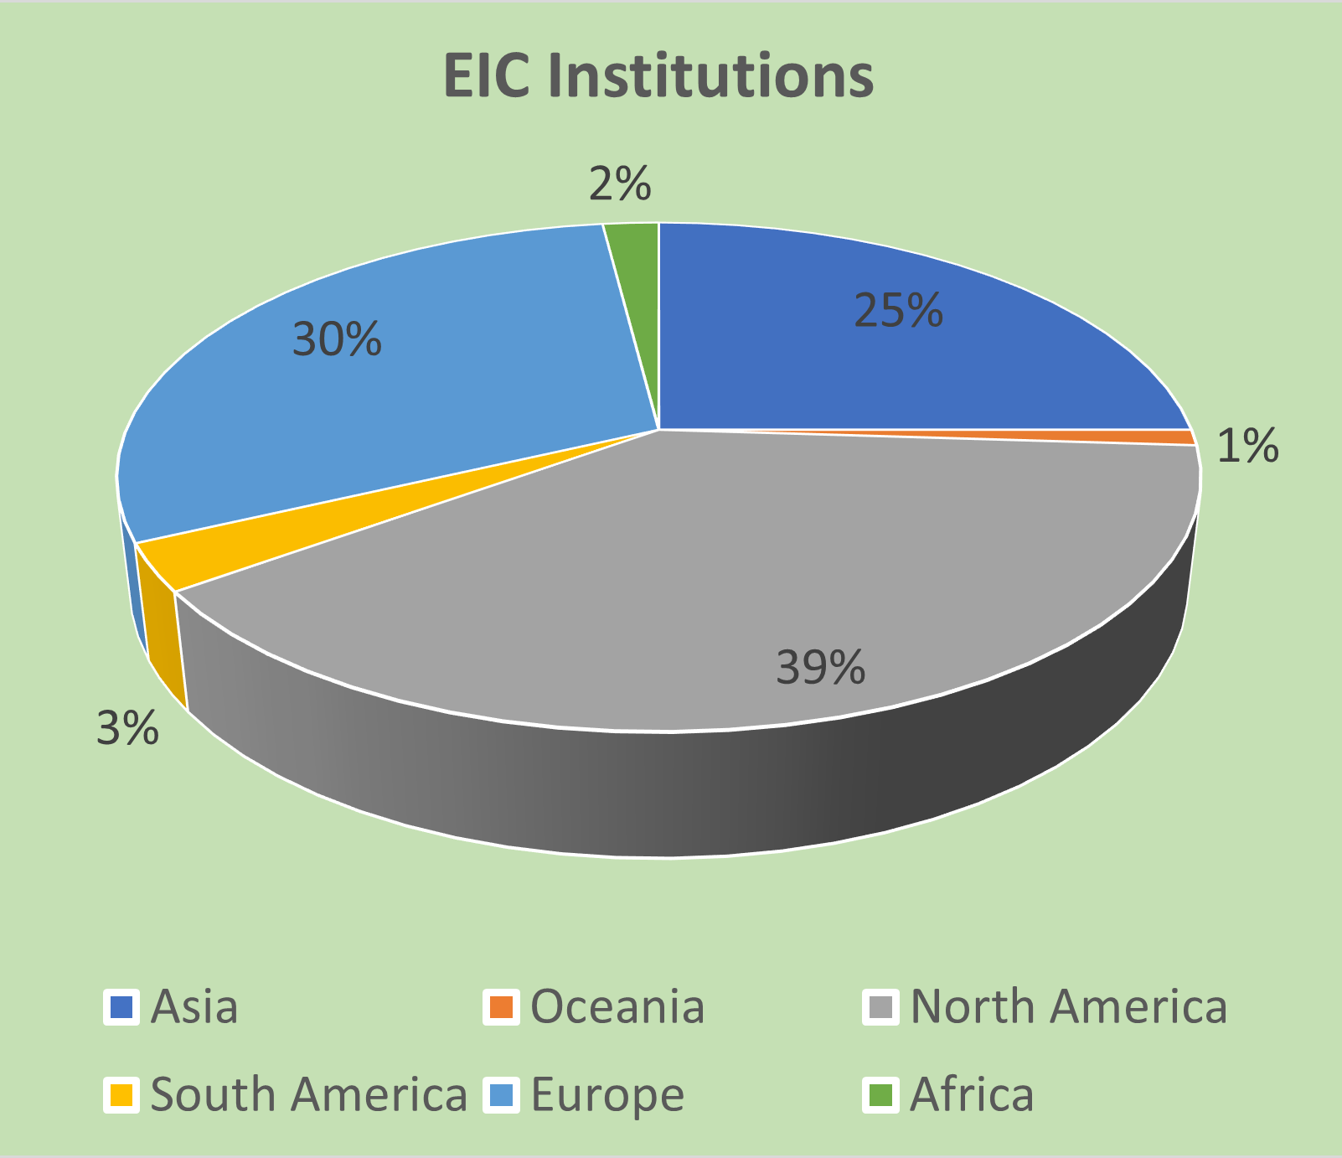
Worldwide Interest in EIC
The EIC User Group: https://eicug.github.io/
Map of institution’s locations
Formed 2016 –
1361 collaborators,
36 countries,
267 institutions as of September 20, 2022.
Strong and Growing International Participation.
Annual EICUG meeting
2016 UC Berkeley, CA
2016 Argonne, IL
2017 Trieste, Italy
2018 CUA, Washington, DC
2019 Paris, France
2020 Miami, FL
2021 VUU, VA & UCR, CA
2022 Stony Brook U, NY
2023 Warsaw, Poland
21

Slide 22
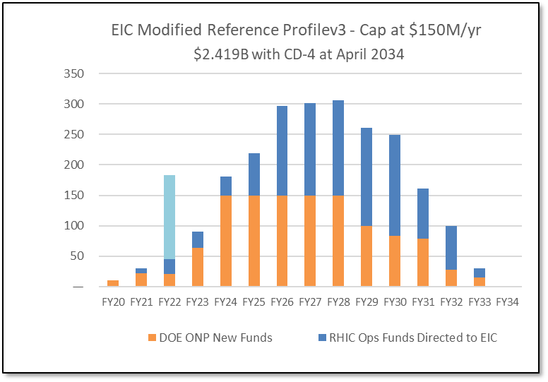
Latest News on the Funding and Schedule
Inflation Reduction Act:
$217M to Nuclear Physics in FY22 to be spent by FY27.
Includes EIC (to get to CD-2) – $138.24M.
(IRA funds can ONLY be used for project scope, but NOT to add scope)
Schedule: CD-2/3A = January 2024; CD-3 = April 2025; CD-4 Project Completion = 2034
RHIC operations conclude and EIC tunnel work starts in June 2025
Cost: CD-1 cost range of $1.7B-$2.8B
→ The DOE funding to ensure CD-2/3A timeline (baselining, start of long-lead procurement items) and CD-3 (start of construction) seems secured.

Slide 23
Uniqueness of EIC
EIC will be unique facility worldwide: there is no equivalent of the EIC science capabilities due to its versatility in energies, polarization, and ion species.
Global competition can exist in subsets of the EIC science, e.g.:
  Ideas for an Electron-Ion Collider in China (EicC) which would operate at center-of-mass energies up to COMPASS@CERN.
  Annual ongoing workshops related to adding a high-energy electron beam to interact with LHC beams at CERN (LHeC).
In addition, several programs have natural complementarity:
  Consideration to add a fixed-target spin program at the LHC – LHCspin (@LHCb).
  The AMBER experiment at CERN mainly emphasizing the valence and sea quark regions with pion and kaon beams.
  Ultraperipheral and heavy-ion reactions at CERN/LHC to constrain low-x behavior.
  (within the US) The polarized RHIC pp and pA program, addressing universality questions in QCD.
  (within the US) The Jefferson Lab fixed-target program at high luminosity (12 GeV and energy extension), adding crucial data in the strongly-interacting valence quark region.
\

Slide 24
EIC Status: Take-Away Messages
“Now is the time to realize the EIC in the U.S.” (LRP 2015).
The NAS Report concluded: “EIC science is compelling, timely and fundamental.”
The EIC Science Case is as strong as, if not stronger than, before.
The EIC is executed as a partnership of BNL and JLab, in strong collaboration with the large EIC user community.
The EIC User Group continues growing, and currently stands at 1361 members in 36 countries.
  This is a strong community that has delivered on the EIC Science White Paper, the Yellow Report, and three detector proposals.
  Efforts towards the ePIC detector and a path to a 2nd detector are ongoing.
Recent IRA funding results in a phase change – the schedule for EIC to CD-3 (~2025) is likely to be technically driven.
  This underscores DOE/SC is committed to EIC as a top priority
  The focus of the EIC Project will be schedule, schedule, schedule
There will be one EIC with this high level of performance in the world.
  This will keep the U.S. on the frontiers of nuclear science, accelerator, and detector technologies.

Slide 25
Prospects for AI at the EIC
Relevance of AI for EIC highlighted in the Yellow Report:
  Volume I – Executive Summary (chapter 4, “Opportunities for Detector Technology and Computing”)
  Volume III – Detector (chapter 11.12 “Artificial Intelligence for the EIC Detector”)
AI4EIC 1st workshop – summary of similar EIC Overview and Schedule talk: AI is becoming ubiquitous in Nuclear and Particle Physics
  Logical development if one folds in complexities of relativistic, quantum-mechanical, strongly interacting many-body system where data will always be sparse and limited.
  Time to engage in AI for EIC is now, from material and detector design and optimization, to large-scale simulations, to embedding AI in streaming readout and software, to including AI in high-level physics data analysis and visualizations.

Slide 26
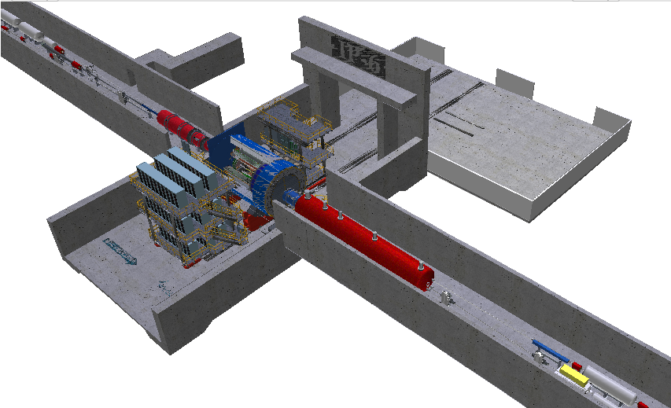
EIC: Fully Integrated Detector/Interaction Region++
Far-Backward Region ~ 40 m
EIC science: ALL particles count!
Many particles with β = 1, but in the far-forward region @ 30 m distance also many particles with β = 0.5 or so
→ Δt = 200 ns
Ultimate EIC Streaming Model:
integrate machine, detector, electronics, data acquisition, software and physics analysis.
Central Detector ~ 10 m
Far-Forward Region ~ 40 m

Slide 27



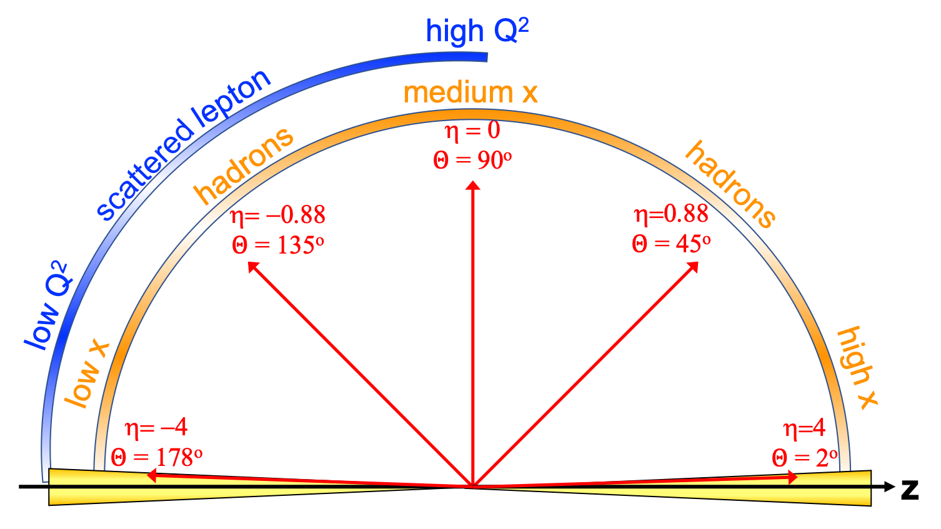
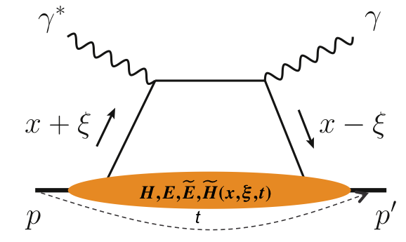
EIC General Purpose Detector: Concept
p/A beam
electron beam
inclusive DIS:
semi-inclusive DIS
Backward-η
Forward-η
Central
Detector
HCAL
Lepton
Endcap
Magnet
Hadron
Endcap
HCAL
ECAL
HCAL
ECAL
ECAL
Tracking
PID
PID
PID
Tracking
very low Q²
scattered lepton
Bethe-Heitler photons
for luminosity
Tracking
particles from nuclear
breakup and
from diffractive reactions
exclusive DIS
ZDC
Luminosity Detector
Forward Tracking
Low Q²-Tagger

Slide 28
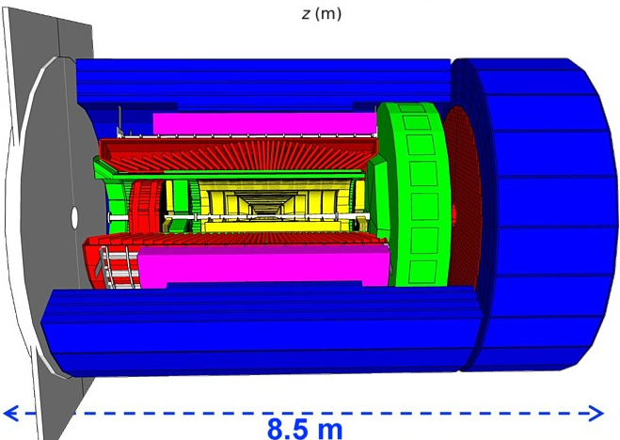
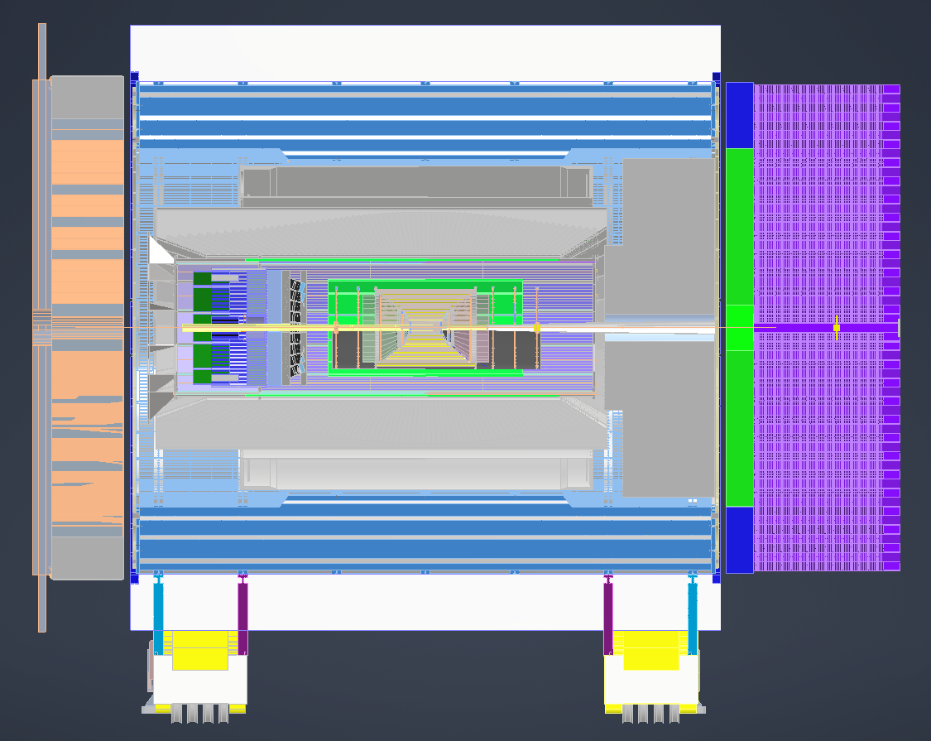
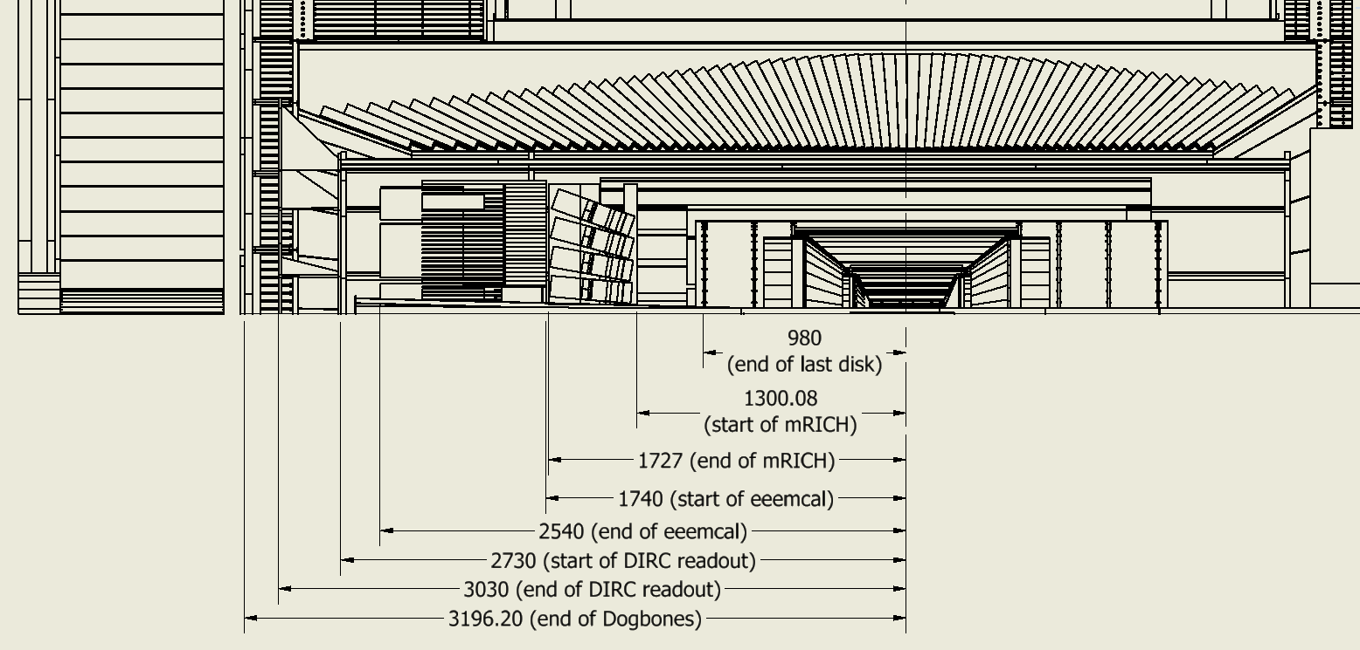
EPIC Central Detector
hadronic calorimeters
solenoid coils
ToF, DIRC,
RICH detectors
e/m calorimeters
MPG & MAPS trackers
CAD model
Overall integration model that we try to keep consistent with the geometry database

Slide 29
Streaming Readout Architecture
Triggerless streaming architecture gives much more flexibility to do physics
Rates quoted are at output of each stage

Slide 30
Assumptions About EIC Detector Readout
Slide courtesy Graham Heyes(JLab)
The detector will be read out by a streaming data acquisition
  Rate around 100 terabits per second
Online systems (hardware, firmware, and software) suppress empty channels and aggregate streams to make efficient use of network hardware
  Suppressed and aggregated rate about 100 terabits per second
An online filter reduces the rate by a further factor of ten to a rate that can be stored in a buffer
  Buffer input and output rate 1 terabit per second
Asynchronously a slower offline filter reads data from the buffer, processes it to reduce the rate by another factor of ten, and transmits the data over the network to both JLab and BNL.
  Rate over network 100 gigabits per second – JLab and BNL will soon be linked via ESnet 6 at this rate

Slide 31
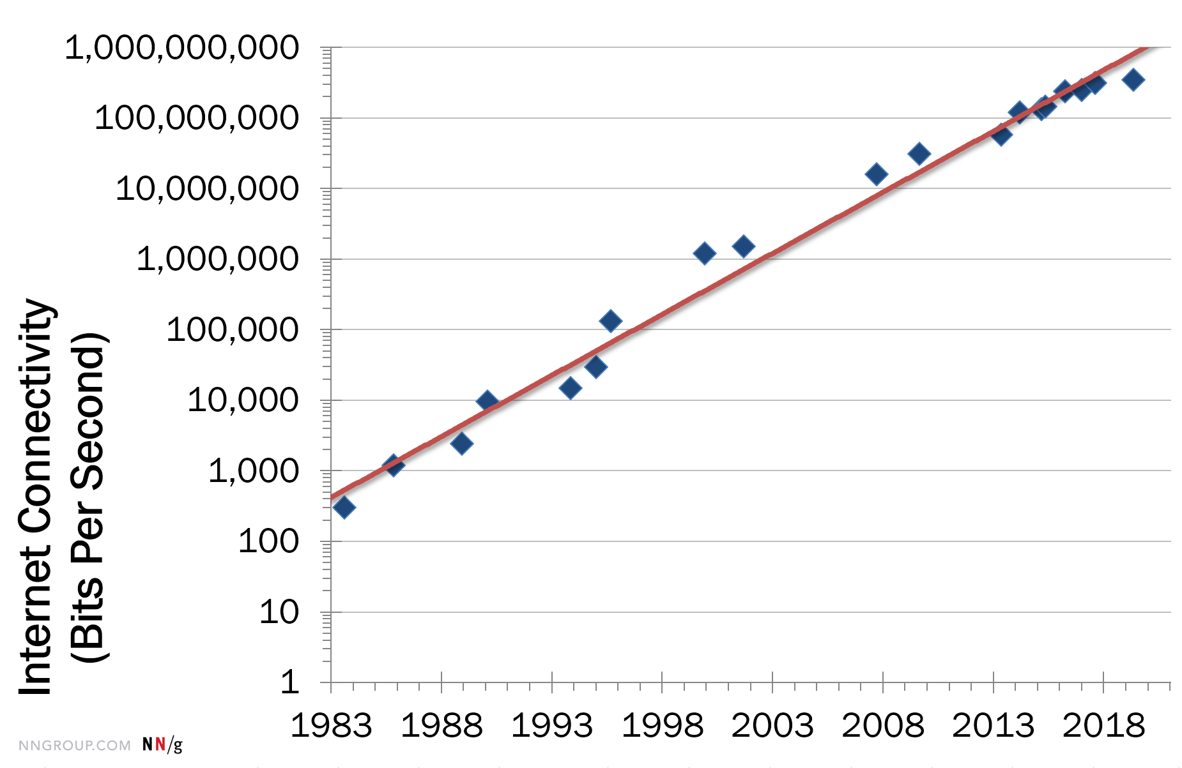
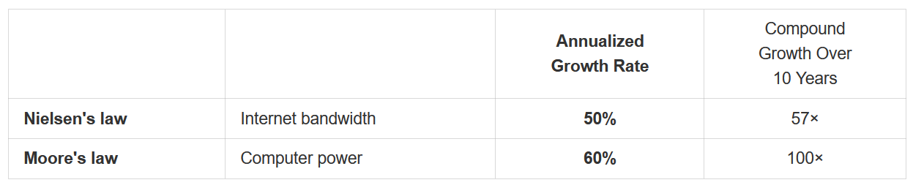
The Network Bandwidth Will Grow!

Slide 32
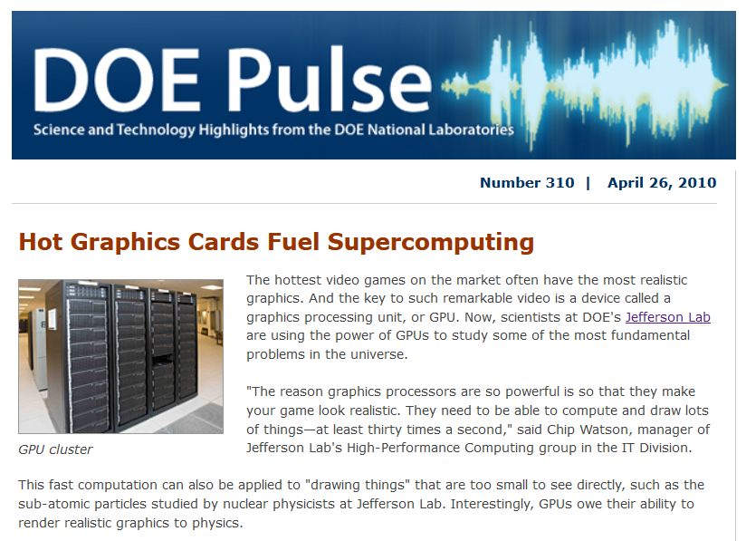
Heterogeneous Computing
First use of CPUs and GPUs together, inspired by Lattice QCD needs

Slide 33
Heterogeneous Architectures – Advantage for Streaming/AI
Based on slide of Nathan Brei (JLab)
The optimization of commercial hardware and specialized software enables cost-effective supercomputing.
2015 NSAC Long-Range Plan, Figure courtesy Balint Joo (ORNL)

Slide 34
EIC Detector Computing Technology choices
Based on slide of Graham Heyes (JLab) and Jerome Lauret (BNL)
Two areas of computing that are rapidly evolving currently are the use of heterogeneous hardware and AI/ML
  In some ways these drive each other.
Heterogeneous Hardware
  We anticipate supporting heterogeneous hardware at all stages of pipeline
    GPU, TPU, CPU, FPGA, …
    Currently the optimum mix of hardware flavors is not known. We expect studies over the next few years will clarify
  What is key is that the infrastructure and frameworks support exists
    BNL and JLab are working on the infrastructure
    Detector software groups are working on the frameworks
AI/ML support
  Expected at all stages (design, simulation, filtering, calibration, reconstruction, analysis, …)
  Type of hardware depends on AI model (some models run faster on CPU)
  Many groups are working independently in these areas, but coherence is starting to emerge. For example, workshops on AI for nuclear physics, AI for EIC, …

Slide 35
AI/ML for Streaming Readout at the EIC
Or another example from Miguel Arratia’s Presentation
New (or Old, from H1) Jet Observables using ML

Slide 36
AI for a QCD Event-Level Analysis
Figure describing workflow for a QCD event-level analysis from a SciDAC-approved proposal on Femtoscale Imaging of Nuclei using Exascale Computing (ANL, JLab, VaTech)
AI can (and undoubtedly will) be applied at every level of this workflow! → @event-level discriminator, @”QCD background”-level for parameter generator, @trial QCF model to trial PMD model, @calibration level for detector model, @ visualization at the Femtoscale level, @ …

Slide 37
Final Thoughts – EIC in the AI Era
Combining Streaming, AI, heterogeneous computing and modern software in our physics detector, data handling and analysis (from calibration to high-level physics analysis) is a no-brainer.
We “just” have to make it work.
Heterogenous architectures, AI/ML, and the other technologies are rapidly evolving… On the timescale of EIC data taking the landscape is likely to be completely different. We must ensure an agile framework that can evolve rapidly over time!

Slide 38
Backup

Slide 39
EIC Timeline – What Is Coming
CD-0 approval December 19, 2019
Community-wide Yellow Report effort Dec. 2019 – Feb. 2021
CD-1 review (includes CDR) January 26-29, 2021
Call for Collaboration Proposals for Detectors March 6, 2021
CD-1 approval June 29, 2021
DOE/OPA Status Review October 19-21, 2021
Status Update to Federal Project Director June 28-30, 2022, @BNL
Cost and Schedule Event(s) May-June 2022
Technical Subsystem Reviews January – December 2022
OPA Status Review Jan. 30 – Feb. 2, 2023
Preliminary Design Complete & Review May 2023
Final Design/Maturity Readiness for CD-3A Items May 2023
CD-2/3A review (expectation), requires pre-TDR ~October 2023
CD-2/3A (expectation) ~January 2024
CD-3 review (expectation) ~January 2025
CD-3 (expectation), requires TDR ~April 2025

Slide 40
Schedule – what do the CD milestones mean?
CD-0 – Approve mission need: this documents that a scientific goal or a new capability, requiring material investment exists.
CD-1 – Approve Alternative Selection and Cost Range: serves as a determination that the selected alternative and approach is optimized to meet the mission need defined at CD-0. What is perhaps most relevant is that CD-1 allows for release of Project Engineering and Design (PED) funds, which means the next phases of design of accelerator and detector can begin.
CD-2 – Approve Performance Baseline: CD-2 is an approval of the preliminary design of the project and the baseline scope, cost, and schedule. What is most relevant is that CD-2 means there is now a definitive plan that the project will be measured against in cost, schedule and technical performance.
CD-3 – Approve Start of Construction: CD-3 is an approval of the project’s final design and authorizes release of funds for construction. What is most relevant is that projects can now proceed with construction related procurements and activities. CD-3 is sometimes split in CD-3A in a tailored approach to approve start construction for long-lead procurements.
CD-4 – Approve Start of Operations or Project Completion: CD-4 provides recognition that the project’s objectives have been met. CD-4 is sometimes split in CD-4A that allows, after agreed-upon criteria for technical success have been met, for transition into operations, and CD-4B that provides the formal closeout of the project.

Slide 41
Benefits of Heterogeneous Hardware to Nuclear Physics
Slide courtesy David Lawrence (JLab)
GFlop/Watt is significantly lower for GPUs than CPUs
  e.g. https://www.karlrupp.net/2013/06/cpu-gpu-and-mic-hardware-characteristics-over-time/
Price per flop is lower for GPUs than CPUs
  n.b. can be hard though to keep GPU fully busy
Large HPC/HTC systems have significant compute capability tied up in heterogeneous hardware (including cloud services)
Higher memory bandwidth (good for streaming)
  See LHCb Allen project: https://arxiv.org/abs/1912.09161
Well-suited for AI/ML models
  not all models are efficient on GPUs, but some (e.g. CNNs) are extremely efficient
  tools like HLS4ML making FPGAs more accessible (https://fastmachinelearning.org/hls4ml/)
Faster simulation via GANs

Slide 42
Nuclear Femtography - Imaging
In other sciences, imaging the physical systems under study
has been key
to gaining new
understanding.
Structure mapped
in terms of
b_{T} = transverse position
k_{T} = transverse momentum
Also information on orbital angular momentum: r x p

Slide 43
Exploring the 3D Nucleon Structure
After decades of study of the partonic structure of the nucleon we finally have the experimental and theoretical tools to systematically move beyond a 1D momentum fraction (x_{Bj}) picture of the nucleon.
    High luminosity, large acceptance experiments with polarized beams and targets.
    Theoretical description of the nucleon in terms of a 5D Wigner distribution that can be used to encode both 3D momentum and transverse spatial distributions.
Deep Exclusive Scattering (DES) cross sections give sensitivity to electron-quark scattering off quarks with longitudinal momentum fraction (Bjorken) x at a transverse location b_{T}.
Semi-Inclusive Deep Inelastic Scattering (SIDIS) cross sections depend on transverse momentum of hadron, P_{h⊥}, but this arises from both intrinsic transverse momentum (k_{T}) of a parton and transverse momentum (p_{T}) created during the [parton → hadron] fragmentation process.
PDFs
Nuclear Femtography

Slide 44
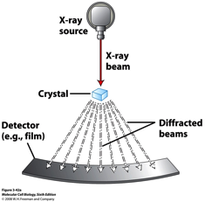
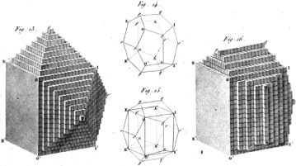
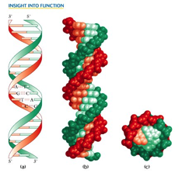
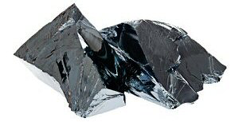
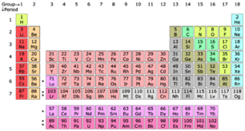
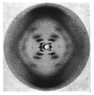


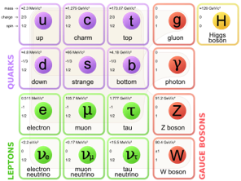
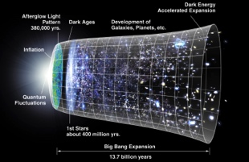
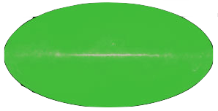
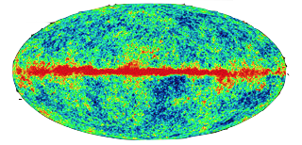
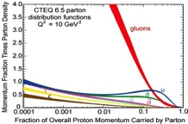

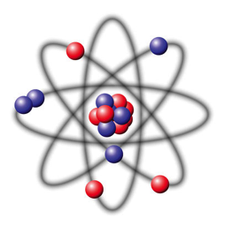




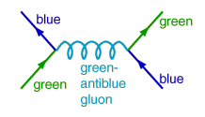
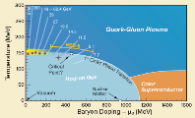
Imaging Physical Systems is Key to New Understanding
Dynamical System | Fundamental Knowns | Unknowns | Breakthrough Structure Probes | New Sciences, New Frontiers
Solids
Electromagnetism
Atoms
Structure
X-ray Diffraction
(~1920)
Solid state physics
Molecular biology
1801
DNA
Universe
General Relativity
Standard Model
Quantum Gravity,
Dark matter, Dark
energy. Structure
Large Scale Surveys
CMB Probes
(~2000)
Precision
Observational
Cosmology
CMB 1965
Nuclei
and Nucleons
Perturbative QCD
Quarks and Gluons
Non-perturbative QCD. Structure
Electron-Ion Collider
(~2030)
Structure & Dynamics in QCD
2017

Slide 45
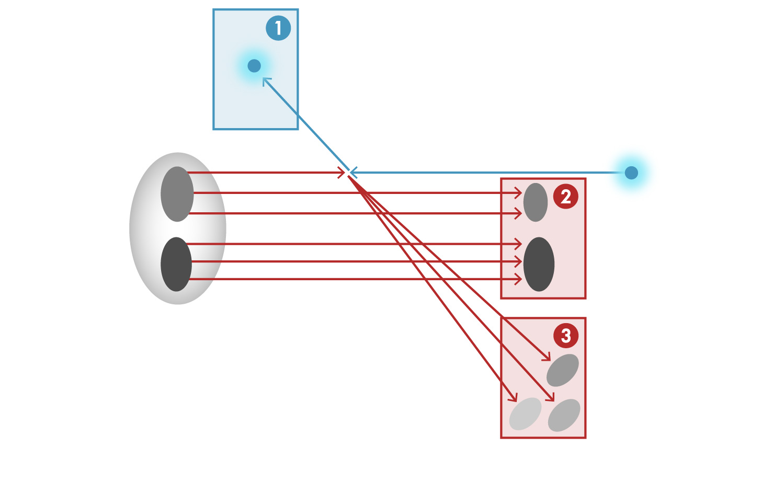


Detector Integration Challenge of the EIC
e’, $ν$
Aim of EIC is 3D nucleon and nuclear structure beyond the longitudinal description.
This makes the requirements for the machine and detector different from all previous colliders.
e
$γ,$Z,W
p/A
q
p remnant
“Statistics”=Luminosity × Acceptance
EIC Physics demands ~100% acceptance for all final state particles (including particles associated with initial ion)
e’
e
p/A
Ion remnant is particularly challenging
not a usual concern at colliders
at EIC integrated from the start with a highly integrated (and complex) detector and interaction region scheme.
Scattered electron
Particle associated with initial Ion
Particle associated with struck quark (or associated gluon)
45

Slide 46
Cartoon/Model of the Extended Detector and IR
EIC physics covers the entire region (backward, barrel/central, forward)
The detector requirements differ in these regions due to the EIC asymmetry
Many EIC science processes rely on excellent scattered electron detection and excellent and fully integrated forward detection scheme
p: 41 GeV, 100 to 275 GeV
e: 5 GeV to 18 GeV
Adapted from 2nd Yellow Report Meeting, Detector Working Group
p/ion beam
e beam
far-backward
e-detection
e final-focus quads
“Central detector”, includes e-endcap, barrel, and p/ion endcap detectors
forward dipole
incl. h detection
Ion final-focus quads
forward dipole
far-forward h-detection
far-forward
h-detection
Low-Q²
spectroscopy
Inclusive Structure Functions, TMDs, heavy flavors and jets, electrons for GPDs
GPDs/DVCS, tagging, diffraction, high-medium t
Baryon decay
π/K structure
evaporated n
GPDs, tagging, diffraction, lowest-t
GEMs
Diamond detectors?
Vertex and Tracking detectors, particle identification detectors, calorimetry detectors, muon detectors, etc.
Si/GEMs
Roman pots,
e/γ calorim.
GEMs
Roman pots
e/γ calorim.
Roman pots
ZDCs
physics examples
detector examples
46

Slide 47
What is Needed Experimentally?
experimental measurements categories to address EIC physics:
Parton Distributions in nucleons and nuclei
Spin and
Flavor structure of nucleons and nuclei
Tomography Transverse Momentum Dist.
QCD at Extreme Parton Densities - Saturation
Tomography
Spatial Imaging
inclusive DIS
semi-inclusive DIS
exclusive processes
measure scattered electron
multi-dimensional binning: x, Q²
reach to lowest x, Q² impacts
Interaction Region design
measure scattered electron
and hadrons in coincidence
multi-dimensional binning:
x, Q², z, p_{T}, Θ
particle identification over entire region is critical
measure all particles in event
multi-dimensional binning:
x, Q², t, Θ
proton p_{t}: 0.2 - 1.3 GeV
  cannot be detected in main detector
  strong impact on Interaction Region design
∫Ldt:
1 fb⁻¹
10 fb⁻¹
10 - 100 fb⁻¹
machine & detector requirements

