Slide 1
The barrel ladder tests
G. Nukazuka (RBRC),
R. Nouicer(BNL), R. Pisani(BNL), M. Hata(NWU), M. Watanabe(NWU), W. Tang(NCU)

Slide 2
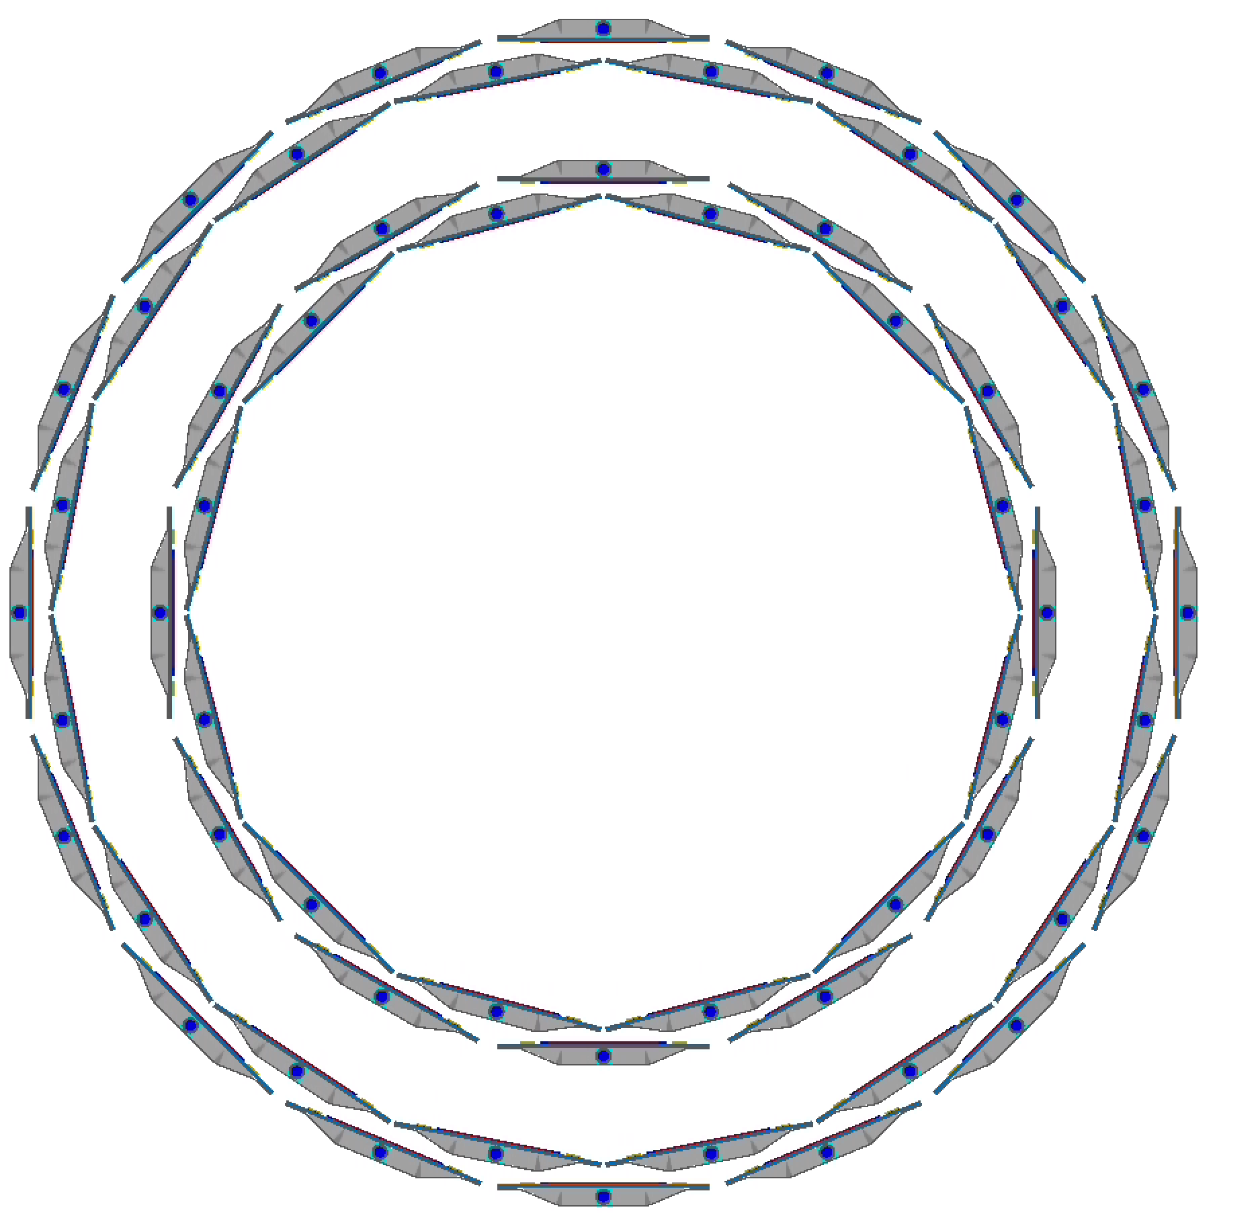
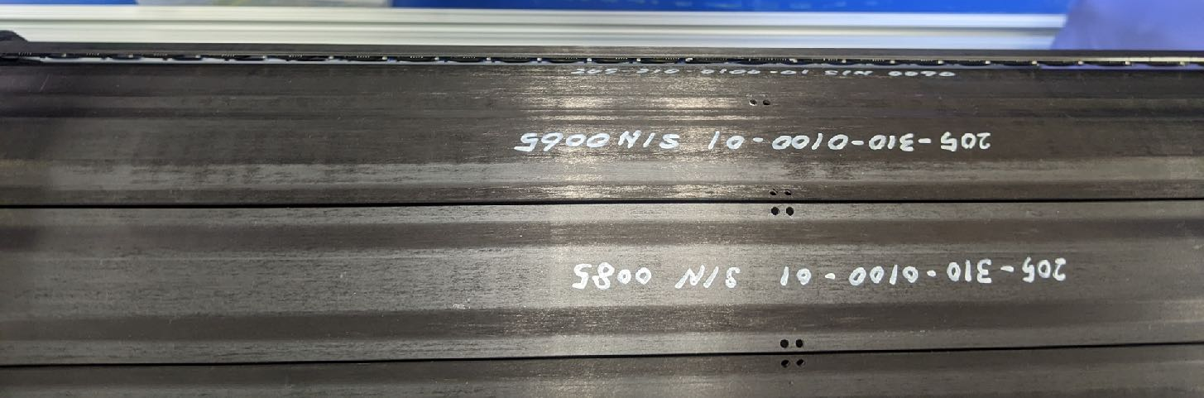
Tests of the barrel ladders
B0L0
June/06 : Ladder installation and cabling done
June/10 : Ladder survey done
June/14 : Ladder calibration tests done
B0L1
June/15: Ladder installation and cabling done
June/17: Ladder survey done
now: Ladder calibration tests ongoing
Notation: BxLyzz
x: Barrel ID (0 for inner or 1 for outer)
y: Layer ID (0 for inner or 1 for outer)
zz: Ladder ID (from 0 to 15)
 | Date | Tested layers | Results
1st test | June/10-June/14 | B0L0 | Good.
2nd test | June/17-July/07 | B0L1, some of B0L0 | Some ladders in B0L1 were noisy. GND condition was investigated.
3rd test | Aug/10- now | B1L0 (some of) B0L1&B0L0 | Ongoing Tested ladders showed good results.
4th test | later…
B0L0
B0L1
B1L0
B1L1

Slide 3
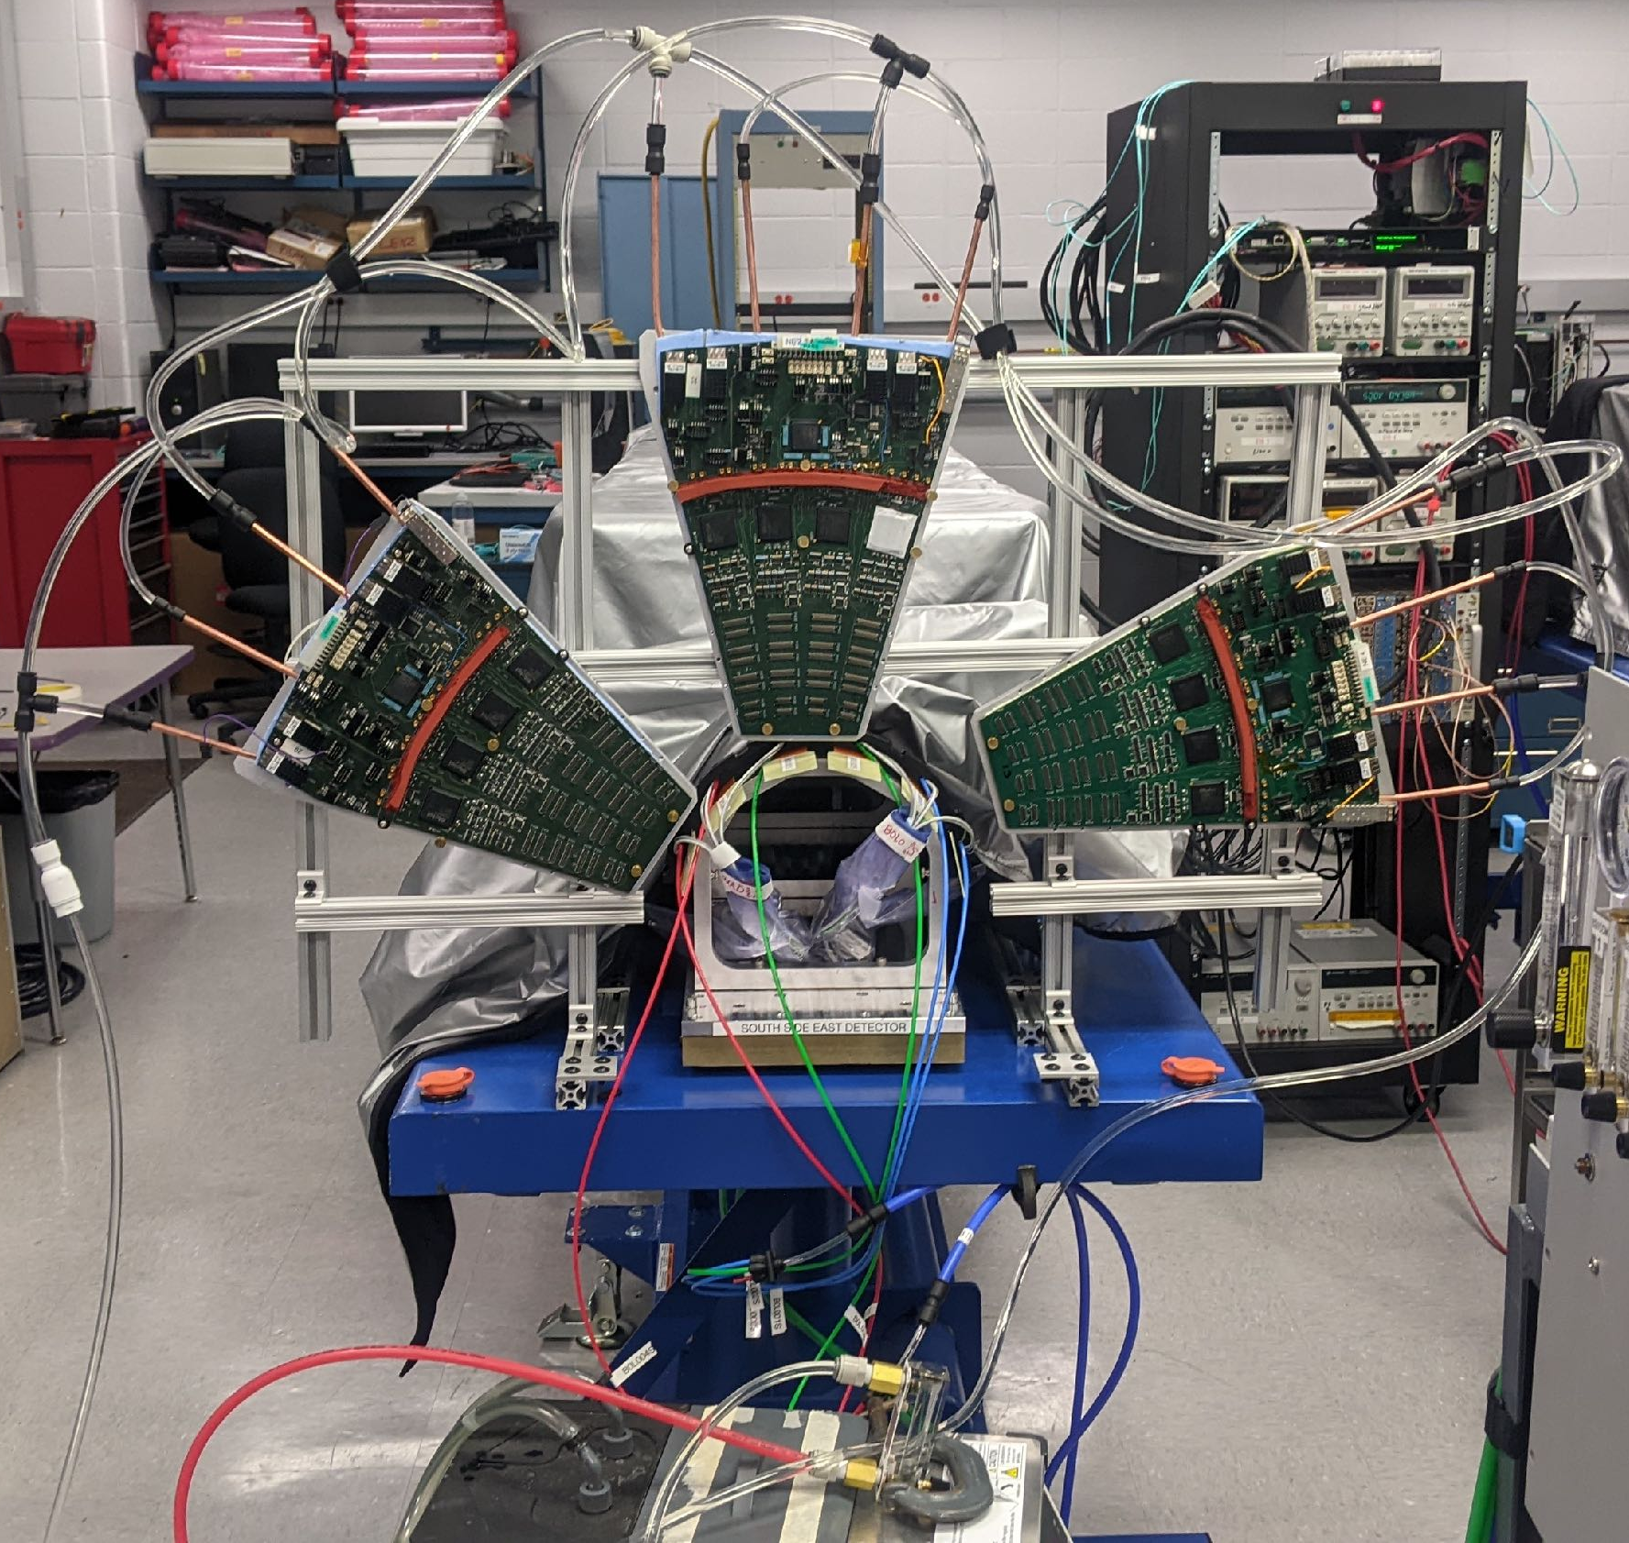
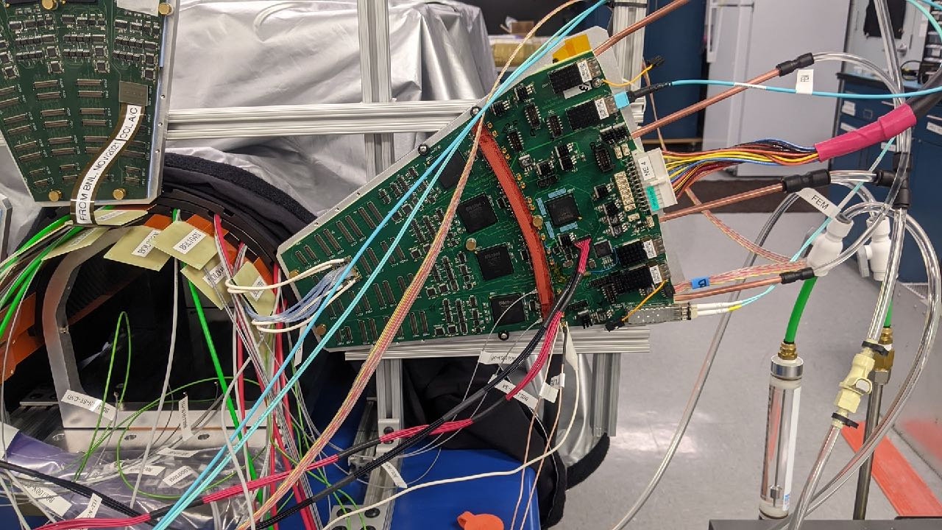
The barrel calibration tests: The setup
3 good ROCs (NE2, NE4, and #29)
3 ROCs were put on each side in the 3rd test
The FEM/FEM-IB system
The same LV system as the test bench
upgraded in the 3rd test
The new temperature monitor system
The ladder cooling and the ROC cooling
The FPC conversion cable or the μ-coaxial conversion cable was used. No difference found b/w the 2 types.
A single ladder was operated to test it.
NE2
#29
NE4

Slide 4
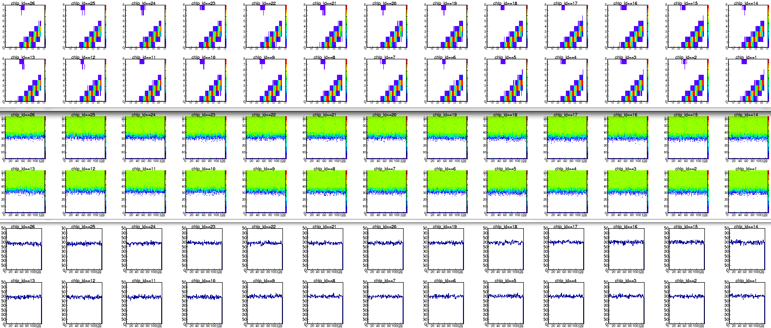
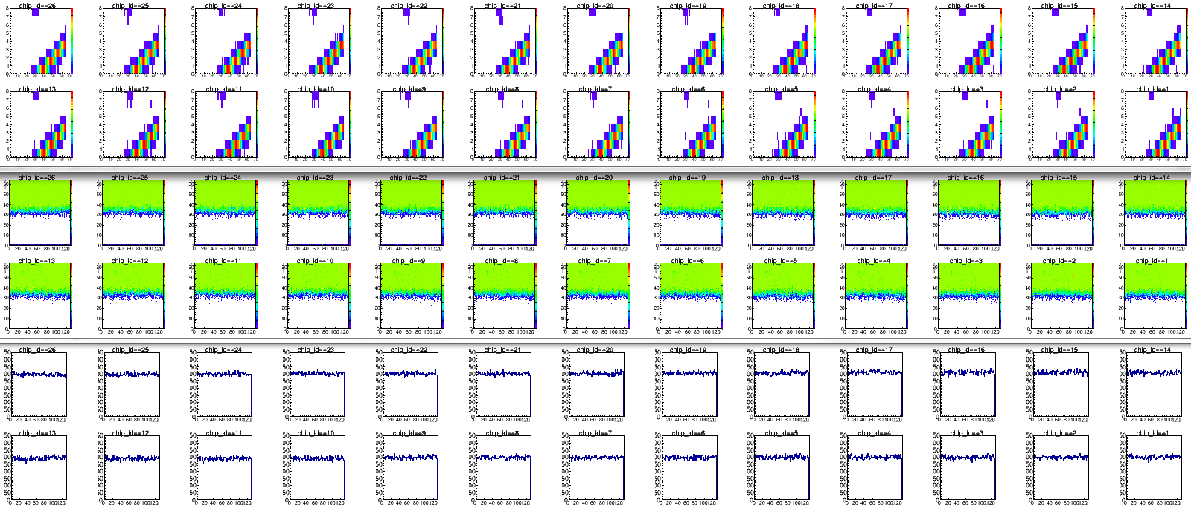
Results: A typical good case (the 1st&2nd tests)
B0L002S (PB1-L031)
Bias current
type-A: 184 nA
type-B: 141 nA
south side
Test bench
Chip13
Data: 20220513_1217, 111 cm Bus extender + 20 cm FPC conversion cable
Chip13
Generally speaking, many ladders showed results as good as ones in the test bench
Barrel
(1st test)
Bias current
type-A: 135 nA
type-B: 102 nA
Data: 20220613_1546

Slide 5
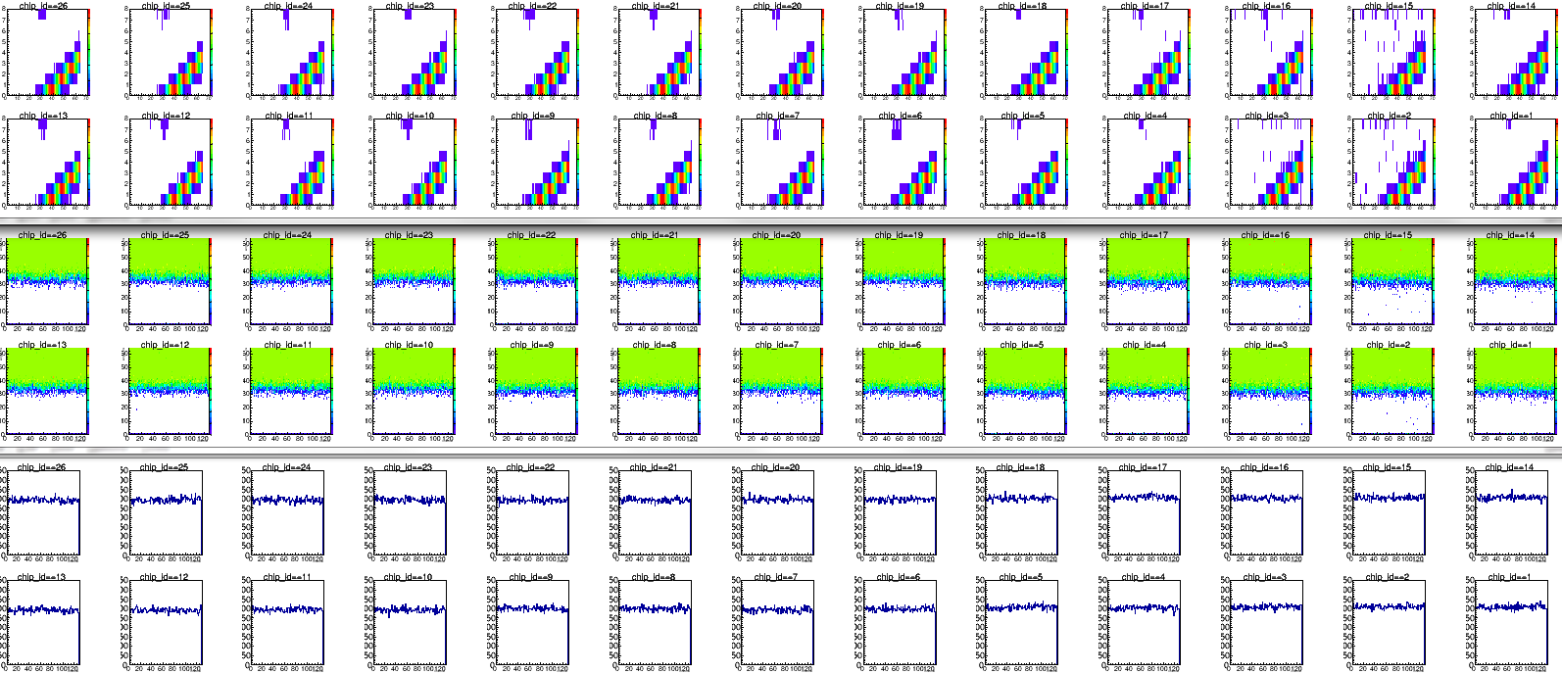
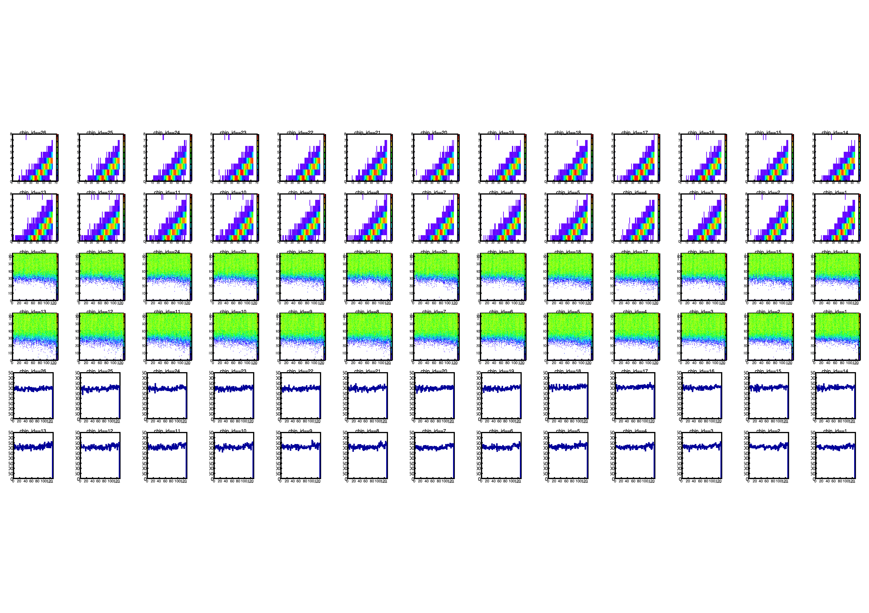
Results: A typical difficult case (the 2nd test)
Many ladders showed results as good as ones in the test bench
Some ladders had more noise… …, for example: B0L103N
B0L103N (PB1-L0??)
Due to the radiation source↓
Bias current
type-A: 139 nA
type-B: 98 nA
north side
Test bench
Chip13
Data: 20220420_1927
Chip13
Results in the barrel had more noise than those in the test bench on some B0L1 ladders.
Barrel
Bias current
type-A: 117 nA
type-B: 83 nA
Data: 20220622_1248 (after modification of GND, good results were obtained)

Slide 6
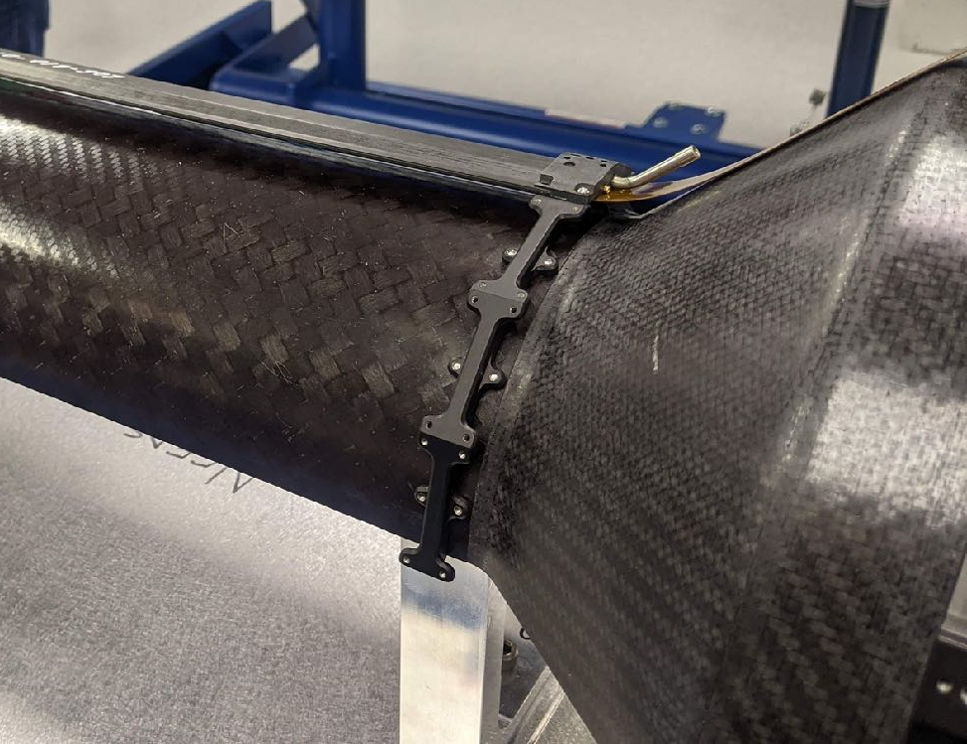
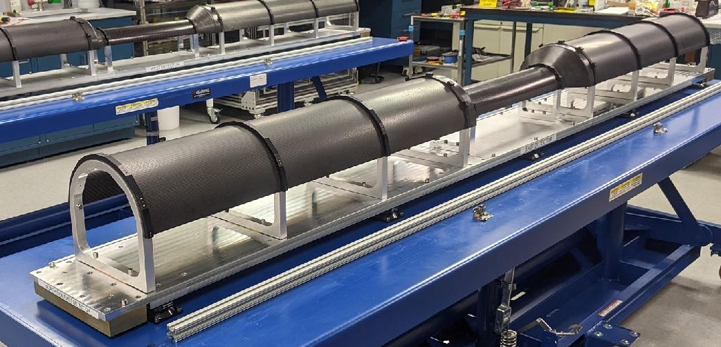
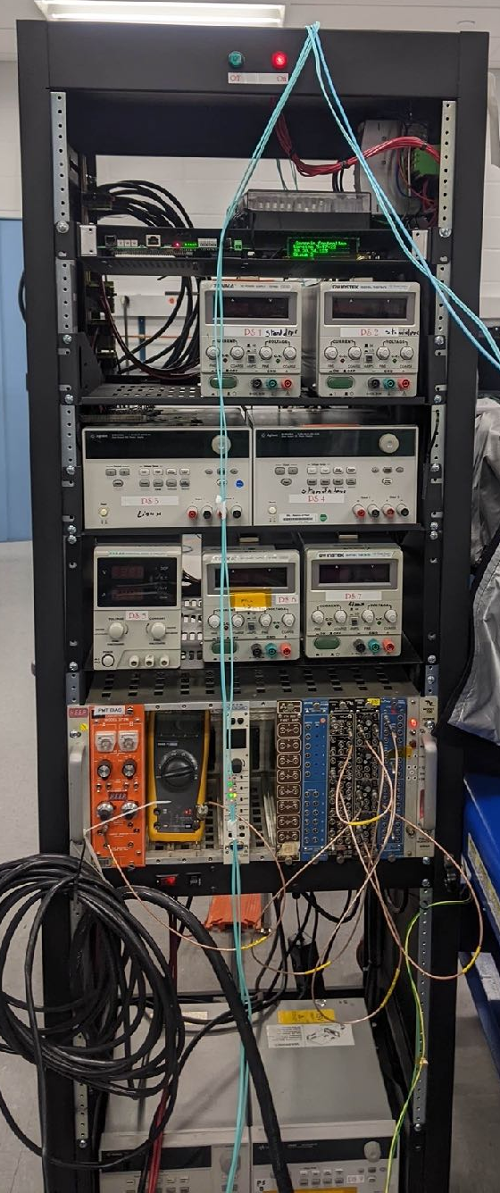
The barrel calibration tests: The setup
to the power supplies
ROC power supply cables
FPHX power supply cables
to the bias power supply
Bias cables
HDI
Bus extender
ROC
power
supplies
B0L1 (East)
Conversion cable
Stave
GND
cables
Stave GND cables
B0L0 (East)
Stave
GND
cables
Bias
power
supply
Stave GND cables
Aluminum supporting structure
Note: CFC cone omitted
power for the lack

Slide 7
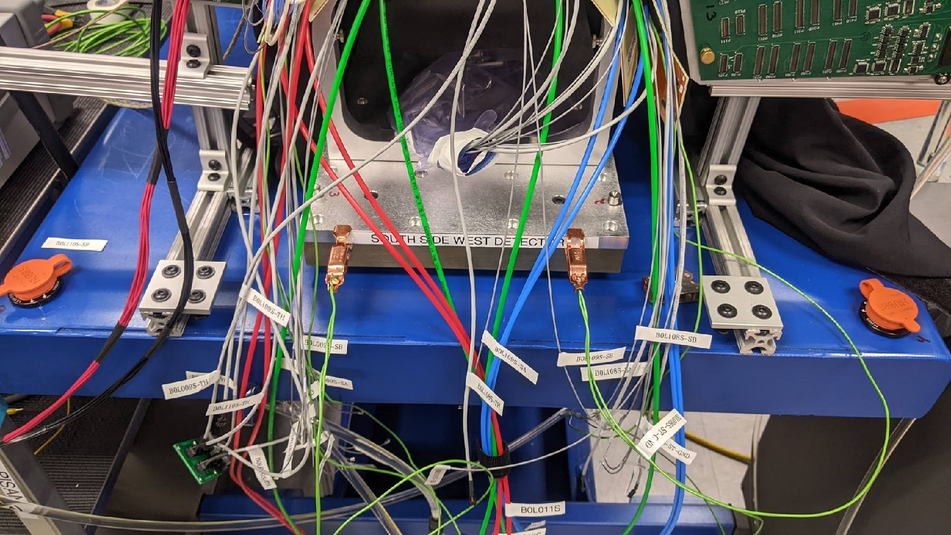
GND investigations in the 2nd test
to the power supplies
ROC power supply cables
to the bias power supply
B0L1 (East)
Bias cables
HDI
Bus extender
Conversion cable
Stave
GND
cables
B0L0 (East)
Stave
GND
cables
Stave
GND
cables
Without the stave GNDs connection to the aluminum supporting structure,
B0L0 <—> the supporting structure: ~0 Ω
B0L1 <—> the supporting structure: 180 Ω
Aluminum supporting structure
Note: CFC cone omitted

Slide 8

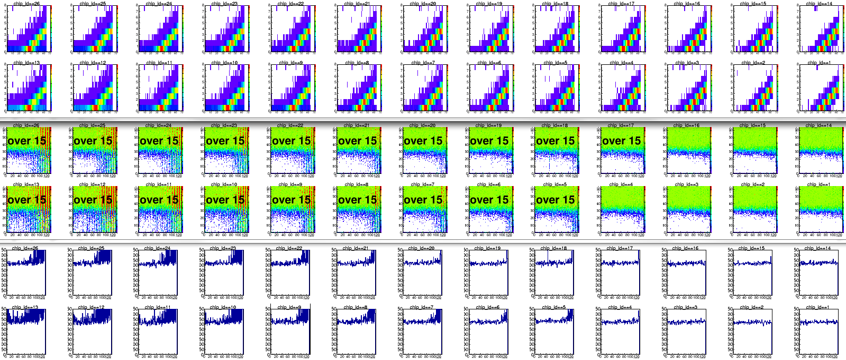
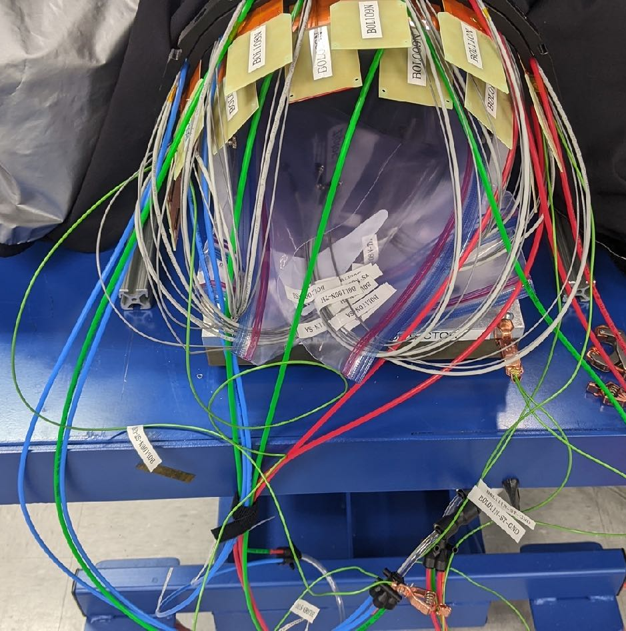
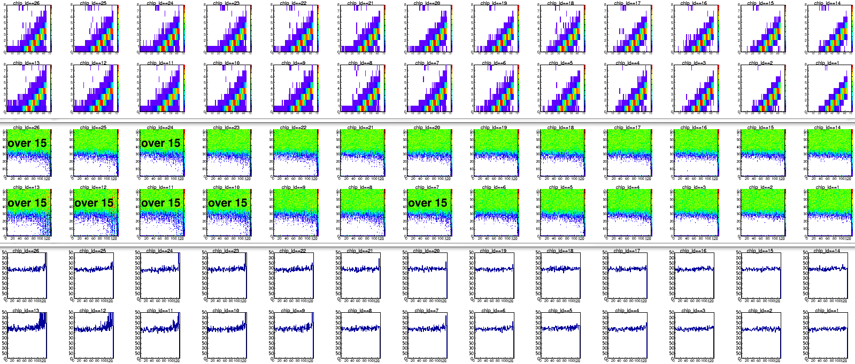
GND investigations: The harvest
9
8
10
9
8
10
7
7
11
11
6
6
Connecting the stave GNDs to the aluminum supporting structure drastically improves the condition.
B0L111S
June/29
B0L0 ↔ the supporting structure: ~0 Ω
B0L1 ↔ the supporting structure: 180 Ω
South side
July/07
B0L0 ↔ the supporting structure: ~0 Ω
B0L1 ↔ the supporting structure: ~0 Ω
All staves must be well connected to GND. In the IR, there is a GND port for this purpose. In the silicon lab, the aluminum supporting plate on the table can be large enough GND port.
Power supplies with less noise are also necessary.
North side

Slide 9
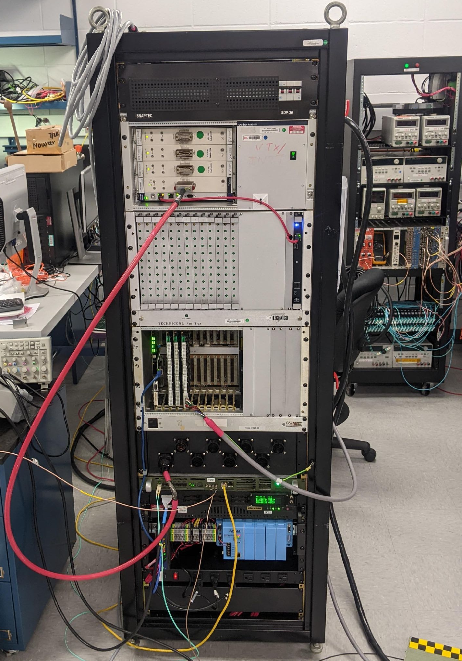
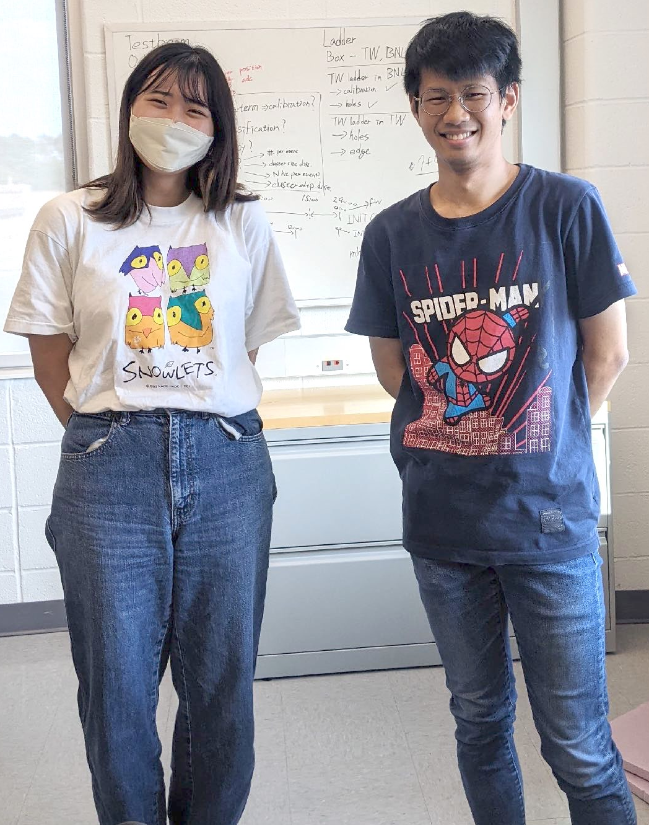
Upgrades on HV&LV
old HV&LV
system ↓
HV & LV power supplies were upgraded to the same one used in IR, so the environment is much cleaner now.
Thanks to Maki&Wei-Che, the new power supply system is operational.
See their reports for more details:
HV by Maki
LV by Wei-Che
The 3rd test was started on Aug/10.
Maki Wakata
(Rikkyo Univ.)
Wei-Che Tang
(NCU)
The new HV&LV system

Slide 10
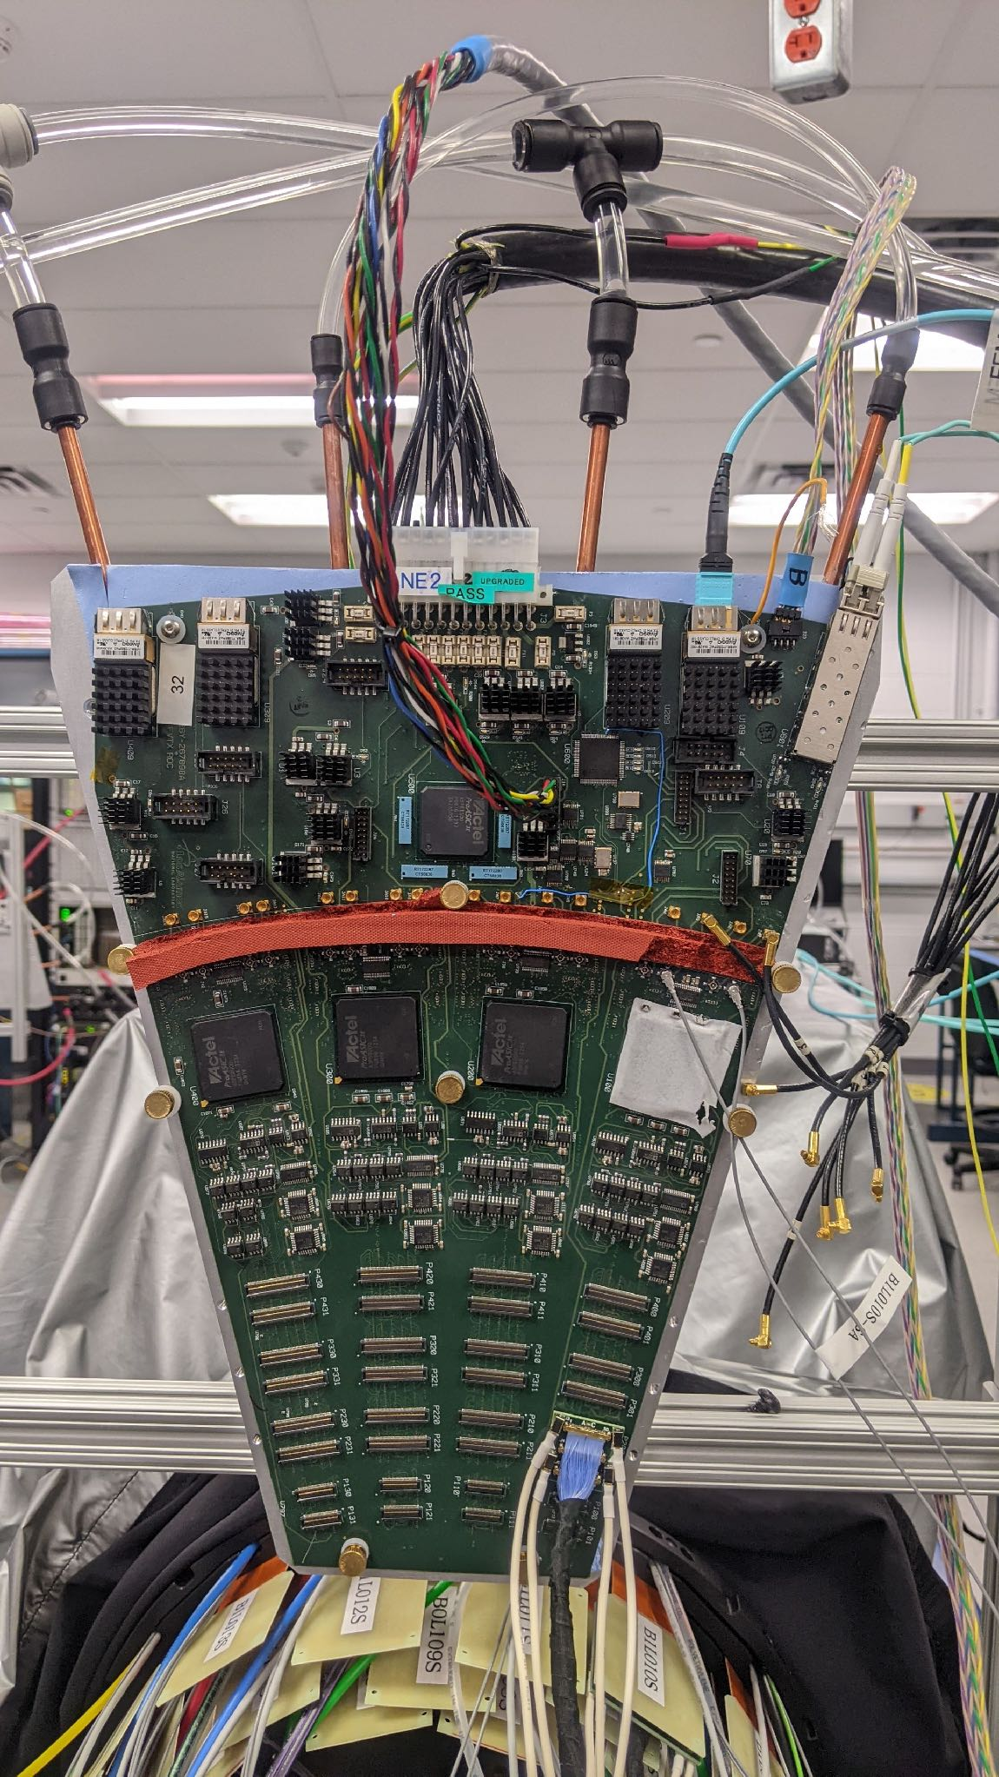
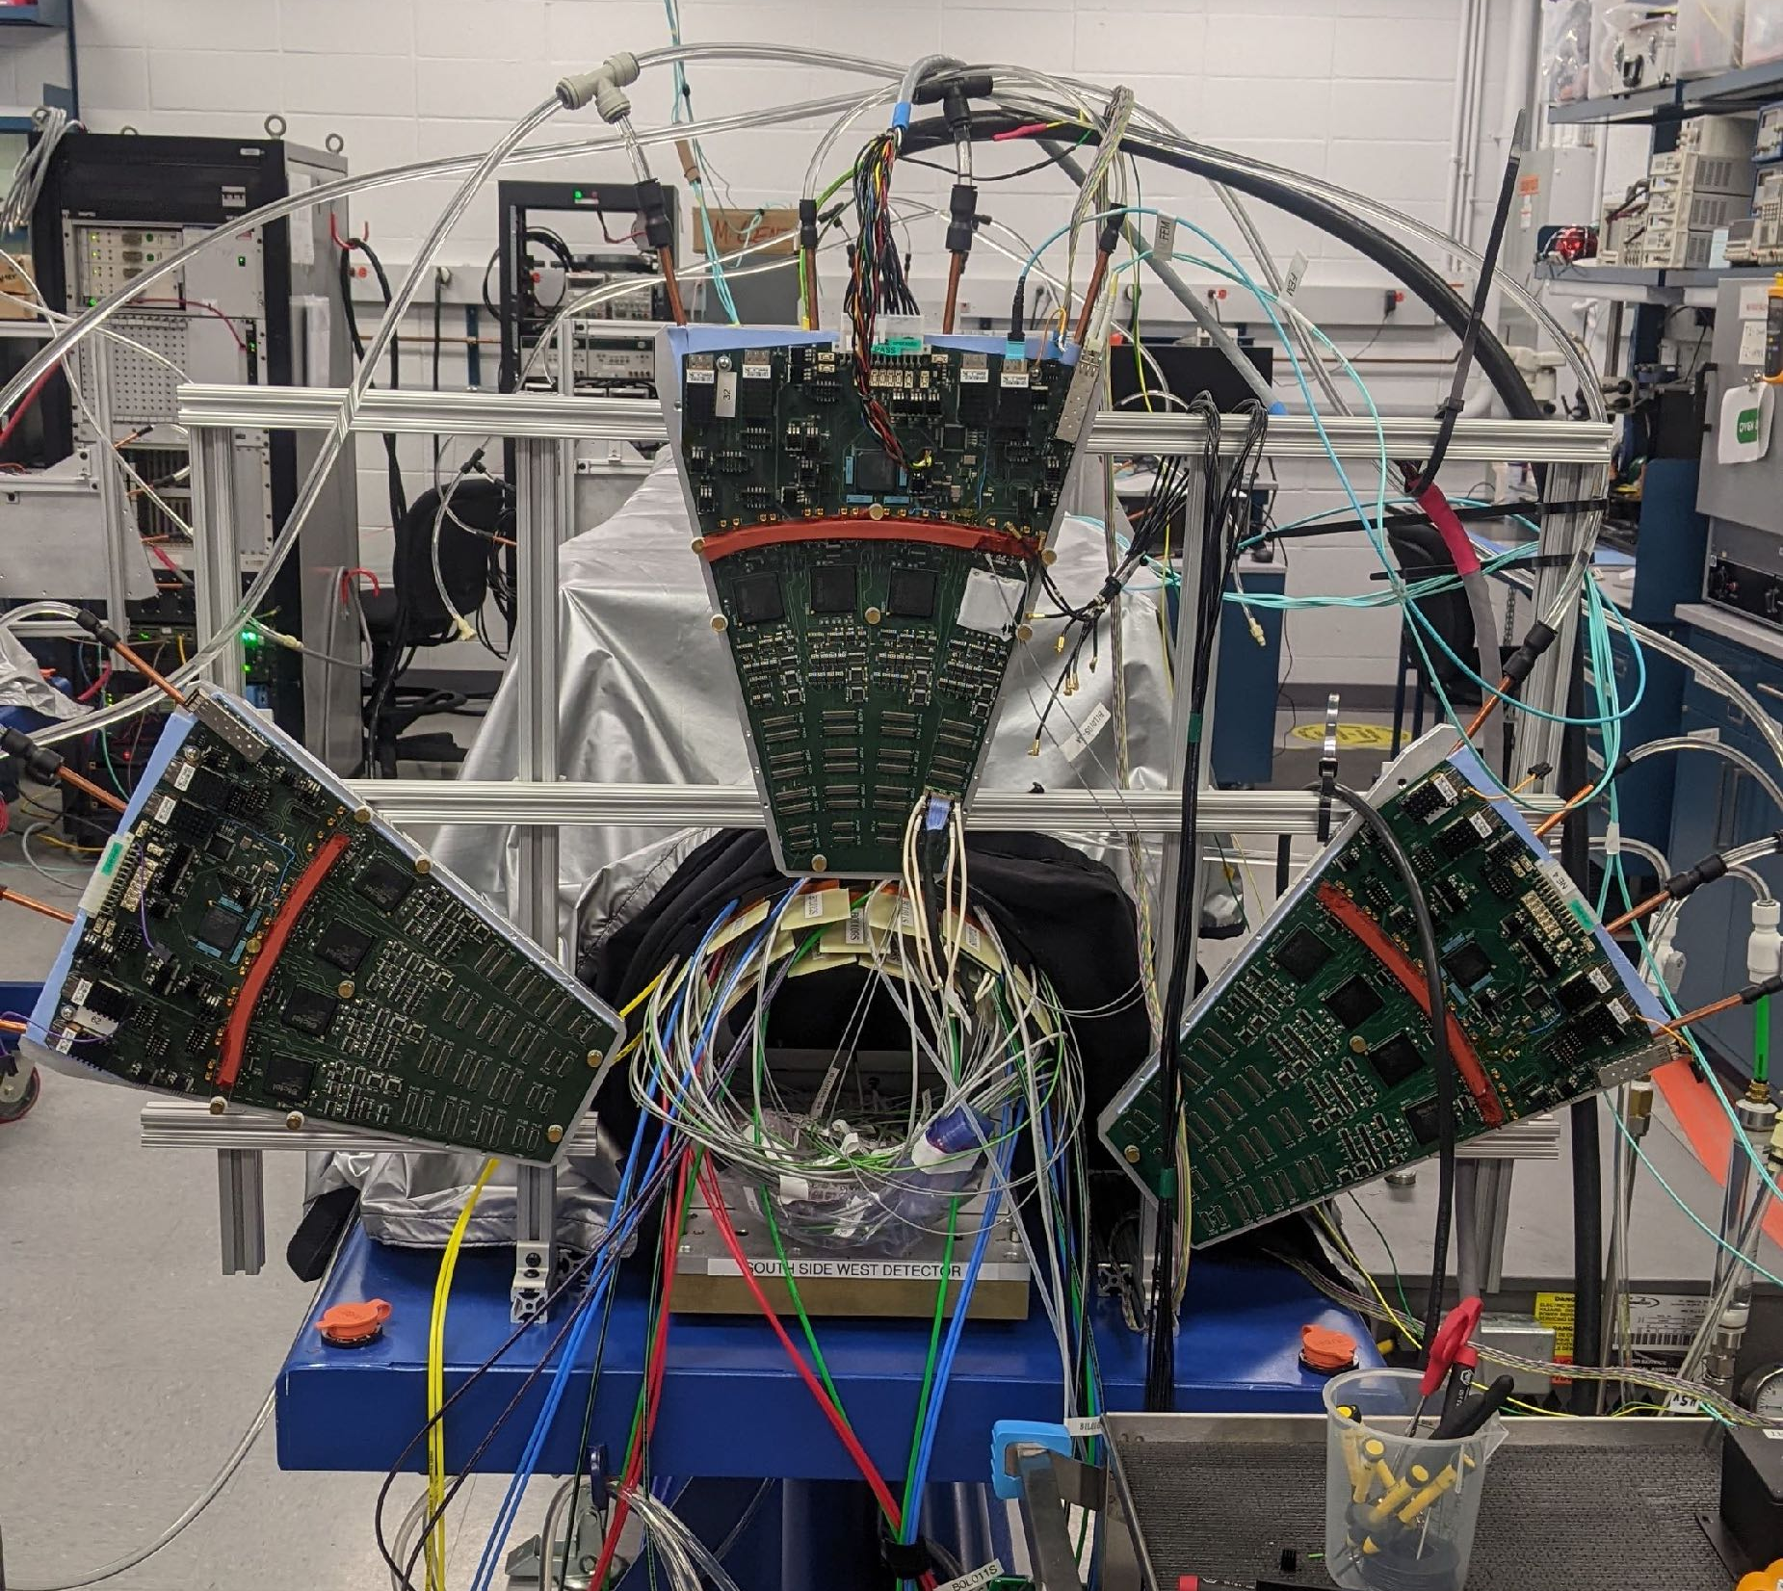
The 3rd test
new ROC power cable
new FPHX power cable
new bias cables

Slide 11
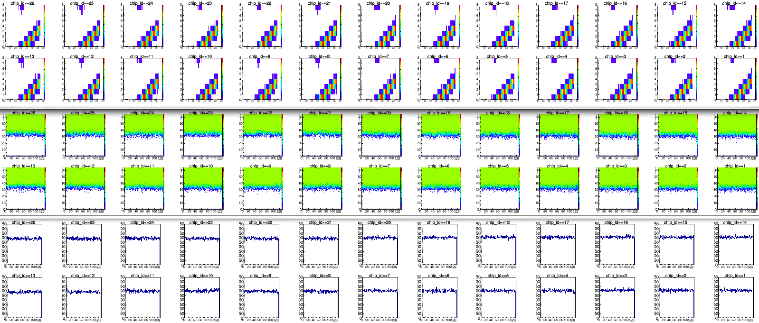
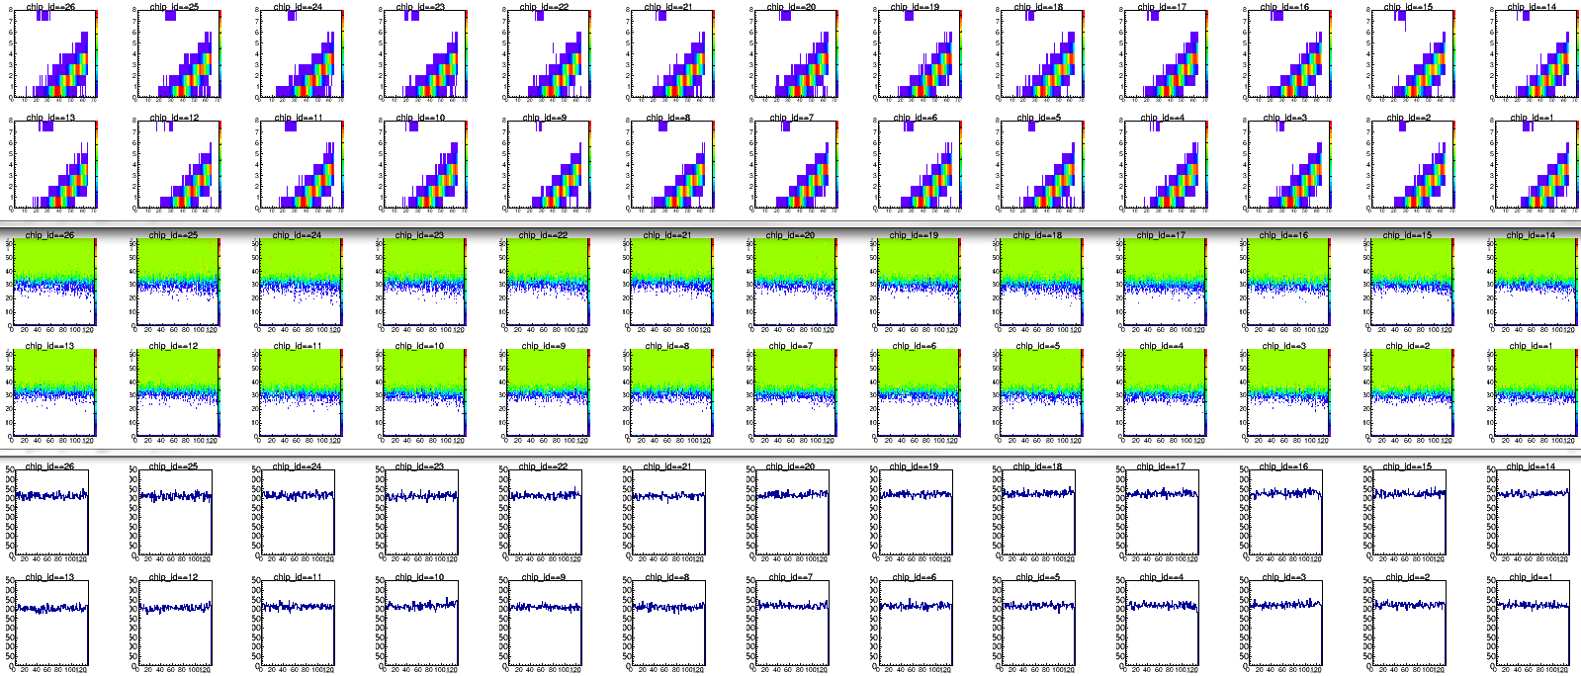
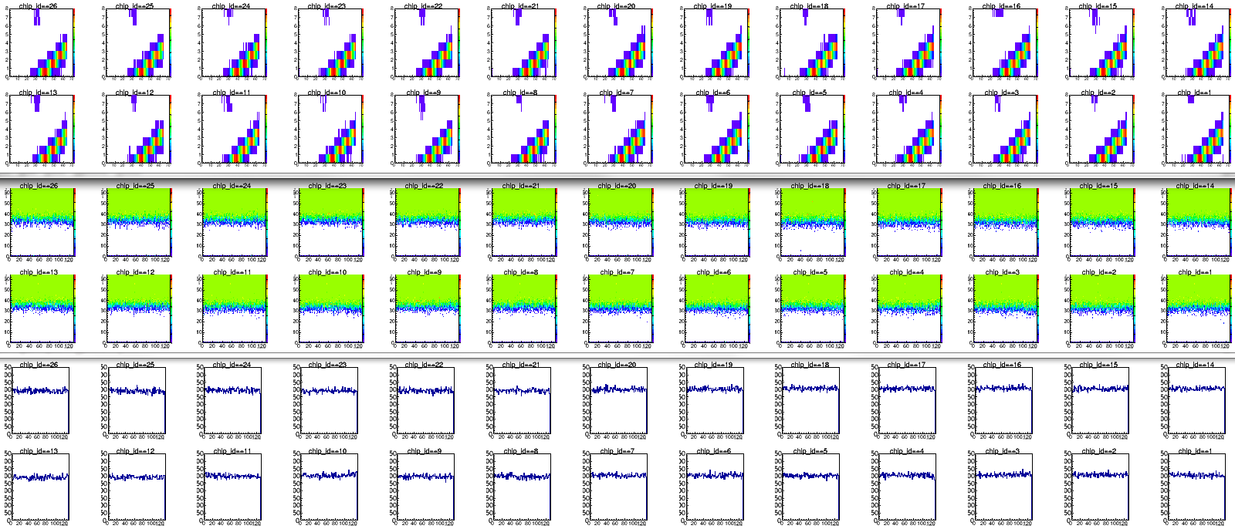
Results: Good news from 3rd test
Many ladders showed results as good as ones in the test bench
Some ladders had more noise… …, for example: B0L103N
B0L109N (PB1-L023)
Chip26
Test bench
Bias current
type-A: 204 nA
type-B: 105 nA
Data: 20220506_1747
Chip26
north side
Barrel
the 2nd test
Bias current
type-A: 143 nA
type-B: 87 nA
Chip13
Data: 20220621_1316
Chip26
Bias current
type-A: 117 nA
type-B: 83 nA
Barrel
the 3rd test
The noise in the 2nd test is not in the 3rd test. It’s as good as the one on the test bench.
Bias current
type-A: 262 nA
type-B: 291 nA
Data: 20220811_1137

Slide 12
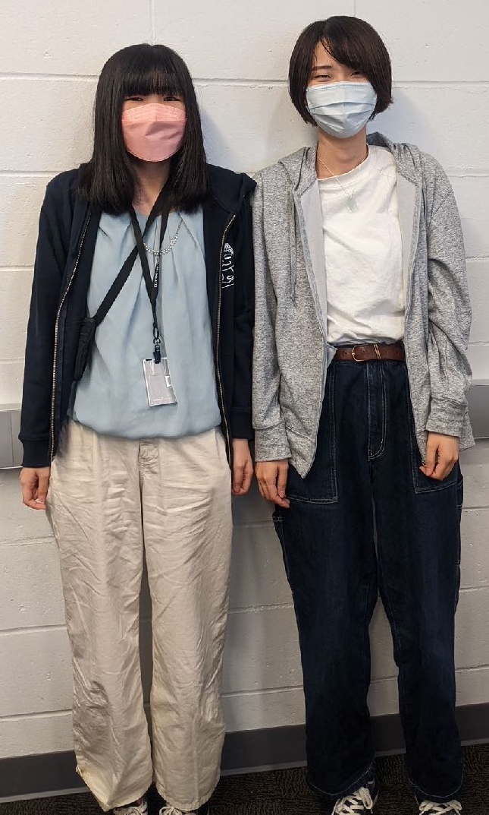
The 3rd test: Current situation and prospect
North South
3rd test is ongoing now, mainly by M. Hata and M. Watanabe.
For the moment, all tested ladders showed very good results like in the test bench.
In the best cases, testing 1 half-ladder takes ~10 min. If we test all ladders, there are 2×(12 + 12 + 18) = 84 ladders, it takes about 14 hours.
20 min/half-ladder is in average. → 28 hours
Maybe 6 working days are enough.
Once the 2nd Felix operation system is available for these tests, we will migrate from the FEM/FEM-IB system to the new one.
Tested, very good
Tested, slightly noisy
Tested, noisy
Mai Watanabe
(NWU)
Misaki Hata
(NWU)
: OK, but the results are with readout issues

Slide 13
Summary
 | Date | Tested layers | Results
1st test | June/10-June/14 | B0L0 | Good.
2nd test | June/17-July/07 | B0L1, some of B0L0 | Some ladders in B0L1 were noisy. GND condition was investigated.
3rd test | Aug/10- now | B1L0 (some of) B0L1&B0L0 | Ongoing Tested ladders showed good results.
4th test | later…
North South
Tested, very good
Tested, slightly noisy
Tested, noisy
3rd test is ongoing now, mainly by M. Hata and M. Watanabe.
For the moment, all tested ladders showed very good results like in the test bench.
In the best cases, testing 1 half-ladder takes ~10 min. If we test all ladders, there are 2×(12 + 12 + 18) = 84 ladders, it takes about 14 hours. 20 min/half-ladder is in average. → 28 hours Maybe 6 working days are enough.
Once the 2nd Felix operation system is available for these tests, we will migrate from the FEM/FEM-IB system to the new one.
Status of the 3rd test

Slide 14
backup

Slide 15
y (vertical)
Notation: BxLyzz
x: Barrel ID (0 for inner or 1 for outer)
y: Layer ID (0 for inner or 1 for outer)
zz: Ladder ID (from 0 to 15)
B1L115
B1L114
B1L100
B1L015
B1L000
B0L100
B1L113
B1L014
B0L111
B0L101
B1L001
B1L101
B0L011
B0L000
B1L013
B0L010
B0L001
B1L02
B1L112
B0L110
B0L102
B1L102
B1L012
B0L009
B0L002
B1L003
B1L111
West
z
East
x
(horizontal)
B0L109
B0L103
B1L103
B1L011
B0L008
B0L003
B1L004
B1L110
B0L108
B0L104
B1L104
B0L007
B0L004
B1L005
B1L010
B0L006
B0L005
B0L107
B0L105
B1L105
Axis
x-axis: y⃗ × z⃗
y-axis: Vertically upward direction
z-axis: The blue beam direction (pointing to the north)
B1L109
B1L009
B1L006
B0L106
B1L008
B1L007
B1L108
B1L106
B1L107

Slide 16
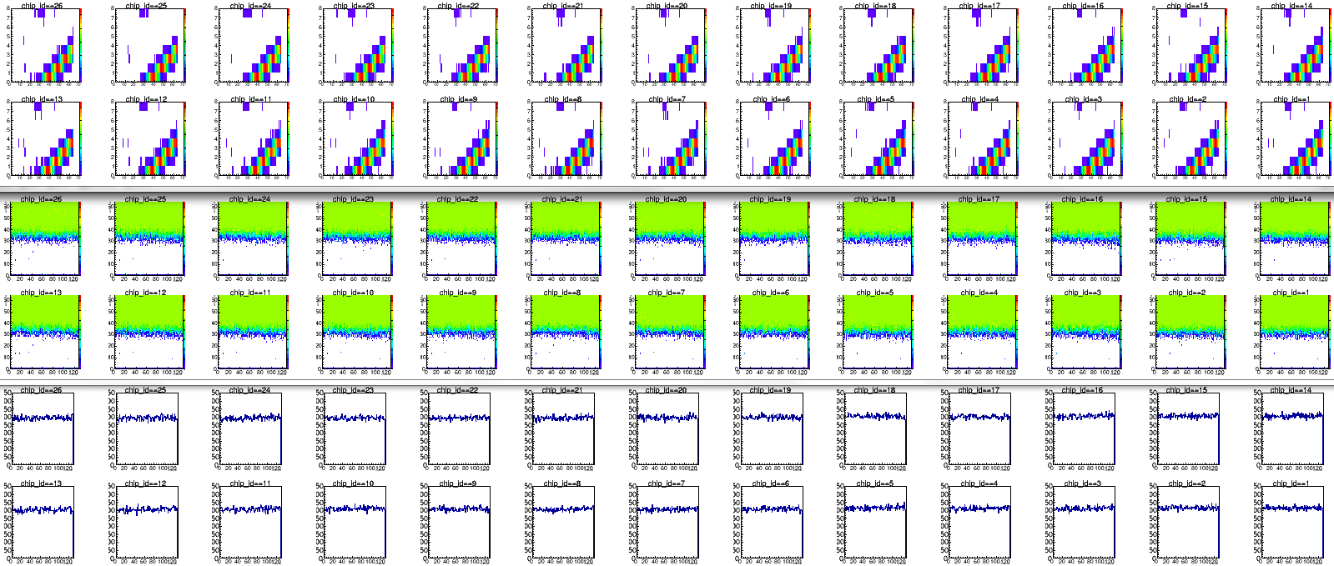
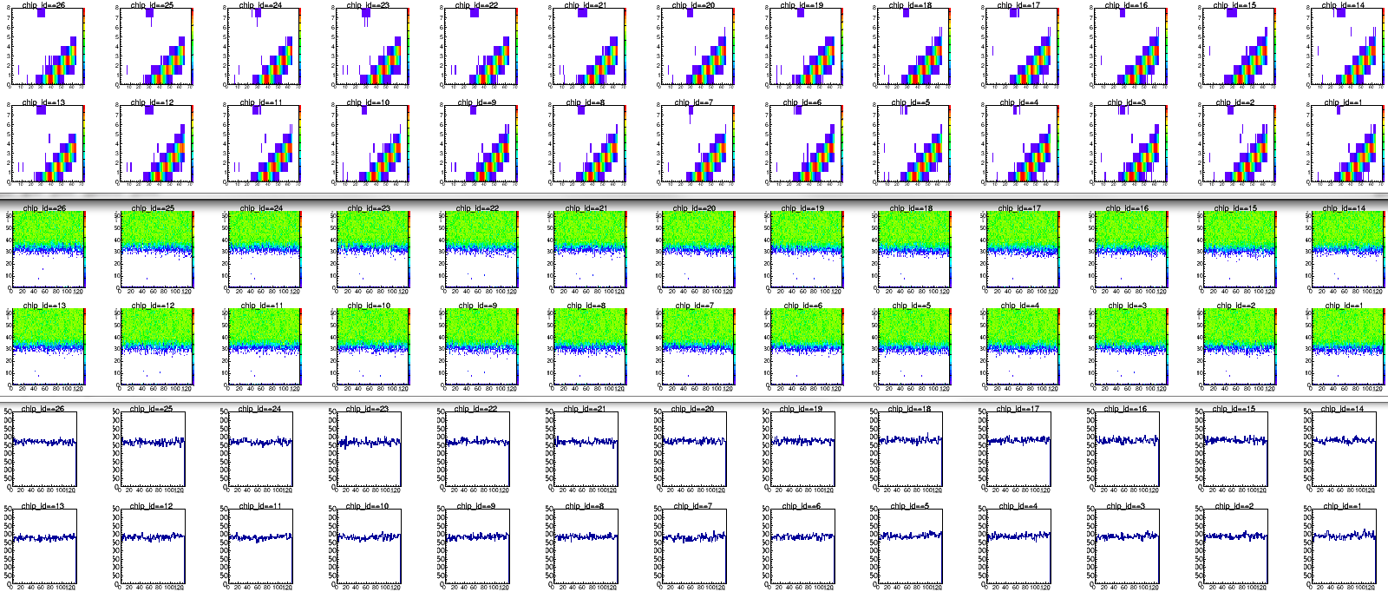
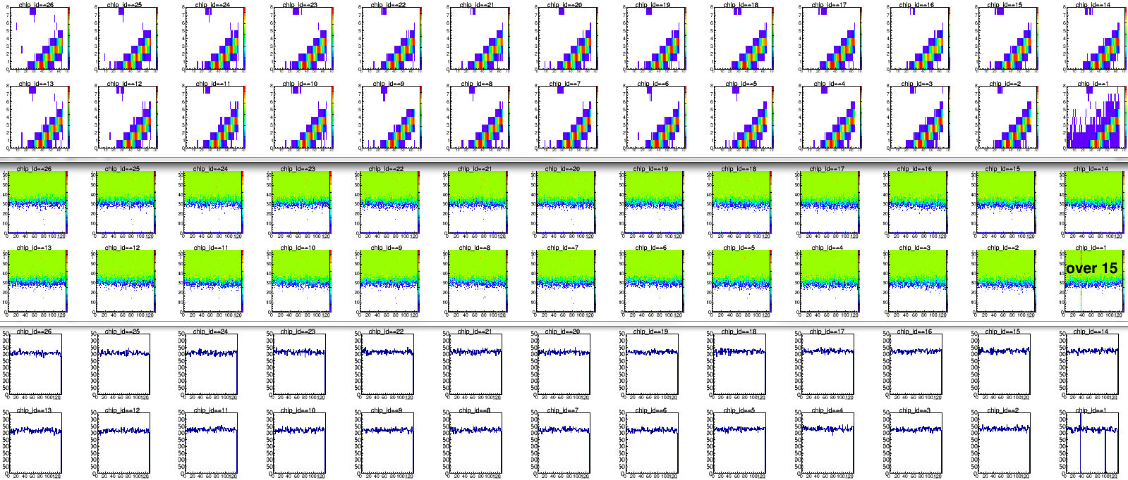
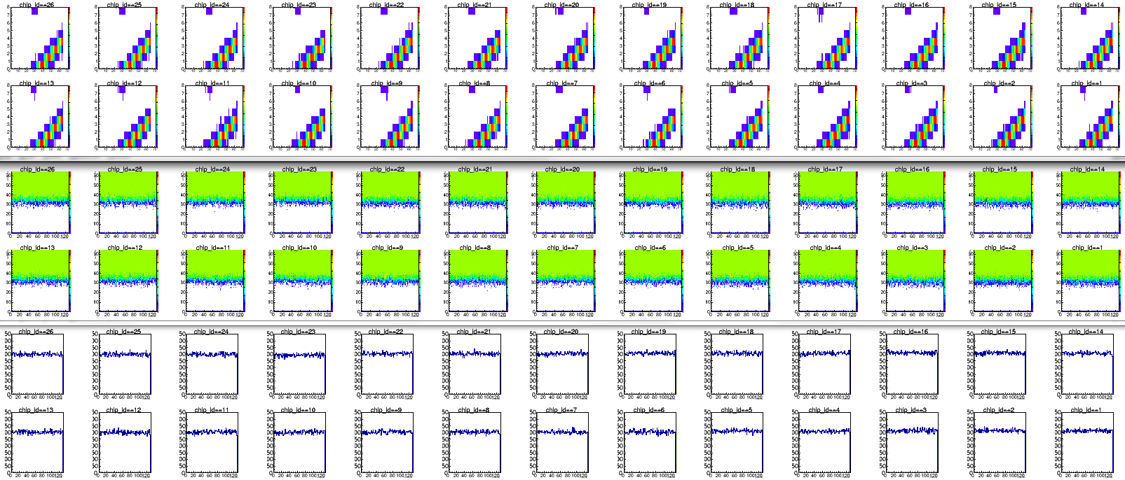
The barrel calibration tests: Results
4
3
3
2
2
10
9
9
8
8
5
4
1
1
11
10
7
7
5
0
11
6
0
6
B0L000
East
barrel
West
barrel
B0L006
North
ROC: #29, C3
ROC: #29, C3
ROC: NE4, C1
ROC: NE4, A3
South

Slide 17
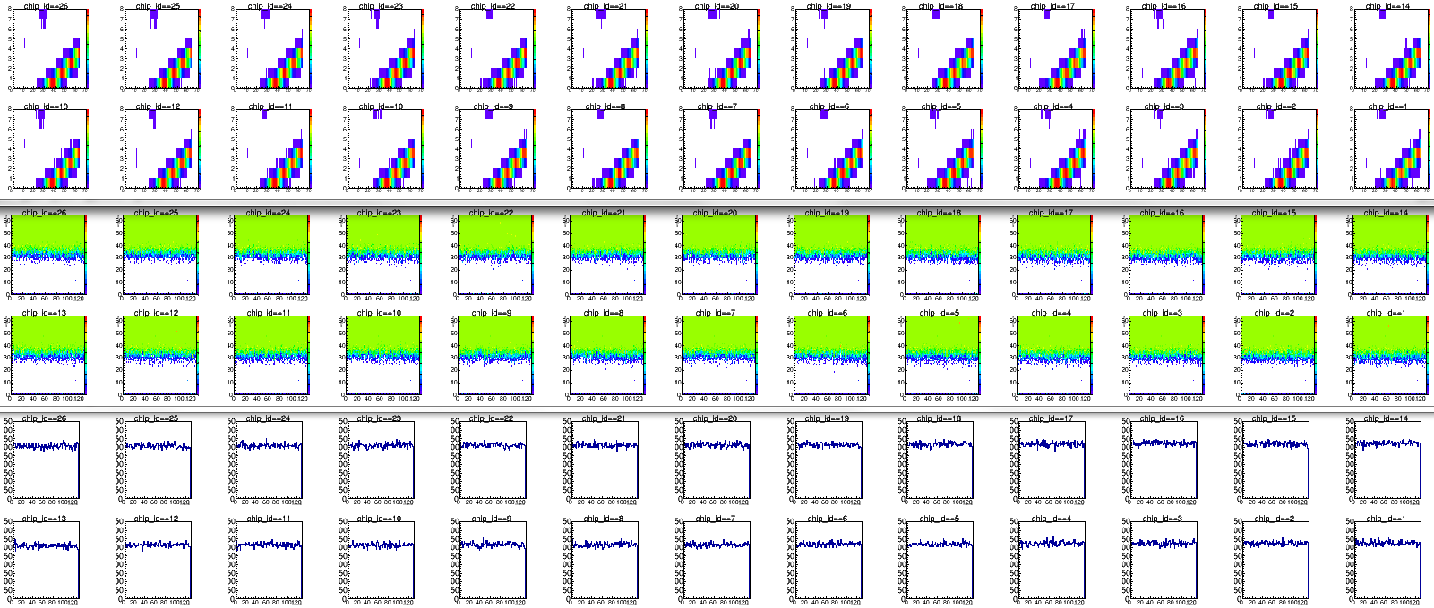
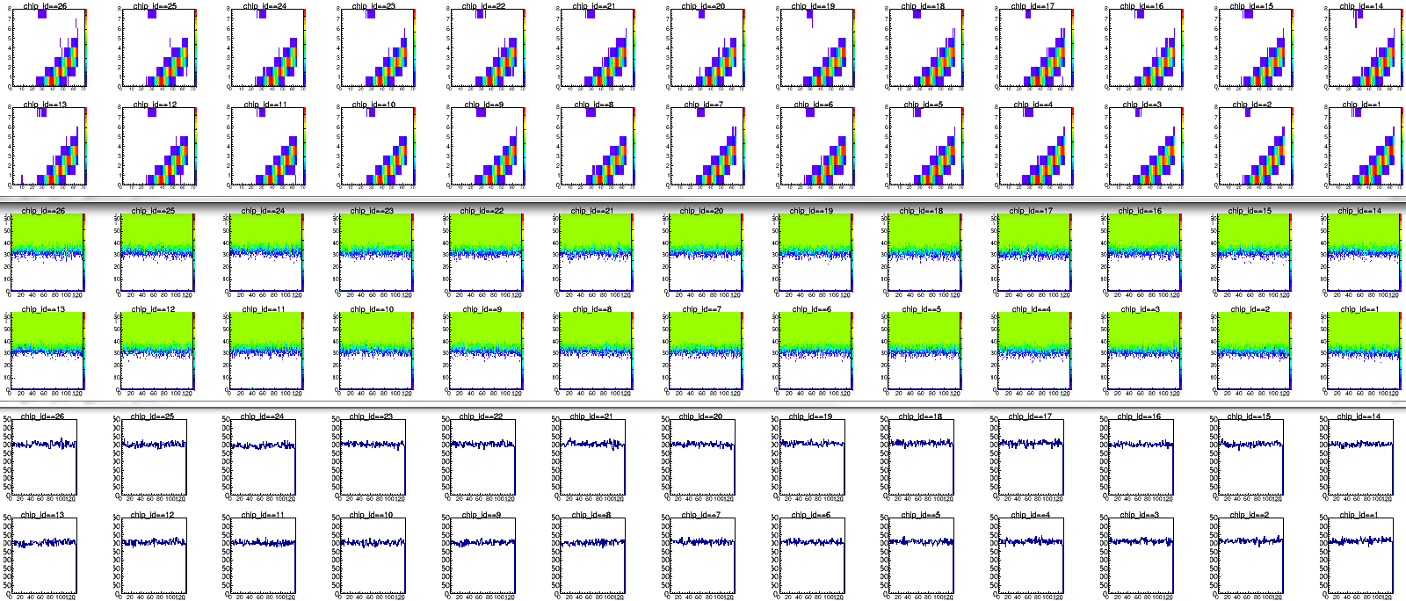
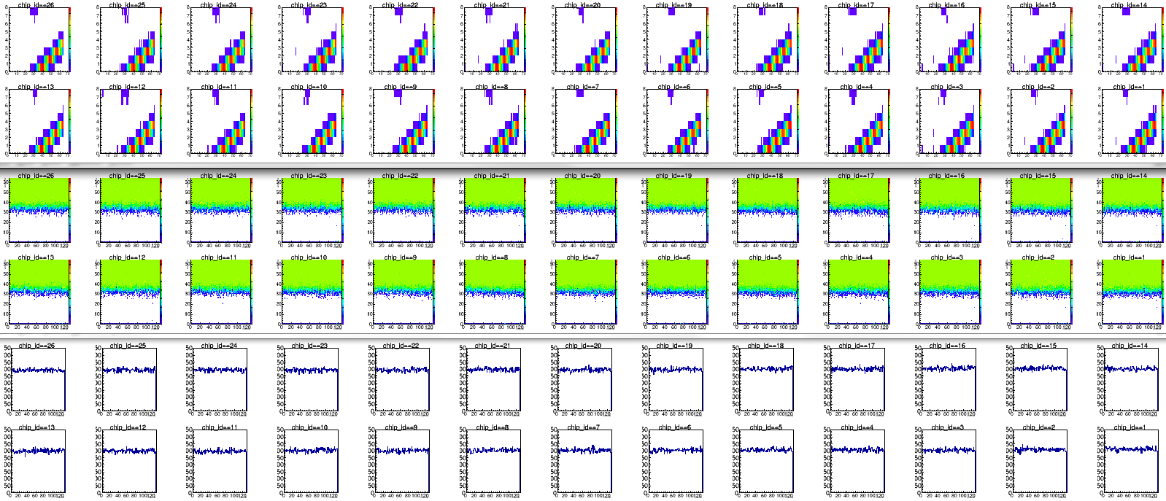
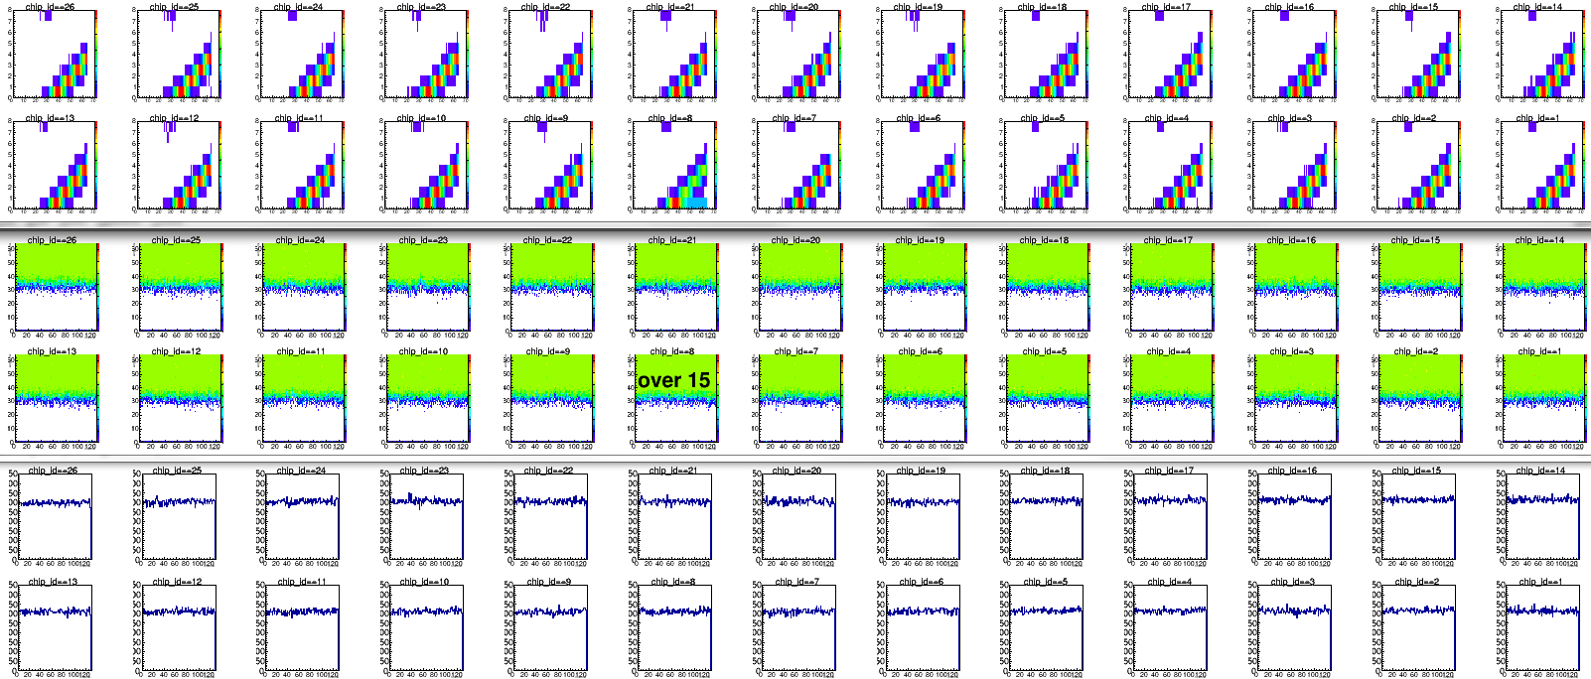
The barrel calibration tests: Results
4
3
3
2
2
10
9
9
8
8
5
4
1
1
11
10
7
7
5
0
11
6
0
6
B0L001
East
barrel
West
barrel
B0L007
North
ROC: #29, C1
ROC: #29, C3
ROC: NE4, C2
ROC: NE2, C2
South

Slide 18
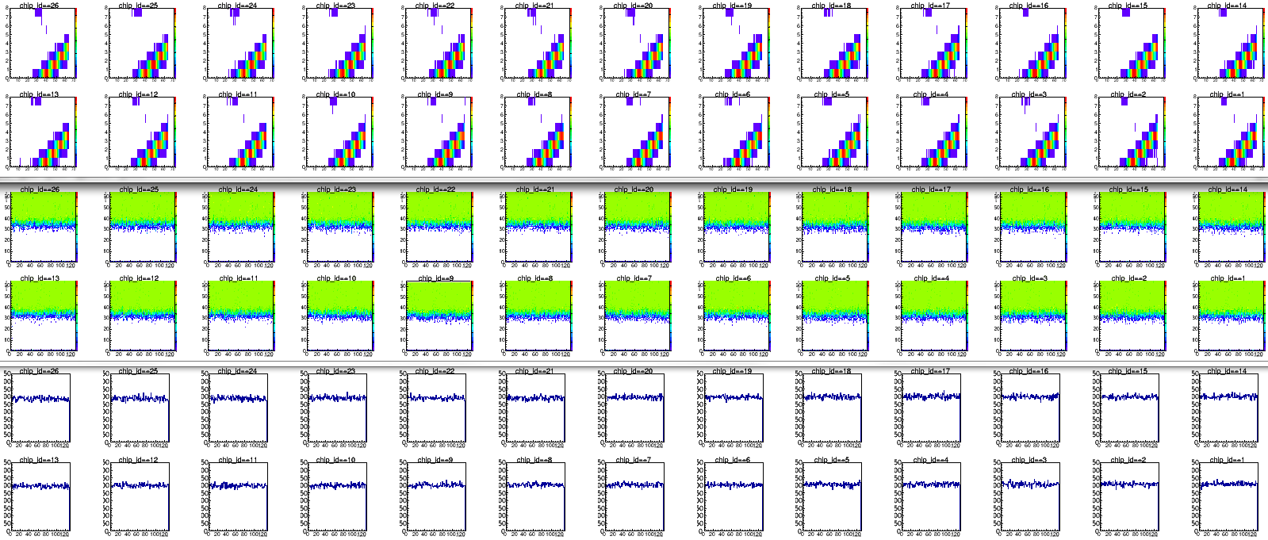
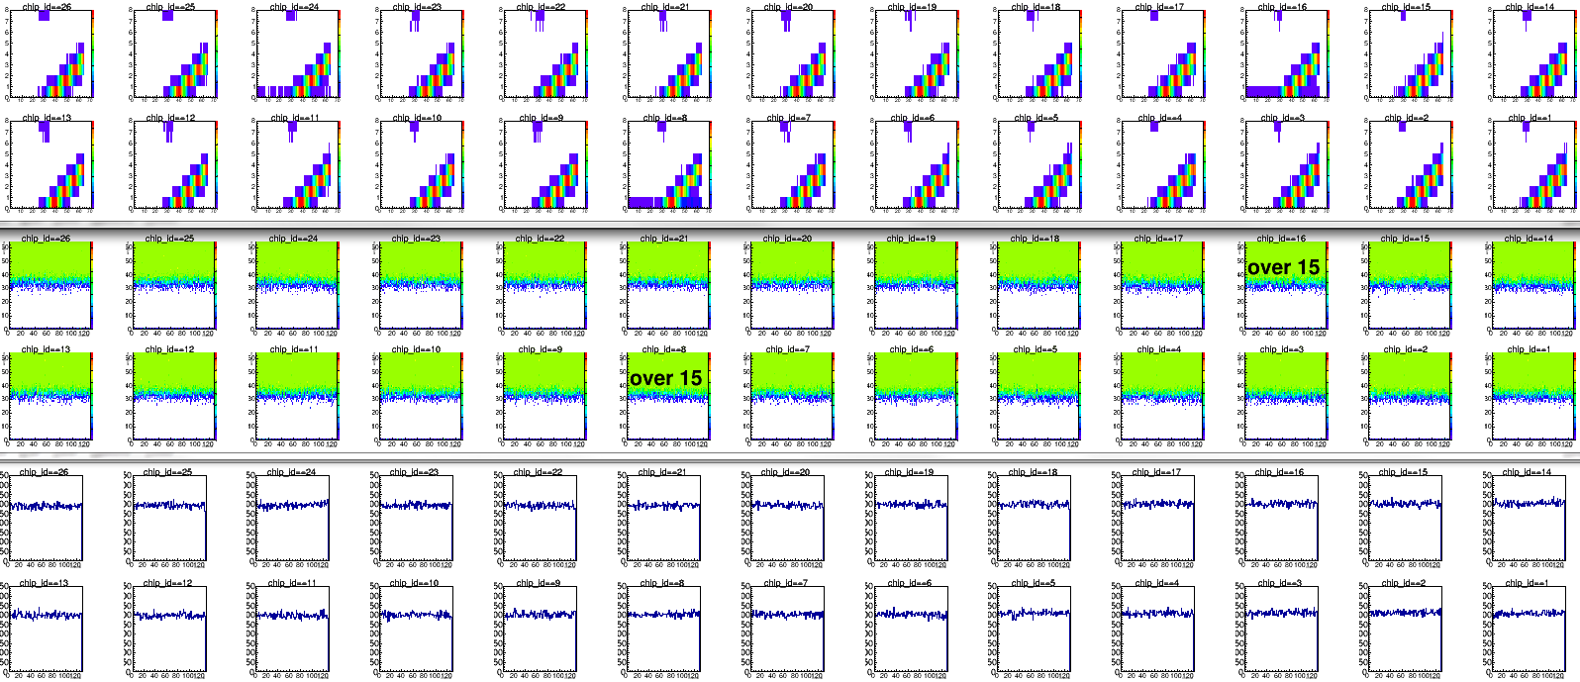
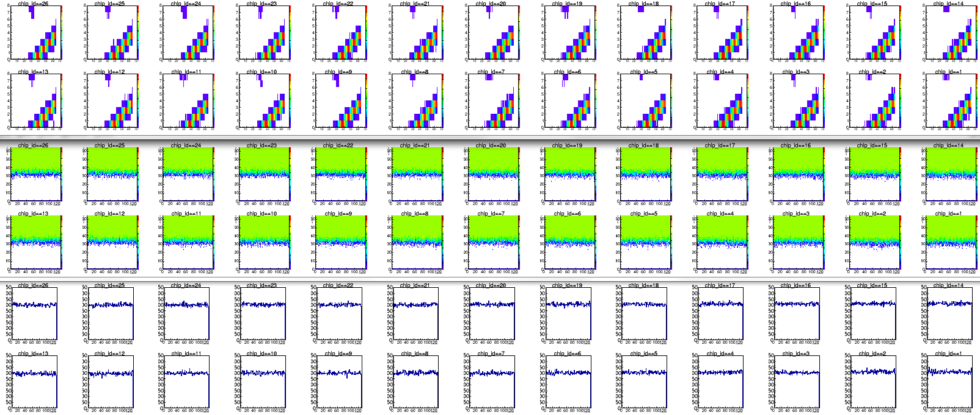
The barrel calibration tests: Results
4
3
3
2
2
10
9
9
8
8
5
4
1
1
11
10
7
7
5
0
11
6
0
6
B0L002
East
barrel
West
barrel
B0L008
North
ROC: NE2, C3
ROC: NE2, C2
ROC: NE2, A3
ROC: NE2, A3
South

Slide 19
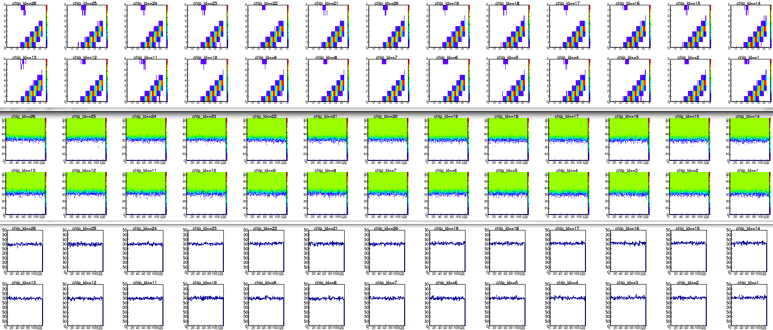
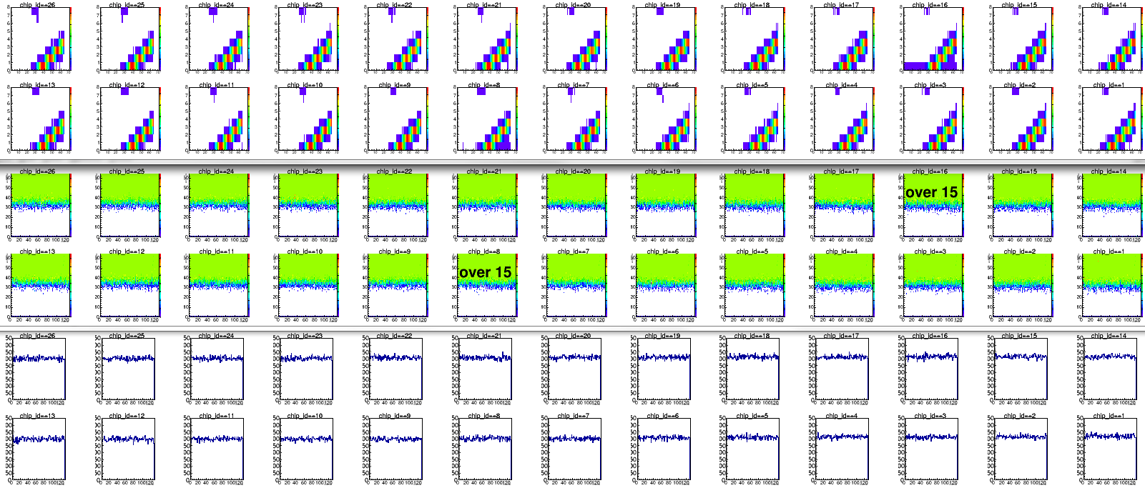
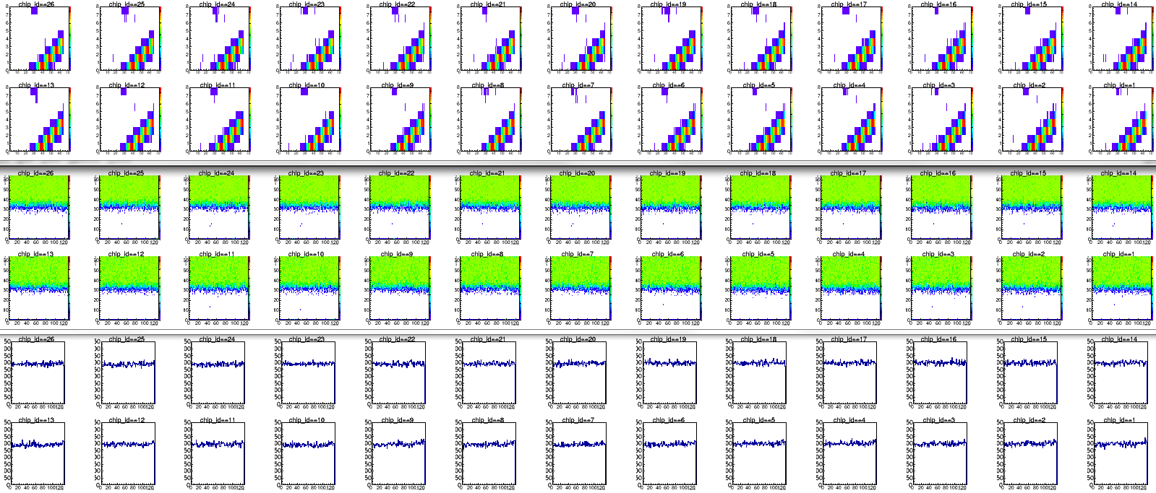
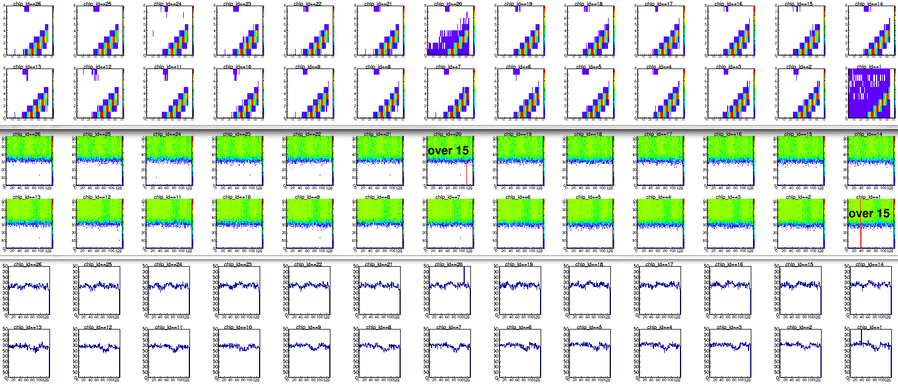
The barrel calibration tests: Results
4
3
3
2
2
10
9
9
8
8
5
4
1
1
11
10
7
7
5
0
11
6
0
6
B0L003
East
barrel
West
barrel
B0L009
North
ROC: NE2, A3
ROC: NE2, A2
ROC: NE2, C3
ROC: NE2, C3
South

Slide 20
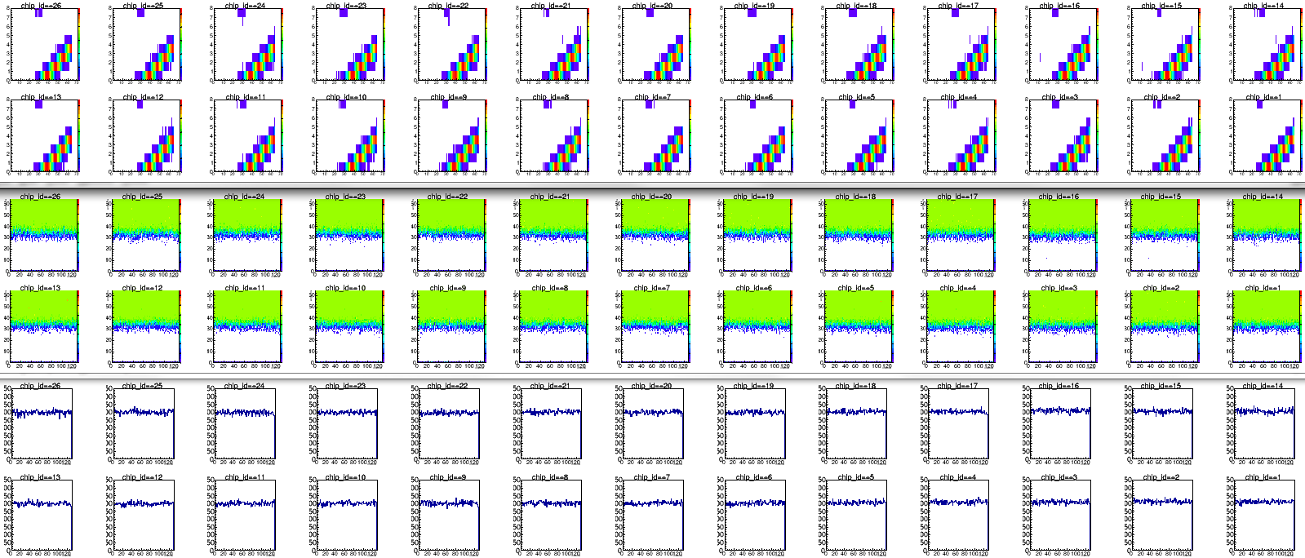
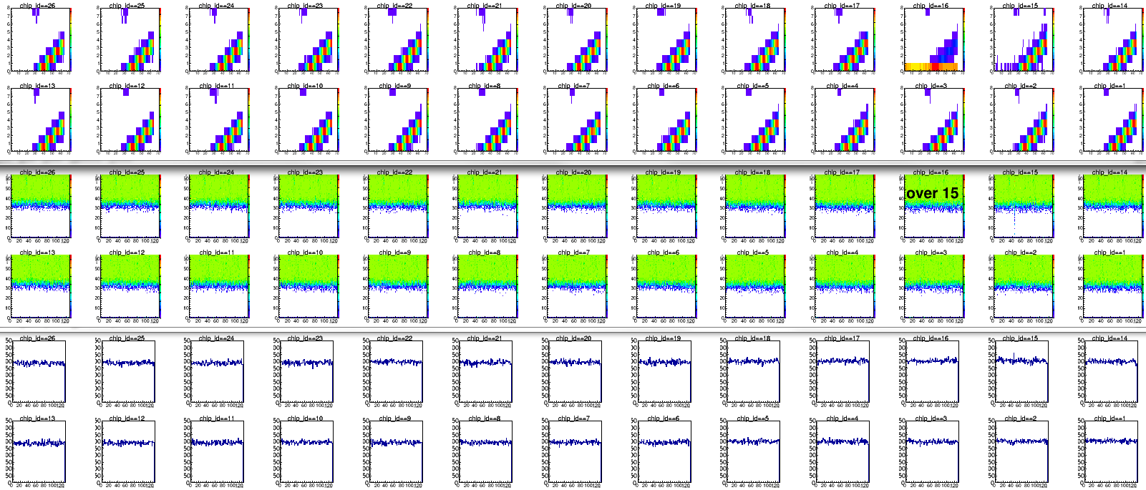
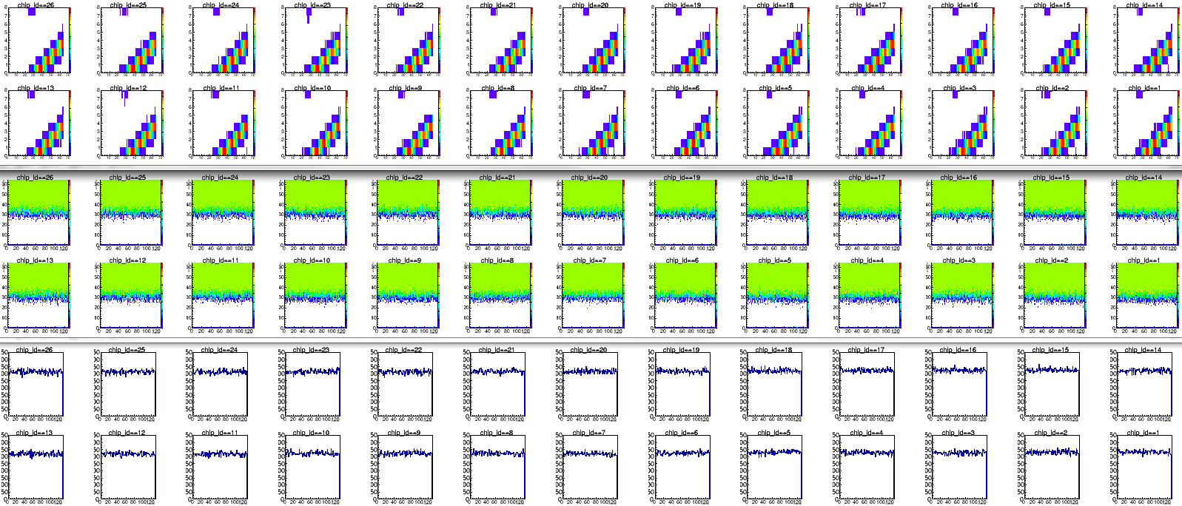
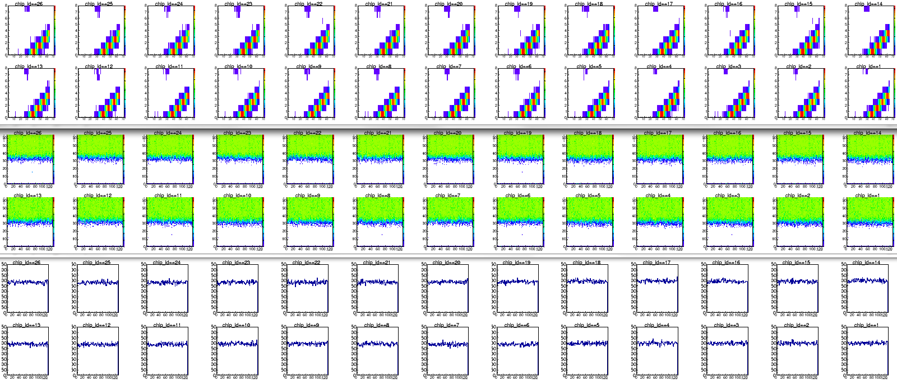
The barrel calibration tests: Results
4
3
3
2
2
10
9
9
8
8
5
4
1
1
11
10
7
7
5
0
11
6
0
6
B0L004
East
barrel
West
barrel
B0L010
North
ROC: NE4, C2
ROC: NE4, C2
ROC: #29, C1
ROC: #29, C3
South

Slide 21
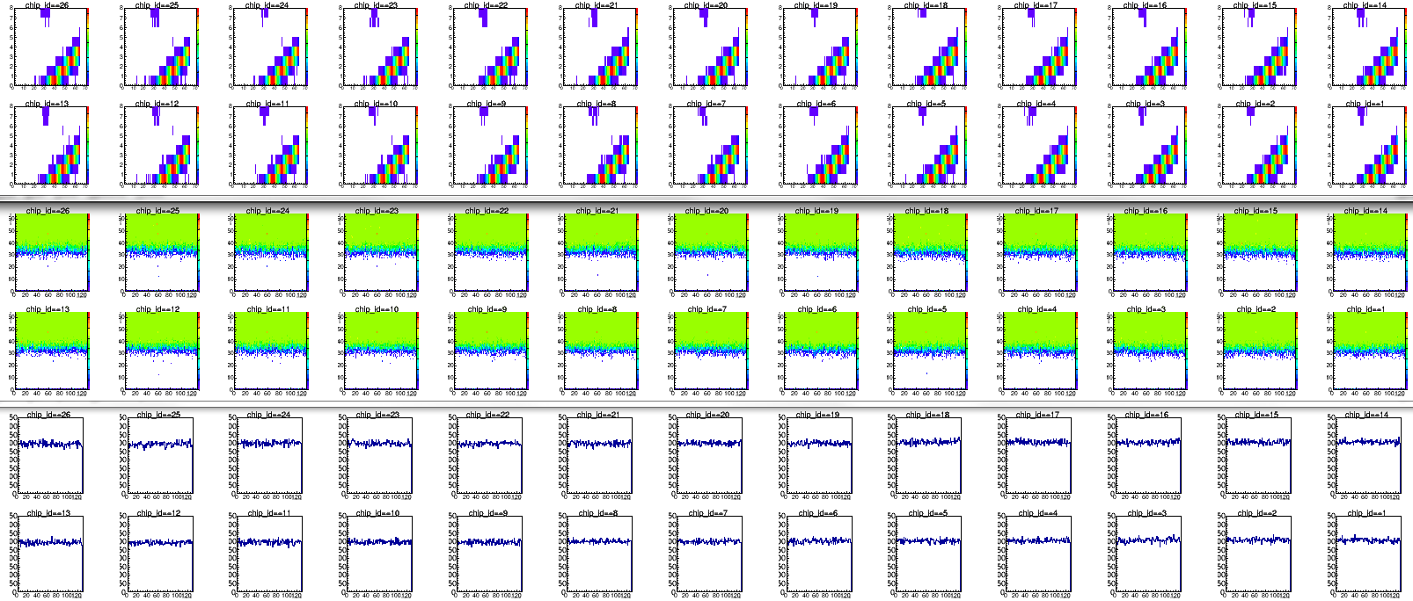
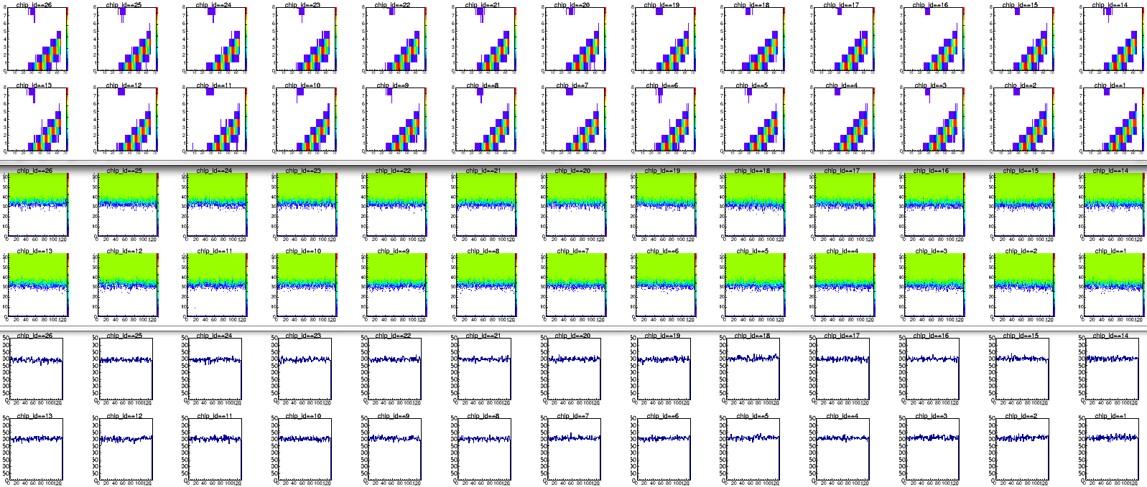
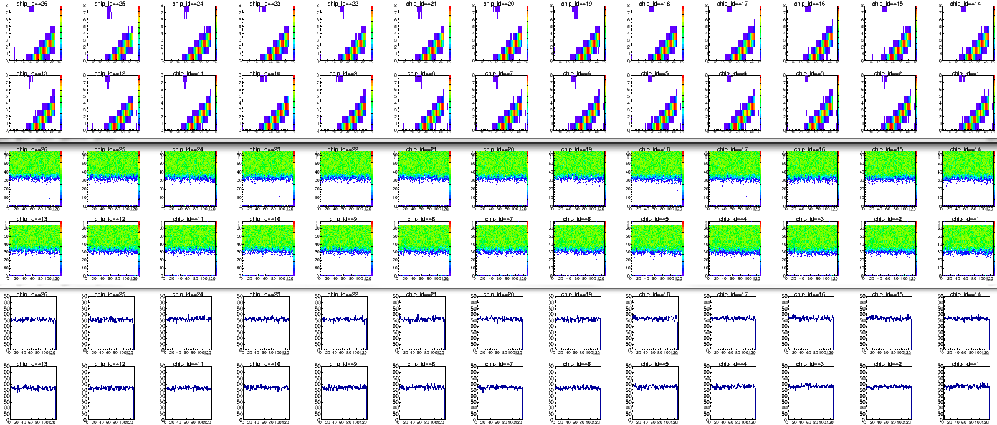
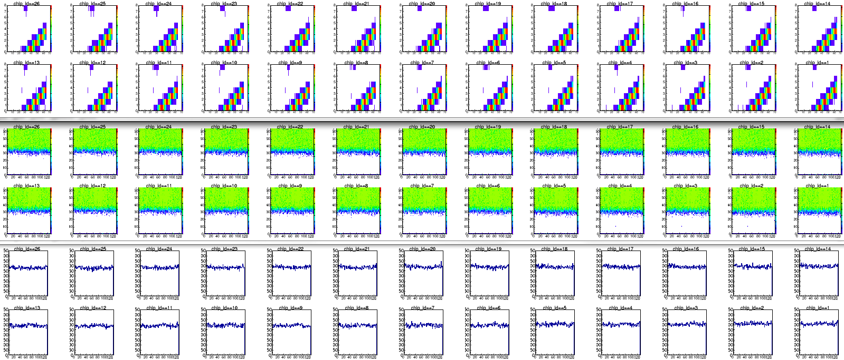
The barrel calibration tests: Results
4
3
3
2
2
10
9
9
8
8
5
4
1
1
11
10
7
7
5
0
11
6
0
6
B0L005
East
barrel
West
barrel
B0L011
North
ROC: NE4, C3
ROC: NE4, C3
ROC: #29, C3
ROC: #29, C3
South

Slide 22
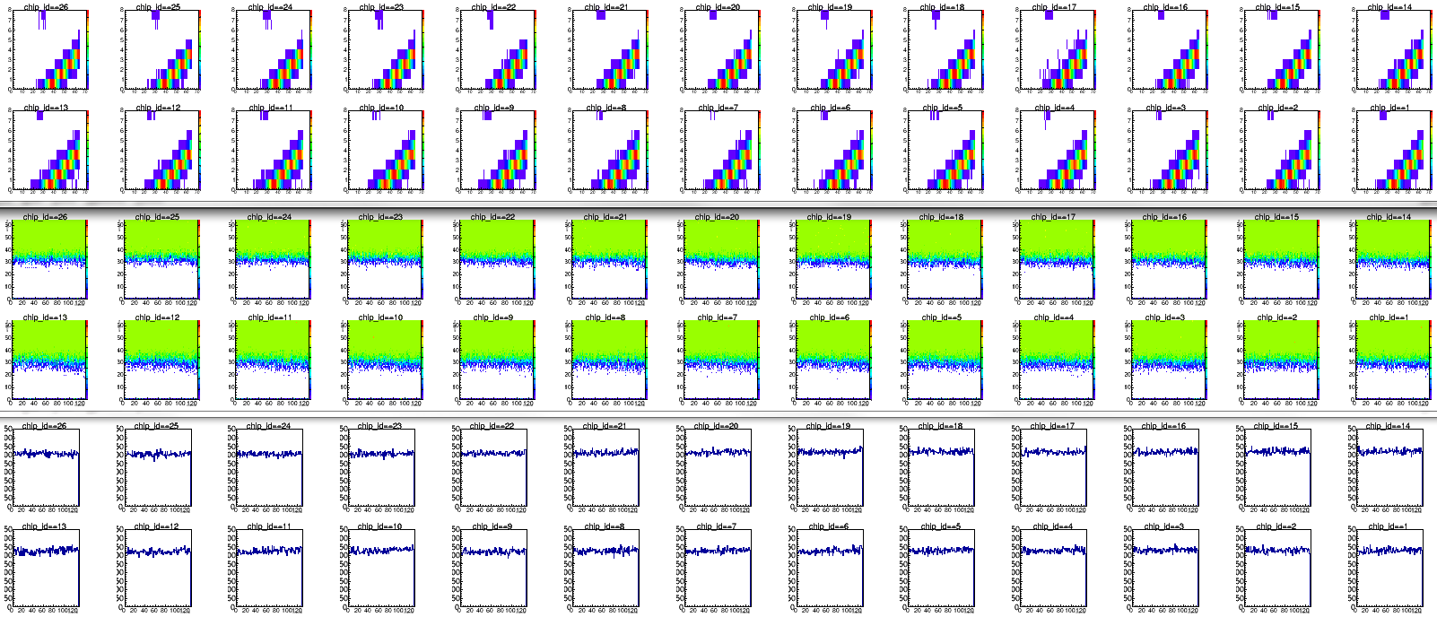
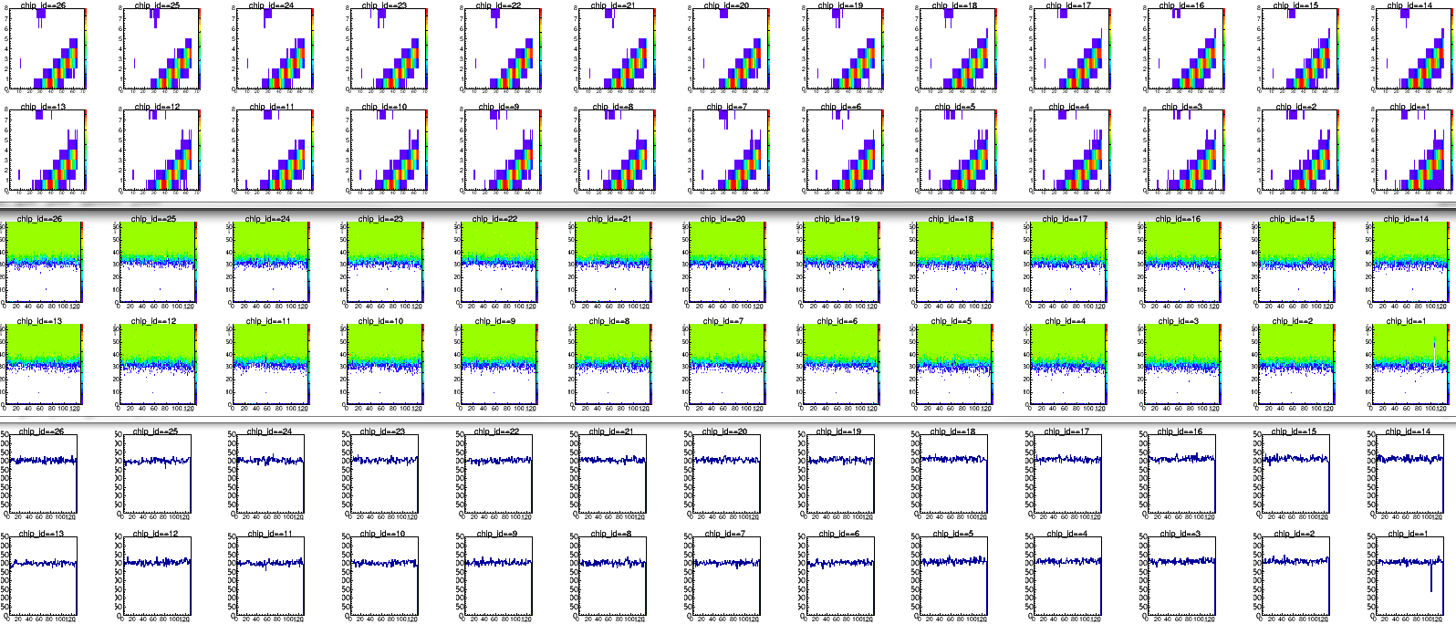
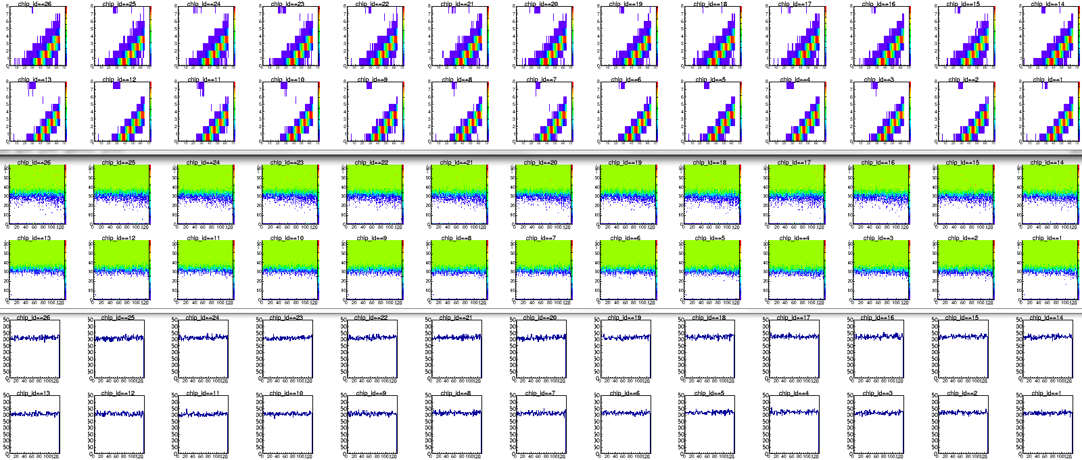
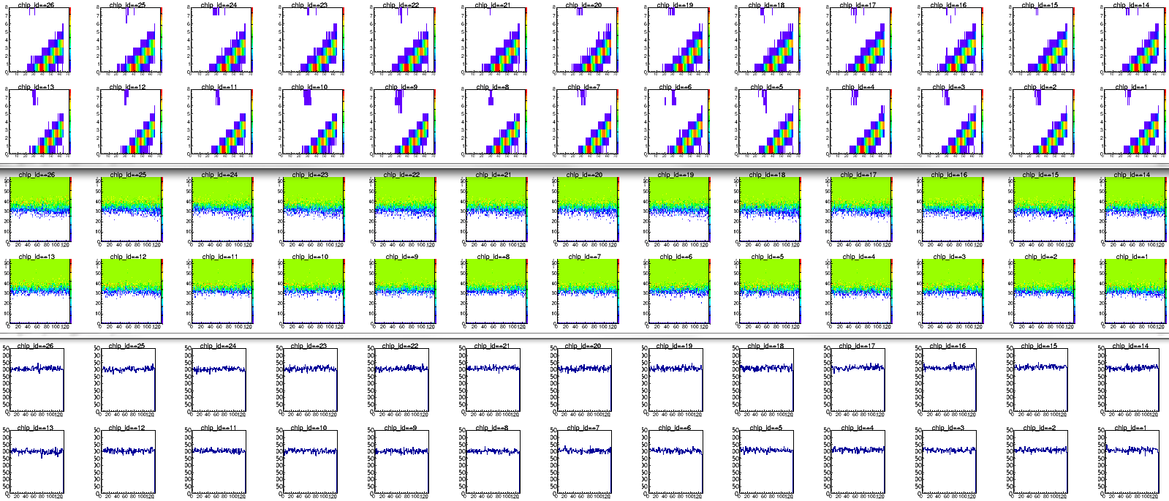
The barrel calibration tests: Results
4
3
3
2
2
10
9
9
8
8
5
4
1
1
11
10
7
7
5
0
11
6
0
6
B0L100
East
barrel
West
barrel
B0L106
North
ROC: #29, D2
ROC: #29, C2
ROC: #29, B1
ROC: NE2, A1
South

Slide 23




The barrel calibration tests: Results
4
3
3
2
2
10
9
9
8
8
5
4
1
1
11
10
7
7
5
0
11
6
0
6
B0L101
East
barrel
West
barrel
B0L107
North
ROC: #29, A1
ROC: #29, C3
ROC: #29, C3
ROC: NE2, C3
South

Slide 24




The barrel calibration tests: Results
4
3
3
2
2
10
9
9
8
8
5
4
1
1
11
10
7
7
5
0
11
6
0
6
B0L102
East
barrel
West
barrel
B0L108
North
ROC: NE2, C3
ROC: NE2, C2
Chip12 always has only half entries
ROC: NE2, A3
ROC: NE2, C3
South

Slide 25



The barrel calibration tests: Results
4
3
3
2
2
10
9
9
8
8
5
4
1
1
11
10
7
7
5
0
11
6
0
6
B0L103
East
barrel
West
barrel
B0L109
North
ROC: NE2, C3
ROC: NE2, A2
Chip14 always has only half entries or strange results
ROC: NE2, C2
ROC: NE2, C3
South

Slide 26




The barrel calibration tests: Results
4
3
3
2
2
10
9
9
8
8
5
4
1
1
11
10
7
7
5
0
11
6
0
6
B0L104
East
barrel
West
barrel
B0L110
North
ROC: NE2, C3
ROC: NE2, A3
ROC: NE2, C3
ROC: NE2, C3
South

Slide 27



The barrel calibration tests: Results
4
3
3
2
2
10
9
9
8
8
5
4
1
1
11
10
7
7
5
0
11
6
0
6
B0L105
East
barrel
West
barrel
B0L111
North
ROC: NE4, C1
ROC: NE4, C2
ROC: NE4, C2
ROC: NE2, C3
South
→ a very good improvement obtained today

