Slide 1
INTT Collaboration Meeting (power distribution plan and grounding)
Ivan
for Aug 16, 2022

Slide 2
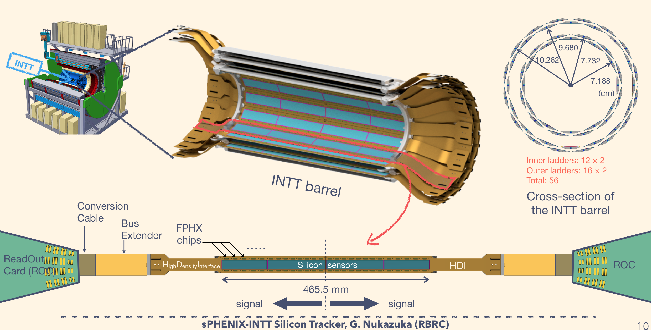
INTT general view

Slide 3
System outline
General system specs: 224 channels/half ladders total
ROC boards → 8 per side → 16 total
ROC LV power cables
1 board power cable per ROC → 8/side → 16 total
4 stave power cables per ROC →32/side → 64 total
LV supply/return lines
board power – 22 (11x2) lines
stave power – 16 (8x2) lines
Bias lines (one line per half ladder)
32+24=56 ladders per side
56x2 =112 HV lines/per side (ROC has 16 HV inputs → 128 /side)
Bias up to 200V, low current, below 1mA
Cable routing (from experiment model):
Cable length → 10+2 m (39 ft), Roland Wimmer routing (2m – flexibility)

Slide 4
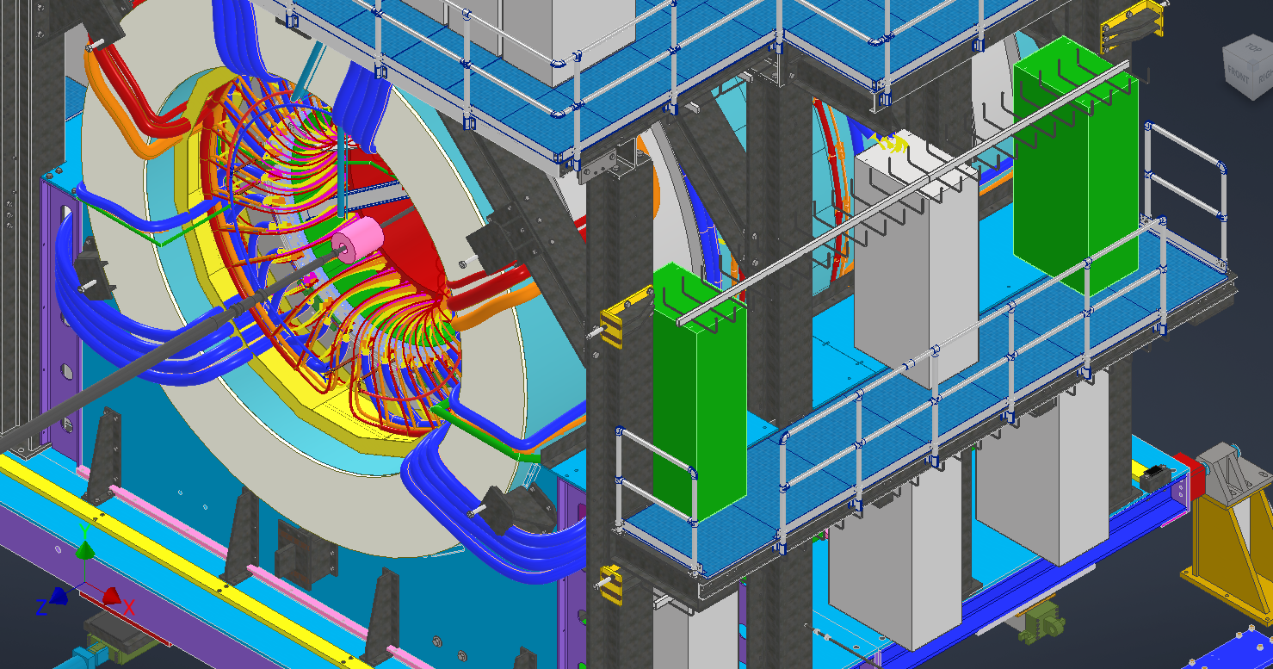
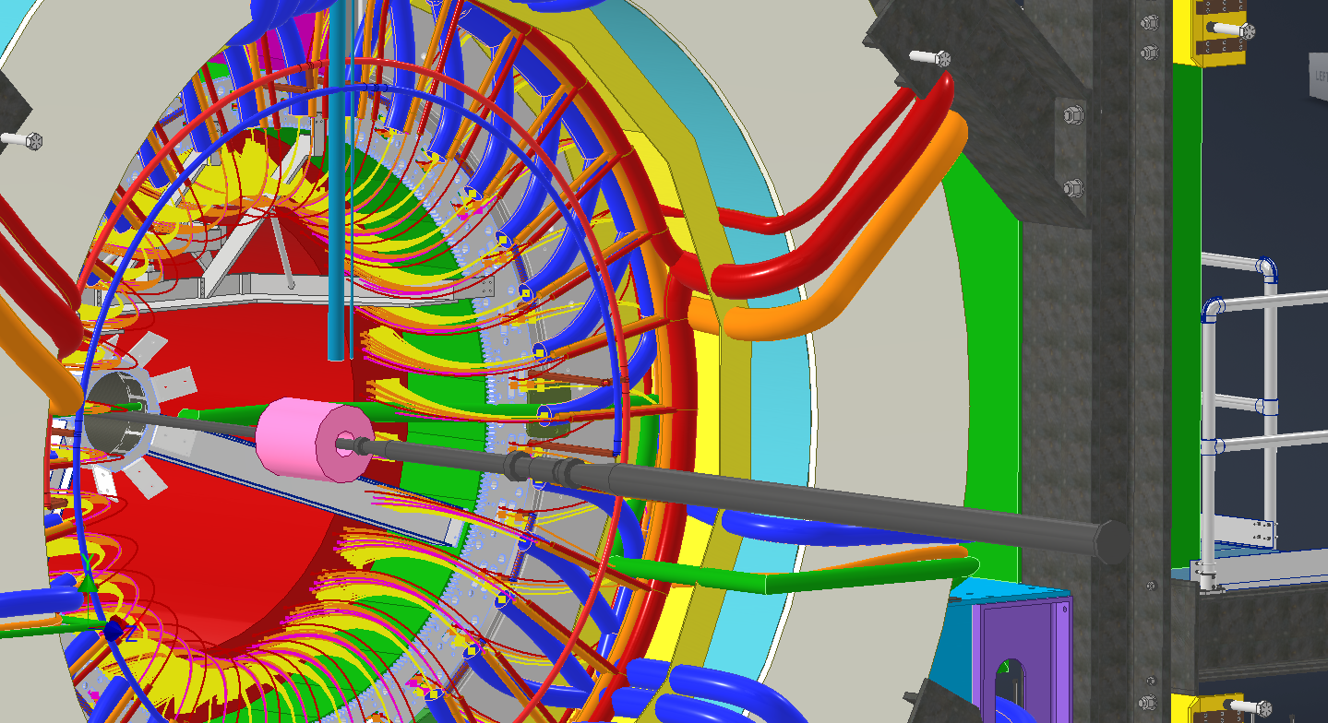
Cable route

Slide 5
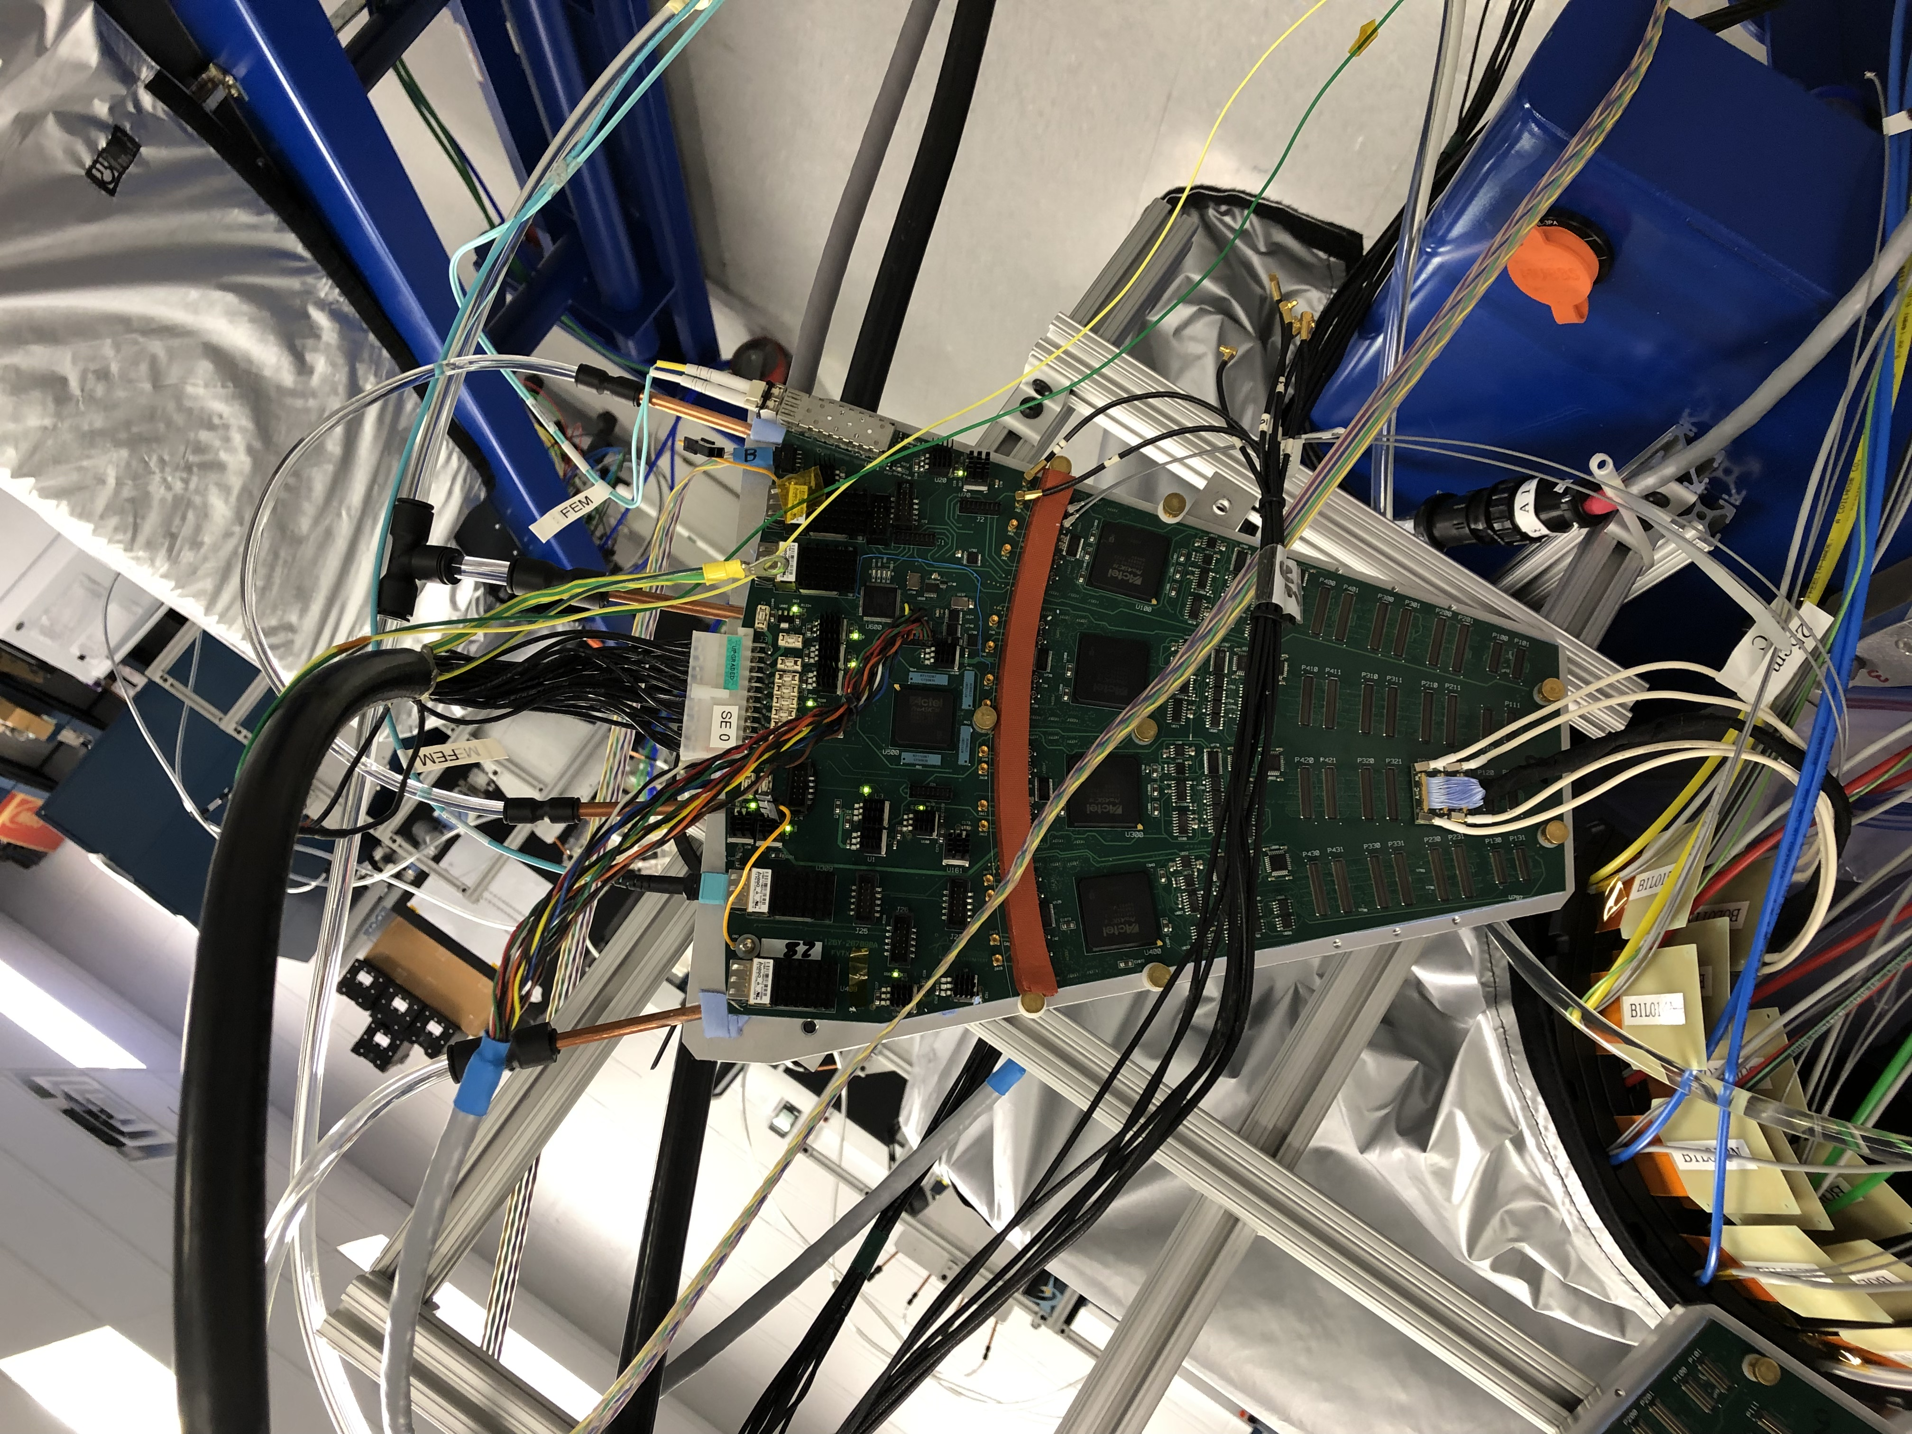
ROC board

Slide 6
LV ROC board power
ROC connector J3 |  |  |  |  |  |  |  |  | cable 2x10m |  | switch |  | power
 |  |  |  | LDO | LDO | LDO | LDO |  | #14 AWG | # 16 AWG | 0.02 Ohm |  | dissipation
power to | pins |  |  |  | max I | max V drop | V out | min Vin | V drop | V drop | V drop | min V source | #14 AWG
pulser A | 1 | 2 | 2 | LT1587CM | 3A | 1.3V | 5V | 6.3V | 0.5V | 0.79V | 0.06V | 6.9V | 1.5W
pulser B | 3 | 4 | 4 | LT1587CM | 3A | 1.3V | 5V | 6.3V | 0.5V | 0.79V | 0.06V | 6.9V | 1.5W
 | 5 | 6 | 6
FPGA U100 | 7 | 8 | 8 | LT1585CM | 4.6A | 1.3V | 2.5V_D_A | 3.8V | 0.76V | 1.21V | 0.09V | 4.65V | 3.5W
FPGA U200 | 9 | 10 | 10 | LT1585CM | 4.6A | 1.3V | 2.5V_D_B | 3.8V | 0.76V | 1.21V | 0.09V | 4.65V | 3.5W
FPGA U300 | 11 | 12 | 12 | LT1585CM | 4.6A | 1.3V | 2.5V_D_C | 3.8V | 0.76V | 1.21V | 0.09V | 4.65V | 3.5W
FPGA U400 | 13 | 14 | 14 | LT1585CM | 4.6A | 1.3V | 2.5V_D_D | 3.8V | 0.76V | 1.21V | 0.09V | 4.65V | 3.5W
FPGA U500 | 15 | 16 | 16 | LT1585CM | 4.6A | 1.3V | 2.5V_D_SC | 3.8V | 0.76V | 1.21V | 0.09V | 4.65V | 3.5W
transm A/B/SC | 17 | 18 | 18 | LT1587CM-33 | 4.6A | 1.3V | 3.3V_D1 | 4.9V | 0.76V | 1.21V | 0.09V | 5.75V | 3.5W
transm C/D/CLK | 19 | 20 | 20 | LT1585CM | 3A | 1.3V | 3.3V_D_FO | 4.9V | 0.5V | 0.79V | 0.06V | 5.46V | 1.5W
JTAG | 21 | 22 | 22 | LT1585CM | 3A | 1.3V | 2.5V_D_JTAG | 3.8V | 0.5V | 0.79V | 0.06V | 4.36V | 1.5W
Optoisolation | 23 | 24 | 24 | LT1118CST-5 | 1.2A | 1.3V | 5V_1 | 6.3V | 0.2V | 0.32V | 0.02V | 6.52V | 0.24W
 | GND |  |  |  |  |  |  |  |  |  |  |  | 25.7W
 |  |  |  |  |  |  |  |  | #14 AWG -> 2.525 Ohm per 1000ft -> 0.166 Ohm per 10x2 m
part number (?): Molex 0039012240, digi-key # WM3711-ND conn recept housing, 24 pos dual |  |  |  |  |  |  |  |  | #16 AWG -> 4.016 Ohm per 1000 ft -> 0.264 Ohm
conn socket 16 AWG crimp tin: Molex 0039000217, digi-key #WM3118CT-ND - Cut Tape (CT) |  |  |  |  |  |  |  |  | #18 AWG -> 6.385 Ohm per 1000 ft -> 0.419 Ohm
 |  |  |  |  |  |  |  |  | https://www.powerstream.com/Wire_Size.htm

Slide 7
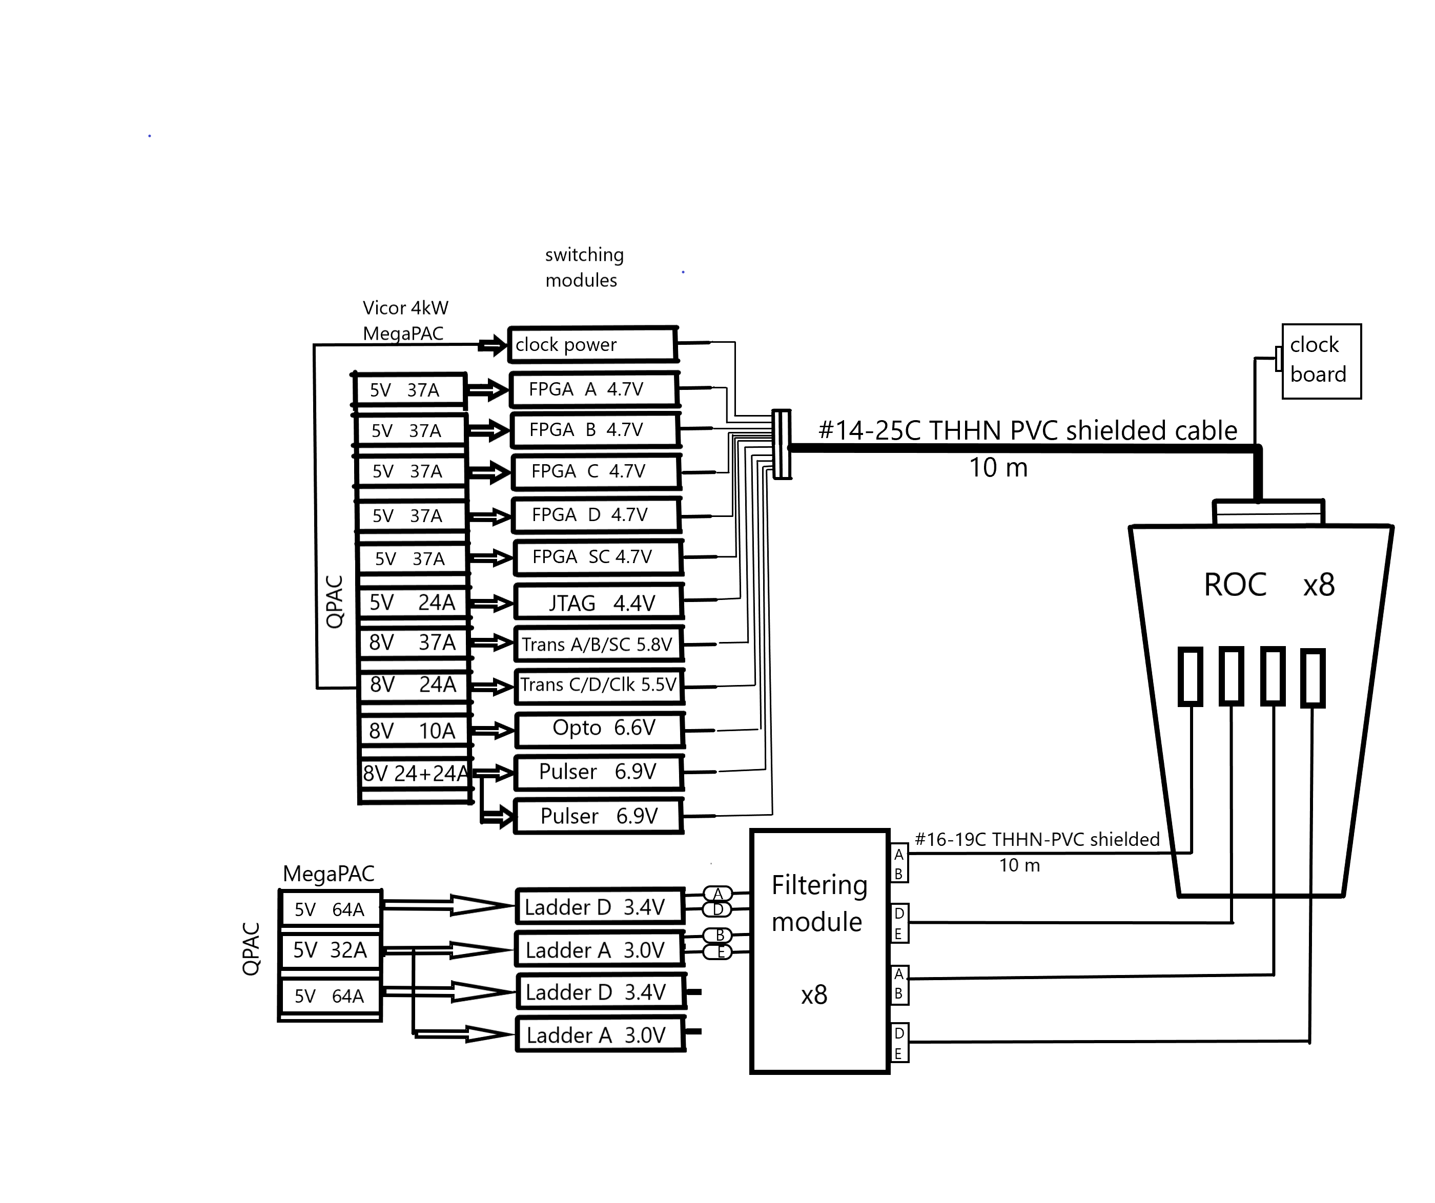
ROC power scheme

Slide 8
LV stave power
ROC connectors J1, J1A, J2, J2A |  |  |  |  |  |  |  | cable 2x10m | switch | filter |  | cable power
 |  |  | LDO | LDO | LDO | LDO |  | # 16 AWG | 0.02 Ohm | 0.17 Ohm |  | dissipation
channel | pins |  |  | max I | max V drop | V out | min Vin | V drop | Vdrop | Vdrop | min V source
D_0,_4_8_12 | 2 | 1 | MCP1726 | 1A | 0.5V | 2.5V | 3.0V | 0.26V | 0.02V | 0.17V | 3.45V | 0.26W
A_0,_4_8_12 | 4 | 3 | MCP1700 | 0.25A | 0.35V | 2.5V | 2.85V | 0.07V | 0.005V | 0.04V | 3.0V | 0.02W
D_1,_5,_9,_13 | 6 | 5 | MCP1726 | 1A | 0.5V | 2.5V | 3.0V | 0.26V | 0.02V | 0.17V | 3.45V | 0.26W
A_1,_5,_9,_13 | 8 | 7 | MCP1700 | 0.25A | 0.35V | 2.5V | 2.85V | 0.07V | 0.005V | 0.04V | 3.0V | 0.02W
D_2,_6,_10,_14 | 10 | 9 | MCP1726 | 1A | 0.5V | 2.5V | 3.0V | 0.26V | 0.02V | 0.17V | 3.45V | 0.26W
A_2,_6,_10,_14 | 12 | 11 | MCP1700 | 0.25A | 0.35V | 2.5V | 2.85V | 0.07V | 0.005V | 0.04V | 3.0V | 0.02W
D_3,_7,_11,_15 | 14 | 13 | MCP1726 | 1A | 0.5V | 2.5V | 3.0V | 0.26V | 0.02V | 0.17V | 3.45V | 0.26W
A_3,_7,_11,_15 | 16 | 15 | MCP1700 | 0.25A | 0.35V | 2.5V | 2.85V | 0.07V | 0.005V | 0.04 | 3.0V | 0.02W
 | GND |  |  |  |  |  |  |  |  |  |  | 1.1W
 |  | 17-20 NC ?
part number: DF11-20DP-2DSA - straight pin header; accept 22-30 AWG
IDC Socket: DF11-20DS-2R26 - for 26 AWG wire
Crimping Socket: DF11-20DS-2C |  |  | Crimping Contact for Socket: DF11-22SSC(F)A - 22 AWG, gold contact; DF11-22SC(F) - tin contact; tin plated annealed coper wire

Slide 9
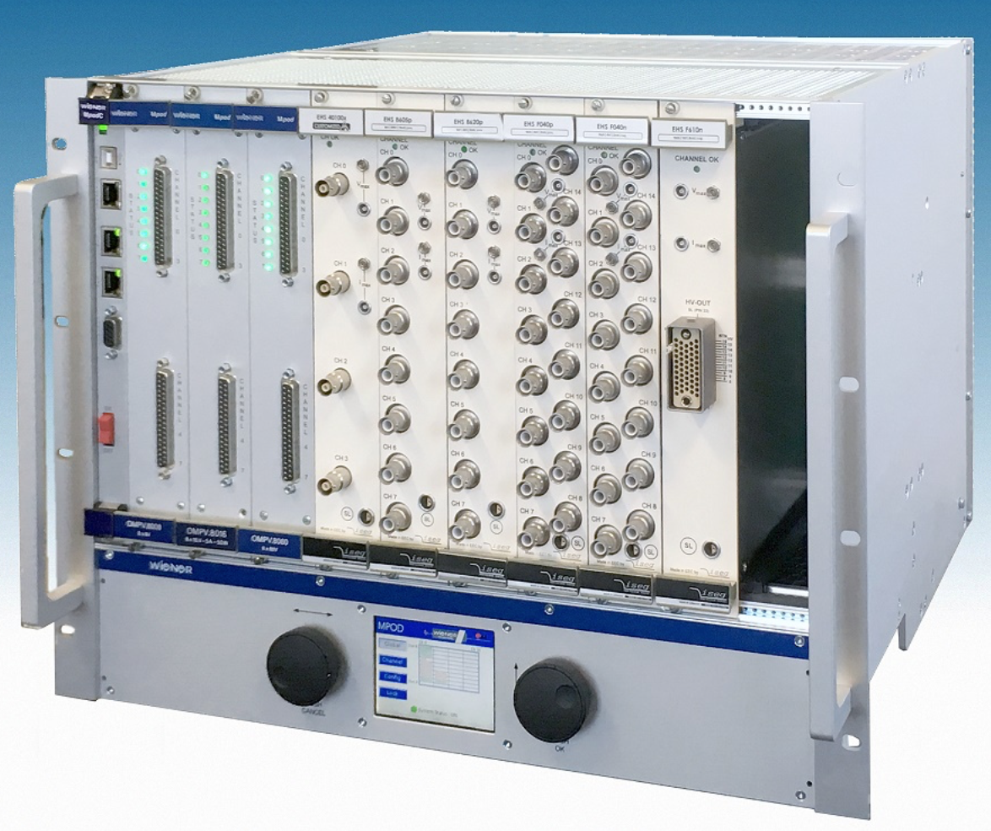
Bias power distribution
Bias power supply crate – Wiener Full crate MPODs
1 Full crate/side
Bias PS module – iseg EHS F 605p-F
1 module → 16 channels, 500V/1 mA
voltage & current control per channel
Hardware V and I limits per module
need 8 modules/side (8x16= 128 ch)
Bias filtering modules
16 channel/ROC → 128 ch/side
→ 16 modules/side (16*8)

Slide 10
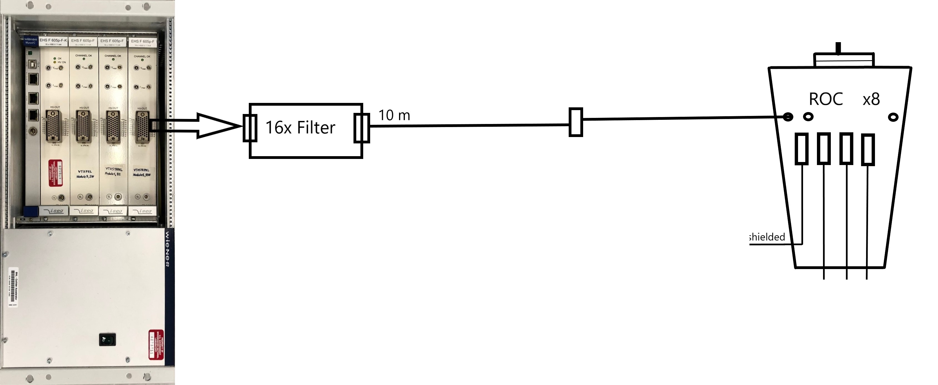
Bias power scheme

Slide 11
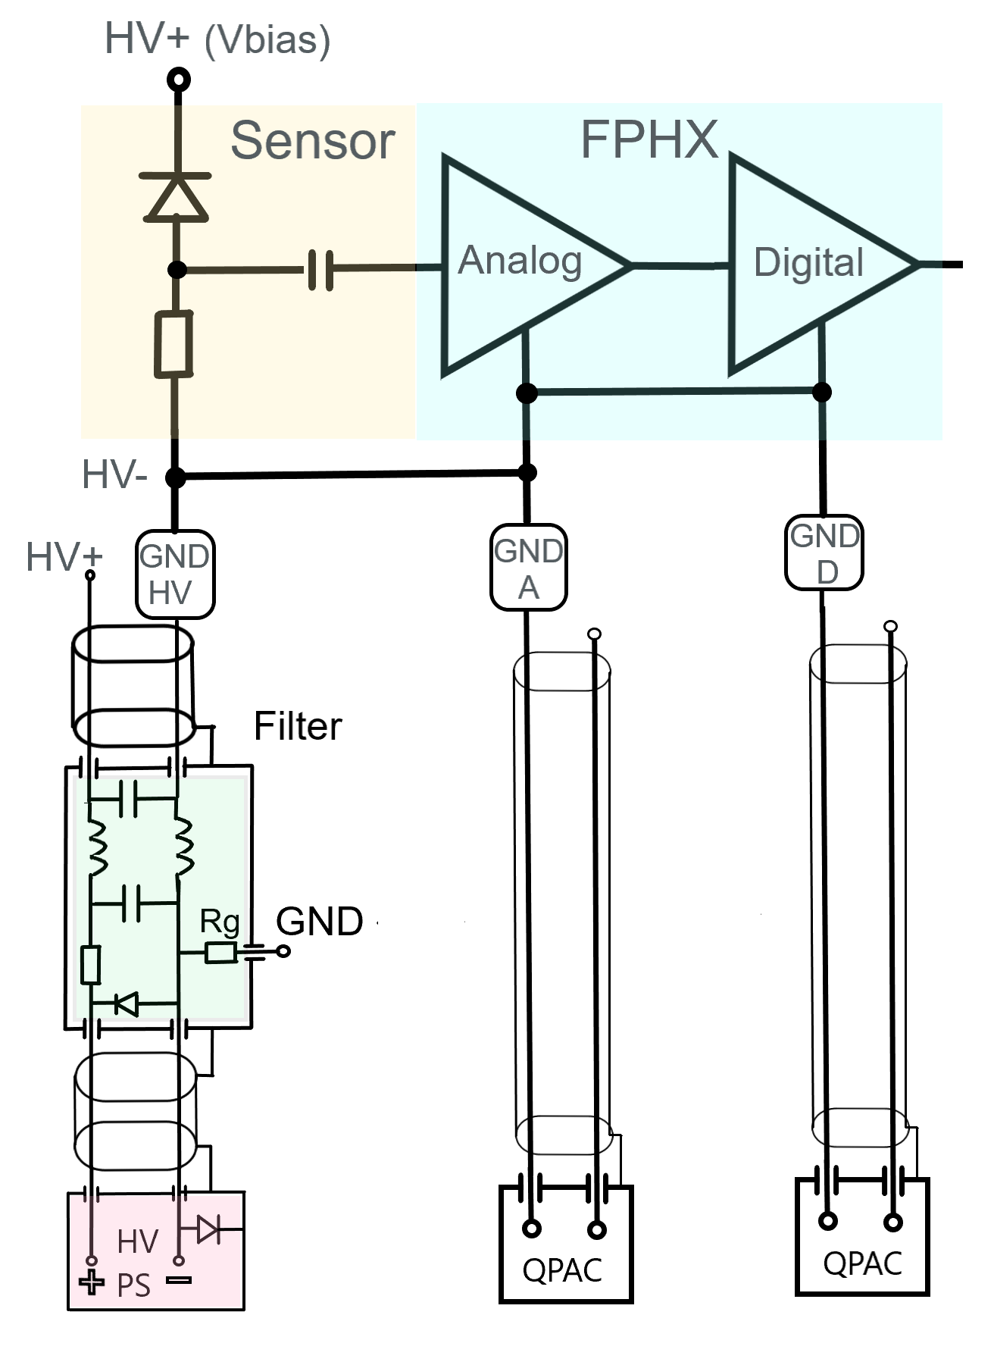
Grounding

Slide 12
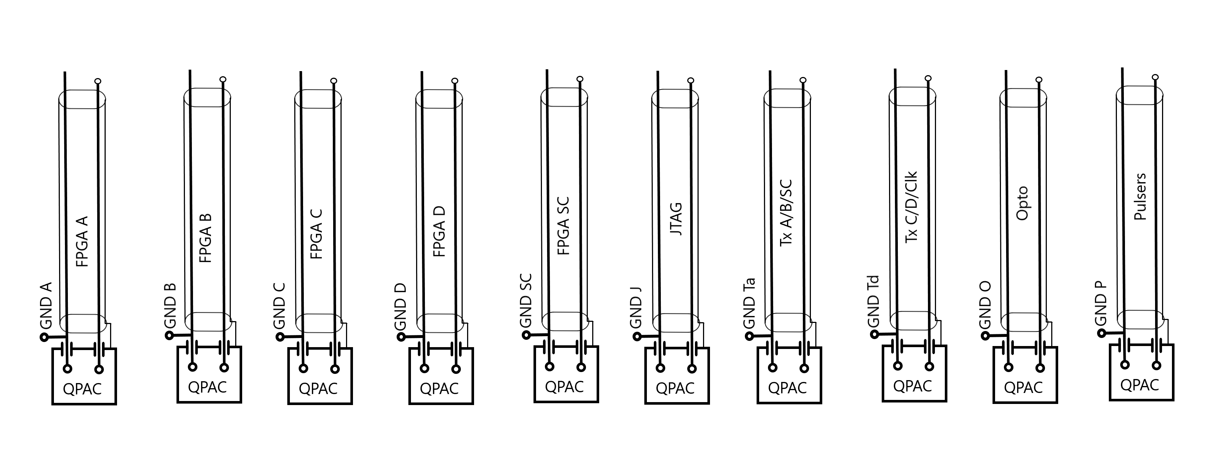
Grounding (2)

Slide 13
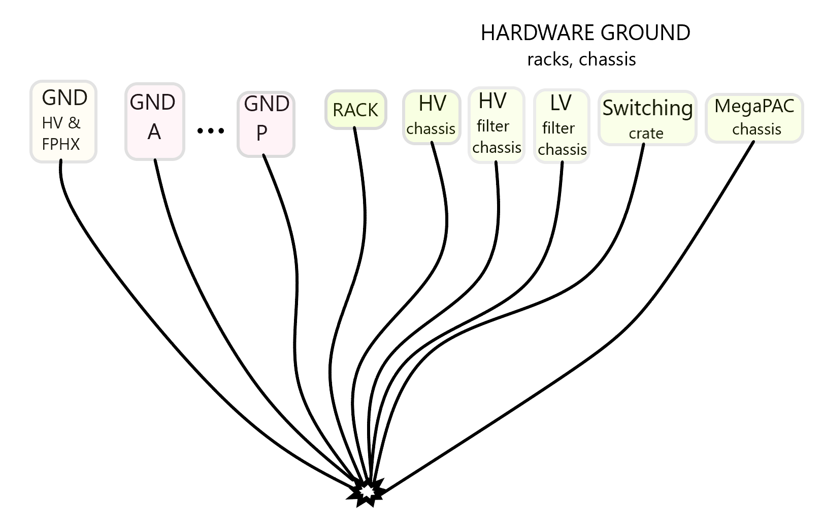
Grounding (3)

Slide 14
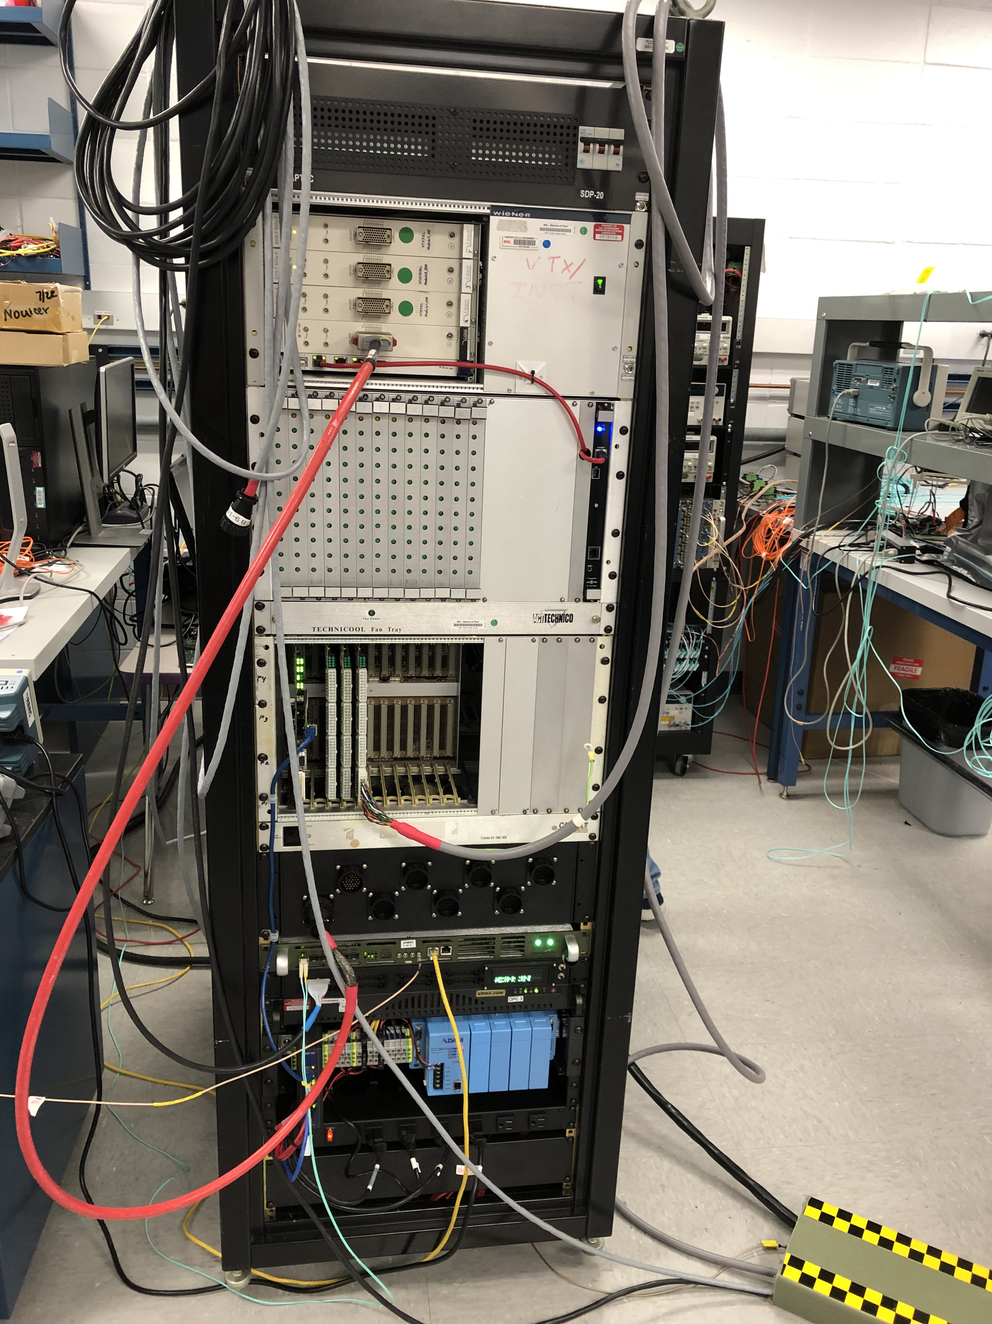
INTT rack

Slide 15
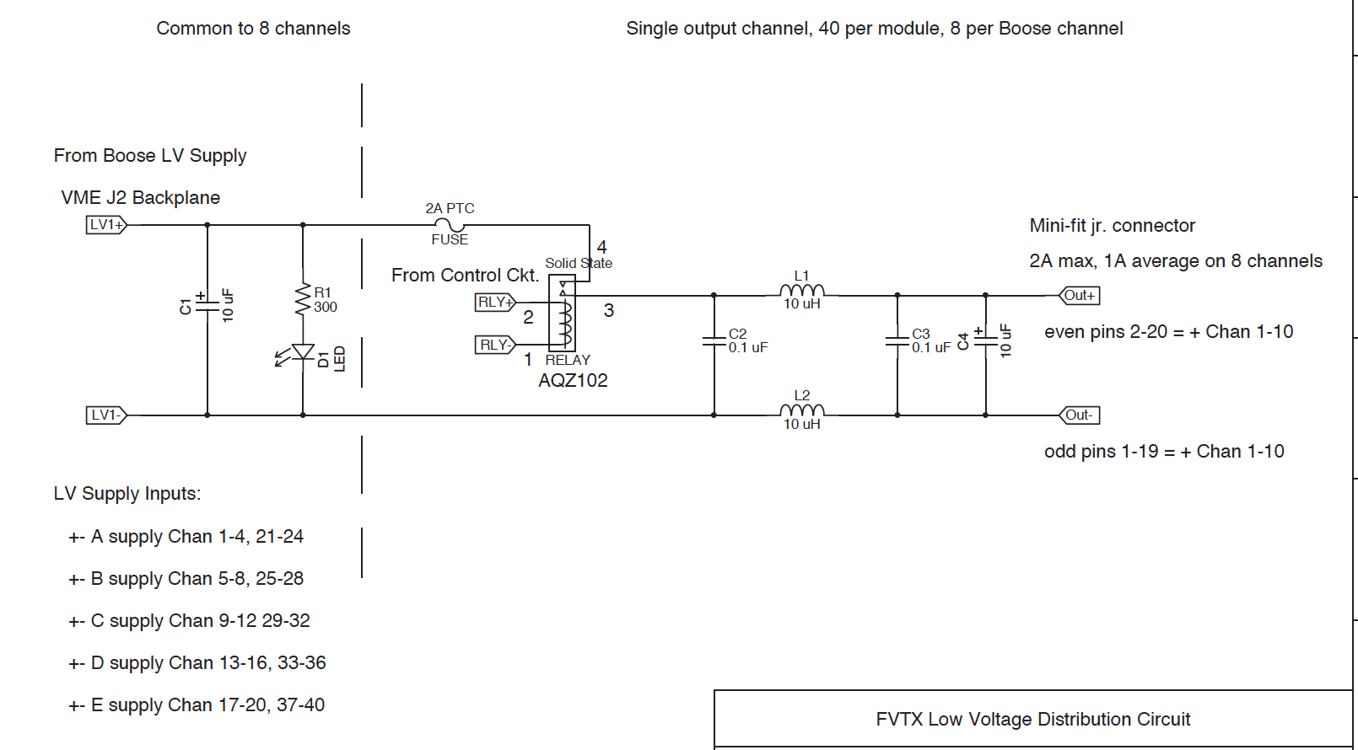
Filtering modules:

Slide 16
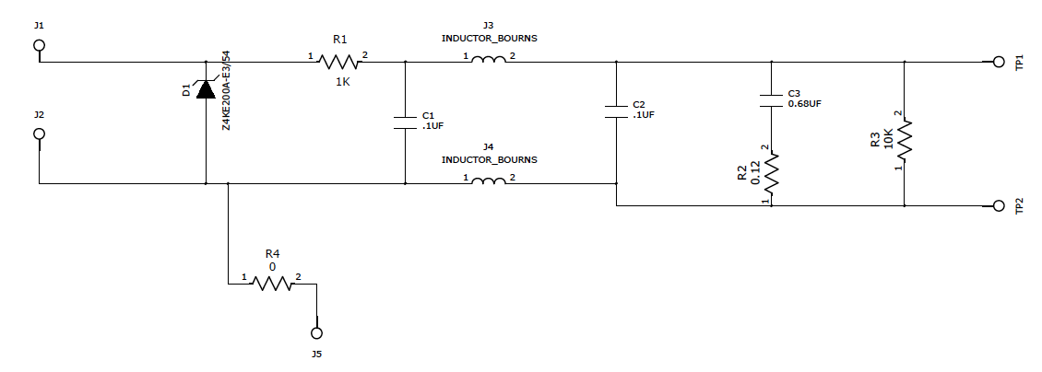

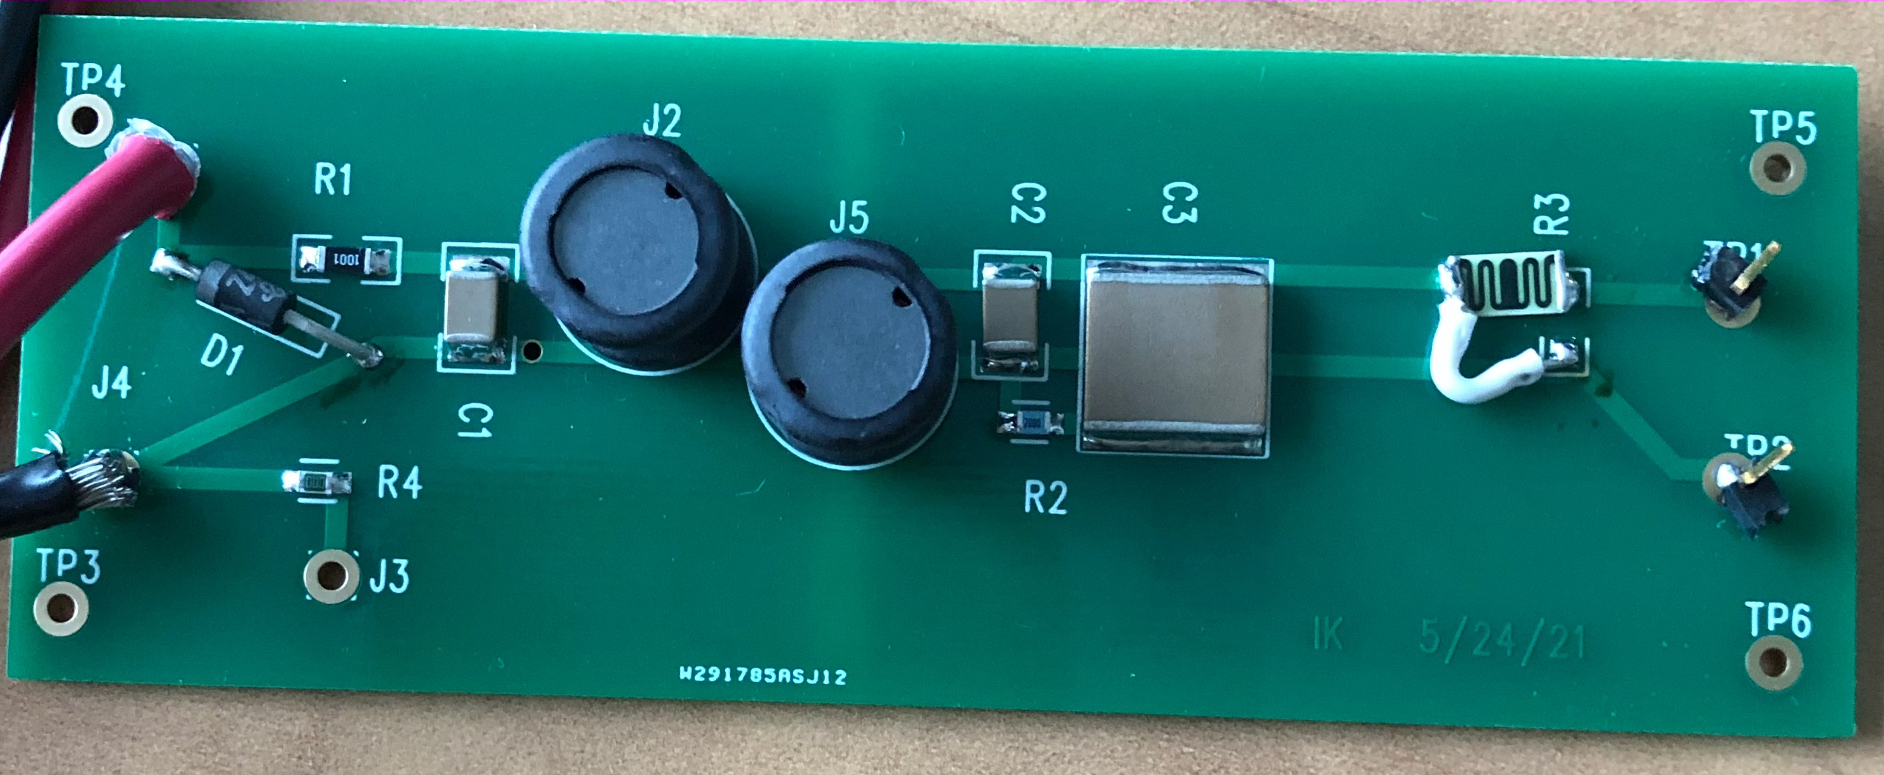
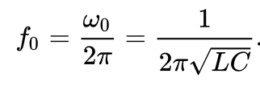
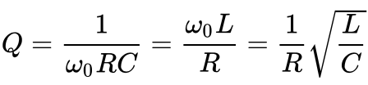
HV filter module
Filter components:
RC filter – 1K+0.1 uF
Pi filter – 4.7 mH +0.1 uF
Damping – C3+R2
RC filter cutoff
frequency:
fc=1.6 kHz
Pi filter resonance
frequency:
f0= 7.3 kHz
damping factor:
Q=1 → R~ 200 Ohm

Slide 17
Backup & Details

Slide 18
Power Distribution Components
Power source: total
MegaPAC (chassis) - 2 /side → 4
QPAC 8V - 4 /side → 8
QPAC 5V - 9 /side → 18
Switching modules:
16 /side → 32, 2 crates + 2 controllers
Filtering modules:
LV, 8 /side → 16, 2 crates + 2 controllers
HV,16 /side → 32, 2 3U box
Bias power source: → 16 Bias modules

Slide 19
Power consumption and cable losses
cable | single supply line max current | max voltage drop, V | single line power dissipation, max | Power dissipation, total
ROC power, #14 | 4.6 A | 0.76V | 3.5W | 26W
Chips power, #16 | 1.0A | 0.26V | 0.26W | 1.1W

Slide 20
ROC power cable, 10m - #14-25C THHN-PVC Shielded Tray Cable
https://www.wireandcableyourway.com/14-25c-thhn-pvc-shielded-tray-cable.html
PVC/Nylon/PVC, Control, Shielded, 600V, UL Type TC-ER, TFN Insulation
Color: Black
Applications: In free air, raceways, cable trays, or direct burial. In wet or dry locations. Approved for direct burial, Class I, Div. 2 industrial hazardous locations per NEC. Permitted for Exposed Run (ER) use in accordance with NEC for 3 or more conductors.
Also Known As: Instrumentation cable, raceway cable, shielded underground cable, multi-conductor THHN cable,…. Type TC
Features: Rated at 90°C dry, 75°C wet. Ripcord applied to all cables with jacket thickness of 60 mils or less. Provides outstanding sunlight, cold bend and cold impact resistance.
Offers the smallest cable O.D. available for suitable applications. Provides long service life. Provides good oil and chemical resistance. Meets cold bend test at -25°C. Meets the crush and impact requirements of Type MC cable.
Compliances: ICEA S-73-532; ICEA S-95-658; UL 1277; UL 66; UL 83
Conductor: Fully annealed stranded bare copper to ASTM B3 Class B stranding per ASTM B8
Shield: Shielded: cabled in concentric layers with interstices filled with suitable fillers as required. A helically wrapped aluminum tape, with synthetic backing,
gives 100% shielding. A tinned copper drain wire is placed in contact with the aluminum side of the tape,
Insulation: Flame-retardant PVC/Nylon type THHN/THWN-2 per UL 83 for sizes 14 AWG to 500 kcmil.
Color-coded per ICEA Method 1, Table E-2 plus alpha-numeric printed numbers (does not include white or green)
Jacket: Lead-free, flame-retardant, sunlight-resistant Polyvinyl Chloride (PVC)
Specifications*:
Size: 14 AWG Number of Conductors: 25 Jacket Thickness: .060 inches Outside Diameter: 21.08 mm / 0.83 inches Net Weight: 0.51 lbs per ft
Bend Radius: 5 x overall diameter installed / 8 x overall diameter during installation pull-in.

Slide 21
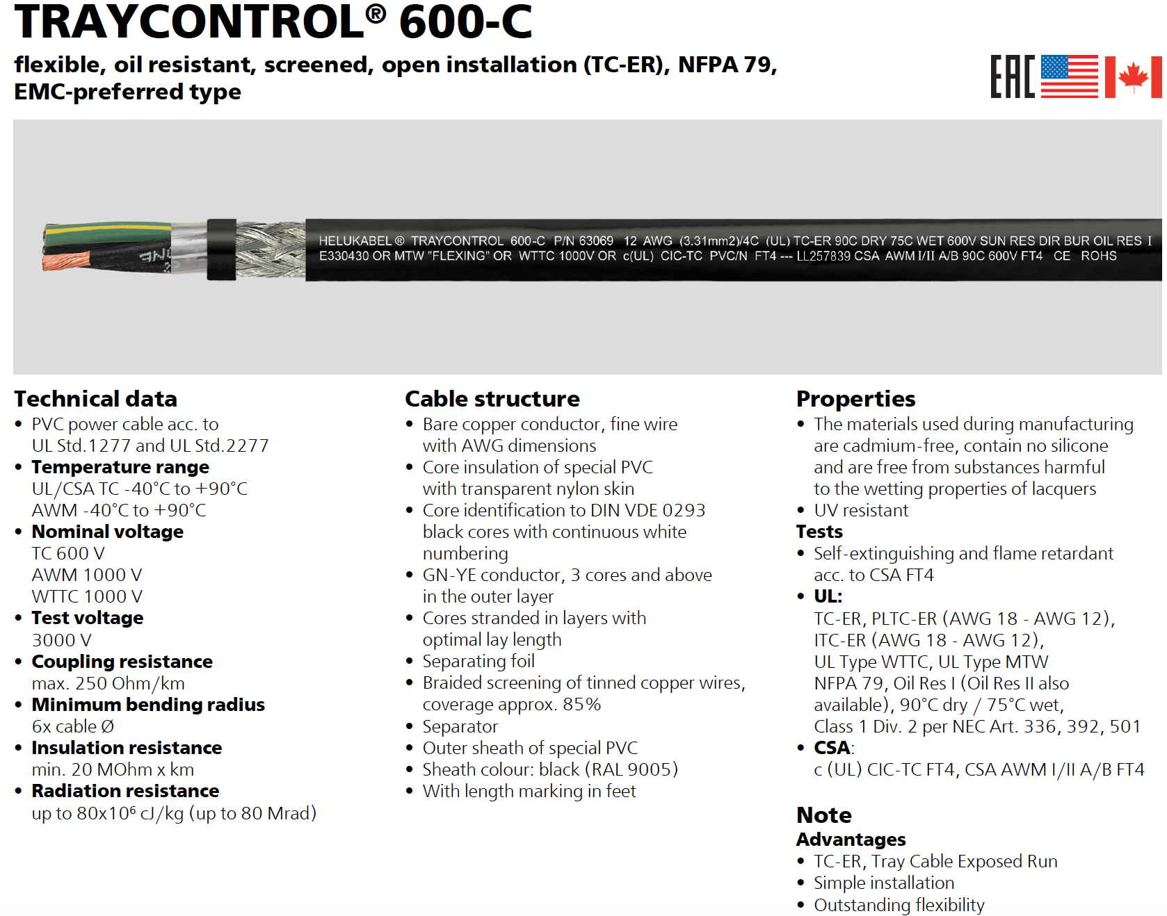
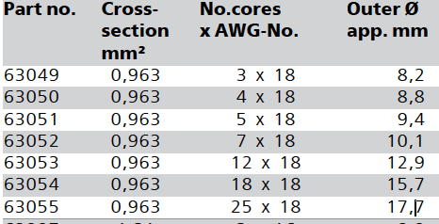
ROC power cable, 2m- TRAYCONTROL 25x#18 Shielded Tray Cable 63055

Slide 22
Chips power cable, 10m - #16-8 pair PVC jacket Shielded Tray Cable
https://www.wireandcableyourway.com/16-19c-thhn-pvc-shielded-tray-cable.html
PVC/Nylon/PVC, Control, Shielded, 600V, UL Type TC-ER, TFN Insulation
Color: Black. Applications: In free air, raceways, cable trays, or direct burial. In wet or dry locations. Approved for direct burial, Class I, Div. 2 industrial hazardous locations per NEC. Permitted for Exposed Run (ER) use in accordance with NEC for 3 or more conductors.
Also Known As: Instrumentation cable, raceway cable, shielded underground cable, multi-conductor THHN cable, lighting cable, shielded control cable, signal and communication circuit cable, Type TC
Features: Rated at 90°C dry, 75°C wet. Ripcord applied to all cables with jacket thickness of 60 mils or less. Provides outstanding sunlight, cold bend and cold impact resistance. Offers the smallest cable O.D. available for suitable applications. Provides long service life. Provides good oil and chemical resistance. Meets cold bend test at -25°C. Meets the crush and impact requirements of Type MC cable.
Compliances: ICEA S-73-532; ICEA S-95-658; UL 1277; UL 66; UL 83
Conductor: Fully annealed stranded bare copper to ASTM B3 Class B stranding per ASTM B8
Shield: Shielded: cabled in concentric layers with interstices filled with suitable fillers as required. A helically wrapped aluminum tape, with synthetic backing, gives 100% shielding. A tinned copper drain wire is placed in contact with the aluminum side of the tape, to lower the resistance and to assist in the termination of the shield.
Insulation: Flame-retardant PVC/Nylon type THHN/THWN-2 per UL 83 for sizes 14 AWG to 500 kcmil and type TFN per UL 66 for 18 AWG and 16 AWG.
Color-coded per ICEA Method 1, Table E-2 plus alpha-numeric printed numbers (does not include white or green)
Jacket: Lead-free, flame-retardant, sunlight-resistant Polyvinyl Chloride (PVC)
Color Code: Black, Red, Blue, Orange, Yellow, Brown, Red/Black Stripe, Blue/Black Stripe, Orange/Black Stripe, Yellow/Black Stripe, Brown/Black Stripe, Black/Red Stripe, Blue/Red Stripe, Orange/Red Stripe, Yellow/Red Stripe, Brown/Red Stripe, Black/Blue Stripe, Red/Blue Stripe, Orange/Blue Stripe
Specifications*: Size: 16 AWG Number of Conductors: 19 Jacket Thickness: .060 inches Outside Diameter: 17.53 mm / 0.690 inches Net Weight: 0.31 lbs per ft Bend Radius: 5 x overall diameter installed / 8 x overall diameter during installation pull-in.
Alternative: BELDEN 1485A #16, 8 pair IEEE 1202/383 flame rating
KC electronics
P/N 6608SPOS
ADVANCED DIGITAL CABLE Inc
16 AWG 8 pairs
Type TFN SPOS
(UL) Type TC or TC-ER
90C, SUN RES, DIR BUR
600V
FT4/IEEE1202 E195597

Slide 23
Material overview. Bias cables & connectors
PS to filter box cable
PS vendor made, Wiener
PS side – REDEL connector 12kV test voltage
https://www.lemo.com/en/products/high-voltage-connector/redel-ks
Filter side – CPC-37 connector p.n. A1307-ND/206151-1
CPC-37 connectors Series 1, p.n. A1364-ND/206306-1 & A1307-ND/206151-1
Flammability Rating: UL94 V-0 https://www.digikey.com/en/products/detail/te-connectivity-amp-connectors/206151-1/15607?s=N4IgTCBcDaIIIEYDMAGA7AWgHIBEQF0BfIA
Operating Voltage (VDC): 600V. https://www.te.com/usa-en/product-206306-1.html
10m cable same as Chips power cable, rated 300V
CPC-37 connectors on both ends A1364-ND/206306-1 & A1307-ND/206151-1
2m flex coax cable RG-174 used in PHENIX (alternatives RG-178,RG-316)
https://www.awcwire.com/rg-catalog/rg174-coax-cable
Flame Rating: UL 1581 VW-1 Vertical Flame Test
UL: AWM Style 1354
CPC-37 connector p.n. A1307-ND/206151-1
MMCX connector (on the ROC board)
https://www.mouser.com/datasheet/2/643/pi-CCS-JOHN-135-9402-111-1289993.pdf
https://www.molex.com/pdm_docs/ps/PS-89675-1920-001.pdf
Dielectric Withstanding Voltage: 500 V RMS at sea level
Corona Level: 190 volts min at 70,000 feet
Working Voltage: 170 V RMS at sea level (VAC (RMS) * 1.414 = max DC → 240 V DC)

Slide 24
Material overview. LV Connectors
ROC power:
ROC board (reference)
Molex 0015249247 - Connector Header Through Hole, Right Angle 24 position 0.165" (4.20mm)
Cable ROC end
Molex 0039012240 conn receptacle housing 24 pos dual (digi-key # WM3711-ND)
Molex 0039000217 conn socket 16 AWG crimp tin (digi-key #WM3112CT-ND-CT)
Specs: https://www.molex.com/pdm_docs/ps/PS-5556-001.pdf
max current ratings for AWG #16: brass – 6A; phosphor bronze – 5A

Slide 25
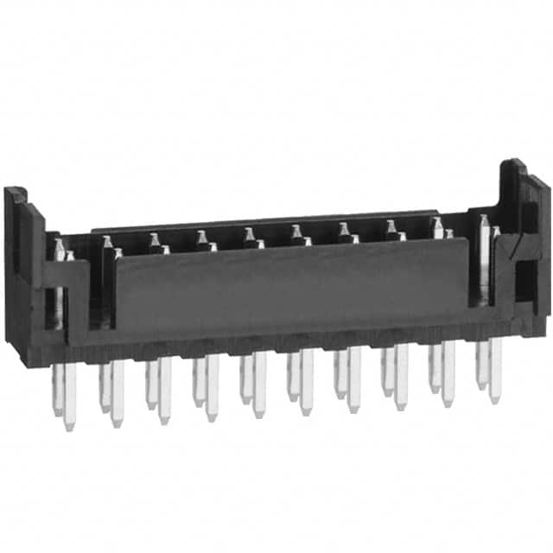
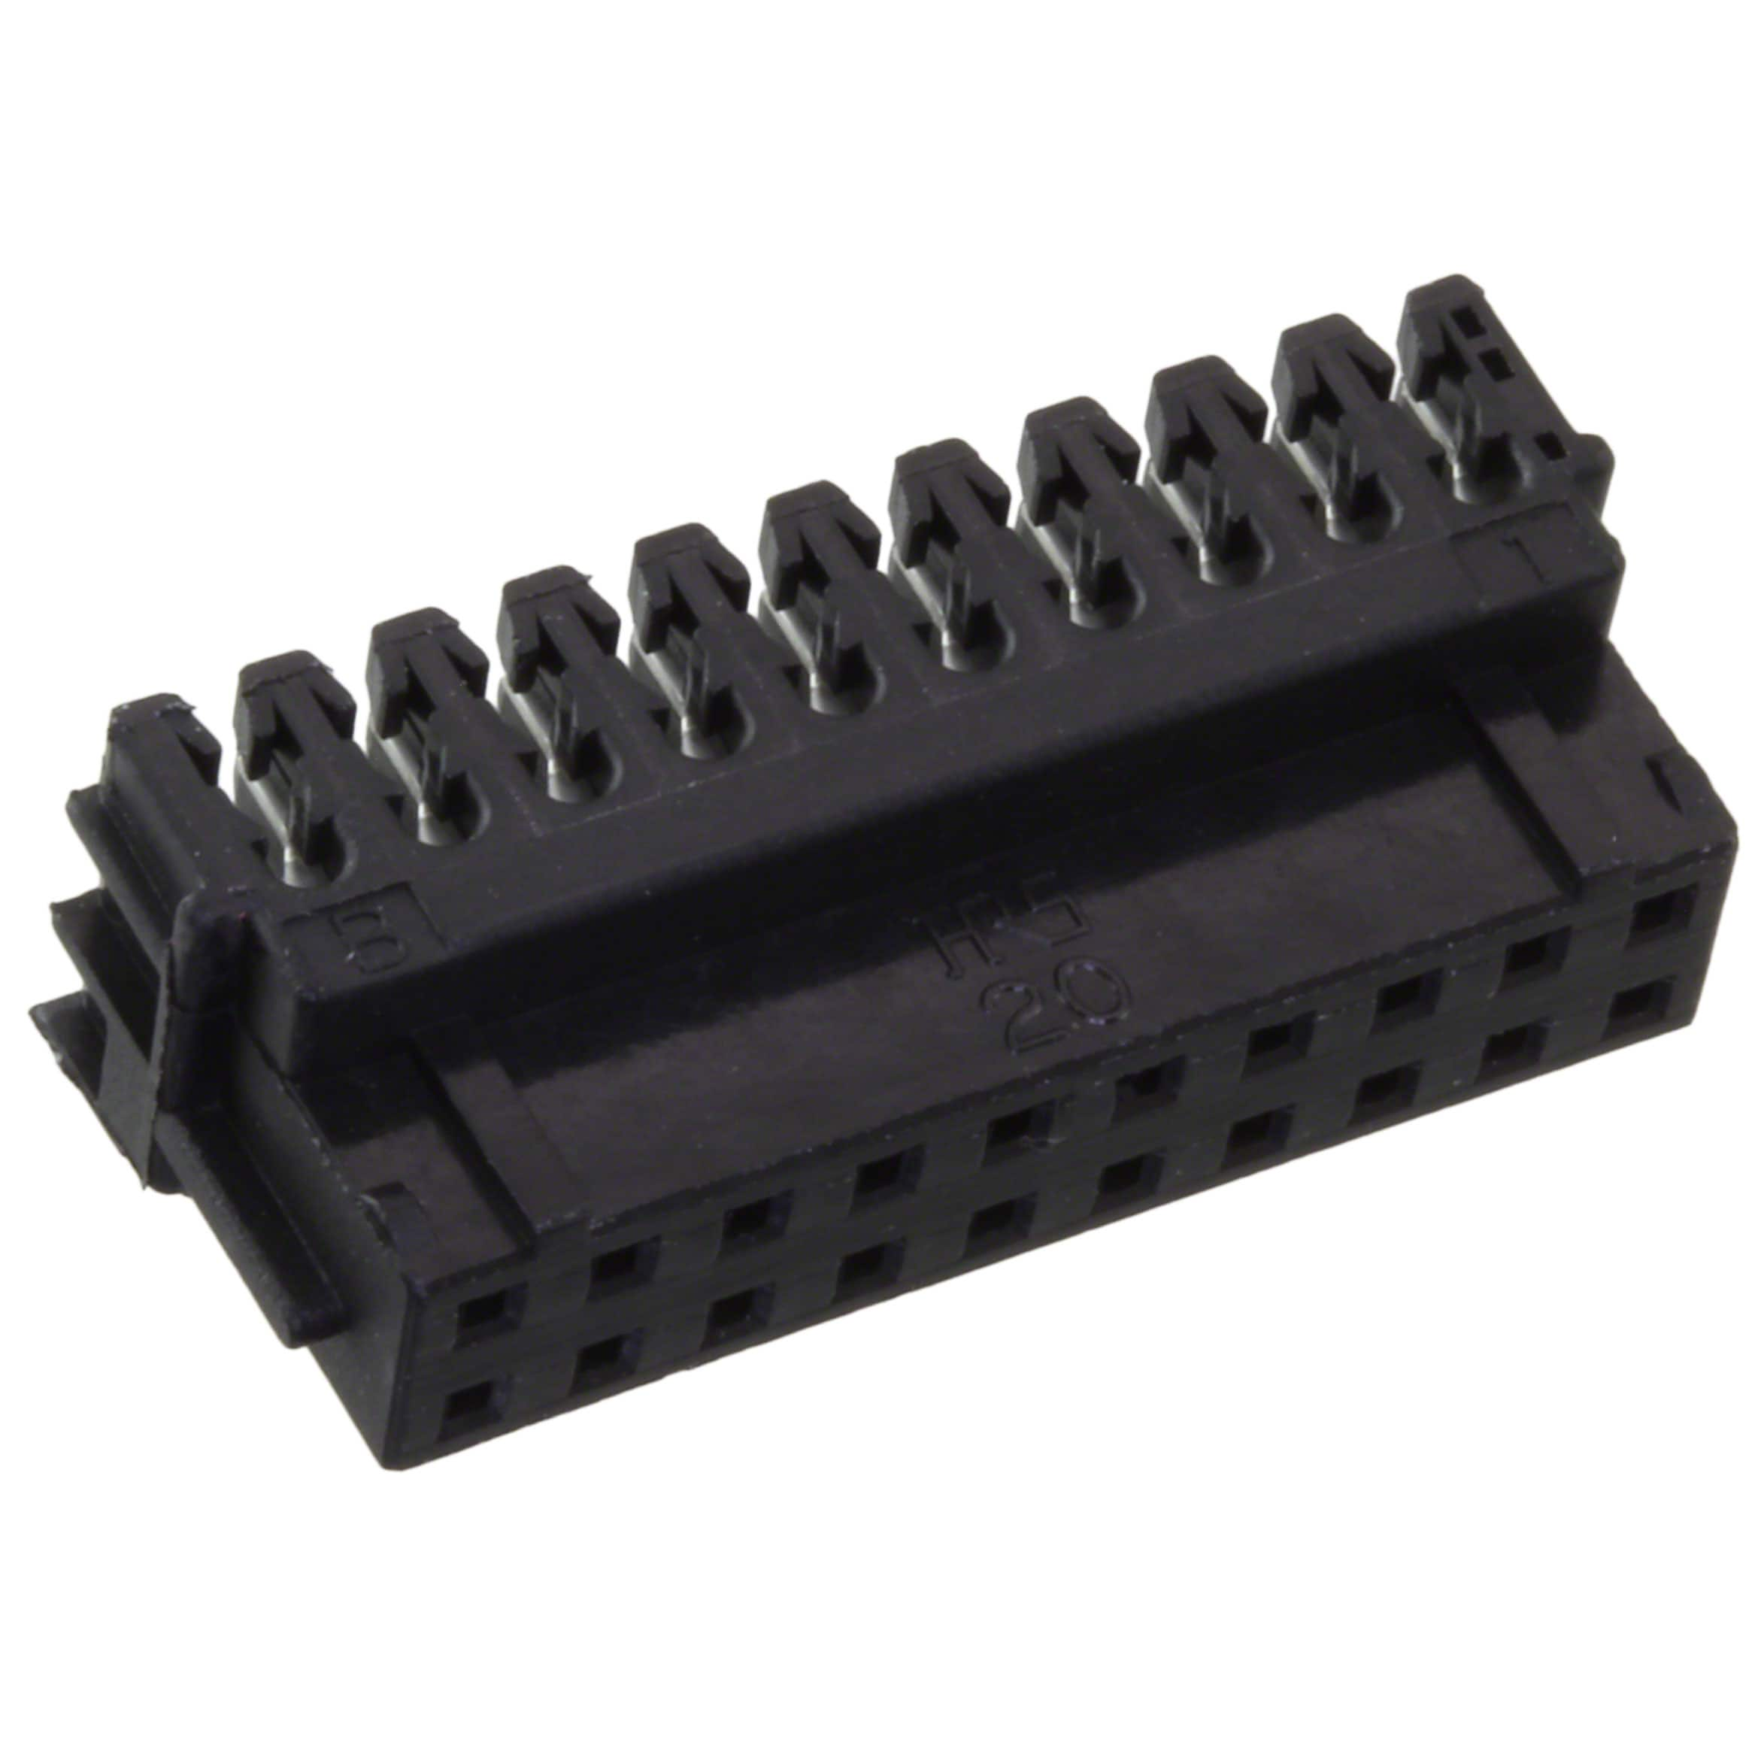
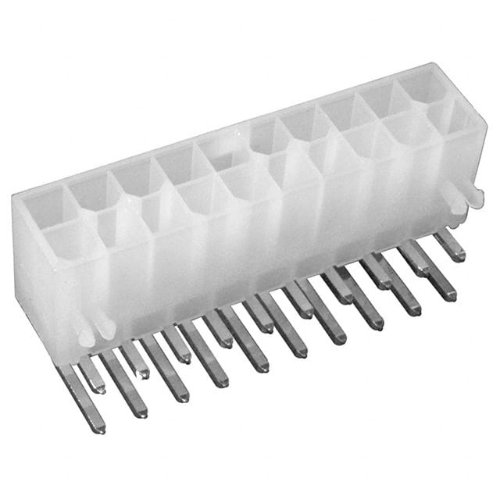
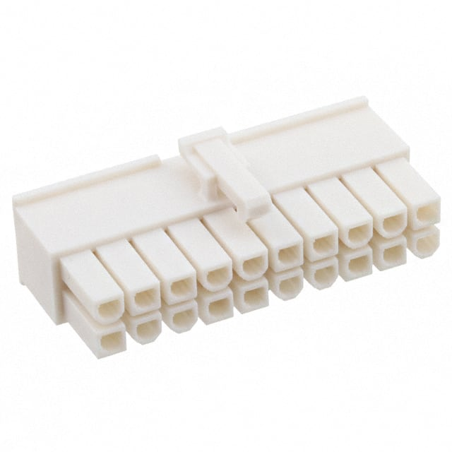
Material overview. LV Connectors (2)
Chips power connectors:
ROC board end
Board: Hirose DF11-20DP-2DSA - CONN HEADER VERT 20POS 2MM; accept 22-30 AWG
Cable: Hirose DF11-20DS-2R26 - CONN RCPT 20POS IDC 26AWG TIN
Specs: https://www.hirose.com/product/document?clcode=CL0543-0544-8-52&productname=DF11-26DP-2DS(52)&series=DF11&documenttype=Catalog&lang=en&documentid=D31688_en
max current ratings for AWG #22-26 -- 2A
Cable filtering module end
Board: Molex 39301200 - CONN HEADER 20POS 4.2MM R/A TIN, WM1360-ND
Cable: Molex 39012200 - 20 Rectangular Connectors - Housings Receptacle Natural 0.165" (4.20mm)
Sockets: Molex 39000077 - Socket Contact Tin 16 AWG Crimp Power
max current ratings for AWG #16 – 6A

Slide 26
Cables safety compliance summary
Cable | Type | Compliance
ROC power, 10m | #14-25C THHN-PVC Shielded Tray | UL 1277; UL 66; UL 83
ROC power, 2m | #18-25C TRAYCONTROL Tray, 63055 | UL: TC-ER; PLTC-ER; ITC-ER; UL Type WTTC; UL Type MTW; NFPA79
Chips power, 10m | #16-8pairs PVC jacket Shielded Tray | NEC: 725 - PLTC, 760 - FPL, NPLF; 336 - TC, TC-ER FT4/IEEE1202
Chips power, 2m and Bias trunk, 10m | #22-9pair BELDEN 9520 | UL 1685 FT4 loading, FT4, T-29-520, IEEE 1202 FT4 Article 725, Article 727, Article 800, CMG, ITC-ER, PLTC-ER; AWM 2464
Bias flexible, 2m | RG-174 | UL 1581 VW-1; AWM Style 1354; Mil-Spec Equivalent M17/119-RG174

Slide 27
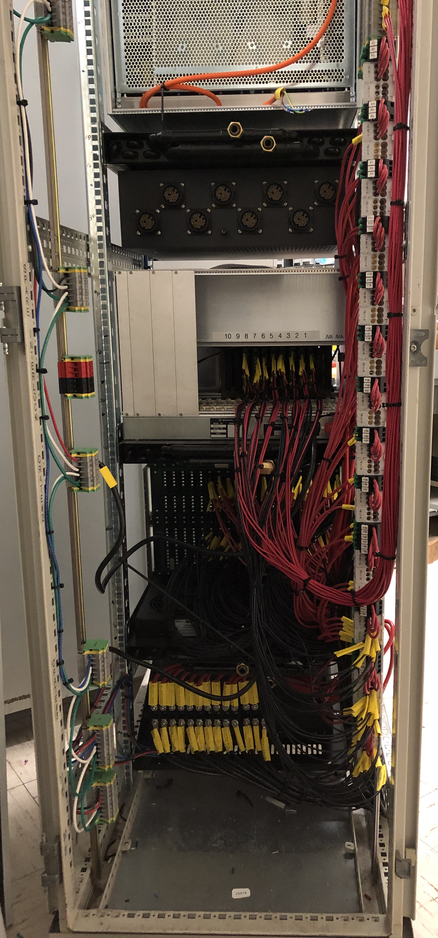
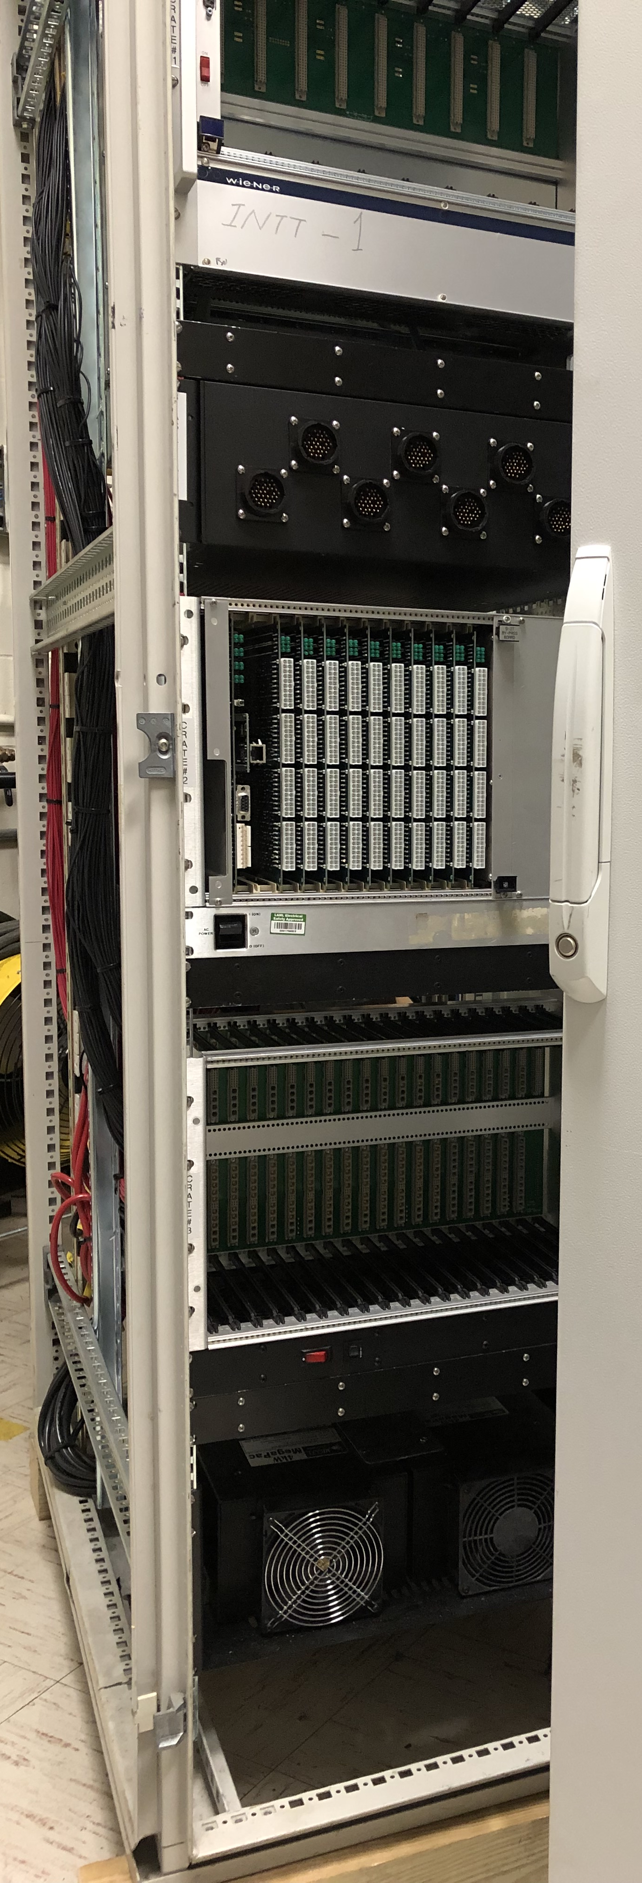
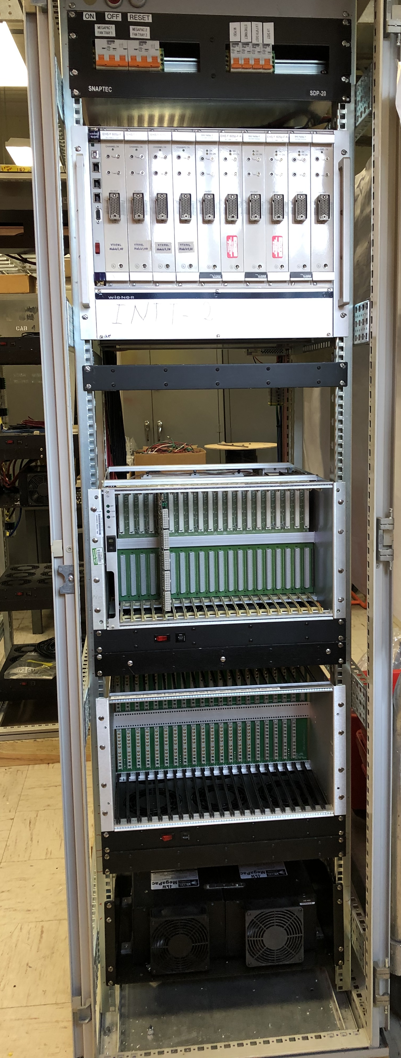
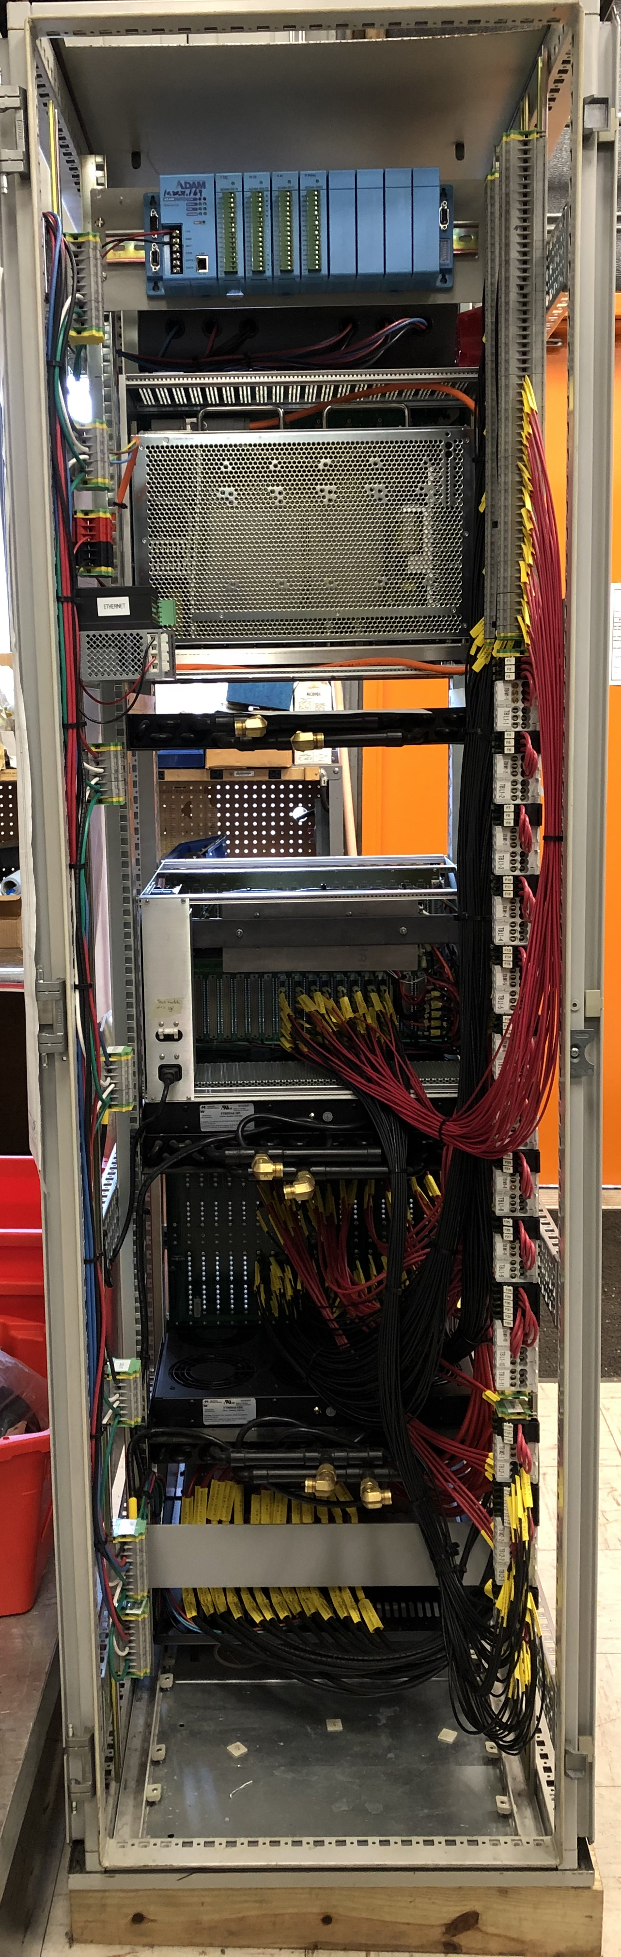
INTT racks, rack #1 front and back and rack #2 front and back (left to right)
Bias crate
Bias Filter
box is in →
construction
LV filter
crate
Switching
crate
Vicor
MegaPACs

Slide 28
Components Status: LV Power
Vicor 4kW MegaPAC-EL chassis 2 chassis/side ➔ 4 chassis http://www.vicorpower.com/documents/datasheets/megapac.pdf
ConverterPAC - QPAC, QPAC(L/GL) http://cdn.vicorpower.com/documents/datasheets/ds_qpac.pdf
QPAC - DC to DC converter, 400W output power
Suggested modules
Vout = 8.0V, 50A (+/-50% Trim) 4 modules/side ➔ 8 modules
Vout = 5.0V, 80A 9 modules/side ➔ 18 modules
Alternative for 5.0V - QPAC(L), 200W/40A output ➔ 22 modules
Switching system
crate+backplane+controller 1 unit/side ➔ 2 units
switching modules 15 modules/side ➔ 30 modules
patch panel (TPC design). 1 panel/side ➔ 2 panels
Filtering system
crate+backplane+controller 1 unit/side ➔ 2 units
filtering modules 8 modules/side ➔ 16 modules
patch panel 1 panel/side ➔ 2 panels

Slide 29
Filtering modules:
One switching channel feed 8 filtering channels
Number of filtering modules required
40 channels/module → 32 channel in use
single ROC 8 ROCs
16 digital (1A) channels – 1/ 2 module → 4 /side
16 analog (0.25A) channels – 1/2 module → 4 /side
20A @5V → 160A /side [← 5 QPAC(L)]
Voltage drop in filtering modules:
Solid state relay AQZ102 – 0.09 Ohm in On state
Inductors 682C - 2x0.02 Ohm = 0.04 Ohm
Polyswitch RGEF300 – 0.043 Ohm
→ 0.17 Ohm total resistance in On state

Slide 30
Switching modules:
Number of switching modules required:
board power for 8 ROC
regulated SWout
5 FPGA “2.5V” → 4.6V → 40 ch/side → 5 modules
2 Pulser “5V” → 6.8V → 16 ch/side → 2 modules
2 Transm “3.3V” → 5.7V → 16 ch/side → 2 modules → 11 modules/side
1 JTAG “5V” → 4.3V → 8 ch/side → 1 module
1 Opto “5V” → 6.5V → 8 ch/side → 1 module
Ladder power for one side
8 ROC X 4 cables X 4 channels → 128 Analog and 128 Digital channels
One switch serves 8 channels → 16 Analog + 16 Digital
16 switches for Analog “2.5V (1A)” → 8A/switch 3.4V SWout
→ 16 ch → 2 switching modules
16 switches for Digital “2.5V (0.25A)” → 2A/switch 3.0V SWout
→ 16 ch → 2 modules
total number of switching modules → 15 modules/side → 1 crate

Slide 31
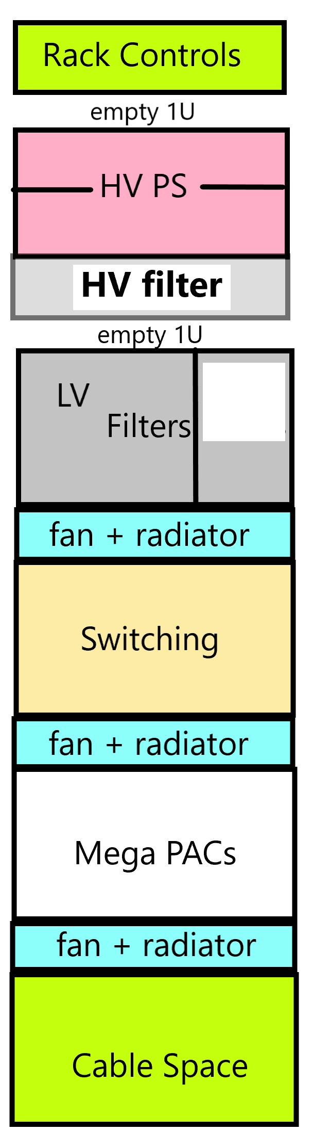
Rack space: 42Ux1.75”
Rack #1
Rack #2
-------------------------- 3U -----------------
----HV, crate&filter 8U+3U =11U -------------
----LV Filters 6U+2U=8U -----------------
------- Switching 6U+2U=8U ----------------
----- Mega PACs 4U+2U=6U ----------------
---------- 42U-36U-2U = 4U -----------------
2U – HV crate gap for cabling

Slide 32
Rack power
total power conservative (+30%) estimate:
4.2kW (208V) + 0.3kW (110V, for HV)
2.2 kW total at MegaPACs+QPACs output
MegaPac efficiency: 82%
QPAC (DC-DC) efficiency: 80-90%
both efficiencies are taken into account

Slide 33
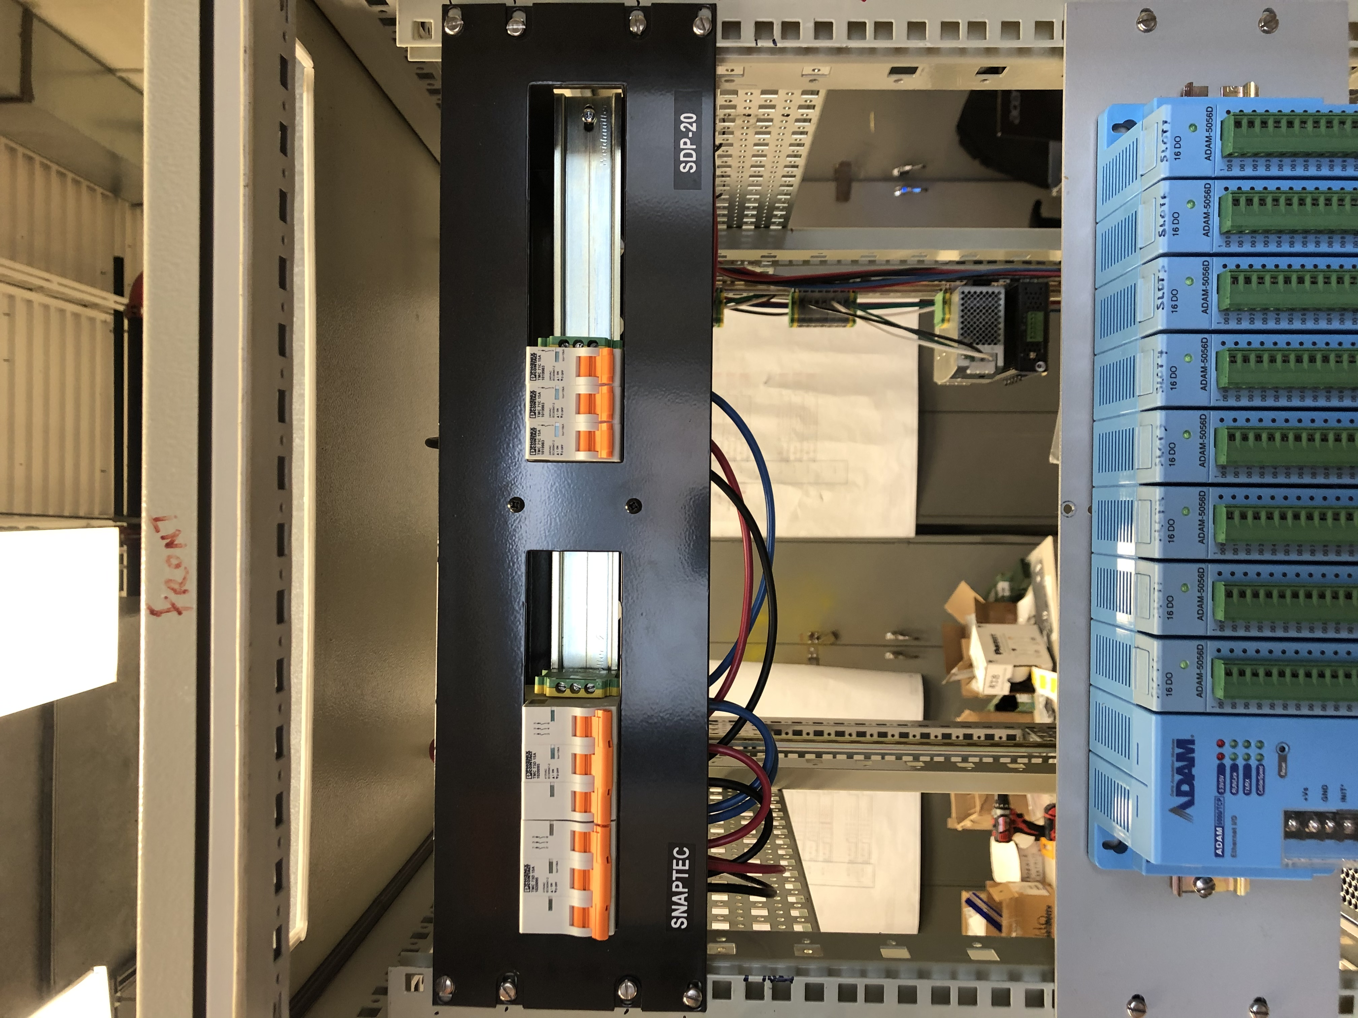
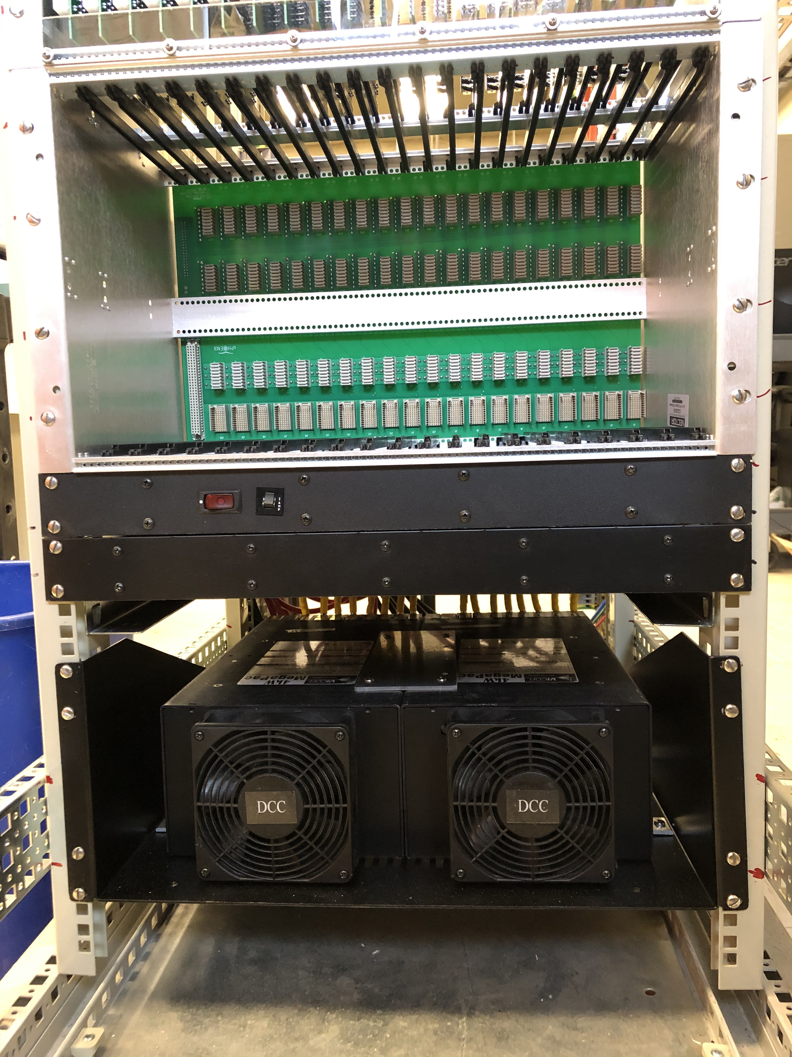
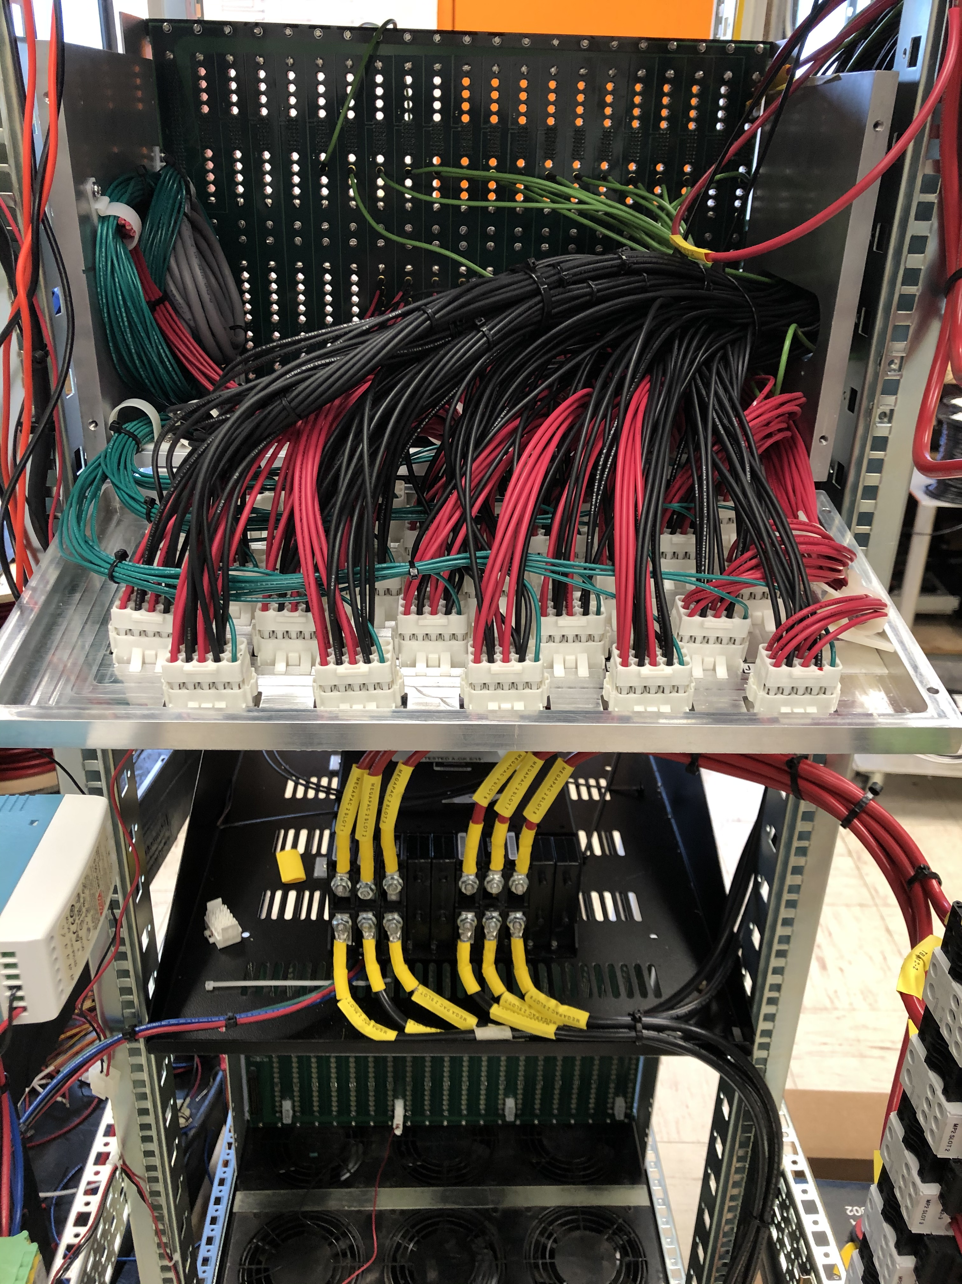
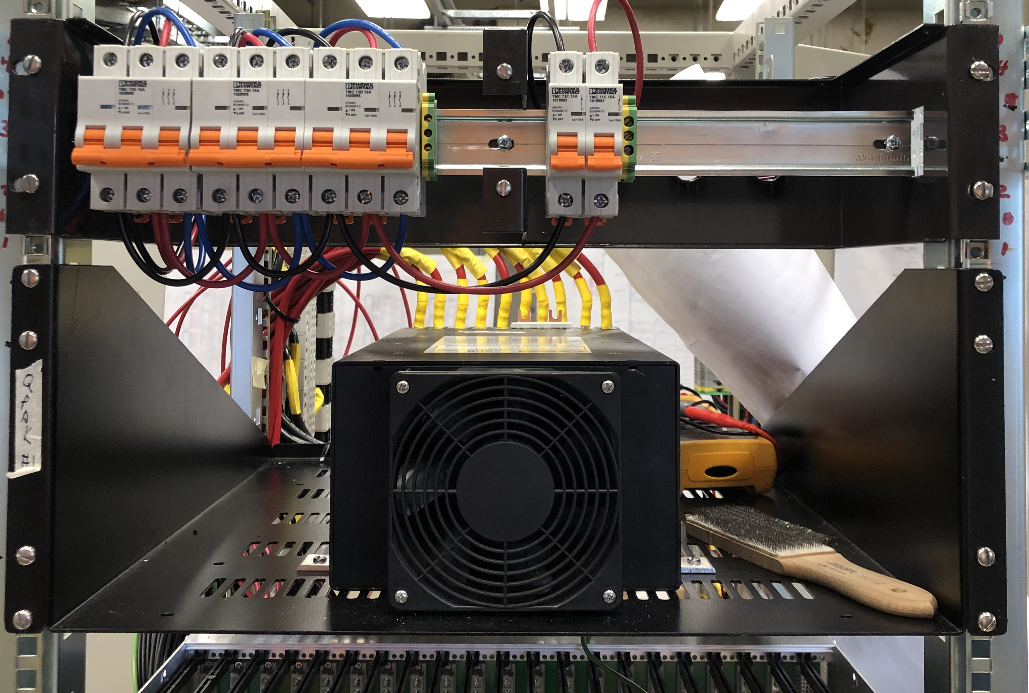
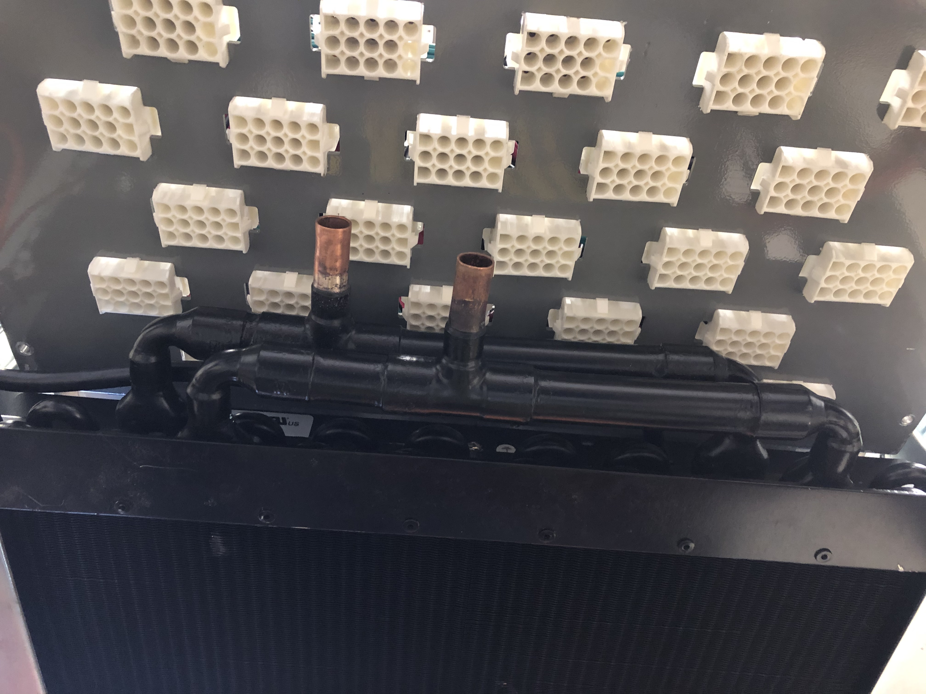
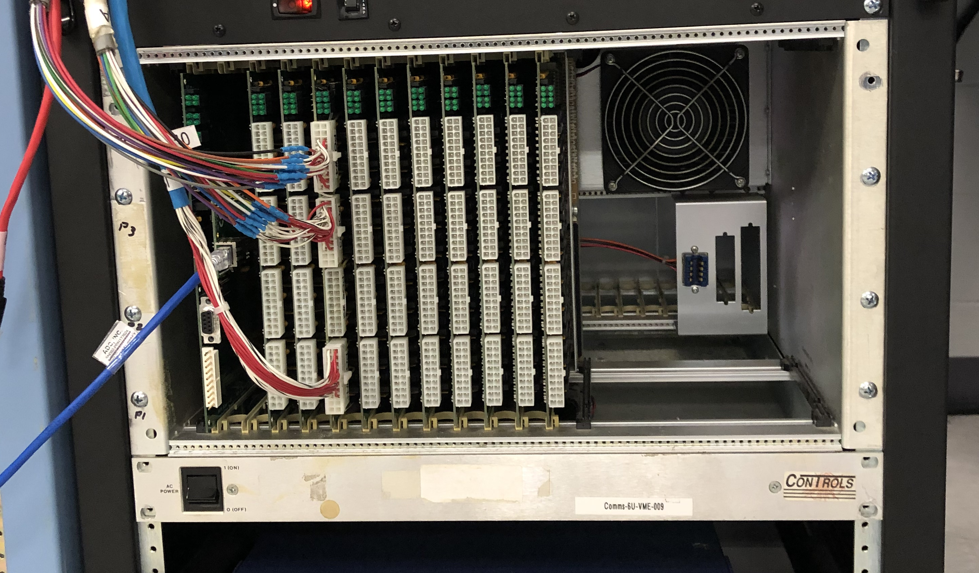
Rack components. TPC & Emcal Examples

Slide 34
Rack Components Status, summary
Rack Components Status 2021.06.23
Component |  | Required qty | Qty on Hand | Rack #1 | Rack #2
HV power | crates | 2 Full MPODS | Ordered 2 | ✅ | ✅
 | modules | 16 | 13 | ✅ | partial
 | filters | 32 ( 8 ch) modules | in design | 16 | 16
LV power | MegaPAC | 4 | 4 | ✅ | ✅
 | QPAC 8V | 8 | 8 | ✅ | ✅
 | QPAC 5V | 9 | 9
Switching | crate+backplane+controller | 2 | 2 | ✅ | ✅
 | modules | 30 | 30 | ✅ | ✅
Filtering | crate+backplane+controller | 2 | 2 | ✅ | ✅
 | modules | 16 | 16 | ✅ | ✅

Slide 35
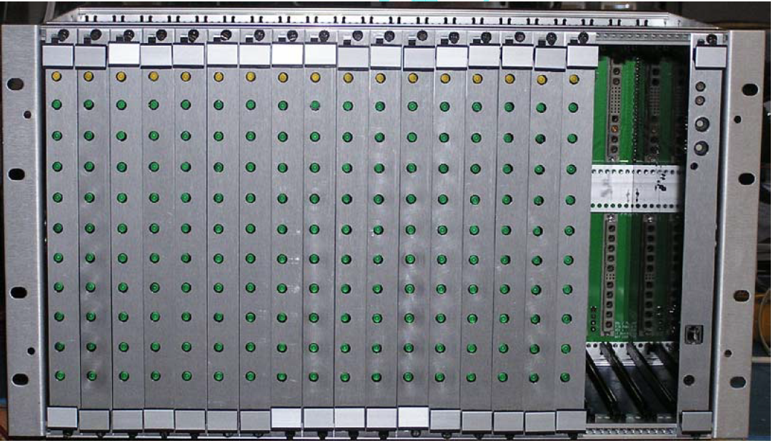
LV switching crate
Need 3 voltage lines per FEE card - 3 switching modules feed 5 cables → 20 FEEs (1 cable → 4 FEEs)
6 X 3 =18 modules feed 26 cables → 104 FEEs + spare channels
→ crate is organized as 6 groups of 3 modules in each, for example:
modules 1,4,7,10,13,16 – serve V1 lines
modules 2,5,8,11,14,17 – serve V2 lines
modules 3,6,9,12,15,18 – serve V3 lines
This way cables are right behind modules feeding them

Slide 36
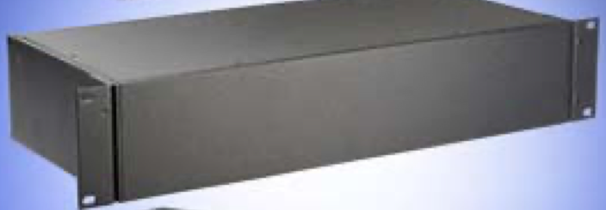
HV crate MRCAH2504R1J
Mpod EC HV: 10slots
- fan and controller MpodC
- up to 600W HV
$6,849.00 (x2, one per side) →$13,698
HV module EH166005x1560000200:
ISEG_EHS F6 05x
- 16ch x 500V
$7,416.00 (x4, inc. one spare,
need 16, on hand 13) →$29,664
HV filter cost estimate $4.8k
HV filter cost break down:
(2 filter boxes, 16 pcb +4 spare)
- components - $2.8k
- pcb fabrication – $2k
- pcb design – 1 week designer time
- pcb populate – 1 week tech time
- assembly&wiring – 1 week tech time
Rack space 42Ux1.75”
controls -3U
HV crate 8U+2U filter
LV Filters 6U+2U=8U
Switching 6U+2U=8U
MegaPACs 4U+2U=6U
42U-37U-2U = 5U

Slide 37
HV filter module
Filter components:
RC filter – 1K+0.1 uF
Pi filter – 4.7 mH +0.1 uF
Damping – C3+R2
RC filter cutoff
frequency:
fc=1.6 kHz
Pi filter resonance
frequency:
f0= 7.3 kHz
damping factor:
Q=1 → R~ 200 Ohm

Slide 38
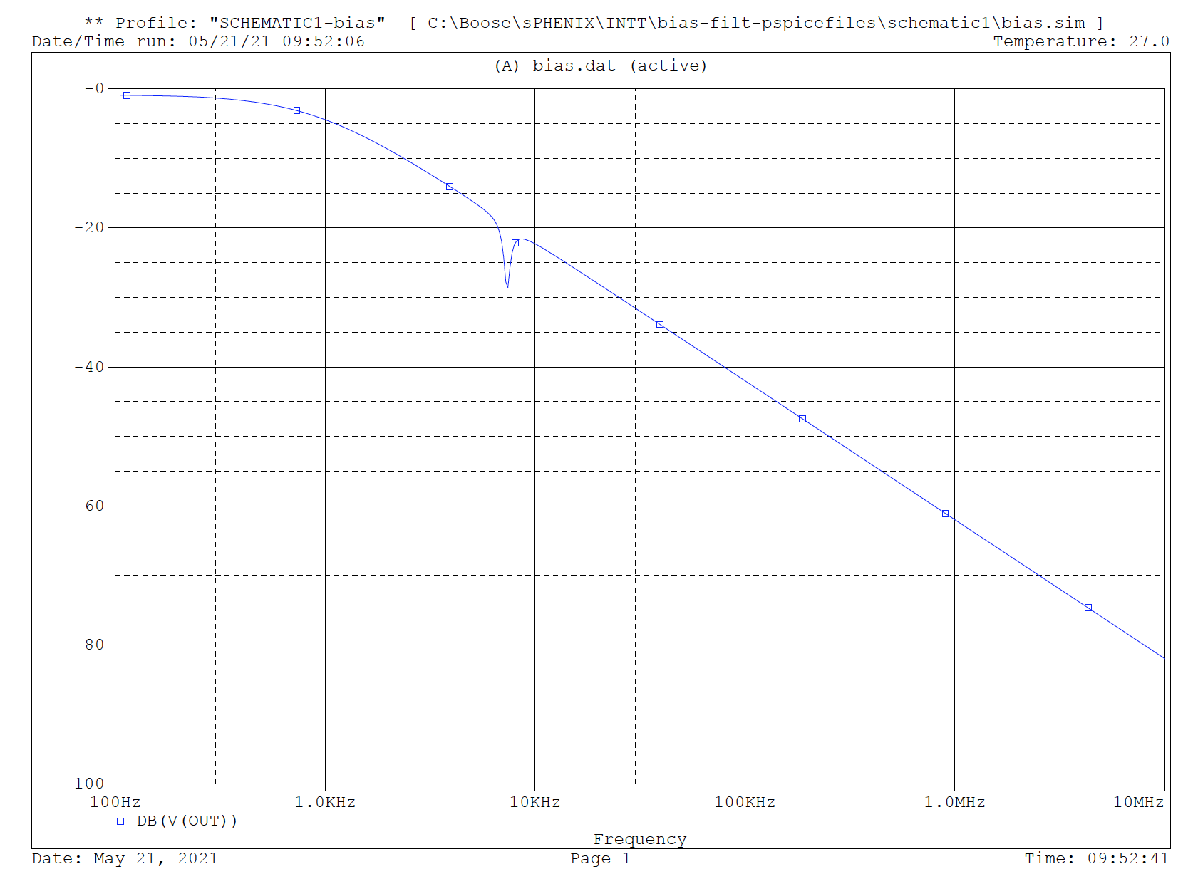
HV filter module (2)
Steve ran HV filter without damping through pspice and produced the bode plot →

Slide 39
HV filter module (3)
Components:
number of module = 16 + 4 spare = 20 → 320 channels
module connectors – 4x20 = 80
corresponding wire connectors – 64
connector pins – 64x16=1024 (1280 )
box input connectors - 8x2 = 16
box output connectors – 16
number of input pins 16x32= 512
number of output pins – 512
inductors – 640
0.1uF caps -640
1k resistors – 320
damping resistors – 320
damping caps – 320

Slide 40
Components Status: HV Power
HV crate – Wiener Full crates 1/side ➔ 2 crates are ordered
HV module - iseg EHS F 605p-F, 8 modules/side ➔ 13+3
HV filtering 16, 8 ch modules/side ➔ 32 modules

Slide 41
HV cable –RG-316 (?)
https://catalog.belden.com/techdata/EN/83284_techdata.pdf
Product: 83284 Mil-Spec Coax, 50 Ohm, RG-316, 26 AWG Str SCCS, 95% SC Braid, FEP Jkt, Commercial Non-QPL
Product Description
Mil-Spec Coax, 50 Ohm, RG-316, 26 AWG (7x34) Silvered Copper Covered Steel Conductor, PTFE Insulation, 95% Silvered Copper Braid Shield, FEP Jacket, Commercial, non-QPL
Technical Specifications
Non-UL voltage rating – 900V (Mil-Spec)
Operating temperature - -70°C to +200°C
Bend radius – 1”
Military Compliance: Commercial, non-QPL product (M17/113-RG316)

Slide 42
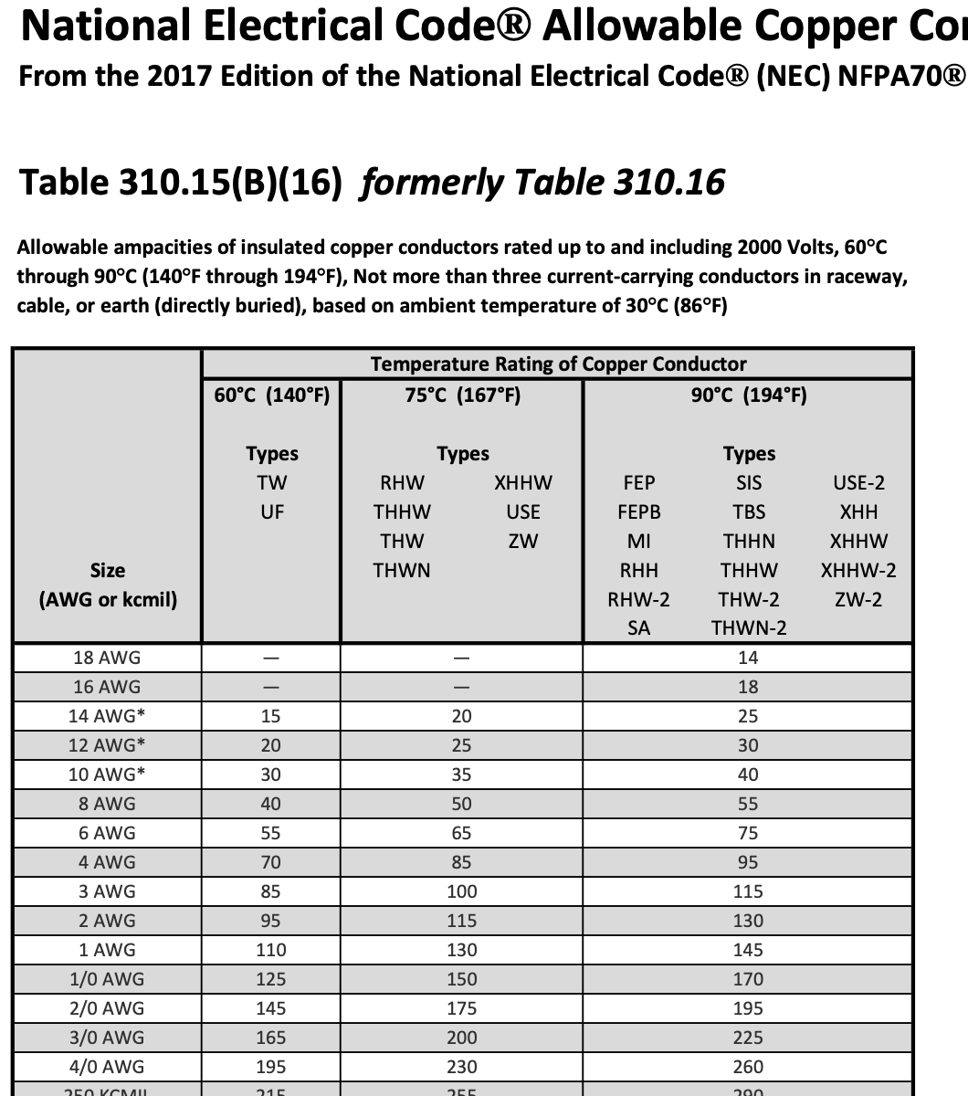
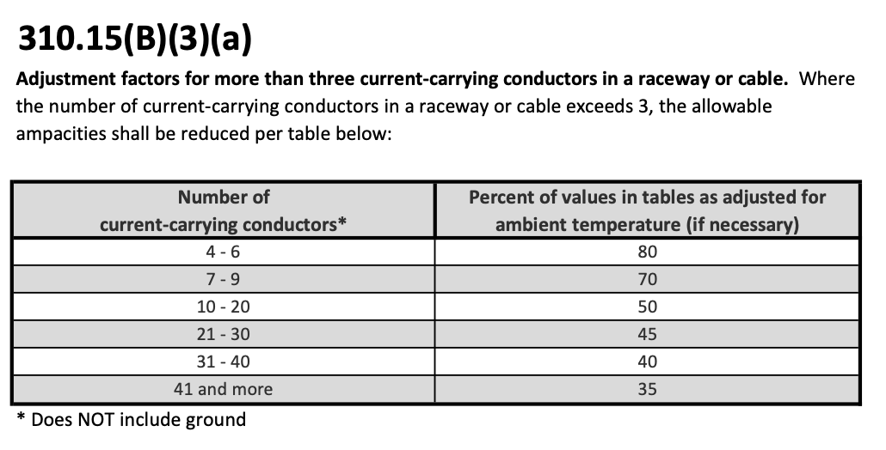
NEC ampacities table
Unless otherwise specifically permitted elsewhere in the NEC NFPA70 Code,
the overcurrent protection for conductor types marked with an asterisk shall not exceed
15A for No. 14 copper, 20A for No. 12 copper, and 30A for No. 10 copper,
after any correction factors for ambient temperature and
number of conductors have been applied.

