Slide 1
News and Announcement
Detector 1 TOF-PID WG meeting
August 8, 2022

Slide 2
Follow-ups from EICUG meeting on July 26-29
Physics cases & requirements for low momentum PID need to be defined and strengthened
Roles of RICH veto mode vs. TOF-PID for low momentum PID should be clarified
Need realistic evaluation of integration needs (service, mechanics, cooling etc.)
Role of AC-LGADs layer in tracking: does it contribute to improve momentum resolution?
We need to start actively reaching out to physics WGs, other detector WGs, etc. and hold (regular) joint discussions

Slide 3
Follow-ups from EICUG meeting on July 26-29
S. Torre

Slide 4
Follow-ups from EICUG meeting on July 26-29

Slide 5
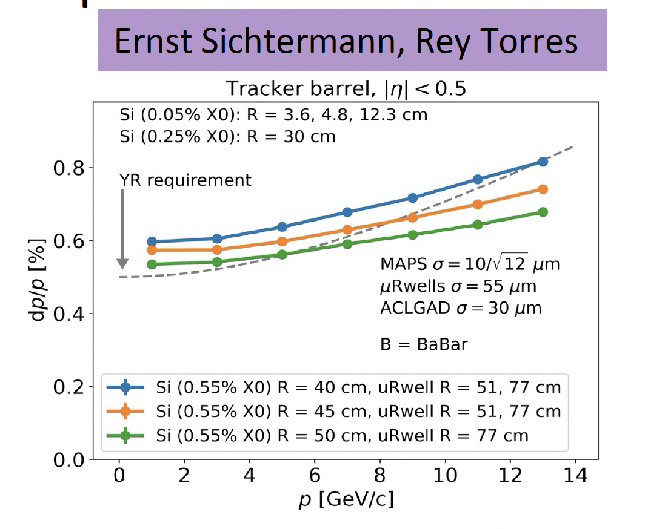
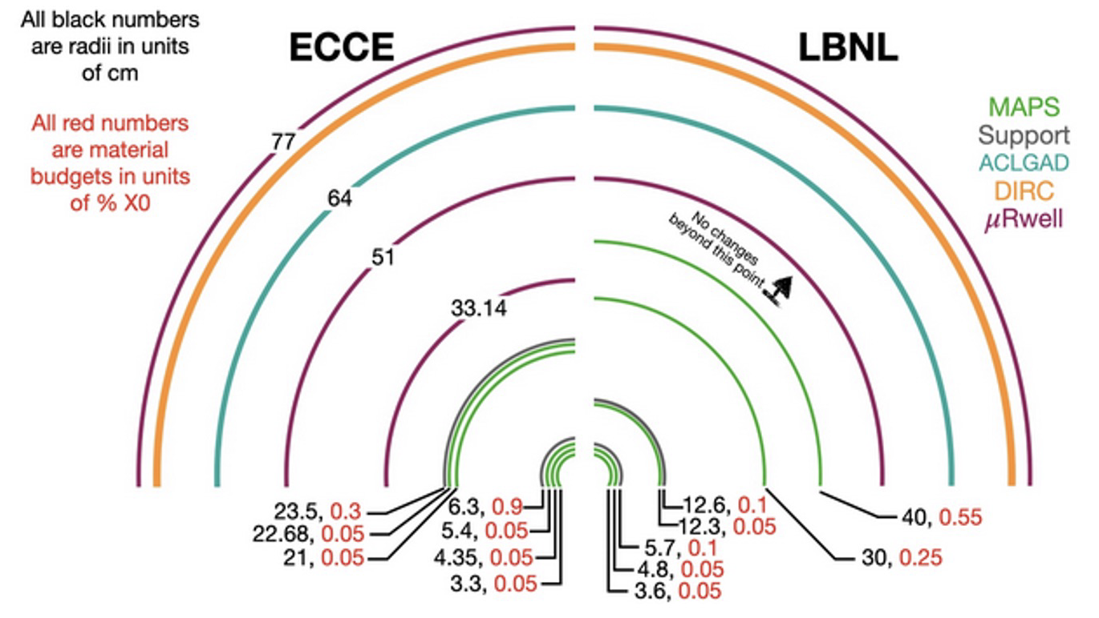
Follow-ups from EICUG meeting on July 26-29
Re-arrangement of inner tracking layers
Do outer layers (MPGDs, AC-LGADs)
have any impact to momentum resolution?
New MPGD layer added to constrain tracking angular resolution inside the dRICH

Slide 6
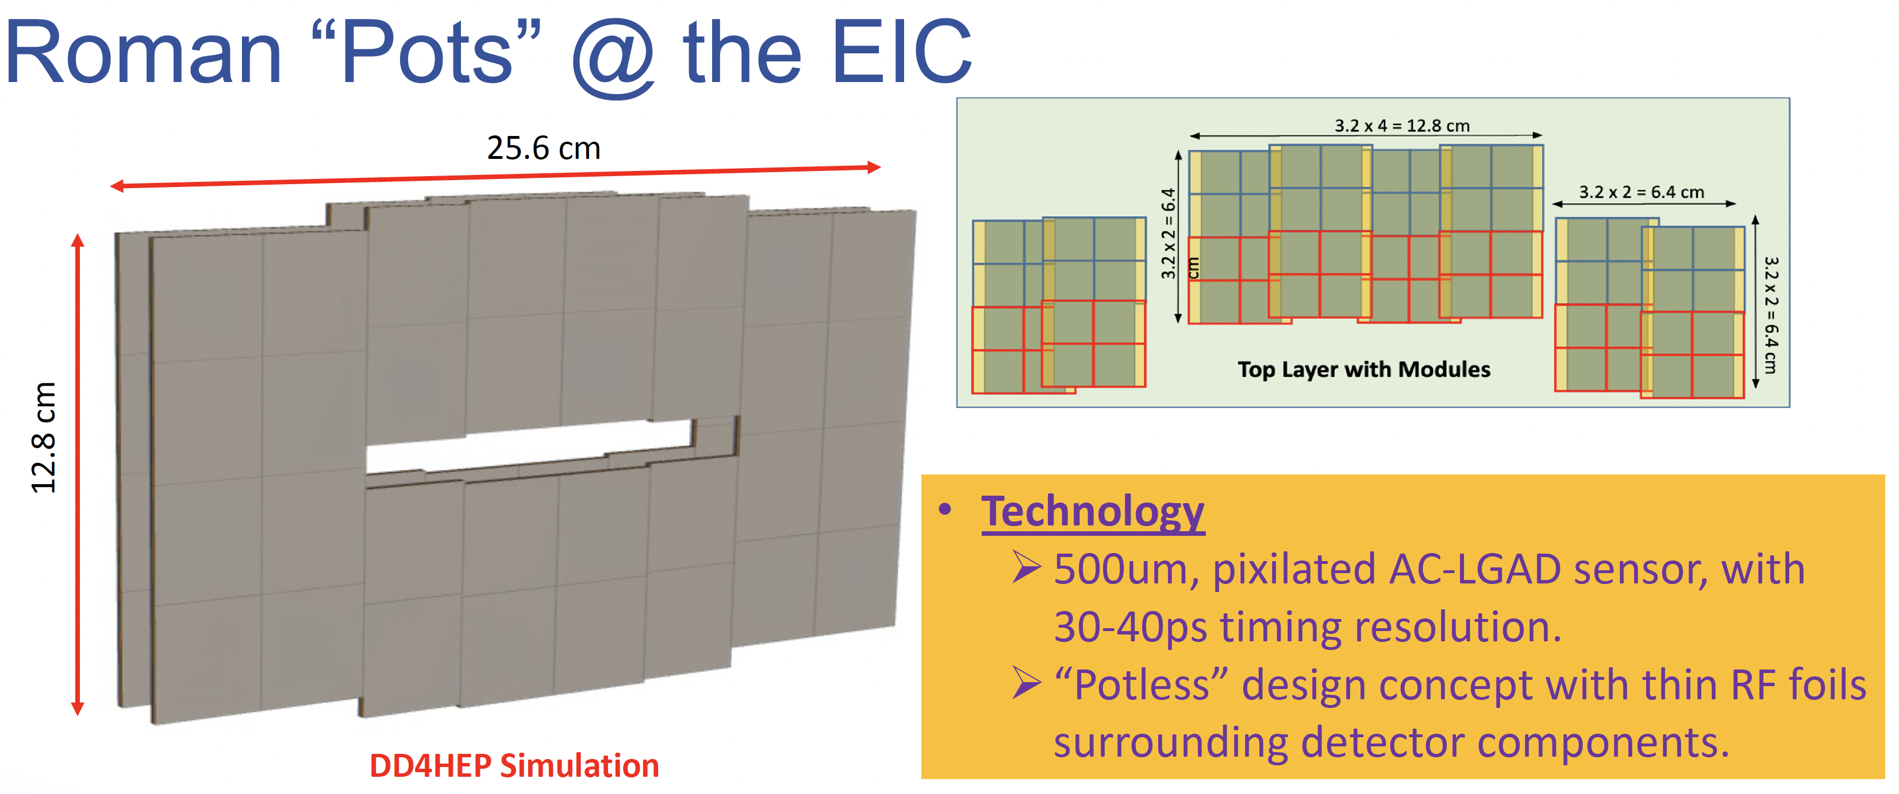
Follow-ups from EICUG meeting on July 26-29
Strong preference of 0.5x0.5 mm² pixels for RPs indicated. Shall we try to adopt the same for endcaps (simpler for layout)?

Slide 7
Today’s agenda

