Slide 1
Status
Experimental Program
E.C. Aschenauer (BNL)
R. Ent (JLab)
Co-Associate Directors for the Experimental Program
DOE-NSF-EIC Informational Meeting
August 18, 2022

Slide 2
Experimental Program Preparation
Yellow Report and EIC Conceptual Design Report are both available and include a reference detector concept
BNL and TJNAF Jointly Leading Process to Select Project Detector | BNL and TJNAF Jointly Leading Process to Select Project Detector
2020 | Call for Expressions of Interest (EOI) https://www.bnl.gov/eic/EOI.php | May 2020
 | EOI Responses Submitted | November 2020
 | Assessment of EOI Responses | On-going
2021 | Call for Collaboration Proposals for Detectors https://www.bnl.gov/eic/CFC.php | March 2021
 | BNL/TJNAF Proposal Evaluation Committee | Spring 2021
 | Collaboration Proposals for Detectors Submitted | December 2021
✔️ | Decision on Project Detector – “ECCE” | March 2022
 | Guide process to joint “Detector-1” Collaboration | Spring 2022
 | EPIC Collaboration* Formed – 160 institutions | July 2022
*Merger of two large ATHENA and ECCE proposals

Slide 3
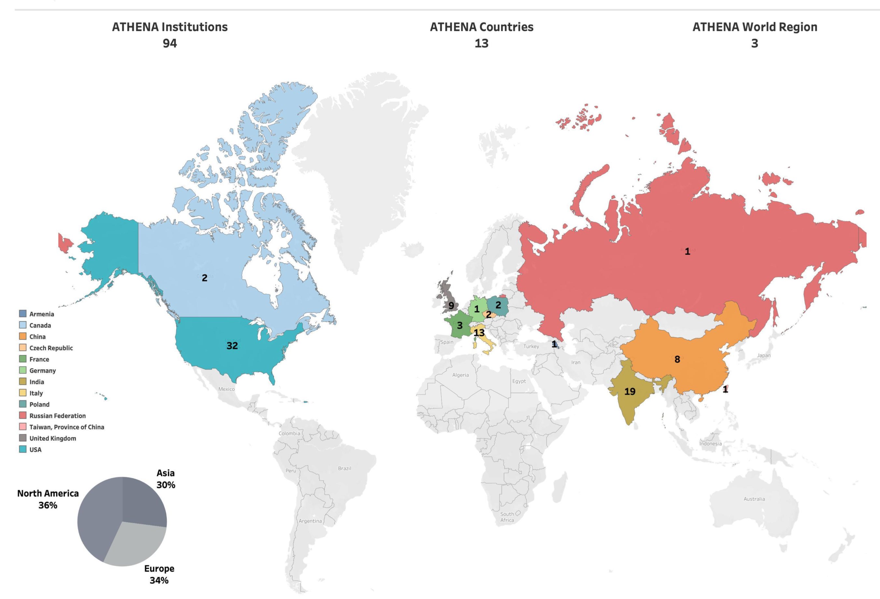
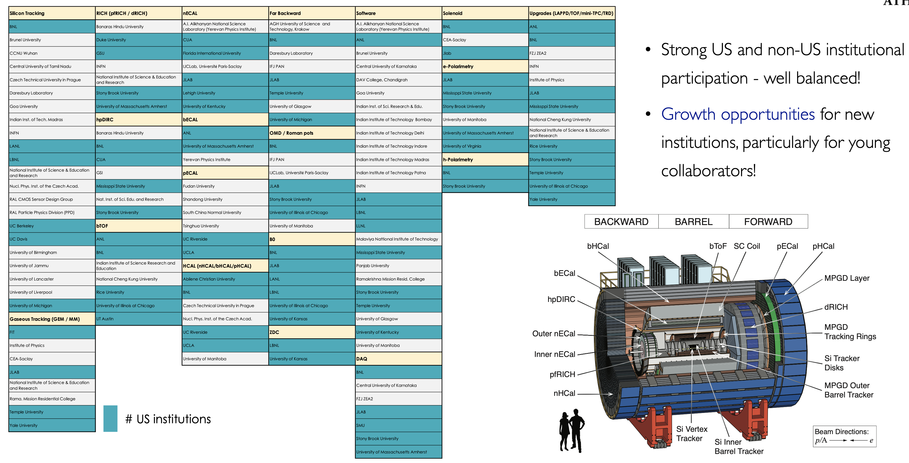
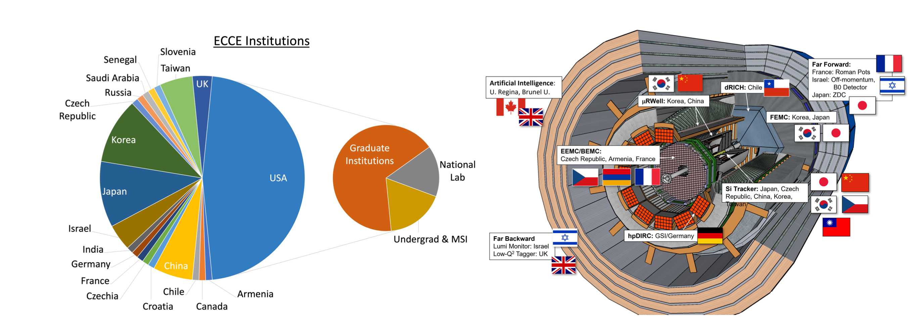
Path to EIC Project Detector Collaboration
ATHENA:
ECCE:
consolidate to EIC Project Detector Collaboration

Slide 4
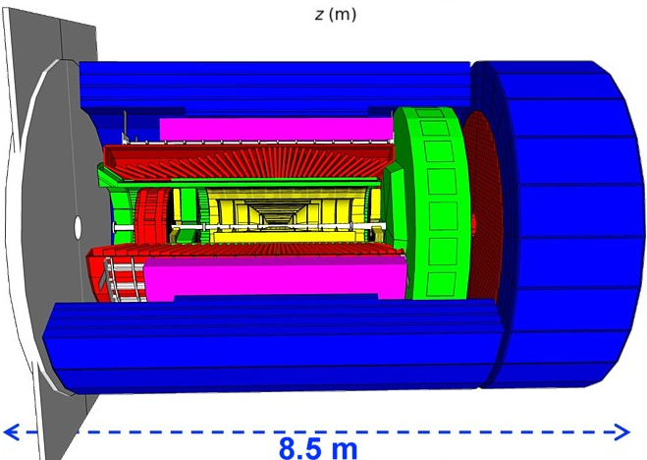
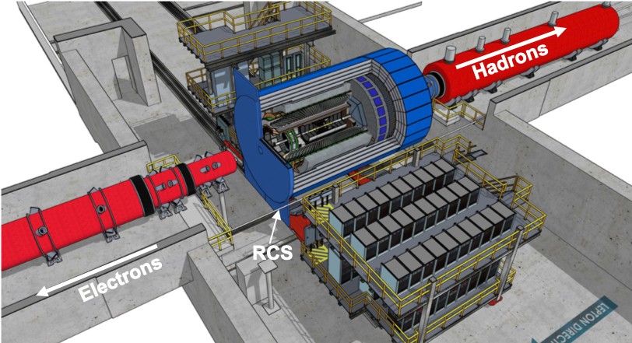
Recent Accomplishments
hadronic calorimeters
solenoid coils
ToF, DIRC,
RICH detectors
Finalized Project Detector selection process 8th of March 2022
→ ECCE general-purpose Detector around
a 1.5 T BaBAR like Solenoid
e/m calorimeters
MPG & MAPS trackers
Consolidation of ECCE and ATHENA in full swing, make integration of all groups as welcoming as possible
Combined Leadership Team formed
Combined Physics and Technical WG formed
named collaboration EPIC at July EICUG-meeting
EPIC institutional board formed
collaboration charter writing started
Elect collaboration management by November
Updated P6 cost and schedule based on ECCE as reference design
R&D rolled out to Users and P6 updated with respective milestones
Integration of ECCE reference detector in Interaction region
Integration of ancillary detectors in wider IR (+/- 40 m)
Excellent progress on CAD based design of detector
Moving full speed to CD-2/3A
  technical reviews for all WBS level-3 systems
  move design to required design maturity
  define Long Lead Items
  ………..

Slide 5
Timeline: What is Coming
EIC
Preliminary Design ~50-60%; Final Design $≥$85%
Operating* Funds
Project Engineering and Design (PED) Funds
Construction & PED
Funds
Operating Funds
Initiation
Definition
Execution
Closeout
Conceptual Design
Preliminary Design
Final Design
Construction
    EIC Critical Decision Plan
    CD-2/3a January 2024
    CD-3 April 2025
    CD-4a early finish April 2031
    CD-4a April 2032
    CD-4 early finish April 2032
    CD-4 April 2034
Critical
Decisions
CD-0
Approve Mission Need
CD-1
Approve Alternative Selection
and Cost
Range
CD-2
Approve Performance Baseline (PB)
CD-3
Approve Start of Construction or Execution
CD-4
Approve
Start of Operations or Project Completion
What has happened
CD-0 approval December 19, 2019
Community-wide Yellow Report effort Dec. 2019 – Feb. 2021
CD-1 review (includes CDR) January 26-29, 2021
Call for Collaboration Proposals for Detectors March 6, 2021
CD-1 approval June 29, 2021
DOE/OPA Status Review October 19-21, 2021
Status Update to Federal Project Director June 28-30, 2022, @BNL
Technical Subsystem Reviews January – December 2022
EICUG Meeting at SBU July 2022
What is coming next
EPIC Collaboration Formation Summer-Fall 2022
OPA Status Review January 2023
Preliminary Design Complete & Review May 2023
Final Design/Maturity Readiness for CD-3A Items May 2023
CD-2/3A review (expectation), requires pre-TDR ~October 2023
CD-2/3A (expectation) ~January 2024
CD-3 review (expectation) ~January 2025
CD-3 (expectation), requires TDR ~April 2025

Slide 6
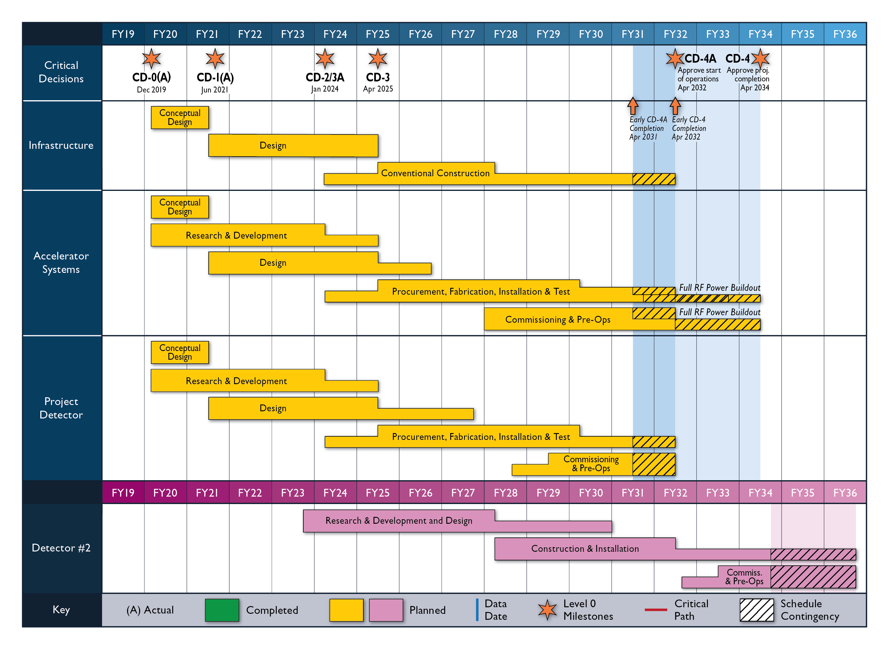
High Level Reference Schedule
The thinner bars indicate that R&D and design
can continue at a small level beyond CD-2 and CD-3
for LLP construction
starts at CD-2/3A
Notional Schedule
2nd IR and
Schedule
Generic Detector R&D

Slide 7
Overview EEMCAL
Scattered electron kinematics measurement is essential at the EIC
High precision, hermetic detection of the scattered electron is required over a broad range in h and over energy range from 0.1 to tens of GeV
  In the very backward direction high precision is required for electron kinematics measurement
  In backward and barrel region it is required for clean electron identification. In the barrel region, driven by high-x and high-Q² science drivers
SciGlass (developed with DOE/STTR) in the barrel provides excellent e/h separation due to its good energy resolution, matched to the backward region need, and its cost effectiveness
Requirements
Good energy resolution
  e.g., region -2 < η < -1 requires ~7%/√E
e/h separation up to 10⁻⁴
η | [-4 .. -1.75] | [-1.75 .. 1.3] | [1.3 .. 4]
Material | PbWO₄ | SciGlass | Pb/Sc
X₀ (mm) | 8.9 | 24-28 | 16.4
R_{M} (mm) | 19.6 | 35 | 35
Cell (mm) | 20 | 40 | 40
X/X₀ | 22.5 | 17.5 | 19
Dz (mm) | 60 | 56 | 48

Slide 8
EEEMCAL Project Scope - DRAFT
“Apparatus for the Detection and Identification of Electrons of the Electron-Ion Collider”
13 institutions, 10 US, 3 international
EIC-NSF Level XX (Draft) | Institution (Draft) | Major Funding | Major Team Member (Draft)
Mechanical Structure | IJCLab-Orsay MIT/MIT-Bates | International DOE | Carlos Munoz-Camacho Richard Milner
Radiator | Charles U./Prague CUA | International NSF | Miroslav Finger Tanja Horn
Front-end electronics | Lehigh U. FIU | NSF and DOE DOE | Rosi Reed Lei Guo
Back-end readout electronics, DAQ, full-chain tests | James Madison U. Ohio U. JLab | NSF NSF DOE | Ioana Niculescu Justin Frantz Vladimir Berdnikov
Prototyping, test stands, calorimeter assembly | AANL U. Kentucky Abilene Christian U. | International NSF DOE | Ani Aprahamian Renee Fatemi Jim Drachenberg
Simulation, reconstruction | W&M (also Ohio U.) | NSF and DOE | Cristiano Fanelli
Assumptions on EIC Project: Global Integration & Project Management Support

Slide 9
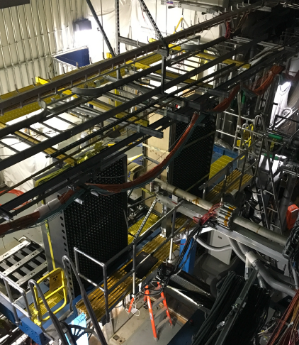
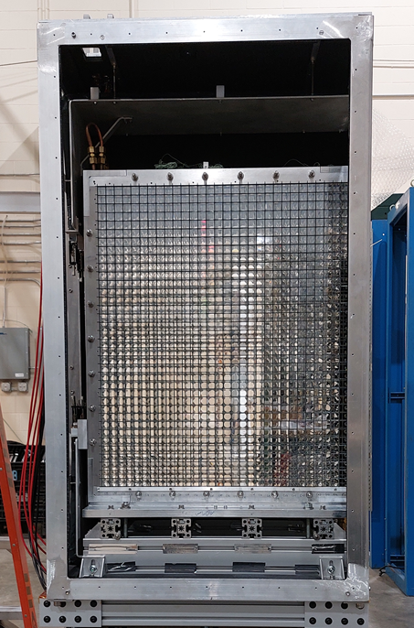

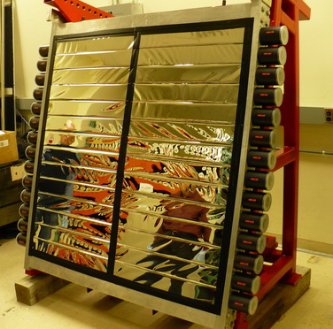
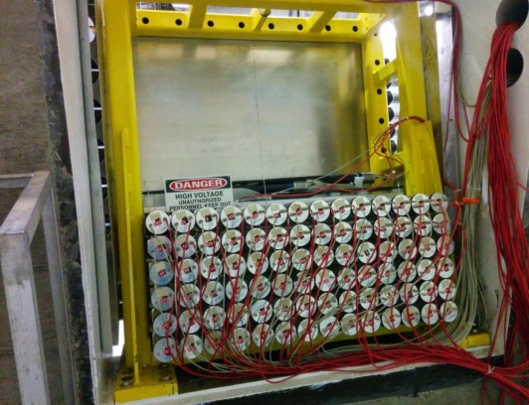
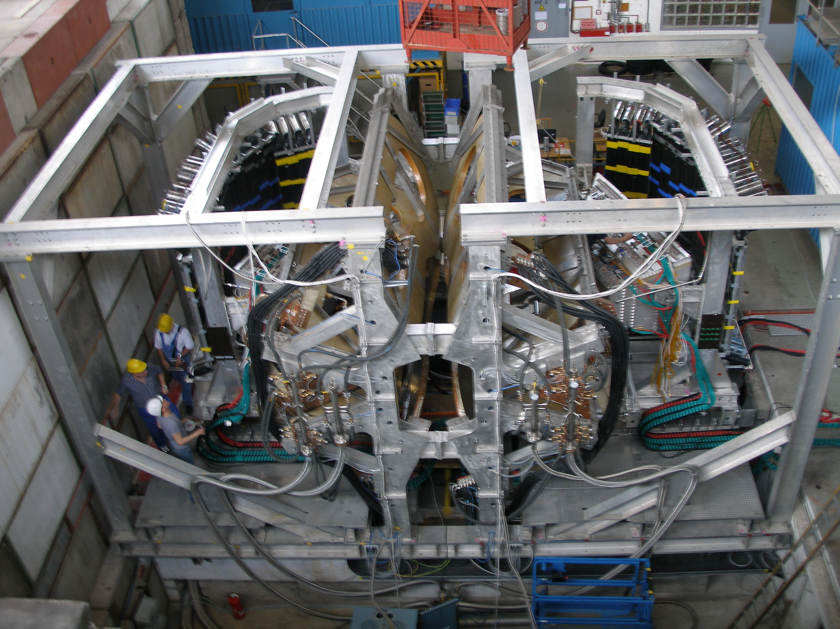
Examples of Infrastructure and Expertise
Selected calorimeters
NPS: NSF/MRI, mechanical design (IJCLab), PbWO₄ (CRYTUR)
STAR: ECAL of the forward upgrade
SHMS EMCal: 252 TF-1 blocks
One infrastructure example
Collective experience includes detector design and construction, technical support and infrastructure, readout electronics, crystal/glass fabrication and characterization
Collective background includes hadron and heavy ion physics at BNL and JLab
OLYMPUS/DESY (BLAST) spectrometer: designed, fabricated, commissioned and operated at Bates
9

Slide 10
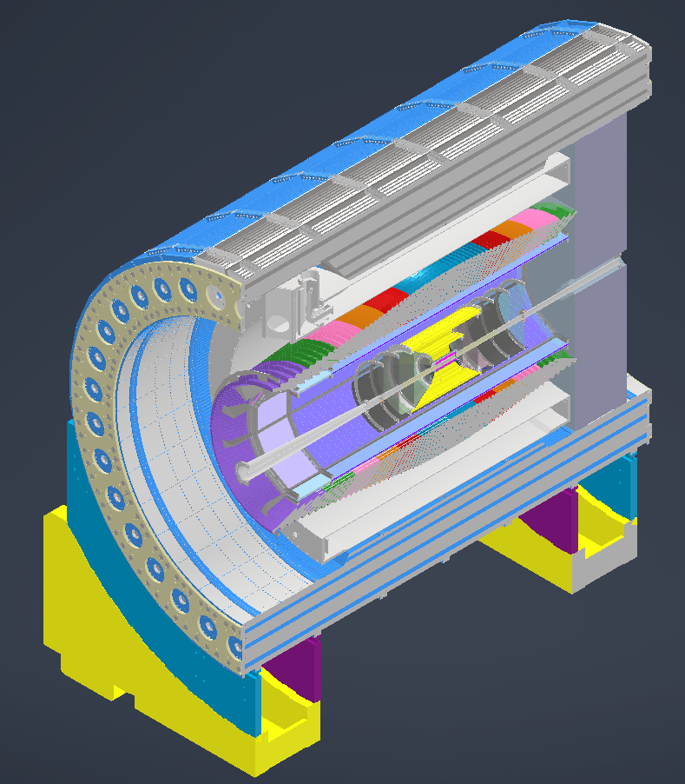
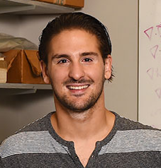

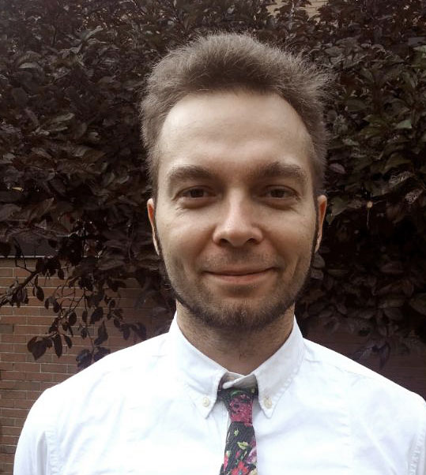
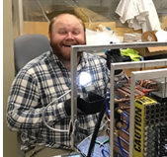

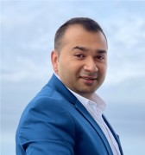

Electromagnetic Precision Calorimetry
electron detection essential at the EIC
Homogeneous EM calorimeter – typical materials in lepton induced hadron scattering: crystals and glass, a well-established detector technology
Barrel EMCal readout electronics can be identical with the backward EM calorimeter → no additional technology required
Experienced team of institutions (AANL, CUA, FIU, JMU, UK, MIT..) including many early-career researchers working on design, simulation, prototypes
Opportunities for many early-career in-kind contributions for radiator, design/construction, simulation, readout

Slide 11

















Electromagnetic Precision Calorimetry
(AANL, CUA, UKY, MIT, Lehigh, FIU and IJCLab had earlier meeting with NSF to pre-discuss)
+ possible additional institutional interest

Slide 12


Slide 13


Slide 14
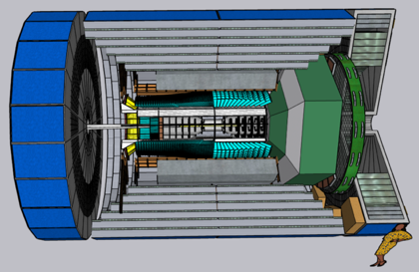
EIC Proto-Collaborations
Received 3 proposal for the call
ATHENA (https://sites.temple.edu/eicatip6/)
Focus on becoming the “project detector”@IP6
New 3 T magnet and the YR Reference Detector
Leadership: S. Dalla Torre (INFN Trieste), B. Surrow (Temple)
~117 collaborating institutions from Armenia, Canada, China,
Czech, France, Germany, Italy, India, Poland, Romania, UK
CORE (https://eic.jlab.org/core/)
An EIC Detector proposal based on a new 3 T compact
magnet for the 2nd EIC detector @ IP8
Contacts: Ch. Hyde (ODU) and P. Nadel-Turonski (SBU)
Smaller-scale effort, ~20-30 active collaborators
ECCE (https://www.ecce-eic.org)
Project detector @IP6 or the 2nd EIC detector @ IP8
  using existing 1.5T “Babar” solenoid
Leadership: O. Hen (MIT), T. Horn (CUA), J. Lajoie (Iowa State)
~98 collaborating institutions from Armenia, Canada, Chile,
Croatia, China, Czech, France, Germany, Israel, Japan,
Senegal, Korea, Russia, Slovenia, Taiwan, UK

Slide 15
Detector Proposal Advisory Panel
Reviewed detector proposals from the three proto-collaborations - all three proposals received high marks
Concluded that ATHENA and ECCE satisfied the requirements
Noted that many collaborators are involved in multiple proposals and none of the proto-collaborations are currently strong enough to build the project detector
Strongly encouraged the three proto-collaborations to move forward together based on ECCE as the reference design for the project detector
Expects the integration of new collaborators and new experimental concepts and technologies to improve physics capabilities, and to prepare the detector as part of the EIC project baseline, the next major DOE schedule milestone
Enthusiastically supported a second detector as needed to take full advantage of the unique capabilities of EIC facility
Expects the EIC User Community to come together in support of the project detector as well as a second detector

