Slide 1
High intensity electron beams (for EIC and other applications)
Alexei Fedotov
Brookhaven National Laboratory
September 8, 2022
BNL

Slide 2
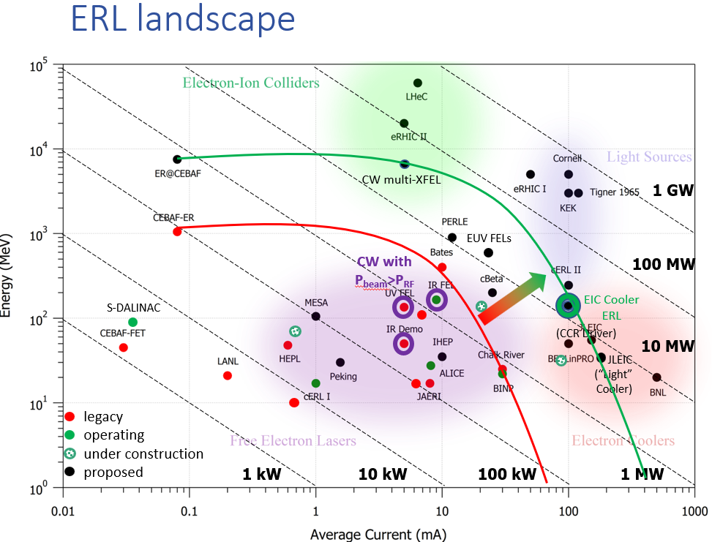
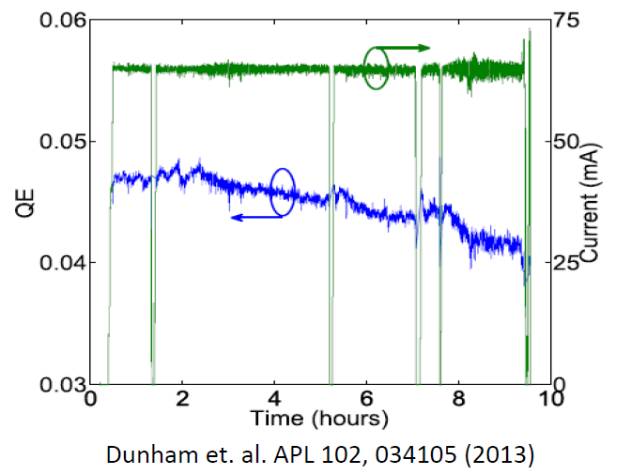
Motivation:
courtesy Erdong Wang
EIC electron beam coolers:
1) Low-energy coolers (13 and 22 MeV electron accelerators)
2) High-energy cooler (150 MeV electrons)
require stable long-term operation of electron source at around 100mA current.
High-current Energy Recovery Linacs (ERL) f and other applications
High-current operational experience:
High-current R&D using DC and SRF guns at BNL
Cornell University DC gun:
Demonstrated 65mA over several hours
LEReC DC gun:
1) 24/7 operation at about 20 mA current (2020-21)
2) Achieved stable operation at 50mA in tests (April 2022)
65mA
51mA
Current [mA]
Time
2

Slide 3
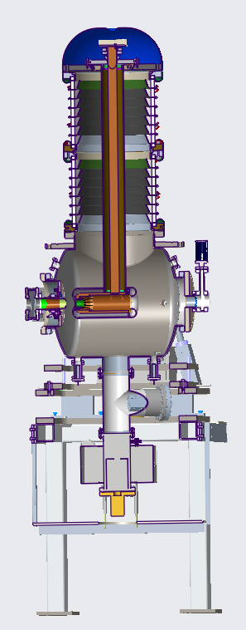
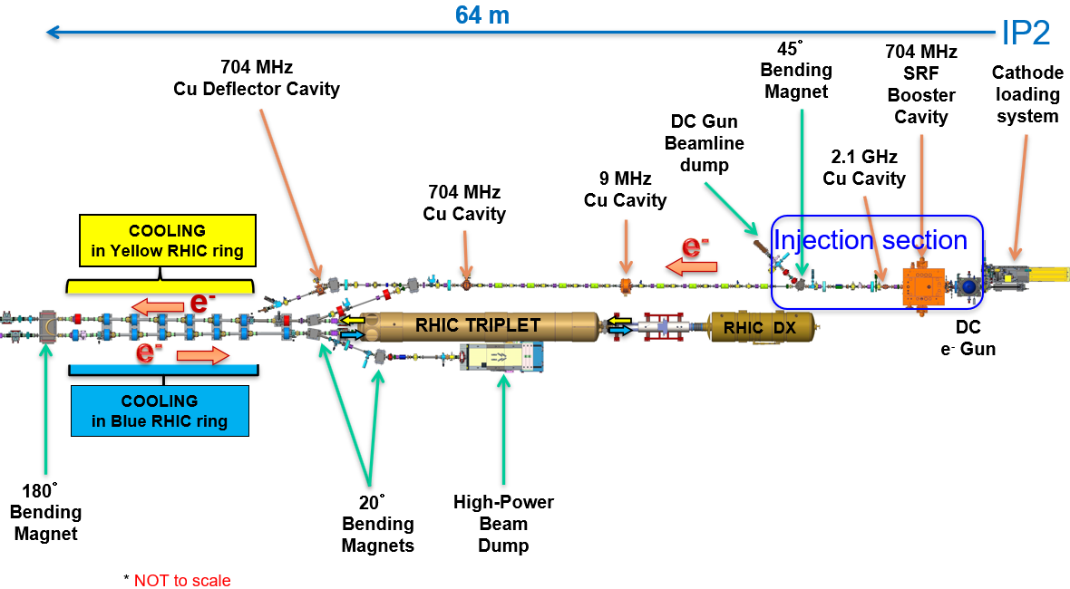
DC Gun electron source high-current R&D
Explore Gun operation at high currents. Determine limitations of the Gun and HVPS:
Explore Gun and HVPS long-term stability at high currents.
Explore Gun voltage limitations at high currents.
Explore operation with active cathode on center vs cathode off center.
Explore large cathode area vs small active area. Explore various laser spot sizes on the cathode.
Explore cathode QE lifetime at various laser powers with and without cathode stalk cooling.
Test multi-alkali photocathodes using different growth methods.
High charge and high peak current (beam halo and losses) studies. Explore possible upgrade of laser system to allow ramping of high-current for fixed electron bunch charge.
LEReC layout
Plans:
1. LEReC Gun: Explore operation at high currents up to 100mA.
2. EIC R&D: 500kV inverted Gun under design.

Slide 4
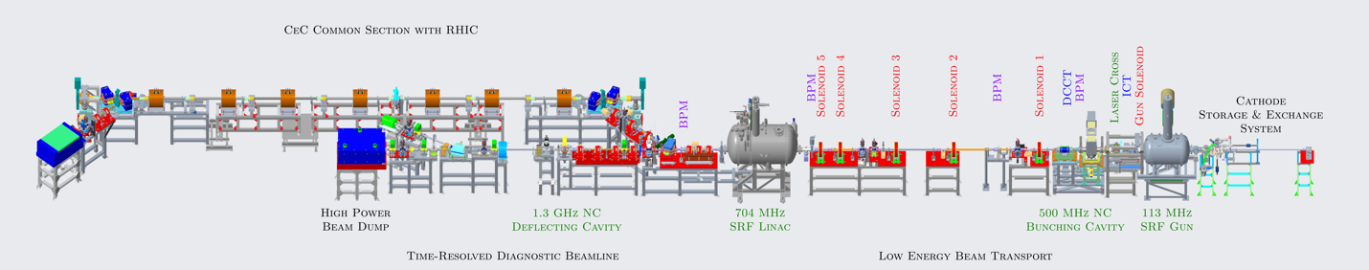
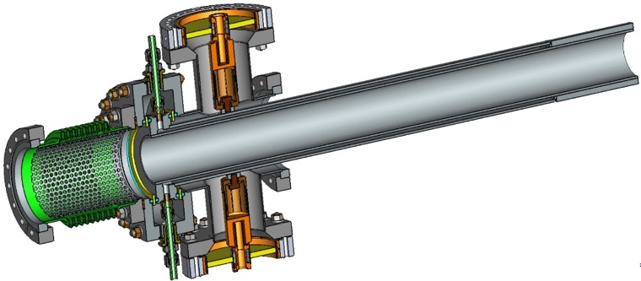
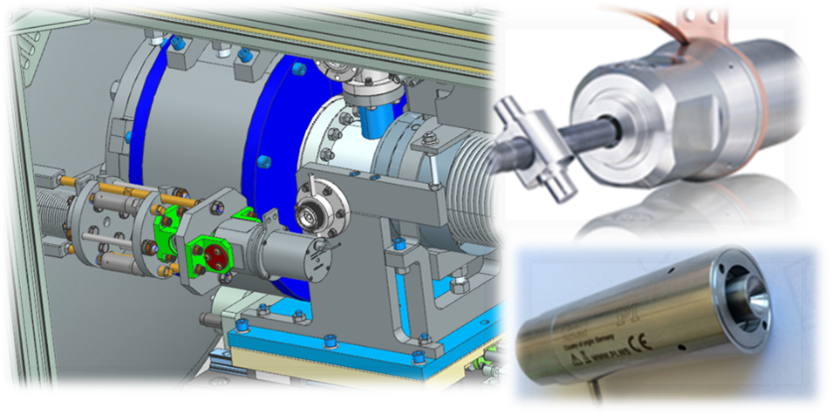
CeC SRF gun high current R&D
The focus of this research is to increase average current of unpolarized electron beam from the SRF gun to 1-3 mA in the first two years (Phase I) of the project, and to 30-100 mA during follow-up Phases of the project.
Phase I: All necessary components and upgrades of existing CeC SRF gun are in place for demonstration of 1-3 mA average beam current – new seed laser with high rep-rate, new quadrupoles and solenoids, new Machine protection system (MPS) mode and diagnostics upgrade are all completed.
Follow-up Phases: Demonstration of the gun operation at 30-100 mA requires significant modification of the SRF gun and will be pursued in future when additional fundings are allocated.
Install a new Fundamental Power Coupler (FPC) capable of delivering 100 kW power and the test stand.
Procurement and installation of 100 kW CW RF system in the Bldg. 912 at BNL.
Assembly and tests of 100 kW FPC and supporting accessories.
Procurement and tests of the cavity tuner.
A prototype of the new FPC and slow tuner (design is completed and shown above – FPC (left) and slow tuner (right) ) will be installed, tested at the FPC test stand.
4

