Slide 1
Update on Polarized e-Source Development and the EIC Pre-Injector
Presented by John Skaritka
September 8th 2022

Slide 2
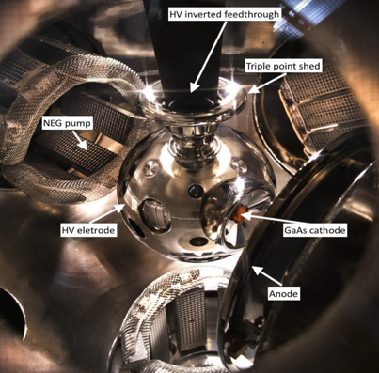
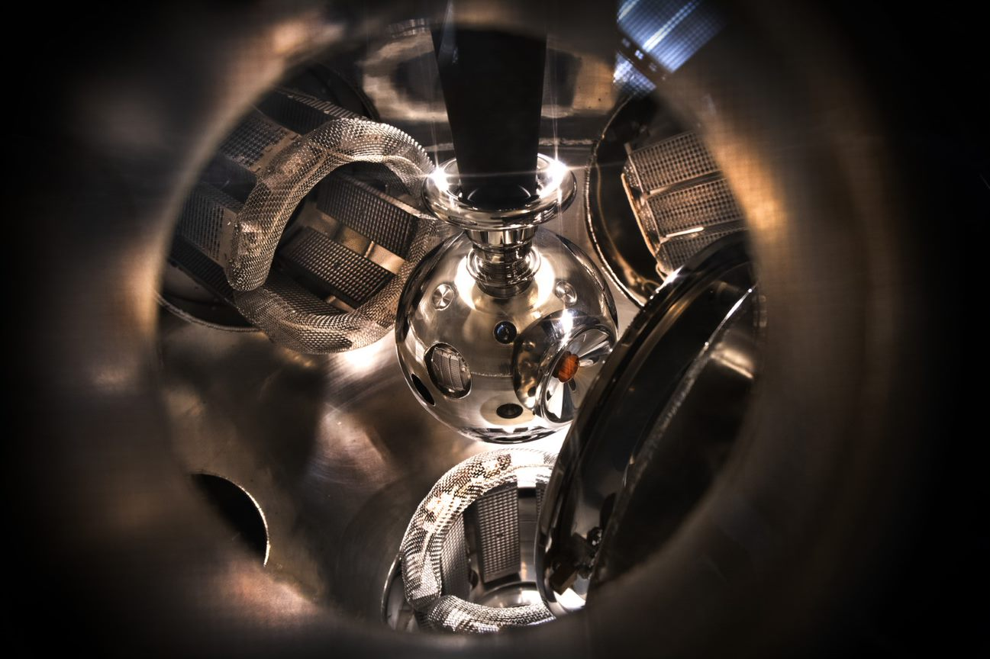
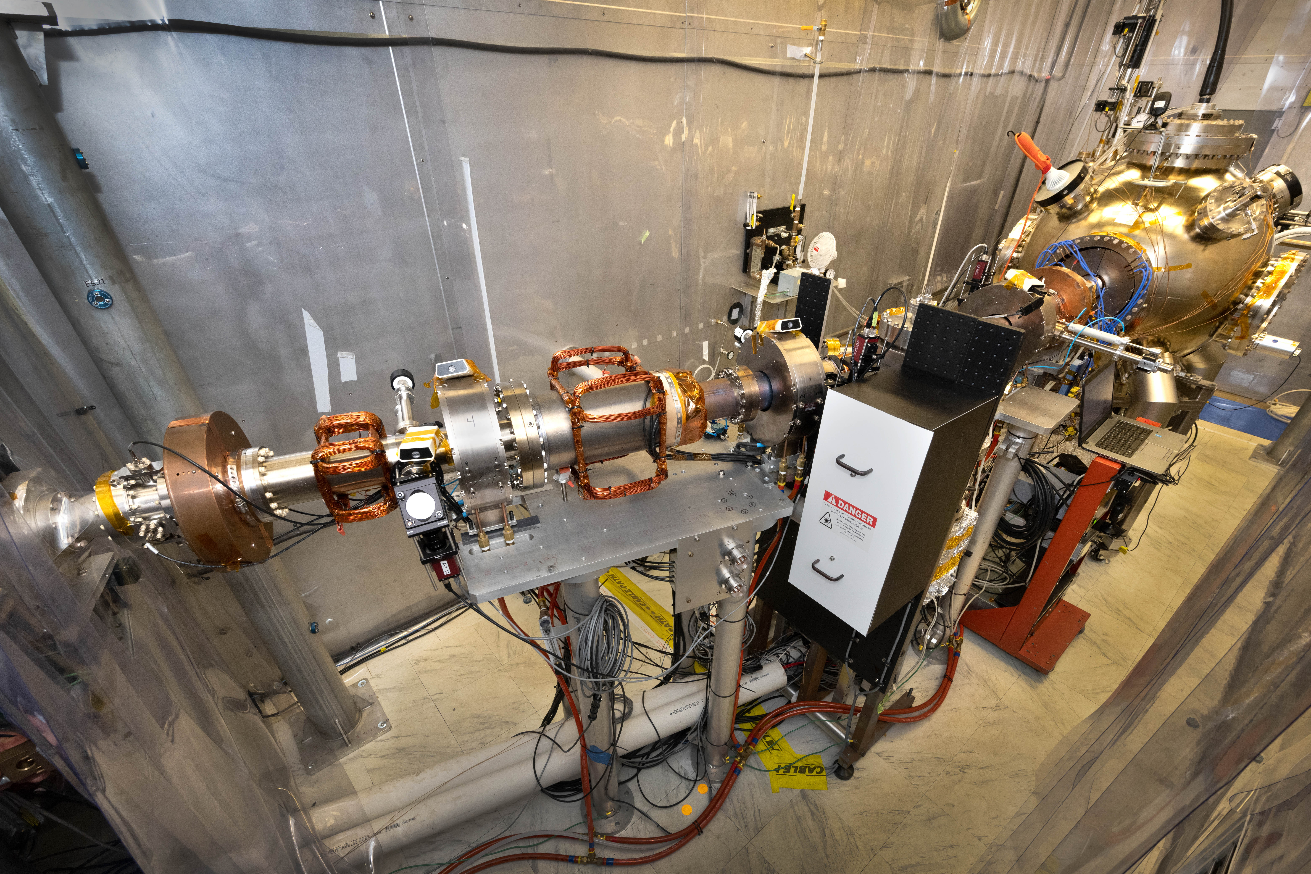
EIC Polarized e-Source and Diagnostic Beam Line at Stony Brook University
e -Gun performance
since December 2020
16 nC Bunch Charge
7-10nC @ 300kV
Accelerated Life tests >9000bunches/sec.
Bulk Cathode exceeds EIC required charge lifetime by 30 weeks.
Gun operates at full current in 10⁻¹² Torr
Polarized beam from bulk Cathode material.
e-Gun Conditioned to 350kV without field emission
After a 6-month hiatus e-Gun reconditioned to 350kV without significant events
Diagnostic Beam Line to Faraday Cup and vacuum isolated end Station
Laser Optics to place 780 nm beam on to GaAs photo cathode
e-Gun and Cathode transfer and Prep. Chambers

Slide 3
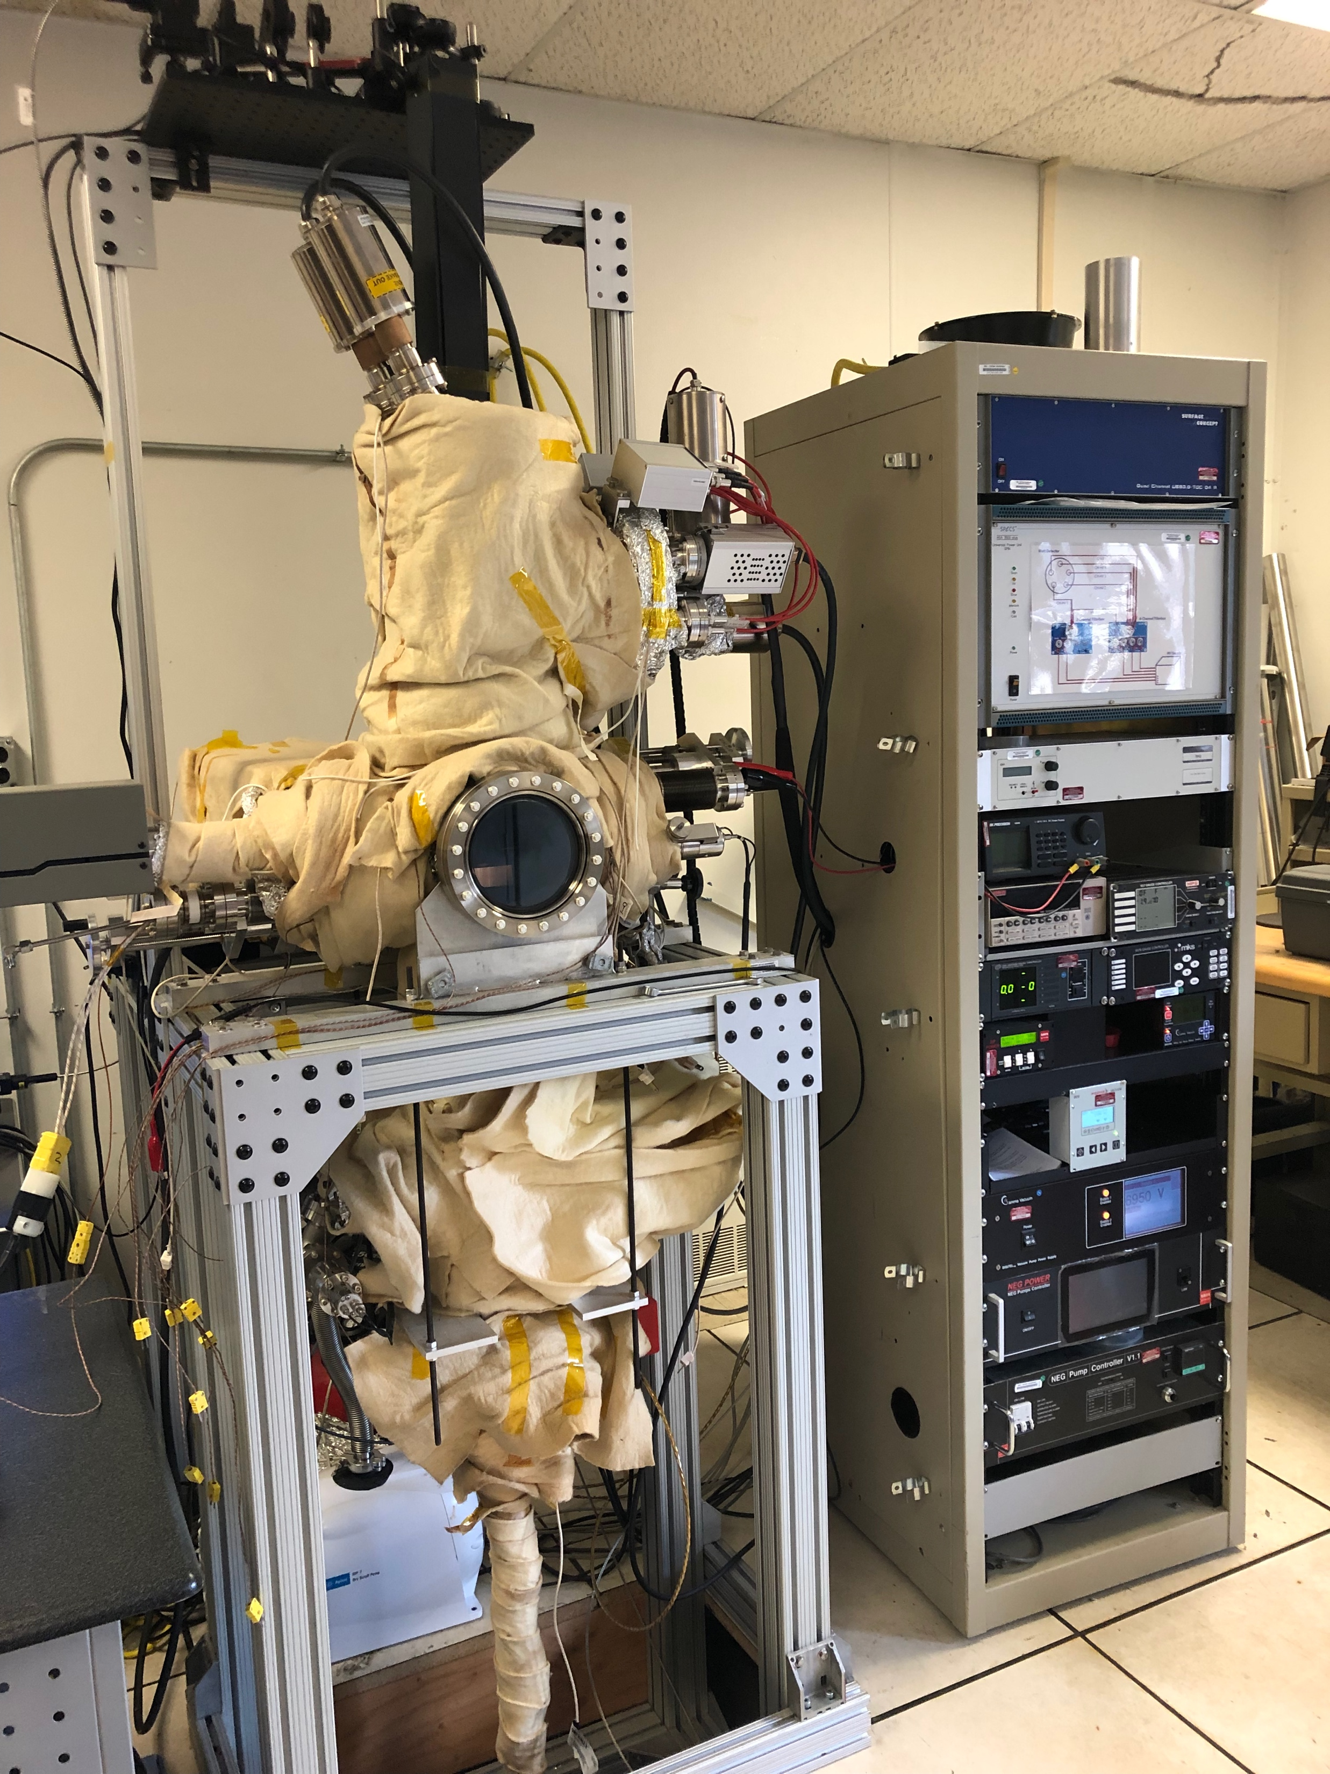
Cathode R&D, Polarimeter Facility at CAD-BNL to Evaluate Photo-Cathode Performance QE and ESP
Laser optics
SPECs Spin detector
Polarimeter
Preparation chamber
Load-lock manipulator
Controls cabinet

Slide 4
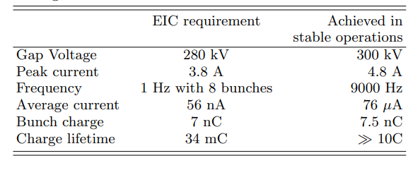
EIC e-Source Performance and Ongoing Development
SBU Lab. safety systems and procedures meet BNL requirements.
The Laser system is being upgraded to improve stability and implement exact EIC pulse train requirements out of the e-Source.
Strained Superlattice GaAs Cathodes, due to arrive later this month will first be evaluated in the Polarimeter and then incorporated into the e-Source for Charge Lifetime testing. These Cathodes will be retested in the Polarimeter to confirm polarization levels in the gun.
In the EIC gun and beam line, extended Life testing is only limited by outgassing from the beam stop in the end station.
An orifice and halo viewer will be installed ahead of the end station to improve vacuum isolation by10 to 100X to advance accelerated charge lifetime studies and to study e-source beam halo.

Slide 5
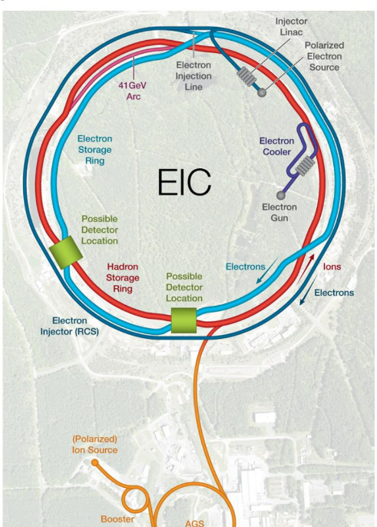
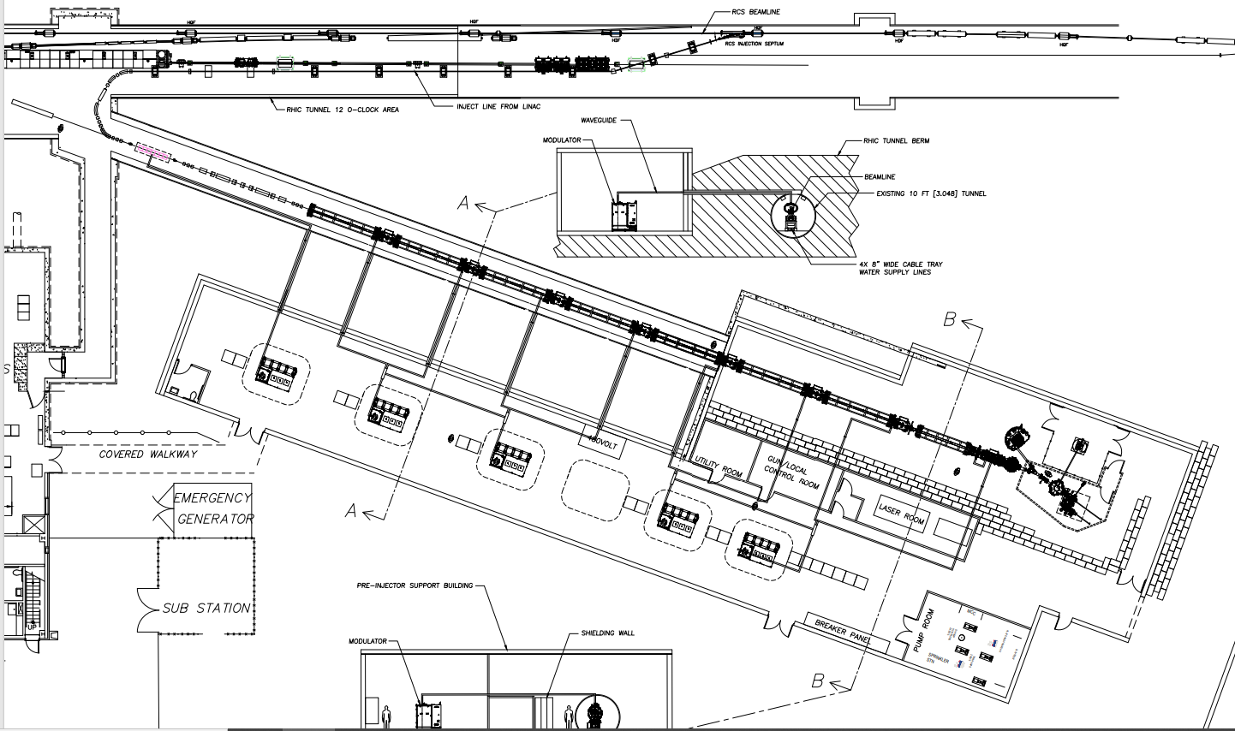
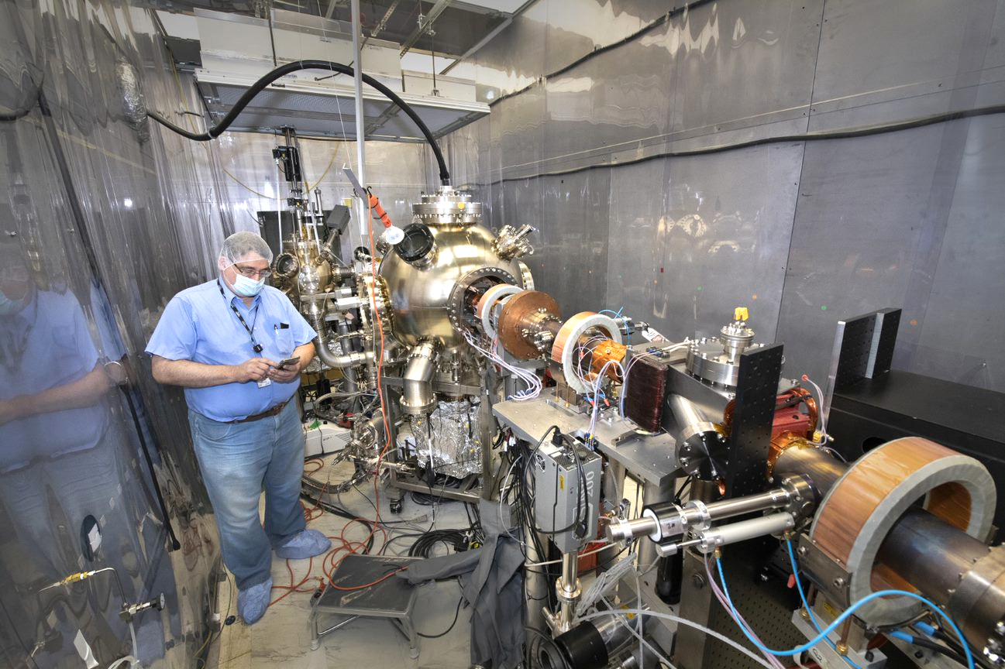
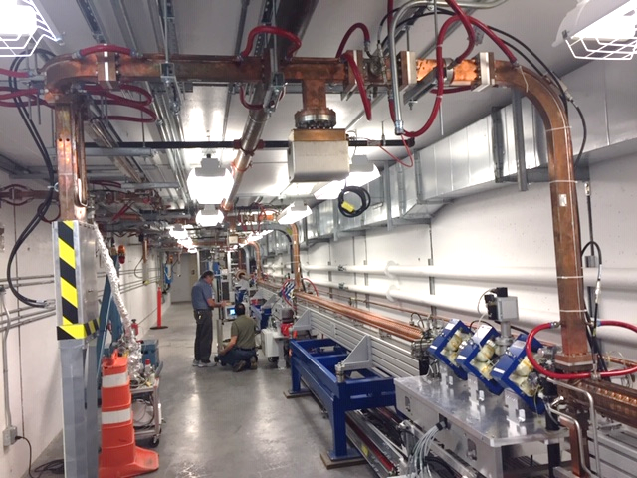
Status of EIC Pre-Injector 400 MeV LINAC System
RHIC Tunnel
Polarized e-Source
Spin Rotator RCS Matching
injection into RCS
400 MeV Linac
Existing Spur Tunnel at 12 o’clock
70M
Bunching Section
Photo from NSLS II Linac tunnel
New Pre-Injector support Building
LINAC Performance Parameters | Value
Minimum energy at exit of LINAC | 400 MeV
Minimum Energy Margin | > 25 %
Repetition rate f_{rep} | 100 Hz
Energy spread ΔE/E | < 0.2% rms
Bunch Length | 40 ps
Pulse to pulse time jitter | < 10 ps rms
Retained e-Beam polarization | >85%
Acquisition Status of 400 MeV LINAC System
Physics Modeling Studies Completed
Draft Specification, Statement of Work and Acquisition Plan Prepared.
External Review Completed July 2022
BNL/RFI found two possible Vendors
Vendor visits to take place shortly.
Procurement Package to be ready for DOE Review by January 2023

Slide 6
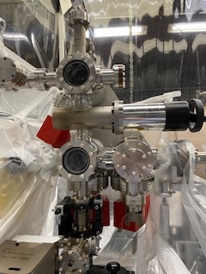
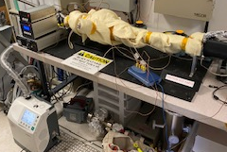
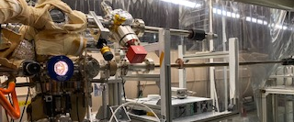
Progress for CeC SCRF Gun to deliver polarized e- beam
Vacuum in the Cathode transfer system had to improve x 100 to allow the use of GaAs cathodes to be used to produce polarized beams.
A major upgrade to the cathode transfer and injection system took place last year, Vacuum in this area was improved, achieving the 10⁻¹² Torr range.
Cathodes are not created in the 2 o’clock area of RHIC and must be transferred from Instrumentation bldg. 535.
To survive the cathodes must be transported at a vacuum of 10⁻¹² Torr, but this has never done before.
Last Year we modified and conditioned a multi-cathode “Garage” and tested the system to 10⁻¹² Torr Vacuum.
System was commissioned earlier this year and retested in August.
Upgrades to the SCRF Cavity vacuum system are now underway to be completed for the next RHIC run.
Upgraded Cathode Storage transport and transfer system at the end of the CeC SCRF cavity at 2 o’clock

Slide 7
Perfecting a Robust Polarized e-Source will be an essential enabling component for any new polarized electron accelerator facilities:
Electron Ion Collider at Brookhaven National lab (high bunch charge of nC range)
Positron Source for fixed target experiments at JLab (mA range average current)
Proposed Large Hadron electron Collider (LHeC) (20 mA average current)

Slide 8
Section Break

