Slide 1
AI/ML for accelerator operations
Presented by Georg Hoffstaetter
(BNL and Cornell University)
September 8th 2022

Slide 2
Context
Large accelerators have thousands of measured parameters that describe their state, e.g., field strength, magnet alignments, etc.
Once known, these parameters can be used to make a virtual accelerator model (VAM). An accurate model is needed for operations, e.g., to run feedback systems, to optimize luminosity.
Today, human intervention and dedicated beam study times are often required to find system parameters.
Today: Time consuming dedicated studies, sensitivity to human errors.
AI/ML has the potential to automatically determine system parameters from successive measurements to build the much-needed VAM.
An accurate VAM (existing or from ML) can provide a digital twin to the control system that controls the twin just like the physical accelerator. Prototypes (CBETA-V & CESR-V) have led to enormous operational simplifications and optimizations, to virtual detectors, and to early fault detection.

Slide 3
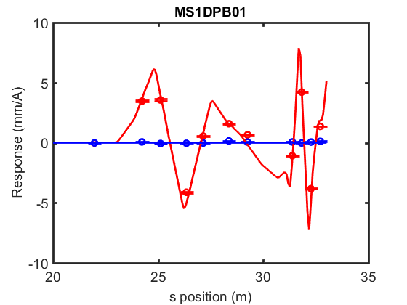
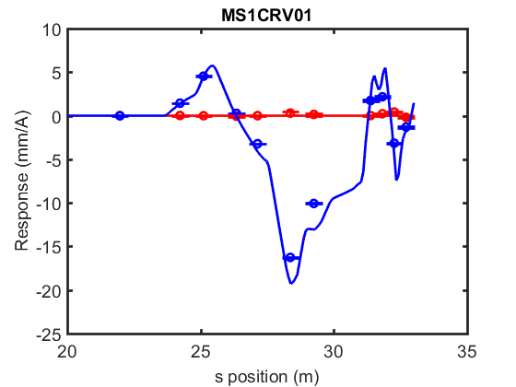
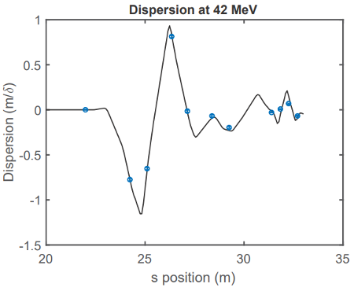
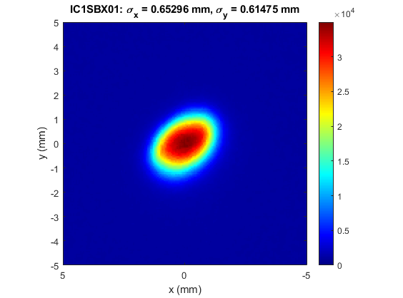
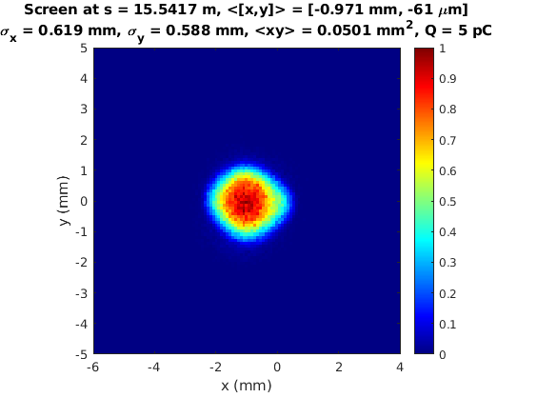
Examples for digital twins
CBETA-V: measuring beam trajectories and compare to the digital twin in real time on control-system screens.
First horizontal dipole kick
First vertical dipole kick
Energy-dependent trajectories
Measuring bunch profiles and compare in real time with neural network models of slow space-charge calculations.
C1 screen
(simulated)
C1 screen
(measured)

Slide 4
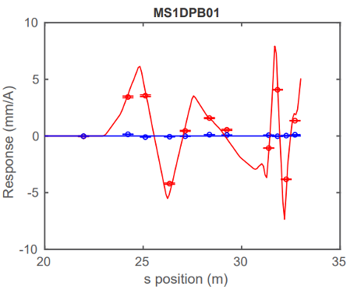
Benefits
Continuous update of the virtual accelerator model.
Savings in dedicated study time.
Early warnings about component deterioration.
Confidence estimates for detectors.
Availability of a VAM for feedbacks and optimizations.
Virtual detectors from the digital twin.
Ease of operation and controls developments.

Slide 5
AI/ML Accelerator operations projects
Background projects:
Orbit correction at CBETA (PhD work)
Beam profile neural networks for CBETA (prove of principle)
Cooling rate optimization at LEReC (published)
Slice emittance measurement at the CeC beamline (ongoing)
Exciting new project:
Provide a control system procedure that evaluates the main parameters of an accelerator automatically and parasitically to user operation.
As a first example, establish this procedure initially by means of the Orbit Response Matrix. Afterwards add other measurables, e.g., parasitically evaluate injection oscillations.
First example: The Oribt Response Matrix method
Use the orbit change at M detectors when N magnets are changed to determine system parameters.
1st Goal: Establish the ORM automatically and parasitically, without dedicated study time in the AGS (ongoing), RHIC, and NSLS-II.

Slide 6
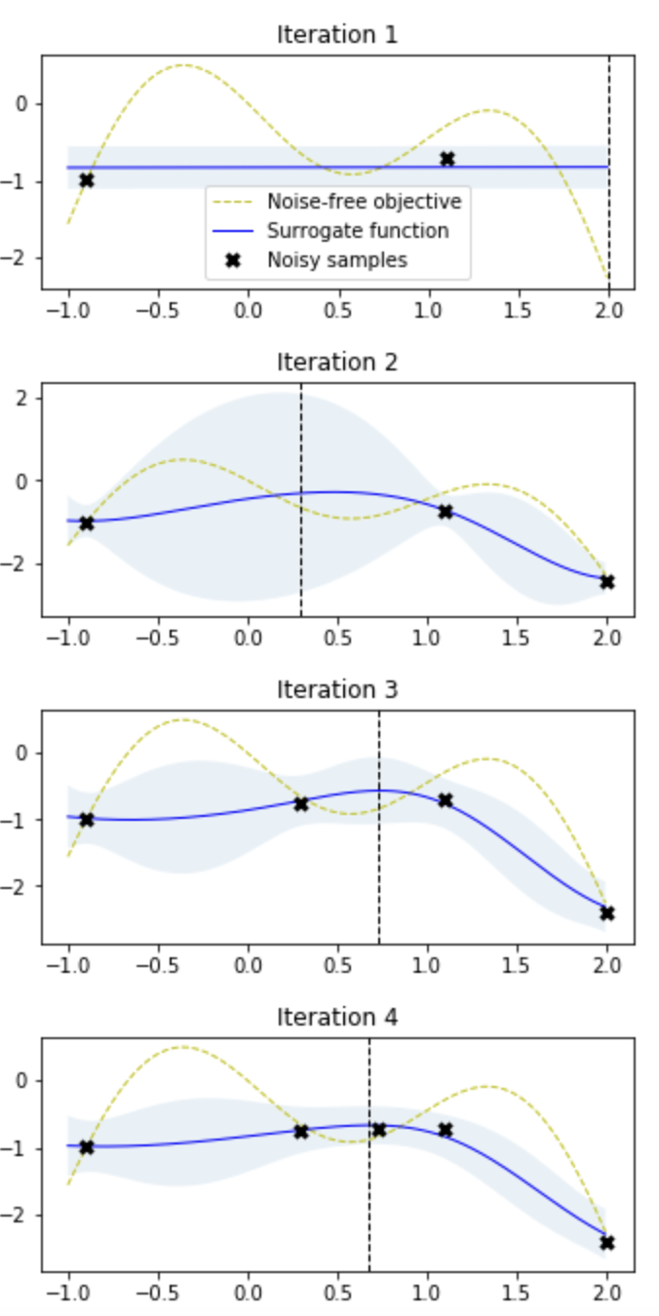
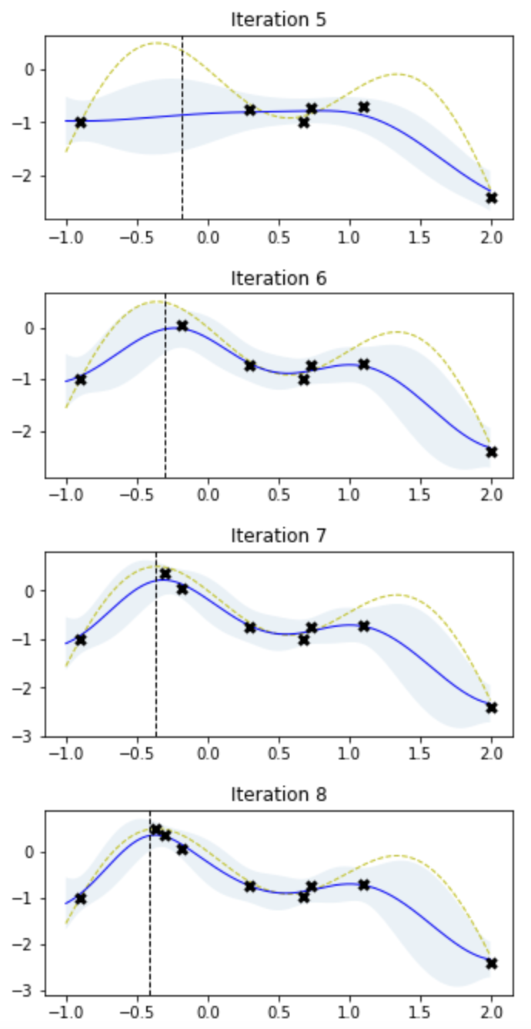
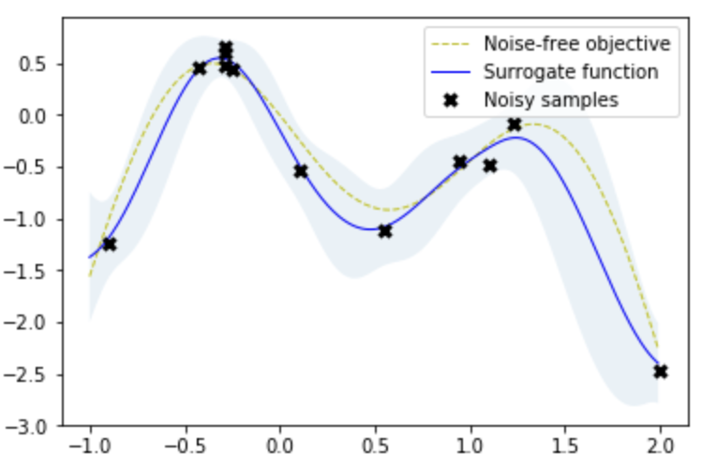
Methods to achieve the goals
Bayesian optimization
Functions are successively approximated, with diminishing uncertainty.
Detector noise can be included.
6

Slide 7
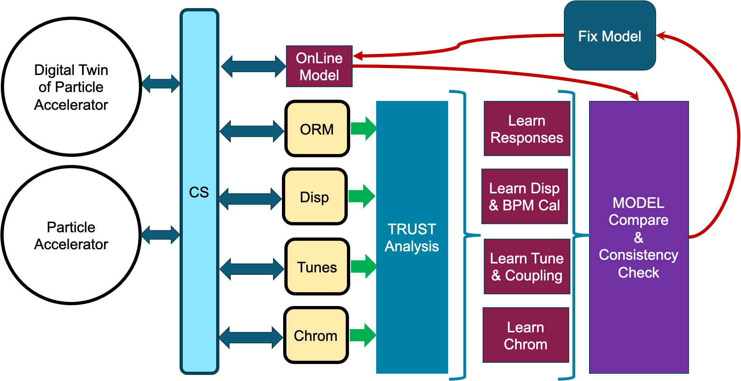
Implementation to achieve the goals
Control system implementation and the Digital Twin
The Digital Twin is based on the Virtual Accelerator Model and can be addressed from the control system just like the physical accelerator.

Slide 8
Summary
Accelerator optimization and feedback systems need an accurate accelerator model.
Obtaining the parameters for that model often requires human interaction and dedicated study time.
AI/ML provides techniques to successively improve the knowledge of accelerator parameters during user operation.
The Virtual Accelerator Model can therefore be continuously updated, providing: (a) accurate optimizations and feedback, (b) early fault detection, (c) virtual diagnostics.
Important for the future!
  Improving accelerator performance provides large rewards for NP.
  There is large and growing interest in AI/ML applications in accelerators, manifested in papers and invited presentations.
  All NP accelerators will benefit, as well as new international accelerators.
  The investment will be returned amply in reduced accelerator study times.

Slide 9
Credit:
Collaborations with BNL-CAD, EIC, CeC, NSLS-II, Cornell, Stony Brook, SLAC, and FNAL.

