Slide 1
Accelerator R&D @ CAD with Fixed Magnetic Field
Presenter(s) Dejan Trbojevic, Stephen Books and Scott J. Berg
Date
September 8, 2022

Slide 2
Accelerator R&D @ CAD with Fixed Magnetic Field
Presenter: Dejan Trbojevic
September 8, 2022

Slide 3
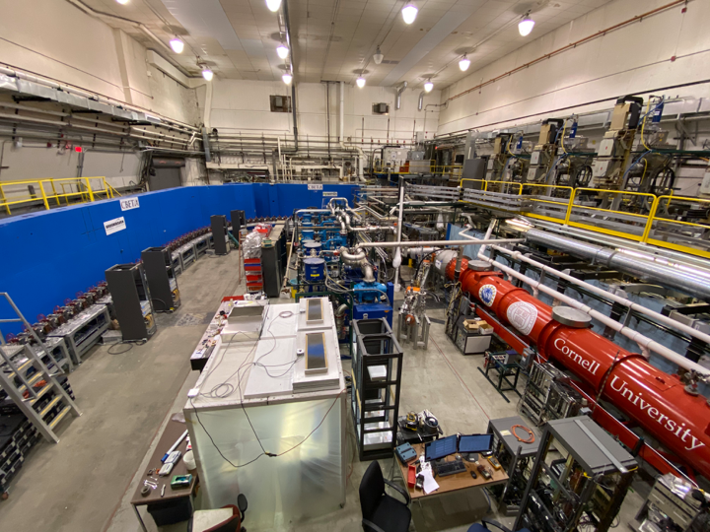
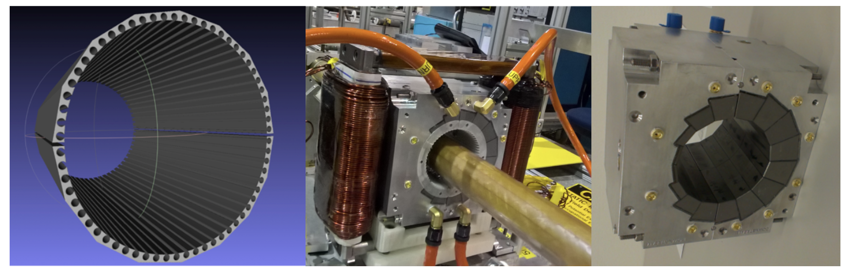
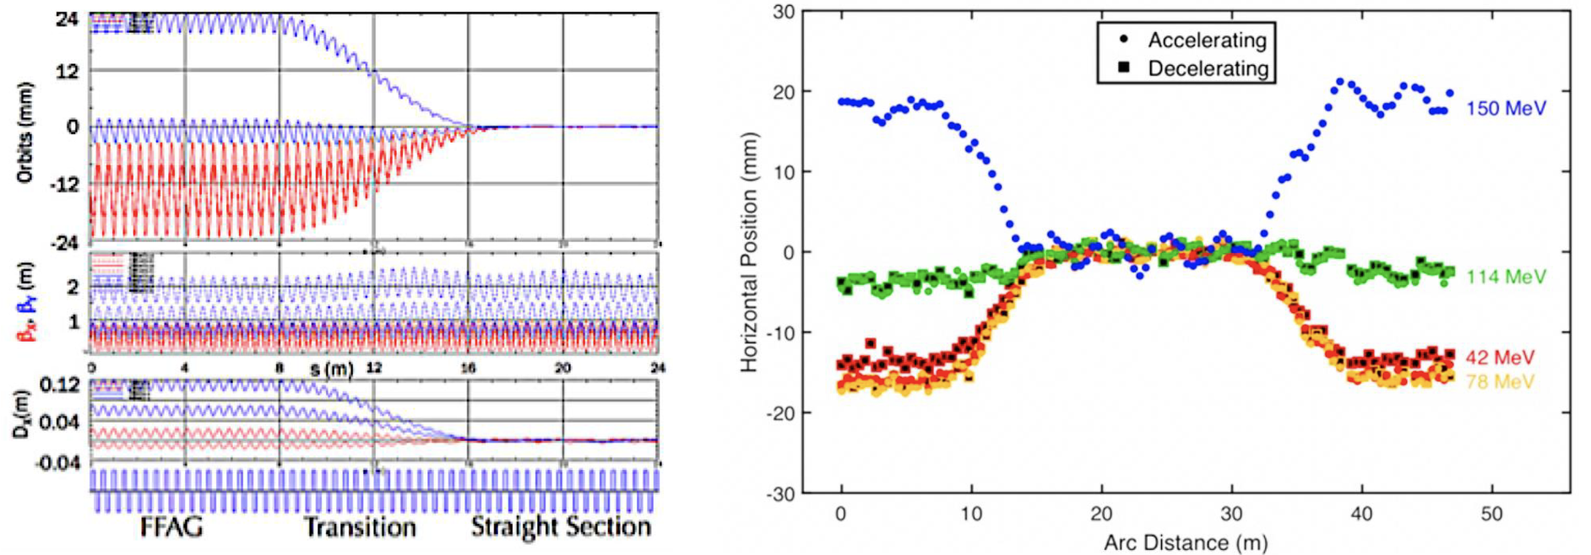
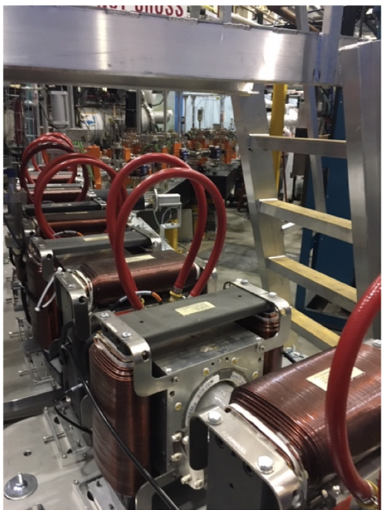
Following the CBETA success the NPP Accelerator R&D continues for the CEBAF energy upgrade from 12-23 GeV with a single FFA beam line
Cornell University Brookhaven National Laboratory Electron Test Accelerator - CBETA
Full proof of principle for the Non-scaling Fixed Field Alternating Gradient and full Energy Recovery
Merging multiple energy orbits into a single straight-line orbit
Development of the new permanent magnet technology
Dejan Trbojevic, Sept. 8, 2022 – Mini Town Meeting

Slide 4
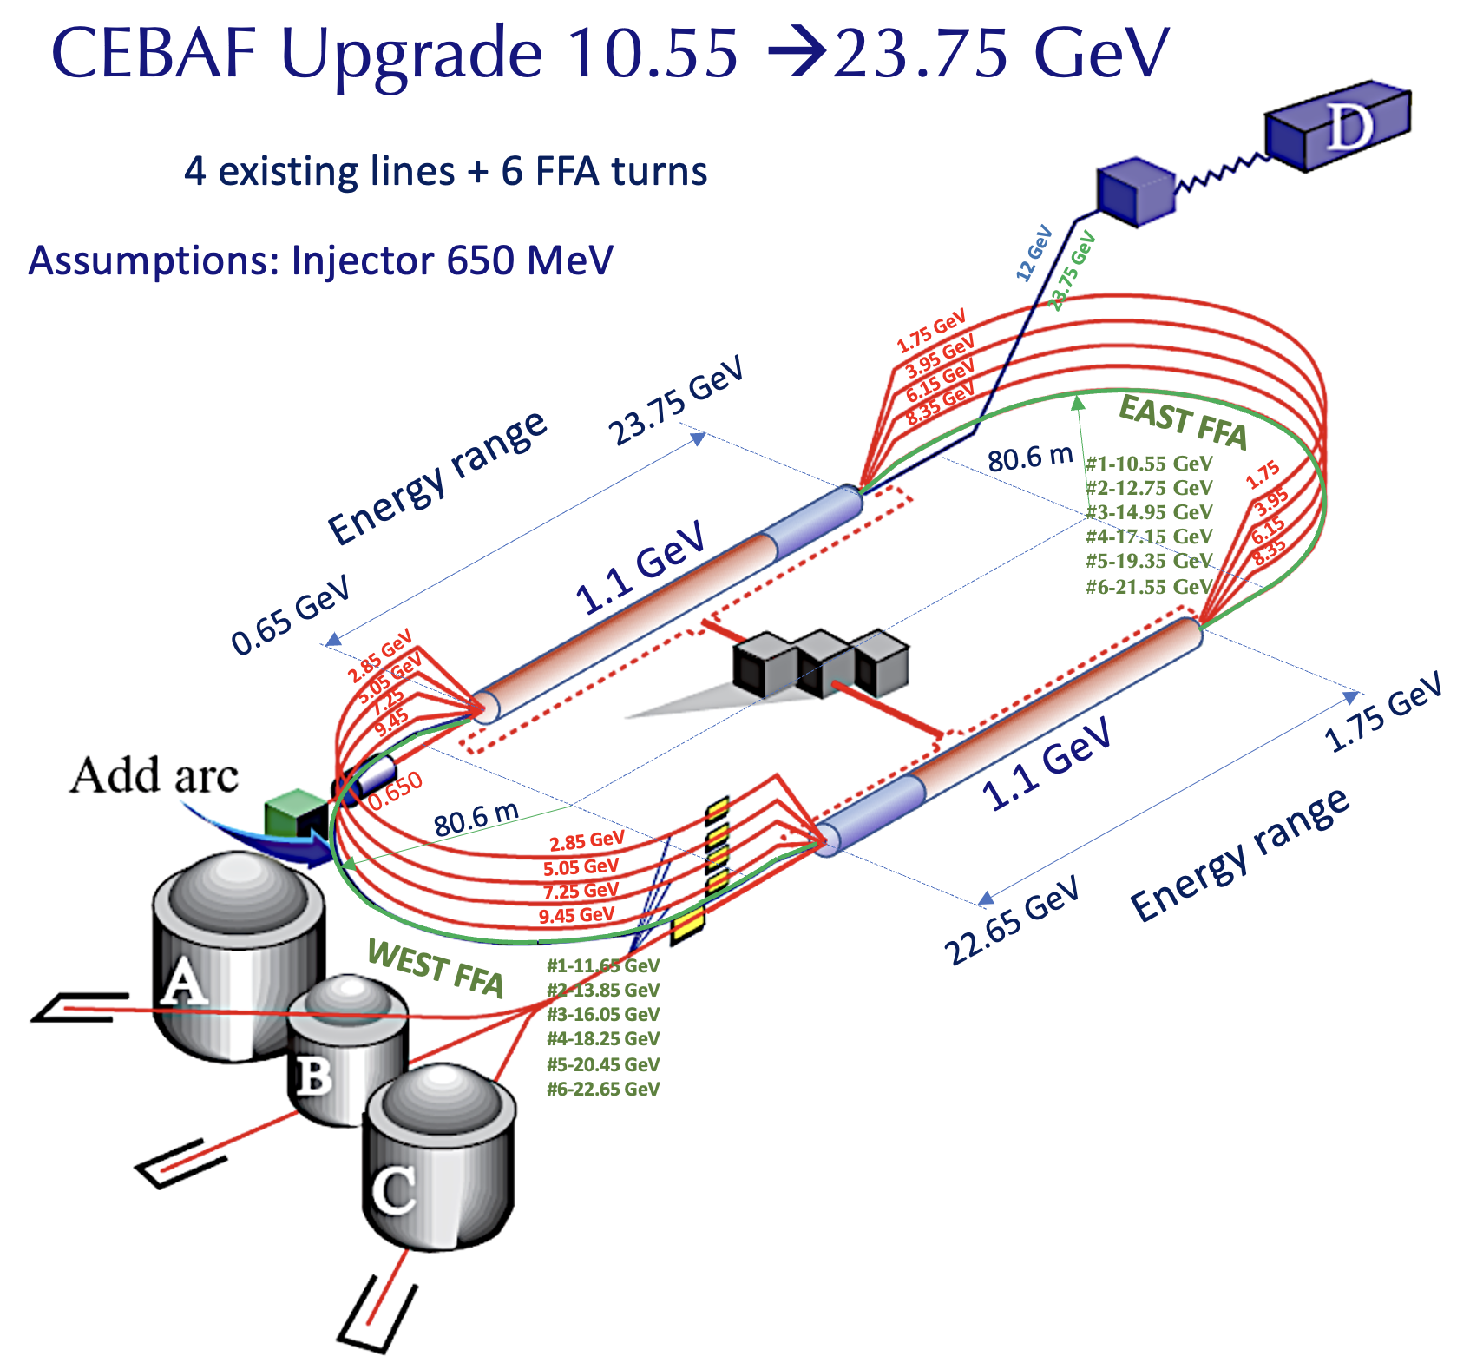
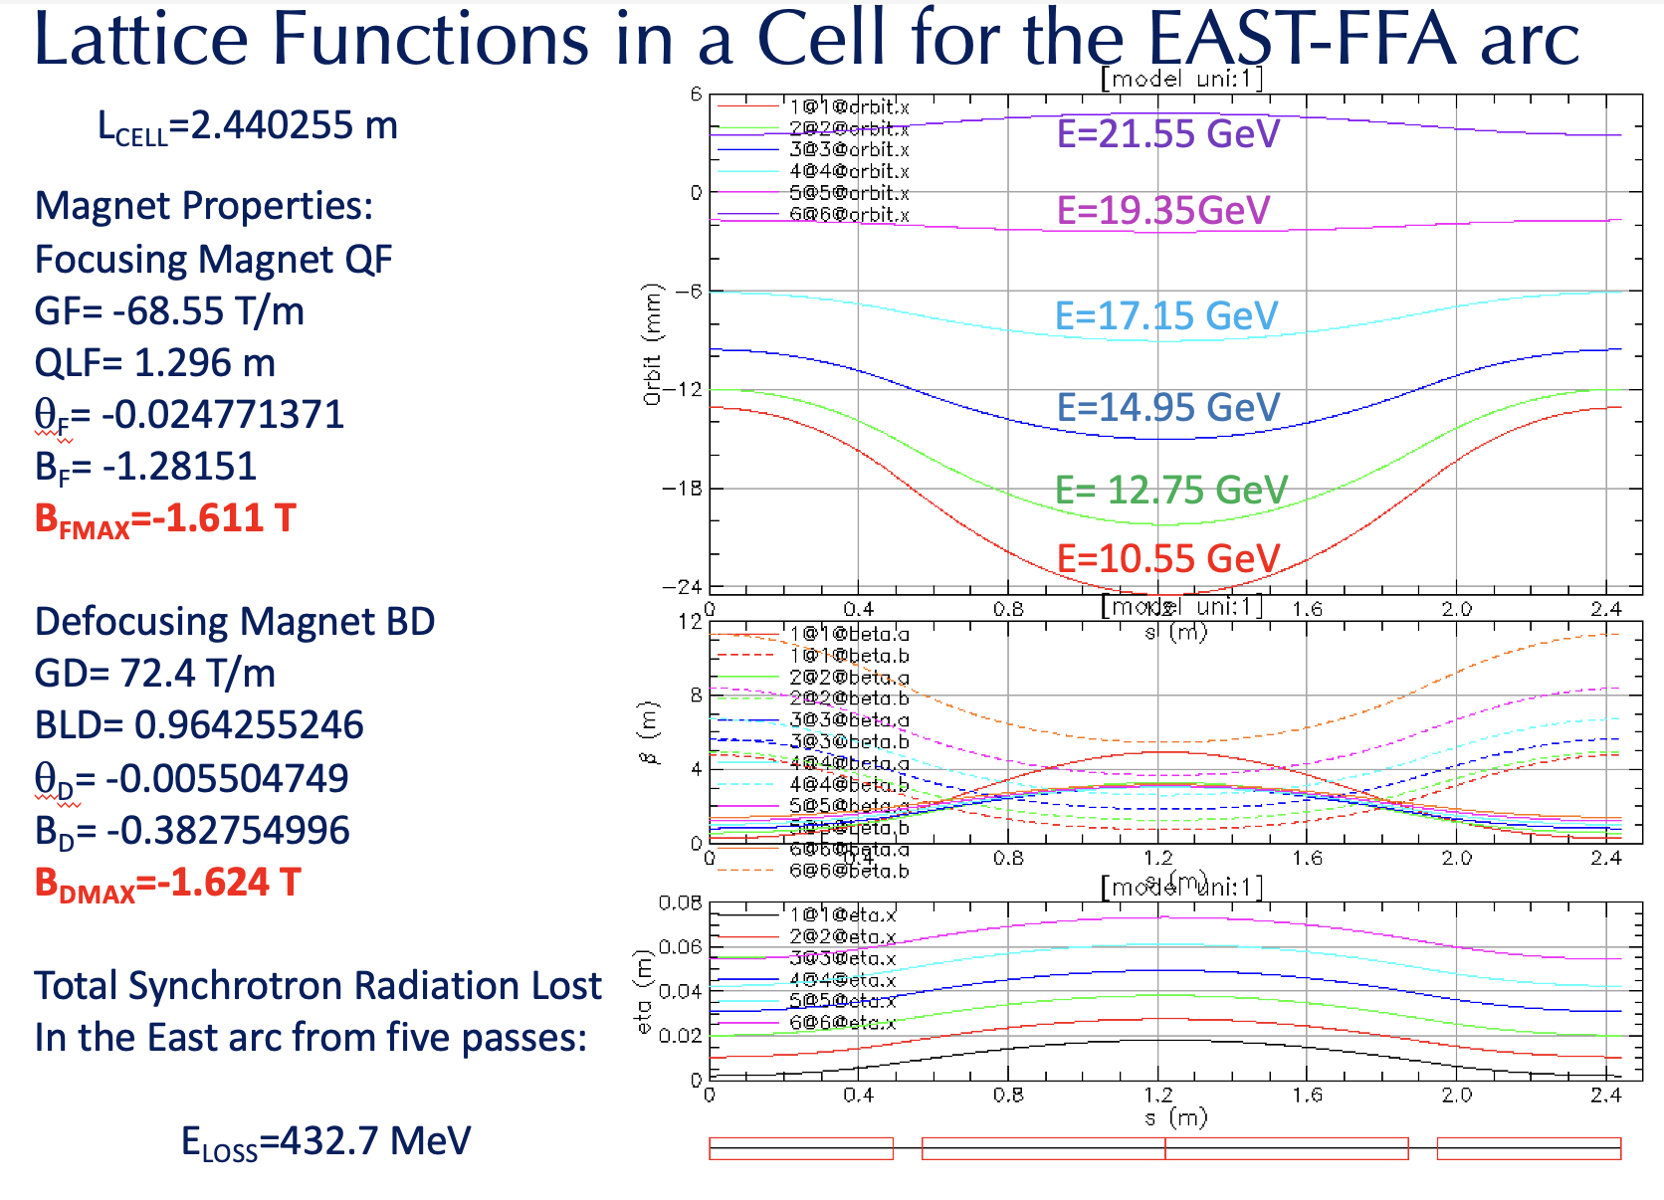
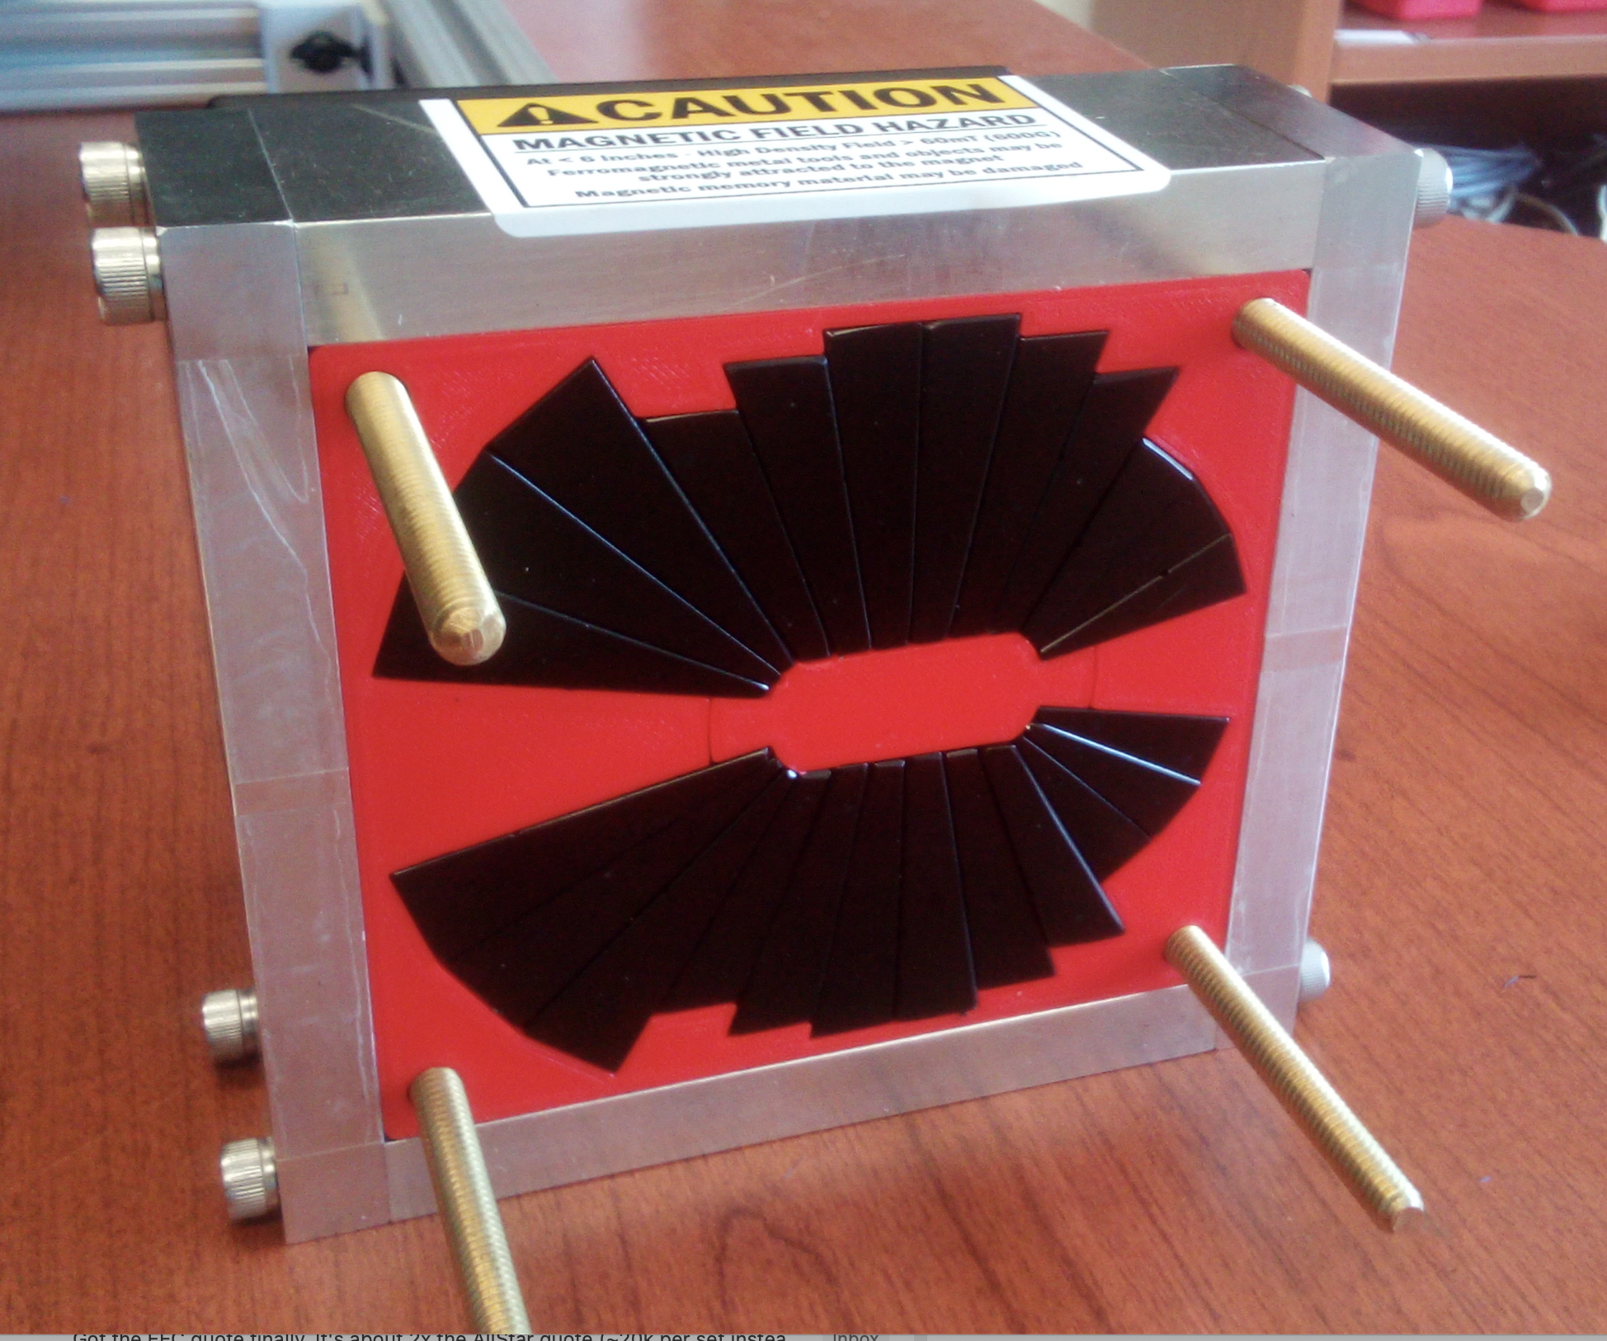
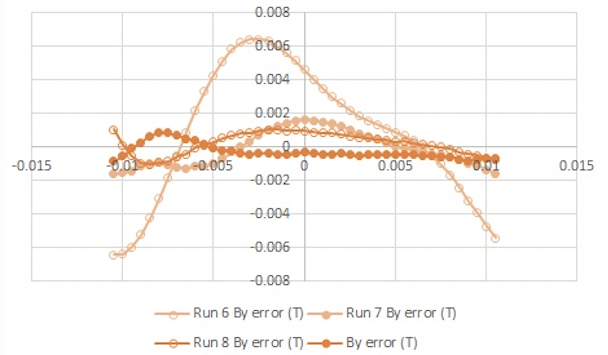
A. Accelerator R&D for the CEBAF energy upgrade from 12-23 GeV with a single FFA beam line (following the CBETA success)
Permanent Magnet Development
Total Synchrotron Radiation Loss from both: East and West arc:
432.71 MeV
525.33 MeV
-----------------
958.04 MeV
Dejan Trbojevic, Sept. 8, 2022 – Mini Town Meeting

Slide 5
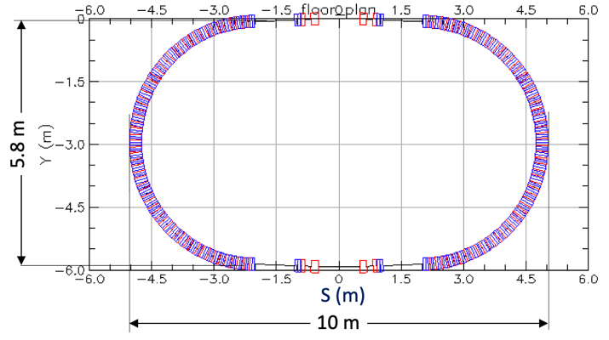
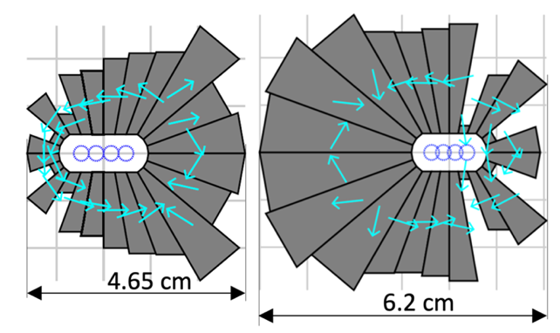
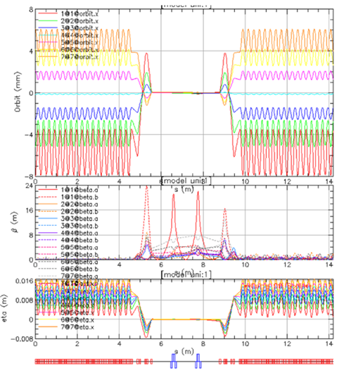
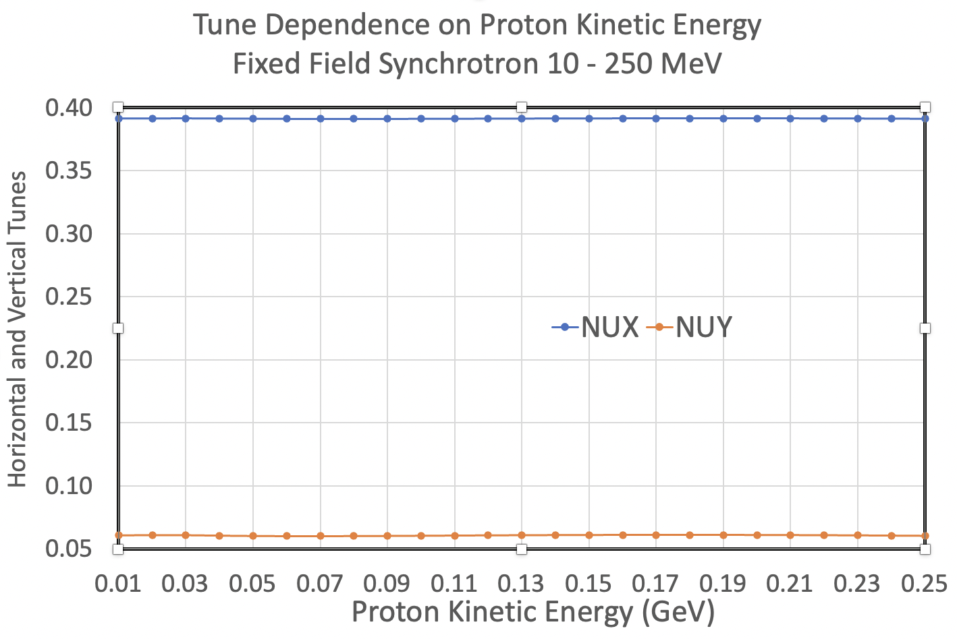
B. Fast Cycling Synchrotrons with Fixed Betatron Tunes and Fixed Magnetic Field
Small permanent magnets
APPLICATIONS and ADVANTAGES:
Significant Power Consumption Savings due to Fixed Magnetic Field
VERY FAST ACCELERATION as it depends only on RF
2.1 RHIC INJECTORS upgrade
2.2 ERLs for ion cooling
2.3 Synchrotrons for EIC (reduction in cost, savings in power, large dynamical aperture, small magnets)
SPIN-OFFS in Medical applications
Proton Drivers
Dejan Trbojevic, Sept. 8, 2022 – Mini Town Meeting

Slide 6
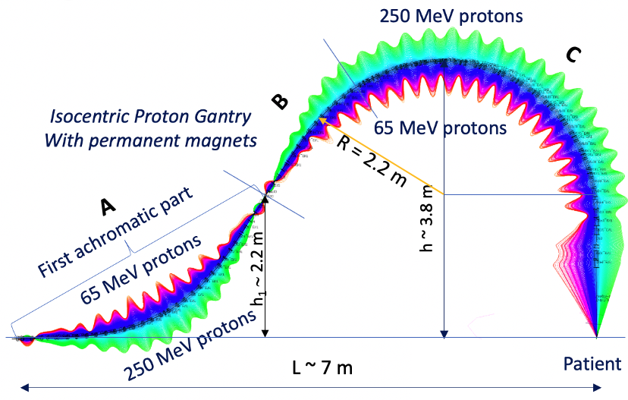
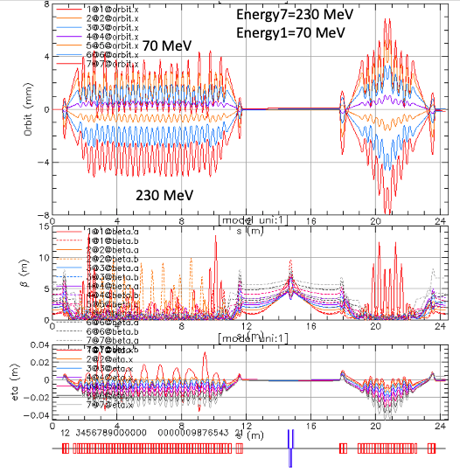
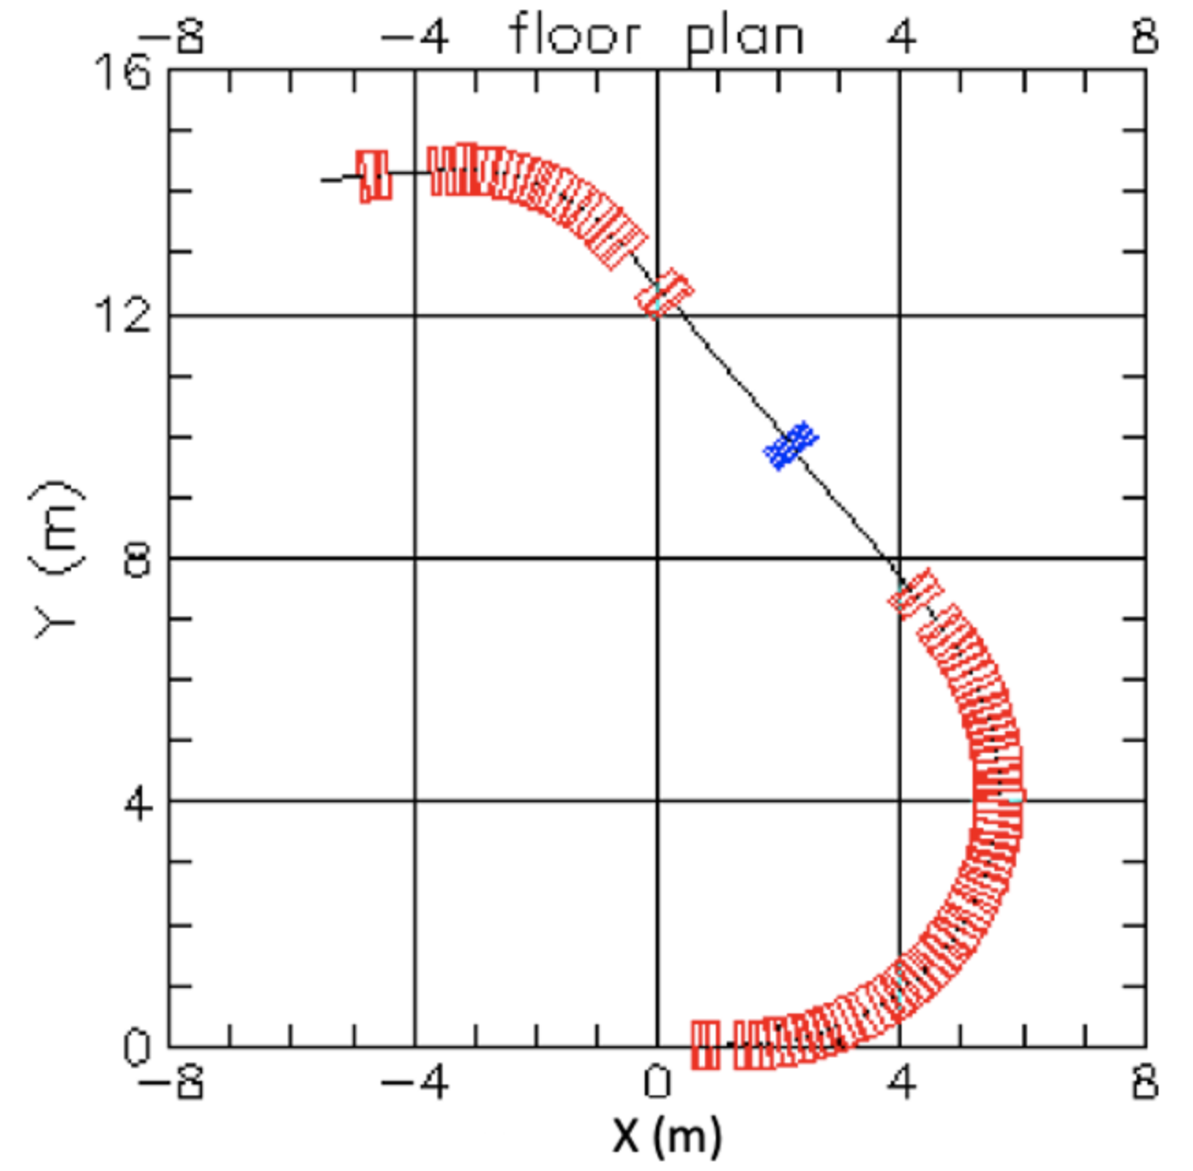
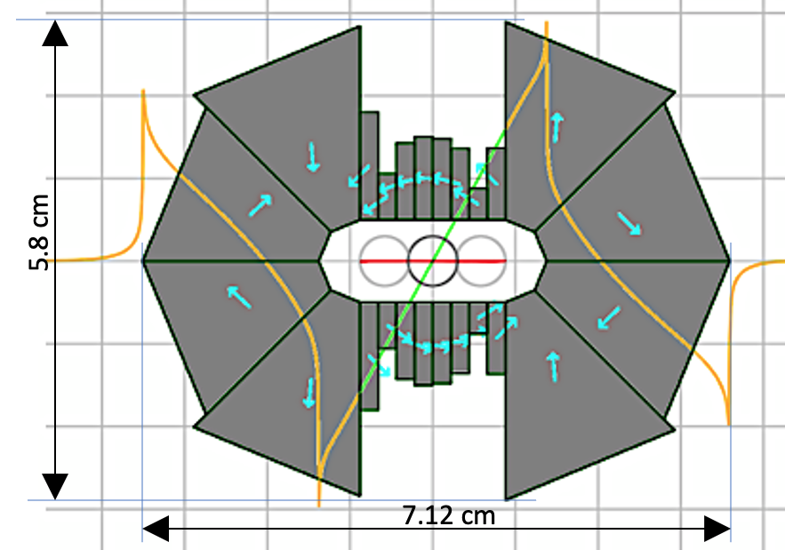
C. SPIN-OFFS from the nuclear physics research in Fast Cycling Synchrotrons:
C.1. Permanent Magnets for the ElC Electron Cooling ERL
C.2. Medical Applications in proton cancer therapy: FLASH beam lines, fast cycling proton synchrotron 10-250 MeV and Proton permanent magnet gantry
C.3. Permanent Magnets for the next Generation Synchrotron Light Sources
C.4. Muon Collider research
Permanent Magnet Gantry for the FLASH proton cancer therapy
Large energy acceptance beam lines
Dejan Trbojevic, Sept. 8, 2022 – Mini Town Meeting

