Slide 1
Preinjector Upgrade Plan
D. Raparia
October 06, 2021

Slide 2
Motivation
Increase proton energies to 600 MeV or higher
Allow for more spallation target irradiations
Higher energy allow more fast neutrons for radiation damage studies.
Ave. Beam Current 200 uA, 120 kW
Light Ion linac energies up to 60 MeV/u
To reach the energies and current of light ions which are not available elsewhere for a variety of applications
Nuclear reaction cross section measurements
Ave. Beam Current 200 uA, 84 kW

Slide 3
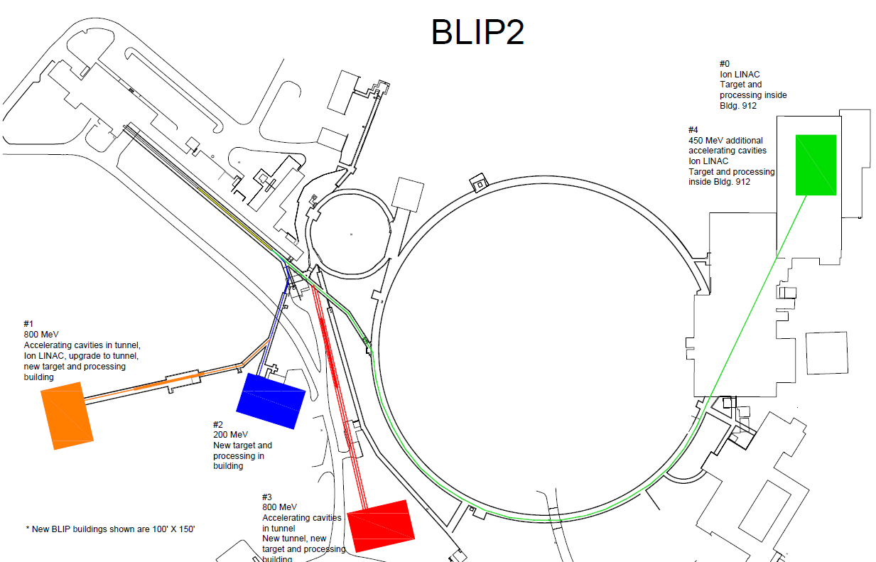
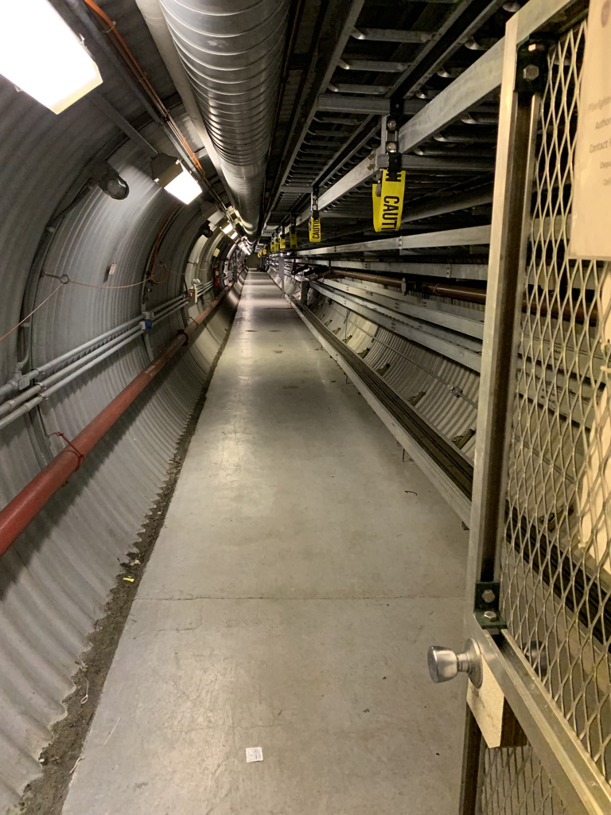
Options for Proton and Ions
Linac
BLIP

Slide 4
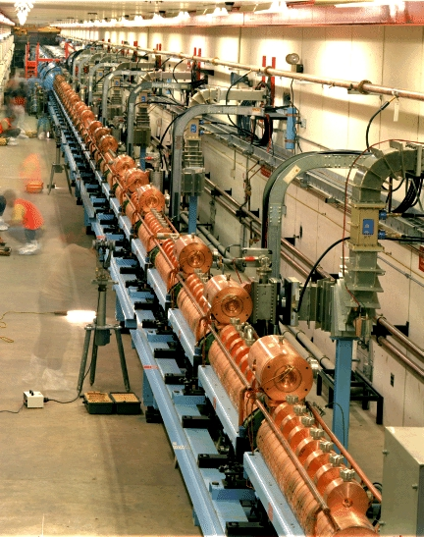
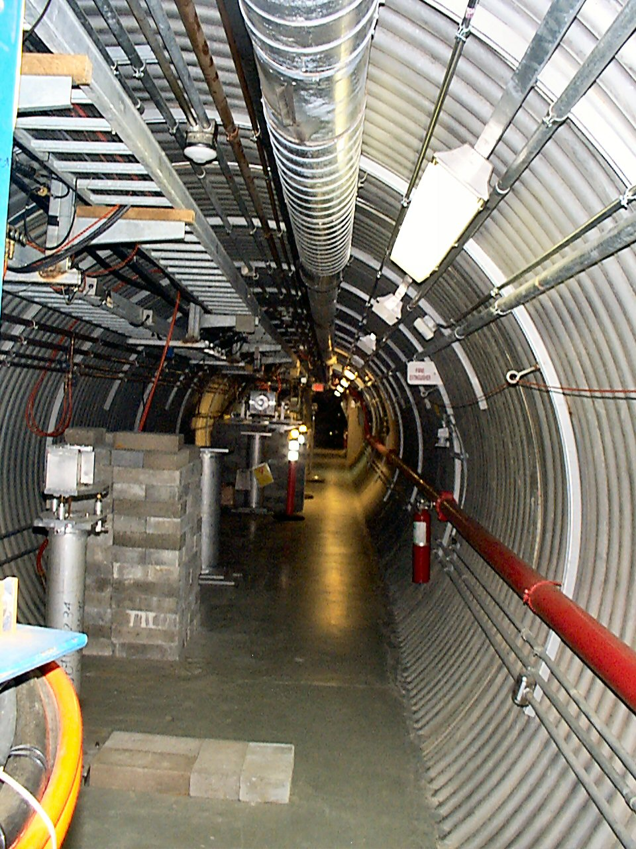
Options for Protons
Green field 600 MeV SC cw/pulse Linac: Too costly
Addon 400 MeV SC linac: Will not fit in the existing tunnels (currently idle), need new tunnel
Replace 5 or 4 tanks of DTL: Interrupt many programs
A 400 MeV CCL in existing tunnel to add on 200 MeV Linac leaving room for expansion
FNAL CCL
REF Tunnel

Slide 5
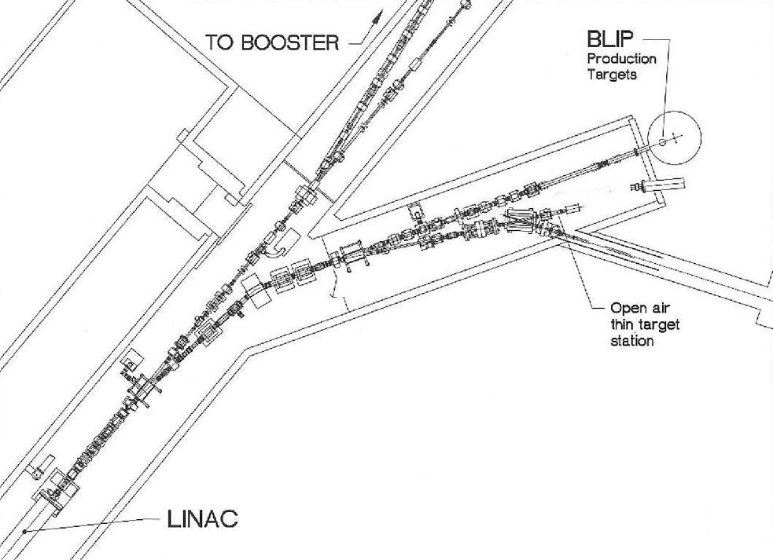
Tank 9 to RFF, TRACE3D
TRACE3D SIMULATIONS
REF
REF
Tank 9

Slide 6
TRACE3D simulation 200 to 600 MeV
Accelerated to 600 MeV
200 MeV beam drifting through CCL

Slide 7
Proposed Design for Light Ion Linac
ECR (Li)
162.5 MHz β_{G} 0.25
45∘
Switcher
RFQ (162.5 MHz)
IH (162.5 MHz)
HWR
HWR
HWR
HWR
^{22.5∘}
ECR (He)
-45∘
1000 keV/u, 2.83m
11 MeV/u, 8. m
60 MeV/u
20 keV/u
ECR (H,D)
Peak beam current 2 mA
Beam pulse length 1 ms
Repetition rate 100 Hz

Slide 8
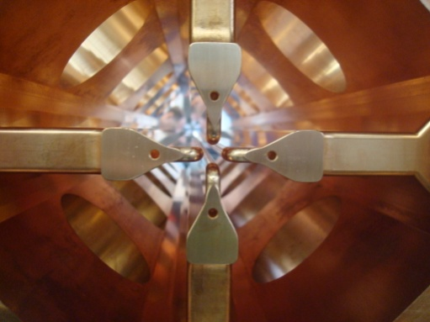
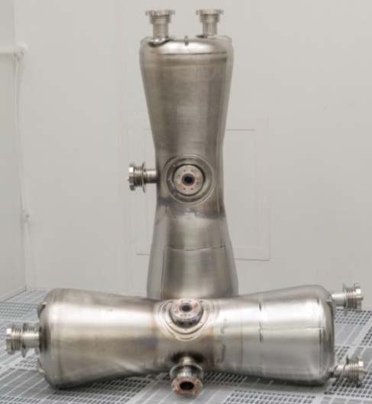
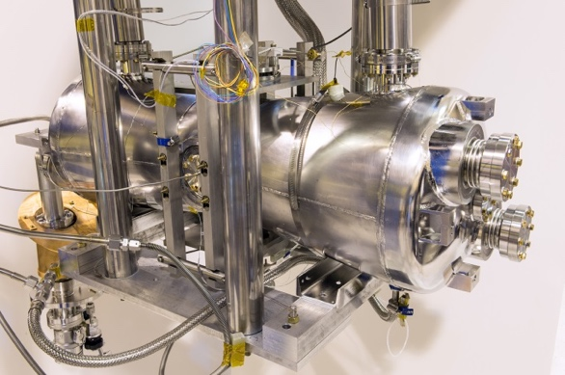
Technologies
IH Linac at BNL
BNL high intensity RFQ 200 MHz
750 keV
ECR Ion source
PIP II 162.5 MHz HWR

Slide 9
SC Sections
TraceWin Simulation
Input Phase Spaces
X, Y profiles
Parameters | Value
E in | 10.8 MeV/u
E Out | 60 MeV/u
Cryomodule | 6
Cavity /(CM) | 6
Solenoid/(CM) | 3
Cavity type | HWR
𝛃_{G} | 0.25
Eacc | 10.5MV/m
Length | 25 m
Output Phase Spaces
𝚫E and 𝚽 Profiles

Slide 10
Summary
Protons
Protons 200 to 600 MeV, max beam power 120 kW
Will use existing linac as injector,
Based on Fermilab CCL design at lower Kilpatrick
Use existing tunnel, new RF gallery
A 90 m tunnel available for future upgrades
Since linac can change user 100 ms , will satisfy existing user ( RHIC, NSTL, BLIP)
Light ions
Light ions 5- 60 MeV/u (m/q ~ 2.3), max beam power 84 kW
Use existing technologies
New tunnel and RF gallery

