Slide 1
Gap in Needed Hot Cell Facilities
Cathy S. Cutler
September 8, 2022

Slide 2
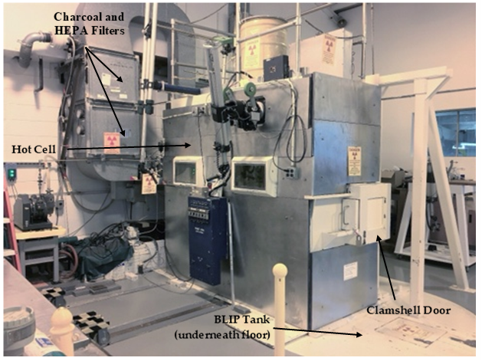
Brookhaven Linear Isotope Producer

Slide 3
Opportunities for isotope production and R&D at BNL
^{nat}Ga(p,xn)⁶⁸Ge
⁸⁶Sr(p,n)⁸⁶Y
⁴⁵Sc(p,2n)⁴⁴Ti
^{nat}Ti(p,2pxn)⁴⁷Sc
^{nat}Rb(p,xn)⁸²Sr ⁷⁵As(p,4n)⁷²Se
^{nat}La(p,xn)¹³⁴Ce
²³²Th(p,2p6n)²²⁵Ac
^{nat}Ag(p, 2pxn)¹⁰³Pd

Slide 4
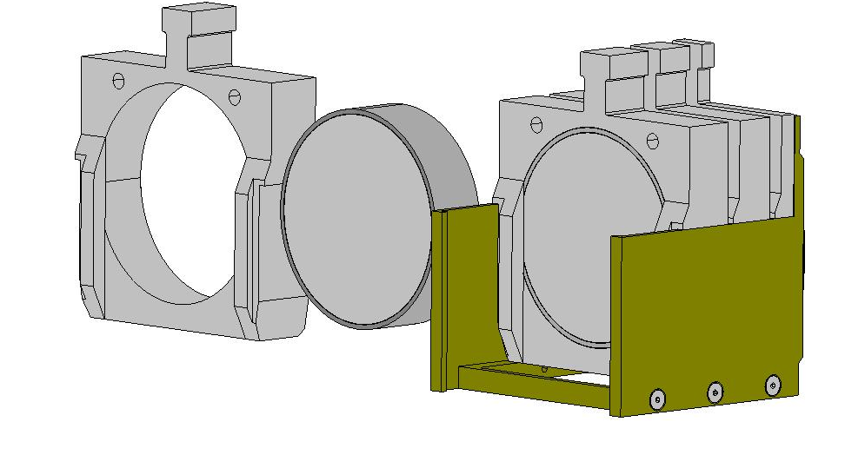
Scaling up Ac-225 production – a stack of 100 g targets
Welded Target d~70 mm
Target holder
1
Support basket
Five 100 g Th targets can fit in the basket
Test irradiation to test target survival under conservative thermal load (1) commenced

Slide 5
Material Evaluations
Need for materials for high power targetry and accelerator components
Targetry for physics experiments and as IP needs are increasing need for targets that can survive multi-MW irradiations with particle beams.
As has been demonstrated components that have been used for other applications are not always suitable and evaluations are necessary.
Necessary to evaluate the long-term accumulated radiations damage as well as the short bursts that result in thermo-mechanical shock.

Slide 6
Gap In Hot Cell Processing Facilities
1 – Purpose and Need
Current facilities at Oak Ridge National Laboratory (ORNL) and Brookhaven National Laboratory (BNL) cannot accept or process Curie quantities of isotopes, but Curie levels of production will be needed to support clinical trials and FDA-approved drugs and to perform material evaluations.
Year-round supply of Curie quantities of actinium-225 (Ac-225) is needed and is not currently available.
The radioactive inventory of Curie-level targets will require handling under the DOE nuclear facility Orders and regulations.
The legacy hot cell facilities currently utilized by the BNL Isotope Production program were not designed to meet the regulatory requirements of Hazardous Category 3 (Haz Cat 3) nuclear facilities that will be needed to process the Curie-level thorium targets to meet the projected demand for hundreds of Curies of Ac-225 or for handling some of the targets for material evaluations.

Slide 7
Hot Cell Facilities
2 – Overview of Design / Layout
The existing Building 870 was designed and operated as a Haz Cat-3 non-reactor nuclear facility that previously was used for mixed waste storage.
The facility was re-designated as a ‘radiological facility’ in 2008, can be re-configured, and modified, to support the hot cells and Ac-225 production and material evaluations.
The new facility would be designed, and operated, to fully conform to the nuclear orders and regulations.
The building will be outfitted with modular hot cells, glove boxes, and laboratory equipment.
The hot cells would be constructed of concrete or equivalent shielding with an outer layer of steel.
There would be two production lines (north and south) for redundancy in the event that one production line is down for maintenance and/or repair.
The hot cells would have the capability of interfacing with horizontal and vertical casks.

Slide 8
Questions

