Slide 1
Future Isotope Science R&D Needs
Cathy S. Cutler
September 8, 2022

Slide 2
Research Needs
New beams gap in production that can’t be filled by protons alone
Nuclear Data
Enhanced targetry
Automation AI/ML
Radiation resistant materials
Workforce development

Slide 3
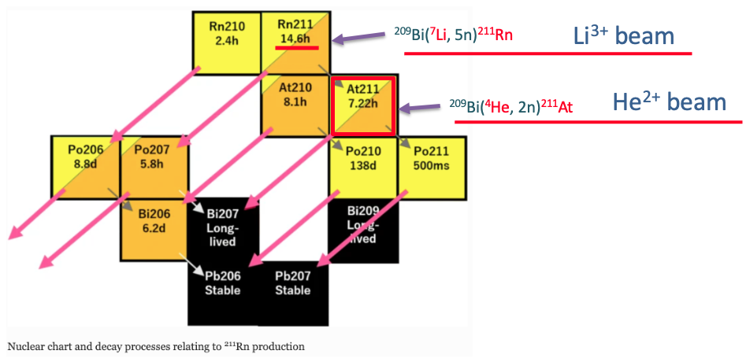
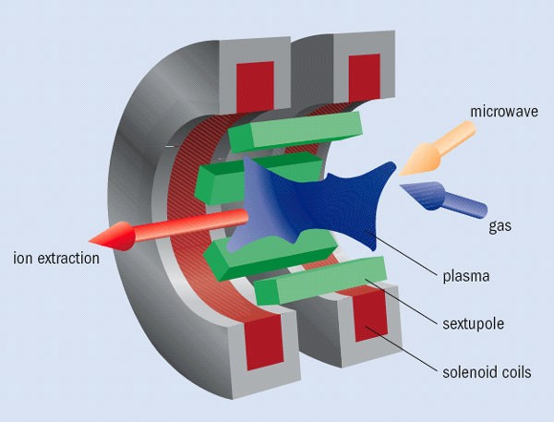
New Ion Source to Supply Li beam
Lab recently submitted a 10-year strategic plan to the DOE Isotope Program
(also a FY21 PEMP notable)
Part of that plan is a new facility CLIP = Center for Linac Isotope Production
Part of CLIP is a Light Ion Linac (d, He, Li) that enables unique isotope production and R&D
No ion source presently exists for this Light Ion Linac
Produce ²¹¹Rn, ¹⁴⁹Tb, ¹⁵⁹Gd
^{Sm(Li}
Cut view of ECRIS
New ion source is needed to provide high power Li and He beams.
We will build a prototype of ECRIS to achieve high current and robust beams.
ECRIS = Electron Cyclotron Resonance Ion Source
Notes:
An overview of the proposed research and development (R&D) that describes the rationale for the proposed R&D and its alignment to the Lab’s strategy.

Slide 4
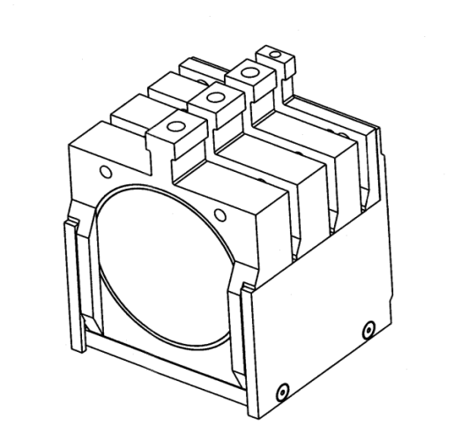
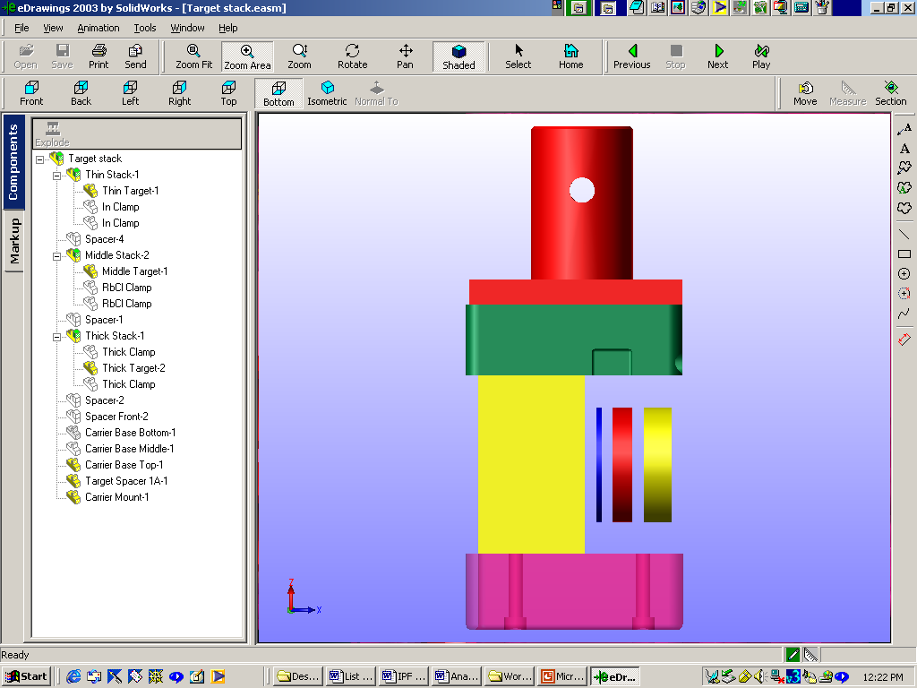
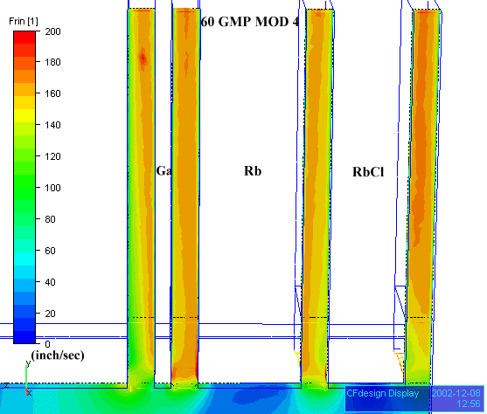
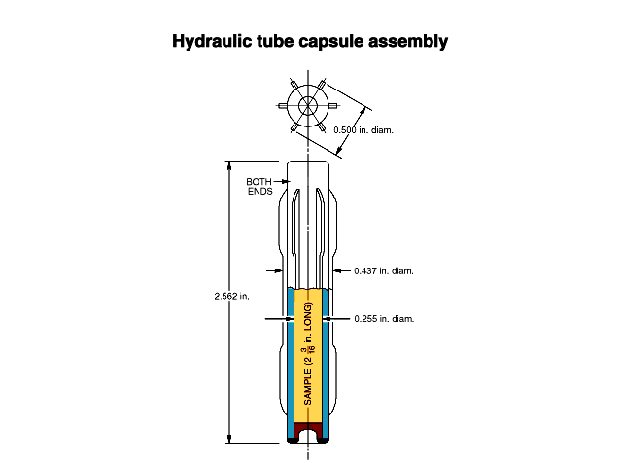
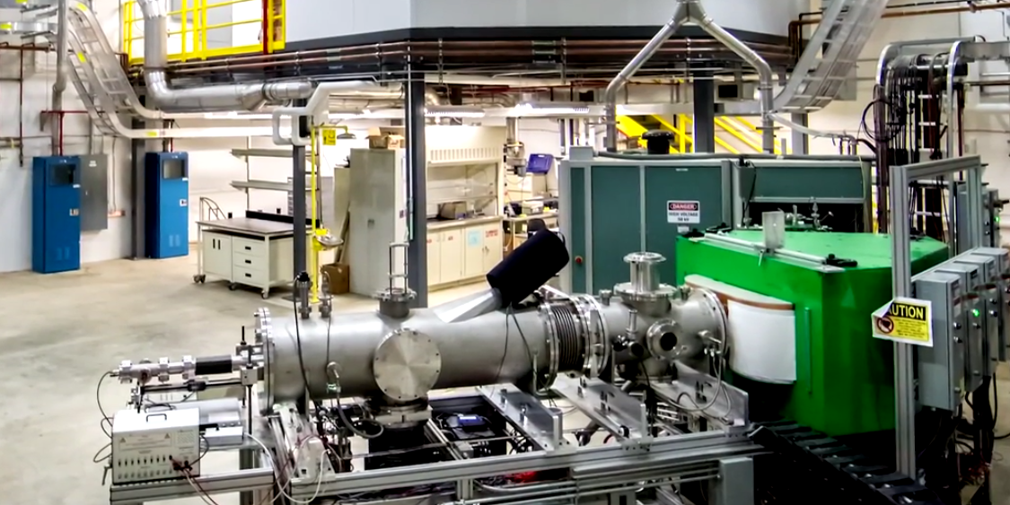
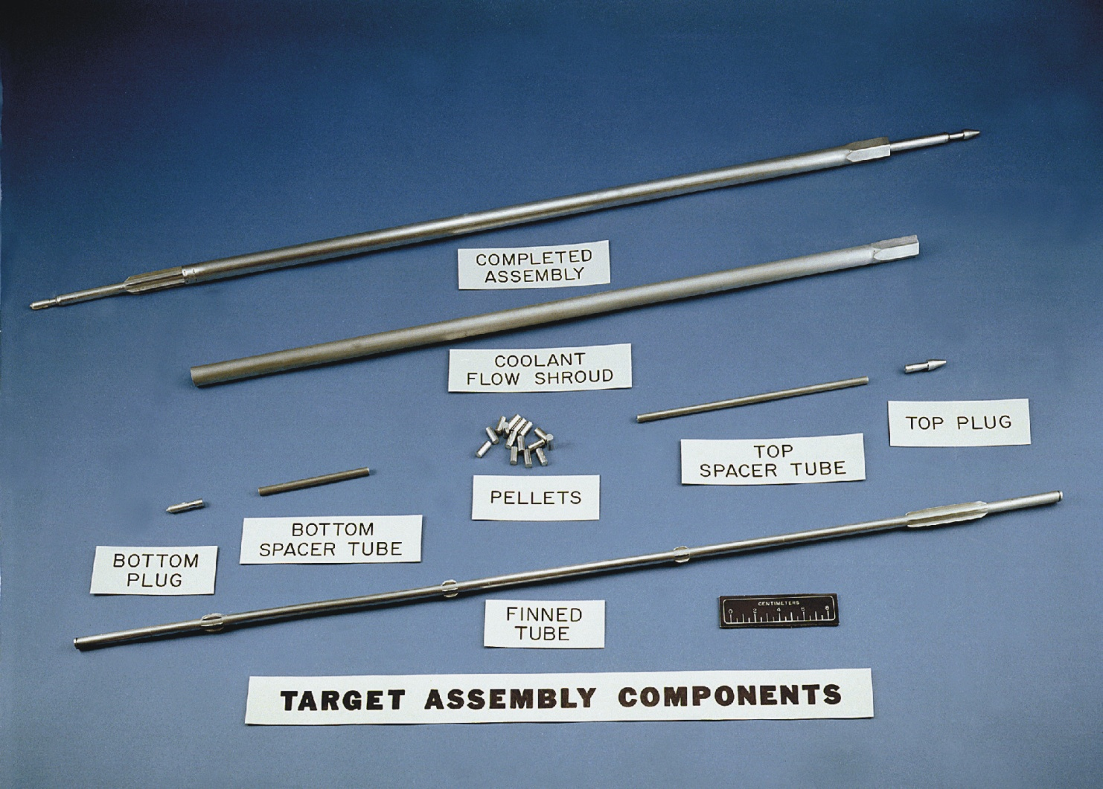
Programmatic Interests
Stable Isotope Enrichment
  High enrichment
  High volume
  Safe, secure operations
Accelerator and Reactor Radioisotope Production
  Targetry design, fabrication and thermal modeling
  Accelerator/Reactor Technologies
  Separations and purification
  Automation and remote handling
  Safe compliant transportation of radioactive products
  Waste management
  In situ target monitoring
  Radiation resistant IX resins, sorbents and extractants
Notes:
The national isotope program maintains a variety of program interests in the areas of stable isotope enrichment – you heard about the ongoing efforts at ORNL earlier with focus on high enrichment, high throughput with focus on safe and secure operations. For those interested in this area, export control of the technology developed must be given proper consideration.
From an accelerator and reactor isotope production perspective, we are all interested in target design, the development of new fab methods and new modeling techniques. In addition, I’d like to feature a couple areas that haven’t been developed with the isotope side of SBIR since isotopes were included for funding consideration in 2010. Specifically automation and remote handling – we have a number of isotope products produced in small batches that have not been looked at from the standpoint of process efficiency – we could use industry expertise in this area. Since coming to the office of science, we’ve seen our radioisotope portfolio blossom with strong R&D support. This is creating problems with transportation of these new products internally and to end users with particular focus on the need for more flexible type B containers

Slide 5
Goal for Nuclear Reaction Studies
In-beam measurements of the prompt gamma rays and
secondary particles emitted from proton-induced reactions
give insight for isotope production research and development
and understanding the mechanisms of nuclear reactions
  The energies available for protons at the Linac provide access to the direct, compound, and pre-equilibrium stages of nuclear reactions
These measurements complement the foil stack method
performed at BLIP for isotopes whose production rates cannot
be measured through post-irradiation analysis
Measurements of secondary neutrons provide information for
nuclear data efforts but also can be used to help predict
secondary-neutron-generated products in target stack
configurations

Slide 6
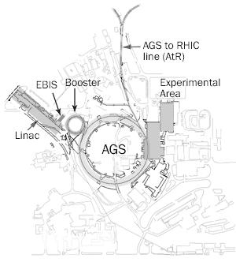
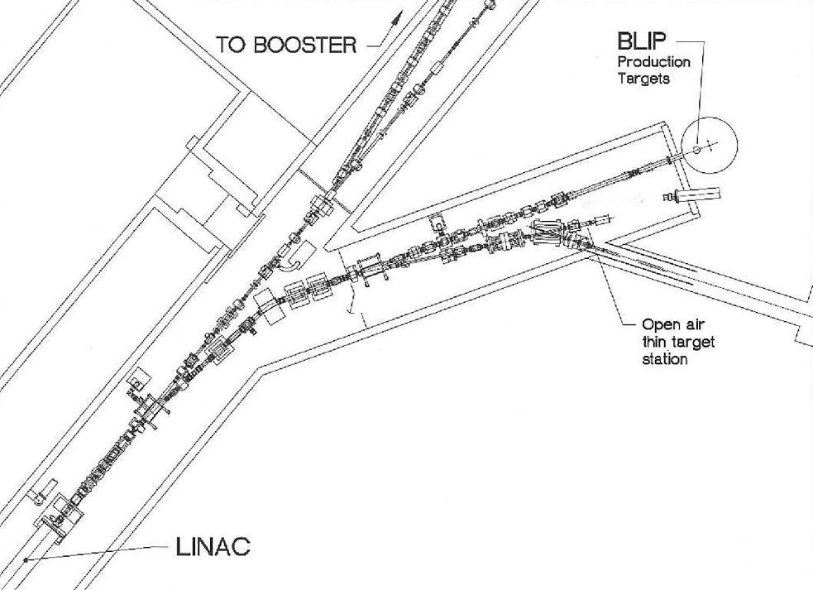
Proposed Location
Low Current
Target Station

