Slide 1
Mini Town Meeting – Nuclear Science Advisory Committee (NSAC) Long Range Plan
Diversity, Equity and Inclusion and Education
Kayla Hernandez
Silvia Verdú-Andrés
September 8, 2022

Slide 2
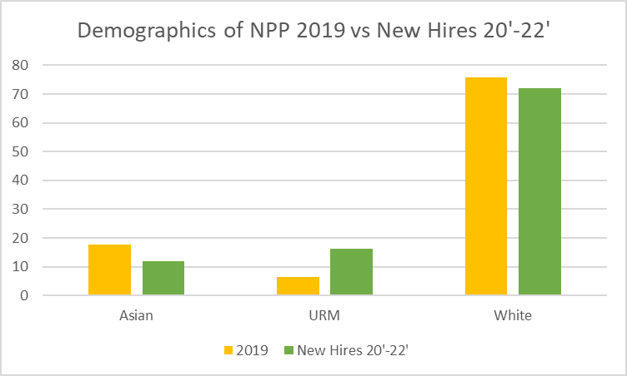
Some Statistics...
Of the new hires (93), 16% were URM (23)
NPP Demographics (804) in 2019 6.4% were URM
Note : According to NSF, URM workforce graduated in 2014 between 9 to 24% in relevant specialties. Despite progress, there is room to improve
Notes:
Before we jump in lets just take stock of where we are. Lets compare the demographics on NPP before the pandemic, and the demographics of our 93 new hires from the last 2 years with the demographics of recent graduates across America, a rough estimate of the available workforce. Disclaimer- this will be very hand wavy- but I think its important to get a sense of scale .
NSF reports that since 1995, about 20% of people graduating with bachelors degrees in engineering are women, and about 25 percent are URMs. 10% of Doctorates in the physical sciences awarded in the states go to URMs, and that 30% of the doctorates in physical sciences go to women. In 2019 less than 10% of NPP was URM, but of the 93 new hires we brought in ~15% URMS. That’s good news, we are getting closer to the best case senario..

Slide 3
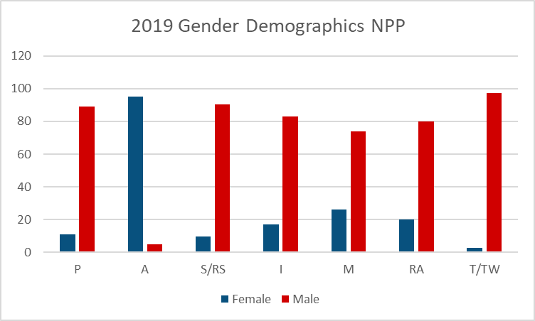
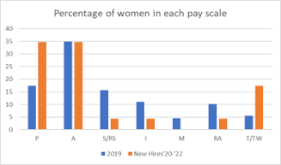
Of the new hires (93), 25% were women (23)
NPP Demographics in 2019 13.5 % women
We are making progress! The women we hired in 20-22' are in a larger spread of professions
Note: Female workforce graduating in 2014 with relevant PhDs was 20% to 30%. Our hiring does not match.
P = Engineers, Scientific Assoc., etc
A= Admins
S/RS= Scientist/ Research Staff
M= Managerial
RA = Research Assoc.
T/TW= Technicians
Notes:
The graph on the top is the 2019 demographics of NPP by pay scale, you can see we don’t reach the targets of the 20-30% female workforce in Engineering and in Science, but you can see that that our new hires are slowly shifting the dynamic. We are a better off in the P and T categories, though not so much in the S and I categories.

Slide 4
A vision on NPP / EIC driving EXCELLENCE through DEI
INCLUSION
EQUITY
Adoption of best DEI practices in hiring processes
Outreach to community colleges, universities
Strategic partnering with HBCU and HSI
Welcome program (“buddies”)
Mentorship program
Team building activities
DIVERSITY
Continuous upskilling of technical and professional skills and behaviors
Externships
EIC Fellowship
Notes:
NPP and EIC are working towards having more diverse hiring committee, DEI best practices for hiring have been put in place and The DEI council will enforce this. Moving forward, As the pandemic comes to a 'steady state' NPP and EIC should look to form and to leverage partnerships with URM serving institutions by engaging through lectures, by advertising internship opportunities, and job positing's to these schools. Same goes for professional groups like the National Society of Black Physicists and the Society of women in Engineering- we should be regularly sending early career members of our departments to these groups conferences, recruiters should be setting up tables.
We need to provide a framework for people to build their careers on! In general We should be encouraging our people to "upskill" to work on the underdeveloped areas of their skill set. Whether that be hard or soft skills like how to give an impactful presentation, or learning project management techniques. We could provide a way to Toohig fellow ship, for accelerator physicists, was a contortion of national labs that would host postdoc fellow, and one lab could move to the other (DOE project) we could do something similar! Concortion of national labs building EIC together. Prestige fellowship- attracts talent! Professional Development or "externships" could benefit all kinds of employees both scientific and support staff. We should be Developing our talent so we are more efficient, more effective at teaching the next generation, and communicating our science both at conferences and to the public.

Slide 5


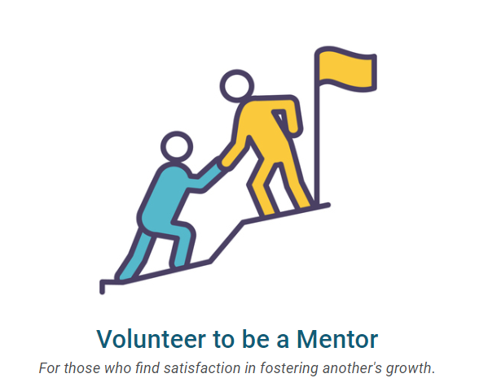
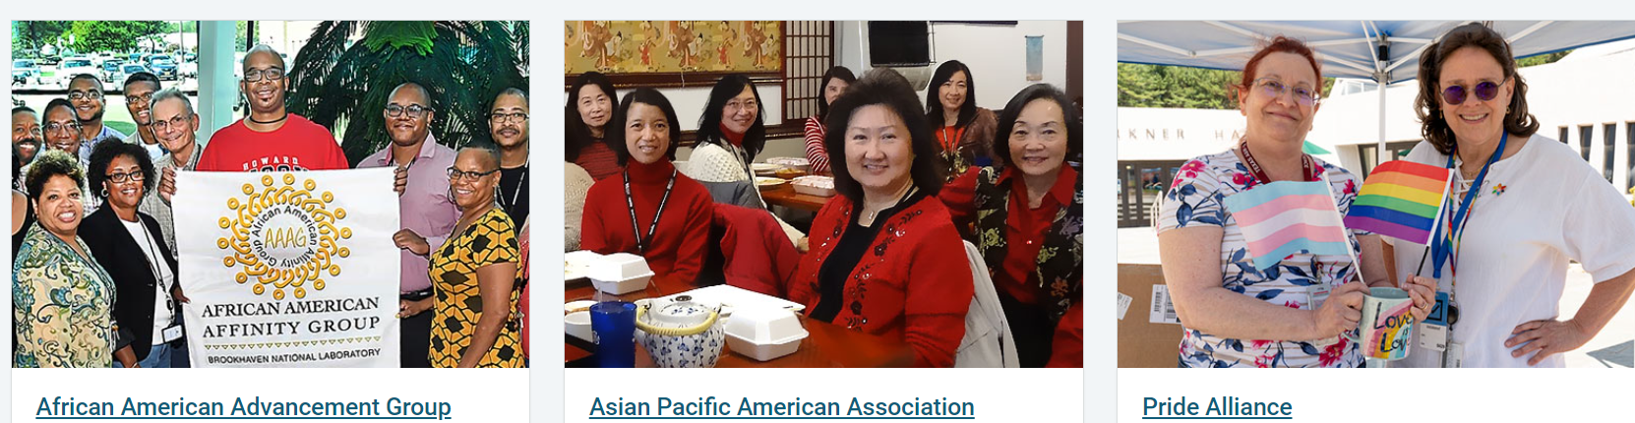
DE&I: Progress at an individual level: Keep it up!
Take DE&I training
Join an ERG
Become a mentor
See something Say something
Notes:
The whole institution suffers when DE&I is not achieved. Diversity Equity and Inclusion is everyone's problem. We all have implicit bias, we are all unwittily perpetuating bad habits that make our workplace less inclusive then it could be. The good news is that means the solution lies with us. Yes there is plenty of work to do on an institutional level, but there is also plenty that can be accomplished on the individual level.
You are already doing a lot of that work ! When you participate in an ERG, take DE&I Training, or attend a workshop on implicit bias. That can also look like remembering to pull people in- whenever you can, include people with different backgrounds – youll get better outcomes. Mentor early career people. When someone makes an uncomfortable joke at a colleges expense, respectfully call them out on it. Most importantly show up to work fully as you are, it gives everyone else around you permission to do the same thing.

