Slide 1
Edward Bouchet Initiative
Abhay Deshpande (SBU/BNL) & Mickey Chiu (BNL)
September 8, 2022
Mini Town Hall Meeting at BNL

Slide 2
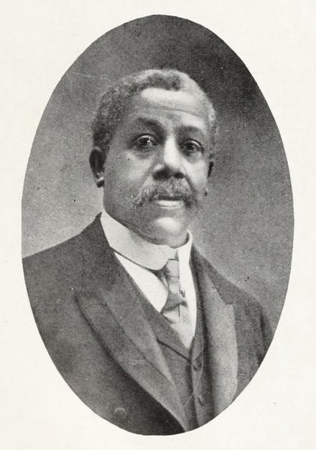
Lilly Alexander (Edward) Bouchet
Who was Edward Bouchet?
American physicist and educator
1st African American to earn a Ph.D. from any American University (1876)
6th Ph.D. in physics at Yale
Amongst the first 20 Ph.D.’s in Physics in the country
Ph.D. thesis: Refractive Indices of various glasses.
Taught at the Institute for Colored Youth (now Cheyney University of Pennsylvania) for 26 years starting in 1876.
Wikipedia
September 15, 1852 – October 28, 1918

Slide 3
Edward Bouchet Initiative for URMs Center for frontiers in Nuclear Science (CFNS) Brookhaven National Laboratory & Stony Brook University
An undergraduate component at BNL : led by Mickey Chiu (BNL) Co-PI (Abhay Deshpande and others) funded by a grant from DOE (nuclear physics traineeship) – See following presentation.
A sequential graduate program at Stony Brook : funded by Center for Frontiers in Nuclear Science, Stony Brook office of DEI and a DOE grant (Abhay Deshpande) and GEM fellowship at BNL ➔ will request sustained funding from DOE or/and NSF in future.
An NSF funded initiative (IANN-QCD) focused primarily on creating networks amongst south and central Americas with US institutions to promote participations of hispanics and other minorities for high energy QCD (i.e. EIC/LHC etc). (Co-PIs: Christine Aidala (U. of Michigan), Carlos Bertulani (Texas A&M), Jean Delayen (ODU), Abhay Deshpande (SBU/BNL) & Daniel Tapia Takaki (Kansas U.)

Slide 4
What is needed for success?
Various studies indicate that the secret to success for minorities to prosper requires a sustained “pipeline approach”, with ample personal care and mentorship
Pipeline Approach
K-12
Undergraduate
Graduate
Post Doc
BNL and SBU have
many programs for HS
and younger children
Nuclear Physics Traineeship Grant from DOE for UG studies
Graduate Traineeship
CFNS, SBU sourced
Many opportunities for URMs
Another most important reason for success is showcasing success stories of people from their own background – one of the goals of the IANN-QCD

Slide 5
Edward Bouchet Graduate Initiative
In 2021/22 five students from the BNL NPT Traineeship graduated and applied for graduate school. All five have joined Masters or Ph.D. programs: 1 at U. of Michigan, 2 at Stony Brook University and 2 at U. of Puerto Rico.
The two students at Stony Brook:
Brynna Moran – Joined January 2022, passed 1st semester graduate classes with flying colors while working on EIC related nuclear in the 2nd EIC/IR & and building GEM trackers for MOLLER experiment at Jefferson Lab.
Allen Pierre Louis – Joined September 2022, taking classes now and continues (some) simulations studies on EIC related topics.

Slide 6

Inter-American Network of Networks of QCD Challenges (IANN-QCD) https://www.iann-qcd.org/home C. Aidala, C. Bertulani, J. Delayen, A. Deshpande & D. Tapia Takaki
This initiative focusses on designing and establishing networks across the US, Canada, and Latin America to accelerate the process of “tacking QCD challenges” by providing support for collaborations, training students and early career scientists from emerging institutes in to established centers in QCD.
Activities:
Establish communication and relationships amongst existing networks and formation of new networks
Organize scientific meetings to bring communities together: workshops, summer schools, by networks and network partners
Research exchange and mobility amongst scientists amongst Latin America, US and Canada.

Slide 7
IANN-QCD network partners:
EIC, Jefferson Lab, RHIC-AGS Users Groups, US LHC Users association, Association of Latin American Nuclear Physics and Applications (ALAFNA), Southeastern Universities Research Association (SURA), Latin American Association of High Energy, Cosmology and Astro-Particle Physics, Nuclear Physics and Applications (INCT-FNA), Rede Nacional de Fisica de Altas Energias (RENFAE), Mexican Particle Physics Community (CMAP), EIC-Canada Consortium, California EIC Consortium
Center for Frontiers in Nuclear Science (CFNS), EIC² at Jlab, Center for Accelerator Science at ODU, ICTP South American Institute for Fundamental Research (ICTP-SAIFR), Canadian Institute of Nuclear Physics, TRIUMF, INT@UW, and Center for Nuclear Femtography

Slide 8
A call driven process
A call goes out every six moths.
Any member of the IANN-QCD family/partners can initiate a request.
The request reviewed by the PIs (coordinators) and opined on by selected members of the International Advisory Committee
Funding proceeds from the partnering institutions as needed.
Recent example: CFNS led Workshop on Precision QCD held at Stony Brook. Four scientists from Argentina, Mexico and Brazil were supported through this grant. Visiting scientists also met with SBU’s Hispanic students in physics.

Slide 9
Thank you.

Slide 10
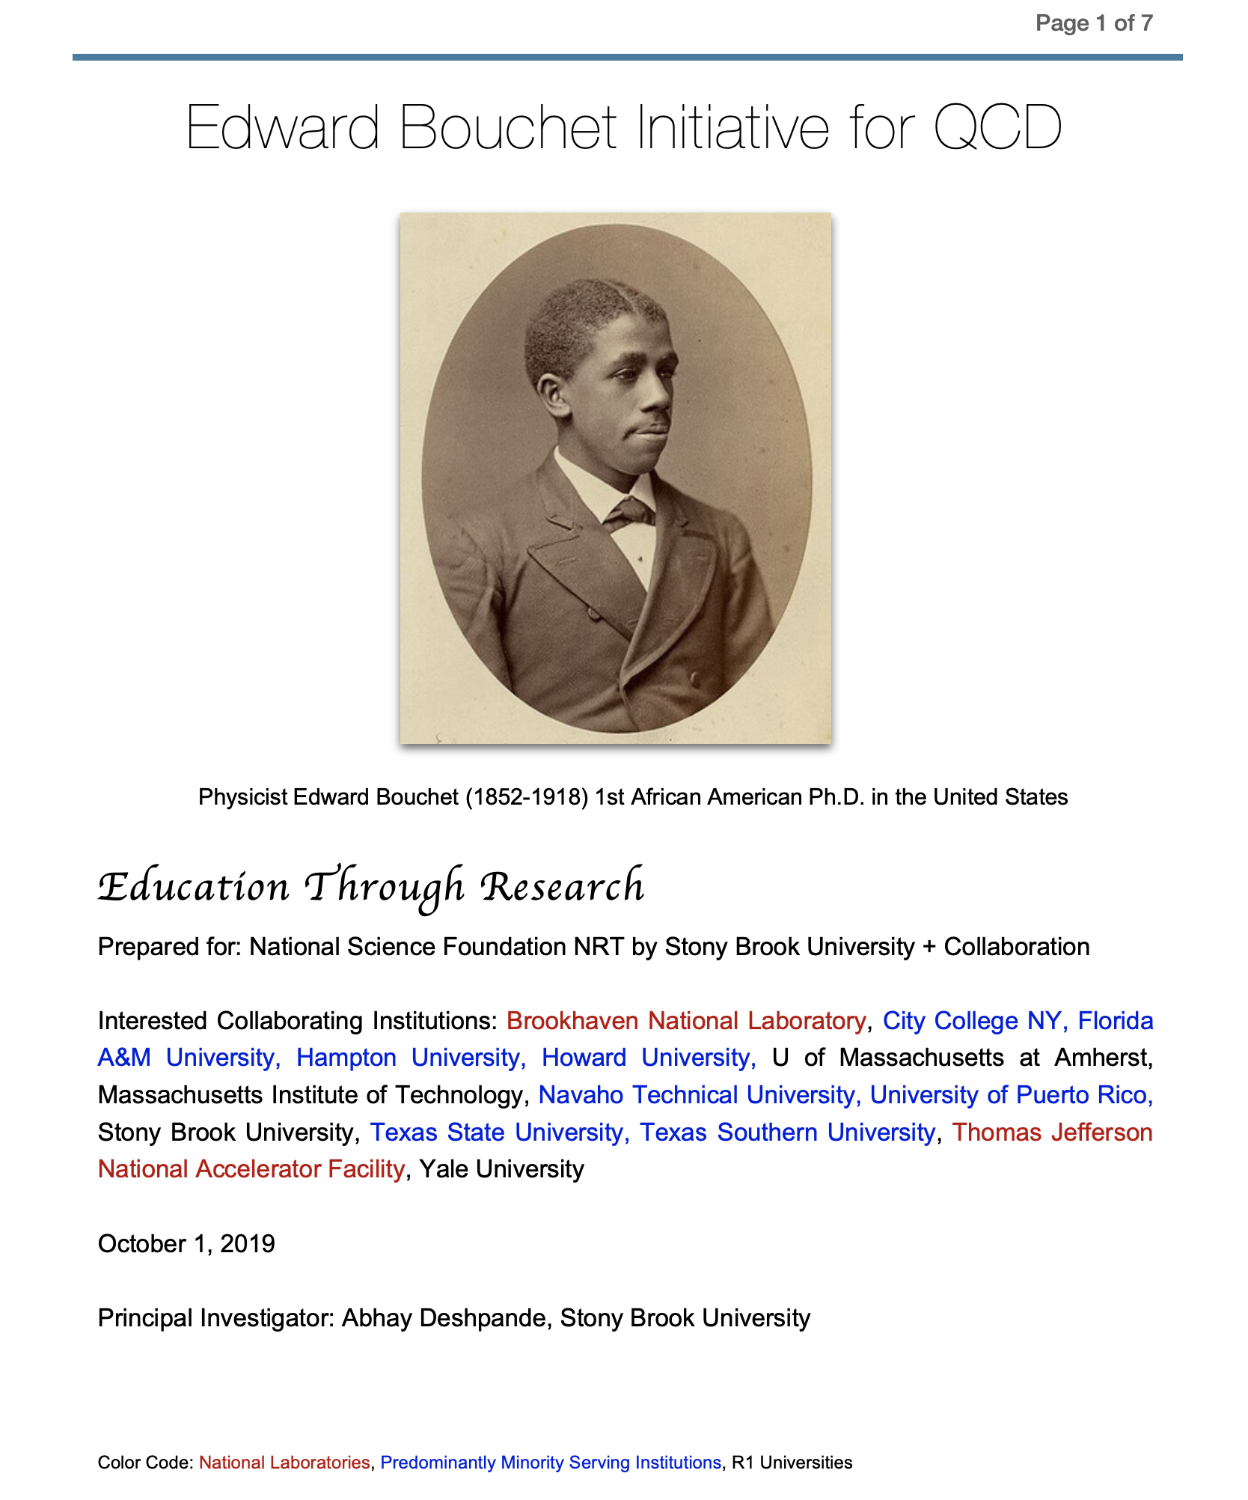
2019 EB Initiative to NSF
Education through Research
NSF evaluated it highly but did not fund it.
Referee: “we could get minorities in our graduate program”. Advised us to show that we can sustain URMs in Physics at SBU. Create a small “history” of success.
That is what we are doing now in 2022.

Slide 11
IAC and Latin American Contacts
Prof. Luisa Cifarelli (Bolgna)
Prof. Barbara Erazmus (CNRS/IN2P3)
Prof. Paulo Giubellino (GSI, U. of Darmstadt)
Prof. Oliver Kester (TRIUMF)
Prof. Jorge Lopez (U of Texas, El Paso)
Prof. Luciano Maiani (Rome)
Prof. Robert McKeown (JLab & U. of W&M)
Prof. Larry McLerran (INT, U of W)
Prof. Veroniqua Riquer (Rome)
Prof. Alberto Santoro (Rio de Janeiro, Brazil)
Prof. Robert Tribble (U of Texas, and BNL)
National Contact Persons:
Argentina (Daniell De Florian),
Chile (Will Brooks),
Mexico (Irais Bautista Guzman and Gerardo Herrera Corral)

