Slide 1
Nuclear Data needs for the future of space exploration
Gustavo P. A. Nobre (gnobre@bnl.gov)
On behalf of Dave Brown
National Nuclear Data Center
Nuclear Science and Technology Department
8 September, 2022
BNL mini Town Hall on NSAC Long Range Plan for Nuclear Science

Slide 2
The GCR background spans a huge mass and energy range covering virtually all of Nuclear Physics
Galactic Cosmic Rays include nuclei as heavy as ⁵⁶Fe and E/A up to 50 GeV
For reference, E_{binding}(⁵⁶Fe) ≈ 0.5 GeV
The range of 1 GeV proton in Al is > 1 m.
It’s even worse near the gas giants where their magnetic field meets the solar wind.
These high-energy particles create cascades of hundreds of secondary, tertiary etc. particles
The shielding itself can contribute to the variety of secondary particles produced.
Charged secondary particles deposit a portion of their energy more locally than neutrons
The solar system beyond the atmosphere and the earth’s magnetic field is a tough neighborhood!
Slide from Lee Bernstein
T.C. Slaba et al.
Life Sciences in Space Research 12 (2017) 1–15
Space exploration requires appropriate shielding over a wide range of energy

Slide 3
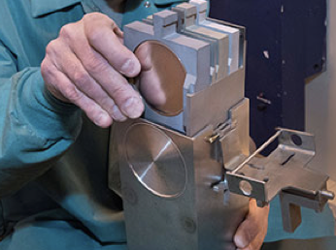
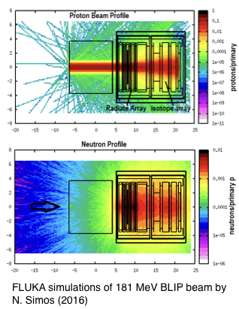





Transport codes for shielding applications
 | FLUKA | INFN (Italy) | http://www.fluka.org/fluka.php | Free reg.
 | PHITS | JAEA (Japan) | https://phits.jaea.go.jp | Open Source
 | MCNP | LANL | https://mcnp.lanl.gov | EC, RSICC
 | GEANT4 | CERN | https://geant4.web.cern.ch | Open Source
 | HZETRN | NASA | https://software.nasa.gov/software/LAR-18803-1 | EC, NASA, Free reg.
Figure 1: Photograph of a BLIP target stack ready for proton bombardment. (courtesy of C. Cutler)
All codes have built in models that cover different physical regimes
FLUKA simulation of the BLIP target stack showing the primary proton beam and secondary neutron production (N. Simos (2016))

Slide 4
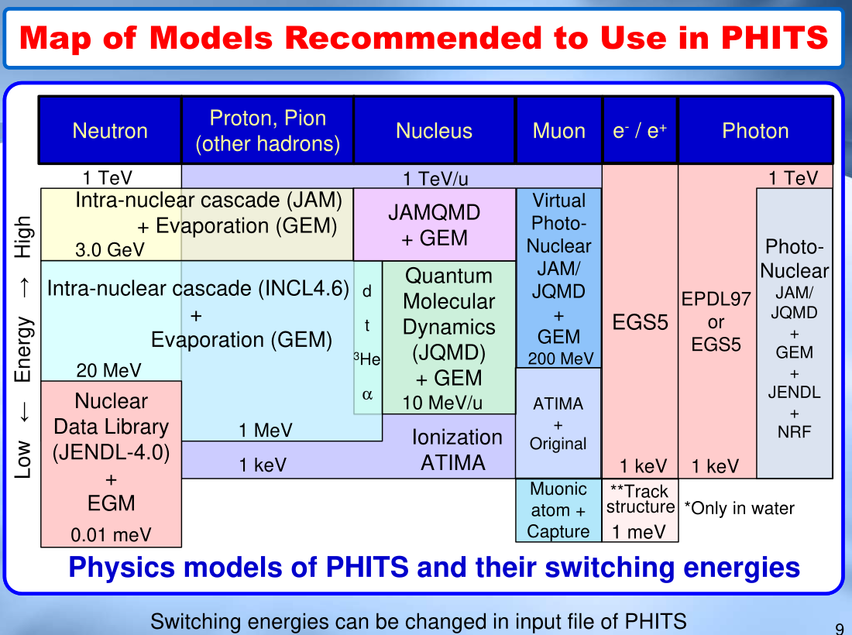
https://phits.jaea.go.jp/lec/phits-introduction-en.pdf

Slide 5
(ENDF) data tables
https://phits.jaea.go.jp/lec/phits-introduction-en.pdf
Stopping Powers

Slide 6
John Norbury et al.* have shown that large gaps exist in experimental data needed for shielding optimization
*J.W. Norbury et al.
Radiation Measurements 47 (2012) 315e363
“All” projectiles signify He, C, O, Si, Fe
This is where STAR @ RHIC can really help!
Slide from Lee Bernstein

Slide 7
What data do these codes need to produce meaningful results?
Cross sections: Only total cross section and elastic/reaction cross section needed to first approximation
Particle multiplicities
Outgoing particle distributions: dN/dE’dΩ
Flow, femtoscopy, jets, etc. are unimportant, but coellecense yields are essential!
Two opportunities!
Modeling support for shielding & isotope production applications!
Additional fixed target run at RHIC before EIC

Slide 8
There are gaps in data compilation: no heavy-ions, not enough high energy
Evaluated (this is what goes in transport codes):
PDG only elementary particle properties
CSEWG’s ENDF (US data program) only < 150 MeV + decay data
Three major regional data projects (JAEA, US, EU) have made forays into HE
Experimental data compilation:
EXFOR/NSR partial tabulation of data/references most comprehensive but poor HE coverage
Smaller scale projects with basic science focus: HEPdata, nn-online, GWU DAC
3 year ROSSINI3 project (ESA-NASA-GSI) (see https://www.gsi.de/work/forschung/biophysik/fragmentation, https://crosssection-db.herokuapp.com)
Pilot project to compile RHIC/AGS data @NNDC circa 2000, but data appears lost
Opportunity to collaborate to meet data needs for space physics leveraging the high-energy and isotope programs

