Slide 1
Open Nuclear Data
Libby McCutchan
National Nuclear Data Center
mccutchan@bnl.gov

Slide 2
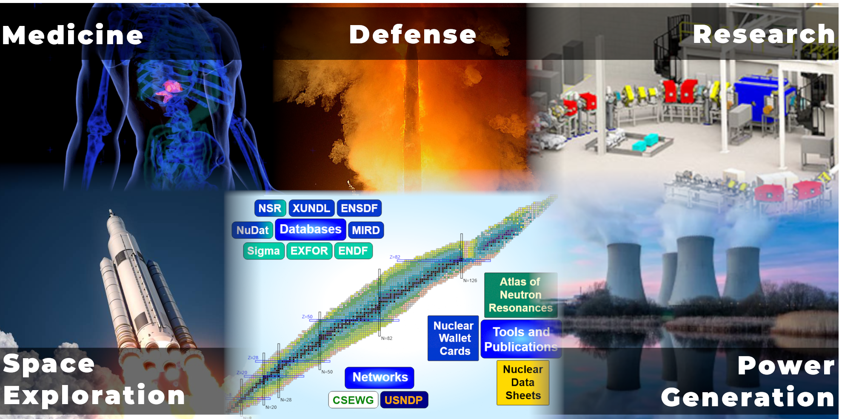
Who we are and what we do … in one slide
www.nndc.bnl.gov

Slide 3
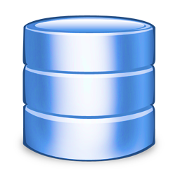
How we do it
Compilation Databases
Evaluated Databases
Nuclear Science References
(bibliographical database)
Structure
ENSDF
XUNDL
NSR
Reactions
ENDF
EXFOR
Publications are 95% source of data
Journals
Lab Reports
Theses
Literature scanned on weekly basis
Extract meta- and numerical data
Data converted to database format
Several consistency checks of data
Critical assessment of all exp data
Provide recommended values
Testing and Validation important component

Slide 4
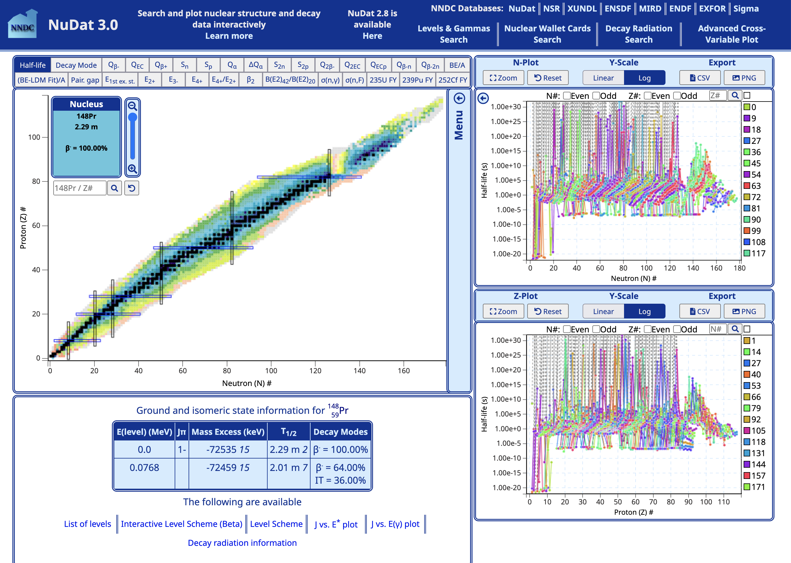
Data Dissemination
Over 5 million data retrievals per year through website alone
Many more through codes like GEANT and MCNP

Slide 5
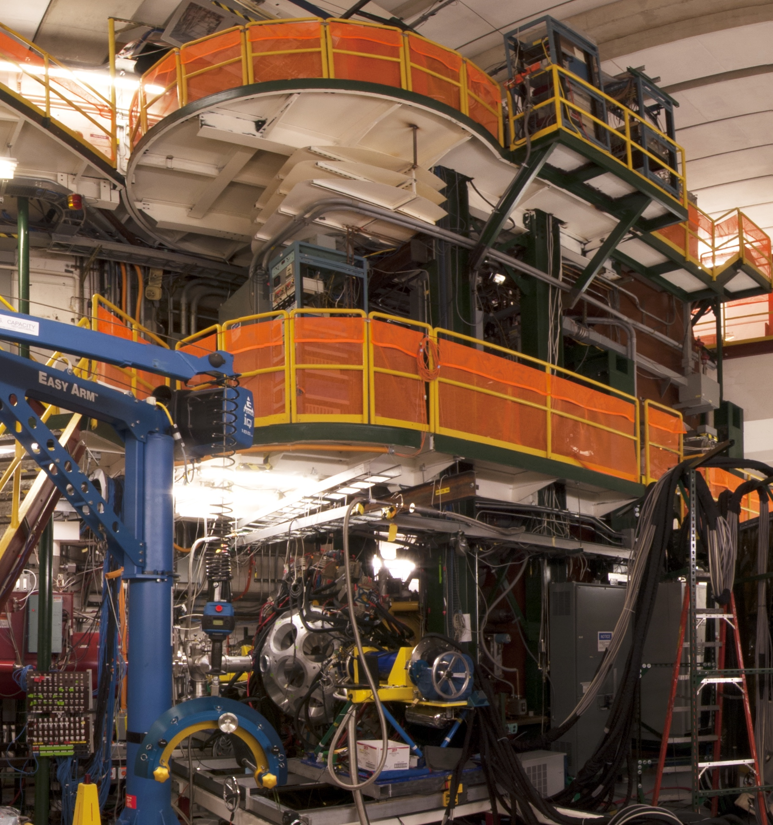

Current Low Energy Nuclear Physics Data Status
Data collection
Data storage
Only a small fraction of experiments are fully preserved. These continue to increase in cost and complexity.
There is NO centralized mechanism for data sharing, resulting in
Potential for repeating experiments
Data that goes unanalyzed
Less resources to plan experiments
No opportunity for reproducibility
Data program parses published tables and digitizes graphs.
Nuclear Databases
Data artifacts
Processed data
Analysis software
Dissemination of Processed Results
Simulation
Average experiment costs ~1 million
~300 experiments into XUNDL alone every year

Slide 6

https://www.whitehouse.gov/ostp/news-updates/2022/08/25/ostp-issues-guidance-to-make-federally-funded-research-freely-available-without-delay/

Slide 7
Brookhaven Open Nuclear Data (BOND)
Data collection
Data storage
BOND will ingest, document, and preserve data at each stage of an experiment
Major goals include :
Nuclear Databases
Data artifacts
BOND
Establish repository of low-energy nuclear data at NNDC
Implement FAIR principles
Leverage RHIC/HP Data Computing Facility expertise
Integrate NNDC in Data Management Plans
Start with new facilities (i.e. FRIB)
Work backwards to legacy data
Processed data
Analysis software
Dissemination of Processed Results
Simulation
Notes:
Integrating, expanding and automating the pipeline are the key elements that will get more reliable data to users faster while expanding our capabilities

Slide 8
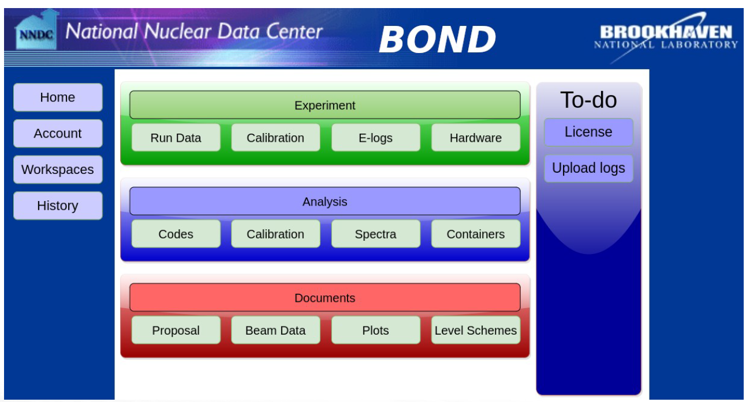
Example Mock-up UI

