Slide 1
EIC Software Infrastructure Review
EPIC
Data & Analysis Preservation
Kolja Kauder
On behalf of the EPIC Collaboration

Slide 2
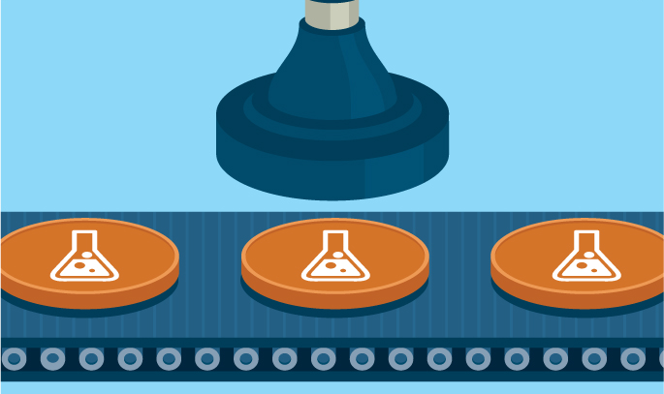
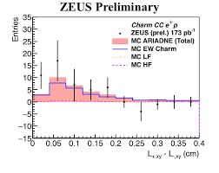
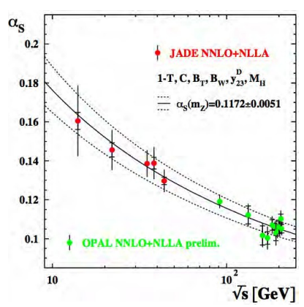
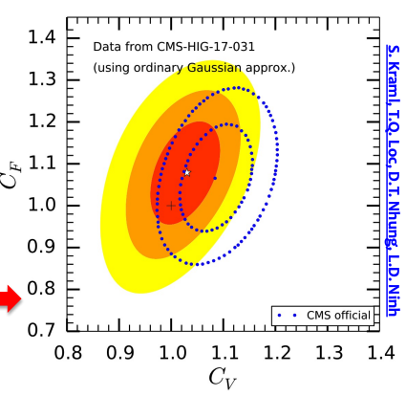
Data and Analysis Preservation Goals
Reproducibility - the most fundamental scientific requirement
Reusability - apply modern techniques on existing data
Reinterpretation – totally new approach on existing data - SciPostPhys.9.2.022 (2020)

Slide 3
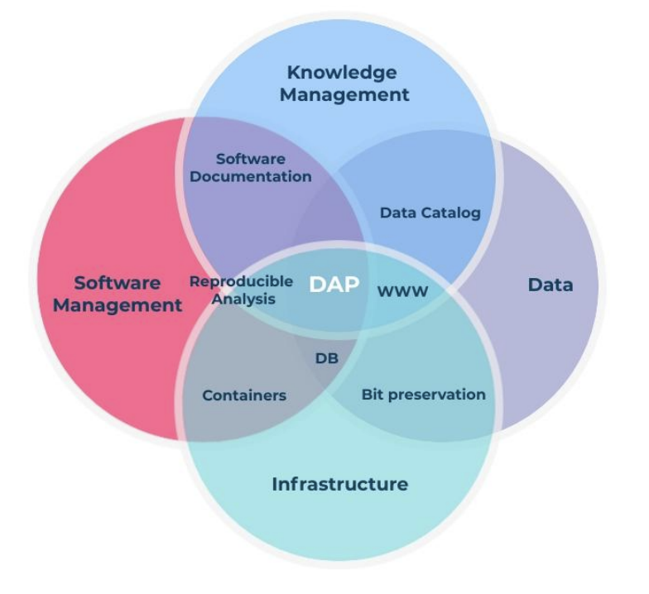
Challenges
DAP is a massively sprawling subject — every subject discussed is linked with it (ex. PODIO, CI, …)
Need workflows, not only analysis + data
Won't map easily onto the given charge
Not a new field. Multiple decades of experiences from LEP, HERA, FNAL, to LHC, JLab and RHIC — and not one smashing success among those that ceased operations

Slide 4
New Technologies
We now have more options than ever before
… and new technologies to preserve E.g. Machine Learning DAP is largely unexplored

Slide 5
Our Resources
Our Principles, specifically important:
6. We will have reproducible software:
Data and analysis preservation will be an integral part of EIC software and the workflows of the community.
We aim for fully reproducible analyses that are based on reusable software and are amenable to adjustments and new interpretations.
4. We will aim for user-centered design
5. Our data formats are open, simple and self-descriptive
7. e) We will not reinvent the wheel
Speakers:
Maxim Potekhin DAP in PHENIX, CERN's DPHEP
Ulrich Schwickerath DAP at LEP
Ernst Sichtermann Perspective from Muon g-2

Slide 6
Requirements
“Holistic approach”: data without the software is useless, as is software without build and verification systems and/or necessary additional data.
Conceive preservation from the beginning as an integral part of the standard frameworks, retrofitting will be nearly impossible.
A data plan needs to be exercised and tested, and Access is as important as archival.
Prefer existing solutions.

Slide 7
Requirements cont.
Success relies heavily on users. It requires training, as well as buy-in and enforcement by conveners and management
Solutions should be intuitive and easy to use.
Low or no barriers. The more gatekeeper's consent is needed, the worse will be the users' uptake
Discoverability. All options need to be complemented by catalog tools, search tools, and the like.

Slide 8
More Specific
Test beam data and simulation data must be preserved and cataloged.
They should be open and discoverable to the public.
Plots and tables can be reproduced by anyone.
Important documents need to be stored permanently. Wiki's change.
Granular (enough) access controls to make proprietary information only accessible to the right group of people while making it easy to add and retrieve open documents.

Slide 9
Decision
Too complex a field to decide for a handful of software options and call it a day. Instead, the decision document has a list of recommendations, and this resolution:
"[A]spects to consider beyond a choice of software [] include policy decisions that will require endorsement from the collaboration as a whole and resources to back them up. A task force assigned to this purpose was called for in the discussion. [] The task force will be organized by two interim co-leads until the official formation of a collaboration."
Full task force charge draft is in the backup. This review's charge will be incorporated as appropriate.

Slide 10
Task Charge
Policy Recommendations
Develop a draft policy on Data Analysis & Preservation for EPIC
How to build in DAP aspects from the beginning
Consider which incentives can ensure that researchers engage in Data Analysis & Preservation practices.
Implementation Plan
Identify possible resources, a timeline, and a plan for management and maintenance.
Take the EIC Software Statement of Principles into account
Subject technology choices to the charges as posed by this review
By early September, we will form the Task Force to deliver clear guidance by the end of the year

Slide 11
Backup – Task Force Charge
Data Analysis & Preservation in this context concerns the capturing of all aspects of scientific workflows, from data production to final publication, data archival, and potentially public release. This must however not be interpreted as a limiting definition.
Consider which aspects of Data Analysis & Preservation can be built in from the start so they become an integral part of the collaboration's efforts.
Consider what is needed to increase the reusability of analyses in the EPIC collaboration, that is the ability for new researchers to reuse existing components of previous analyses in order to build on them.
Consider what the appropriate level of reproducibility is for various products the collaboration will produce, from internal reports to publications, and to what extent these apply to data, analysis, and environments.
Consider what requirements a digital information repository for the collaboration must satisfy.
Consider which incentives can ensure that researchers engage in Data Analysis & Preservation practices.
Develop a draft policy on Data Analysis & Preservation for the EPIC collaboration, which contains the overarching philosophy and principles, but should not mention specific technology choices.
Consider the EIC Software Statement of Principles in the development of implementation suggestions.
Consider accessibility to the entire collaboration (and audiences beyond) in implementation suggestions.
Provide a possible implementation plan that identifies possible resources (even if not presently available), a possible timeline, and a plan for management and maintenance.
The task force is asked to present its findings as an EPIC internal report with an executive summary listing the specific recommendations and a presentation to a dedicated joint meeting of the EPIC Collaboration CompSW and SimQA and the EICUG Software Working Groups.

