Slide 1
Kick-off meeting of the ePIC Charter Committee August 15th, 2022
Victoria Greene (Vanderbilt), Franck Sabatié (CEA-Saclay)
Agenda:
Introduction and timeline
Charter Committee organization
Practical matters
AOB

Slide 2
Foreword
Apology for time-zone issue
Due to this, Ralf Seidl is not able to join.
Please allow us to record this meeting !

Slide 3
Timeline, Milestones – Institutional Board
July 26th, 2022
Following a comment period, a text describing the role of an IB in this preliminary collaboration stage as well as the voting rules was adopted by consensus by the members of the IR.
July 18th, 2022
1st meeting of Institutional Representatives convened by VG and FS to discuss formation of an Institutional Board (voting body).
We now have an Institutional board !
June 24th, 2022
Vicki Greene and Franck Sabatié appointed by SC to facilitate the formation of the EIC Project Detector Collaboration, starting by convening the Institutional Representatives of the EIC Detector-1.
Charge:
Prepare the formation of the collaboration bylaws/charter.
Prepare and conduct the bylaws/charter approval process.

Slide 4
EPIC Institutional Board - Adopted
The EPIC Institutional Board (IB) consists of representatives of all participating institutions. The Institutional Board is composed of one individual Representative from each member institution. Each member institution selects its own Representative. The Institutional Board makes all major policy decisions within the collaboration. Initially, the Institutional Board chairs were chosen by the EIC Detector 1 pro-tempore steering committee: Victoria Greene and Franck Sabatié.
The initial activity of the IB is to (i) nominate members for a charter/bylaws drafting committee, and (ii) adopt the charter/bylaws once the committee has drafted them. Adoption of the charter/bylaws will require a 2/3 majority of all votes cast within the Institutional Board. Following the adoption of the collaboration bylaws, the Chairperson(s) and the Vice Chairperson of the Institutional Board will be elected by a vote of the Institutional Board from among its ranks, as described by the newly adopted charter.
Meetings of the Institutional Board will, by default, be open to all members of the collaboration unless declared closed by the Chair(s). If a Representative is not available for a specific Institutional Board meeting, an alternate may be appointed if that person is designated to the Institutional Board chair at least 24 hours before the meeting.

Slide 5
Timeline, Milestones – Bylaws/Charter
We are here
Late september
IB adopts bylaws/charter !
Mid-september
Bylaws/charter ready to be distributed to IB for feedback.
August 15th
VG and FS convene and charge the bylaws/charter committee.
August 5th
Appointment of committee members. Announcement of the composition of the committee to all.
Pietro Antonioli (INFN-Bologna)
Olga Evdokimov (University of Illinois at Chicago)
Douglas Higinbotham (Jefferson Lab)
Barbara Jacak (University California Berkeley)
Zein-Eddine Meziani (ANL)
Rosi Reed (Lehigh University)
Ralf Seidl (RIKEN)
Peter Steinberg (BNL)
July 25th
An email was sent to the IR list to collect nominations for a bylaws/charter committee. Deadline: July 31st
In parallel, we would like to:
• Appoint members of the DEI committee.
• Convene and charge the DEI committee with developing code of conduct.

Slide 6
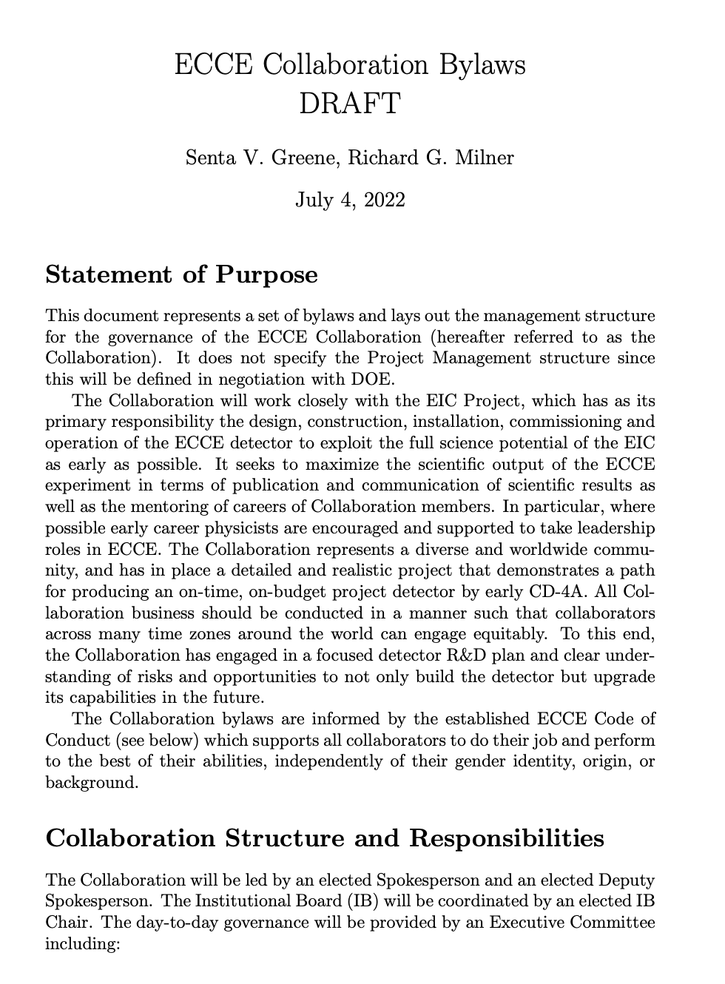
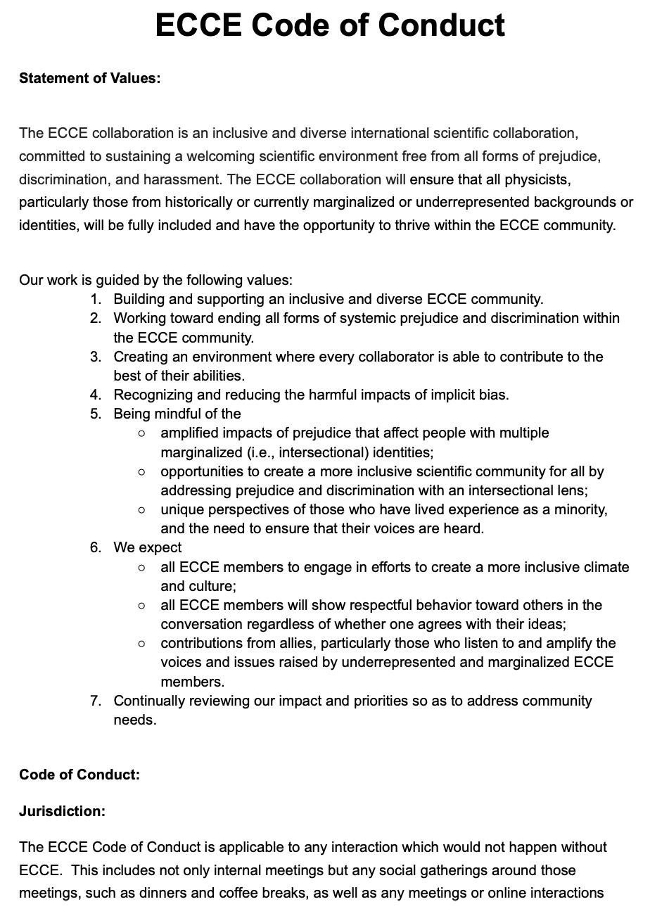
Charter/bylaws – We are not starting from scratch!
ATHENA and ECCE have worked on charters/bylaws/codes of conduct.
ATHENA’s Charter is particularily well-developed and was approved.
ECCE produced and adopted a Code of Conduct.
All the work done is an invaluable resource and starting point for the EPIC charter/bylaws.
28 pages of
charter and policies
3 pages of bylaws and
6 pages of Code of Conduct

Slide 7
Timeline, Milestones – What is next?
The charter will describe how the next stage happens. In principle VG and FS job is finished here.
However we can imagine the following in an optimistic timeline:
Early October:
The IB will elect its chair, vice-chair.
Since the bylaws/charter will define what a collaborator in good standing is, we will collect the full list of collaborators.
The IB leadership will then organize the collaboration leadership election.
End of October: we have an elected collaboration leadership !

Slide 8
Organization and Practical matters
Pick chair/co-chair: any volunteers ?
Vicki and Franck will not actively participate in the process but stay in as ex-officio. The rest of the committee will do the heavy lifting. We will handle the interaction with the IB and SC.
Early Career nominations: two people. We will start a poll ASAP.
DEI: (4-5 people) we are working on it
We expect them to work closely with the charter committee.
Practical matters:
Will send shortly the word files of the ECCE CoC and ATHENA charter/policies.
Document management : to be discussed, Overleaf? Google doc?
Indico: will ask BNL to create a Charter Indico area so that you can all organize meetings.
Working groups definition: next slide.

Slide 9
Working Groups
WG1: Code of Conduct : handled by DEI – Olga, Rosi
WG2: Membership (urgent) - Doug, Peter, Pietro
WG3: Institutional Board (starting from the temporary board) - Barbara, Pietro, Zein-Eddine, Olga
WG4: Spokesperson(s) and executive board – Barbara, Rosi, Pietro, Ralf, Zein-Eddine, Olga
WG5: Election policy – Doug, Peter, Rosi
WG6: Publications & Conferences (less urgent) – Ralf, XX, XX
Make sure that WGs have time-zone-compatible members!
We suggest everyone picks 2 WGs so that we have 1 observer working with DEI on CoC and 3 members for each of the 5 other WGs.
The early career members can participate to any WG.
Vicki and Franck will be ex-officio.

