Slide 1
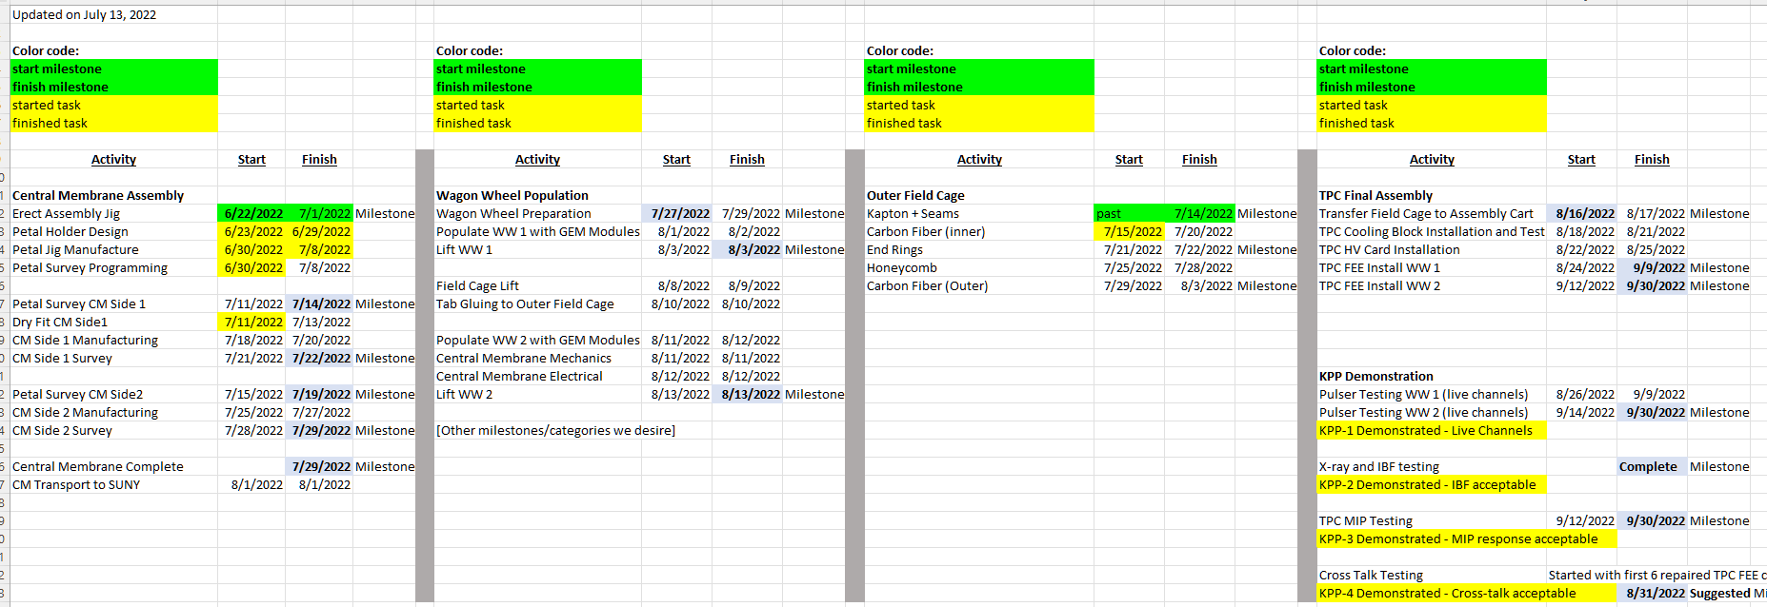
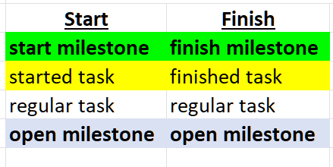
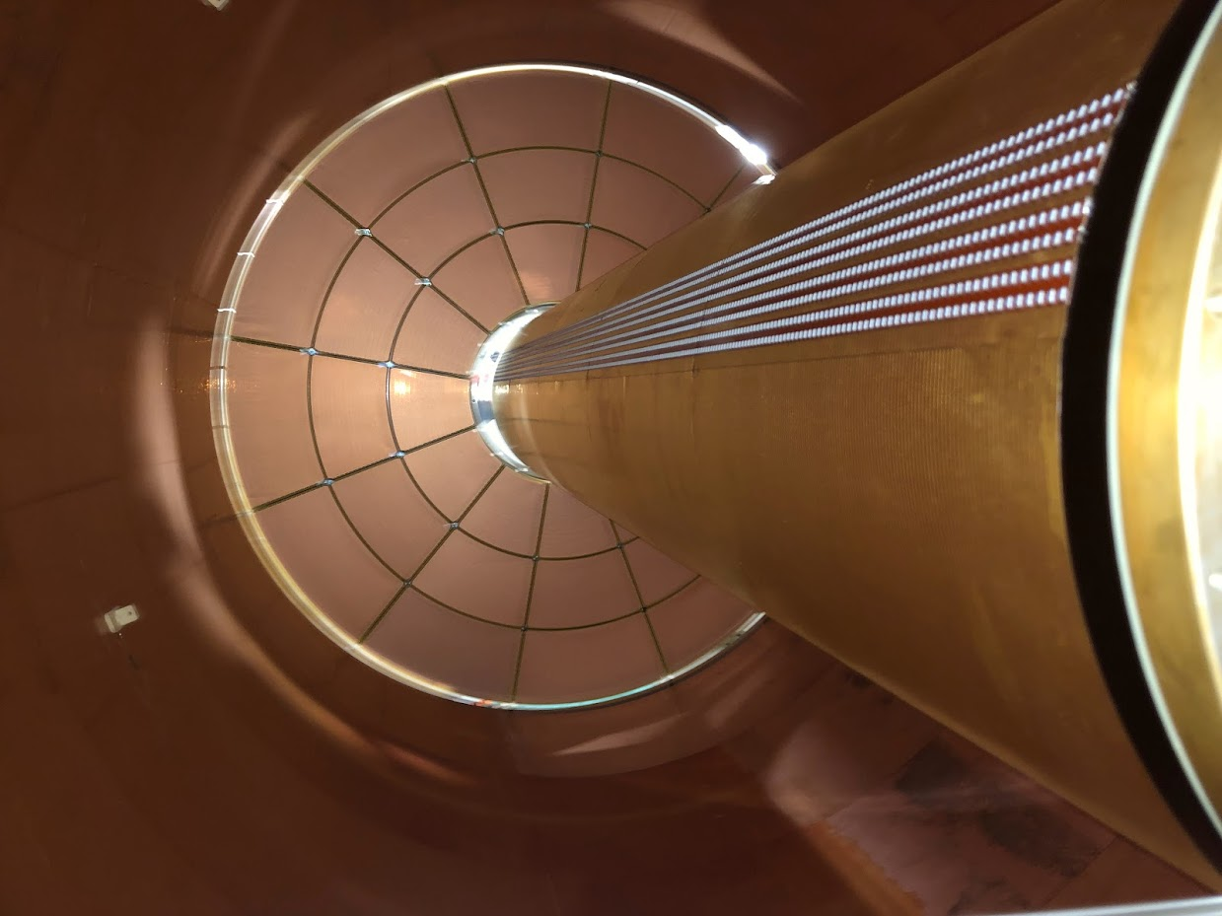
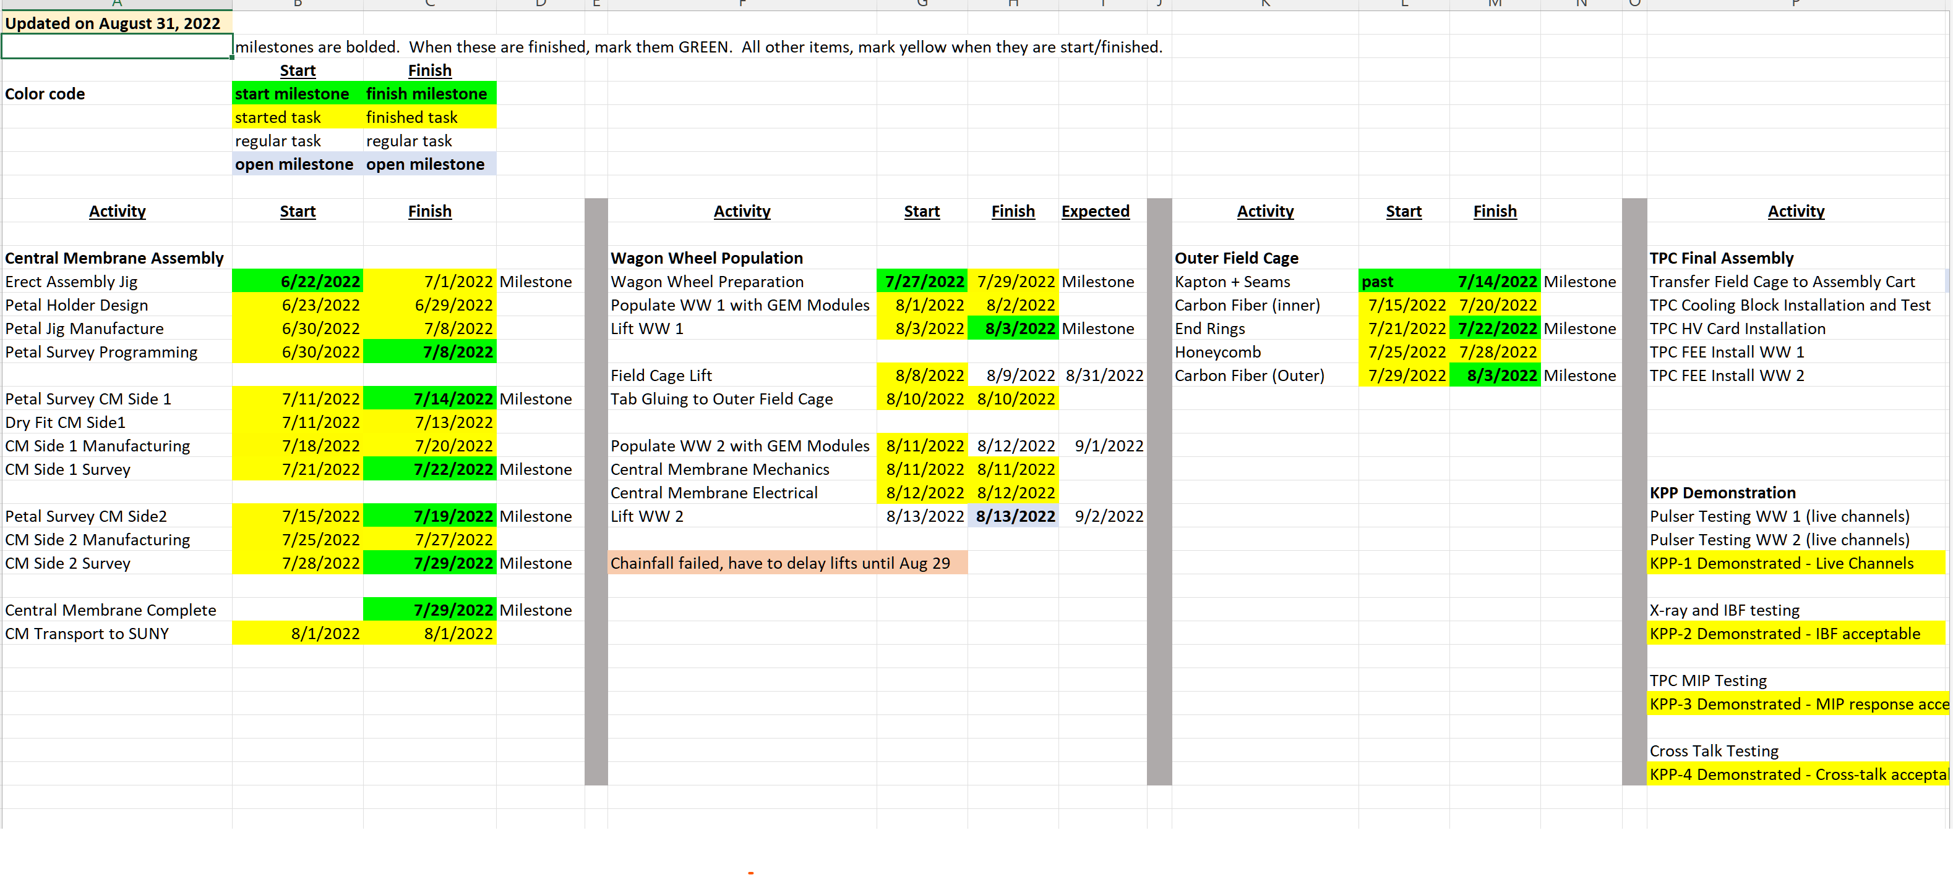
TPC Completion Schedule
TK Hemmick

Slide 2
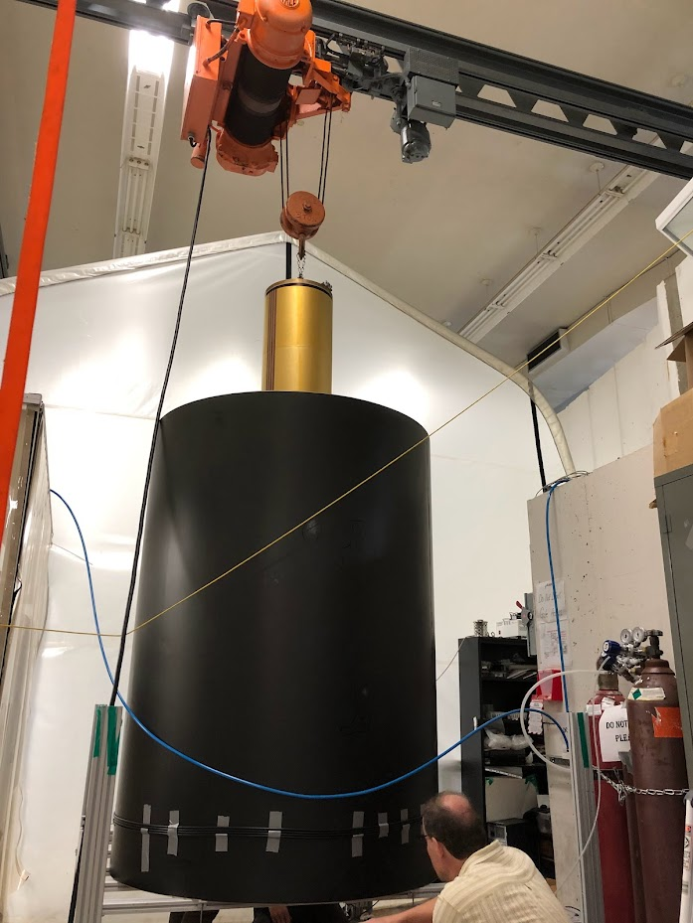
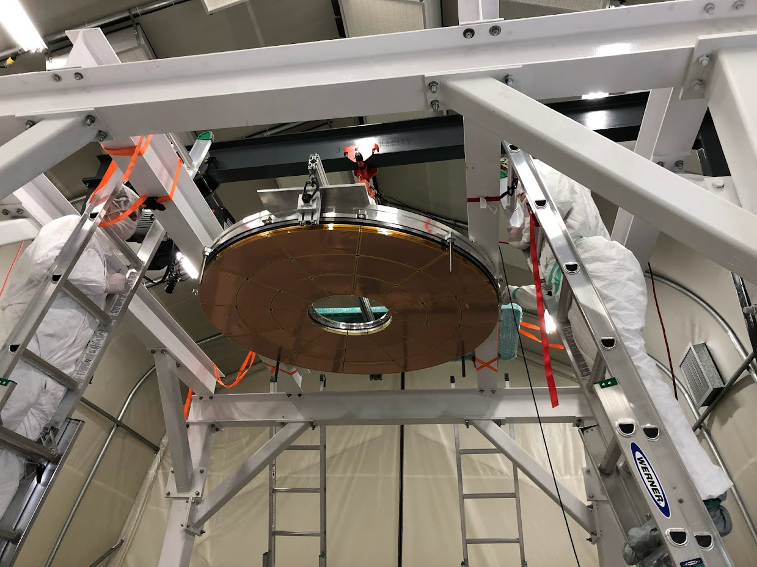
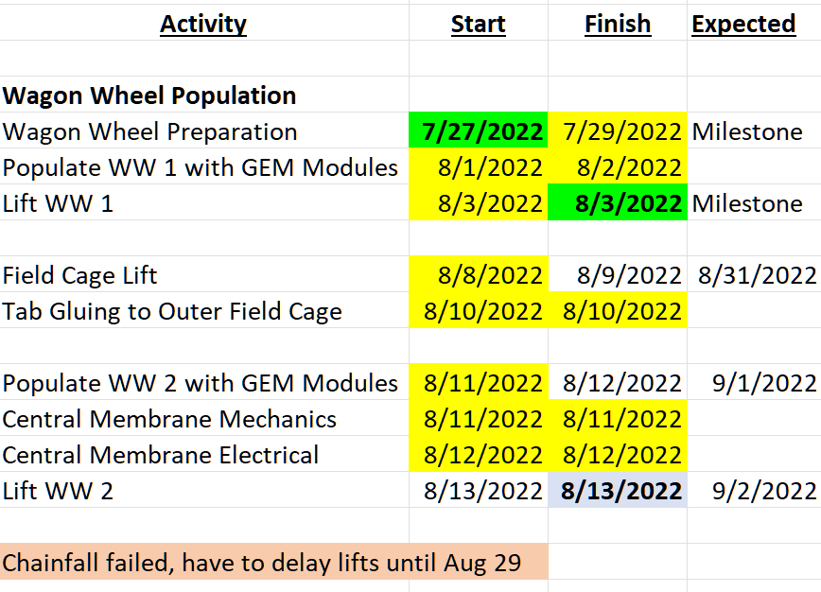
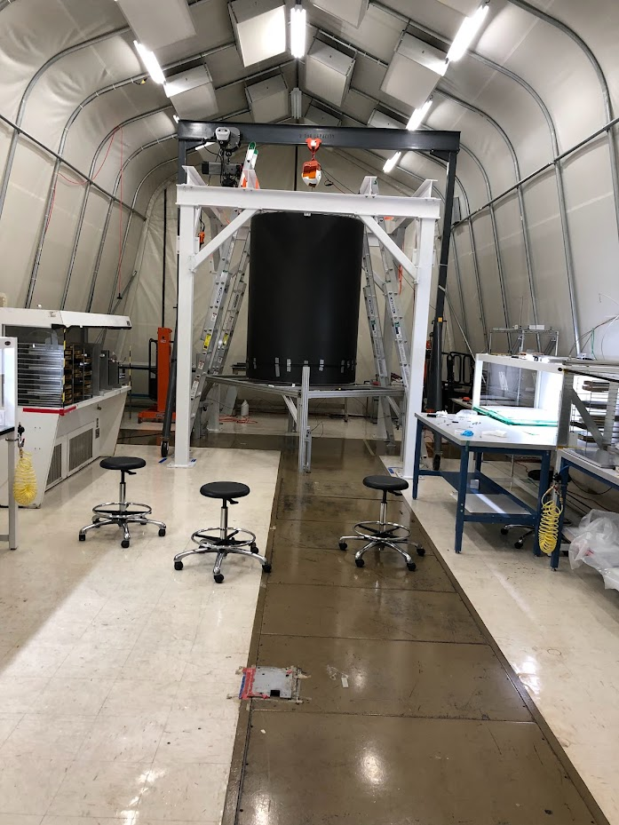
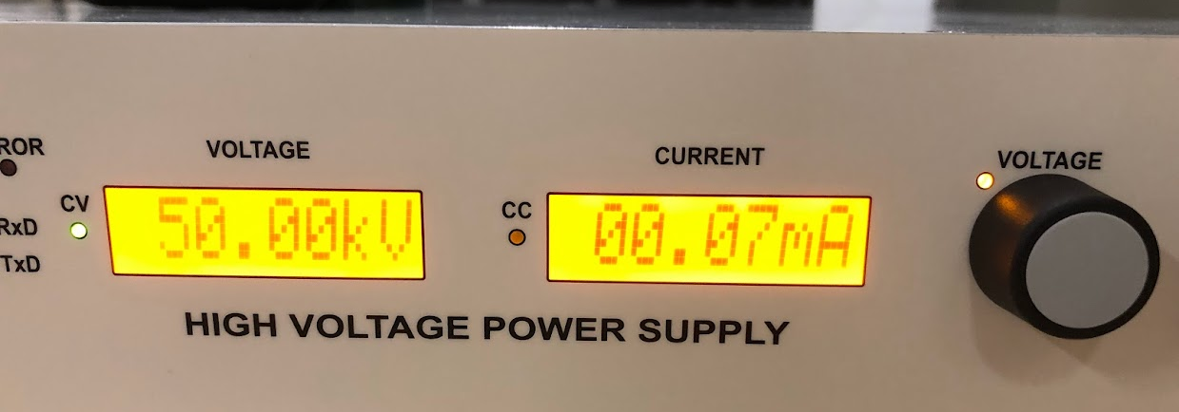
Outer Field Cage Completion
WW1 Up and waiting
Concentric Cylinders
Using weekends to keep weekly schedule.
Henry Klest reconfigured tensioner to meet first deadline early.
Before Field Cage Lift
After Field Cage Lift
“Bench Test” (P6 Milestone) Completed

Slide 3
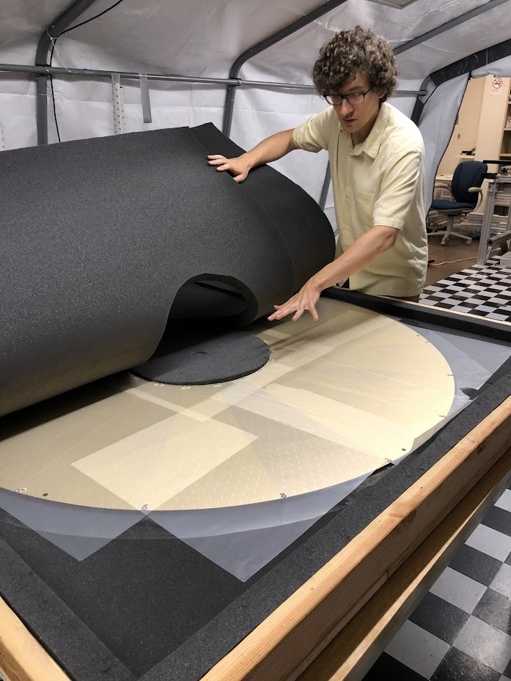
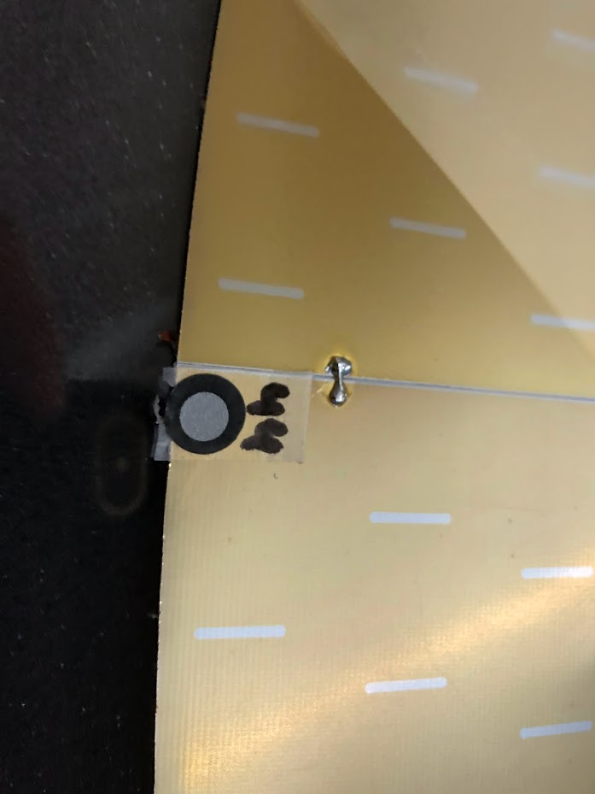
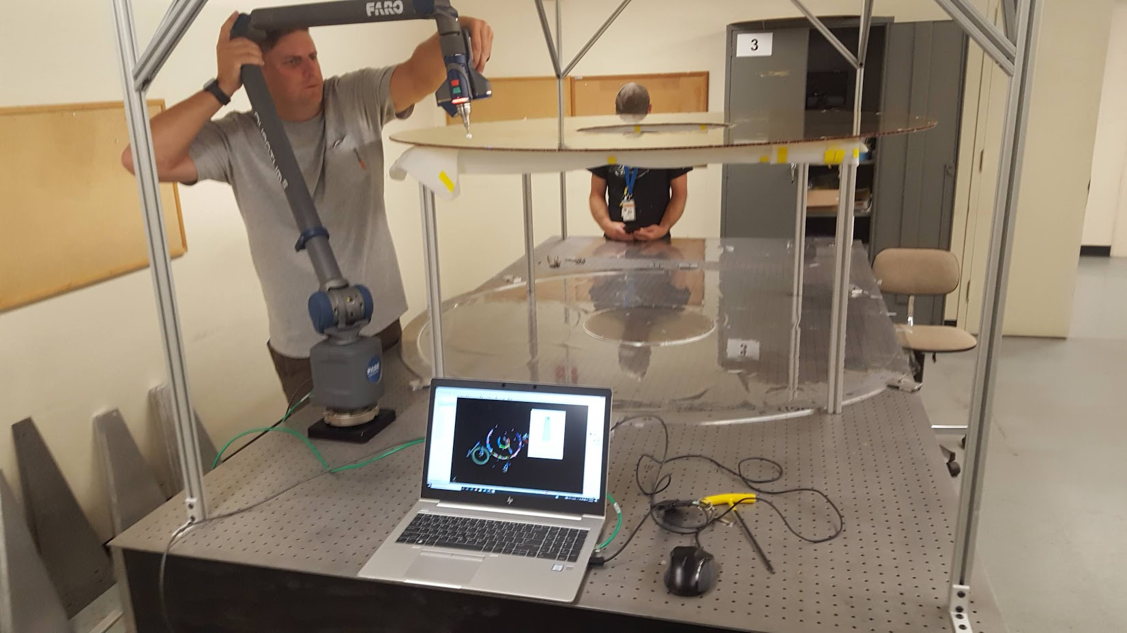
Central Membrane
At SBU
Bond all but one gap.
Successful completion of Central Membrane.
Advanced the schedule of this when chain-fall failed.
Survey:
Every stripe vs survey marks
Every mark to each other

Slide 4
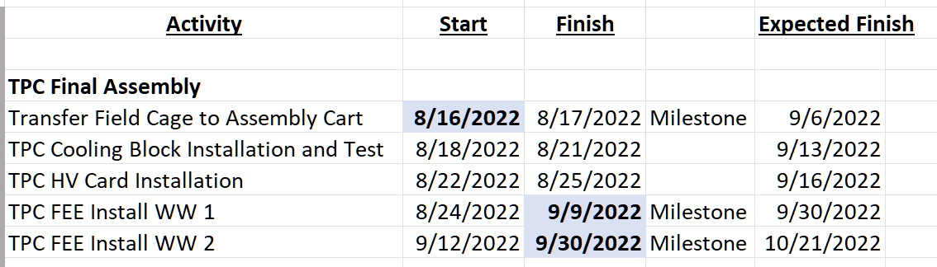
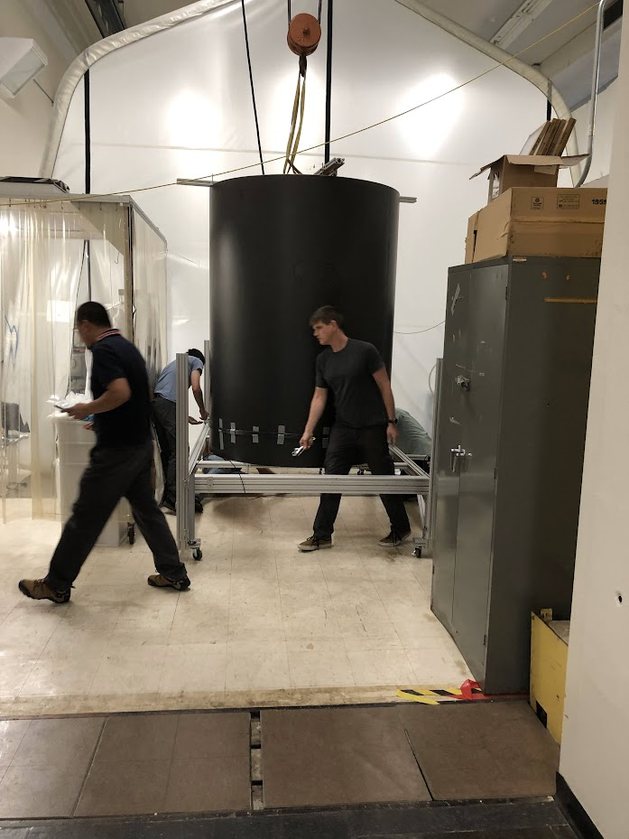
Instrumentation & Testing
Mitigation Strategies:
Cooling blocks plumbed/tested in a dummy status on the empty WW2.
Completes work of tube lengths in advance.
Lessens time required for later installation/testing.
TPC FEE project given extra person power (Roli Eshe…SBU postdoc)
FEE installation projection driven by availability status.
Availability looks good (50% of WW1 complete, rate looks good).
Testing of FEE mitigation: Outside clean room.
Clean Room Foyer.
Remove changing room & cabinets

