Slide 1
TPOT Status
Hugo Pereira Da Costa (LANL),
for the TPOT team
PMG meeting, Sept. 1, 2022

Slide 2
Updates since PMG 2022/07/14
Micromegas detectors
All modules produced, shipped to BNL, received, leak-tested
All modules in gas at either BNL or SBU (4 modules at BNL in Ar, 6 modules at SBU in N2)
One bottle of Ar/iC4H10 available at SBU for HV tests. Missing are HV Mainframe and modules
Mechanics
All parts for TPOT support structure received at BNL. Some needed small modifications. Assembly about to begin
TPOT transportation cart, built at MIT/BATES is completed. Will be shipped to BNL ~ Sept. 12
TPOT installation mechanics: design in progress, fixtures built at MIT/BATES. Meeting with Russ and others on Sept. 6.
Contract between BNL and LANL, needed to place remaining orders on TPOT installation mechanics, about to be finalized
Others
All FEE boards for TPOT readily available and being tested (burnt). 14/20 FEE boards “burnt”.
Placing orders for remaining items:
HV cables (pending validation from BNL engineers concerning cable diameter),
gas and cooling lines,
SHV bulkhead connectors at patch panel
etc.

Slide 3
High level milestones and risk
With respect to PMG meeting on 6/24, dates have shifted further, but risk is now lower as they are more firm. Delivery date unchanged
Milestone | date | Status | risk
Number of TPOT modules produced | Today | 10 | done
FEA analysis finished and reviewed | 18/05/22 | FDR happened. more FEA analyses requested. Agreed with TC to move forward | done
First batch of 5 TPOT Modules assembled & tested (Saclay) | 06/03/22  07/06/22 | 6 modules assembled, test ongoing | done
FEE to detector fabricated and tested | 06/23/22  07/23/22 | cables/boards received on 6/21 | done
HV system tested | 06/16/22 | happened on Week 21 (May 23) | done
Second batch of 5 TPOT modules assembled & tested (Saclay) | 07/15/22  07/22/22 |  | done
Characterization of all TPOT modules at SBU | 08/08/22  09/09/22 | delayed due to HV availability at SBU | low
Gas system designed, ES&H reviewed and tested | 07/07/22  ? | designed and ESRC reviewed on 6/21 | low
TPOT mechanical support assembled | 08/19/22  09/16/22 | delayed due to last minute modifications | low
installation of modules on support structures | 08/26/22  09/23/22 | pending validation of the modules | moderate
End of TPOT assembly | 09/30/22  10/21/22 |  | moderate
Installation of TPOT in sPHENIX | 10/24/22 | (also depends on sPHENIX schedule) | moderate

Slide 4
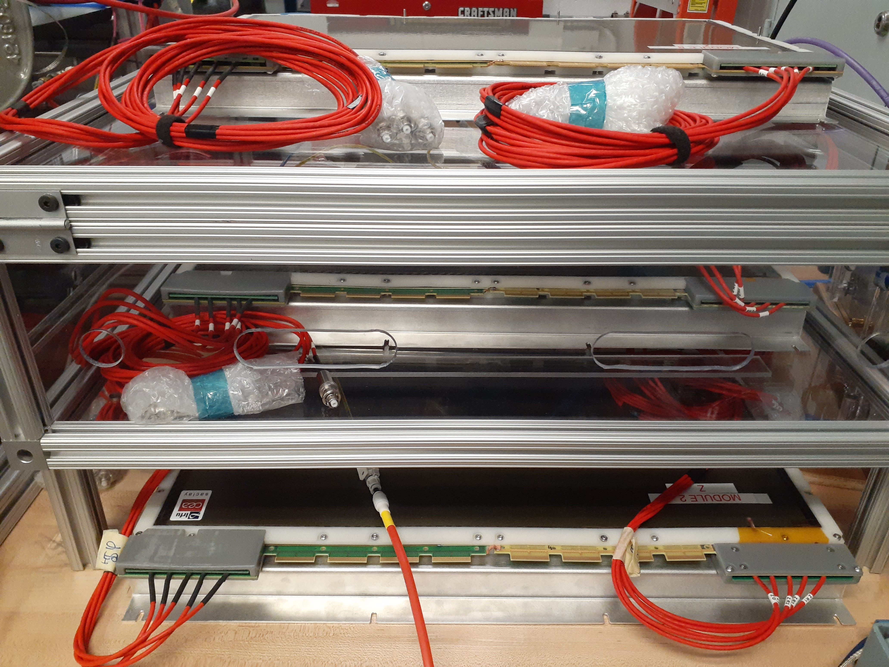
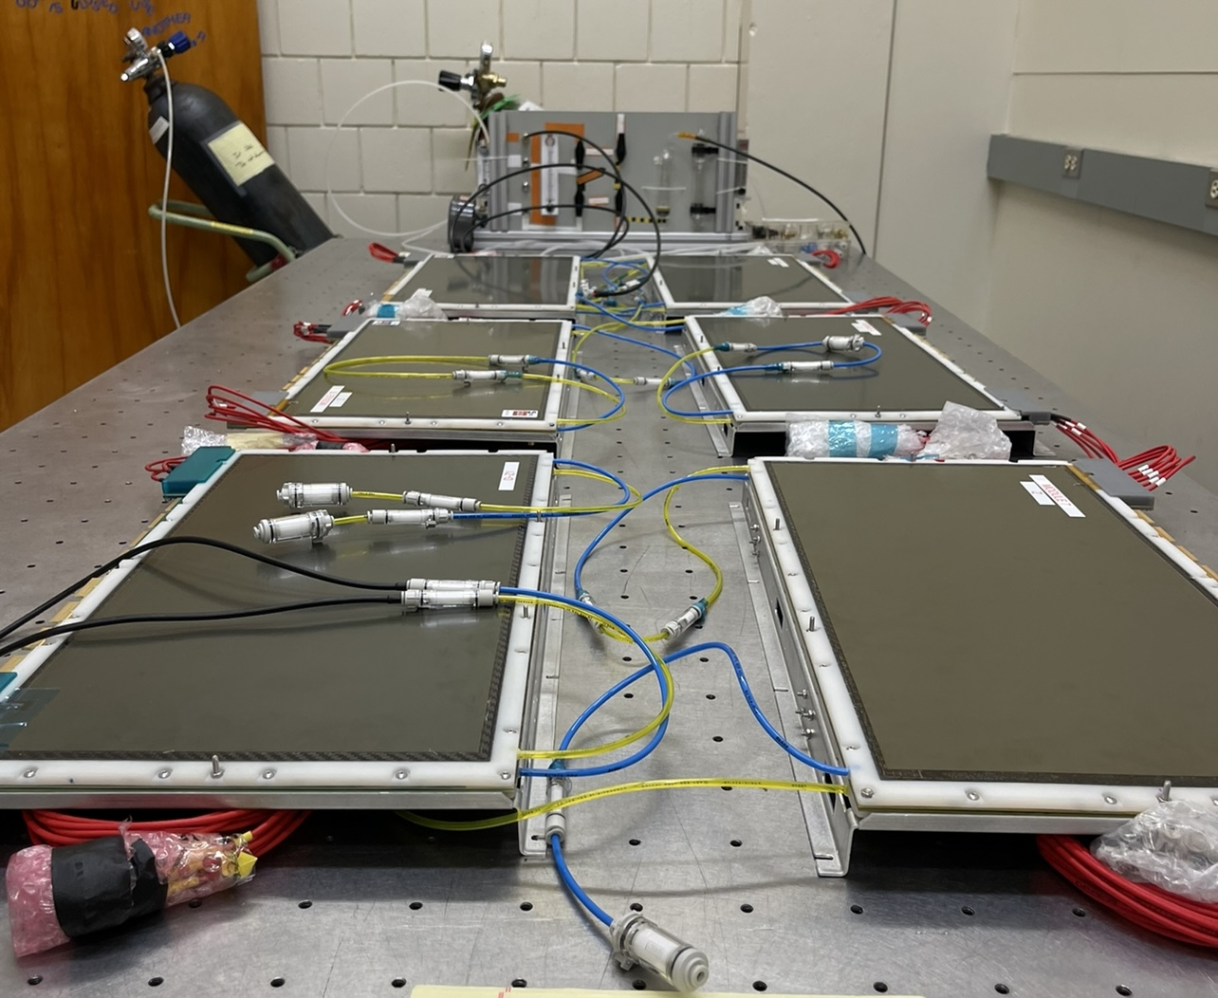
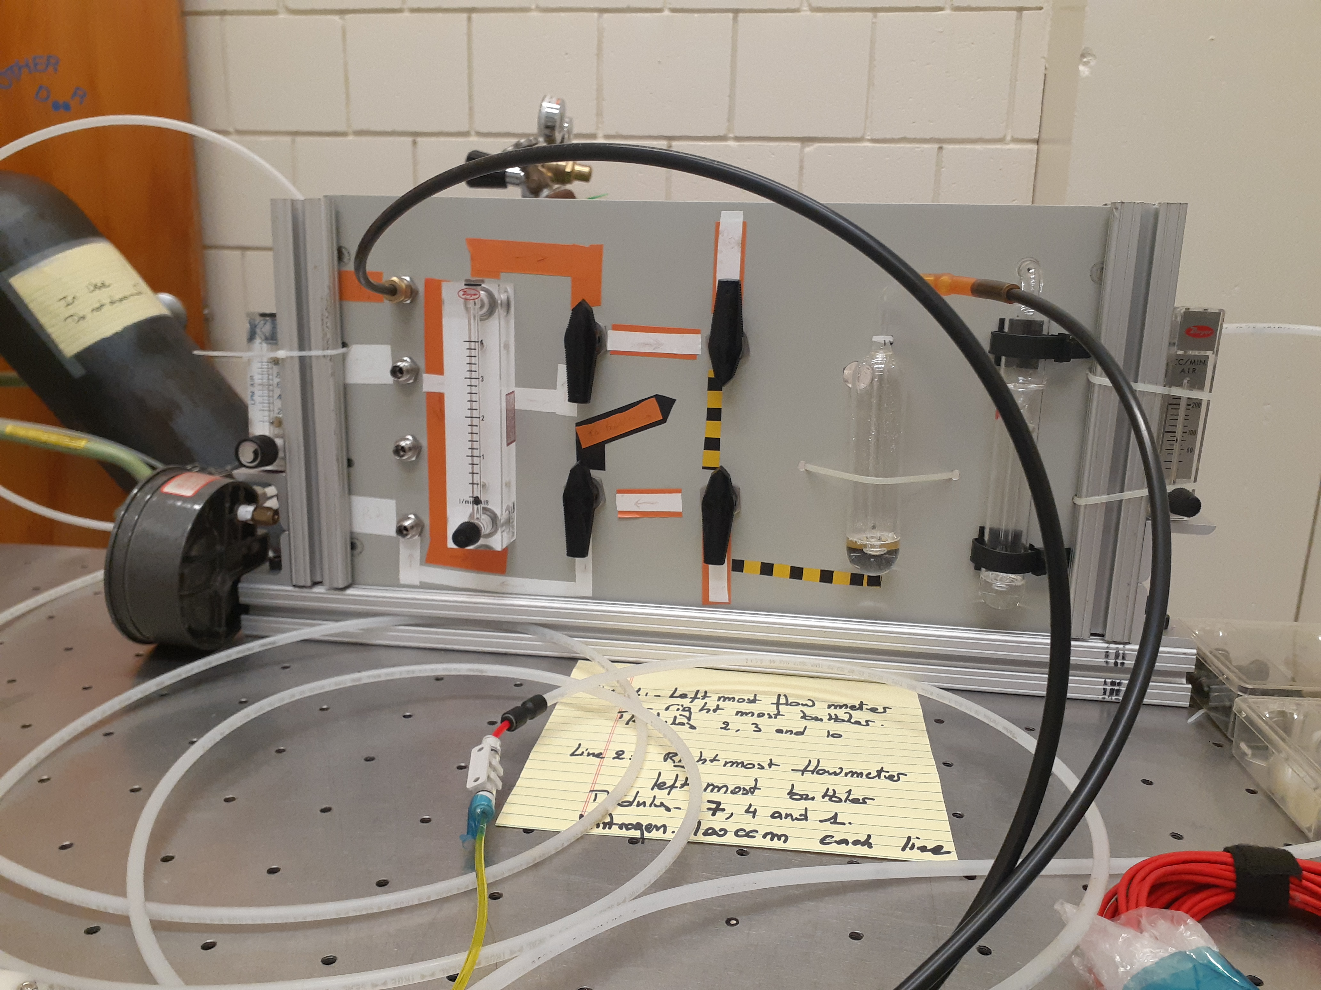
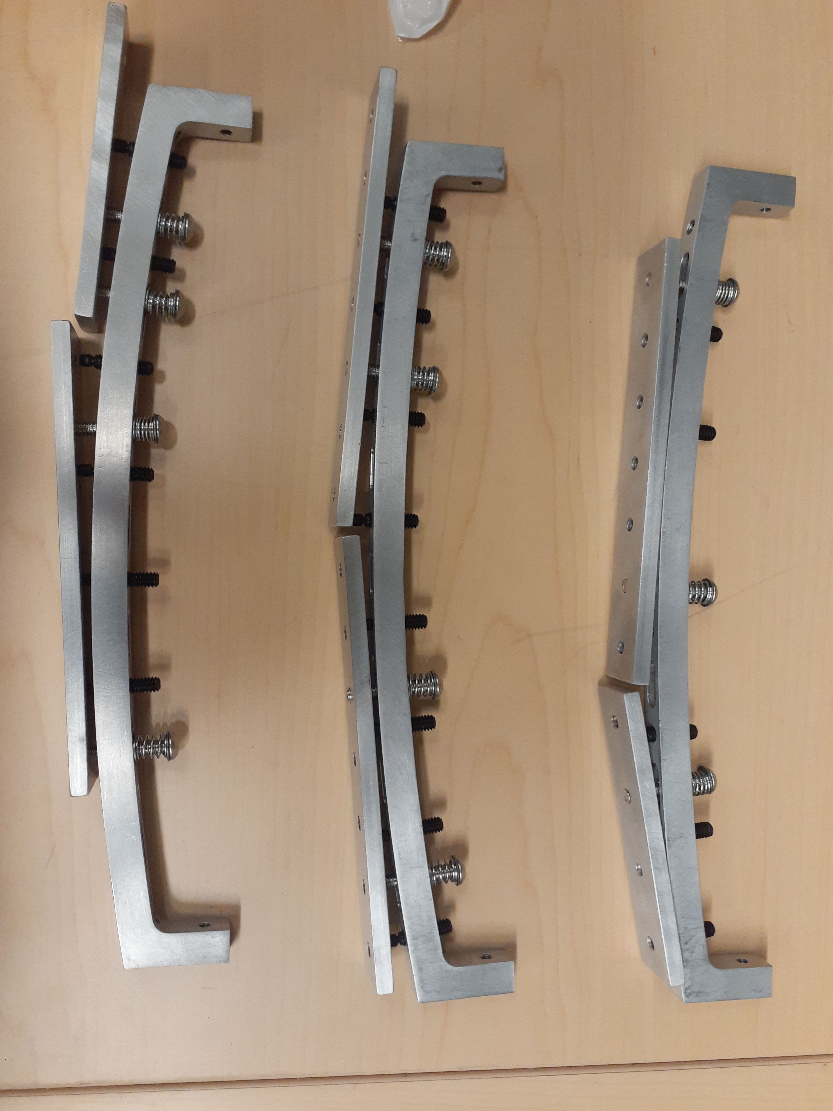
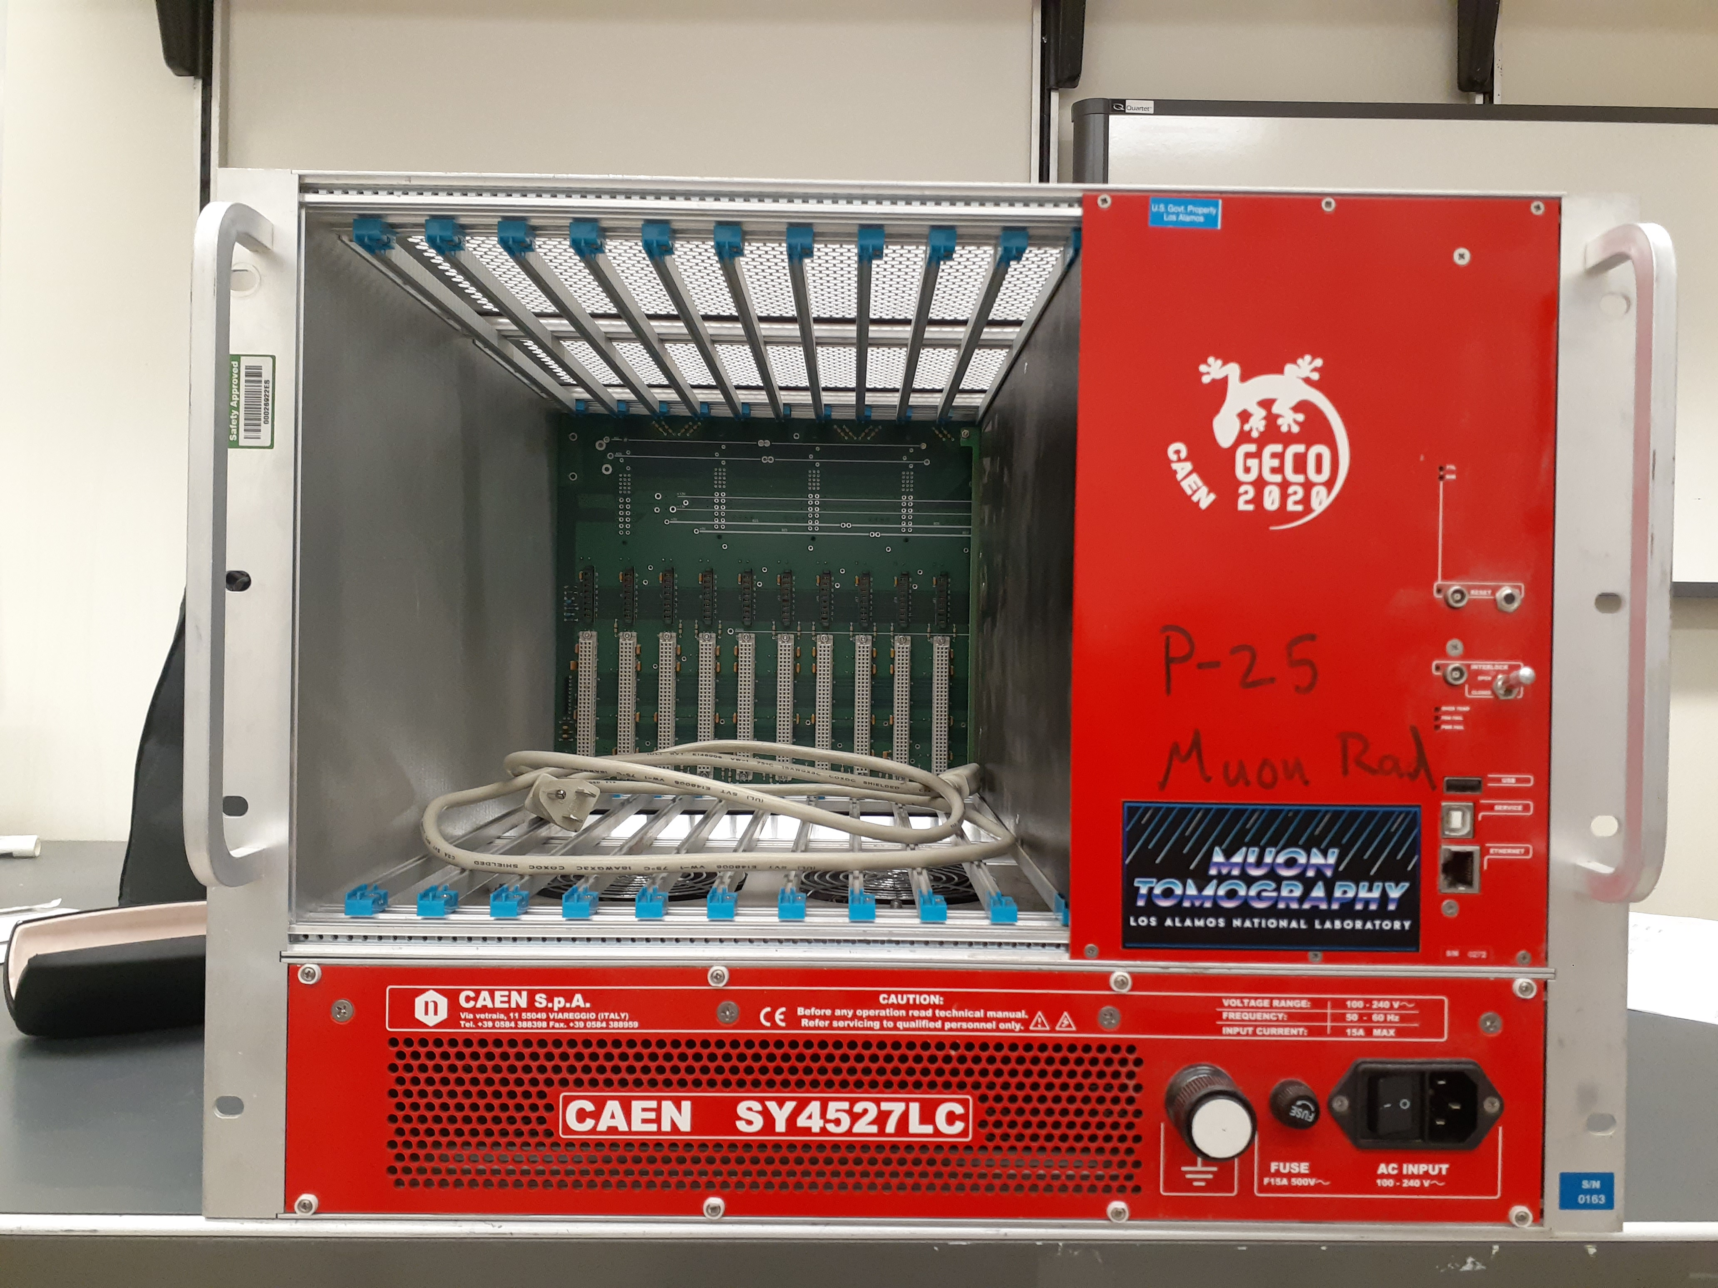
Pictures
TPOT modules at BNL
Gas system at SBU
TPOT modules at SBU
Assembled mid-span support
HV Mainframe at LANL

